Slide 1
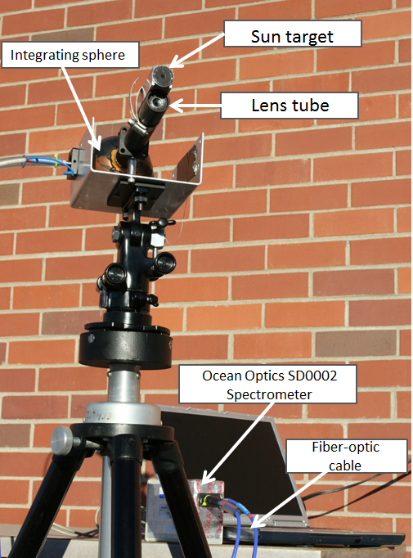
Cloud Optical depth Retrieval by Spectrometer – based Sun Photometer

Slide 2
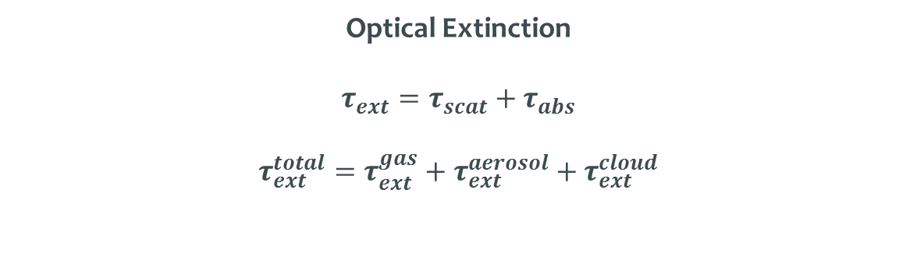

Background
Optical Extinction
$τ_{ext}=τ_{scat}+τ_{abs}$
$$τ_{ext}^{total}=τ_{ext}^{gas}+τ_{ext}^{aerosol}+τ_{ext}^{cloud}$$
Beer-Lambert Law: light traveling through a medium
$I(λ)=I_{0}(λ)e^{−\frac{1}{cosθ}{τ(λ)}_{ext}}=I_{0}{(λ)e}^{−m{τ(λ)}_{ext}}$
Langley Method: Determining extinction from our measurements

Slide 3
For measurements on days with cirrus clouds, we cannot use the Langley method ( no linear regression) we have to use known TOA irradiance values to solve the beer-lambert law directly for the optical extinction.

Slide 4
Determining cirrus cloud optical depth
Clear
Cloudy
We can find the cloud optical depth by subtracting the cloudy TOD from the clear TOD.

Slide 5
Determining cirrus cloud optical depth Con’t
We can conclude there is weak dependence on wavelength for cloud optical depth.

Slide 6
For comparison: TOD values at wavelengths of the handheld photometer
 |  | Wavelength | 430 | 470 | 530 | 660
Time | Air Mass
4:00:00 PM | 3.2491547 |  | 0.250151 | 0.210181 | 0.172667 | 0.099625
4:05:00 PM | 3.4035904 |  | 0.258549 | 0.211771 | 0.17685 | 0.098801
4:10:00 PM | 3.5758833 |  | 0.241985 | 0.189824 | 0.151735 | 0.082071
4:15:00 PM | 3.7691715 |  | 0.238624 | 0.186718 | 0.148213 | 0.07757
4:16:00 PM | 3.8106753 |  | 0.277535 | 0.226586 | 0.190256 | 0.124802
4:17:00 PM | 3.853209 |  | 0.247082 | 0.192686 | 0.156601 | 0.088769
4:18:00 PM | 3.8968106 |  | 0.270947 | 0.212638 | 0.177398 | 0.101816
4:20:00 PM | 3.9873701 |  | 0.259974 | 0.206613 | 0.170928 | 0.106026
4:21:00 PM | 4.034416 |  | 0.253959 | 0.206572 | 0.16987 | 0.102314
4:22:00 PM | 4.0826961 |  | 0.25012 | 0.198703 | 0.161075 | 0.092436
4:23:00 PM | 4.1322612 |  | 0.237819 | 0.18685 | 0.147476 | 0.07669
4:24:00 PM | 4.1831604 |  | 0.240475 | 0.178187 | 0.140588 | 0.066755
4:25:00 PM | 4.2354498 |  | 0.227425 | 0.174952 | 0.141062 | 0.067475
4:26:00 PM | 4.2891817 |  | 0.235708 | 0.178441 | 0.138029 | 0.069711
4:27:00 PM | 4.3444184 |  | 0.234269 | 0.176 | 0.140274 | 0.070876
4:28:00 PM | 4.4012205 |  | 0.230091 | 0.176976 | 0.142018 | 0.067685
4:29:00 PM | 4.4596524 |  | 0.22632 | 0.175678 | 0.137888 | 0.066798
4:30:00 PM | 4.5197896 |  | 0.234383 | 0.176734 | 0.140896 | 0.067631
4:31:00 PM | 4.5817016 |  | 0.22891 | 0.174853 | 0.136202 | 0.068429
4:32:00 PM | 4.6454646 |  | 0.234619 | 0.179745 | 0.142015 | 0.075633
4:33:00 PM | 4.7111677 |  | 0.231347 | 0.178432 | 0.139699 | 0.070404
4:34:00 PM | 4.7788939 |  | 0.246832 | 0.198119 | 0.158402 | 0.09164
4:35:00 PM | 4.8487373 |  | 0.252537 | 0.198243 | 0.155762 | 0.087191
4:36:00 PM | 4.9207978 |  | 0.238904 | 0.188082 | 0.147677 | 0.078405
4:37:00 PM | 4.9951817 |  | 0.229464 | 0.178887 | 0.139045 | 0.06663
4:38:00 PM | 5.0719954 |  | 0.235741 | 0.175509 | 0.139427 | 0.067667
4:40:00 PM | 5.2334185 |  | 0.235577 | 0.17601 | 0.135655 | 0.064476
4:41:00 PM | 5.3182866 |  | 0.230634 | 0.173202 | 0.136958 | 0.067387
4:43:00 PM | 5.4970688 |  | 0.230512 | 0.174367 | 0.135921 | 0.071289
4:44:00 PM | 5.5913077 |  | 0.229771 | 0.176193 | 0.133939 | 0.067495
4:45:00 PM | 5.6890049 |  | 0.238343 | 0.181204 | 0.138343 | 0.073872
4:46:00 PM | 5.7903575 |  | 0.237492 | 0.177864 | 0.136853 | 0.069367
4:47:00 PM | 5.8955732 |  | 0.231208 | 0.172883 | 0.132989 | 0.06647
4:48:00 PM | 6.0048806 |  | 0.232686 | 0.177285 | 0.134385 | 0.070195
4:49:00 PM | 6.1185116 |  | 0.192789 | 0.144937 | 0.1145 | 0.058766
4:50:00 PM | 6.2367216 |  | 0.225636 | 0.173302 | 0.130765 | 0.065986
4:51:00 PM | 6.3597968 |  | 0.233134 | 0.177708 | 0.134855 | 0.06826
4:52:00 PM | 6.4880476 |  | 0.235775 | 0.176031 | 0.133481 | 0.067892
4:54:00 PM | 6.7613907 |  | 0.227506 | 0.173995 | 0.131768 | 0.06724
4:55:00 PM | 6.9072329 |  | 0.232101 | 0.174125 | 0.130531 | 0.070199
4:56:00 PM | 7.0597482 |  | 0.226226 | 0.172012 | 0.12972 | 0.06774
4:57:00 PM | 7.2193963 |  | 0.228549 | 0.173836 | 0.129515 | 0.063333
4:58:00 PM | 7.3866876 |  | 0.228216 | 0.172735 | 0.129524 | 0.061548
4:59:00 PM | 7.5621822 |  | 0.22424 | 0.172062 | 0.130514 | 0.065897
5:01:00 PM | 7.9403018 |  | 0.246057 | 0.193671 | 0.149582 | 0.088372
5:02:00 PM | 8.144348 |  | 0.260067 | 0.202021 | 0.160983 | 0.10062
5:03:00 PM | 8.3594569 |  | 0.249177 | 0.195323 | 0.155998 | 0.094947
5:04:00 PM | 8.5865702 |  | 0.236986 | 0.180421 | 0.136262 | 0.074968
5:05:00 PM | 8.826698 |  | 0.224329 | 0.168852 | 0.125244 | 0.061953
5:06:00 PM | 9.0809887 |  | 0.229922 | 0.168988 | 0.125889 | 0.060689
5:07:00 PM | 9.3507304 |  | 0.228719 | 0.171615 | 0.125597 | 0.063297
5:08:00 PM | 9.6373717 |  | 0.229191 | 0.169055 | 0.1274 | 0.063281
5:09:00 PM | 9.9425355 |  | 0.227939 | 0.173398 | 0.12808 | 0.06633

Slide 7
Comparison

Slide 8
Comparison

