Slide 1

Temperature and Dew Point Temperature
By:
Chasity Martinez
Jessica Macias
Jason Sutherland

Slide 2
Outline
Description of temperature sensor and how it works
Time series of temperature and dew point temperature
Calibration of temperature data
Boundary layer
Lapse rate
Discussion and interpretation of data
Efficiency of Teensy sensors
Improvements for future experiments

Slide 3
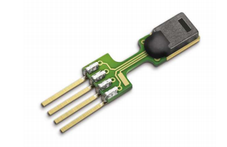
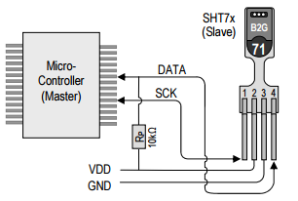
How the Temperature and Humidity Sensors Works
Provides fully digital output
Pin 1: serial clock
Pin 2: source voltage
Pin 3: ground
Pin 4: serial data (transfers data in and out of the sensor)
Long term exposures to humidity can offset RH signal
Self-heating occurs if measurement frequency is too high.

Slide 4
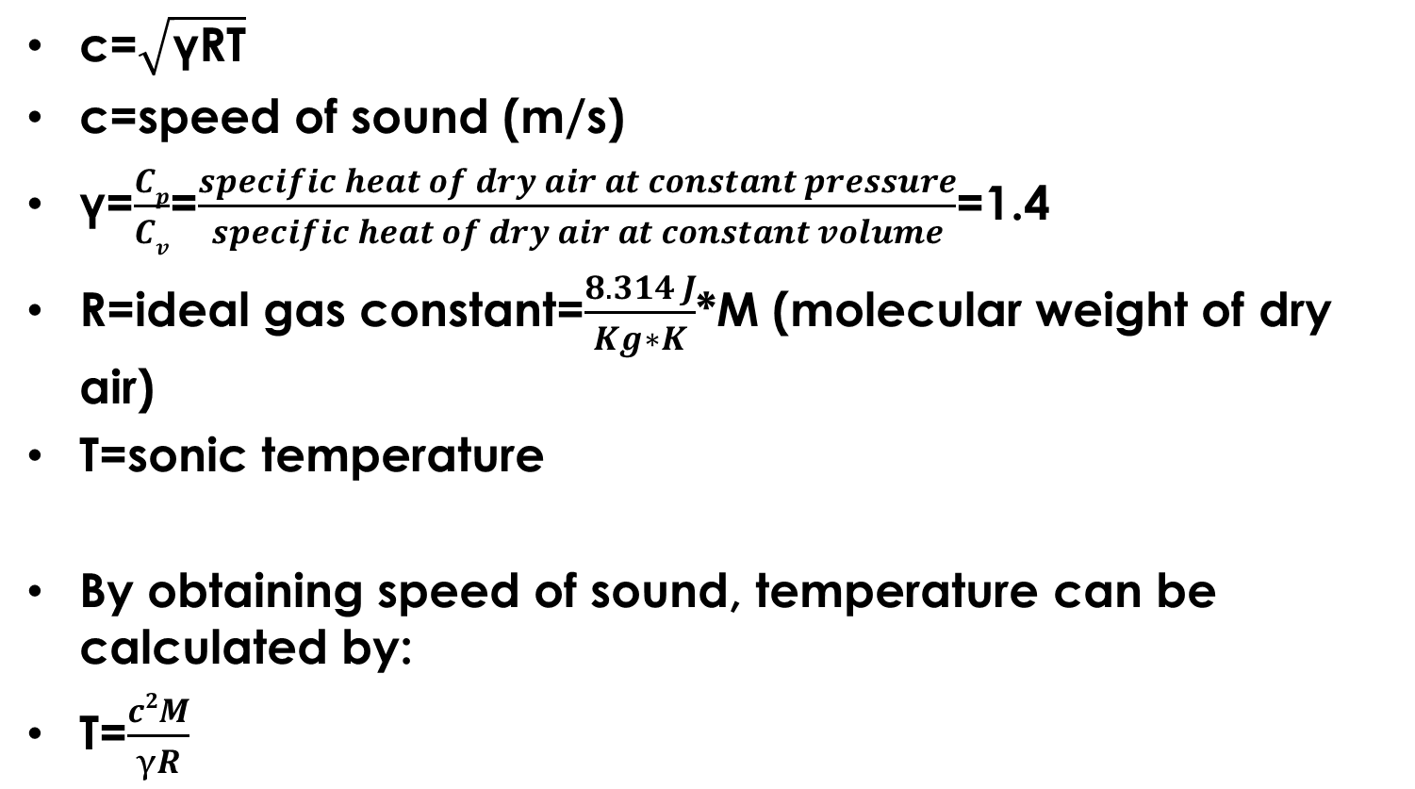
Sonic Anemometer
c=$\sqrt{\text{γ}\text{RT}}$
c=speed of sound (m/s)
$\text{γ}$=$\frac{Cp}{Cv}$=$\frac{specific heat of dry air at constant pressure}{specific heat of dry air at constant volume}$=1.4
R=ideal gas constant=$\frac{8.314 J}{Kg∗K}$*M (molecular weight of dry air)
T=sonic temperature
By obtaining speed of sound, temperature can be calculated by:
T=$\frac{c2M}{γR}$

Slide 5
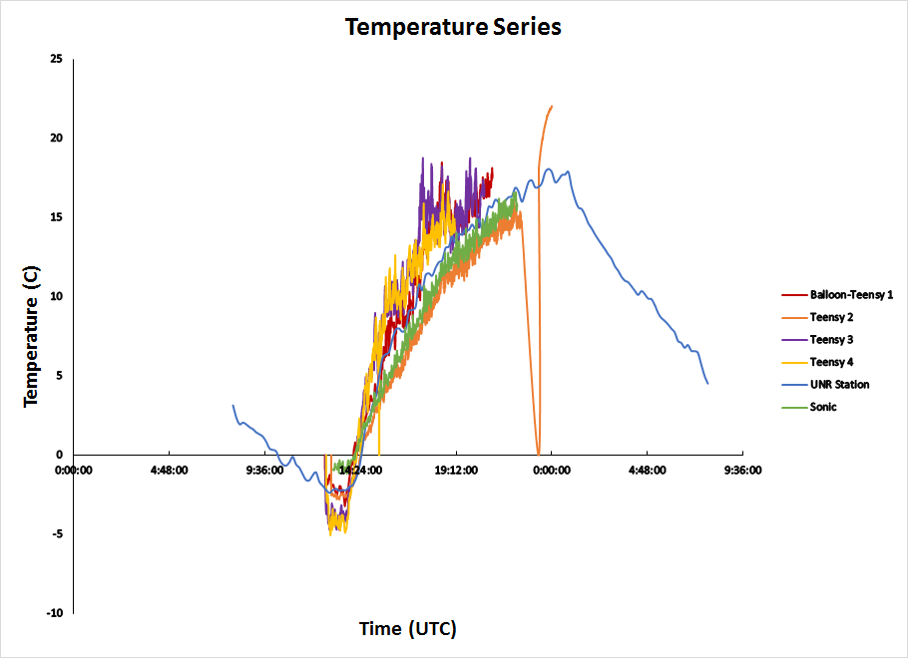
Time Series of Temperature

Slide 6
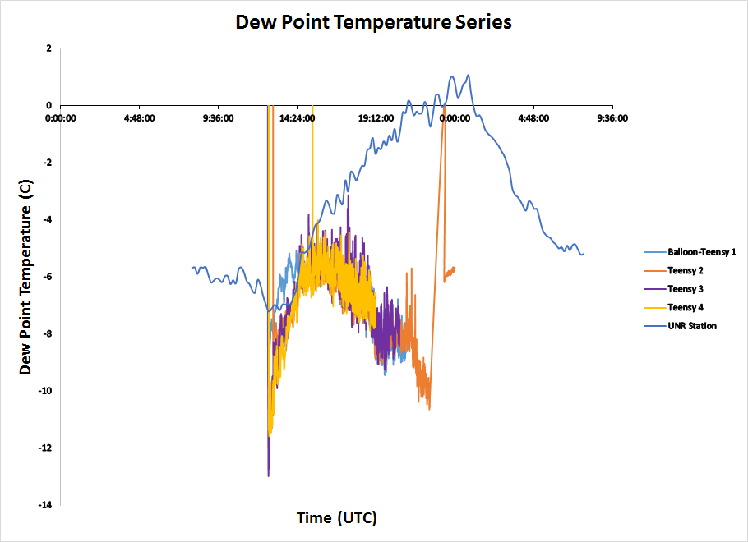
Time Series of Dew Point Temperature

Slide 7
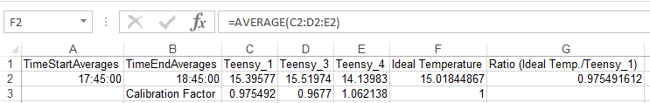
Calibration of Temperature
Teensy 1 (Balloon), Teensy 3 and Teensy 4 showed similarities based on time series graphs.
Averaged values for each Teensy card in time period of 17:45 UTC to 18:45 UTC.
To calculate ideal temperature, we used the values from the previous step and then averaged those values.

Slide 8
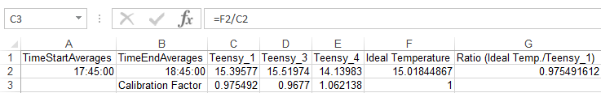
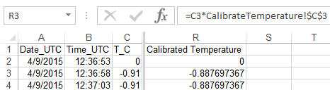
Calibration of Temperature
To calculate the calibration factor, the ideal temperature was divided by each individual Teensy card average.
For each Teensy card, the calibration factor was multiplied for all temperature values and then graphed.

Slide 9
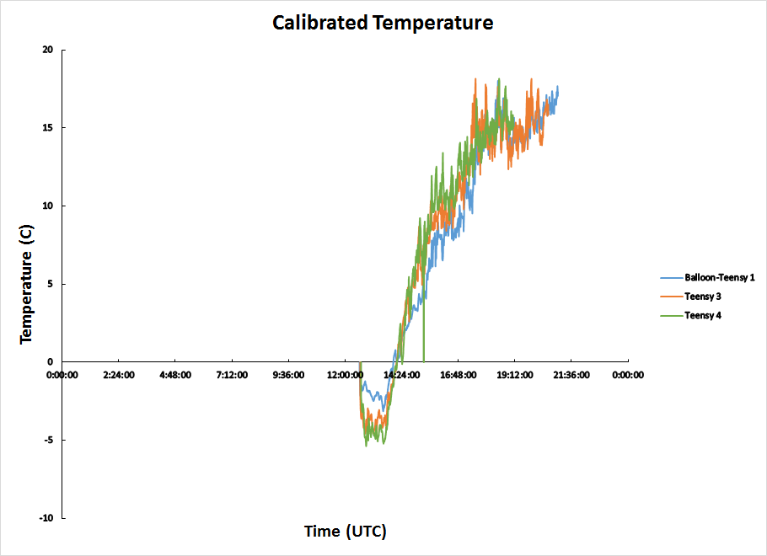
Calibrated Temperature Graph

Slide 10
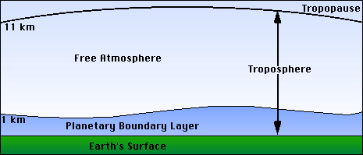
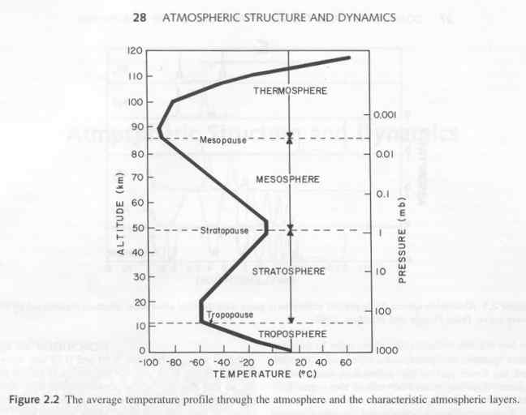
Boundary Layer
The layer most affected by the earth’s surface. (influences temperature, moisture, wind velocity)
It is said to be unstable when the surface is warmer than the air (sunny day with light winds)
It is stable when the surface is colder than the air (clear night)
Temperature decreases at adiabatic lapse rate when air rises and expands.

Slide 11
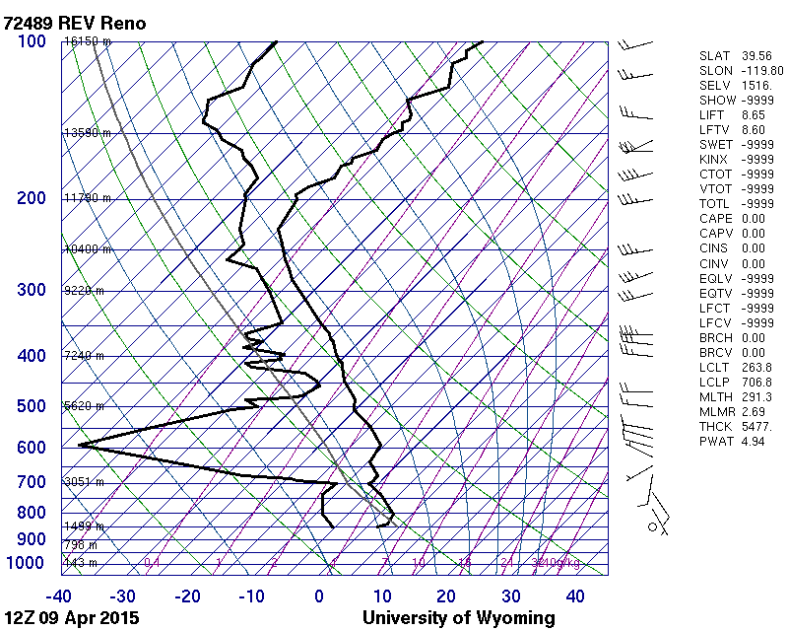
Atmospheric sounding for April 9th (12Z UTC)

Slide 12
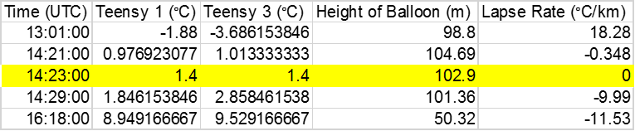

Lapse Rate
To calculate the lapse rate, the following equation was used: Г(z)=$\frac{Tballoon−Tsurface}{z}$, where z=height (provided by Pressure group)

Slide 13
Discussion and Interpretation of Data
Dew point temperature did not need to be calibrated due to values from all four sensors showing similarities
Dew point temperatures and air temperatures were far apart throughout the day
Air temperature needed to be calibrated because there were irregularities with Teensy 2. To form calibration, we used Teensy cards 1, 3, and 4 because they showed most similarities with one another.
Solar heating had an effect on temperature sensors 1, 3, and 4

Slide 14
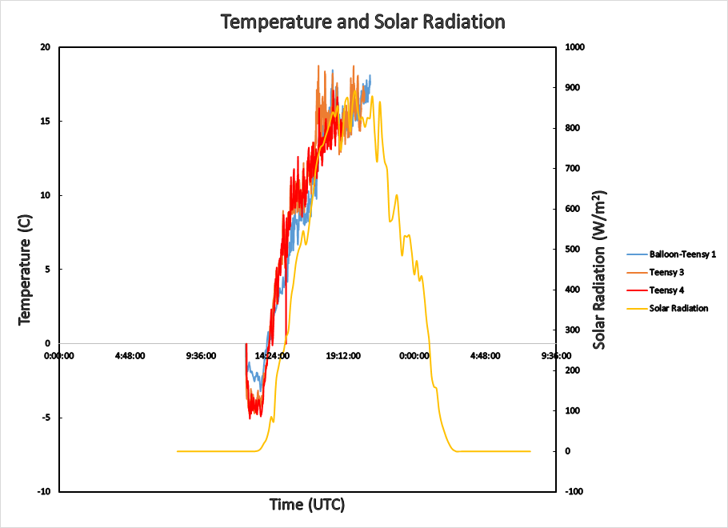

Slide 15

The Efficiency of Temperature Sensors
Location and placement of sensors
Methods of shielding
-The only shield some of the
sensors had were a piece a paper over them.
Lack of ventilation and too many measurements causes self heating (mechanism that produces a warmer condition).

Slide 16
Improvements
Use the same shielding mechanism for each Teensy card
Use a new and improved shielding mechanism to allow ventilation and prevent heating of sensor.
- something better than just a piece of paper wrapped around it.

Slide 17


