Slide 1
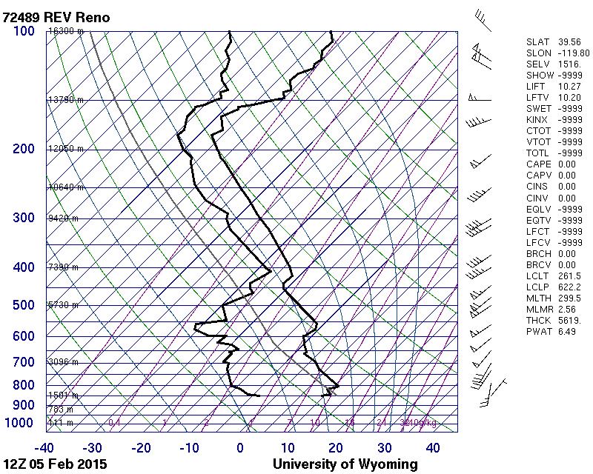
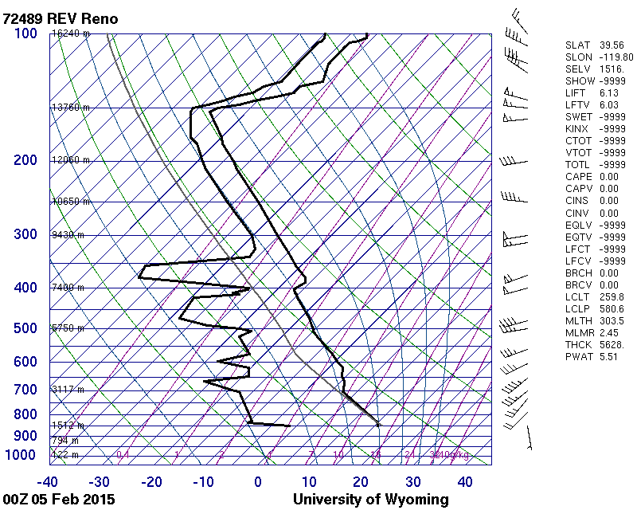
4 a.m. Local Time Morning Sounding
4 p.m. Local Time Afternoon Sounding

