Slide 1
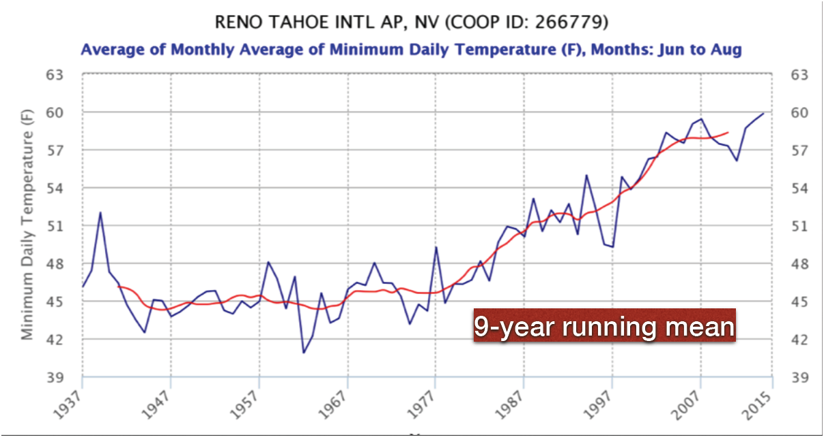
Time Series of Night Time Summer Time Temperature in Reno
Courtesy of Nina Oakley and Tamara Wall

Slide 2
Reno Population

Slide 3
Both Population and Temperature
Courtesy of Nina Oakley and Tamara Wall

