Slide 1
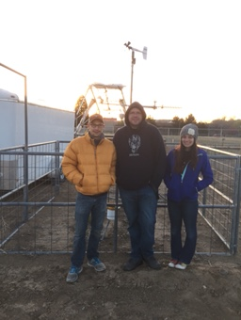
Case Study: Teensy Controllers and Pressure
ATMS 360-1001 Spring 2015
Aaron Alexander
Jordan Parks
Zoey Rosen

Slide 2
Introduction
On April 9, 2015 at the Valley Road Weather Station, interpreting the readings from the ultrasonic anemometer for wind measurement, the balloon sounding system, the standard weather station, and the class weather station, we recorded measurements based on the microcontroller that is used on the balloon system. We also observed the RADAR and SODAR Acoustic Sampler Data system values and compared them to the UNR weather station’s from sunrise throughout the afternoon. Tracking pressure, we looked into the possible sources of error from our findings and used the hydrostatic equation to verify our maximum balloon sounding height.

Slide 3
History of the Barometer and Pressure
“Barometer” comes from the Greek word "baros", meaning weight, and "metron", meaning measure and is an instrument used to measure air pressure.
Early 17th century—Evangelista Torricelli first experimented with the principal of a vacuum to measure the weight of the air.
  Torricelli noticed that air pressure changes with weather changes, which caused the water level to rise and fall within a 35 foot tube.
1670—producers of barometers began selling mercury barometers as a weather instrument to be used in private homes.
1860—Admiral Fitzroy provided a detailed weather forecasting script that he attached to his several barometer inventions.
  Fitzroy is credited with the beginning of the first published weather forecasting in the world and detailing the meaning behind the rise and fall of air pressure.
1840—Lucien Vidie introduced the first mechanical (aneroid) barometer which replaced the use of mercury with a metal vacuum disc, with mechanical arms and a pointer, to measure the air pressure.
  Aneroids became increasingly popular due to their lower cost and their ease of transportation.
Today—the only mercury barometers in the USA still being produced are those made for professional weather stations, aneroids are for personal use.
As barometers measure air pressure, they are also used for measuring altitude, such as for mountain peaks or for the height of a balloon, as well as depth, as with mining and cave depth.

Slide 4
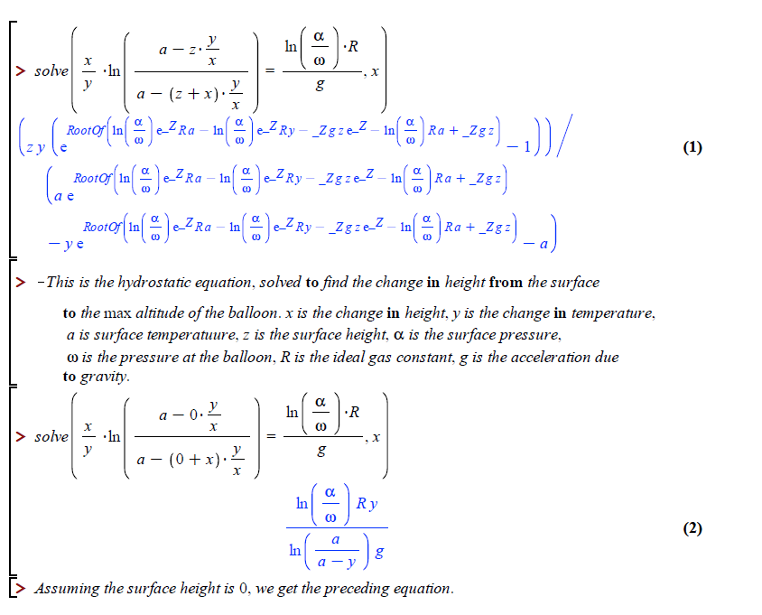
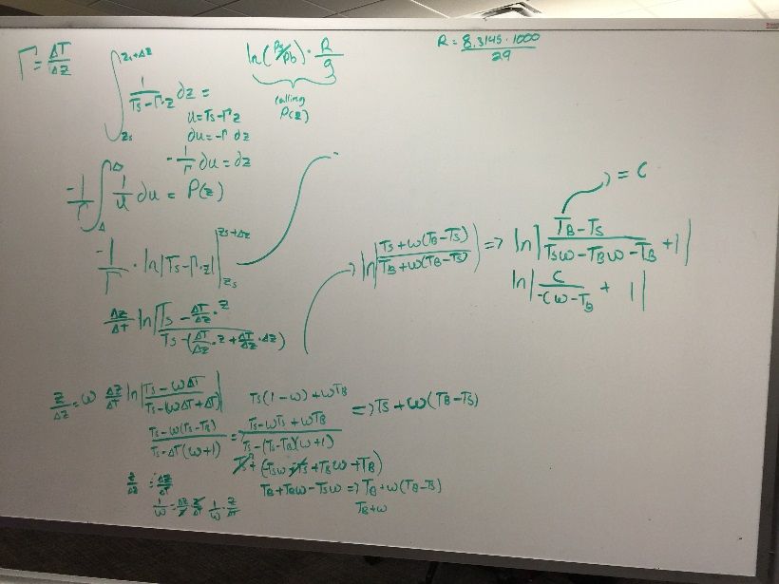
Hydrostatic Equation

Slide 5
Time Series
NOTE: At 14:22 UTC, the dip is caused by the change of lapse rate from negative to positive. Measuring the fishing line used, we found the max height to be about 90.4 meters (adding the height of the pole from the ground). This is very close to the value found using the hydrostatic equation.

Slide 6
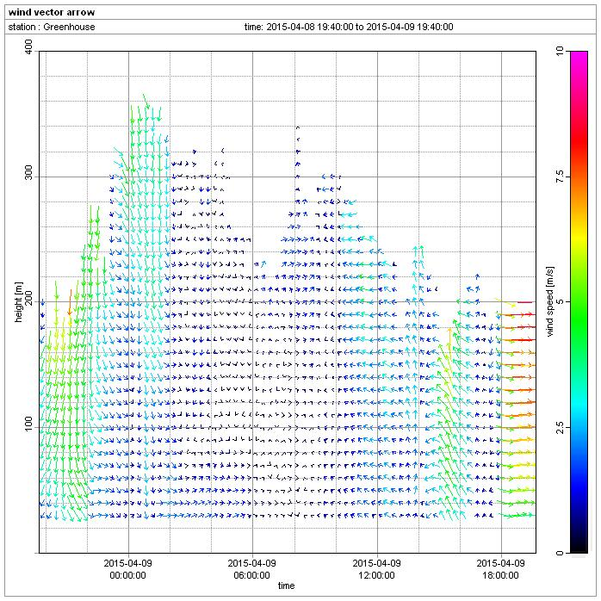
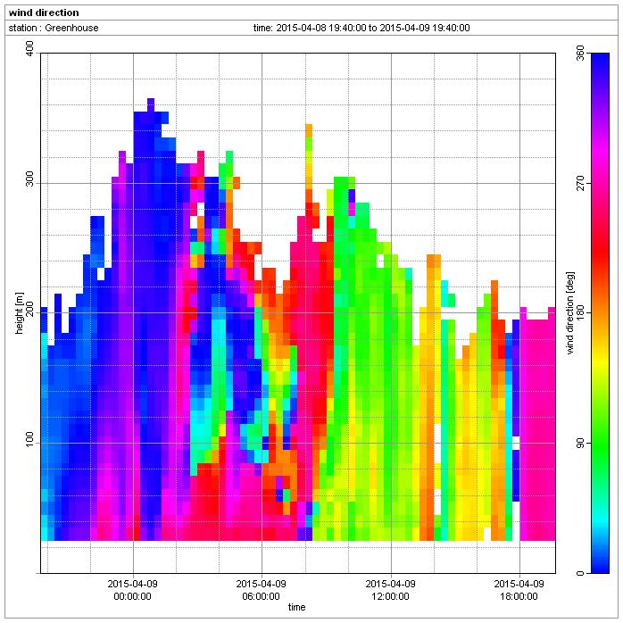
Diagnosing Pressure Variations (SODAR/RADAR)
NOTE: As wind speed increases, altitude dips, so pressure will increase as well.

Slide 7
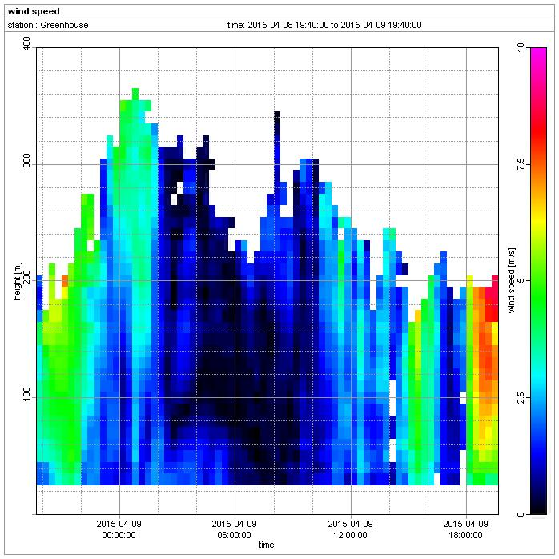
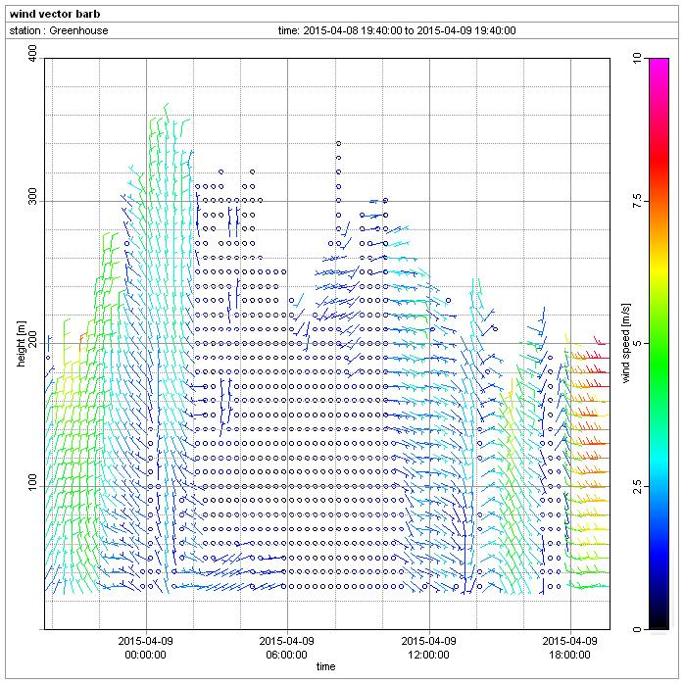
Diagnosing Pressure Variations (SODAR/RADAR) (cont.)

Slide 8
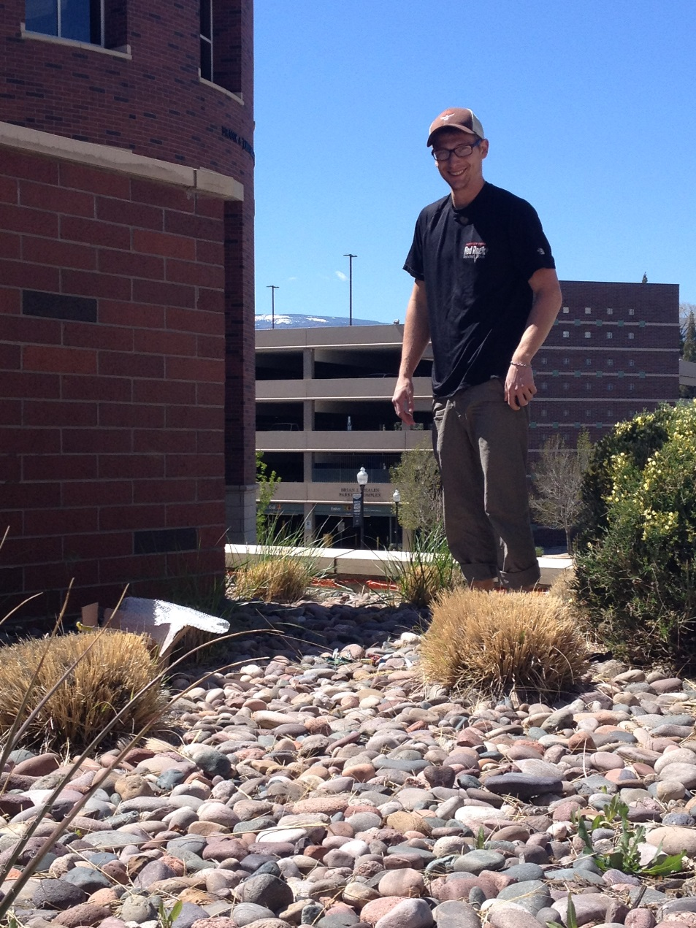
How the Sensors Work
The teensy cards are produced to make accurate measurements in dry conditions. Power comes through the 9V supply and is reduced into 5V paths for each sensor like for Pressure, CO₂ , Temperature, and Humidity. Everything else found was recorded through the weather station and computer. Measurements were recorded between 0 and 3.3V, which then gets sent back to the Teensy Card which files it onto the SD card. We took more measurements than just using the initial case study data, recording back at the same site as well as checking their function outside of the Joe Crowley Student Union.

Slide 9
Testing the Teensy Cards

Slide 10
Good Sensor Reading—Teensy Card 3
NOTE:
Data is giving steady readings over time with a consistent voltage output. At 20:30 UTC, the battery died and consequently the pressure readings increased. This is a good example of our equipment findings.

Slide 11
Diagnosing Teensy Card 2
NOTE: 11:50 UTC is when the data started to diverge from normal reading. As card 2 was connected to the computer, there is an inconsistency between this graph and those of the other teensy cards concerning reading times and data.

Slide 12
Diagnosing Teensy Card 4
NOTE: 15:20 UTC “blip” for voltage

Slide 13
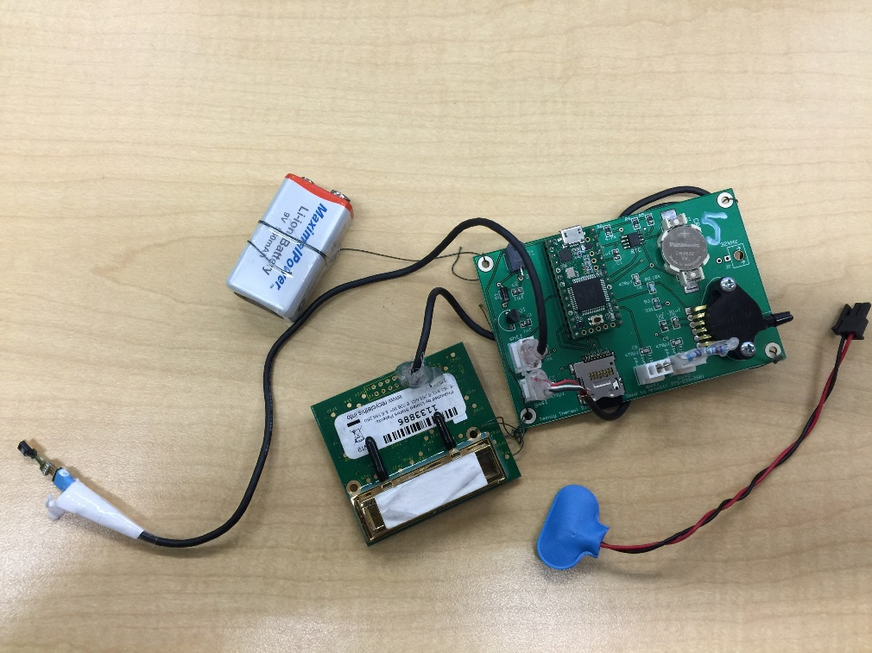
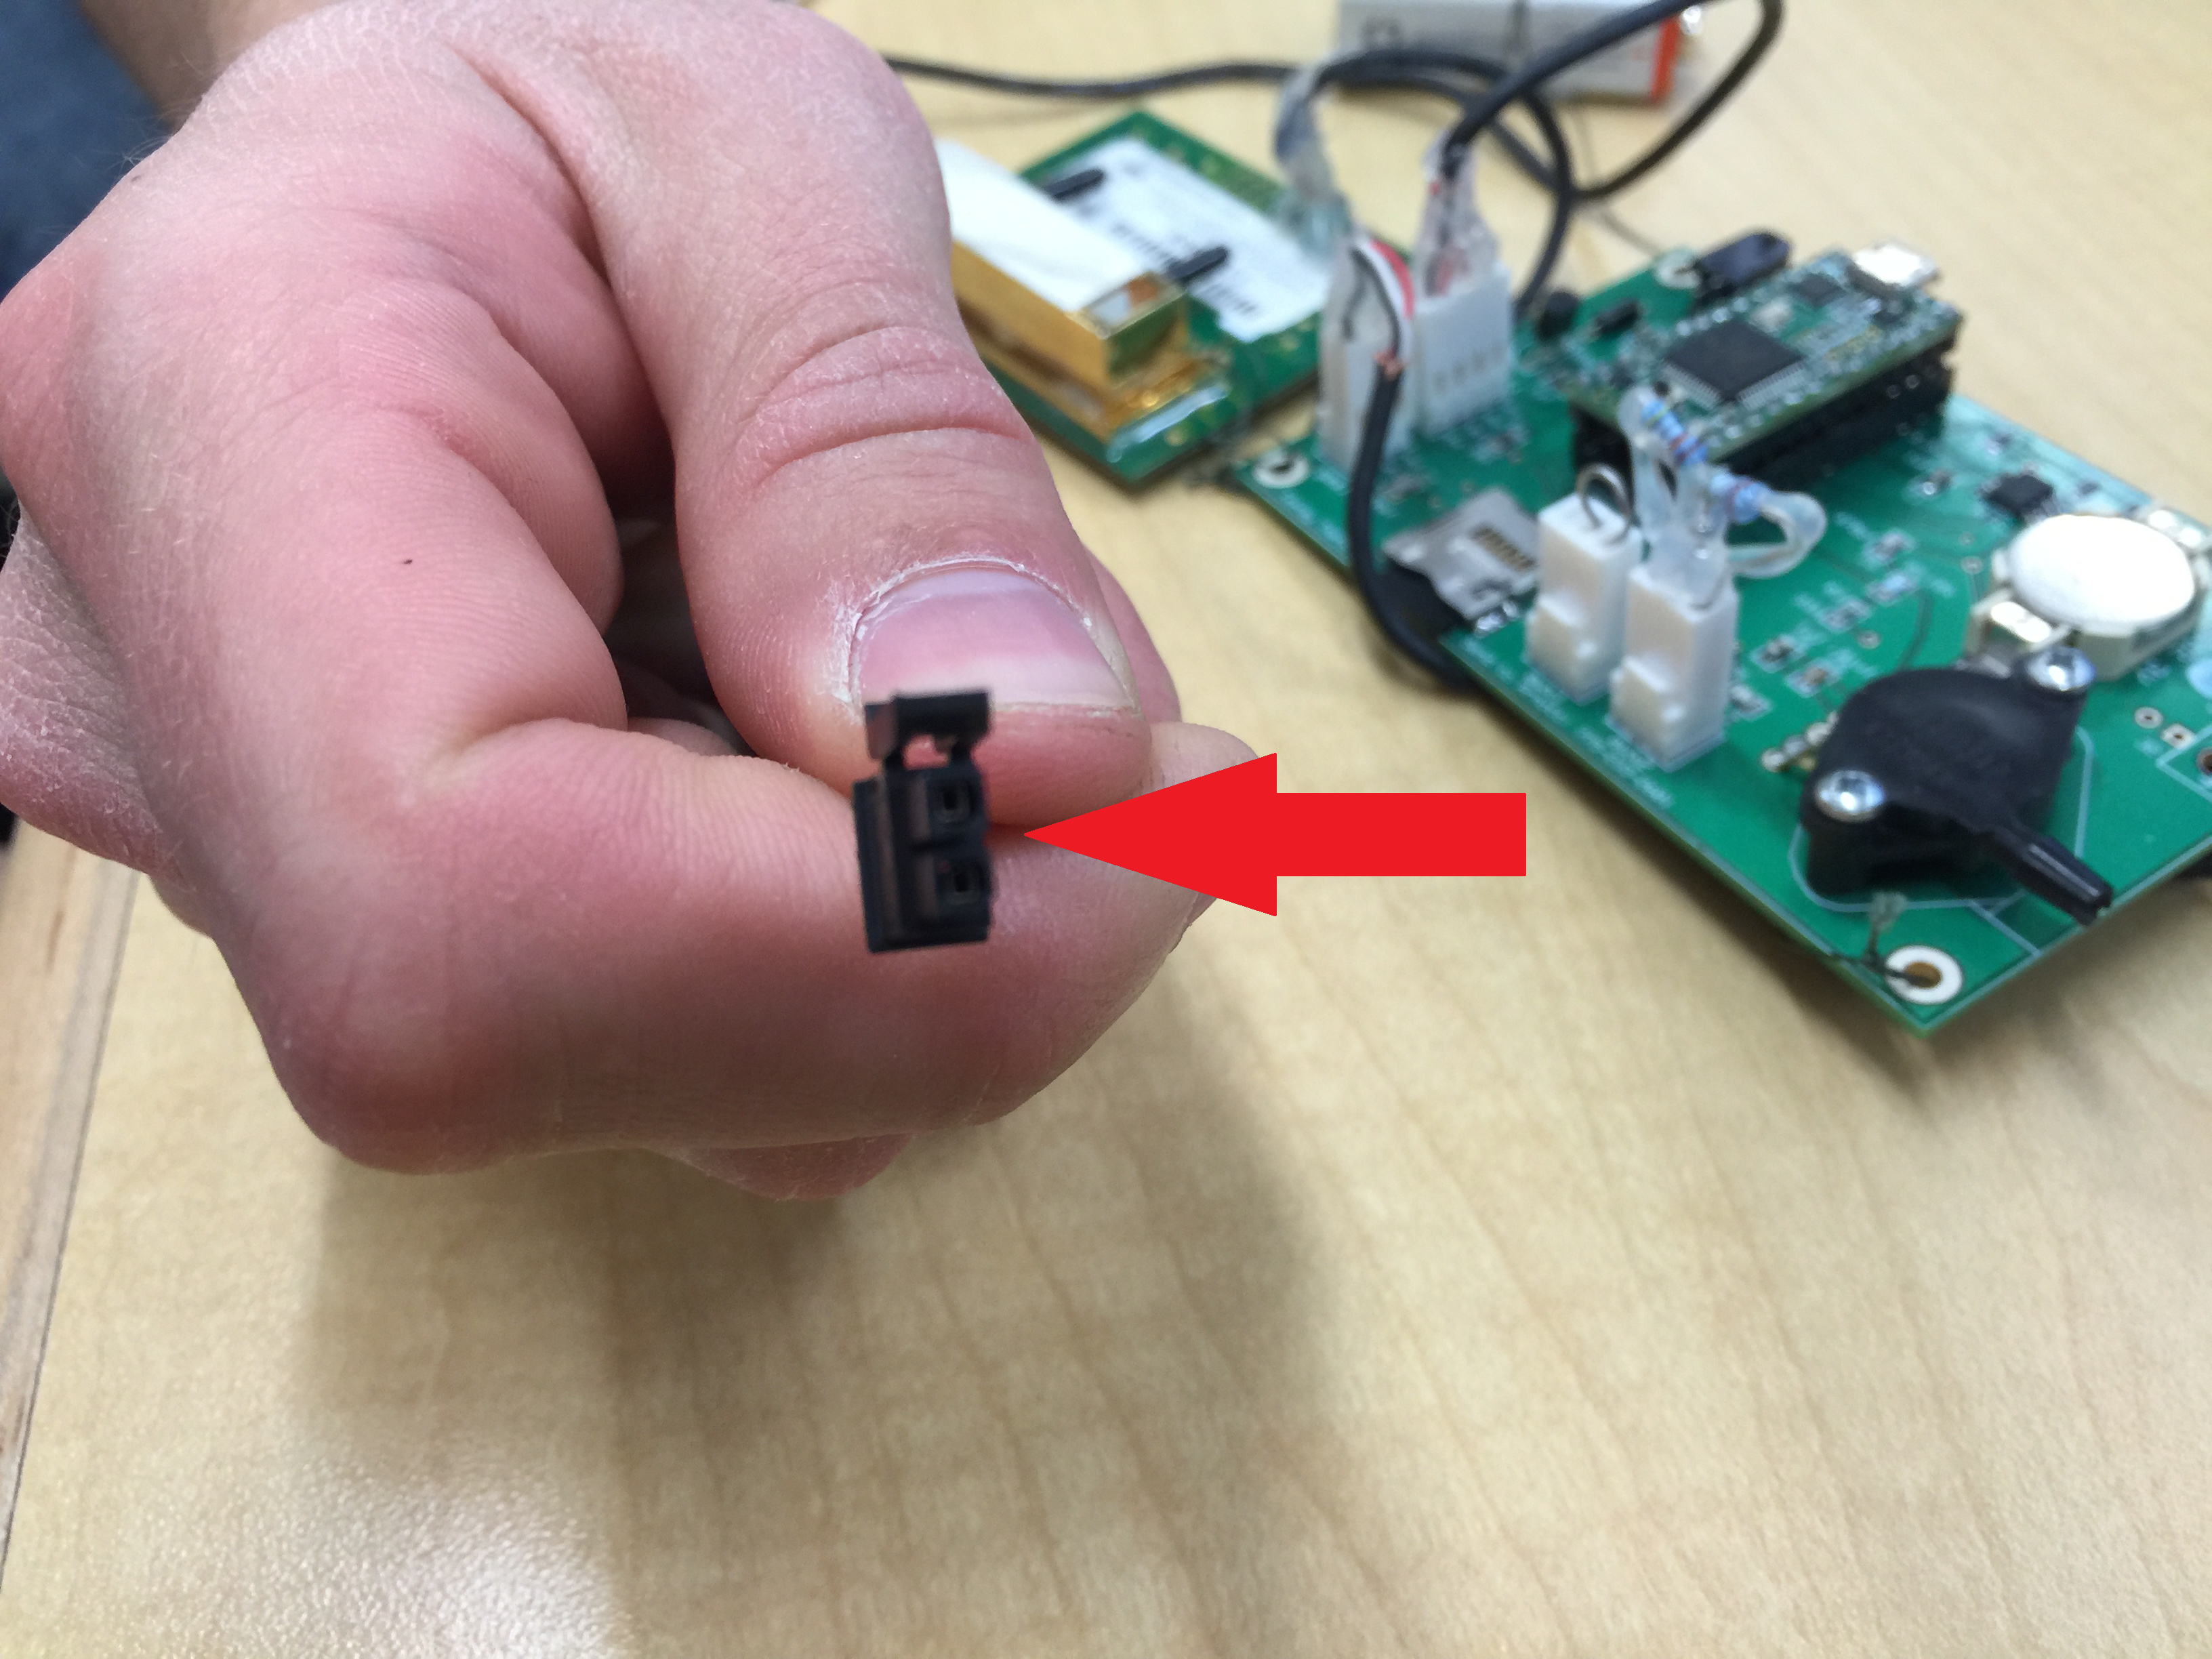
Diagnosing Teensy Card 5
Card 5 had a poor power connection and did not gather any data. The power cord (wire) connected to the battery was loose (“not crimped”) and shorted. Therefore, this complete equipment failure can be diagnosed as power failure, i.e. why this occurred.

Slide 14
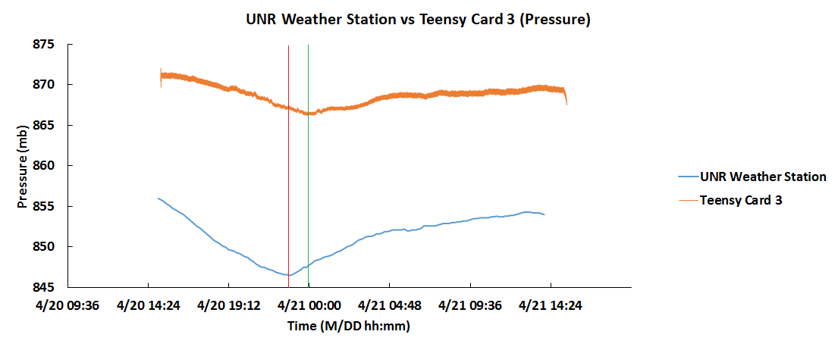
UNR vs Teensy

Slide 15
UNR vs Teensy (Differences)
The UNR station has a pressure sensor with about a +/- 5 mb max error. The teensy has a max error of +/- 15 mb.
This helps explain the large difference between the curves seen on the previous slide.
The UNR Pressure Sensor has a constant voltage, whereas the Teensy Card’s VCC connector (pin 3) varies from 3.3V to 3.4V and the voltage out (pin 1) varies from 5.1V to 5.2V and oscillates as the CO₂ sensor turns on and off. This inconsistent voltage varies the readings.
NOTE: the minimum pressure is seen at different times (green and red vertical lines)—22:50 for Weather Station and at 00:17 for the Teensy (UTC). This could be due to the fact that the UNR station takes 12 measurements total in our timeframe, while the teensy card takes 12 measurements/minute. Thus, the UNR station is more averaged and the reading could be less accurate.

Slide 16
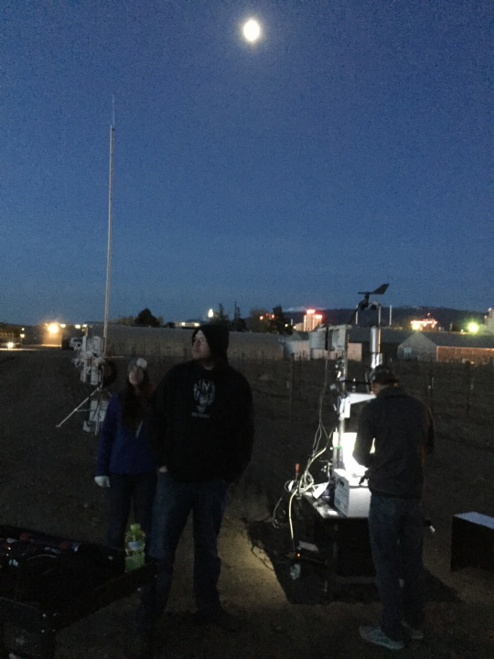
Improvements
We can improve the experiment by:
We think the metal touching the back of the boards may have messed with the temperature and thus the readings. Therefore, in order to improve the experiment, we work to make sure all power connections are reliable, the sensors are removed from outside influences, and have a test run of the instruments before we move them into the field.
We also should have measured the balloon height on-site and had more balloons to support more teensy cards for more readings. We also could have started measurements earlier, providing more measurements before sunrise.

