Slide 1
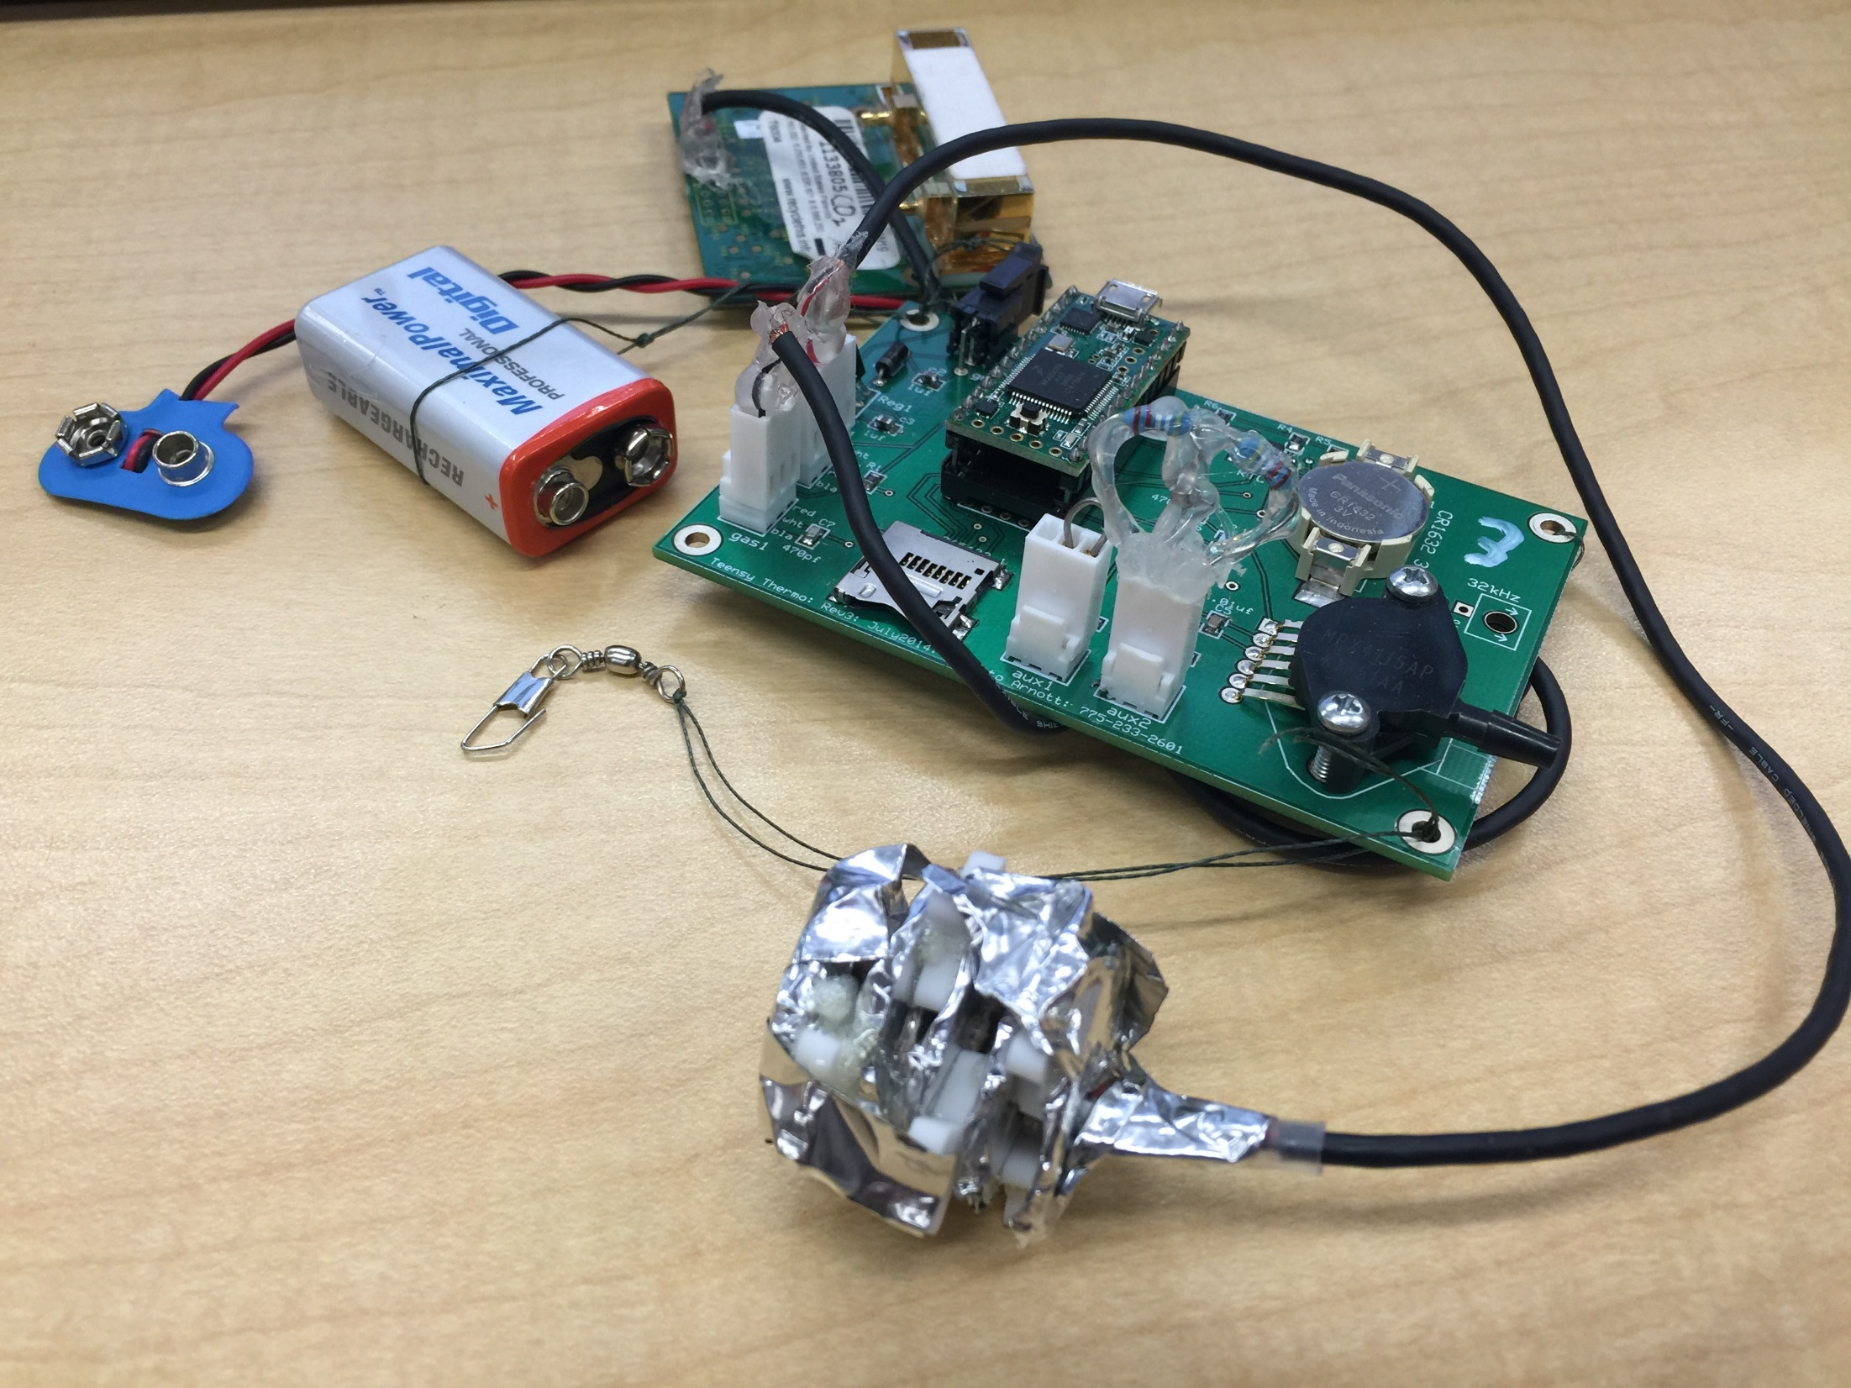
Teensy Card_3 Pressure Test and Temperature Sensor Shroud Test
Aaron Alexander
Jordan Parks
Zoey Rosen

Slide 2
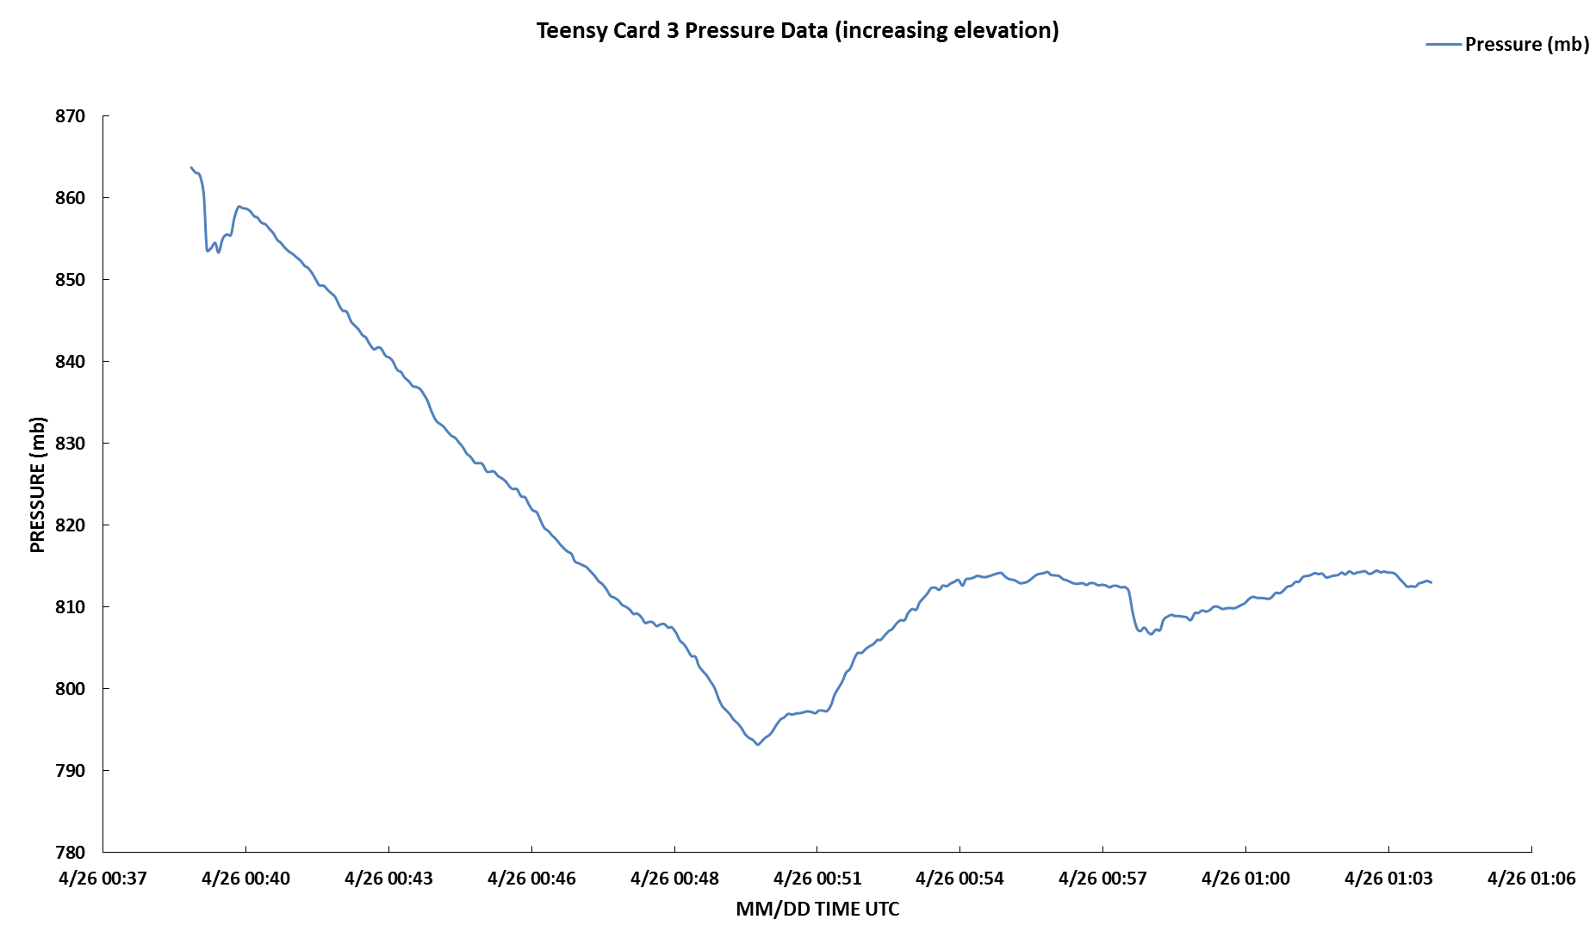
Pressure Test Increasing Elevation

Slide 3
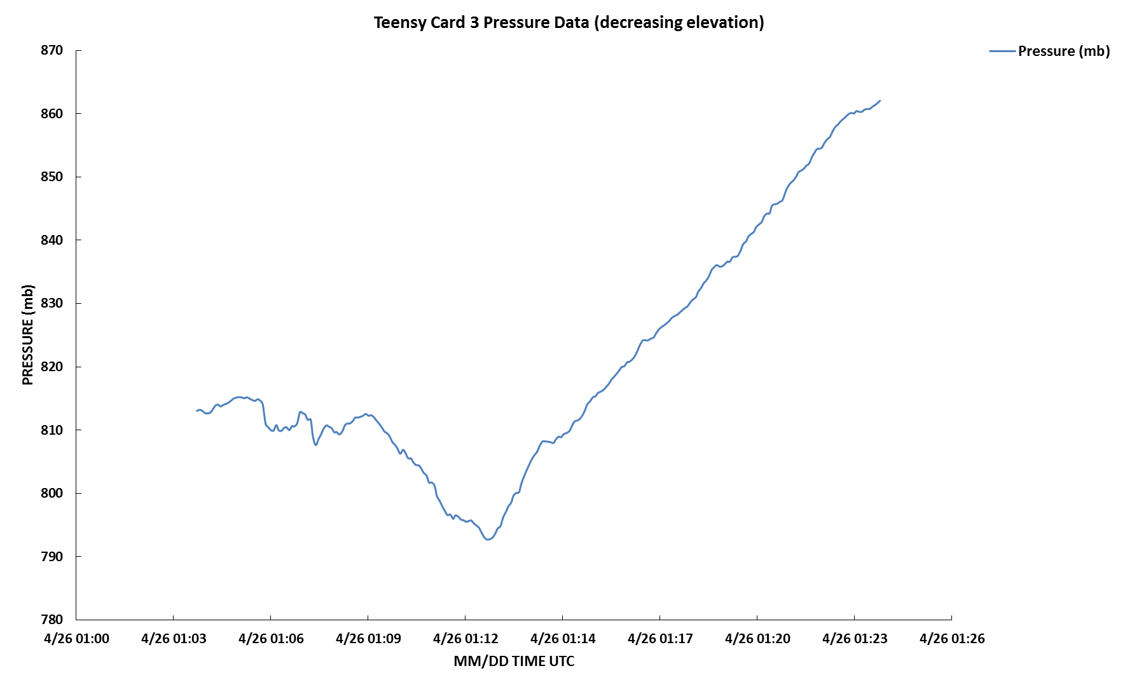
Pressure Increasing with Decreasing Elevation

Slide 4

Pressure Decreasing in Height

Slide 5
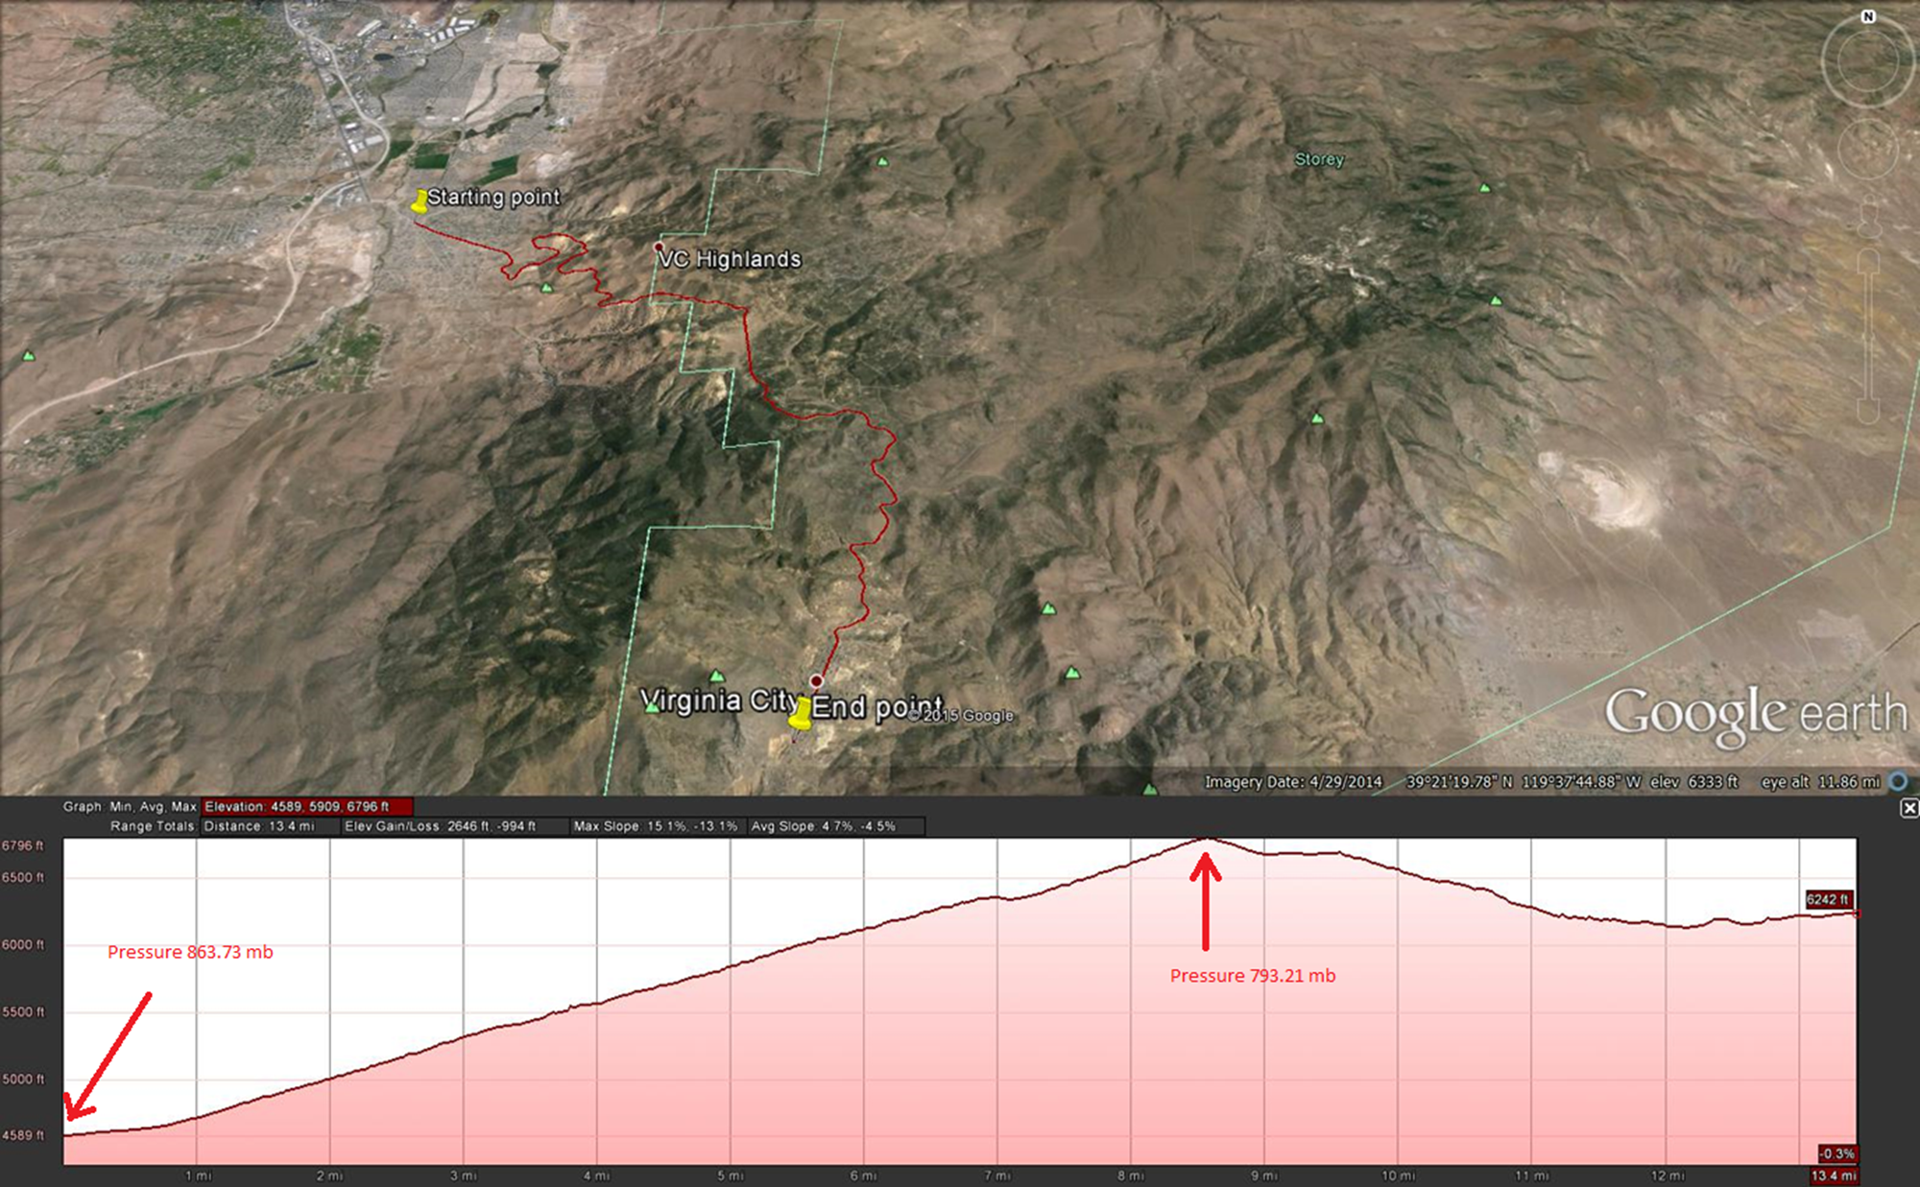
Route Traveled

Slide 6
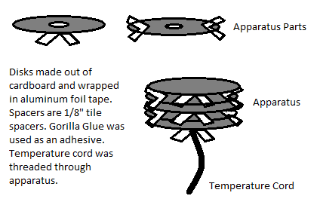
Temperature Shroud Design

Slide 7
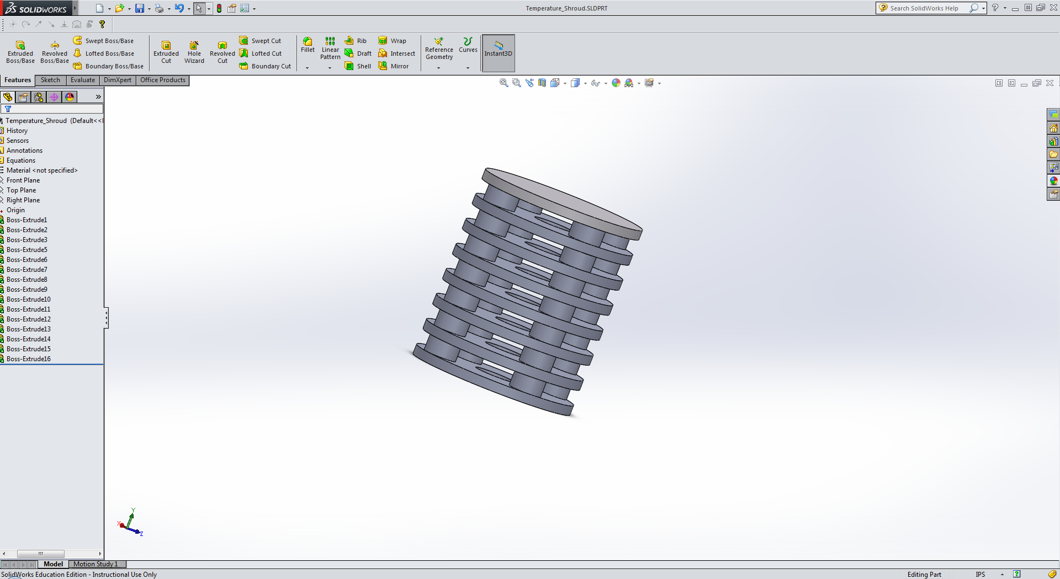
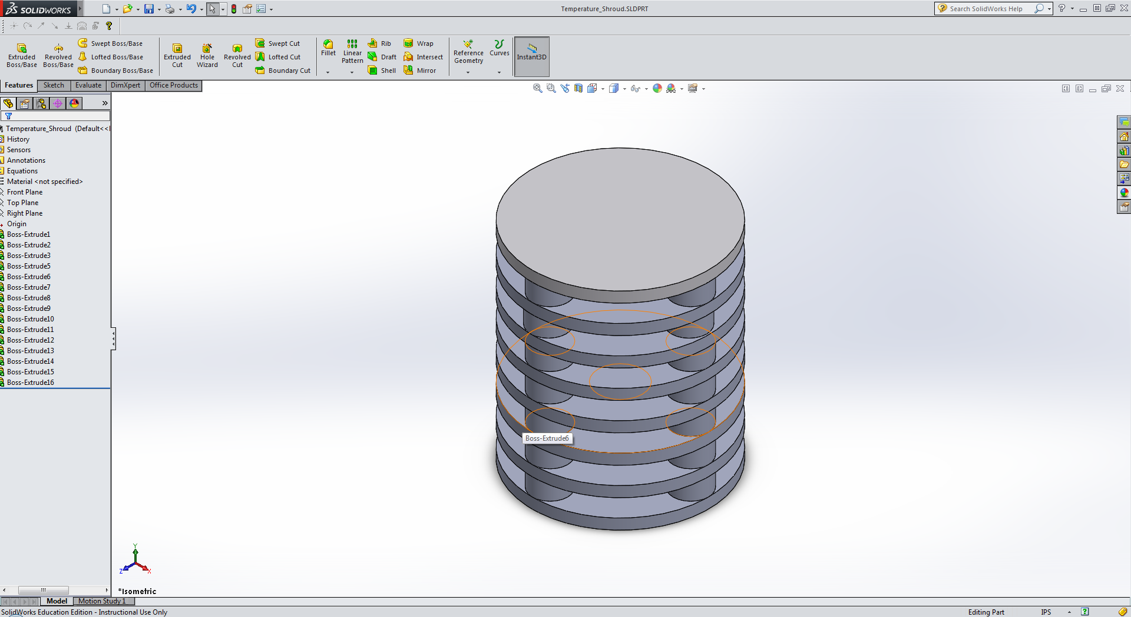
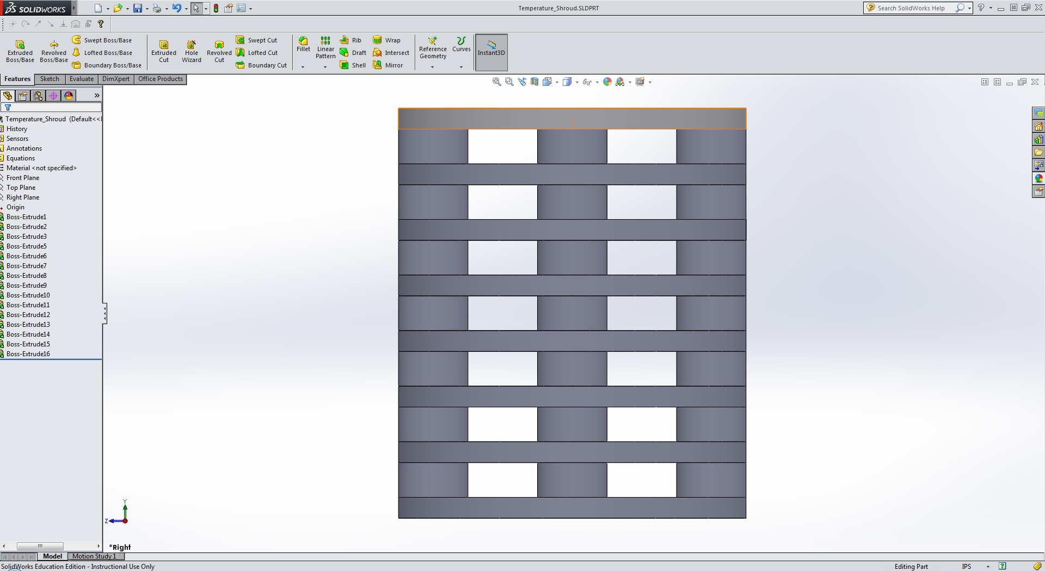
3D Printer Schematics

Slide 8
Temperature Graph Compared to UNR Station

Slide 9
Pressure Graph Compared to UNR Station

Slide 10
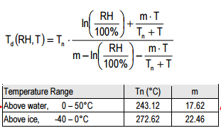
Dew Point Temperature Compared UNR Station

Slide 11
Percent Error at Convergence and Divergence
Percent Error Between Dew Points at Divergence |  | Percent Error Between Dew Points at Convergence
27.2589335 |  | 33.27565315
32.09513904 |  | 5.293562647
54.67769759 |  | 53.90271972
51.15112399 |  | 7.568725197
27.61511521 |  | 8.957071773
32.92904091 |  | 23.82205056
21.80152756 |  | 39.46567091
19.74771816 |  | 72.94610447
24.90735298 |  | 51.12371599
170.0779379 |  | 4.806124305

Slide 12
Conclusion
With the new shroud, the reflectivity allowed more accurate temperature readings.
Pressure decreases with height.
Pressure can be used to compare functionality of the Teensy cards (Virginia City).
We further calculated Dew Point from RH and Temperature.

Slide 13
Ways to Improve
Having a station at our exact start point in nearing Virginia City would have provided more accurate references for height calculation.
Multiple chances for recording measurements at different meteorological conditions allows more chances to test equipment.

