Slide 1
ATMS 360 – University of Nevada Reno CO₂ Measurements
Presented by Nick Burgener, Sam Taylor, and Jasmine White

Slide 2
Why are CO₂ measurements important?
Carbon Dioxide is the primary greenhouse gas emitted by human activities
Combustion of fossil fuels is the main cause
In the last 25 years, emissions have increased by 7%
http://www.epa.gov/climatechange/ghgemissions/gases/co2.html

Slide 3
Why are CO₂ measurements important?
Greenhouse gases are naturally regulated by earth processes
However, humans have created an excess of carbon dioxide, throwing the balance off
This increase in greenhouse gases leads to sunlight being trapped and contributes to global warming
It also dissolves in the oceans, causing them to become more acidic
This raised acidity causes decomposition of coral and other calcium based organisms
http://www.mnn.com/earth-matters/climate-weather/stories/co2-101-why-is-carbon-dioxide-bad

Slide 4
Why are CO₂ measurements important?
By measuring the levels of CO₂ in the air, we can gain a better understanding of how our actions affect the planet
This could help us to lower our emissions
If nothing else, it will show us how much we have already changed our world and how important it is to make changes

Slide 5
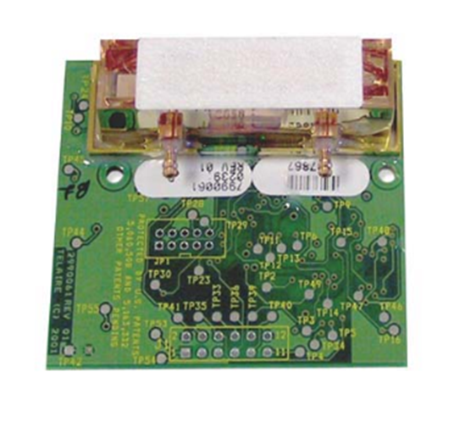
Measuring CO₂ levels – Telaire 6004

Slide 6
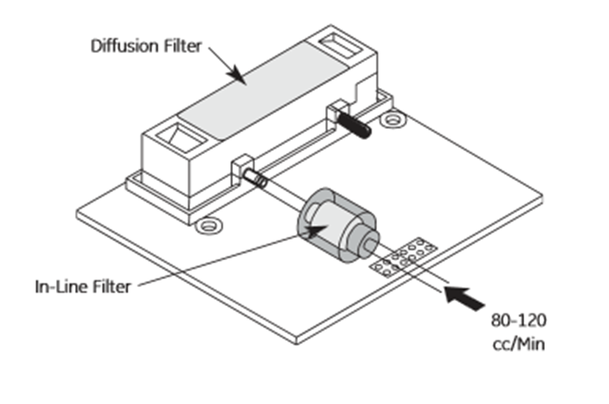
Measuring CO₂ levels – Telaire 6004

Slide 7
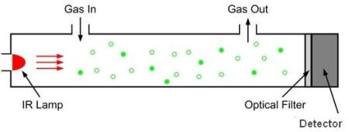
Measuring CO₂ levels – Telaire 6004
http://www.co2meter.com/blogs/news/6010192-how-does-an-ndir-co2-sensor-work

Slide 8
Measuring CO₂ levels
IR light of the specific wavelength which interacts with carbon dioxide is directed through the chamber
The sensor picks up what light still passes through
Whatever light was absorbed and not detected by the filter can be related to the amount of CO₂ molecules present

Slide 9
Measuring CO₂ levels
I = I_{o}e^{-nLα}
L is length of tube
α is the absorption cross section of CO₂ (constant)
n is the number of CO₂ molecules (what we want)
Because we know I_{o} and I from the sensor, the number of CO₂ molecules can be easily calculated

Slide 10
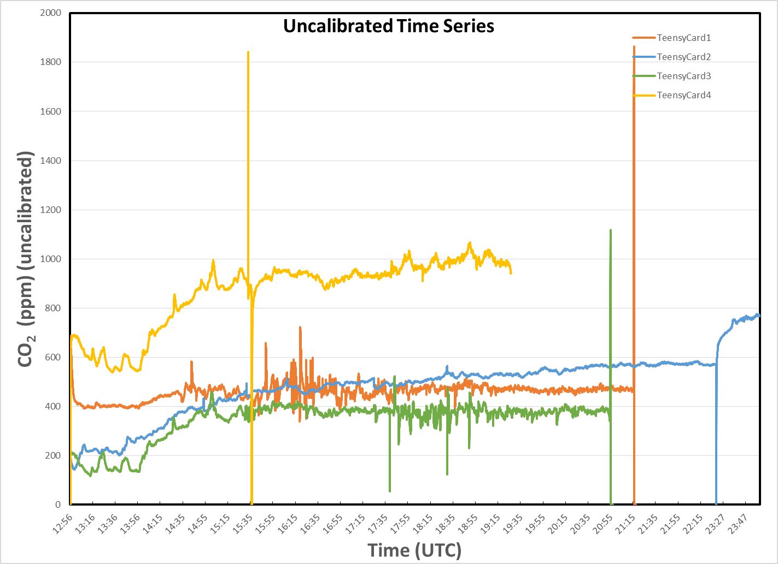

Slide 11
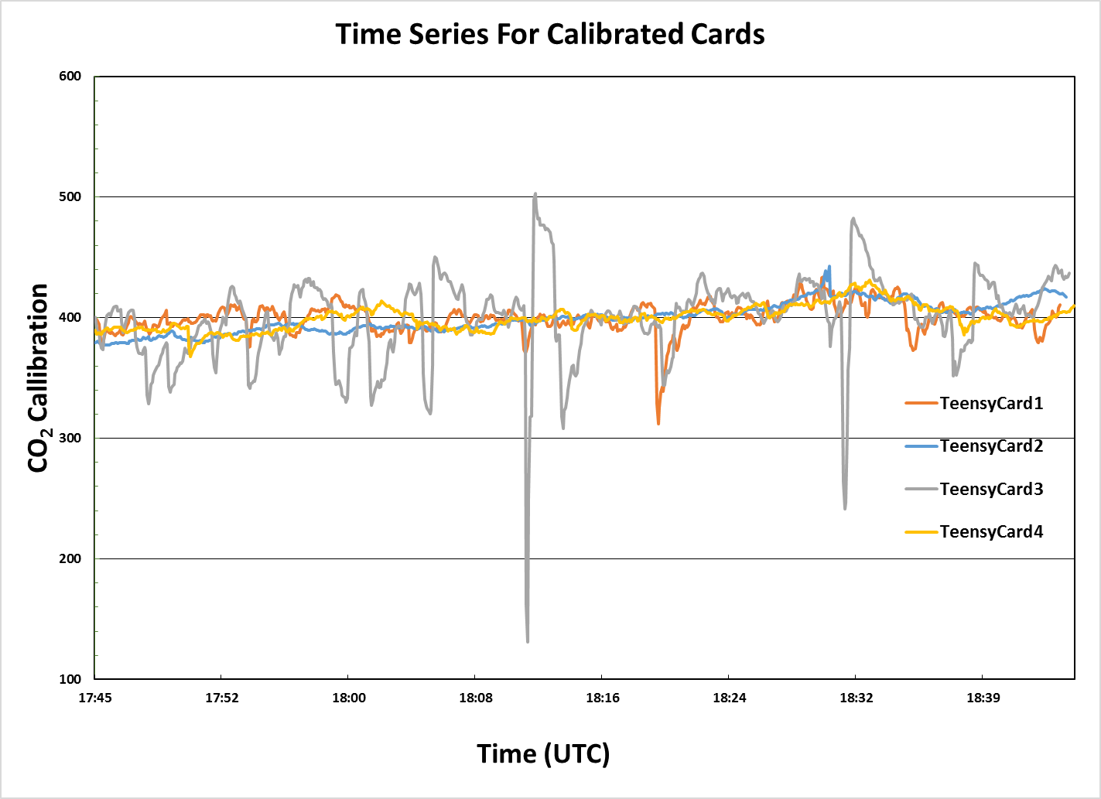

Slide 12
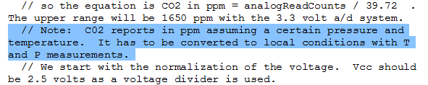
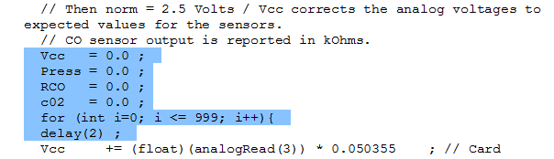
Calibration for Temperature and Pressure

Slide 13
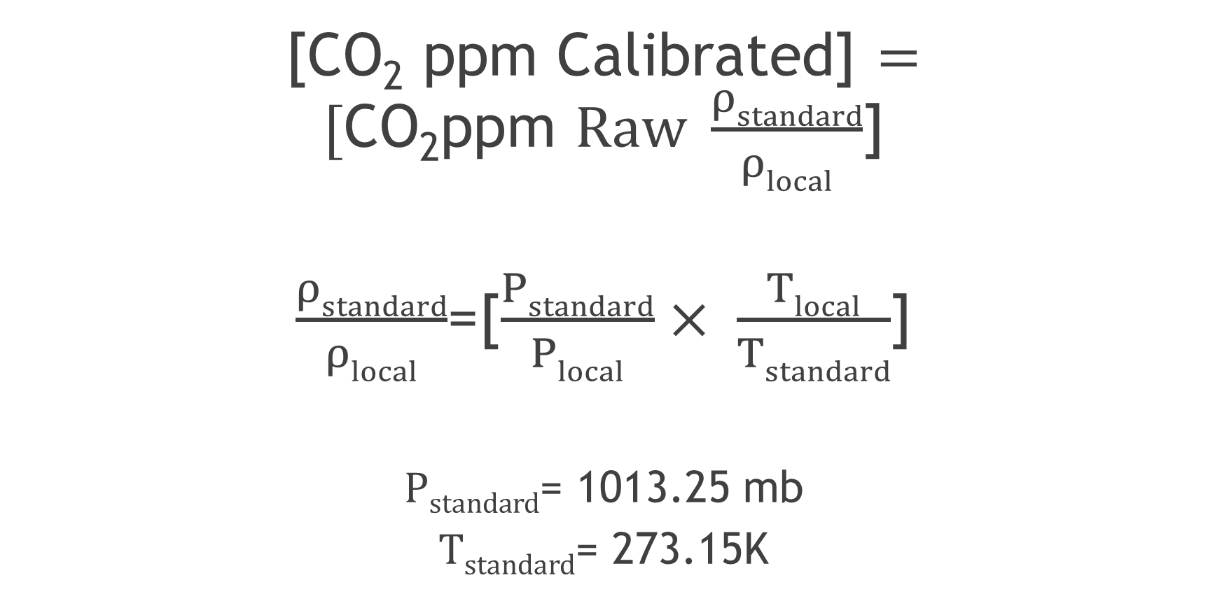
Equations used by the CO₂ Sensor
[CO₂ ppm Calibrated] $=[\text{CO}\text{2}\text{ppm} Raw \frac{ρstandard}{ρlocal}$]
$\frac{ρstandard}{ρlocal}$=[$\frac{Pstandard}{Plocal}× \frac{Tlocal}{Tstandard}$]
$Pstandard$= 1013.25 mb
$Tstandard$= 273.15K

Slide 14
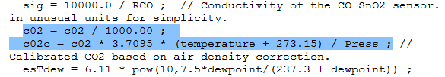
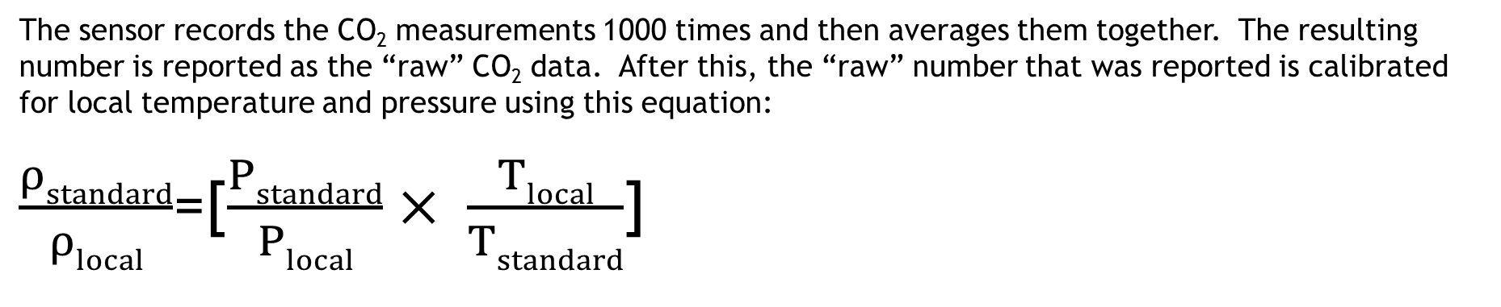
Calibration for Temperature and Pressure Cont.
The sensor records the CO₂ measurements 1000 times and then averages them together. The resulting number is reported as the “raw” CO₂ data. After this, the “raw” number that was reported is calibrated for local temperature and pressure using this equation:
$\frac{ρstandard}{ρlocal}$=[$\frac{Pstandard}{Plocal}× \frac{Tlocal}{Tstandard}$]

Slide 15
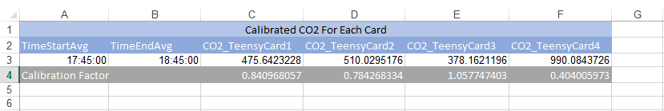
400 ppm Calibration
Before the calibration was applied, teensy card 4 appeared to be very inaccurate. However, once the card was calibrated for 400 ppm, it lined up nicely with the rest of the cards. Card 3 appeared to have some strange values.

Slide 16
Data Analysis
Non-calibrated Time Series: data from all four cards varied from each other.
After calibration, data was averaged around 400ppm between 17:45 - 18:45 (10:45 am – 11:45 am).
Fluctuations in data could suggest tampered levels of CO₂ at surface.
Fluctuations in data could be caused by card mechanics.

Slide 17
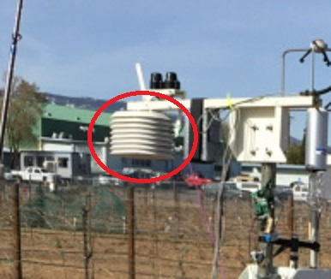
Card Status
Card 1 was described to be standard as it found 400ppm during personal data collection.
Card 2 followed similar pattern despite modifications/location difference.
Card 4 recorded outlier data before calibration.
Card 2 Location

Slide 18
Improvements? Yes!
Hypothesized Card 3 was short-circuited due to contact with a metal pole.
Securing/Examining surrounding area to minimize interference.
Making certain each card worked appropriately.
Test runs versus actual runs.
More cards for larger data pool.
Ensuring proper activation/warm-up time window.

Slide 19
Questions? Comments? Stories? …Anything?

