Slide 1
INVESTIGATION OF SURFACE ALBEDO AND FORCINGS DUE TO EVAPORATIONAL COOLING
MODEL DEVELOPMENT AND FUTURE RESEARCH
BEN SUMLIN AND PHILIP BURT
ATMS 746/360

Slide 2
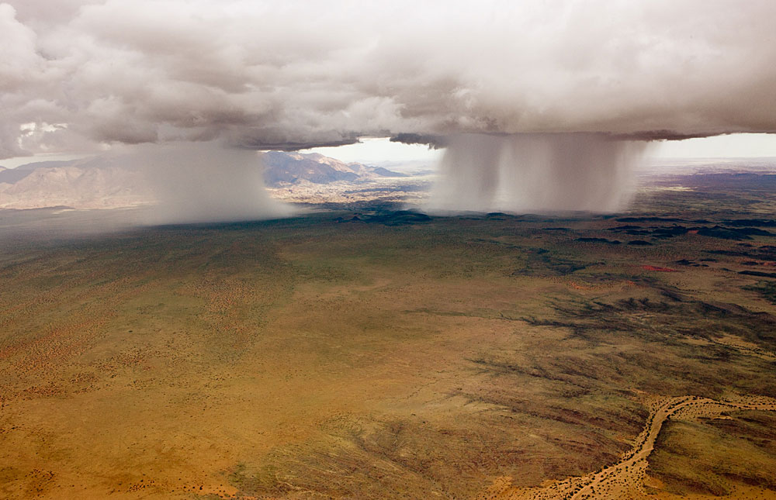
Kaokoland, Namibia. Photo by Michael Poliza.

Slide 3
OUTLINE
METHODS
RESULTS AND MODEL DEVELOPMENT
FUTURE WORK

Slide 4
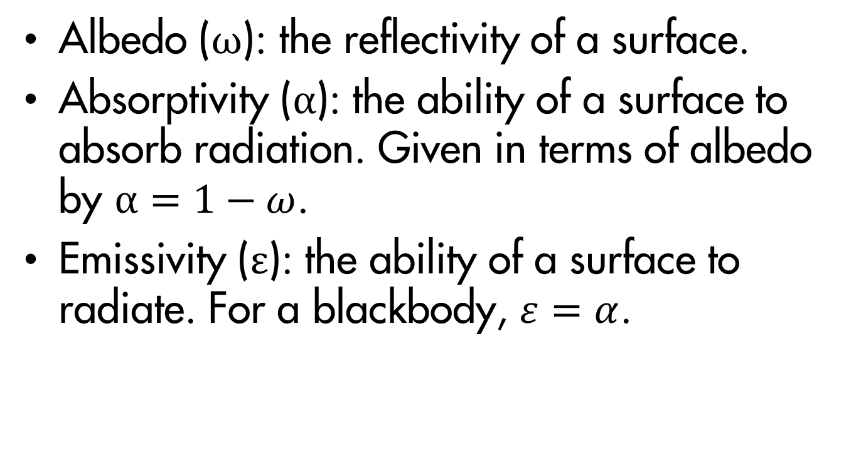
METHODS: DEFINITIONS
Albedo (ω): the reflectivity of a surface.
Absorptivity (α): the ability of a surface to absorb radiation. Given in terms of albedo by $α=1−ω$.
Emissivity (ε): the ability of a surface to radiate. For a blackbody, $ε=α$.

Slide 5
METHODS
Equipment
  Dual spectrometers 350-1000 nm
    Downwelling and reflected spectra
  FLIR infrared camera
  IR thermometer
Computer code
  Fortran program takes these readings and computes an albedo for 350-800 nm

Slide 6
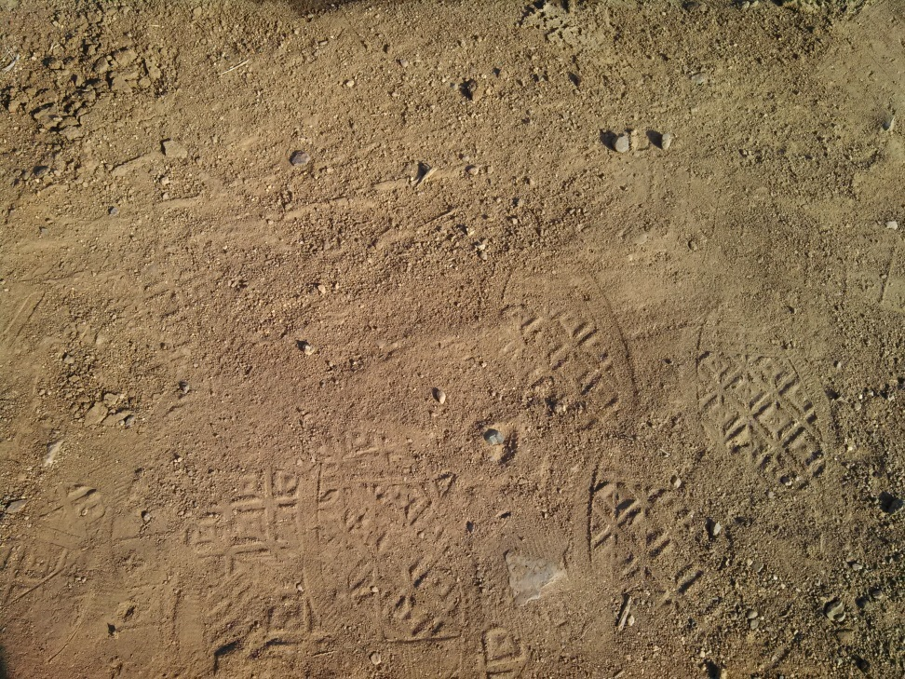
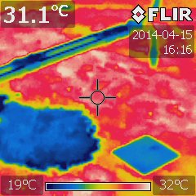
METHODS: DRY SOIL
The measurements were taken during late afternoon, so the soil was very warm from a day’s worth of solar radiation
This provided a better temperature contrast from the wet and moist soil samples

Slide 7
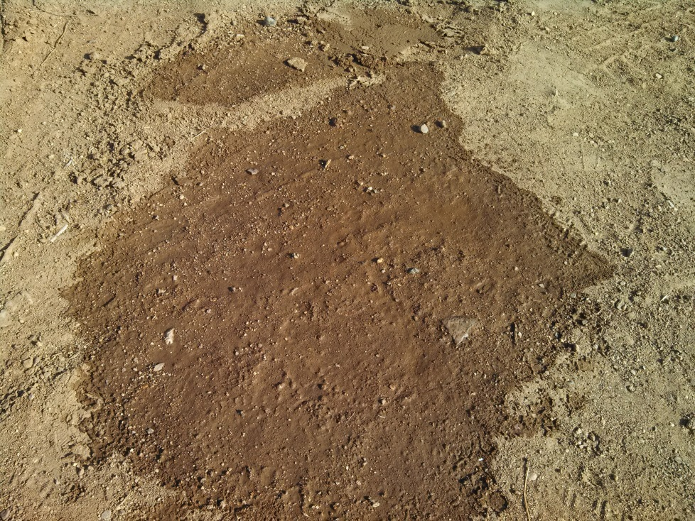
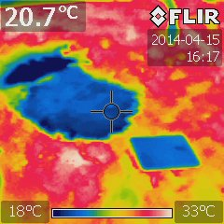
METHODS: WET SOIL
This soil had been wet and then our measurement was taken after all water on the surface had been absorbed into the ground or evaporated

Slide 8
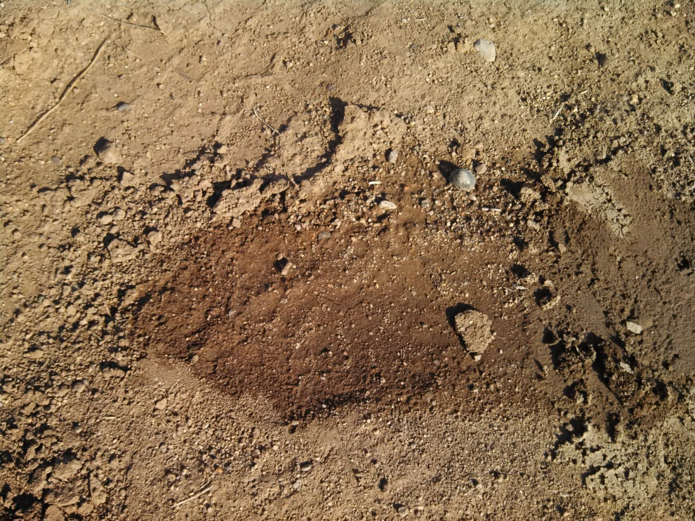
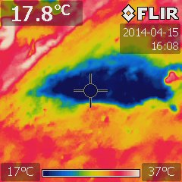
METHODS: MOIST SOIL
This soil had been sprayed with water and left sitting for about ten to fifteen minutes
Evaporating water had more time to cool the surface so the temperature was cooler than the wet soil

Slide 9
OUTLINE
METHODS
RESULTS AND MODEL DEVELOPMENT
FUTURE WORK

Slide 10
RESULTS AND MODEL DEVELOPMENT
Evaluate albedo change while neglecting moisture entirely
  Albedo changes simply because the soil is a different color!
What temperature change do we expect from darker soil that’s still dry?
  What temperature do we measure?
Attribute temperature difference to evaporational cooling
  Latent heat, thermal conductivity, and modified optical properties due to moisture

Slide 11
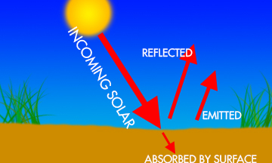
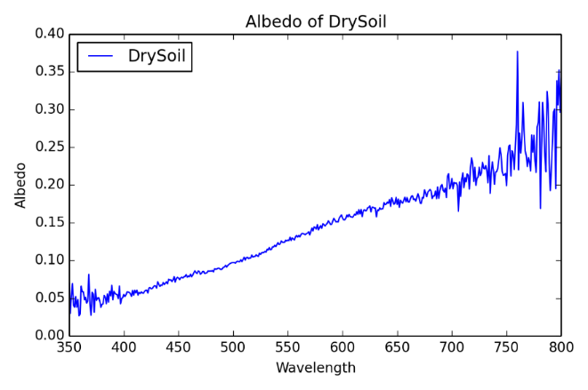
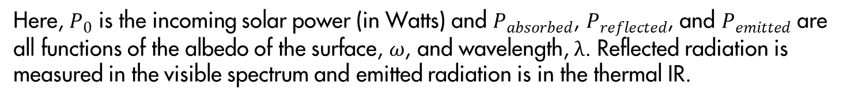
RESULTS AND MODEL DEVELOPMENT
$$P_{absorbed}=P_{0}−P_{reflected}−P_{emitted}$$
Here, $P_{0}$ is the incoming solar power (in Watts) and $P_{absorbed}$, $P_{reflected}$, and $P_{emitted}$ are all functions of the albedo of the surface, $ω$, and wavelength, λ. Reflected radiation is measured in the visible spectrum and emitted radiation is in the thermal IR.

Slide 12
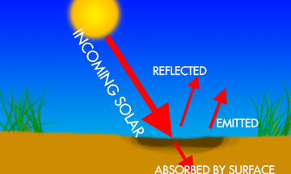
RESULTS AND MODEL DEVELOPMENT
$$P_{absorbed}=P_{0}−P_{reflected}−P_{emitted}$$
Here, since the albedo is lower, the surface absorbs more and reflects less. However, because it absorbs more radiation, it must also emit more thermal radiation, again in the thermal IR. We expect this surface to be WARMER.

Slide 13
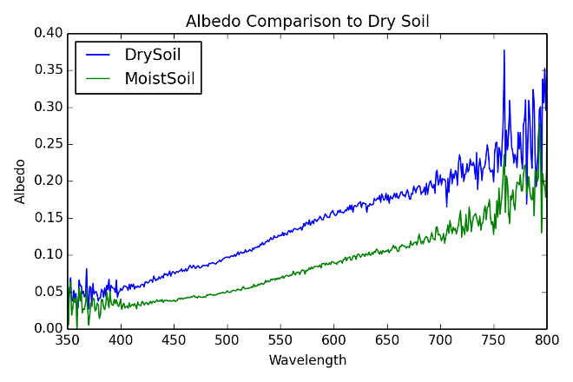
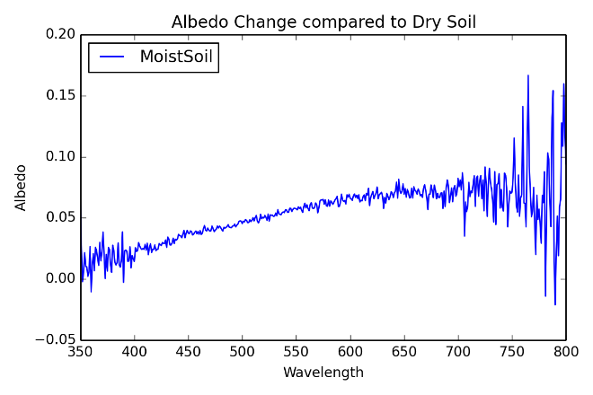
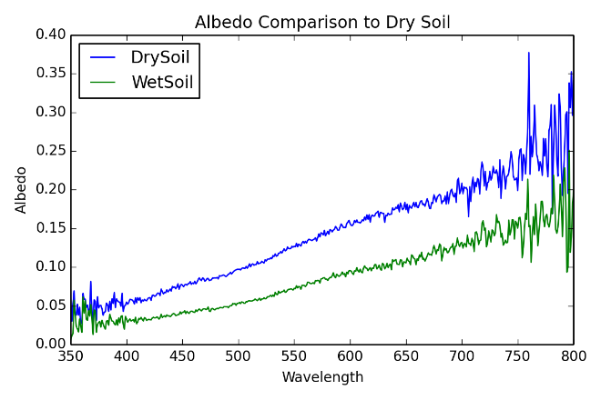
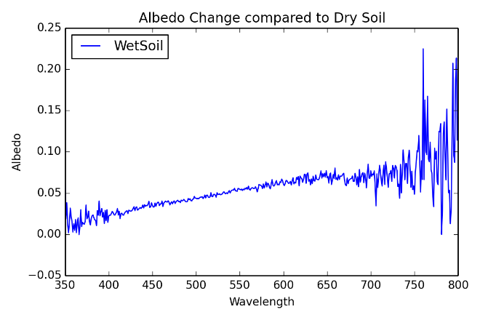
RESULTS AND MODEL DEVELOPMENT

Slide 14
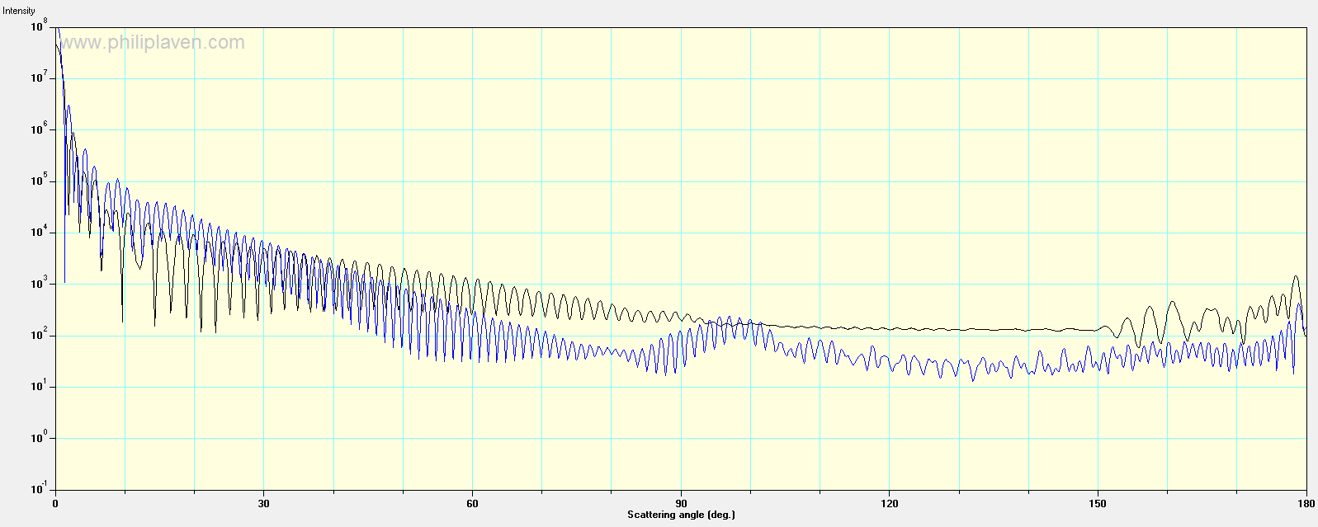
RESULTS AND MODEL DEVELOPMENT
Mie theory scattering phase functions for 10 micron dust in air (black) and water (blue).

Slide 15
RESULTS AND MODEL DEVELOPMENT
We expect the moist surface to be warmer due to higher absorption and emission.
However, the measured temperature was far COLDER than the baseline dry surface.
SOIL CONDITION | THM (°C) | CAMERA (°C) | ALBEDO (average)
Dry | 27.2 | 31.1 | 0.1418
Moist | 24.5 | 17.0 | 0.0885
Wet | 15.0 | 19.0 | 0.0737
Soaked* | 20.5 | 24.8 | 0.0865
Table 1: temperatures and average albedos of various soil conditions.

Slide 16
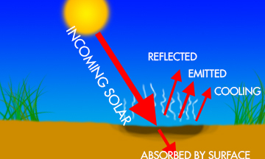
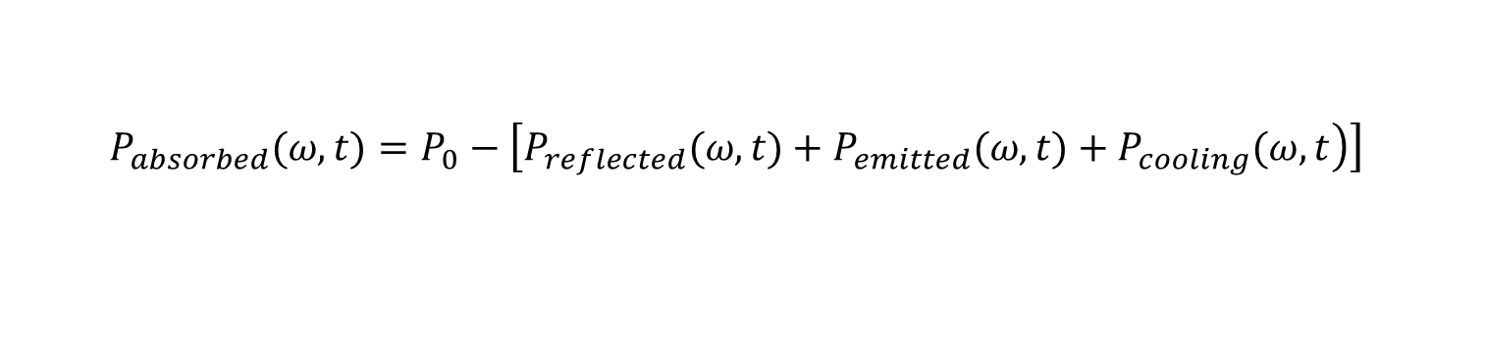
RESULTS AND MODEL DEVELOPMENT
$$P_{absorbed}(ω,t)=P_{0}−\left[\left.P_{reflected}(ω,t)+P_{emitted}(ω,t)+P_{cooling}(ω,t\right)\right]$$
Evaporational cooling must be a significant component of the radiation budget at the surface. Also, the addition of water to the soil alters its thermodynamical properties, changing the thermal conductivity. Heat may also transfer into the dry soil underneath the wet layer.

Slide 17
OUTLINE
METHODS
RESULTS AND MODEL DEVELOPMENT
FUTURE WORK

Slide 18
FUTURE WORK
A carefully controlled experiment may be conducted to completely characterize the forcing effects of wet versus dry soil.
  Known quantities of water soil of various types
  Time series of albedo as water evaporates
    Control mass of soil, i.e., protect it from ablation processes
    Measure mass of system as water evaporates
  Time series of surface temperature as well as temperature at multiple depths
  Hydrological models to investigate soil moisture retention
  Satellite measurements
    ERS-1, -2, METOP-A, SMAP*

