Slide 1
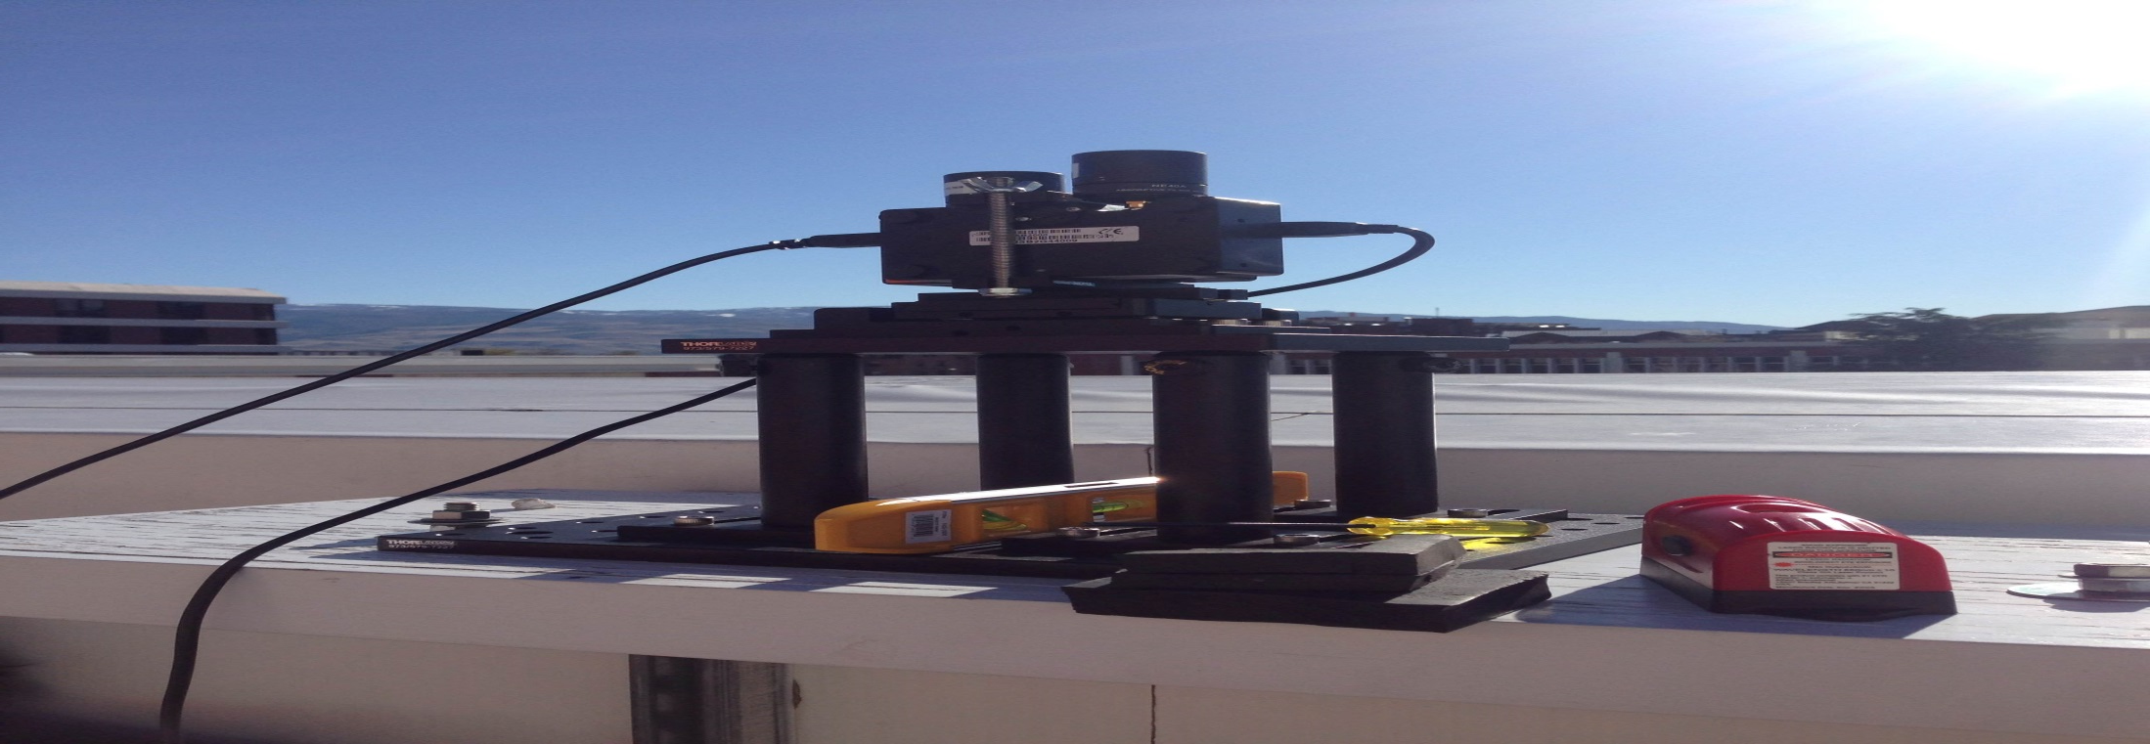
Clear-Sky irradiance observations and models to analyze aerosol characteristic over Semi-arid Reno, NV.
By:
Addison Liming
Jayne Boehmler
Marcela Loria-Salazar
(Jammin group)
:-D

Slide 2


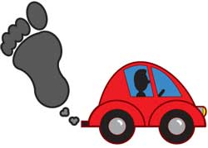
Outline
Purpose
Aerosol properties
Methods
Model parameters
Results
Summary

Slide 3
Outline
Purpose
Aerosol properties
Methods
Model parameters
Results
Summary

Slide 4
Purpose
Use of the sun-photometer to analyze aerosol characteristic in Reno.
Under clear-sky conditions on April 10th 2014 at 16:30 (PST)
Compare SMARTS model against the observations taken from the sun-photometer. Models used:
Urban
Desert Min
Desert Max

Slide 5
Outline
Purpose
Aerosol properties
Methods
Model parameters
Results
Summary

Slide 6
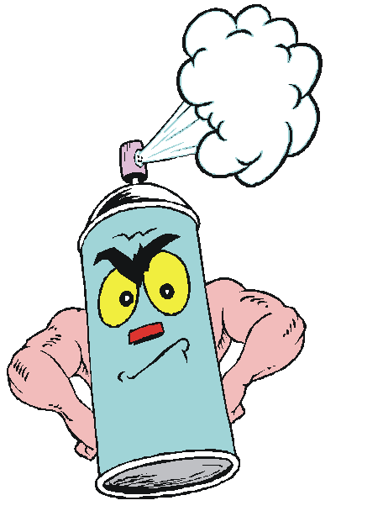
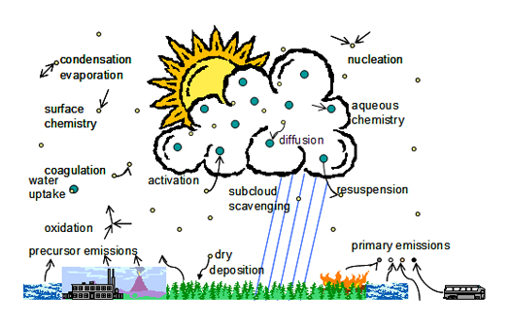
Aerosol
It is a suspension of fine solid particles or liquid droplets in a gas.
Anthropogenic: Causes by human activities
Natural: Causes by the nature

Slide 7
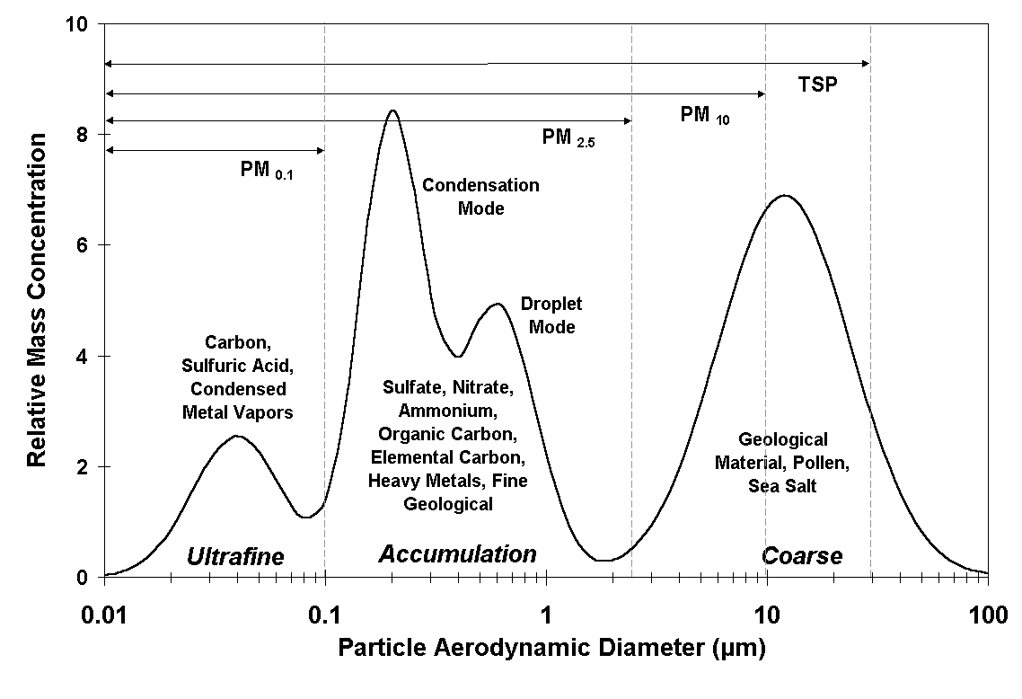
Aerosol modal distribution

Slide 8
Outline
Purpose
Aerosol properties
Methods
Model parameters
Results
Summary

Slide 9
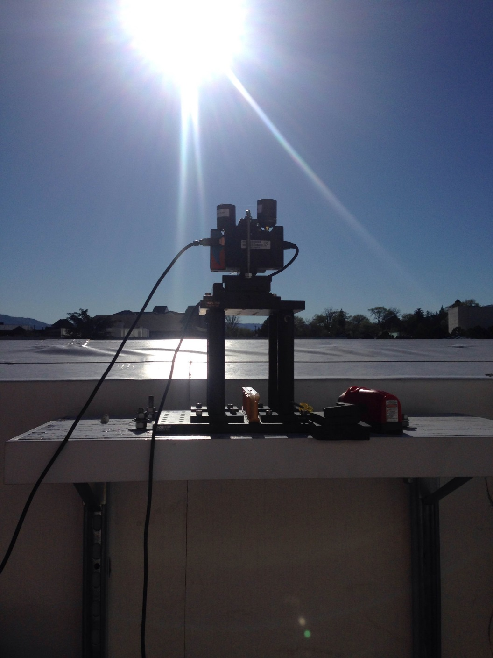

April 10th 2014, 16:30 (PST)

Slide 10
Ocean Optics: Red tide
350 nm -1000 nm
Instruments
AOD(500 nm)=0.1
PW =5mm

Slide 11
Outline
Purpose
Aerosol properties
Methods
Model parameters
Results
Summary

Slide 12
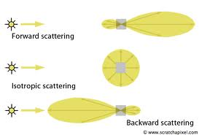
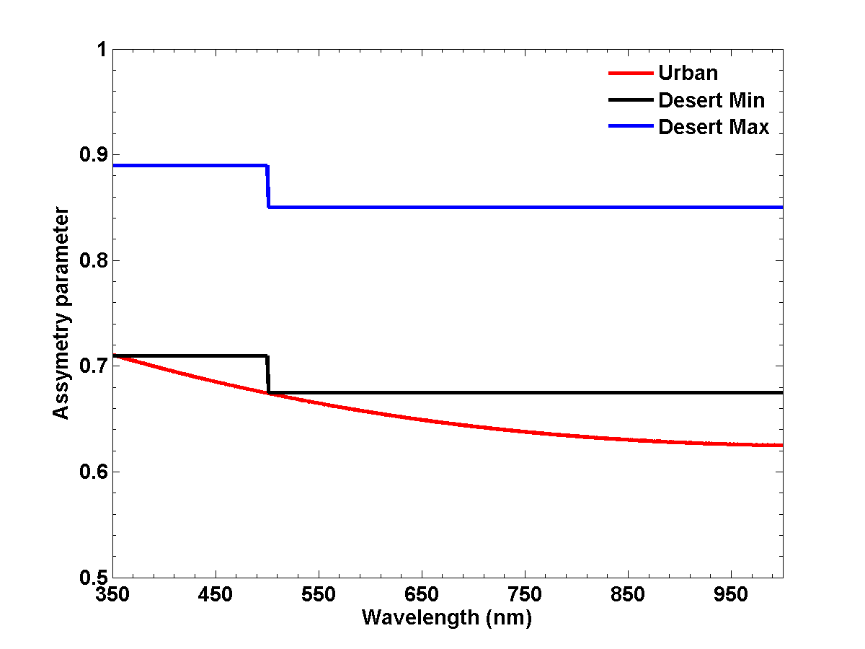
Model Parameter: Asymmetry parameter
It is a measure of the preferred scattering direction
Asymmetry parameter
~ 1
Forward scattering
~ -1
Back scattering

Slide 13
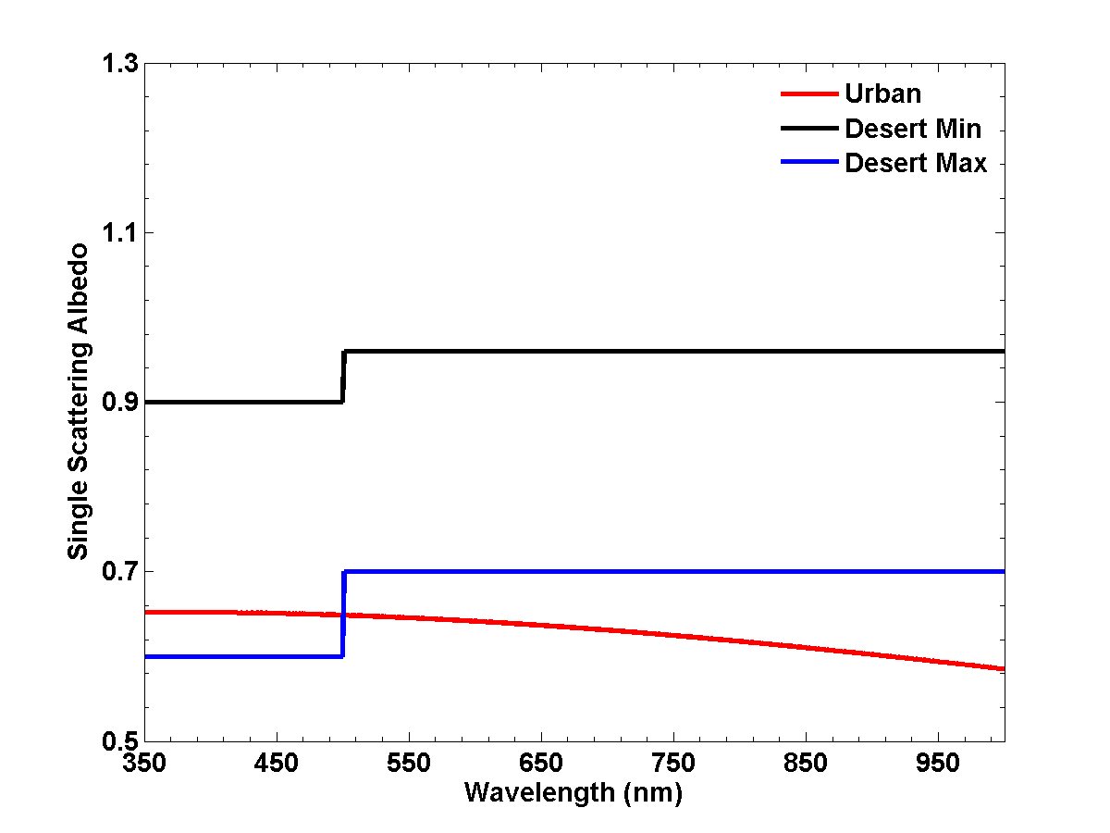
Model Parameter: Single Scattering Albedo (SSA)
Ratio between of light scattering (β_{sca}) and light extinction
(β_{sca} + β_{abs})
SSA
1
Total scattering
0
Total absorption
SSA~0.3
SSA>0.9

Slide 14
Outline
Purpose
Aerosol properties
Methods
Model parameters
Results
Summary

Slide 15
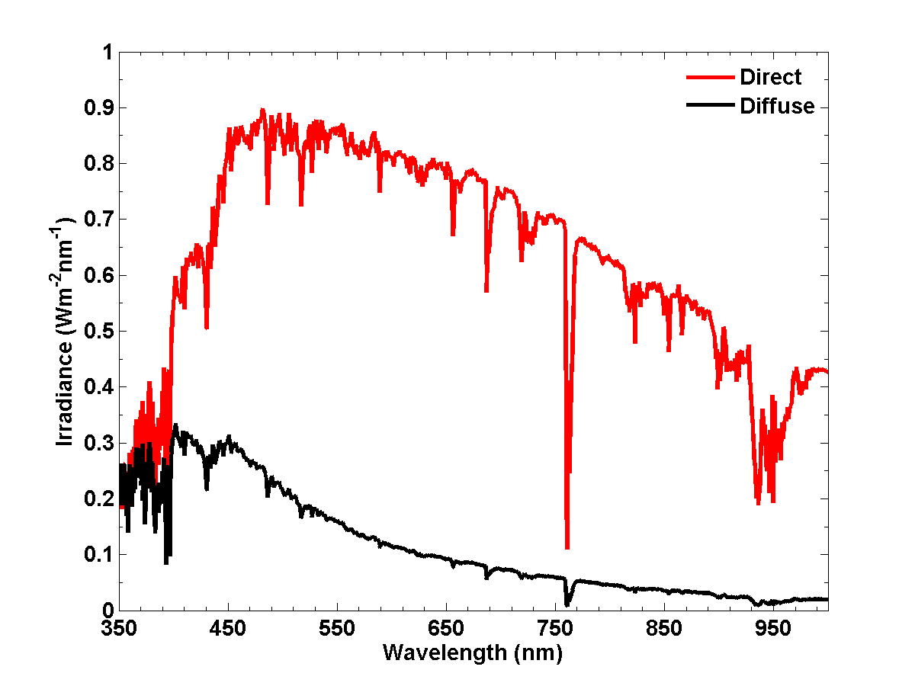
SMARTS: Urban Model

Slide 16
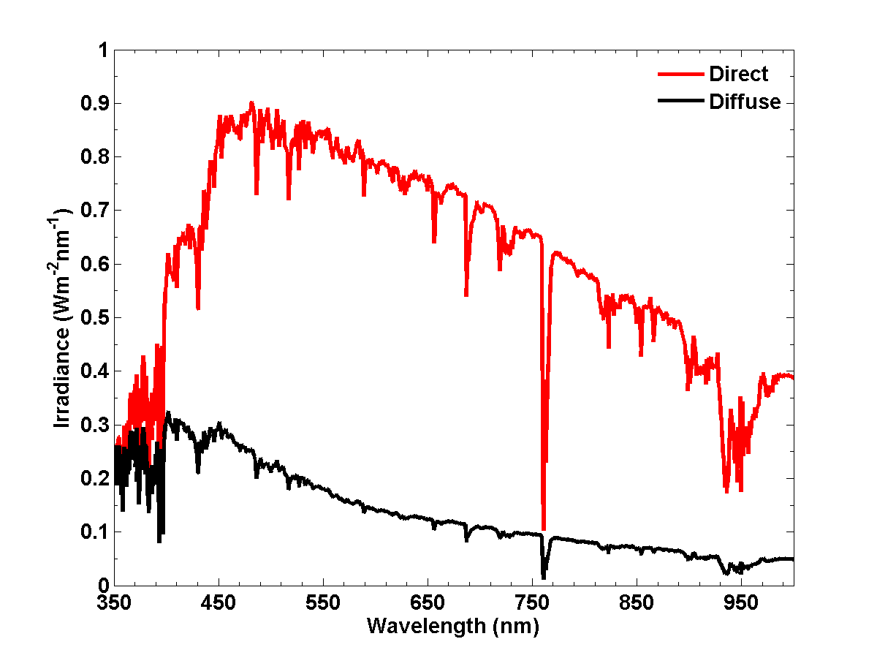
SMARTS: Desert Max Model

Slide 17
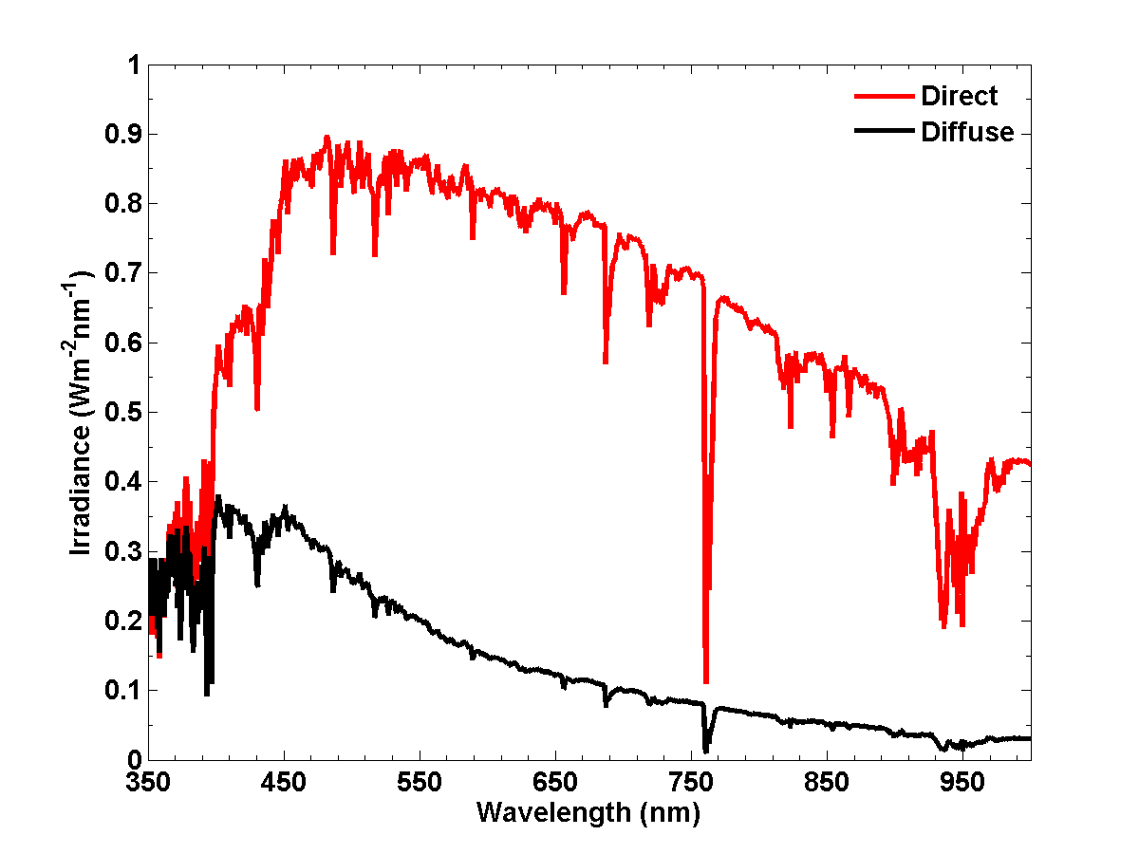
SMARTS: Desert Min Model

Slide 18
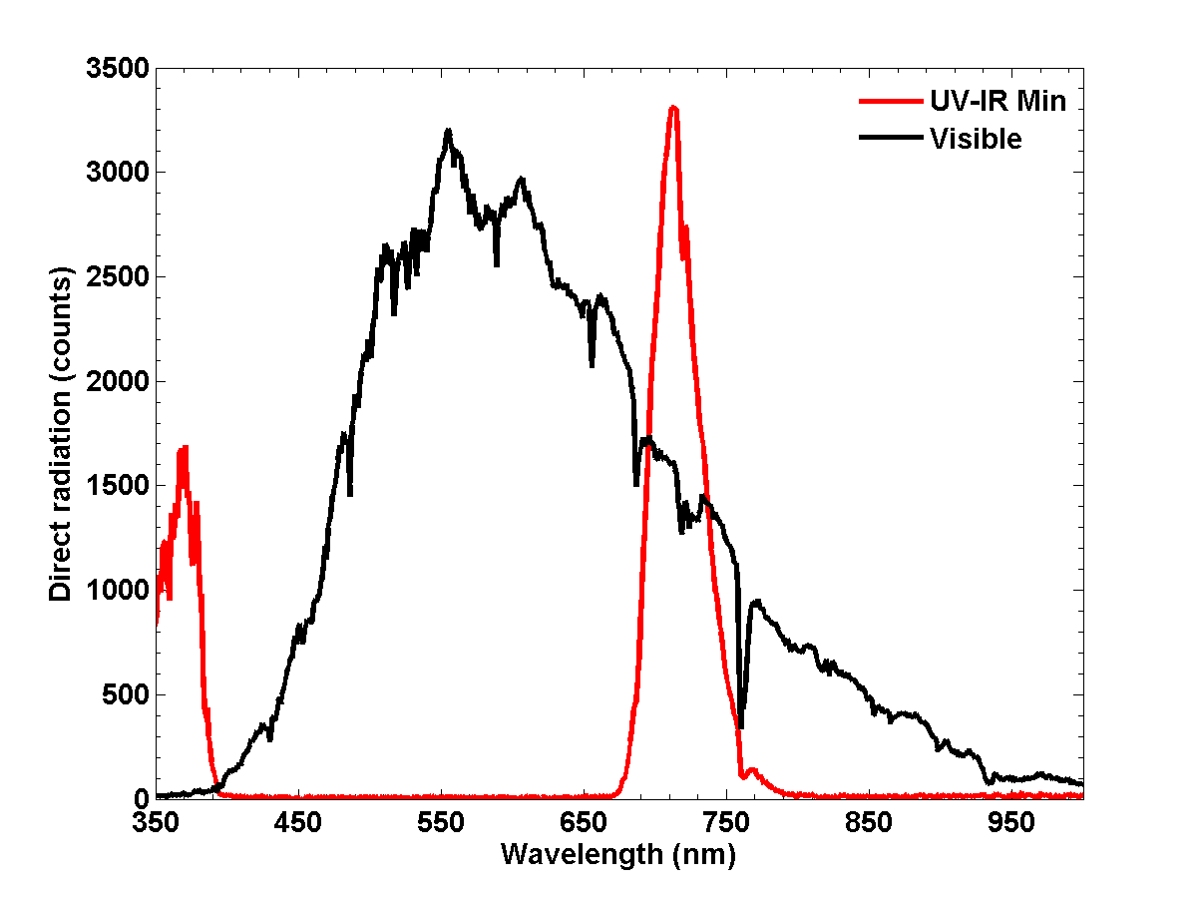
Irradiance measurements from the spectrometer
April 10th 2014

Slide 19
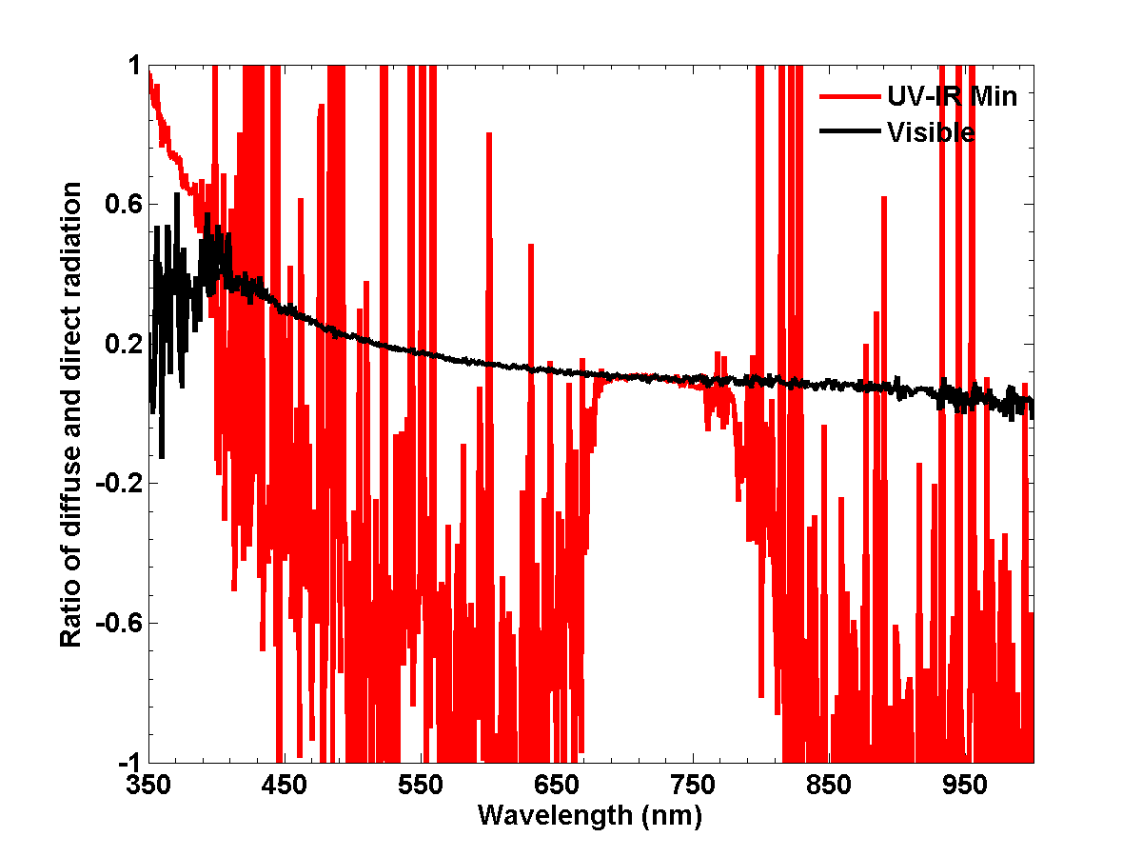
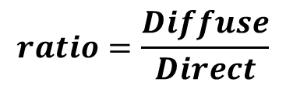
Ratio of diffuse and direct radiation On April 10th 2014
$$ratio=\frac{Diffuse}{Direct}$$

Slide 20
Ratio of diffuse and direct radiation On April 10th 2014
$$ratio=\frac{Diffuse}{Direct}$$

Slide 21
Irradiance measurements from the spectrometer
April 10th 2014

Slide 22
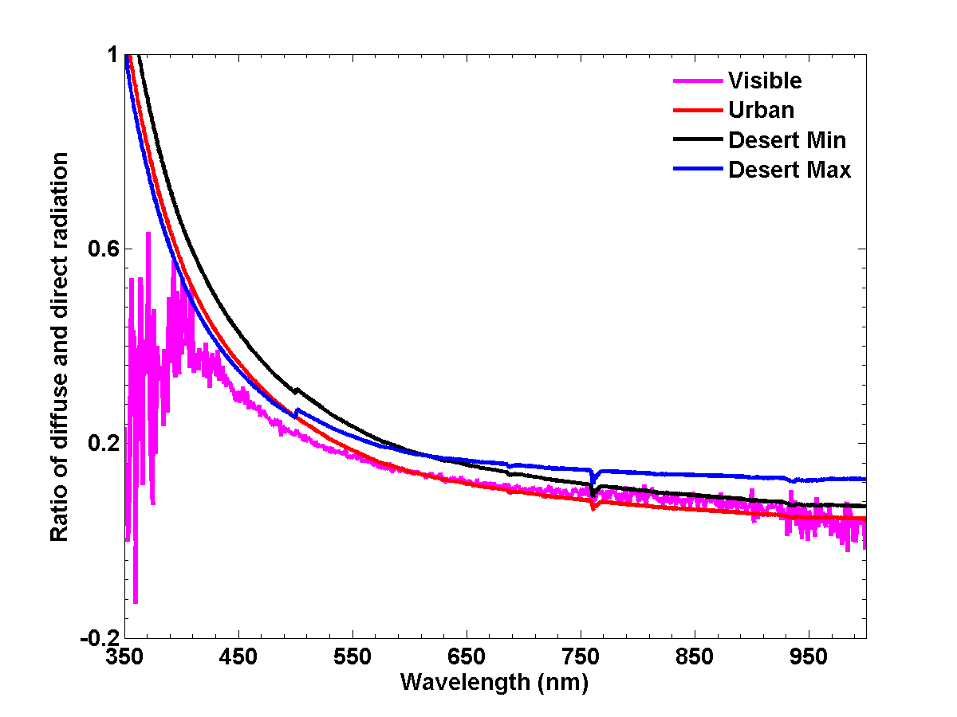
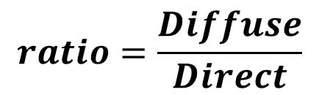
Ratio of diffuse and direct radiation SMARTS and Spectrometer
$$ratio=\frac{Diffuse}{Direct}$$

Slide 23
Ratio of diffuse and direct radiation SMARTS and Spectrometer

Slide 24
Irradiance measurements from the spectrometer
April 10th 2014

Slide 25
Ratio of diffuse and direct radiation SMARTS and Spectrometer

Slide 26
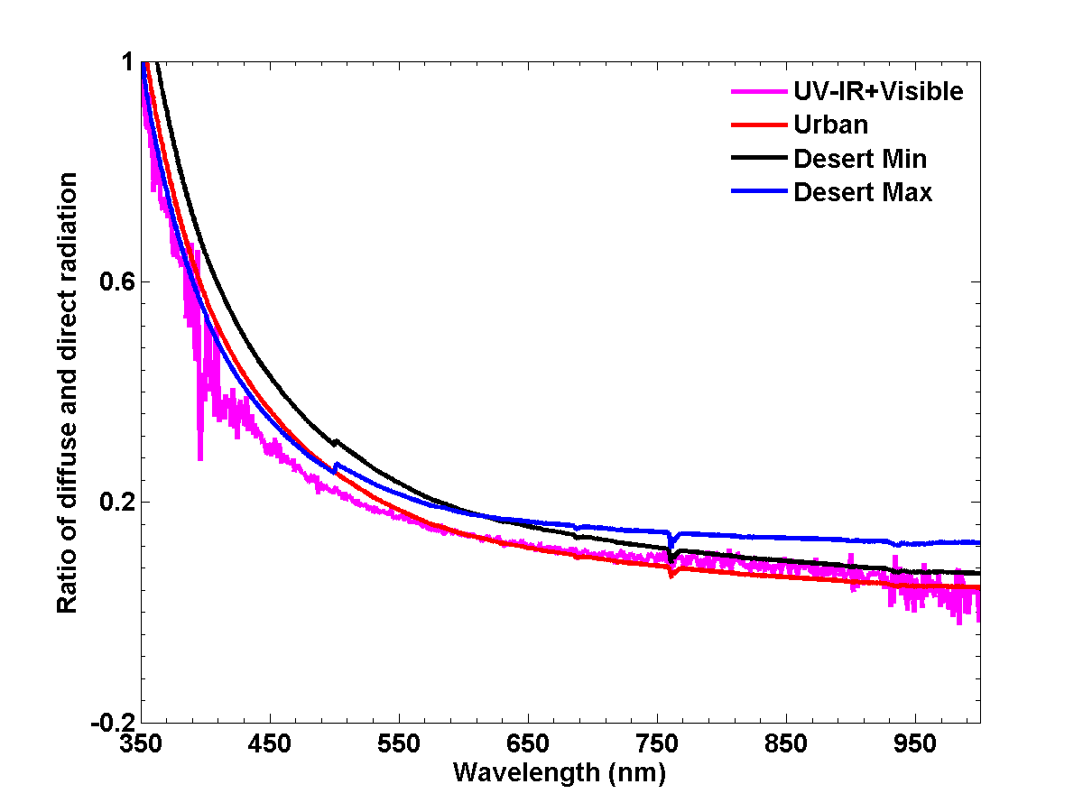
Ratio of diffuse and direct radiation SMARTS and Spectrometer

Slide 27
Outline
Purpose
Aerosol properties
Methods
Model parameters
Results
Summary

Slide 28
Summary
Model:
Model fits with the reality of April 10th 2014 at 16:30 (PST) under clear – sky conditions over semi-arid Reno NV.
Observations:
The noisy ratio from the UV-IR spectrometer is due to the fact that the light is completely filtered at the visible range.
The inverse is true for the visible filtered spectrometer.

Slide 29
Summary
Model and Observations:
Having two spectrometers is necessary to fully understand the aerosol content in the atmosphere especially in desert conditions where the effect of natural desert aerosols is not fully understood.
The ratio of diffuse to direct radiation in Reno fits between the models for urban and desert minimum at longer wavelength .
UV-IR channel responds at shorter wavelength and follows the Desert Max and Urban models.
Coarse mode respond to short wavelength range.

Slide 30
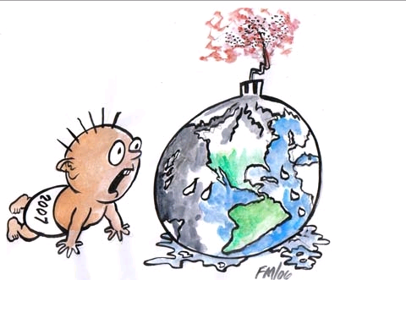
Questions

