Slide 1

ATMS 748 Atmospheric Measurements
Aerosol optical properties for fall time urban conditions
Kerwyn Texeira and Lan Gao
University of Nevada, Reno
Desert Research Institute
2014.05.08

Slide 2
Outline
Introduction
Method
Results
Conclusion
References

Slide 3
Introduction
The lack of detailed knowledge of the optical properties of aerosols results in aerosol being one of the largest uncertainties in the climate forcing assessments.
Aerosols have a direct effect on the radiative balance of the earth by scattering and adsorbing both solar and terrestrial radiation.
Aerosol optical properties depend on the particle size, morphology, refractive index, and the wavelength of the electromagnetic radiation.

Slide 4
Introduction Cont’d
These particles can impact air quality causing regional pollution that can affect human health.
Compared with satellite measurements, the in situ measurements are considered most reliable observations, although it cannot account for globally, it can give more accurate results of the key locations.
In this experiment, we used in situ measurements to study the optical properties in Reno city.

Slide 5
Method
Four wavelength photoacoustic spectrometer was used to obtain aerosol scattering (β_{sca}) and absorption(β_{abs}) at wavelengths 405, 532, 870 and 1047nm.
This instrument ran all year round but we focused on aerosol properties in the fall season for Nov. 2013.
Air pollutant concentration data was also used from EPA including the concentration of PM10, PM2.5, O3, SO2, and NO2.

Slide 6
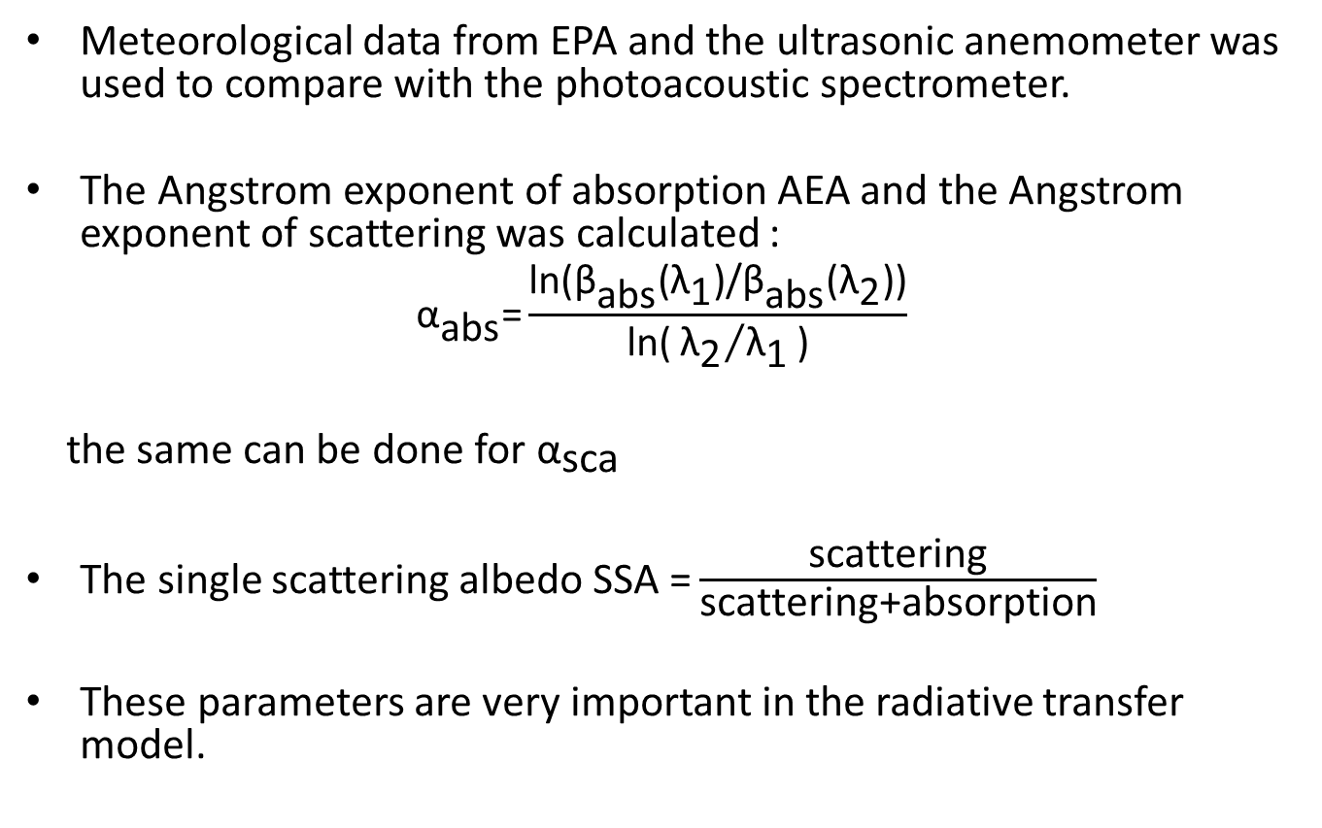
Method Cont’d
Meteorological data from EPA and the ultrasonic anemometer was used to compare with the photoacoustic spectrometer.
The Angstrom exponent of absorption AEA and the Angstrom exponent of scattering was calculated :
$${\text{α}}_{\text{abs}}\text{=}\frac{\text{ln}\text{(}{\text{β}}_{\text{abs}}\text{(}{\text{λ}}_{\text{1}}\text{)/}{\text{β}}_{\text{abs}}\text{(}{\text{λ}}_{\text{2}}\text{))}}{\text{ln}\text{(}{{\text{λ}}_{\text{2}}}/{{\text{λ}}_{\text{1}}}\text{)}}$$
the same can be done for ${\text{α}}_{\text{sca}}$
The single scattering albedo SSA $\text{=}\frac{\text{scattering}}{\text{scattering}\text{+}\text{absorption}}$
These parameters are very important in the radiative transfer model.

Slide 7
Photoacoustic Instrument

Slide 8
Results
Aerosol optical properties
Air pollutant concentrations
Meteorological conditions

Slide 9
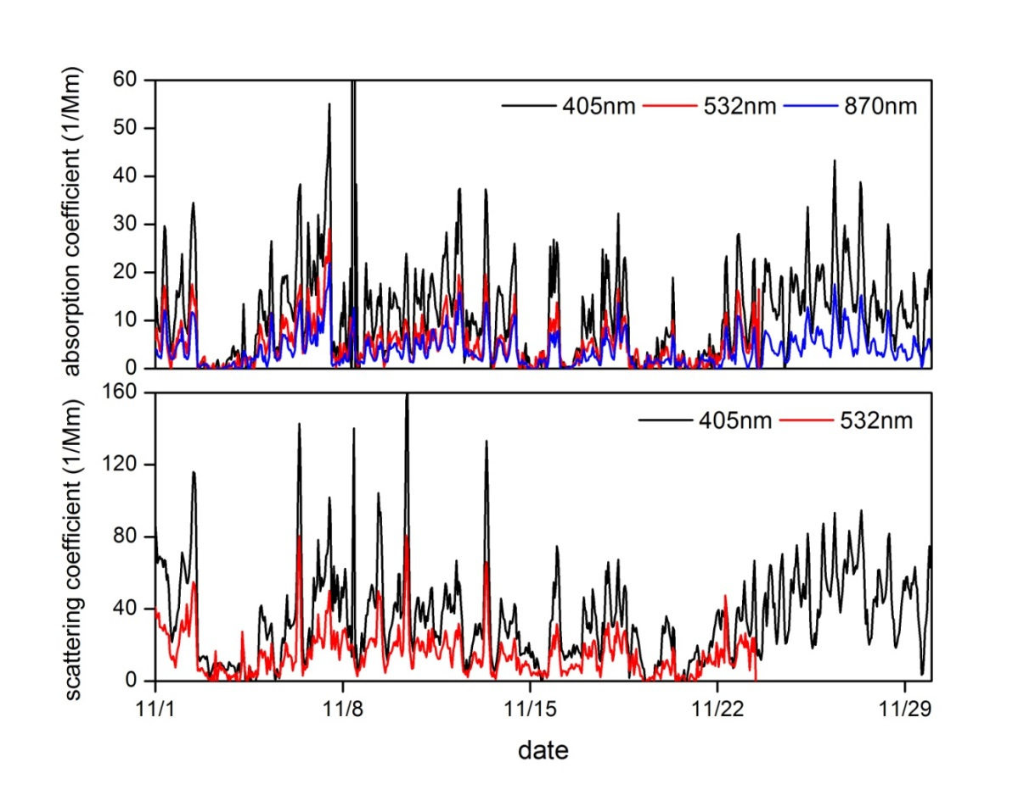
Aerosol optical properties

Slide 10
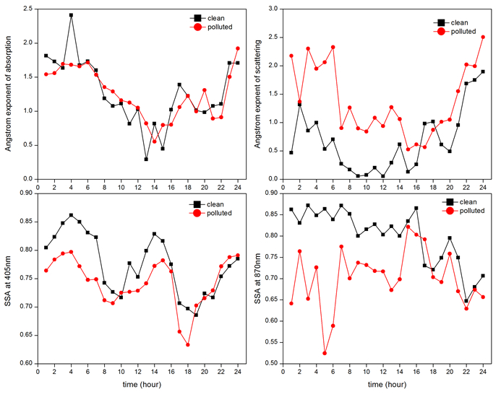
Aerosol optical properties

Slide 11
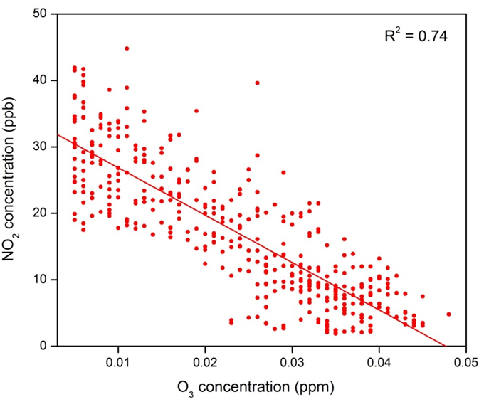
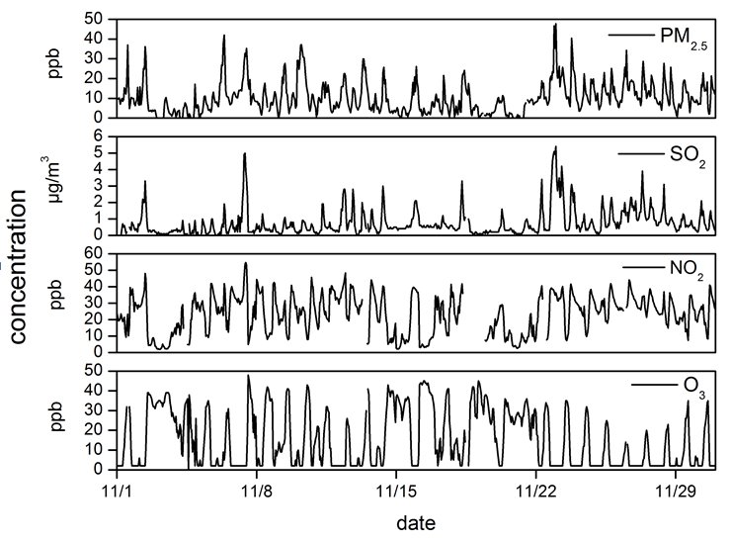
Air pollutant concentrations

Slide 12
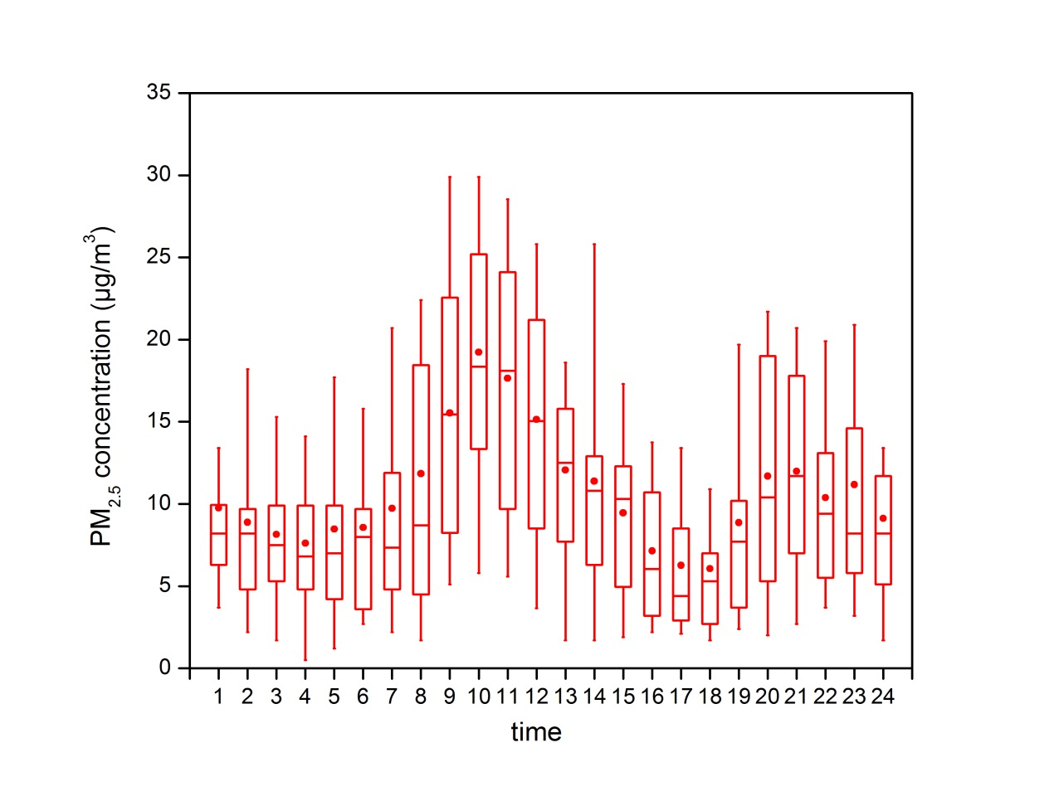
Diurnal variation of PM_{2.5}
average
50% value

Slide 13
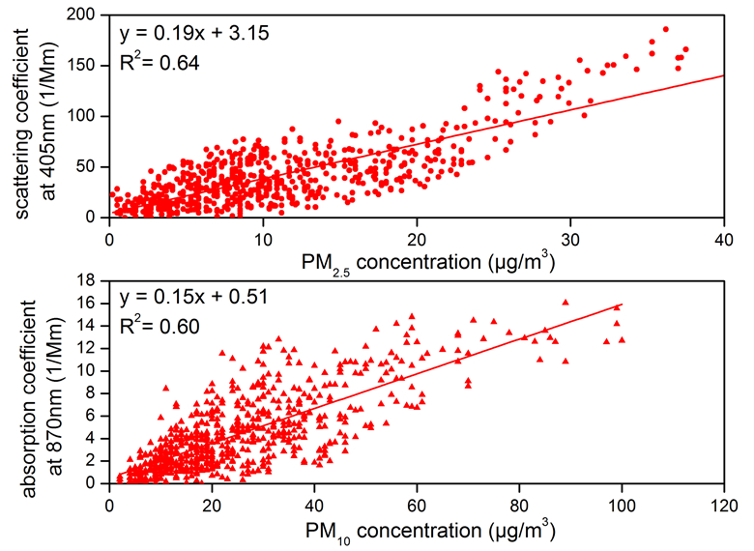
Aerosol optical properties VS. PM concentrations

Slide 14
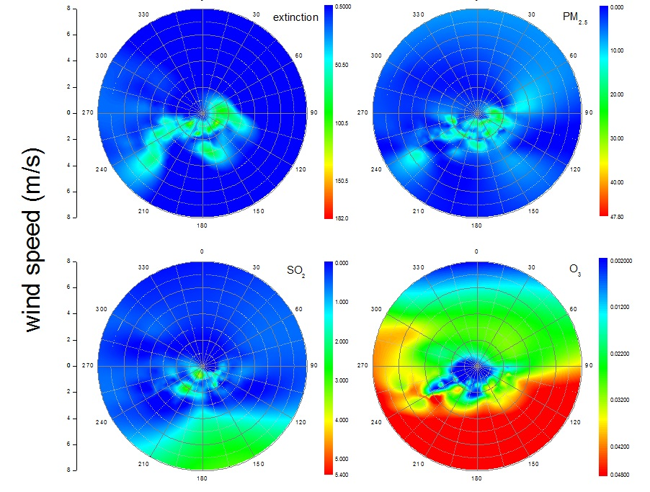
Aerosol optical property and pollutant concentration under meteorological conditions

Slide 15
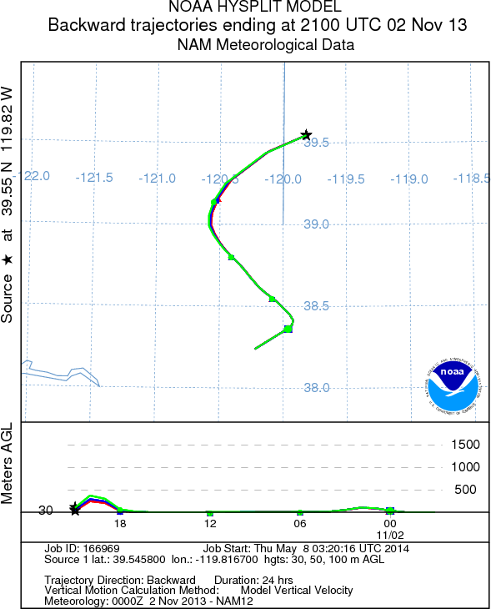
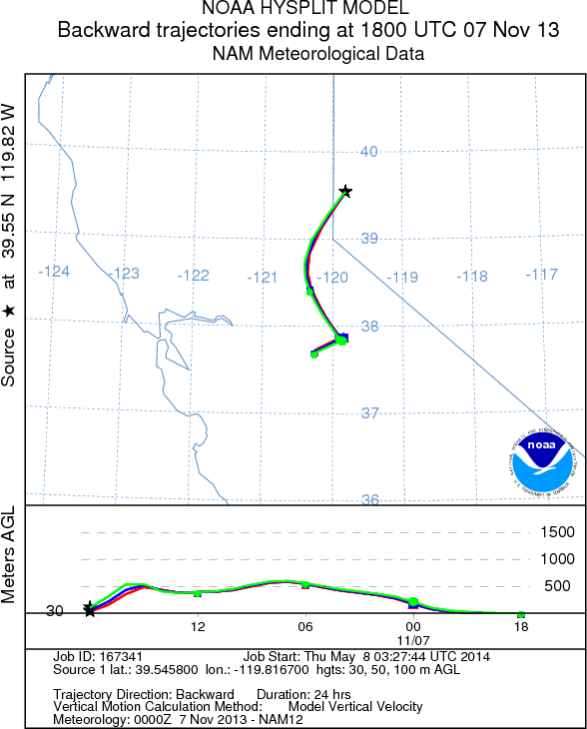
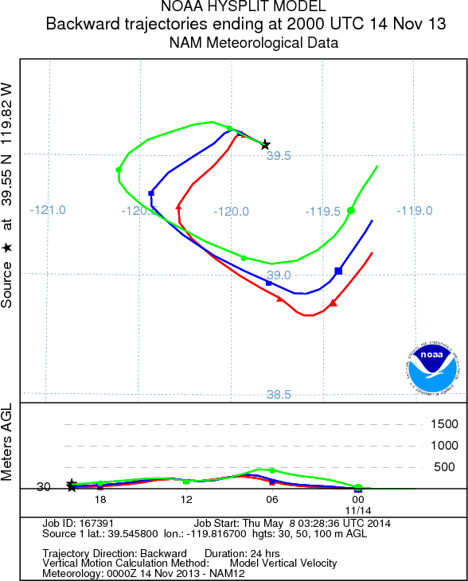
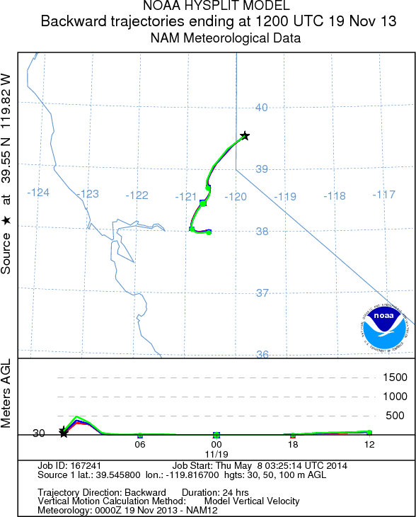
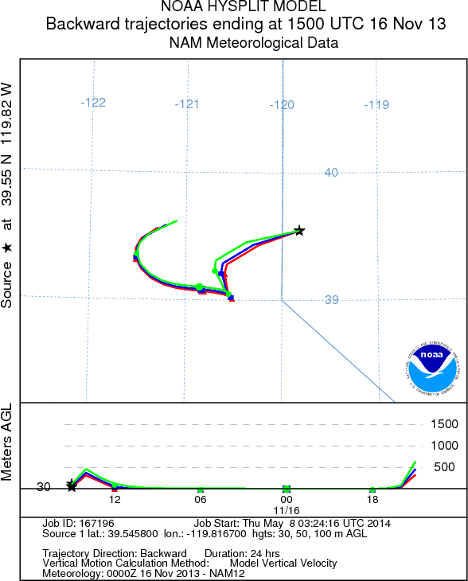
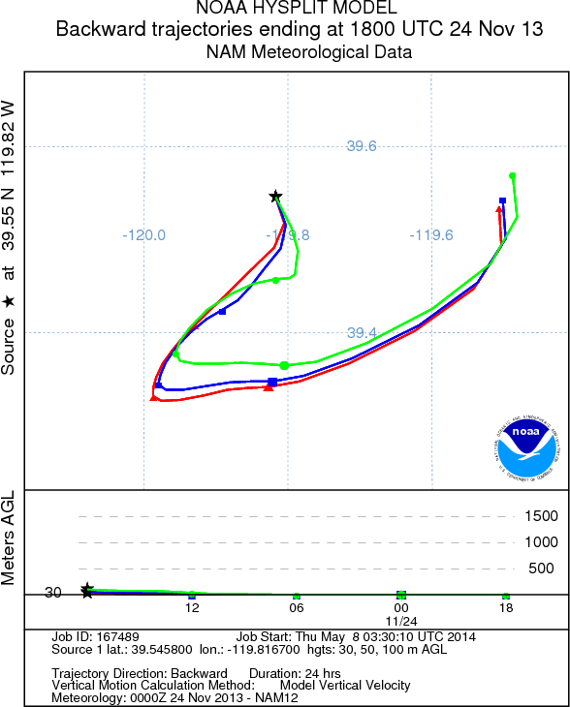

Slide 16
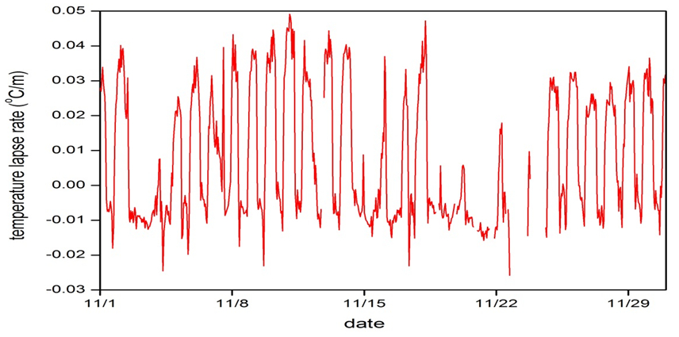
Temperature lapse rate

Slide 17
Conclusion
The aerosol optical parameters and pollutant concentrations have strong diurnal variation.
The PM_{2.5} has a good linear correlation with the scattering coefficient.
The stronger pollution events usually happen in the temperature inversion appears in the boundary layer.
The air pollution in Reno area not only caused by local events but also due to the long range transportation of the air flow.

Slide 18
References
Arnott W.P., Moonsmuller H., Rogers C.F., Jin T. Bruch R., 1999: Photoacoustic spectrometer for measuring light absorption by aerosol: instrument description. Atmospheric Environment 33(1999) 2845-2852.
Clarke, A. D., Noone, K. J., Heintzenberg, J., Warren, S. G., and Covert, D. S.: Aerosol light absorption measurement techniques: Analysis and intercomparisons, Atmos. Environ., 21, 1455-1465, doi: 10.1016/0004-6981(67)90093-5, 1987.
Hansen, J., M. Sato, and R. Ruedy, 1997: Radiative forcing and climate response. J. Geophys. Res., 102, 6831-6864.
Hansen, J., M. Sato, A. Lacis, and V. Oinas, 2000: Global warming in the twenty-first century: An alternative scenario. Proc. Natl. Acad. Sci. USA, 97, 9875-9880.
Heintzenberg, J., R. J. Charlson, A. D. Clarke, C. Liousse, V. Ramaswamy, K. P. Shine, M. Wendisch, and G. Helas, 1997: Measurements and modeling of aerosol single scattering albedo: Progress, problems and prospects. Beitr. Phys. Atmos., 70, 249-263.
King, M. D., Y. J. Kaufman, D. Tanre, and T. Nakajima, 1999: Remote sensing of tropospheric aerosols from space: Past, present, and future. Bull. Amer. Meteor. Soc., 80, 2229-2259.
Levoni, C., Cervino, M., Guzzi, R., and Torricella, F.: Atmospheric aerosol optical properties: a database of radiative characteristics for different components and classes, Appl. Opt., 36, 8031-8041, 1997.
Moosmuller, H. and Chakrabarty, R. K.: Technical Note: Simple analytical relationships between Angstrom coefficients of aerosol extinction, scattering, absorption, and single scattering albedo, Atmos. Chem. Phys. Discuss., 11, 19213-19222, doi:10.5194/acpd-11-19213-2011, 2011.
M. Gyawali, W. P. Arnott, et al. Photoacoustic optical properties at UV, VIS, and near IR wavelengths for laboratory generated and winter time ambient urban aerosols. Atmos. Chem. Phys. Discuss., 11, 25063-25098, 2011.
Reid, J. S., Eck, T., Christopher, S., Hobbs, P. V., and Holben, B. N.: Use of the Angstrom exponent to estimate the variability of optical and physical properties of aging smoke particles in Brazil, J. Geophys. Res., 104, 27473-27489, 1999.
Reid, J. S., Hobbs, P. V., Ferek, R. J., Blake, D. R., Martins, J. V., Dunlap, M. R., and Liousse, C.: Physical, chemical, and optical properties of regional hazes dominated by smoke in Brazil, J. Geophys. Res., 103, 32059¨C32080, 1998.

Slide 19
Thank you !
Questions ?

