Slide 1
Control #94
Passive Noise Suppression Methods for Improvement of Photoacoustic and Photothermal Measurements of Aerosol Light Absorption from Mobile Platforms
W. Patrick Arnott,¹ Arthur J. Sedlacek,² John M. Hubbe³
¹Dept of Physics and Atmospheric Science, University of Nevada Reno, Reno NV,
²Brookhaven National Laboratory, Environmental Sciences Department, Upton, NY,
³Pacific Northwest National Laboratory, ARM Aerial Facility, Richland, WA
Part of the Biomass Burning Observations Project (BBOP)
for the Department of Energy

Slide 2
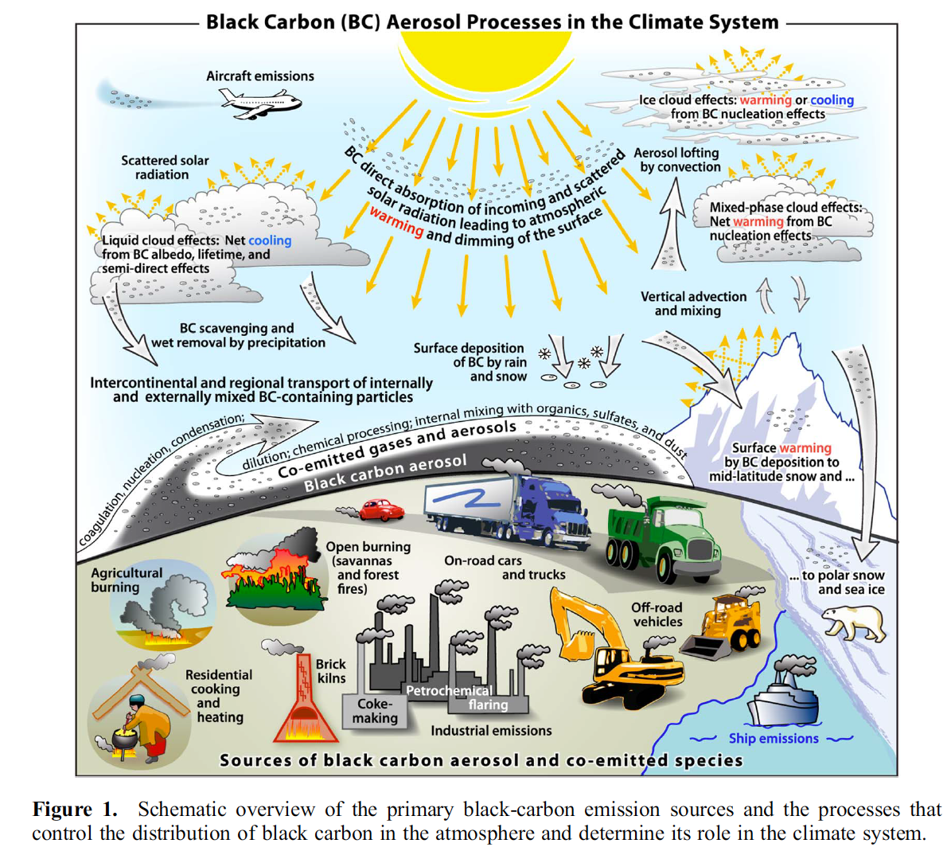
BC and
Climate
(from
Bond et al,
2013
JGR)

Slide 3
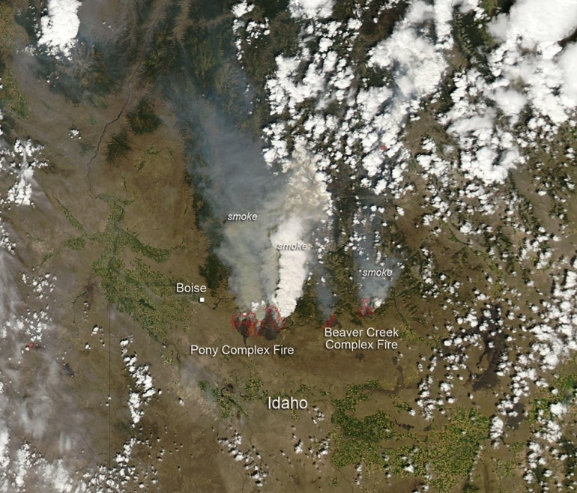
Flight 13 August 2013
Highlights Project Goals
How does the smoke
optics and chemistry evolve
downwind?
Note the strong
difference in the smoke color.
MODIS Image From NASA

Slide 4
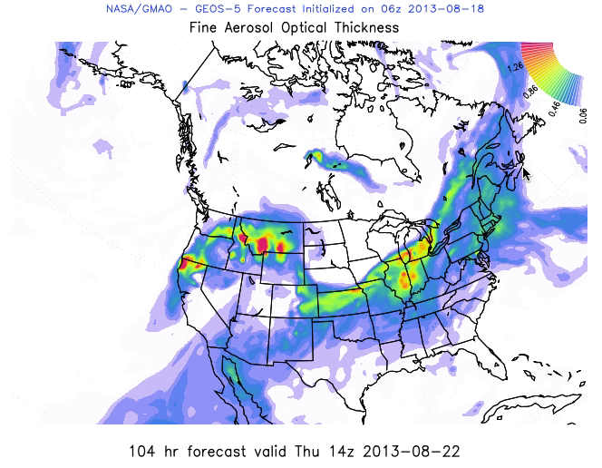
Simulation of Smoke and Air Pollution
Fine Aerosol Optical Thickness is a measure of the smoke in the atmosphere.
It is what satellites ‘see’. It is related to aerosol concentration and health concern.

Slide 5
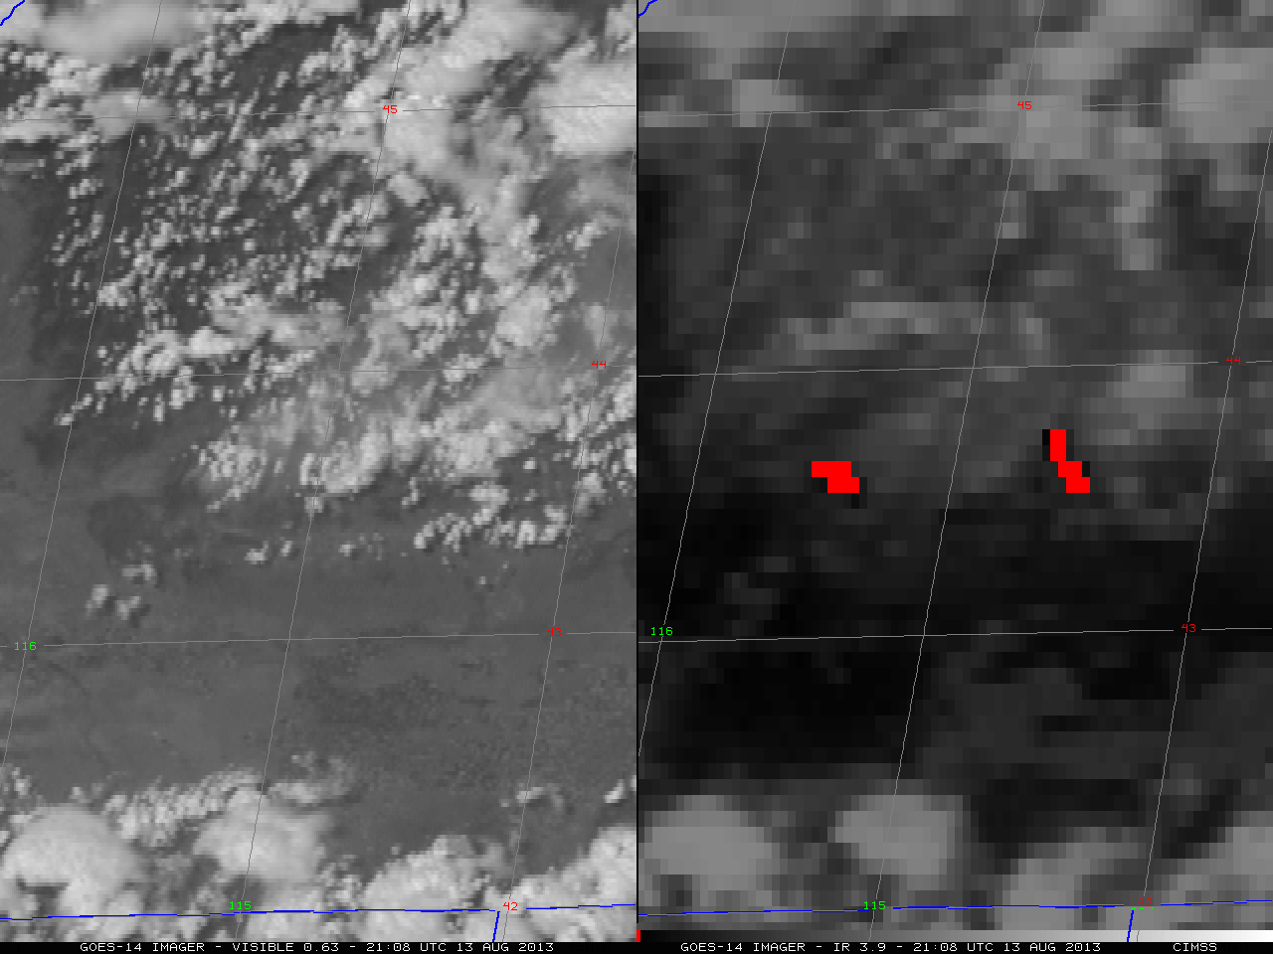
Dramatic GOES Satellite Imagery of Fire Dynamics

Slide 6
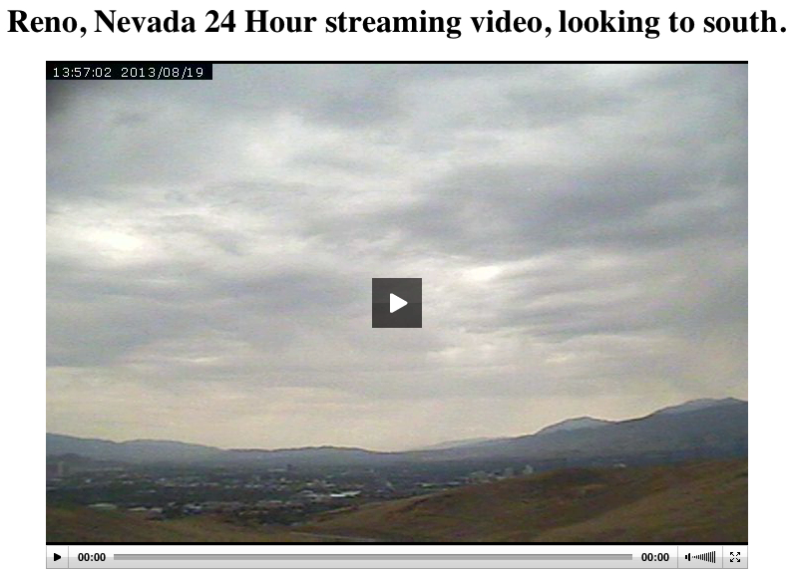
Another Example: Reno Smoke 18 Aug 2013

Slide 7

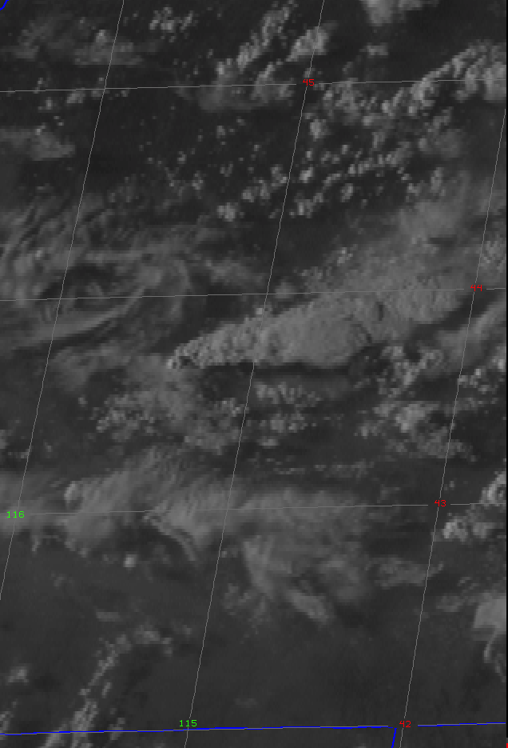









Biomass Burn Observation Project (BBOP)
L. Kleinman and A. J. Sedlacek (BNL)
Pat Arnott (U. Nevada)
P. Buseck (Arizona State Univ.)
P. Davidovits (Boston College)
E. Lewis (BNL)
W. Lin (BNL)
H. Moosmüller (Desert Research Institute)
T. Onasch (Aerodyne Research)
J. Shilling (PNNL)
J. Wang (BNL)
R. Yokelson (U. Montana)
R. Zaveri (PNNL)
GOES images of Pony Express fire: 08-13-2013

Slide 8
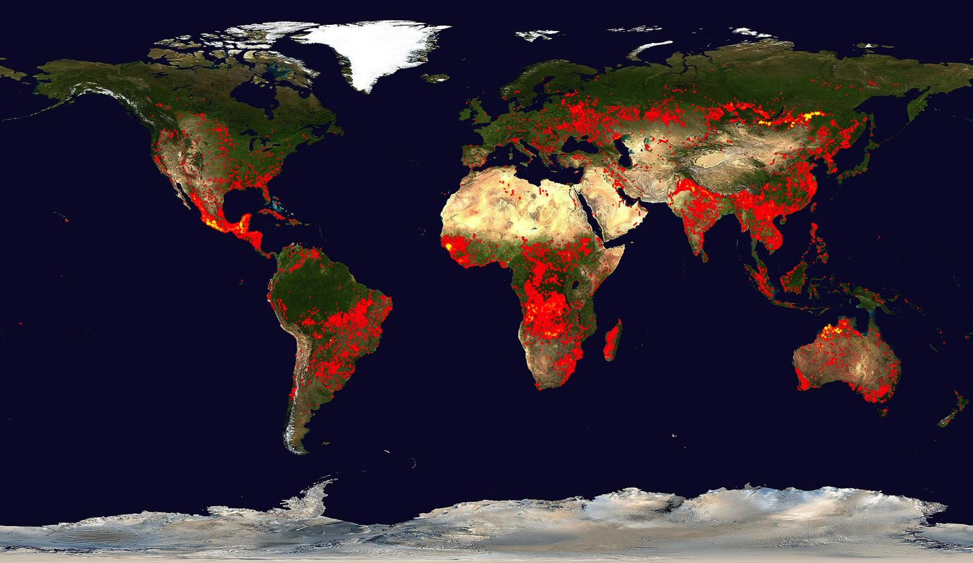
Biomass Burning
Global Fire Activity MODIS Fire detections for 10 days: Apr 30 – May 9, 2012
C. Ichoku and R. Kahn

Slide 9
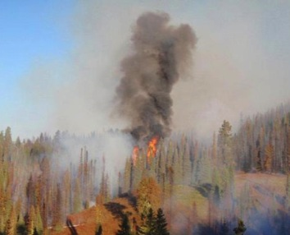
Biomass Burn Aerosols
Black carbon exerts positive aerosol forcing (warming) - second only to CO₂
Aerosol type can vary
  Flaming phase favors BC production
  Smoldering phase favors organic aerosol
  Fuel source
BB is a significant source of brown carbon (BrC)
  Exhibits pronounced λ dependence in absorption
  Role at CCN (in contrast to BC)
Total climate forcing due to BB is estimated to be:
-0.11 (-0.46 to +0.15) W m⁻² (Bond et al. 2013)
  Uncertainly reflects knowledge gaps in BC-cloud interactions & BC interactions with co-emitted organic carbon
POA dominate
BC dominate
Bond et al. 2013
Notes:
Remember to point out that comparisons with satellite observations indicate that bottom-up estimates of aerosol emitted from biomass burning are too low by factors of two to four times which also suggests that emission inventory contributes to this uncertainty.

Slide 10
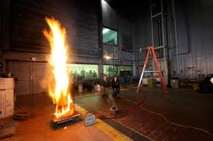
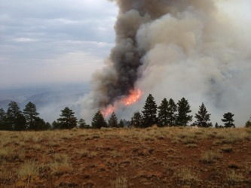
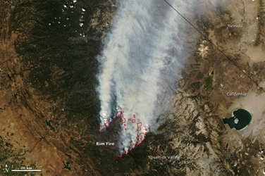
Radiative Forcing Contribution of Biomass Burn (BB) Aerosols
Scientific Challenge:
To understand and quantify the role of BB in aerosol forcing (heating/cooling)
  Investigate the impact of particle morphology and chemical composition on BB particle light absorption
  Better understand the microphysical processes that dictate particle morphology (and hence the optical properties) of BC-containing particles
  Examine and quantify how BB aerosol properties evolve in the near field
  What is the minimum knowledge of chemical composition, source, and particle morphology necessary to accurately parameterize the contribution of absorbing aerosols to radiative forcing?
100 km
Flame lab/MSU
MODIS
Laboratory scale
Near-field scale
Meso scale
Notes:
In order to bound the radiative forcing contribution of BB aerosols fundamental research into both the properties of BB aerosols as well as the processes that dictate those properties must be undertaken. As presented earlier, the best estimate for total BB radiative forcing is negative (cooling) the uncertainty spans the other side of the fence. Therefore, further research is needed to better bound the sign and magnitude of BB radiative forcing. We will contribute to this effort by focusing in on investigating BB aerosol properties in the near field and how these properties evolve in the near field. By near field we mean within the first couple of hours of aerosol aging. We will be investigating the impact of particle morphology and chemical composition on BB light absorption. As I discussed this morning, our work on the negative lagtimes showed pronounced correlation with biomass burn tracers. The logical question is if BB events favor the creation of near surface rBC inclusions, how does this type of particle morphology impact BB light absorption. Similarly we will want to examine the question of how the chemical composition exerts influence over light absorption in a broader effort to begin addresses the question of relative contribution of particle morphology and chemical composition to aerosol light absorption. Hand and hand with this is understanding the microphysical processes that control particle morphology. BB events are unique in that at the source particle coagulation would be expected to be a major contribution to particle growth. As with our laboratory expts, BB BC-POA coagulation could led to BC inclusions on the surface. But much is going on. What is the role of condensation is such an emission rich environment? Similarly, the role of evaporation. And given this environment, how do the properties of BB aerosols evolve? By answering such questions, we can begin to bound the amount of knowledge necessary to accurately capture reality.

Slide 11
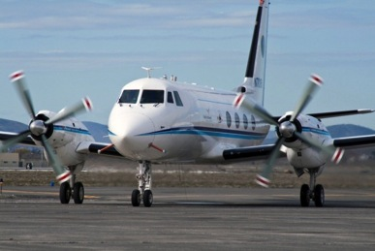
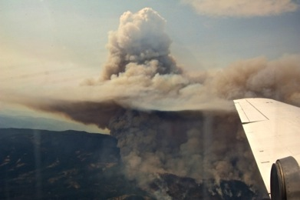
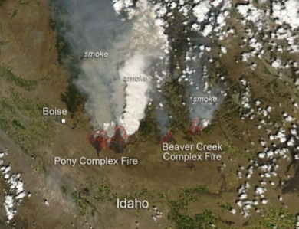
Biomass Burning Observation Project (BBOP)
PI’s – Larry Kleinman (BNL) and Arthur J. Sedlacek (BNL)
+ ~ 30 Scientists from 12 National Labs, Universities, and Companies
120 hours of G-1 Flight Time
July – September: Wildland fires in the Pacific NW
October: Prescribed agriculture burns in the
lower Mississippi River Valley
17 wildfires sampled (ID, OR, & WA)
3 dozen agricultural burns sample (AR)
7 urban plumes (emission contrast)
Notes:
Using the IMPROVE network (Interagency Monitoring of Protected Visual Environments) Park et al. (2007) concluded that in the mid-northern latitudes that BB are a major source of aerosol mass and that year-to-year variability of this mass is dictated by these events.

Slide 12

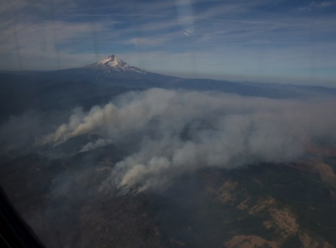
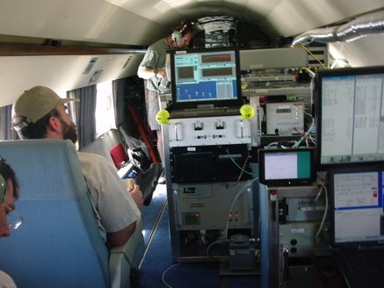
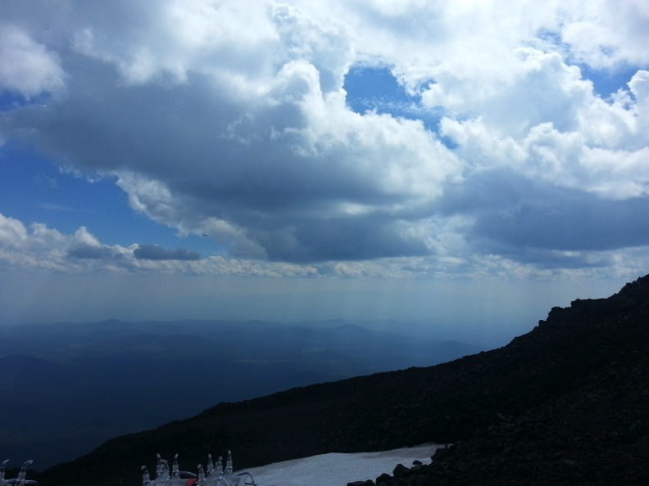
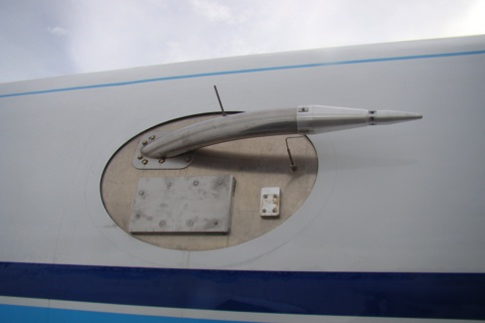
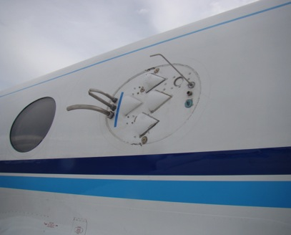
G-1 Platform
S.Collier and S. Zhou

Slide 13
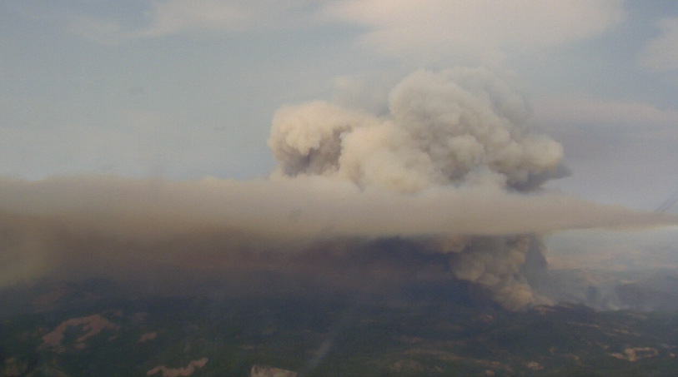
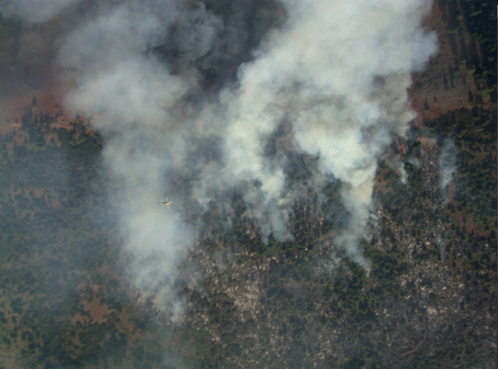
Scenes from BBOP: Wildfires
G1 was outfitted with two cameras: forward-looking and Nadar
Government Flats fire (2013-08-21) was one of the larger fires sampled during BBOP. Over the course of 24-hrs, size increased by > 2500 acres
Government Flats
Colockum fire
100 m
Forward-looking
Nadar
Org loading: ~ mg/m³
rBC loading: 10s-100s μg/m³
Bscat ~10000 Mm⁻¹ and Babs ~ 1000 Mm⁻¹

Slide 14
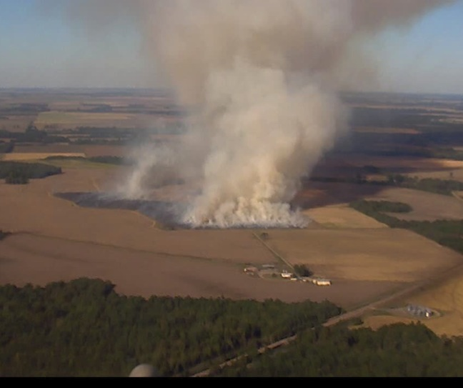
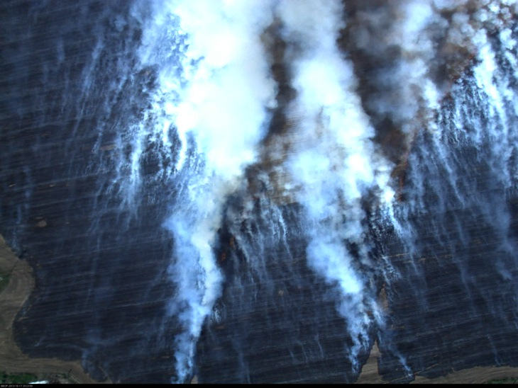
Scenes from BBOP: Agricultural Burns
Agricultural burns provide distinct advantage of being a single source burn. However, fire lifetime (flame/smoldering phase) much shorter duration than wildfires
MODIS no help in identifying potential sites. Most efficient approach: fly high and look fires
2013-10-20: largest Ag-burn sampled.
Forward-looking
Nadar
Notes:
The instrument suite is uniquely targeted for measurement of BB. To realize this, several new or recently upgraded instruments were deployed.

Slide 15
BBOP Instrument Suite
This field campaign will leverage the capabilities of several new instruments or instrument combinations that have not been previously used in aircraft.
Microphysical Properties:
  SP-AMS
  FIMS
  Microscopy (TEM)
  SP2
  Dual column CCN
  UHSAS/PCSAP
  Particle counter
Optical Properties
  3-λ nephelometer (scat; 450, 550, & 700 nm)
  3-λ PSAP (abs; 461, 523, & 648 nm)
  1-λ PAS (abs; 355 nm)
  1-λ PTI (abs; 532 nm)
  1-λ CAPS (ext; 628 nm)
Radiation
  SW, Upwelling hemispheric, spectral
  SW, Upwelling hemispheric, broadband
  IR. Surface Temperature
  SW, Down-welling hemispheric, broadband, global and diffuse
  SW, Down-welling hemispheric, broadband, diffuse
Trace gas
  PTRMS
  H₂O, CH₄, N₂O, NO, NO₂, NO_{y}, CO, CO_{2,} O₃ and SO₂
Notes:
The instrument suite is uniquely targeted for measurement of BB. To realize this, several new or recently upgraded instruments were deployed.

Slide 16
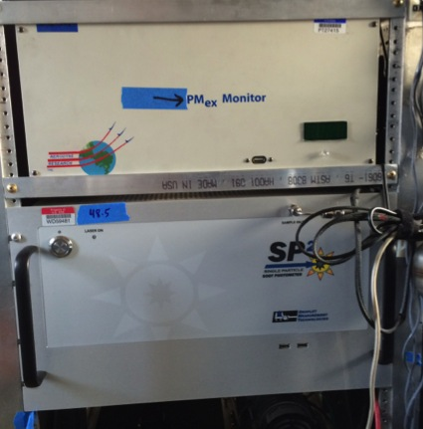
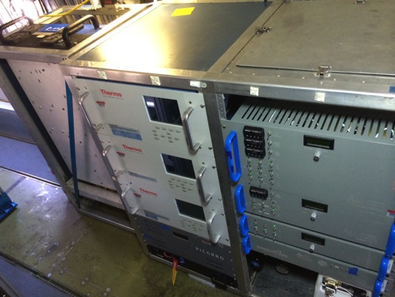
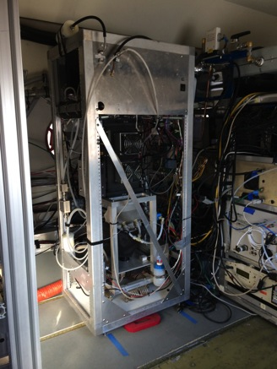
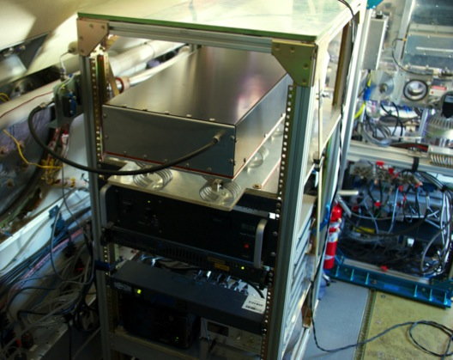
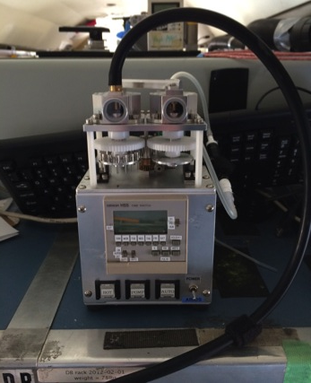
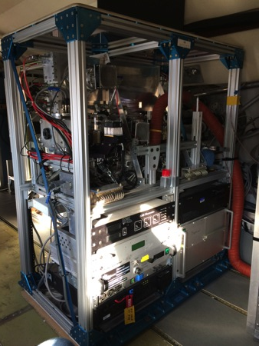
New instruments Not Previously Deployed on an Aircraft
Several new/upgraded instruments are being deployed during BBOP
CAPS
Trace gas
SP2
FIMS
PTI
PAS
TEM Sampler
SP-AMS

Slide 17
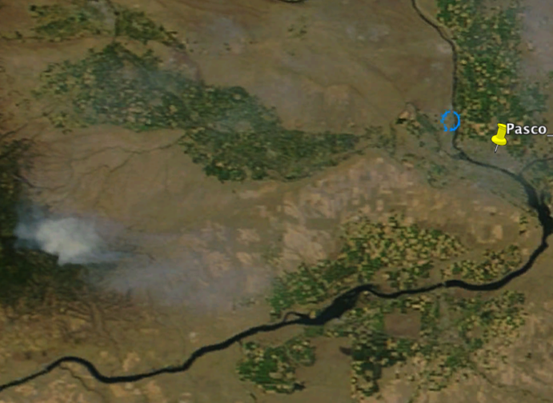

BBOP: Near-Field Evolution of Smoke Aerosol Properties
“28 Mile Marker” Fire sampled at source and 1, 2, 3, 4 hour downwind
Targeted 07-26-2013
Terra MODIS image
20 km
Fire
Pasco
SOA Increase
PASCO
Fire
0
1
2
3
4
hours
0 1 2 3 4 hours
Repeatable
Rapid increase within 1st hour in SOA (25%) and scattering (50%)
Scattering increase
Soot Particle-AMS, Onasch
Notes:
Our goal is to measure the evolution of BB aerosol properties.
Data shown here shows that we are successfully capturing this evolution.
Cite the SOA angle here.

Slide 18
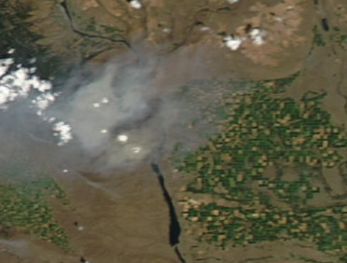
BBOP: Near-Field Evolution of rBC Mixing State
“Colockum Tarp” Fire sampled at source and 1 - 5 hours downwind
Targeted on 2013-07-30
Wind
Fire
5 km
Rapid increase in fraction thickly coated rBC
Notes:
Here we are looking at mixing state and not morphology. Happy to report that negative lagtimes have been observed in BBOP, but not all the time. Need to understand why.

Slide 19
BBOP: Relevance in Community
Quantify the downwind time evolution of microphysical, morphological, chemical, hygroscopic, and optical properties of aerosols generated by biomass burning
Use the time sequences of observations to constrain processes and parameterizations in a Lagrangian model of aerosol evolution
Incorporate time evolution information into a radiative transfer model for determining forcing per unit carbon burned.
BBOP bridges the gap between laboratory studies (nascent particles) and previous field campaigns of BB (older particles)
Notes:
Point out that the community has already expressed interest in BBOP. BNL, in collaboration with Mary Gilles (LBL) recently submitted a proposal to ALS to conduct STXIM analysis on BB particles. This will nicely complement the TEM analysis. I should also point out that we have been quite thoughtful about our field measurements. For example, in several missions, we have conducted back-to-back transects. This means that we have two different grids that can be utilized by two different analysis at two different on the same plume transect and same age. Similarly, U. Arkansas Prof. Gaffney has a Ph.D. student who will be modeling fires and has already expressed interest to use BBOP data.

Slide 20
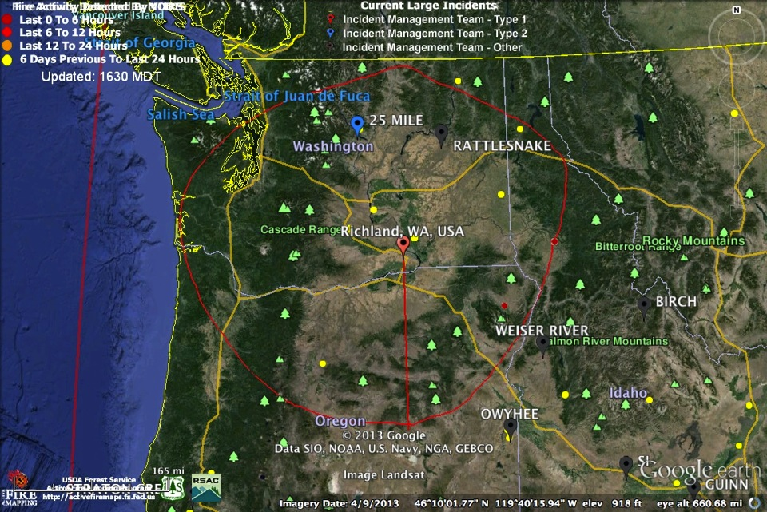
Primary Study Region Pacific Northwest

Slide 21
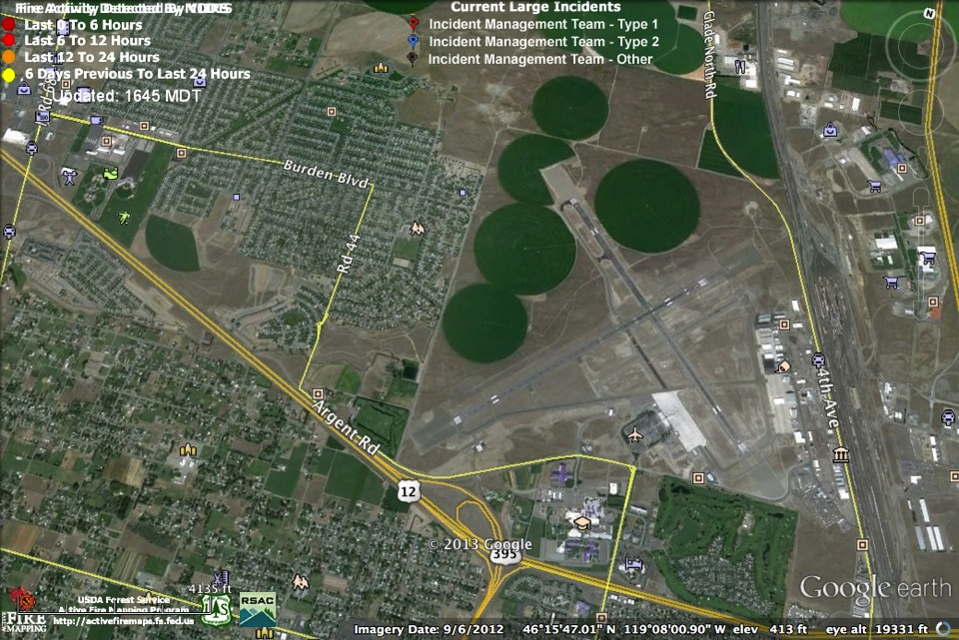
Pasco WA Airport

Slide 22
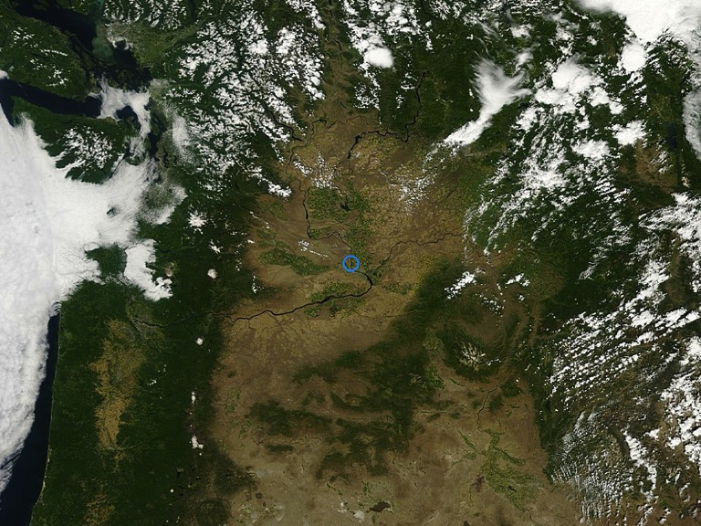
Richland WA AERONET Site

Slide 23
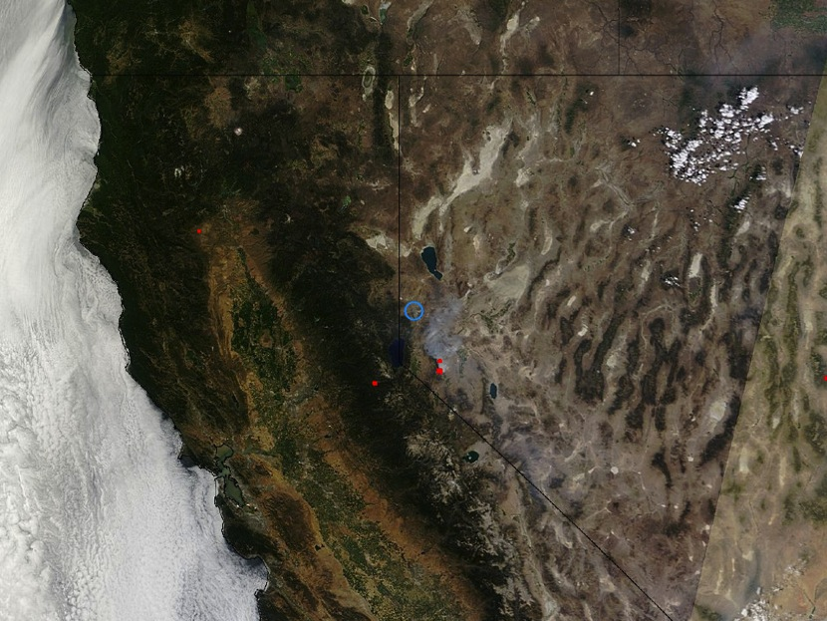
Fires: Satellite Imagery (blue circle is Reno: Red are fires)

Slide 24
Some of our Previous Measurements of Biomass Burning Aerosol Optics

Slide 25
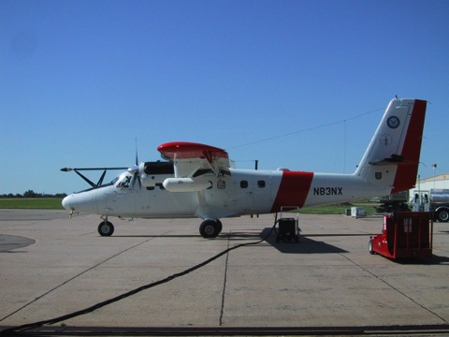
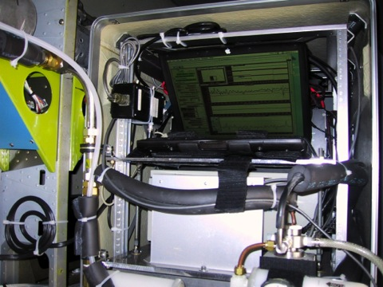
Photoacoustic Measurements from the Twin Otter

Slide 26
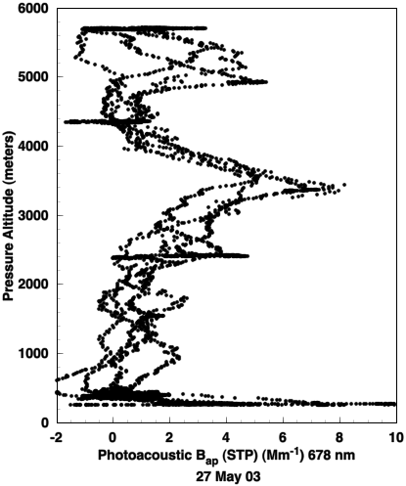

Vertical Profile 27 May 2003: Pancaked Layers of Russian Forest Fire Smoke
PHOTOACOUSTIC LIGHT ABS.
Significant layers of light absorbing aerosol near 650 mb and 550 mb, with a clean layer in between at 600 mb.

Slide 27
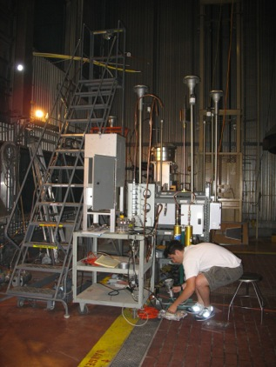
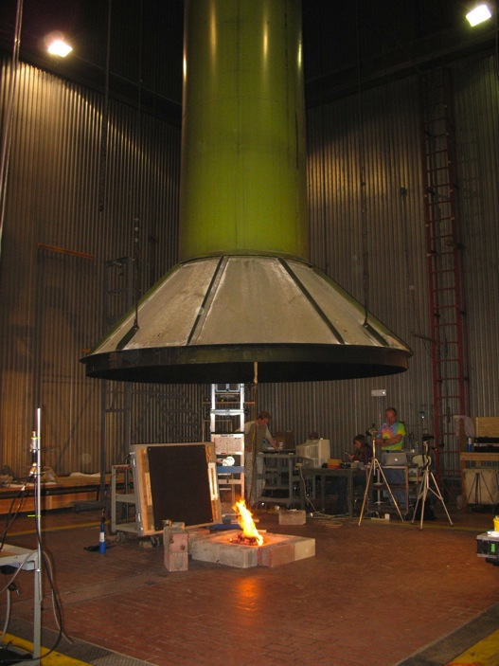
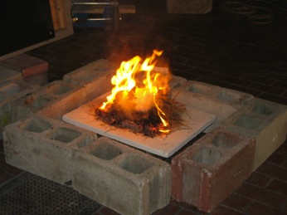
Fire Science Laboratory in Missoula Montana

Slide 28
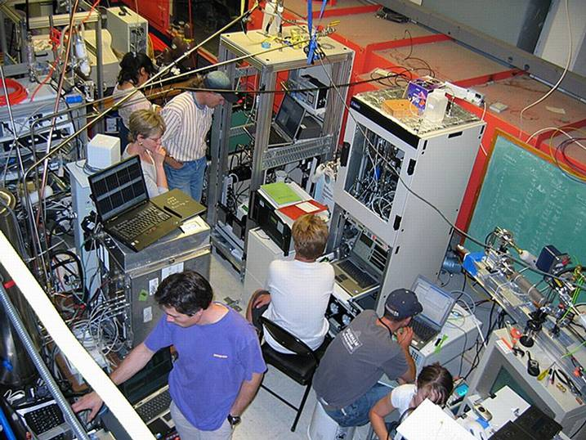
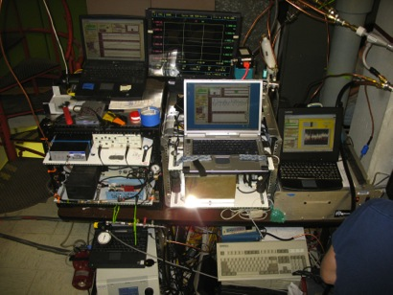
Fire Science Laboratory
Photoacoustic instruments
Instrumentation sampling wood smoke during FLAME Chamber burns

Slide 29
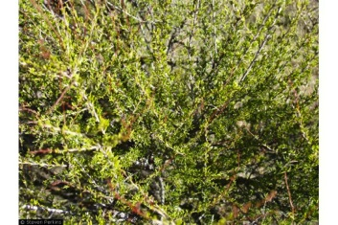

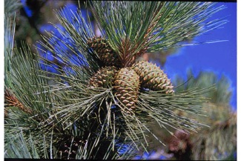
Fuels Tested at the Fire Science Laboratory
Chamise
Rice Straw
Ponderosa Pine
29
Notes:
29

Slide 30
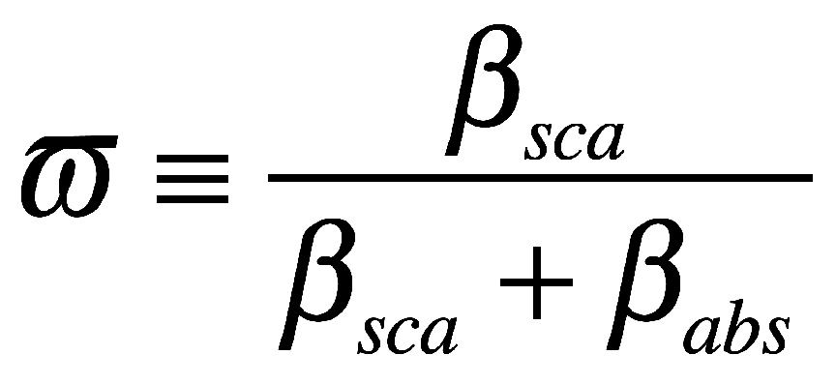
Key Aerosol Optical Parameters
Fraction of total light extinction (B_{abs}+B_{sca}) due to
scattering,
Completely scattering ,e.g. sulphate B∼1
Strongly absorbing diesel soot, freshly emitted BC, ω W0.3
Depends on chemical composition and particle size and morphology
Notes:
30

Slide 31
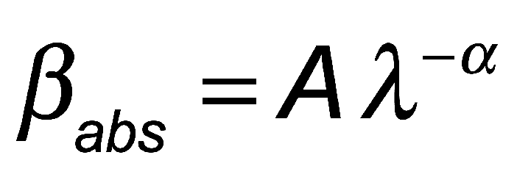
Key Aerosol Optical Parameters
α = Angström Exponent for Absorption.
α ≈ 1 for motor vehicle emission generated BC.
Biomass burning aerosols exhibit α as high as 3.5.
Depends on chemical composition and particle size and morphology.
Use measurements at 405 nm and 870 nm to determine α.
Notes:
31

Slide 32
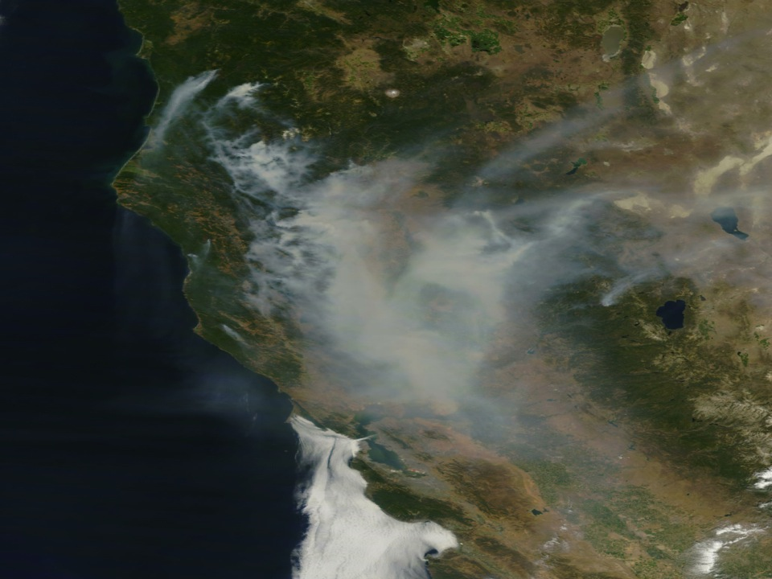
1,000 Fires, Northern CA, Summer 2008: Peak Smoke in Reno around local noon, July 10th.
Summer wild Fires
-Over 1,000
-Most sparked by lightning
-Dry and windy
-Covering 680 Sq miles of central and northern California
Source: NASA California Wild Fires 2008
32
Notes:
32

Slide 33
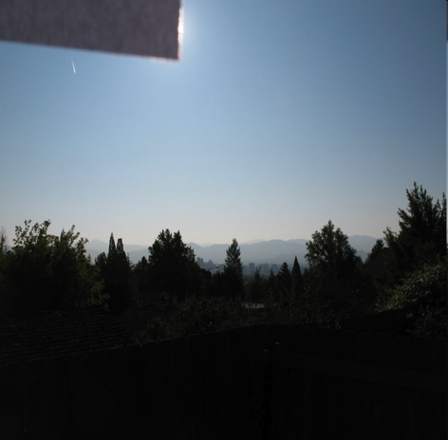
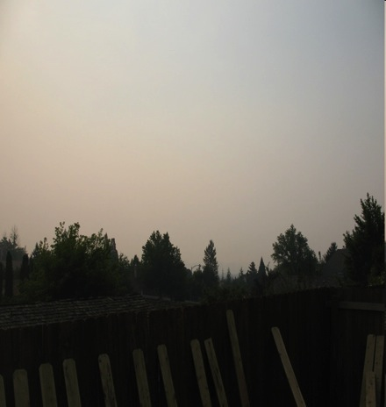
Reno Days in Photographs:
Similar Location and Sun Angle
SEPT-22, 2008
JULY-10, 2008

Slide 34

One Not So Fine Day in Reno

Slide 35

Chemistry of Primary Smoke Emissions Varies Greatly Too!!!!!
(Aerodyne Aerosol Mass Spec measurements.)

Slide 36

Urban and Biomass Aerosol
They are vastly different!!!!!!!!!

Slide 37
Comparison With Lab Data
37

Slide 38




DOE AAF G1 Aircraft

Slide 39


Aircraft Inlet System
Inlet isokinetic conditions are maintained by adjusting outflow
with a mass flow meter
Expansion slows flow
Inlet
Outflow

Slide 40





DOE G1 Instrument Photos

Slide 41

Photoacoustic Instrument Installation on Aircraft Rack
Scattering Preamp
Laser control
Microphone Preamp
Computer and DAQ
Aircraft tire innertube
Main Part of Instrument:
Acoustic resonator,
Interface board, etc.
Aircraft tire innertube

Slide 42

Photoacoustic Instruments For Light Absorption Measurements
Basic principles:
Laser light is power modulated by the chopper.
Light absorbing aerosols convert light to heat - a sound wave is produced.
Microphone signal is a measure of the light absorption.
Light scattering aerosols don't generate heat.
Listen to the sound made by air pollution heated by light.

Slide 43

Aerosol Optics Instrument
Aerosol Absorption, Scattering,
Extinction Coefficients.
Single Scatter Albedo.
355 nm BBOP
405 nm,870 nm
532 nm
671 nm, 676 nm
1047 nm
f₀
f₀ + df
Notes:
43

Slide 44
Single Laser Photoacoustic Instrument: Equation to Obtain the Light Absorption Coefficient

Slide 45

Photoacoustic and Photothermal Rack

Slide 46

Sound Spectrum During Flight on 10 July 2013

Slide 47

Sound Spectrum Time Series in Cabin During 10 July 2013 Flight
The sound spectrum changes during flight. Note the strong selected signals.

Slide 48

10 July 2013 Test Flight
Flew the Columbia River Gorge to Portland
Some legs were flown through Portland
Intercepted a brief fire plume on the return

Slide 49

Light Absorption Measurements
Diagnosis: Prior to flight, noise was low. During flight, the noise was very large (red curve)
though it was low during taxi. Therefore the inlet system wind noise is the primary source
of noise for the system.

Slide 50

Light Scattering Measurements at 355 nm
EXCELLENT!!
Runway prior to flight
Portland, Richland Plumes

Slide 51
Post Flight Analysis
Acoustic background in flight was too high!
The main acoustic noise affecting measurements was from the inlet system, analogous to the noise you hear when you stick your head out the window in a car moving at highway speeds.
Remedy:
Try an ‘acoustic resistor’ to reduce low frequency noise.
Construct a ‘muffler’ to try to remove as much noise from the inlet system.
Try not to increase particle loss along the way.

Slide 52
Acoustic Muffler for
Photoacoustic Measurements: First Design

Slide 53

Acoustic Muffler Prototype:
Irrigation tubing and screen, and acoustic foam on the sidewall

Slide 54

Acoustic Muffler Installed on the Aircraft

Slide 55

Acoustic Resistor for Low Frequency Damper: Wire Welding Tip with 0.025” Tube Diameter

Slide 56
11 July 2013 Flight
Flight purpose: Training for pilots.
Ran the photoacoustic instrument to test its background after I installed the
acoustic resistor and the muffler to reduce instrument noise.
Flight was aborted on test landing because of problem with the landing gear.
I was not on the flight.

Slide 57


Backgrounds and Instrument Pressure
11 July is with acoustic resistor and muffler installed.
11 July shows ambient pressure is about 40 mb lower due to resistance.
Instrument pressure changes as aircraft changes altitude.
Both days, scattering background changes rapidly during the first 15 minutes, then settles.
Absorption background was MUCH more stable on 11 July 2012 after installation of the
muffler and acoustic resistor. In this regard the acoustics changes seems to have helped.

Slide 58

11 July 2013 Absorption
PROBLEM!!! The noise floor is lower now. However, now have a coherent noise source
that raises the photoacoustic signal (red noise is LOWER than the signal now, always!)
Suspect that the acoustic resistor is ‘whistling’ to create the coherent background.

Slide 59

11 July 2013 Scattering Measurement
Scattering seems to be in excellent shape. Need to study zeros carefully.

Slide 60
Conclusion from the 10 and 11 July Flights
Scattering measurements are working well.
The laser needs 30 minutes warm up in the beginning to stabilize its pointing
stability.
On ground absorption noise background is about 10 Mm⁻¹. It will always go
up in flight.
The installed acoustic resistor and muffler reduced the absorption noise
measurement by more than a factor of 2; however, I think the acoustic resistor
will need to be removed because it seems to be whistling, seems to be creating
a coherent noise on the acoustic measurement.
Prior to the next flight, the acoustic resistor should be removed.
Also may want to improve the muffler performance.
May install a noise canceling system for the 1510 Hz frequency used by the PAS.

Slide 61
15 July 2013 flight
First research flight to study the Portland outflow plume.
Results:
Relatively low aerosol scattering at all times.
Photoacoustic instrument preamp was not turned on. Absorption
not measured.

Slide 62

15 July 2013 Scattering Background

Slide 63

15 July 2013 Scattering at 355 nm
FLIGHT

Slide 64
Improved Muffler: Add a bandstop filter

Slide 65

Muffler Construction in Progress
Top and bottom
are symmetrical.
Walls coated with conductive paint.
Screen Cylinder
(used also as an
irrigation system filter)
Aluminum disk
Radial wave
oscillator section
Absorptive volume
filled with open cell
foam to absorb sound
Screen cylinder: 1.67” diameter
Radial oscillator: 4.5” diameter
Nominal 4” sewer system T

Slide 66

Testing the Muffler
Speaker
Sweep the speaker
through the frequency
range of interest.
Record the ratio of
microphone 2 and
microphone 1 signals.
Microphone 1
Microphone 2

Slide 67

Sound Attenuate of -84 dB at 1500 Hz!

Slide 68

Reality Check: Sound Transmission by An Equivalent Length of Tubing

Slide 69

Results of Reality Check: Sound Transmission by An Equivalent Length of Tubing: Oscillates Around 0 dB

Slide 70

Muffler Installed on Aircraft
(installation and photo by John Hubbe)

Slide 71
17 July 2013 Research Flight to Biomass Burning Smoke in Idaho
Words of Dr. Jennifer Comstock, PNNL:
“A successful research flight was completed yesterday into several fire plumes over the Salmon River Mountains in Idaho.”
Rough Creek and Ridge fires of Idaho were studied.

Slide 72


Fire Descriptions

Slide 73

Flight Track
To Richland WA
Rough Creek Fire
Pine Creek Fire

Slide 74


TSI Neph and PSAP Data In Flight

Slide 75

Acoustic Resonator Properties
Bad calibration caused problems.

Slide 76

355 nm Absorption: Still Too Noisy!!
Bad Acoustic Calibration
Bad Zero Propagates ???
Background Noise TOO HIGH!

Slide 77

355 nm Scattering: Excellent ☺

Slide 78

Laser Power and Instrument Temperature ☺

Slide 79
19 July 2013 Flight
PSC to Ridge Fire at 11500 ft.
Flew down to Summit fire, not as pronounced plume.
Turned back toward Ridge Fire and flew downwind of plume perpendicular to plume flow.
First leg @13000 ft.
Next leg at 10,000 ft 5 miles downwind from first leg.
Next leg at 11,000 ft centered on Ridge plume, reversed and did same line at 12,000 ft. Last leg at 13,000 ft.
Pine and Ridge fires were raging. Went 22 miles downwind from fire. Circled around and did the pattern again only in the plume of the ridge fire. Last pass was through the column of the main plume for Ridge fire (thick dark black smoke).

Slide 80


Ridge and Summit Fires
(from http://www.idahostatesman.com/2013/07/18/2659851/ridge-fire-grows-more-than-600.html)

Slide 81

Flight Track: Pasco to Central Idaho

Slide 82

Light Absorption (old muffler)
Very noisy data in flight

Slide 83

Light Scattering Data Good

Slide 84

State Parameters: Temperature Went high for awhile in flight

Slide 85


23 July 2013 Flight
AAF conducted two crew-training flights today, both doing sampling at the Sunnyside Turnoff fire in Central Oregon, with partial payload.
TURNED OUT TO BE A GOOD DAY FOR PHOTOACOUSTICS ☺
Fire View from Tarmac

Slide 86


Light Scattering And Absorption at 355 nm
USEFUL BABS DATA ☺
FIRE PLUME PENETRATIONS

Slide 87

25 July 2013 Flight
Sunnyside Turnoff Fire and Mt Batchelor Observatory Overflight

Slide 88

25 July 2013 Flight
Sunnyside Turnoff Fire and Mt Batchelor Observatory Overflight
Also sampled this fire.

Slide 89


25 July 2013 Flight
Sunnyside Turnoff Fire and Mt Batchelor Observatory Overflight
Pretty thick smoke plumes with dark aerosol.

Slide 90
25 July 2013: First flight with the Muffler Model 2
(installation and photo by John Hubbe)

Slide 91


Muffler 2 doesn’t help much!
Noise Equivalent Absorption is MUCH lower with muffler 1 than muffler 2.

Slide 92

25 July 2013 Scattering
Some large scattering signals were observed during various plume passages.

Slide 93

25 July 2013 Resonator Data
All looks well.

Slide 94
BUT !!!!
Turns out, on the 25th the muffler and inlet system was not set up
properly. Therefore we will have to wait until later to find out what is going on.

Slide 95

26 July 2013: Fire in South Central WA

Slide 96


26 July 2013: Fire in South Central WA
Looks like a fairly low single scattering albedo: actively burning fire, maybe brush.
EXCELLENT coverage of the fire with many plume intercepts.

Slide 97

355 nm Absorption with Muffler 2

Slide 98



Muffler Comparison
Muffler 1
No Muffler
Muffler 2
Key Messages:
Mufflers help reduce acoustic noise (see red curves on each.)
Mufflers 1 and 2 are superficially similar in their effectiveness

Slide 99


Muffler Comparison: More Details
Muffler 1
Muffler 2
Key Messages:
Mufflers help reduce acoustic noise (see red curves on each.)
Mufflers 1 and 2 are superficially similar in their effectiveness
Muffler 1 resulted in severe noise in the past, at times, that made for a bad PAS
acoustic calibration.
Next slide compares ambient pressure (higher likely more turbulent).

Slide 100

Muffler Comparison: Effect of Aircraft Altitude (measured by instrument ambient pressure)
Key Message: Aircraft altitude is related to location in the boundary layer, and effective
turbulence. It was similar for both days; therefore we can more or less directly compare noise
performance.

Slide 101

Direct Comparison of Noise for Mufflers 1 and 2
Noise performance was similar for the mufflers. Muffler 2 (26 July 2013 data) had
more constant values (could be still differences due to turbulence, etc).

Slide 102

Histograms of Noise From Both Mufflers
Message:
Average Noise (> 50 Mm⁻¹) Muffler 1 = 174 Mm⁻¹
Average Noise (> 50 Mm⁻¹) Muffler 2 = 187 Mm⁻¹
Still prefer muffler 2 for now as it was associated with no bad zeros.

Slide 103

355 nm Scattering 26 July 2013
Very strong plumes were observed. Scattering background was excellent.

Slide 104



30 July 2013: Colockum Fire Near Wenatchee WA

Slide 105

Bsca Components
Scattering measurements are working well. The laser power is dropping. It is
likely that the instrument windows may need changed or cleaned soon.

Slide 106

Babs Components
Absorption Signals are Still Noisy!

Slide 107


Filtered Data 355 nm: Bsca > 100 Mm-1
Babs = Babs + BabsBackgnd – 35 Mm-1
Babs comes out of the noise here

Slide 108

6 August 2013 Flight
Coordinated flight with NASA.
Installed both mufflers on the
sample line for this flight to test
their effectiveness.
Sampled fires in SW Oregon.

Slide 109



Both Mufflers 1 and 2 have been Installed
Muffler 2
Muffler 1

Slide 110

Muffler Comparison: More Details
Muffler 1
Mufflers 1 & 2
Key Messages:
Mufflers help reduce acoustic noise (see red curves on each.)
Mufflers 1 and 2 together are more effective than just muffler 1
Use of both mufflers resulted in continuous measurements during the entire flight
Will install muffler 3 in place of muffler 2, and will try the acoustic resistor on the inlet
along with sound insulation on the PAS laser cavity

Slide 111

Muffler and Acoustic Resistor Comparison
Mufflers 1 & 2
Muffler 1 + Acoustic Resistor
Key Messages:
Looking back to the 11th of July, I misinterpreted the effectiveness of the acoustic resistor.
The noise spectrum with the acoustic resistor and muffler 1 is lowest (see red curves).
Will install muffler 3 in place of muffler 2, and will definitely put the acoustic resistor
on the inlet along with sound insulation on the PAS laser cavity. The acoustic resistor
should be in front of the first muffler, closest to the inlet.

Slide 112

Comparison of Babs and Bsca
BabsNew = BabsOld + background – 65 Mm⁻¹ processing of absorption.
100 points averaged.
The main event is resolvable.

Slide 113
Flight on 9 August 2013
Returned to the Colockum Tarps Fire

Slide 114


Absorption and Scattering Components
Some very clear spikes were observed.
Absorption needs some smoothing and zero correction.
Babs = (Babs + Background – 60 Mm-1 ) * Q / 65

Slide 115

Resonator Qualities

Slide 116

Refined Time Series

Slide 117

Single Scattering Albedo at 355 nm

Slide 118

Comparison of B_{sca} and SSA
Peaks of SSA (whitest aerosol) correspond with peaks of scattering coefficients.

Slide 119

Transmission Spectra of 3 Mufflers
(obtained 12 August 2013 while in Pasco)

Slide 120


Muffler 3 and Acoustic Resistor Installed on 12 August 2013
Acoustic
Resistor
(0.025” diameter,
1” long copper capillary)
PAS
PTI

Slide 121



Moved the Acoustic Resistor To My System Only 13 August 2013
Acoustic resistor was found to cause the PTI to have excess noise when the PAS was in the
zeroing phase. Now, with the acoustic resistor on my system only, the following pressures were observed. P_{ambient} = 1004 mb. P_{instrument} = 967 mb, = 950 mb when zeroing.

Slide 122



Muffler 3 Construction
4.5” Diameter
Sewer Pipe Cleanout
Stainless steel screen
is rolled up. The foam
is rolled around the
screen.
A feed through fitting is
used. The ‘dumbell’ on
the right contacts the
screen.

Slide 123

Sound Attenuation by Acoustic Resistor

Slide 124
Acoustic Resistor for Low Frequency Damper: Wire Welding Tip with 0.025” Tube Diameter

Slide 125
Before Takeoff Procedures
The scroll pump (for the PAS and PTI among others) is turned off prior to take off.
It is turned back on when in the air.
The instrument pressure will therefore drop when the pump goes back on.

Slide 126

Al Jazeera Interviewing Jennifer Comstock of PNNL Concerning BBOP

Slide 127
Flight 13 August 2013
Highlights Project Goals
How does the smoke
optics and chemistry evolve
downwind?
Note the strong
difference in the smoke color.
MOSIS Image From NASA

Slide 128
Dramatic GOES Satellite Imagery of Fire Dynamics

Slide 129

B_{abs} Components: Huge Signals!
The noise floor is about 100 Mm⁻¹, much improvement with the muffler and acoustic
resistor.

Slide 130

B_{sca} Components: Excellent!
SSA is about 0.8 during the peak.

Slide 131

Refined Analysis: Babs, Bsca, and Single Scatter Albedo at 355 nm

Slide 132

2 Minute Average Time Series

Slide 133


Scatter Plot and Histogram Of SSA

Slide 134


14 August 2013 Flight
Very dark smoke,
flaming bush
Repeat of yesterday’s flight plan to the massive fire in Southern Idaho.
http://www.independentmail.com/news/2013/aug/13/hundreds-evacuated-amid-idaho-wildfires-some-stay/

Slide 135

More on the Fires In Idaho
Note the darker and lighter smoke
http://www.idahostatesman.com/2013/08/12/2702396/elk-complex-fire-burns-close-to.html

Slide 136


Absorption and Scattering Raw Data
Very nice looking data. Some plumes were intercepted, especially towards the end.
It was difficult to find the plume core due to intense smoke in the area (couldn’t see
the smoke for the smoke). Very useful flight.
The photoacoustic instrument laser can use a good hour or two to warm up in the preflight
time. The laser power increases to a maximum during this time.

Slide 137

Resonator Performance
All of the acoustic calibrations are very good. The Q and calibration pressure are excellent.

Slide 138

Refined Babs and Bsca Data

Slide 139


Single Scatter Albedo
Single scatter albedo is around 0.9 for this flight, similar to yesterday.

Slide 140

Comparison TSI Neph Extrapolated Scattering and PAS Scattering at 355 nm
EXCELLENT! Some residual difference may be due to averaging difference.

Slide 141

Time Series of PSAP and TSI Neph Absorption and Scattering: 2 min ave

Slide 142

Histograms of PSAP and TSI Neph SSA

Slide 143
Comparison SSA PSAP and PAS
355 nm Results

Slide 144

16 August 2013 Flight
Overflight Mt Batchelor Observatory. Likely path shown in red. Forecast back trajectories
show winds from the southwest, carrying smoke from California, over Mt Batchelor.
Radar (green) shows an active front NW of the flight track.

Slide 145

16 August 2013 Flight
Overflight Mt Batchelor Observatory. Likely path shown in red. Forecast back trajectories
show winds from the southwest, carrying smoke from California, over Mt Batchelor.
Radar (green) shows an active front NW of the flight track.

Slide 146

Scattering Components
Modest aged smoke plumes were observed.

Slide 147

Absorption Components
Generally low levels; will need further averaging to study the structure.

Slide 148

Resonator Components

Slide 149

21 August 2013: Government Flats Complex
Discussion date: 29 August 2013.
Morning flight was lackluster.
Afternoon, the smoke punched
through the boundary layer, and
made a spectacular show!

Slide 150

21 August 2013 Government Flats Fire Oregon

Slide 151




Photos From Art Sedlacek During Flight

Slide 152


Raw Scattering and Absorption:
Huge Numbers!!

Slide 153

Resonator Components: Good except before 1st flight

Slide 154

Scattering And Absorption 21 August 2013

