Slide 1
LIDAR, Episode IV THE PURSUIT OF DATA
David Colucci
Derek Burke

Slide 2
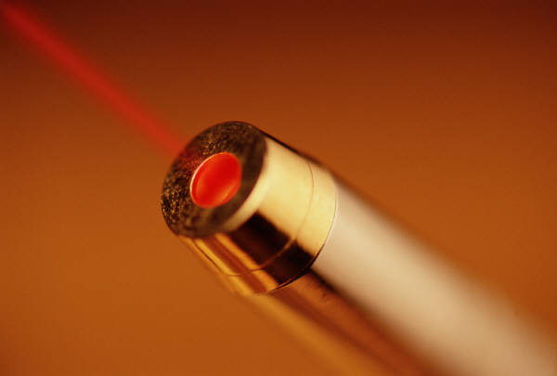

Theory
Laser fired into atmosphere
Varied return based on backscatter from clouds/aerosol etc.
Time measured from pulse fired to backscatter return is used to calculate cloud height and other values
Return signal is diminished according to inverse square law and needs to be normalized
Notes:
Cover the power output of the laser and considerations of wattage considering safety
Major return due to clouds, dwindling aerosol return
Height is found by cutting the time from pulse to return in half (because of travel and return) and multiplying by the speed of light
Normalizing includes multiplying by square of height – this however accentuates noise

Slide 3

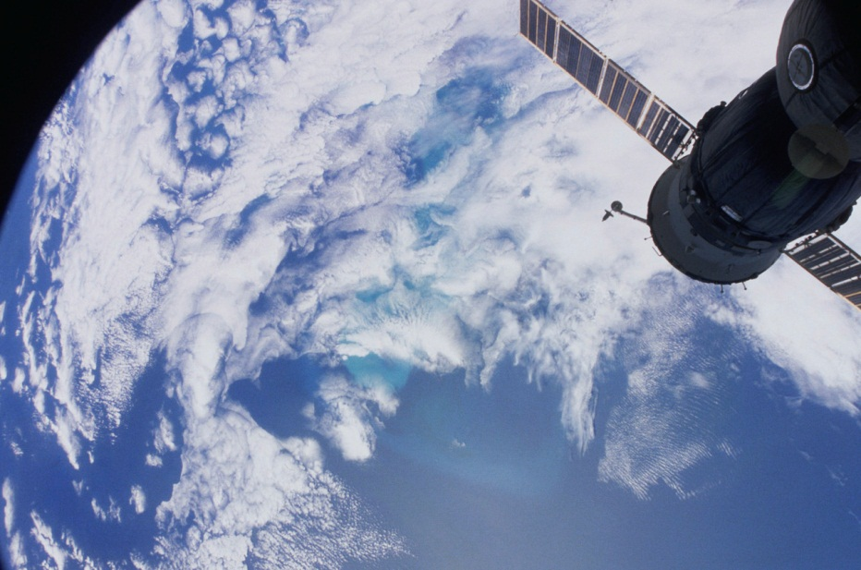
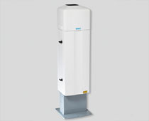
Applications
Valuable as a ceilometer at airports
Volcanic ash warning system for aircraft
Used to study atmospheric aerosol ->

Slide 4
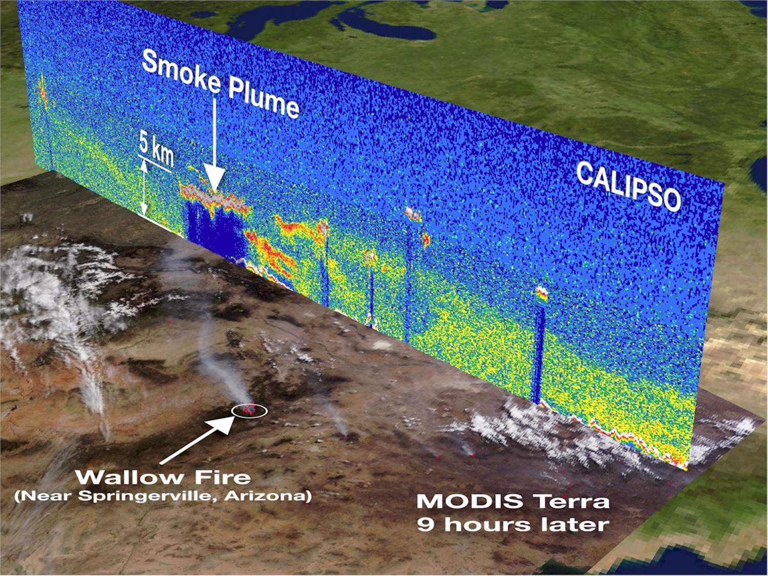
Courtesy of NASA

Slide 5
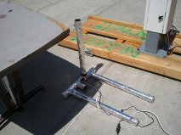
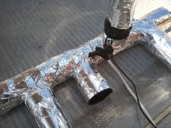
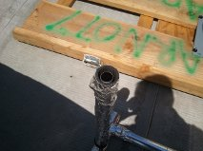
Time Lapse Photography

Slide 6
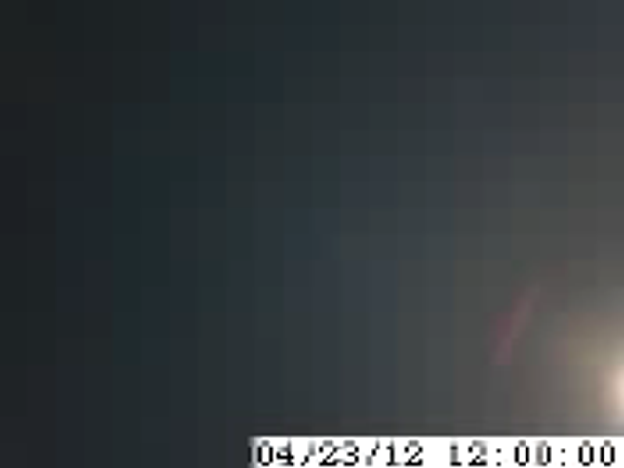
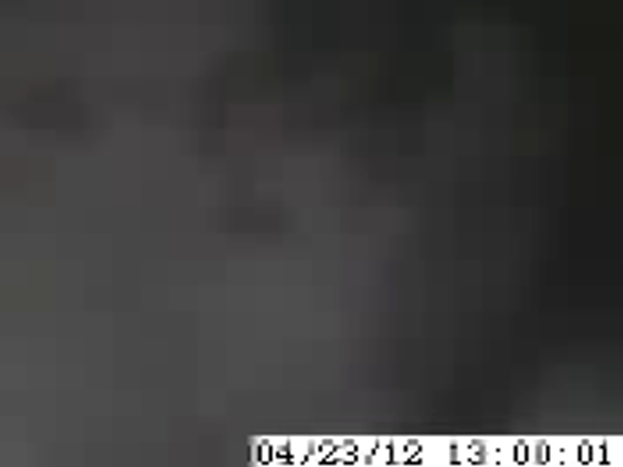
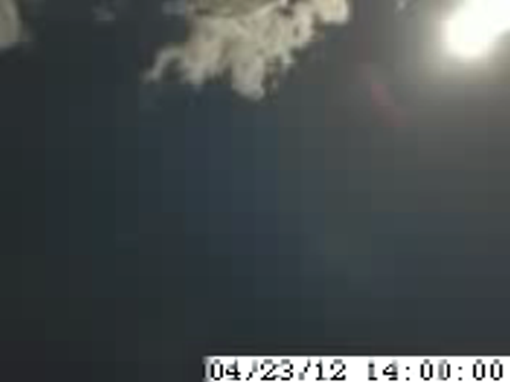
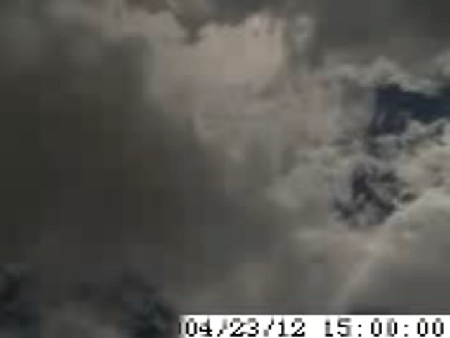
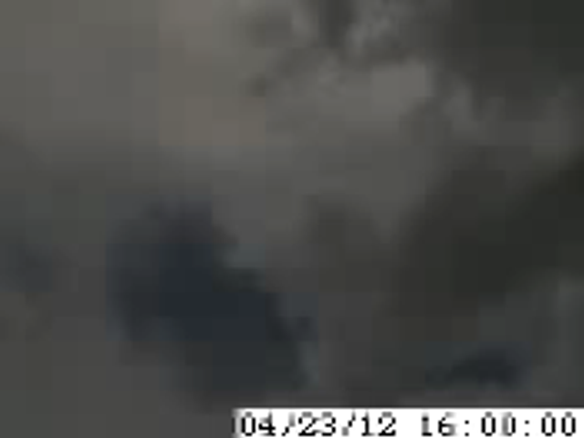
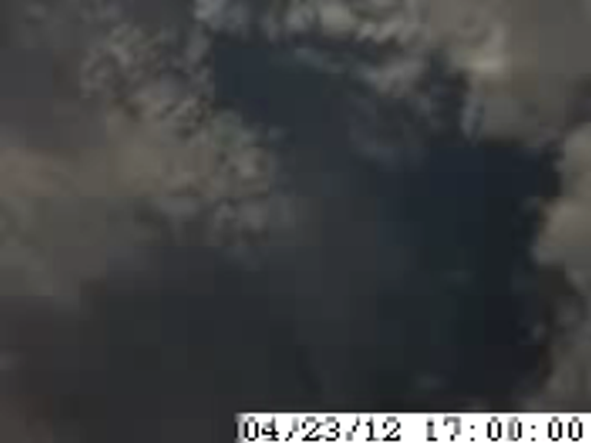
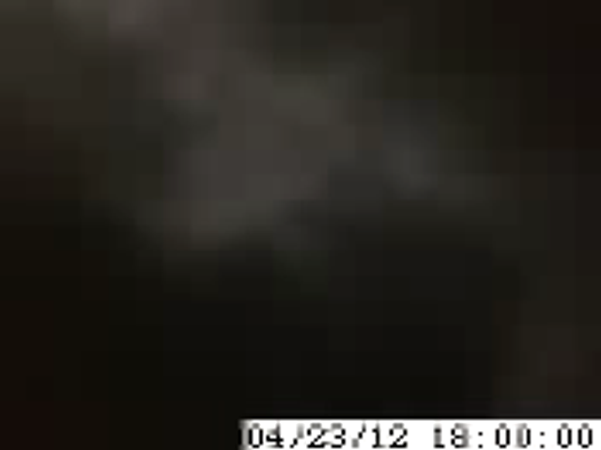
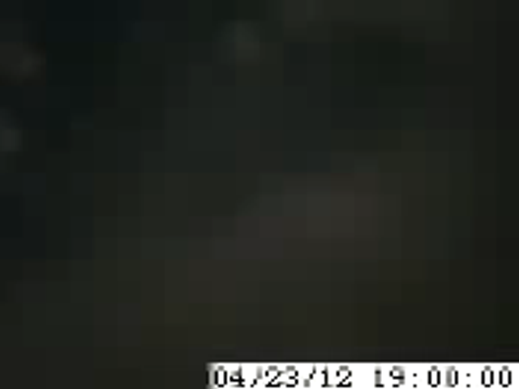
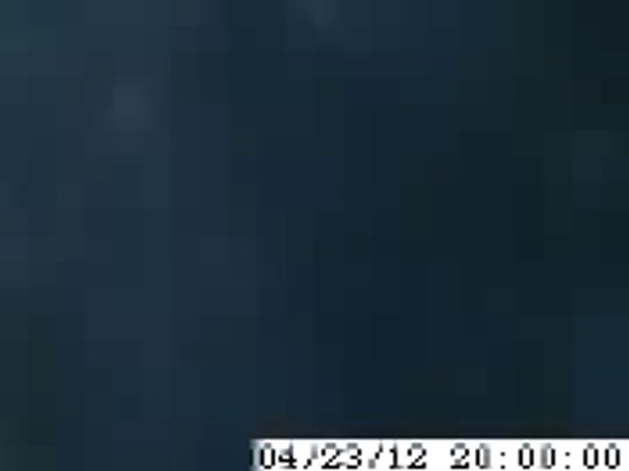
Notes:
Bust out the vaisalia data

Slide 7
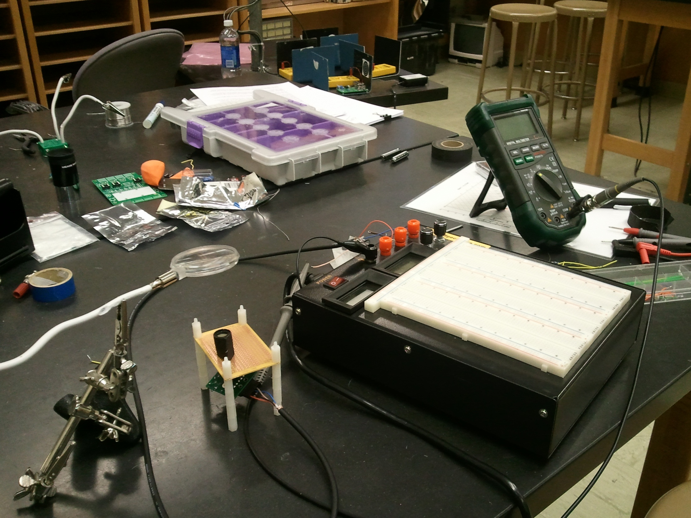
Lidar Development: Phase I
Notes:
Entry level including the major components just to test the basic concept.
Simple laser pointer aimed at ceiling (green)
Lens to focus return
Filter to cut return
Photodiode and
Read signal in voltage on fluke-meter

Slide 8
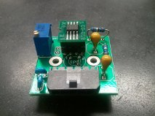
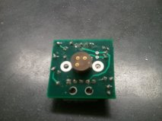
Board for photodiode
Op amp – 410 MHz
Gain increased by Resistor value
Amplifies signal from the diode
Photodiode connects to triport on back of board with use of 10nm filter

Slide 9
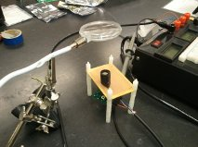
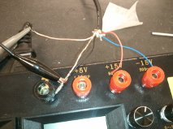

Board in Operation
For the amplifier, a positive and negative voltage are pulled.
The signal out is shown as the white wire
Signal is read on the voltmeter

Slide 10
Lidar Development Phase II
Begin the full scale implementation of a lidar device.

Slide 11
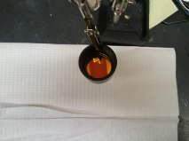
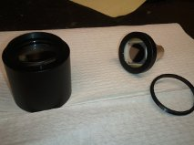
Photodiode/Filter UPGRADED
100mm² active area photodiode with BNC mount
532nm Filter with 2nm tolerance
SM tube assembly

Slide 12
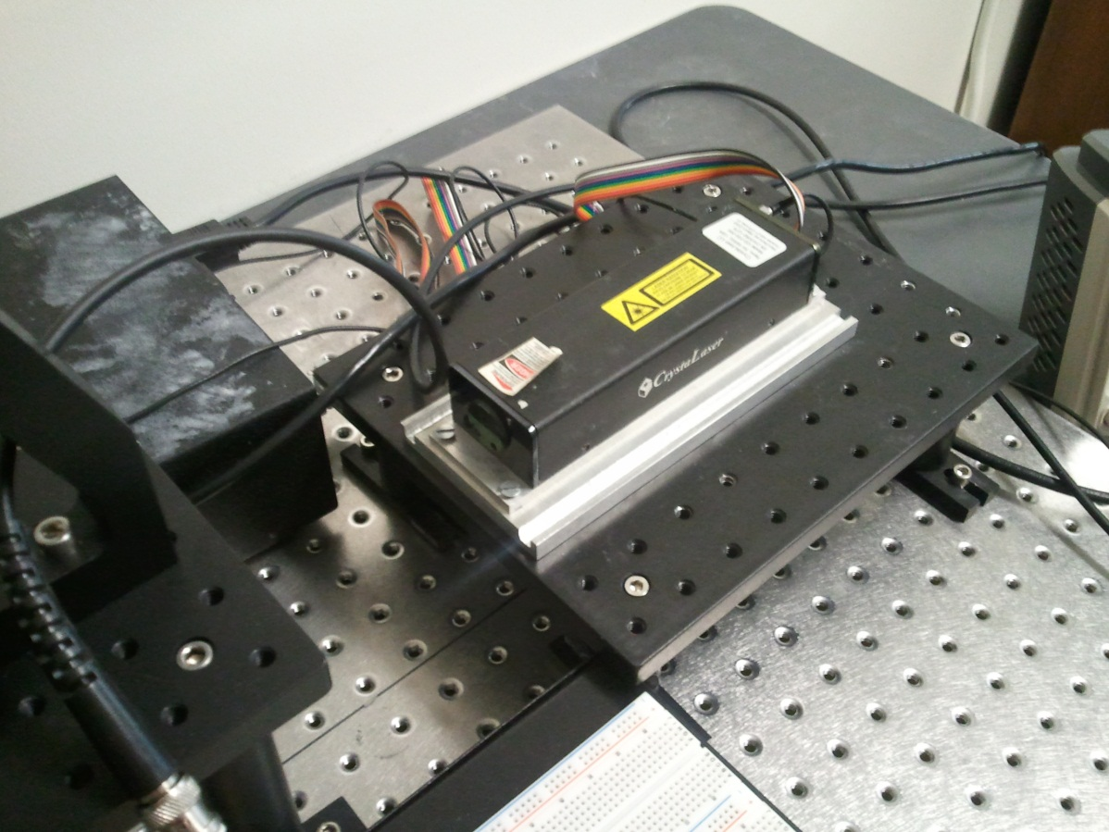

“LASER”
532nm, 100 mW output
Q-switched adjustable pulse frequency
Safety doesn’t take a vacation

Slide 13
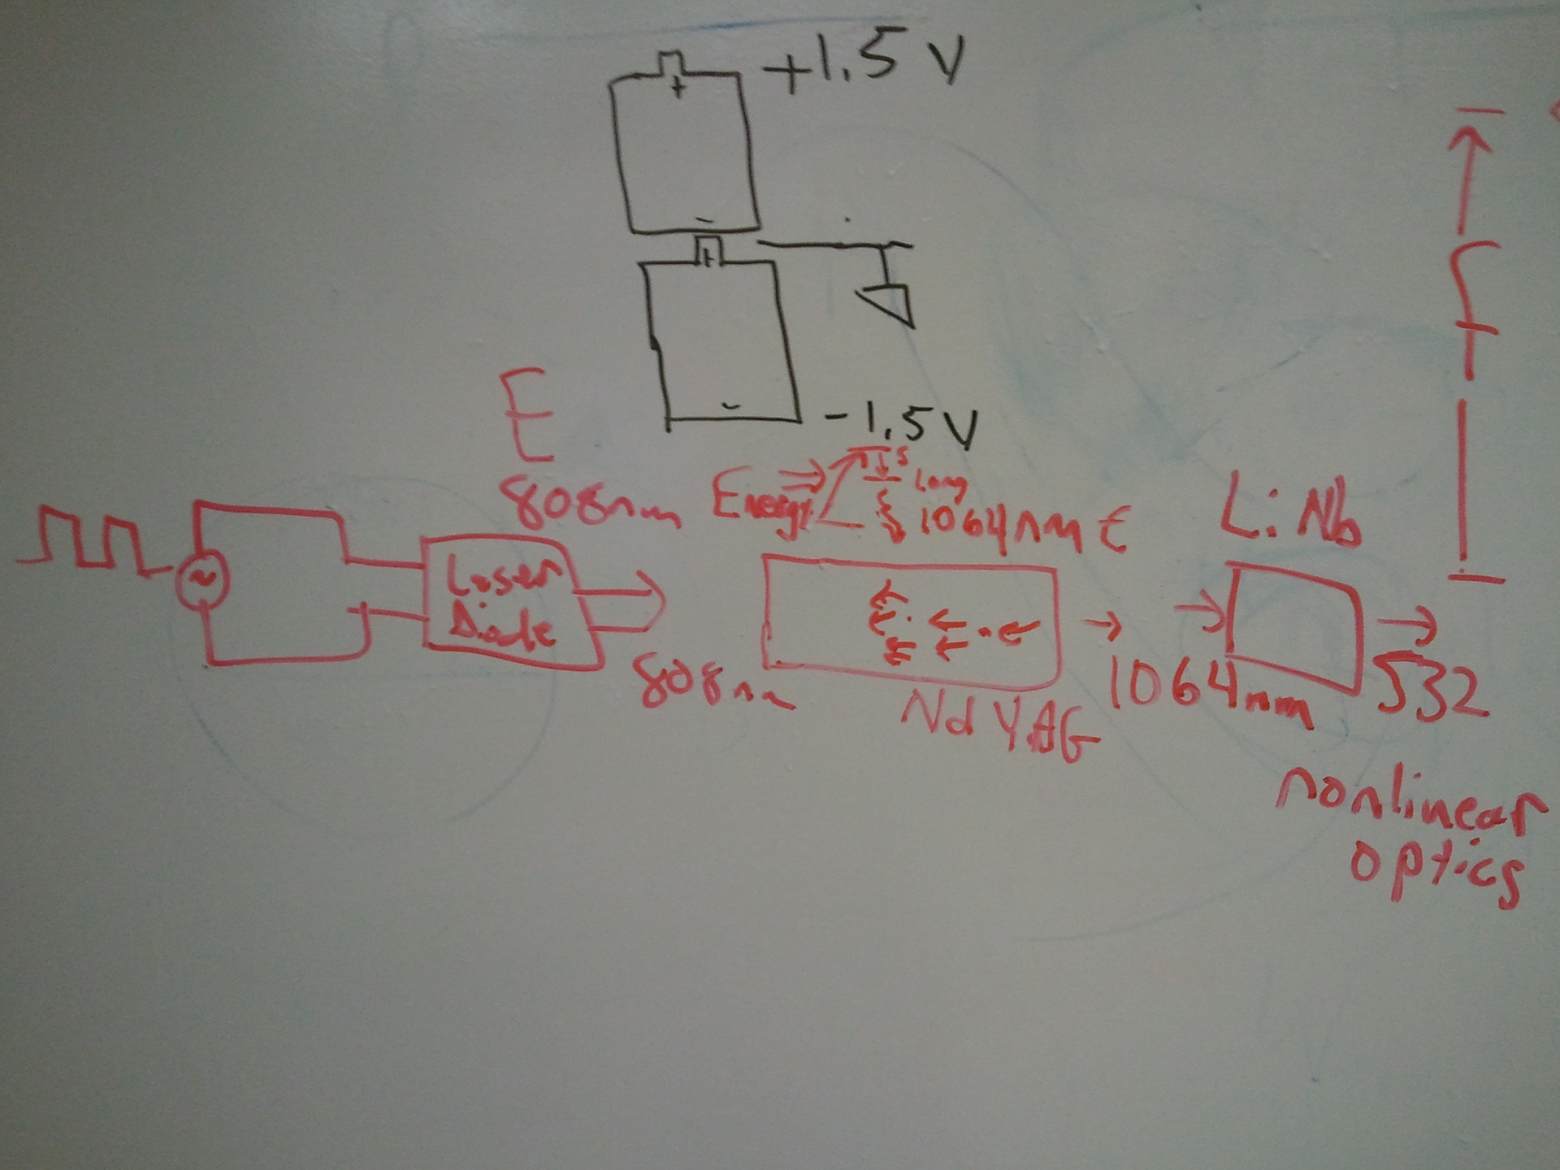

Slide 14
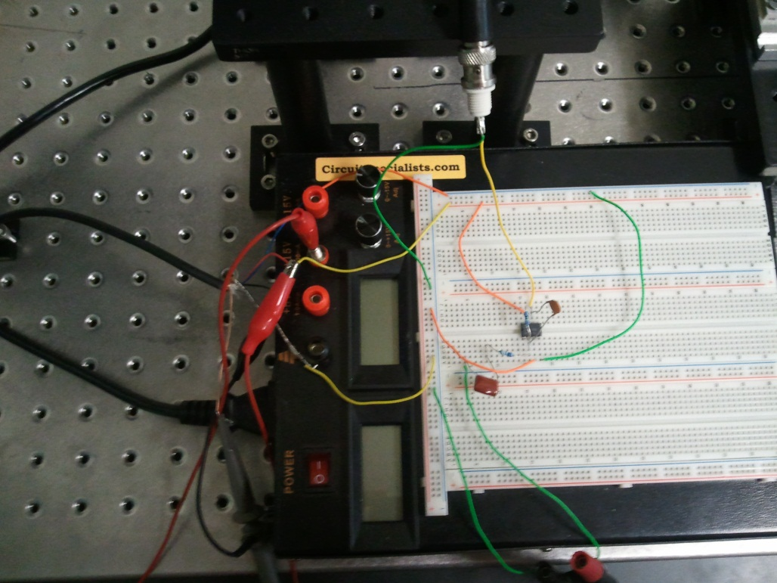
Triggering the Scope
We needed the scope to start acquiring when the laser fired
The external trigger on the laser driver gave a faint “square wave” that followed the laser
We amplified and filtered this signal to trigger acquisition
Circuit shown <-

Slide 15
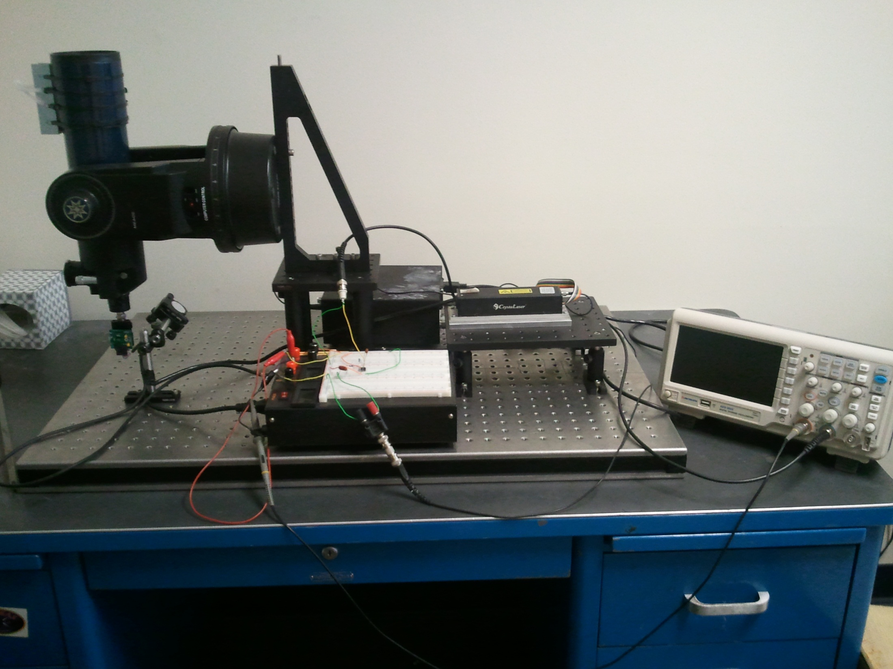
PHASE II COMPLETE

Slide 16
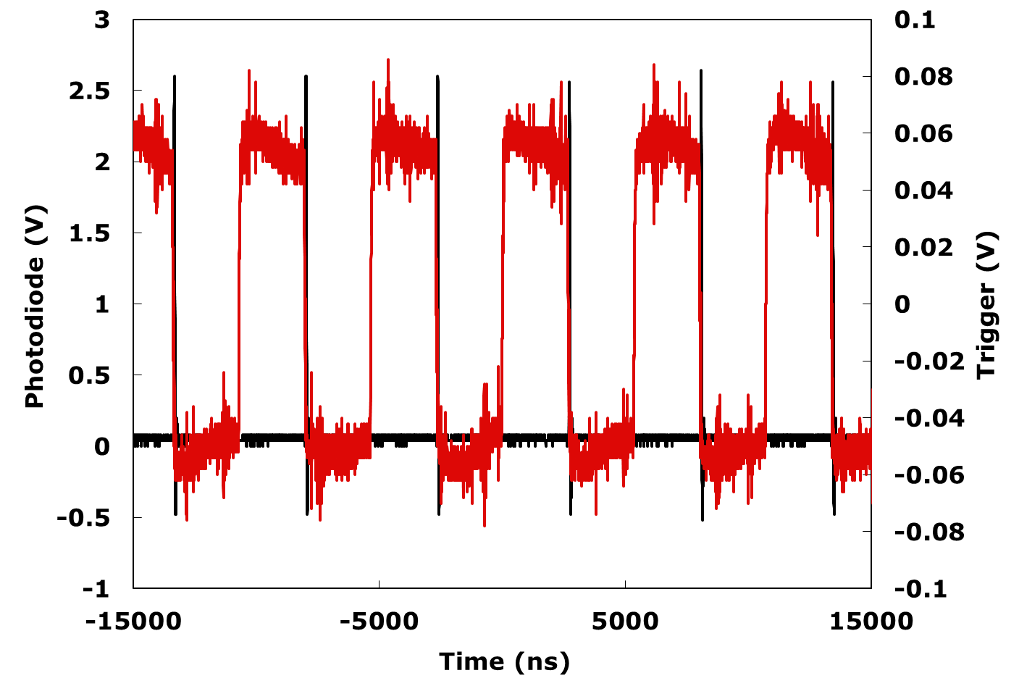
Testfire Data

Slide 17
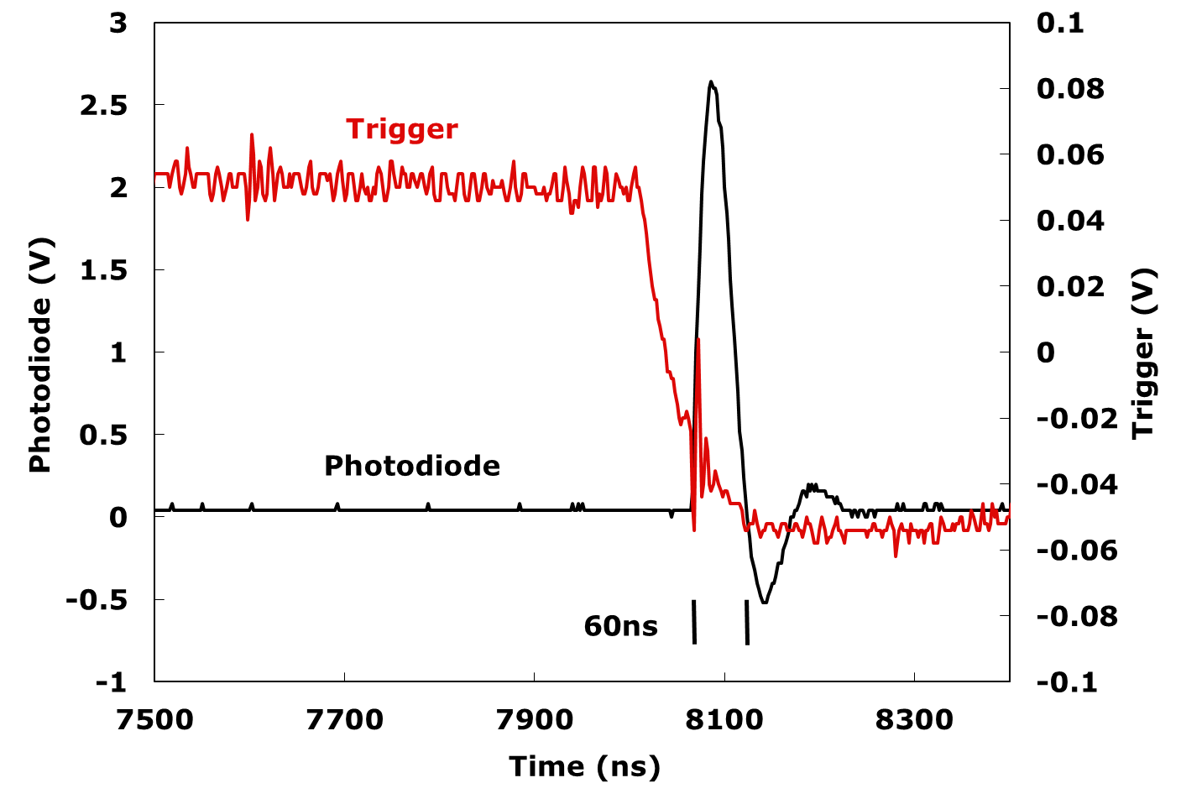
DETAIL OF PULSE

Slide 18
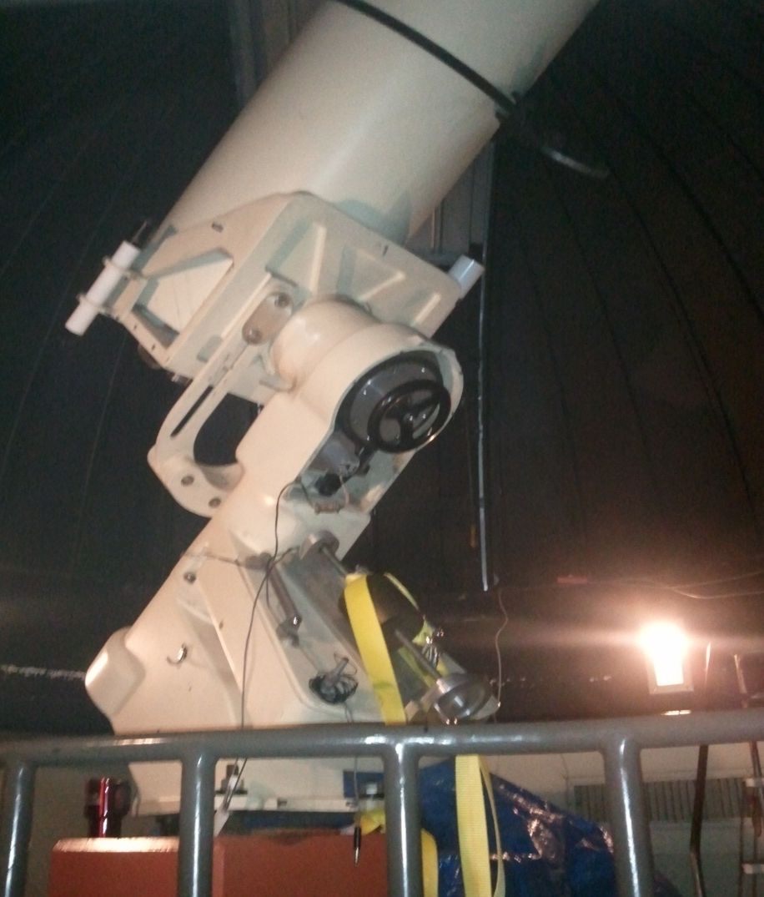
FUTURE…
Larger Optics
Photomultiplier tubes
Dispersion of laser output

Slide 19
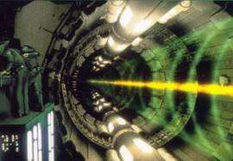
AND BEYOND!

