Slide 1
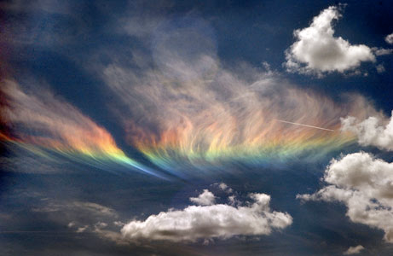
Infrared Spectroscopy of the Atmosphere using the FTIR Spectrometer
Brian Echevarria
Jennifer Link
Introduction to Atmospheric Instrumentation (ATMS 360)
University of Nevada Reno

Slide 2
FTIR
Fourier Transform InfraRed
The FTIR Spectrometer is an optical instrument used to measure infrared spectra from 5 microns to 20 microns.
Interested in the window region from about 13 microns to 8 microns (800cm⁻¹ – 1300cm¹)
Notes:
The FTIR lab calc data uses wave numbers from 500 to 3000cm⁻¹ which converts to a wavelength of 20 microns to about 3 microns. At the point beyond 2000cm⁻¹ the data became very noisy, so it was unnecessary to keep this section of the graph. What we are mainly interested in, is what’s known as the window region. The window region exists from about 13 microns to 8 microns and holds some of the most valuable data.

Slide 3
Applications
Obtains Infrared spectrum of absorption, emission, and photoconductivity of:
Solids, liquids and gases
Identification of Cloud base temperatures
Identification of inorganic compounds and organic compounds
Measures solar irradiance
In Remote sensing
Notes:
There are many applications that you can explore by using the FTIR spectrometer. The most important to our experiment is the more introductory data given by the infrared radiation spectrum of the absorption and emission of gases, identification of cloud base temperatures. Every greenhouse gas emits radiation at a specific wavelength and with the FTIR we are able to witness at what wavelengths they emit the strongest and identify the true presence of the greenhouse effect. Also from the radiance plot we can judge how dry or moist the atmosphere is and if there are clouds present or not. Then by looking at the brightness temperature we can see values for temperatures of the base of clouds, then use outside data such as Skew-T log P plots from the National Weather Service or Lidar data to determine the height of the cloud.

Slide 4
How the FTIR works
The FTIR spectrometer uses a Michelson Interferometer setup that consists of:
A beam splitter, a fixed mirror, and a mirror that translates back and forth.
Cold and hot black
Bodies are for calibration
In order to get correct cloud
Radiance and Brightness
Measurements.
Notes:
The FTIR uses a Michelson Interferometer setup, and to obtain accurate measurement we use cold and hot black bodies that are preferably greater than 30 degrees Celsius apart. These black bodies allow use to get a calibrated range of data to show us a true radiance or brightness temperature of the target (our atmosphere). The FTIR spectrometer and how it works is not something we looked at in great detail due to our time constraint. We mainly focused on data collection and analysis.

Slide 5
Calibration
Circulation Water In
Circulation Water Out
Cone
Thermistor Probe
Black Paint
Notes:
A black body is an object that absorbs or emits all radiation. Two black bodies of different temperatures are used to calibrate the FTIR spectrometer. It is calibrated prior to each measurement of the atmospheric infrared radiation by taking measurements of to black bodies at different temperatures. These measurements are used to calibrate the radiance and brightness temperature of a target.

Slide 6
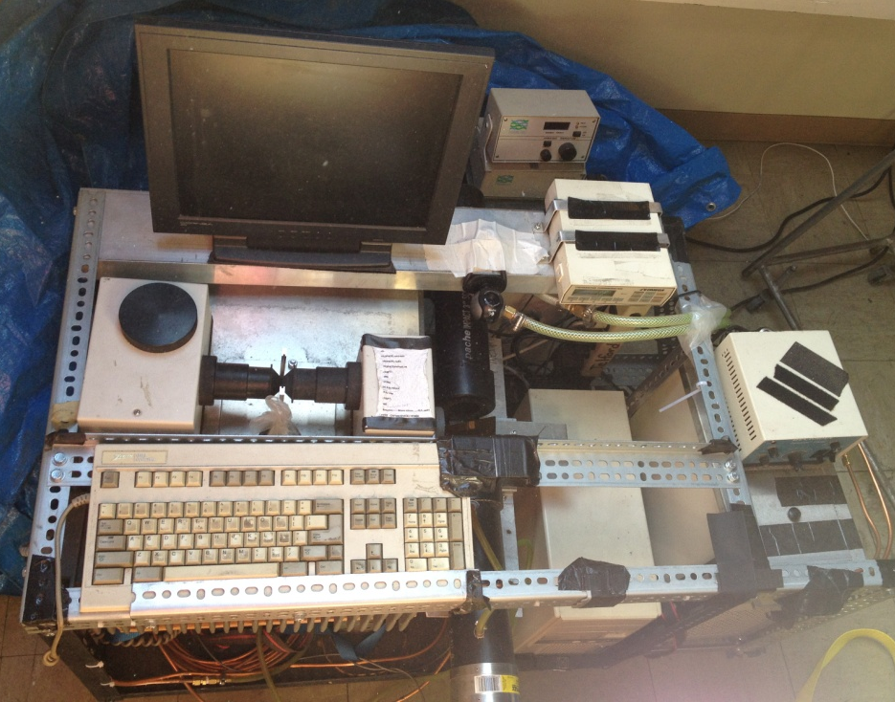
Calibration
j
Cold Black Body
Mirror
Detector
Hot Black Body
Notes:
First the hot and cold water pumps are turned on to circulate water into the hot and cold black bodies. The FTIR is turned on and liquid nitrogen is added to cool the detector. The directories are updated in the computer with the current date. Once the hot and cold black body temperatures stabilize the hot and cold black body temperatures are entered into the exampl.set in the radio directory of the program. The emission program is started, the mirror is first rotated toward the cold black body, then the hot black body. The infrared radiation measured from the black bodies and the entered black body temperatures are used the calibrate the radiance and brightness temperature of the target. The mirror is then rotated toward sky and measurements of atmospheric IR are taken.

Slide 7
Cold Black Body
Entered Cold BBT: -6C
Generated Cold BBT: -5.9C
Notes:
To get measurements of radiance and brightness temperature for a cold black body, after the calibration measurements are taken the mirror is rotated back to the cold black body for the target measurement. The radiance measured is a typical black body curve. The temperature entered into the program was -6°C and the brightness temperature measured by the FTIR spectrometer was approximately -5.9°C. Temperature is read on the spectrum between 500 and 1200 cm⁻¹.

Slide 8
Hot Black Body
Entered Hot BBT: 44.16C
Generated Hot BBT: 44.19C
Notes:
The same process was used to measure the radiance and brightness temperature of a hot black body. Again, the radiance is shown with a black body curve. The temperature entered into the program was 44.16°C and the measured temperature was approximately 44.19°C.

Slide 9
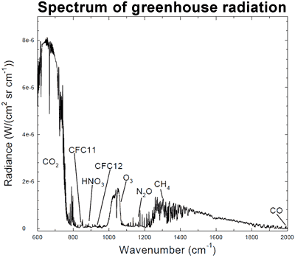
Data Collection
Radiance:
H2O
Notes:
Our main data collection came from the radiance versus wavenumber plot. This allowed us to see a variety of different gases, mainly occurring in the window region. Gases such as O3, N2O, and CFC’s only show up on clear or cirrus clouds days. This is because they are emitting radiation back down to earth from locations near the stratosphere. So, with the blockage from the clouds the signals from these gases are not apparent. The graph shown on the cloud would be on a perfectly clear day.

Slide 10
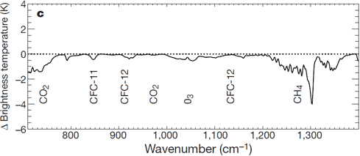
Data Collection
Brightness Temperature:
Cloud Base Temperatures
Comparing surface temperature/moisture conditions
Notes:
Brightness Temperature is explained in good terms by NASA as a, “descriptive measure of radiation in terms of the temperature of a hypothetical blackbody emitting an identical amount of radiation at the same wavelength.” So the brightness temperatures of the gases aren’t necessarily the temperatures of those gases, but the measure of radiation they emit. Another useful piece of information from this plot is the cloud base temperatures and the surface temperatures.

Slide 11
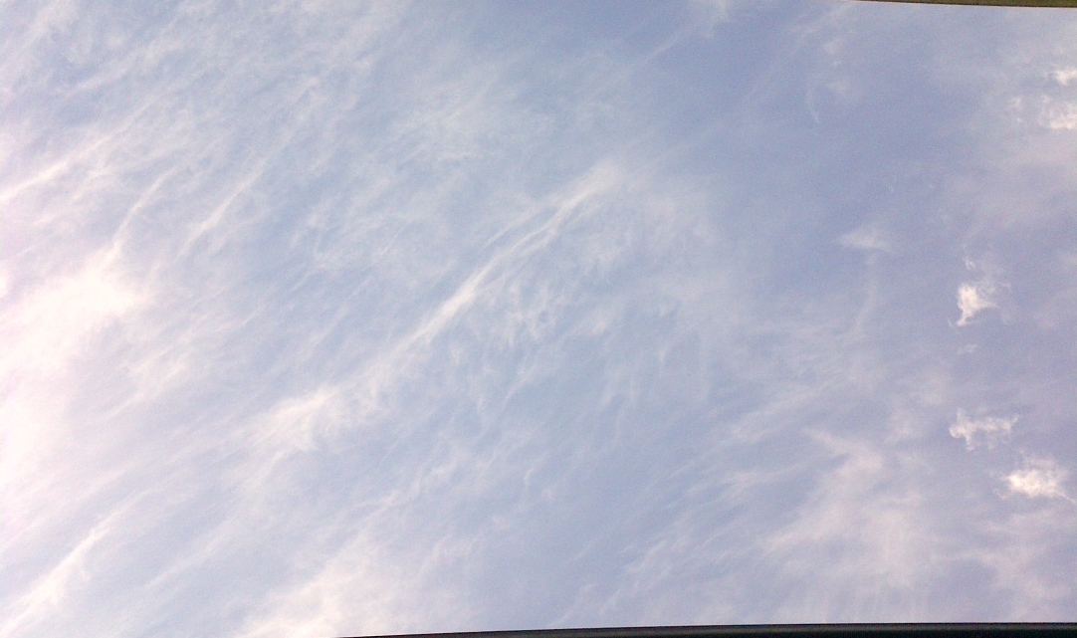
Cirrus- April 10, 17:00
Notes:
Cirrus clouds are high level clouds composed of ice crystals. Black Body temperatures were not far enough apart to get an accurate comparison with the NWS sounding. There was a difference of approximately 100°C in the cloud base temperature. The radiance measurements are similar to that of a clear day. The high, thin clouds allow the FTIR spectrometer to measure higher into the atmosphere.

Slide 12
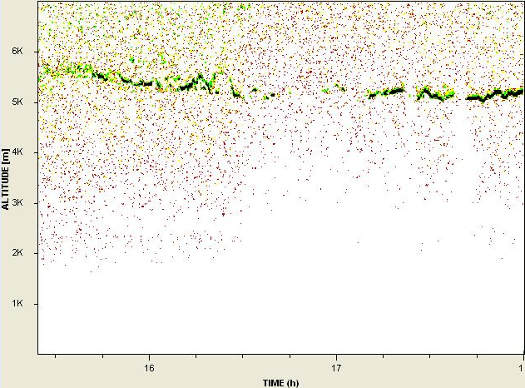
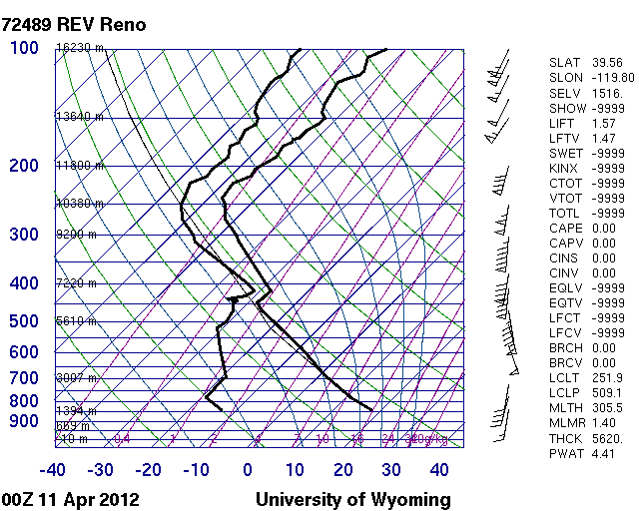
.
Lidar Cloud height@ 1700: 5300m
Sounding LCLH@1700: 5610m
Notes:
The LIDAR shows few clouds at approximately 5300m at 1700hr. This is very close to the NWS sounding at 1700hr. Surface and cloud base temperatures do not coincide with the brightness temperature measured but the radiance measurements correspond with high level clouds in the atmosphere.

Slide 13
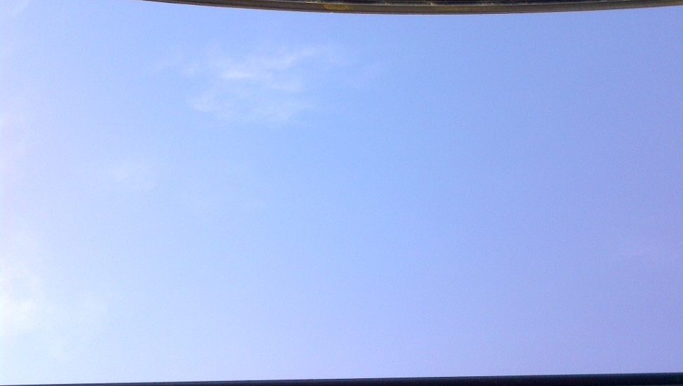
“Mostly Clear”- April 12, 1648
Surface Temperature@ 1648: 9C
Sounding Surface Temp@ 1700: 10C
Notes:
One thing about our data collection during our class time is that we do not have a perfectly clear day. April 12th was a very active day with high winds blowing clouds quickly over the sierras and at this time we hit a pocket of mostly clear skies. This gives us a good enough look at the radiance values of gasses without any blocking from the clouds. You can vividly see the wide range of peaks that represent the various different gasses in the window region for the radiance and brightness temperatures plot

Slide 14
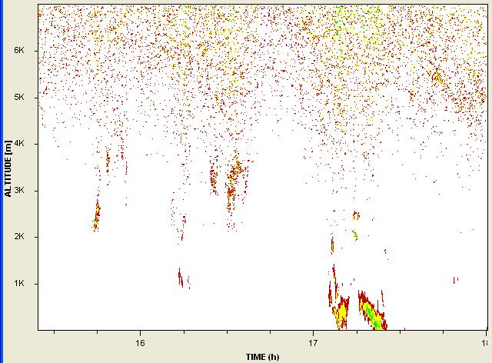
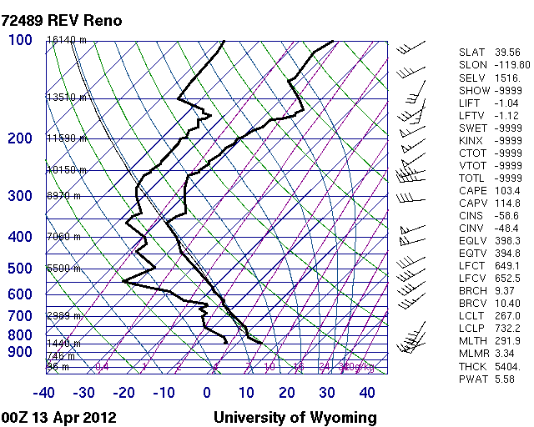
No significant clouds detected by
The Lidar for 1648.
Generally clear from 1645 to 1700
Notes:
Since this is our clear data set, the Lidar is just backing up that it is in fact clear. As for the sounding it shows us a pretty active upper atmosphere and we can use it to compare surface temperature values rather than cloud base temperatures.

Slide 15
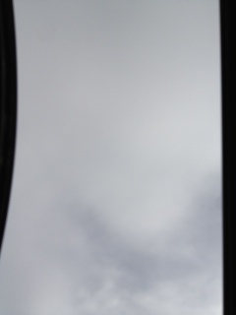
Altostratus- April 17, 16:36
Base Cloud Temperature@ 1636: -15C
Sounding LCLT @ 1700: -11C
Notes:
This is one of our more cloudy days. In the radiance graph we can see the peak of CO2 around 725cm-1 in the room the a drop off then generally stable with possibly some traces of methane and other unknown gasses. As you can see there is no sign of CFC’s or Ozone especially. This is our greatest evidence that ozone is coming from above the stratosphere. The brightness temperature shows us that the base of the stratus cloud temperature is about -15C, we can then compare this with the next slide that has the NWS sounding on it. The sounding shows a temperature of -11C. This is different because of the time, and we have evidence from the Lidar data that the clouds did lower in height as it came to 1700 hours when the balloon launched.

Slide 16
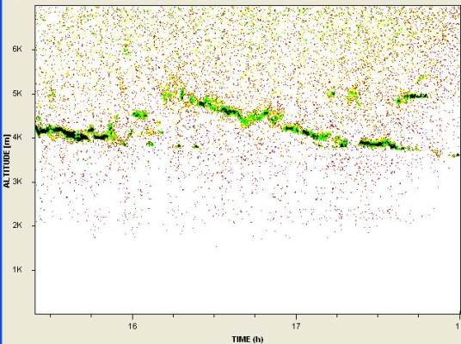
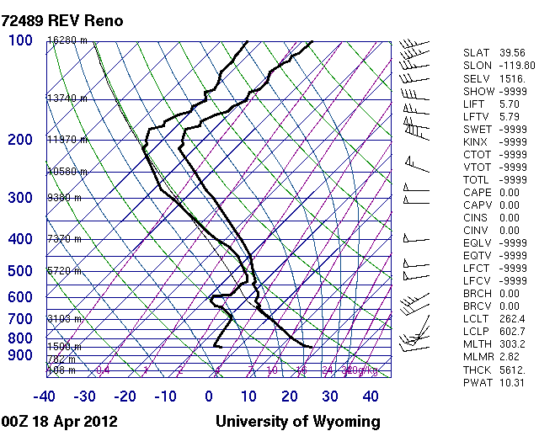
Compare the Cloud Height with the
Lidar and the Cloud temperature with
The brightness temperature
Lidar Cloud height@ 1636 : 4800m
Lidar Cloud height@ 1700: 4300m
Sounding LCLH@1700: 4400m
Notes:
Here we can directly compare the Lidar data with the sounding to make sure that our overall FTIR data is showing correctly. The Lidar cloud height is within 100 meters of the LCLH on the sounding. This is a pretty good range considering the balloon launch occurs a few miles Northeast from our location. Especially on this day we had a lot of shifts in clouds very quickly because winds above the surface were very high and were blowing over the mountains quickly.

Slide 17
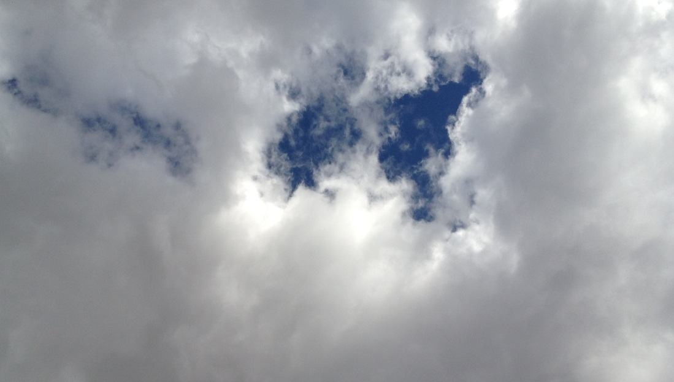
Stratocumulus- April 19, 16:58
Cloud Base Temperature@ 1658: -2C
Sounding LCLT @ 1700: -1C
Brightness Temperature
Notes:
Stratocumulus clouds are low level clouds composed of water droplets. The shape of the radiance curve is closer to that of a black body curve because the lower, thicker clouds create a barrier, blocking radiance due to gases that occur higher in the atmosphere, such as ozone that can be seen between 950 and 1100 cm⁻¹. Water is still present for the FTIR spectrometer to measure due to the higher humidity and the clouds which are composed of water droplets. The cloud base temperature measured by the FTIR spectrometer was very close to the cloud base temperature measured during the NWS sounding.

Slide 18
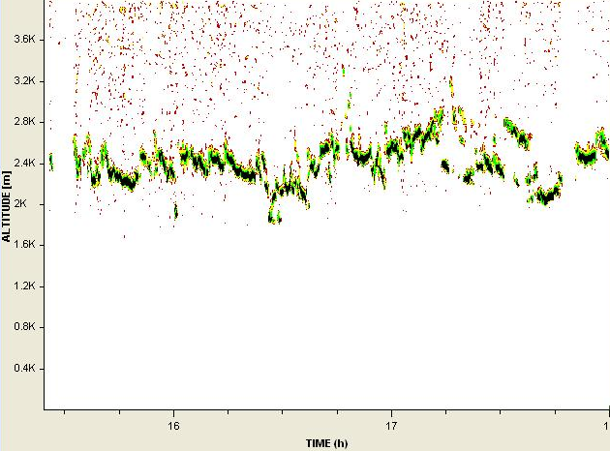
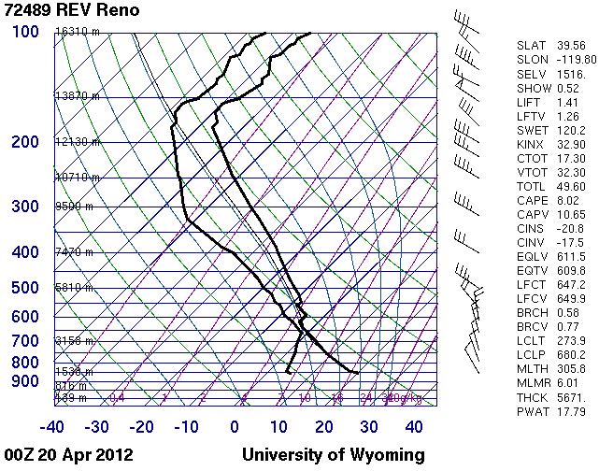
Lidar Cloud height@ 1658 : 2400m
Sounding LCLH@1700: 3800m
Notes:
The LCL in the NWS sounding is approximately 1400m higher than the cloud base recorded by the LIDAR at approximately 2400m. On April 19th there appeared to be both low and middle clouds in the sky. Above the LIDAR and FTIR spectrometer the clouds appear to be stratocumulus, it is possible that of the Reno NWS locations the cloud cover was different.

Slide 19
Little to no CFC detection
No Ozone detection
Notes:
This is what our experiment has come down to, comparing a cloudy and a clear day and noting the differences that we see. We noticed that there is increased CO2, because CO2 mainly comes from the surface and human emission as well as pollution. So, the clouds are acting as a blanket and trapping in the CO2 near the surface which is giving us increased values at the appropriate wavelengths. As for CFC and ozone detection there is slight to no detection. This is proving that these greenhouse gases are emitting radiation from the stratosphere, and since we have clouds it is not making it past them to our detector. Similar we have decreased values of CH4 and N2O due to the fact that these greenhouse gasses are coming both from the surface and stratosphere so some may be blocked by the clouds. Lastly, we have increased H2O due to the simple fact that there is more moisture (clouds) in the upper atmosphere.

Slide 20
Notes:
Similar to the radiance plot we can also see evidence of the exact same increase and decrease in gasses for the exact same reasons.

Slide 21
Errors in Data
Cold and Hot black body temperatures.
Quickly fluctuating hot and cold black body temperatures.
Not a completely clear day for comparison.
Sounding Location.
Notes:
In the beginning weeks of the experiment the cold black body temperature was the ambient temperature. The difference between the cold black body temperature and the hot black body temperature was only about 10°C. The temperatures were to close for accurate calibrations. Large variations in the brightness temperatures and sounding temperatures were seen, especially on days with little or no cloud cover. This problem was resolved by increasing the temperature of the water bath for the black body and adding a cold water bath to cool the cold black body to approximately 0°C.
The black body temperatures did not remain stable, they would fluctuate up to 3°C from the enter temperature. Few clear days were available to measure and the clear days that were measured, the measurements were inaccurate due to the black body temperatures being to close. Brightness temperatures were measuring as low as 0K. Radiance was also measuring below zero. The NWS releases weather balloons twice a day at 0000Z and 1200Z, we used the 0000Z soundings to compare our FTIR measurements. The Reno NWS office is approximately 3 miles northeast of the location the FTIR and LIDAR measurements were taken. Conditions would not always be identical at both locations. To resolve this, a radiosonde could be released at the same time and location as the FTIR and LIDAR measurements are taken.

Slide 22
Conclusion
Evidence of stratospheric greenhouse gases and surface gases.
Determine cloud base temperature and height and compare with Lidar and sounding data.
Further analyze unknown gases in data.
Notes:
In conclusion, we were able to uses the FTIR to obtain evidence of stratospheric and surface greenhouse gases. As well as determine cloud base temperature and height and compare them with the LIDAR and sounding data. If we had more time we could further analyze unknown gases in the data.

Slide 23
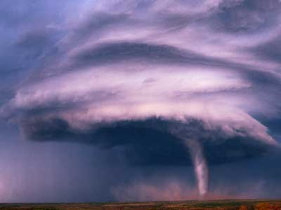
Questions?

