Slide 1
Comparing Meteorological Data between UNR and DRI
Christopher Atkinson
December 3, 2019

Slide 2
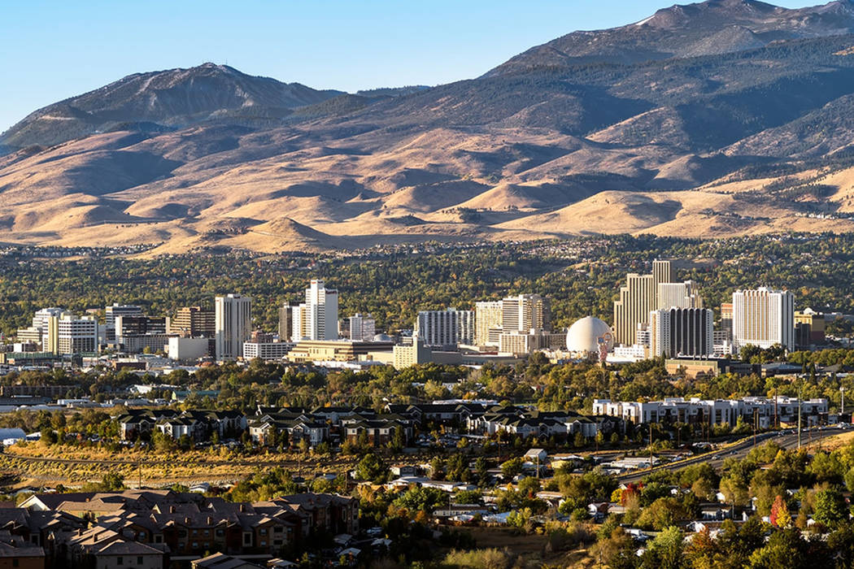
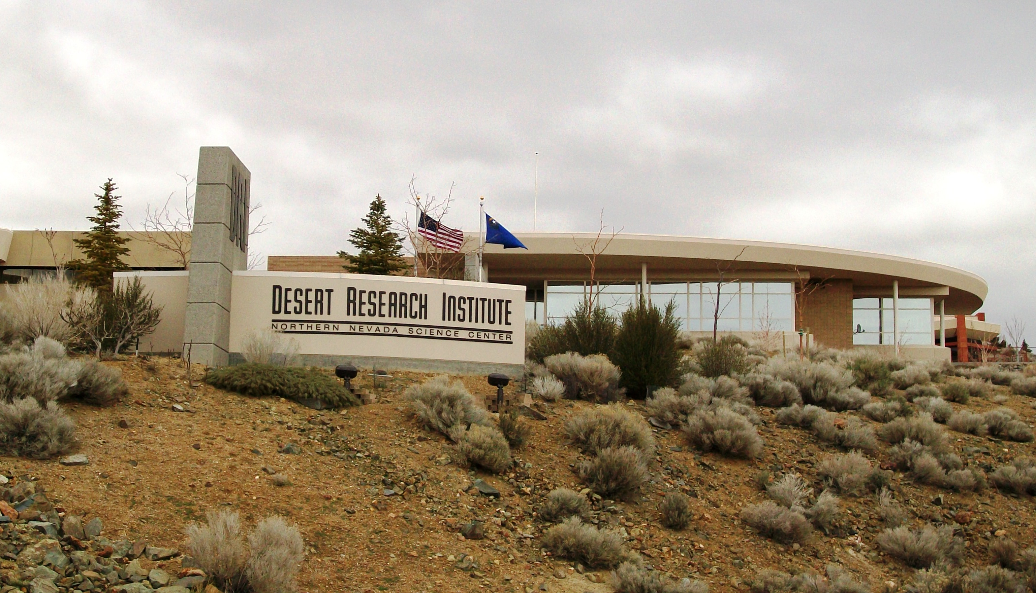
Outline
Background
Approach
Methods
Data Collection
Results
Conclusion

Slide 3
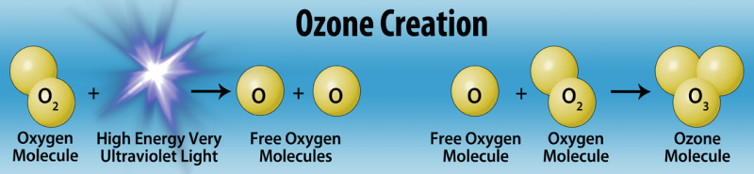
Background
What is in the atmosphere?
Ozone is also present. (Good and bad)
Our atmosphere does not have an even temperature or pressure throughout.
We will focus on the surface. (Factors influence air pollutants)
Comparing UNR and DRI Data (143 m height difference)
Particularly Spring and Winter 2018
Notes:
Our air contains 78% nitrogen, 21% oxygen, 1% water vapor, .9% argon, and .03% carbon dioxide.
Ozone is a highly reactive form of oxygen and is a gas made up of three oxygen atoms (O₃). It occurs naturally in small (trace) amounts in the upper atmosphere (the stratosphere). Ozone protects life on Earth from the Sun’s ultraviolet (UV) radiation. In the lower atmosphere (the troposphere) near the Earth’s surface, ozone is created by chemical reactions between air pollutants from vehicle exhaust, gasoline vapors, and other emissions. At ground level, high concentrations of ozone are toxic to people and plants.
But the atmosphere does not have an even temperature or pressure throughout.
Pressure is greatest when at sea level, and temperature steadily decreased with altitude. The Earth’s temperature change can vary as altitude increases, but in terms of weather and cloud formation, we will focus on the troposphere where most of the world’s weather takes place.

Slide 4
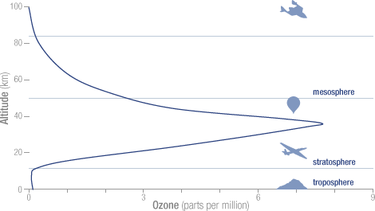
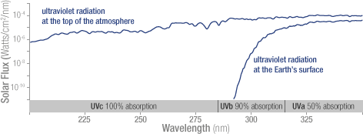
Ozone
The concentration of ozone varies with altitude.
The flux of solar ultraviolet radiation versus wavelength.
Notes:
Ninety percent of the ozone in the atmosphere sits in the stratosphere, the layer of atmosphere between about 10 and 50 kilometers altitude. The natural level of ozone in the stratosphere is a result of a balance between sunlight that creates ozone and chemical reactions that destroy it. Ozone is created when the kind of oxygen we breathe—O₂—is split apart by sunlight into single oxygen atoms. Single oxygen atoms can re-join to make O₂, or they can join with O₂ molecules to make ozone (O₃). Ozone is destroyed when it reacts with molecules containing nitrogen, hydrogen, chlorine, or bromine. Some of the molecules that destroy ozone occur naturally, but people have created others.
The total mass of ozone in the atmosphere is about 3 billion metric tons. That may seem like a lot, but it is only 0.00006 percent of the atmosphere. The peak concentration of ozone occurs at an altitude of roughly 32 kilometers (20 miles) above the surface of the Earth. At that altitude, ozone concentration can be as high as 15 parts per million (0.0015 percent). Peak concentrations, an average of 8 molecules of ozone per million molecules in the atmosphere, occur between an altitude of 30 and 35 kilometers.
Ozone in the stratosphere absorbs most of the ultraviolet radiation from the Sun. Without ozone, the Sun’s intense UV radiation would sterilize the Earth’s surface. Ozone screens all of the most energetic, UV-c, radiation, and most of the UV-b radiation. Ozone only screens about half of the UV-a radiation. Excessive UV-b and UV-a radiation can cause sunburn and can lead to skin cancer and eye damage.
Solar ultraviolet radiation is largely absorbed by the ozone in the atmosphere—especially the harmful, high-energy UV-a and UV-b. The flux is shown on a logarithmic scale, so each tick mark on the y-axis indicates 10 times more energy.

Slide 5
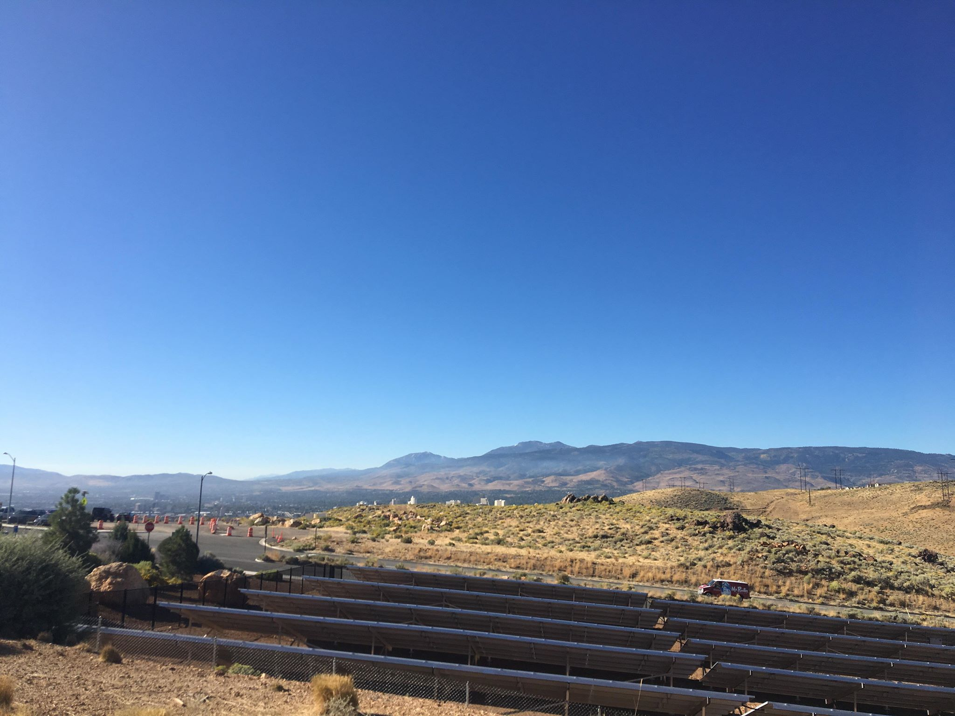
Approach
Under normal atmospheric conditions
The surface becomes heated from the sun’s rays
Reversed air pattern (Temperature Inversion)
“Inverted” from its normal state
Inversions play an important role in air quality.
Its strength and duration control air quality index (AQI).
Other factors play a role too.
(Reno, October 2019)
Notes:
Under normal atmospheric conditions, air temperature becomes cooler as altitude continuously increases. This is due to most of the sun’s solar radiation converting to heat, which warms the air at the surface of the earth.
Throughout the day, the surface becomes heated from the Sun’s rays. Usually, this warmer air would spread and ascend opposite to the surface.
But if the density of the cold air is higher than the warm air, the layer of cold air is trapped beneath the warm layer and will not eliminate contaminants.
This reversed air pattern is considered the temperature inversion. The reason is because the atmospheric temperature profile become “inverted” from its normal state.
As pollutants are produced by vehicles, coal burning, and other industrial activities, inversions trap these pollutants near the surface.
Strength and duration of inversions control air quality index (AQI) levels at ground level. Hydrocarbons and nitrogen oxides that are present during this trapping period become converted into harmful ozone by sunlight, reducing air quality. Strong inversions confine pollutants to a shallow vertical layer, leading to higher AQI levels while weak inversions lead to low AQI levels.
During 1952, the city of London experienced one of the most dangerous air pollution phenomena in the history of England, The Great Smog, as it was blamed for thousands of deaths (Davis, Bell, & Fletcher, 2002). These people most likely experienced severe respiratory diseases.

Slide 6
Other influencing factors
Wind Speed
Temperature
Lapse Rate
Humidity
Wind
Solar Radiation

Slide 7
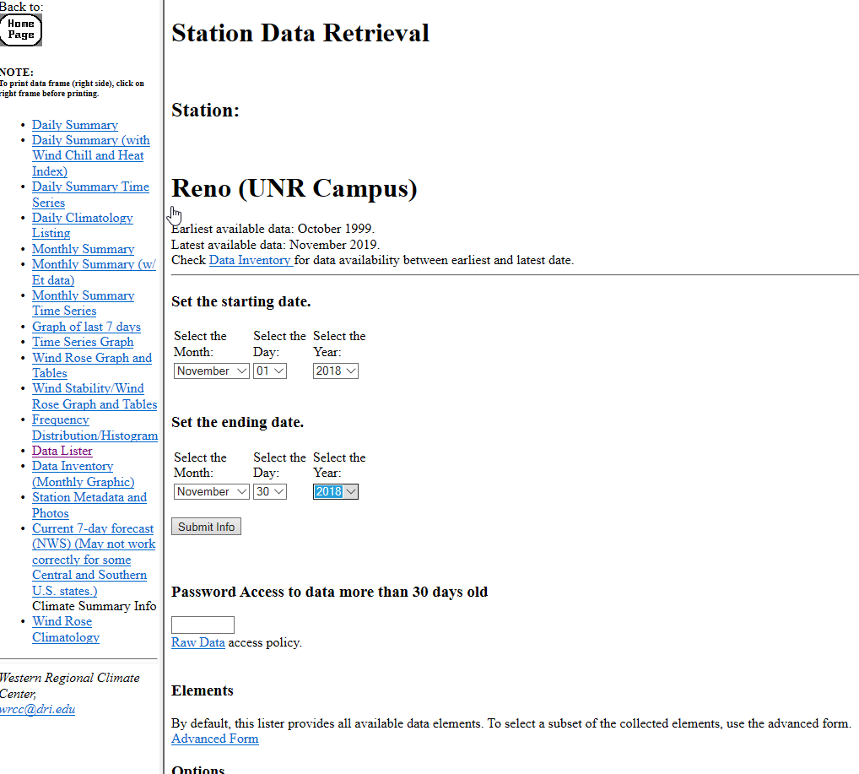

Method
Excel Software program
Western Regional Climate Center Historical and Et Data

Slide 8
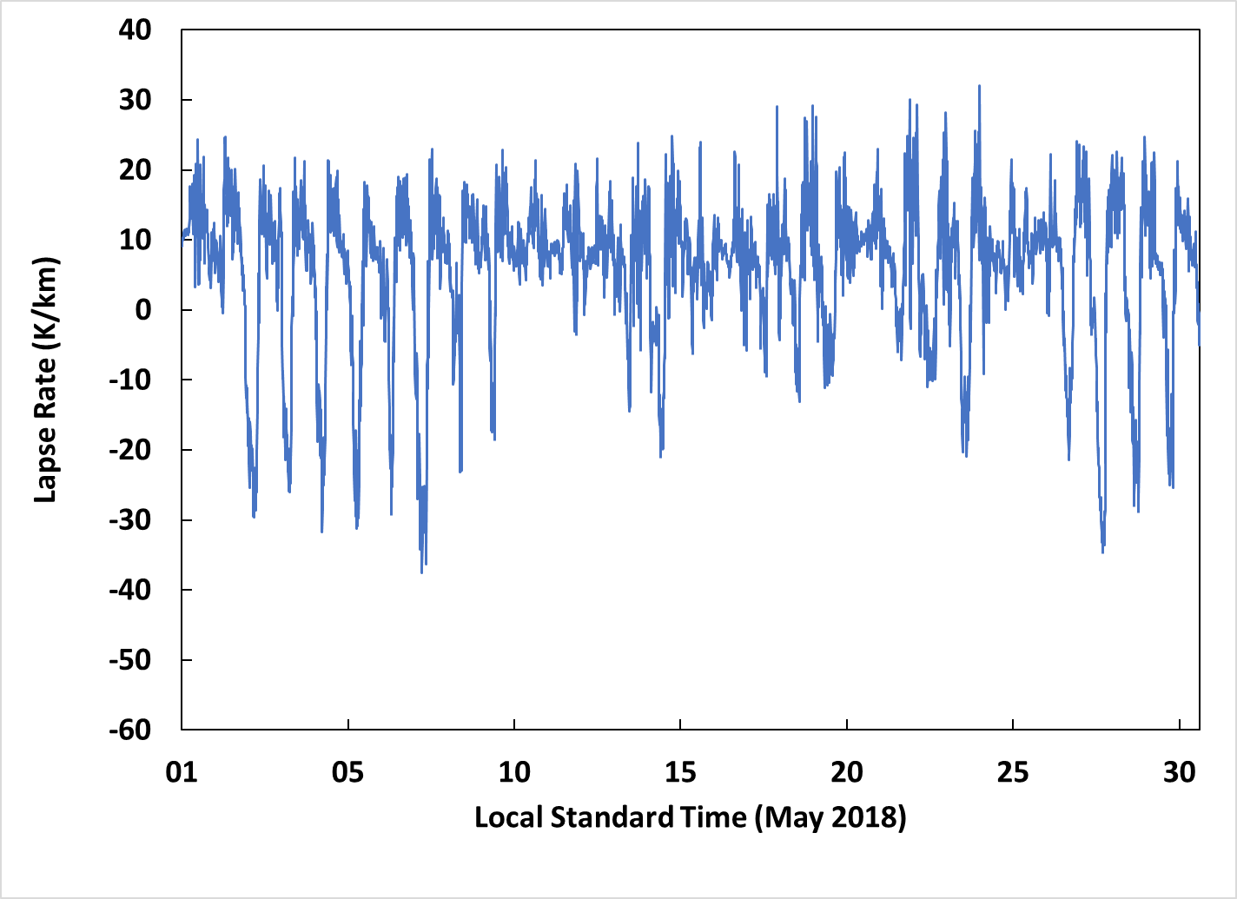
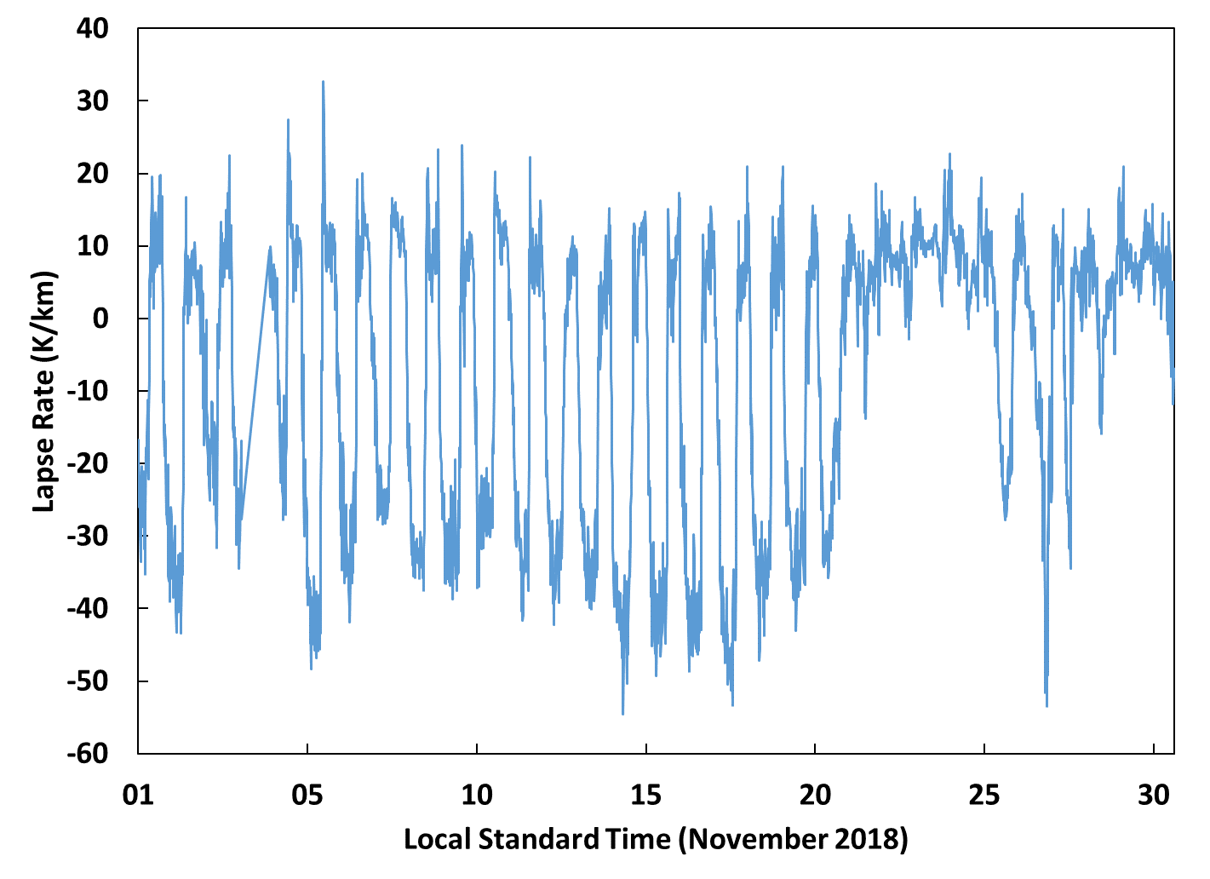
Lapse Rate
May 2018
November 2018
Notes:
Air contaminants build up when inversion layers form close to the ground (mixing depth). Inversion layers trap air contaminants which can cause health and nuisance effects.

Slide 9
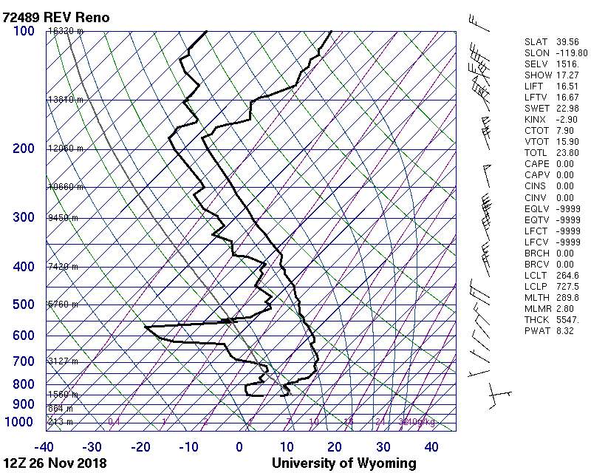
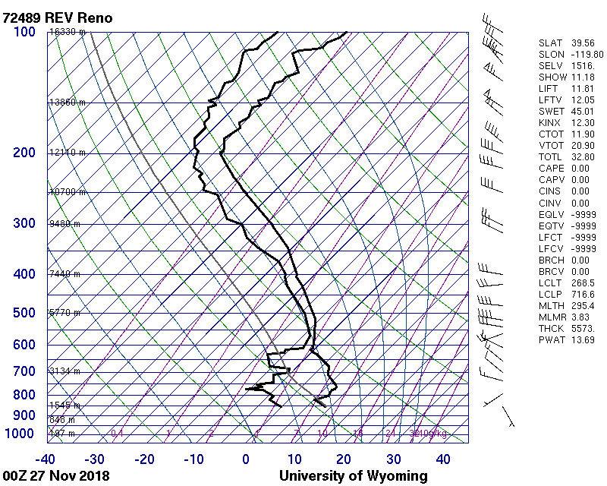
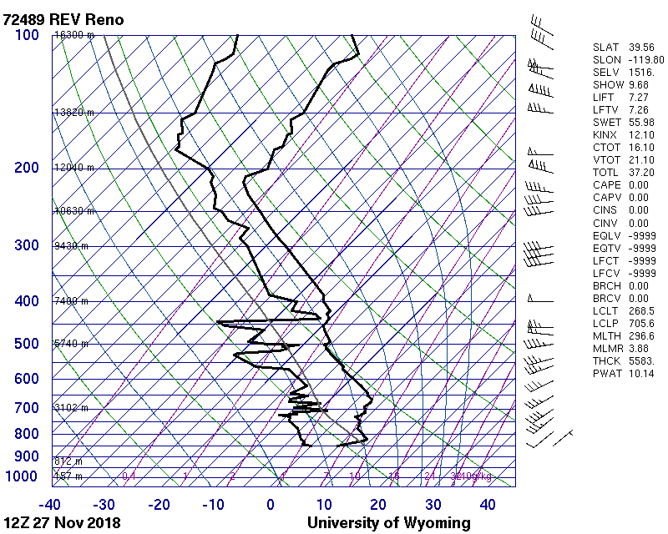
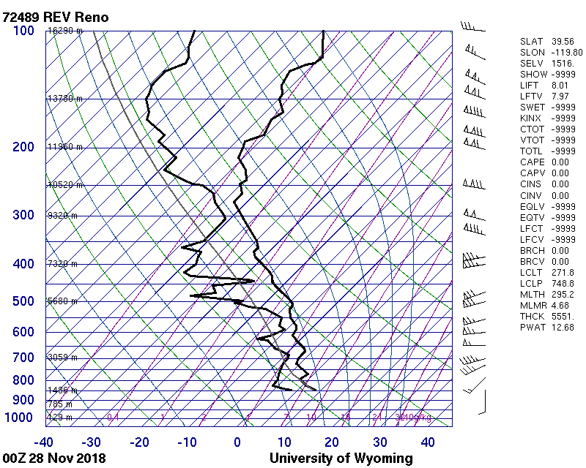
November 26/27 AM
November 26/27 PM

Slide 10
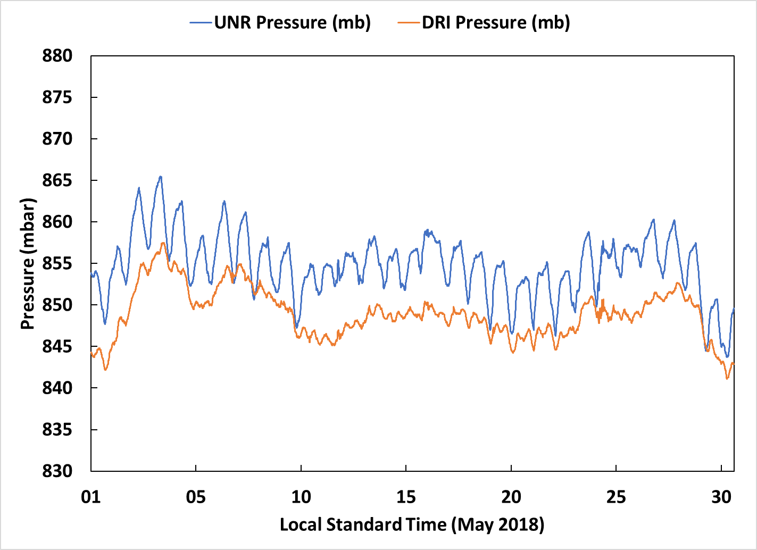
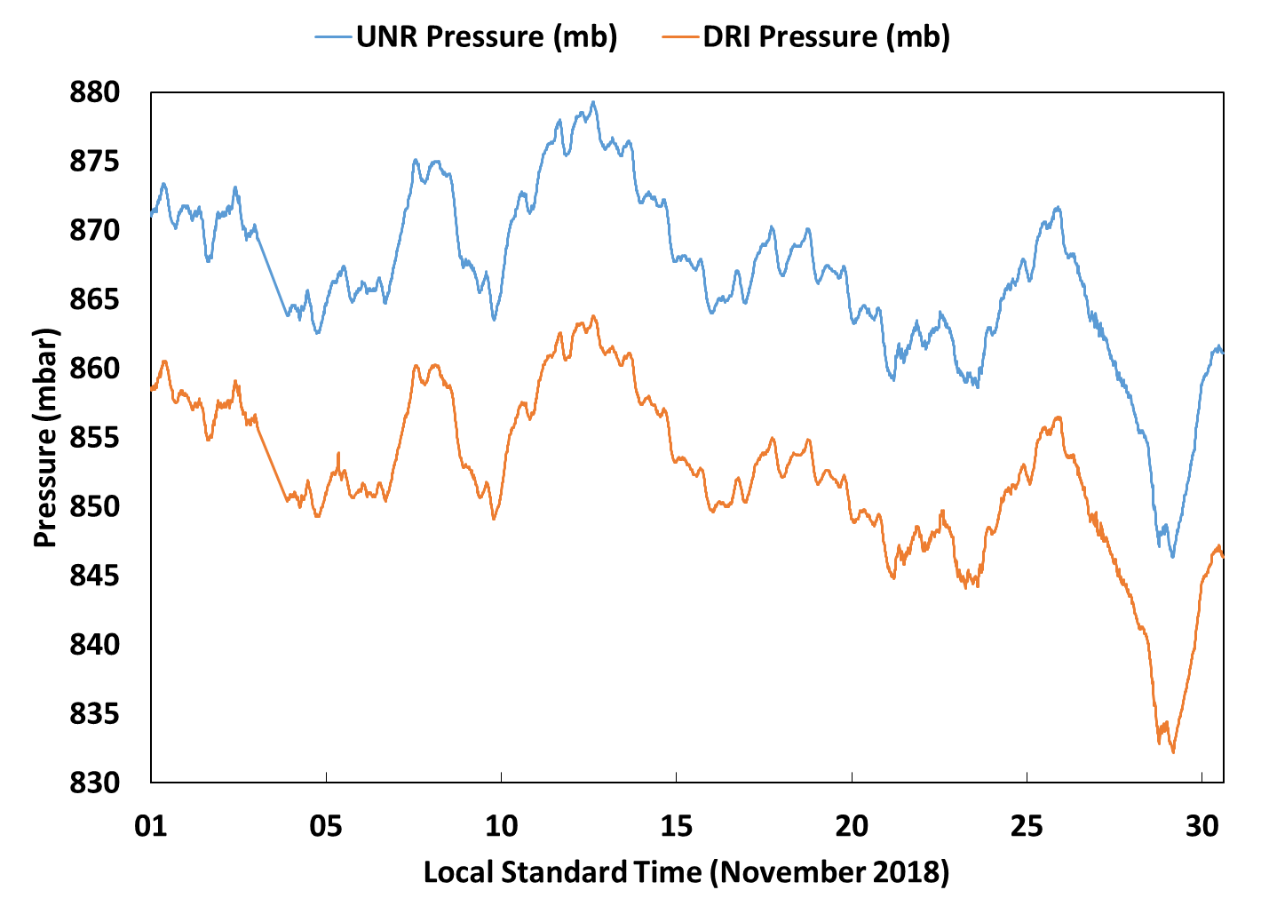
Pressure
May 2018
November 2018
Notes:
The higher atmospheric pressure values during the winter in Reno are caused by the relatively cold conditions experienced in this region compared to summer. Since Cold air is denser than relatively warm air, it has a tendency to sink, relatively, and thus has a higher pressure than warm air. From this, it can be gleaned that the winter months would have an higher average atmospheric pressure than in the summer. Weather patterns complicate the relationship between barometric pressure and temperature.
Very cold temperatures can create areas of high air pressure because cold air has greater density and the concentration of molecules can raise the air pressure. An area of higher pressure, H, is called a high-pressure system and generally has a denser air mass where air temperature is cool. These systems often bring warmer temperatures and dry weather. A low-pressure system, L, is an area of less dense air with warmer air temperatures. The lower concentration of molecules causes lower air pressure in these areas. Low-pressure systems often bring cool, wet weather.

Slide 11
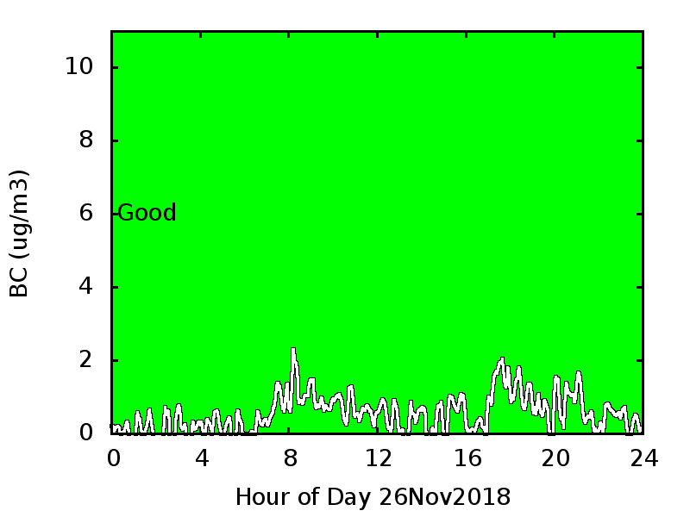
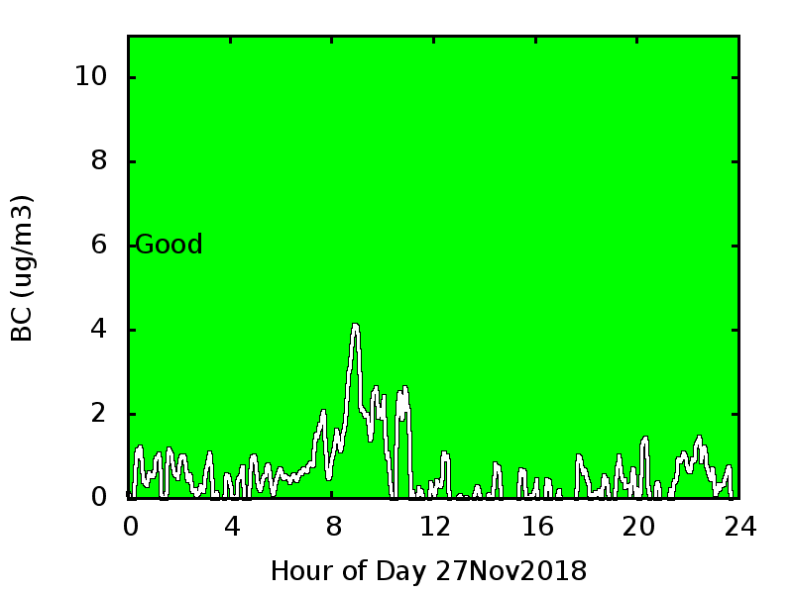
Black Carbon
November 26, 2018
November 27, 2018

Slide 12
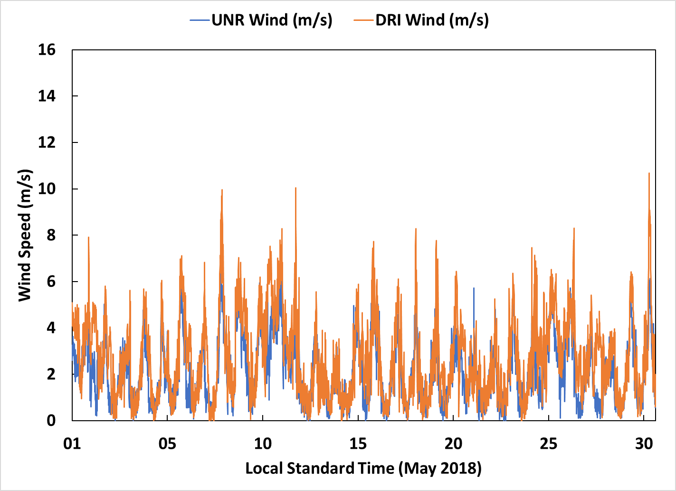
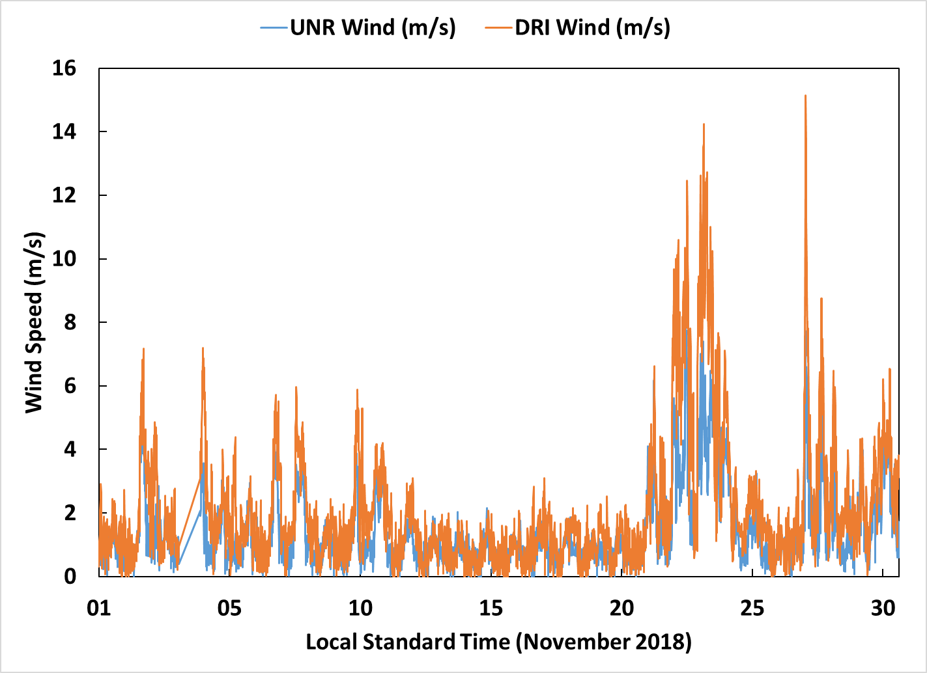
Wind Speed
May 2018
November 2018
Notes:
Wind is simply air in motion. On global or macroscale wind patterns are set up due to unequal heating of earth surface by solar radiation at the equator and the polar regions, rotation of the earth and the difference between conductive capacities of land and ocean masses. Secondary or mesoscale circulation patterns develop because of the regional or local topography. Mountain ranges, cloud cover, waterbodies, deserts, forestation, etc., influence wind patterns on scales of a few hundred kilometers. Accordingly a pattern of wind is setup, some seasonal and some permanent.
The movement of air at the mesoscaie and microscale levels is of concern in control of air pollution. A study of air movement over relatively small geographical regions can help in understanding the movement of pollutants.

Slide 13
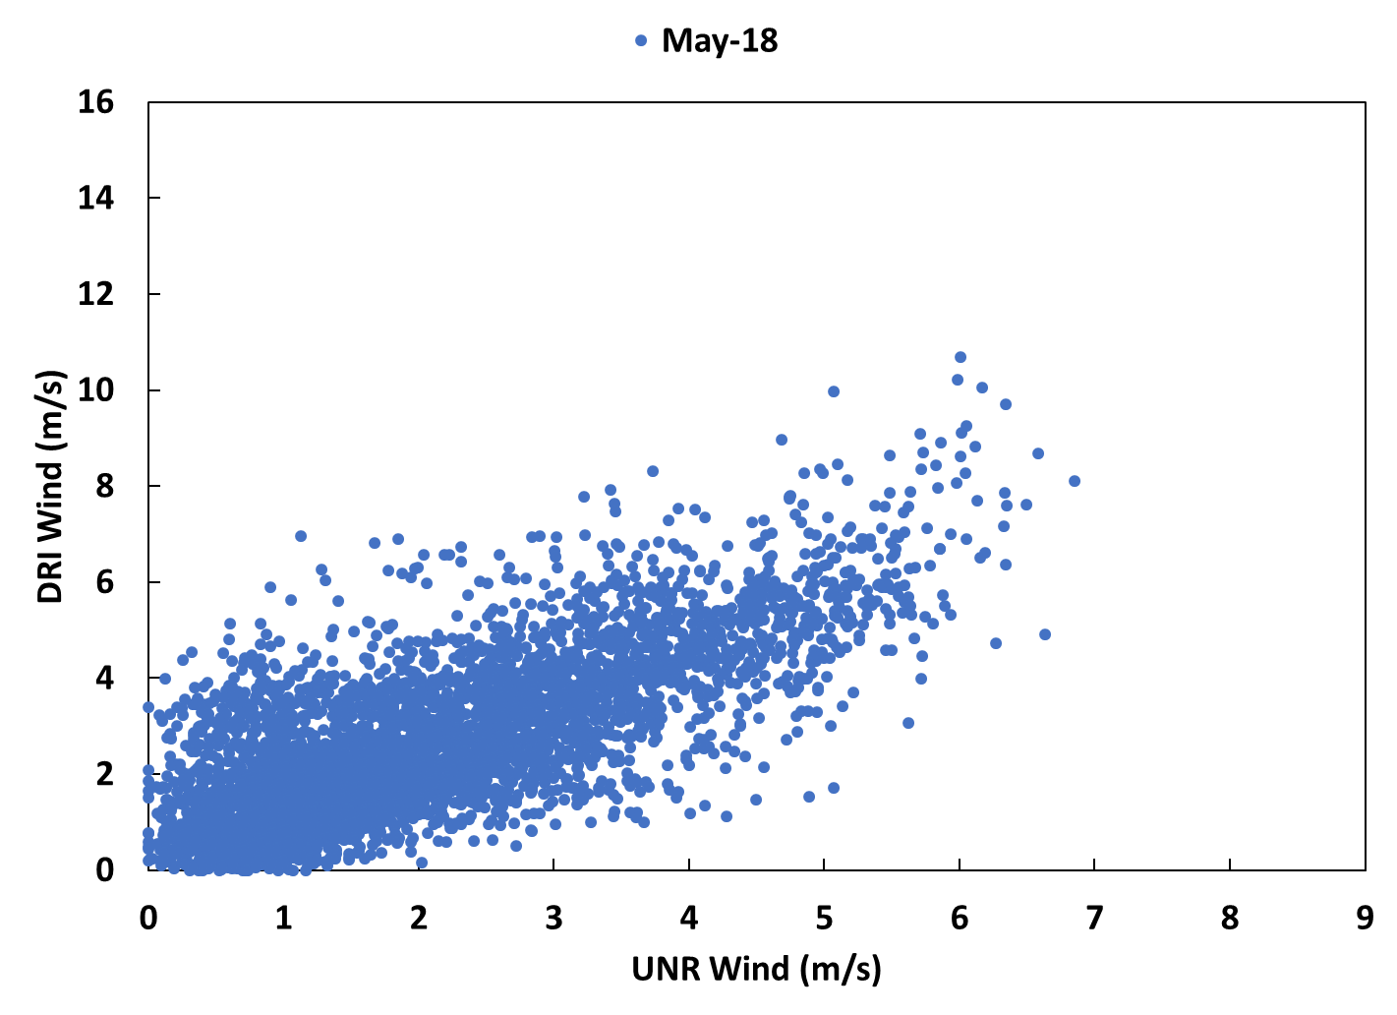
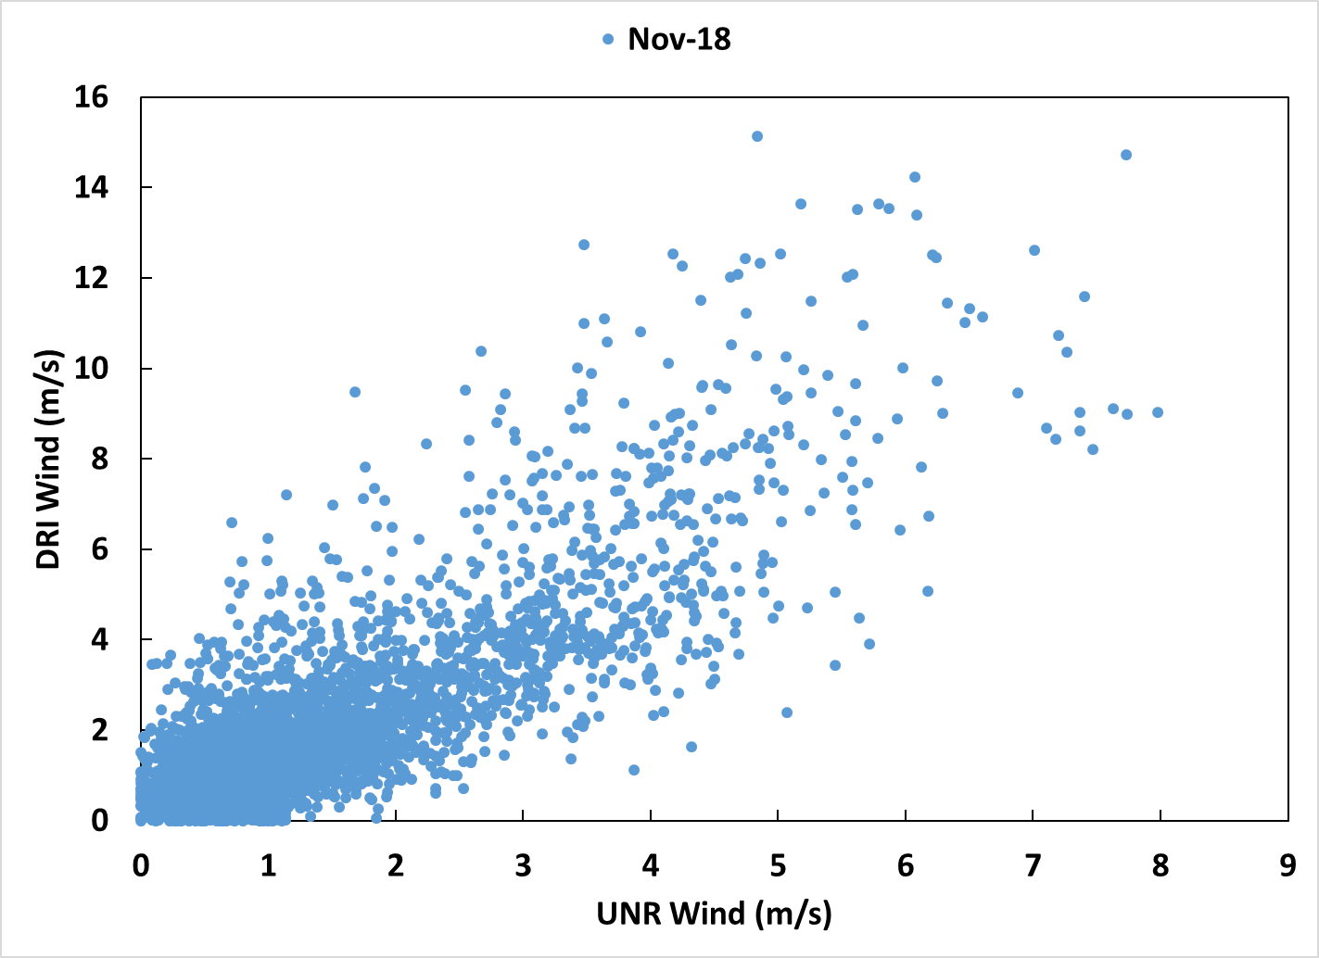
Unr vs. DRI wind speed
May 2018
November 2018

Slide 14
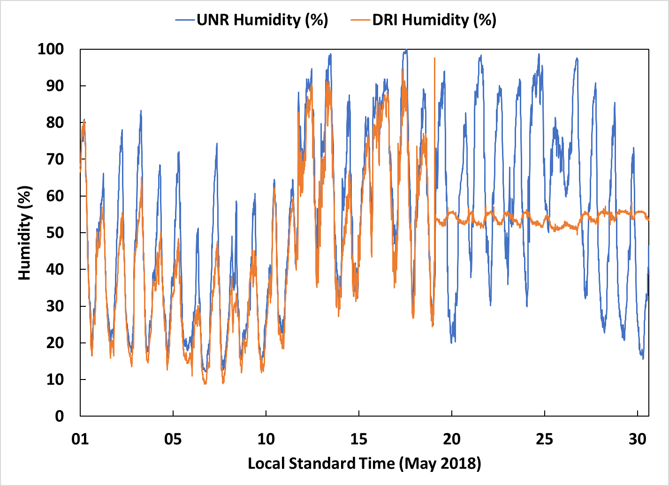
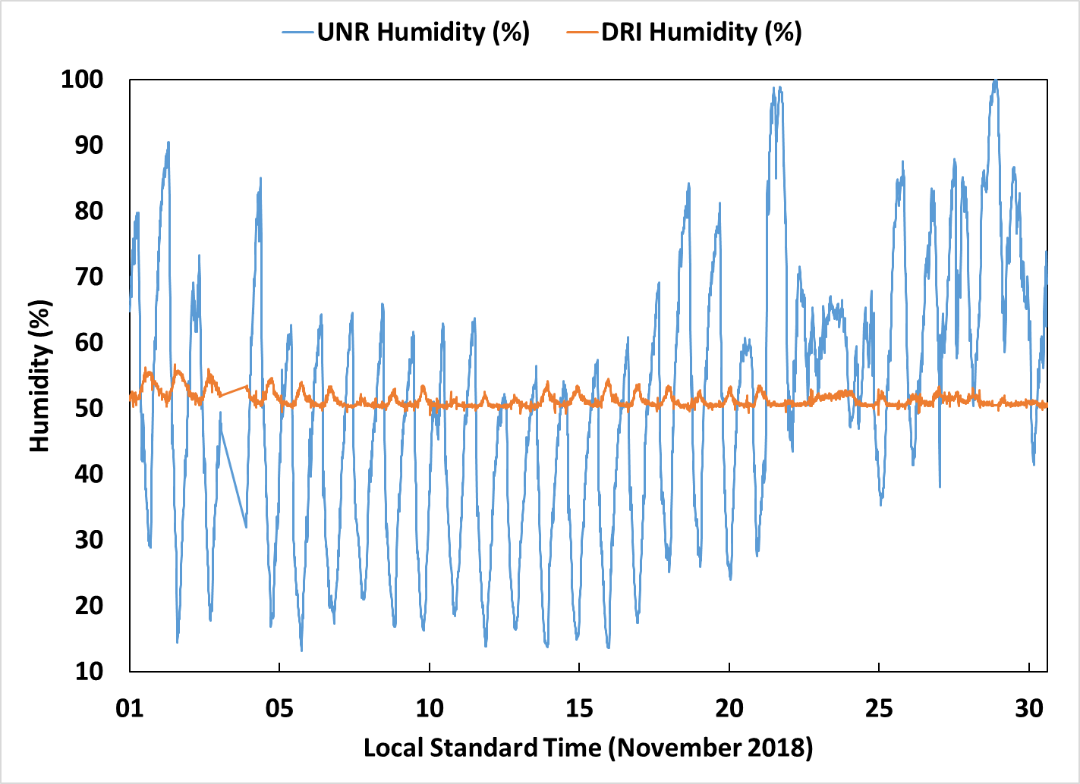
Humidity…?
May 2018
November 2018
Notes:
Like temperature and solar radiation, water vapor plays an important role in many thermal and photochemical reactions in the atmosphere. As water molecules are small and highly polar, they can bind strongly to many substances. If attached to particles suspended in the air they can significantly increase the amount of light scattered by the particles (measuring visibility). If the water molecules attach to corrosive gases, such as sulfur dioxide, the gas will dissolve in the water and form an acid solution that can damage health and property.
Water vapor content of air is reported as a percentage of the saturation vapor pressure of water at a given temperature. This is the relative humidity. The amount of water vapor in the atmosphere is highly variable—it depends on geographic location, how close water bodies are, wind direction and air temperature. Relative humidity is generally higher during summer when temperature and rainfall are also at their highest.
“Relative humidity may reach the same levels in both summer and winter, even reaching up to 100 per cent saturated. Relative humidity, though, is simply a measure of how much water the air is holding at any time, compared to how much it can hold. How much water the air can hold, though, depends on the air's temperature.
High relative humidity during the summer already puts stress on our bodies. When we're out in the summer heat, our bodies attempt to cool down by sweating, but this method is only effective as long as the relative humidity is low enough that the sweat evaporates. With higher humidity, the sweat lingers. At best, it makes for a sticky, uncomfortable time and likely a very poor night's sleep. At its worst, it can lead to heat stress, heat exhaustion, and even heat stroke.
The greater amount of moisture in the air during the summer also has a direct impact on air quality, though.
In an email to The Weather Network, Umme Akhtar, a Regional Air Quality and Health Specialist with Health Canada, said "in summer, higher relative humidity favours the formation of both inorganic and secondary particulate matter. Thus, higher relative humidity can cause more or prolonged smog episodes in summer."
So, while ozone is usually the primary concern for summer smog, due to the more intense sunshine, whenever humidity values start to climb, fine particulate matter concentrations rise, as well.
According to Akhtar, higher humidity can actually make some types of air pollution even worse. While the added water vapour favours the formation of sulphate aerosols, pollutants such as sulphur dioxide can combine with water vapour to form sulphuric acid.”

Slide 15
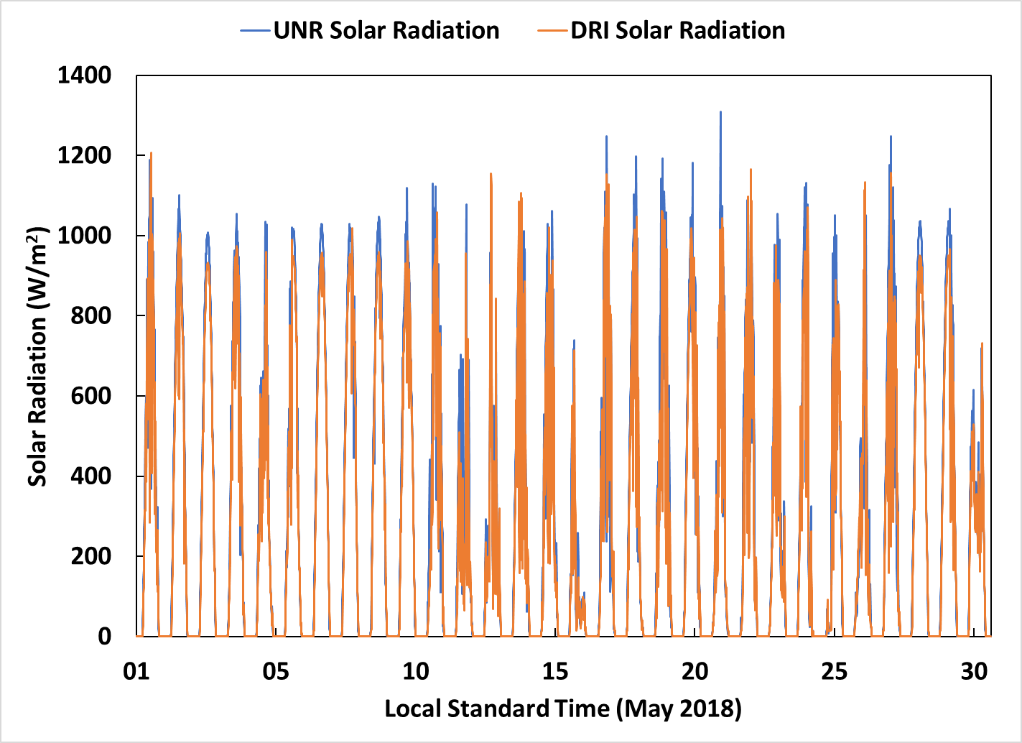
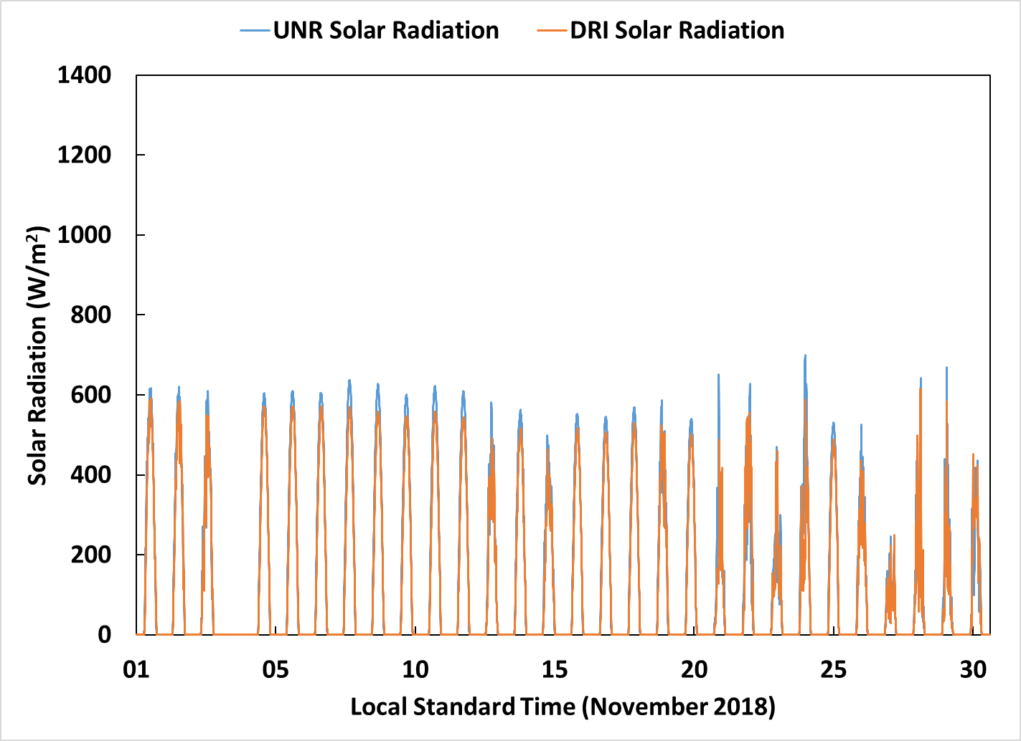
Solar Radiation
May 2018
November 2018
Notes:
It is important to monitor solar radiation for use in modelling photochemical smog events, as the intensity of sunlight has an important influence on the rate of the chemical reactions that produce the smog. The cloudiness of the sky, time of day and geographic location all affect sunlight intensity. An instrument called a pyranometer measures solar radiation from the output of a type of silicon cell sensor.
“Scientists have found that the air pollution absorbs and disperses sunlight and thereby reduces the amount that reaches the Earth’s surface. The latest study, published in Advances in Atmospheric Sciences on Aug 20, 2019 also reports that the smaller the particles, the more harmful the impacts are.

Slide 16
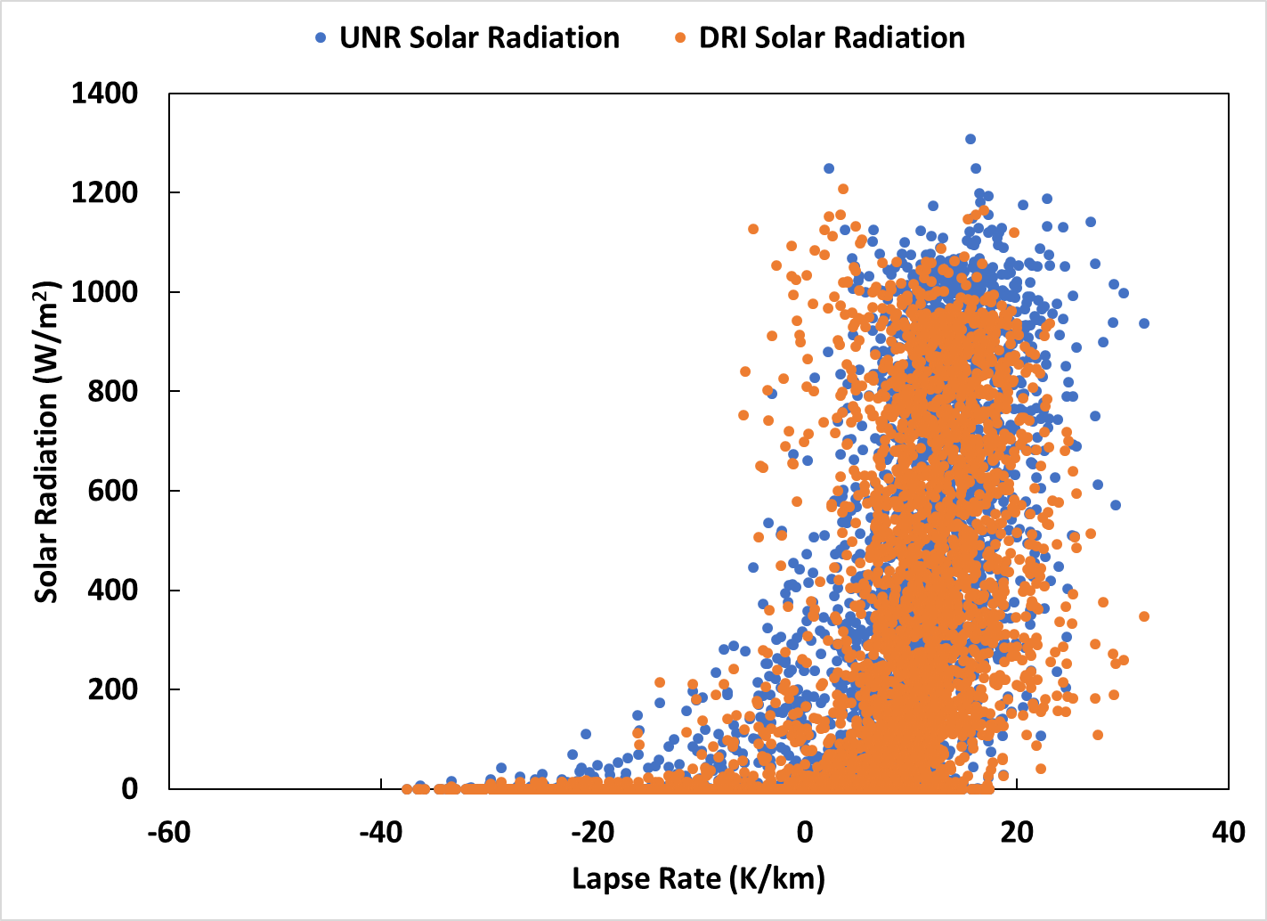
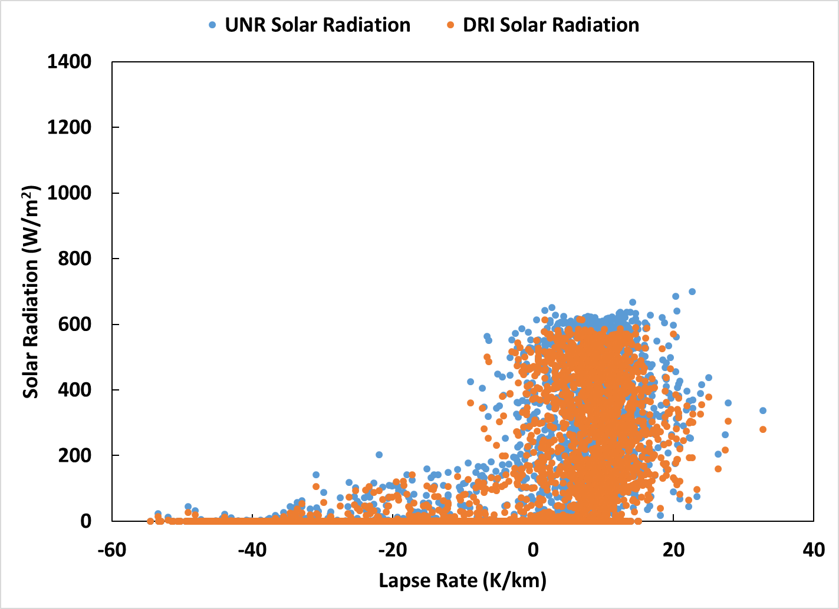
Solar Radiation Versus Lapse Rate
May 2018
November 2018
Notes:
China is the world’s largest producer of photovoltaic (PV) power, the power that is generated from solar panels. At the same time, however, East Asia, especially China, has become one of the most populated and rapidly developing regions in the world over the past several decades. This is because the ever-growing population and human activity have led to a rapid and continued increase in the emission of aerosols and their precursors such as condensation gases. A key precursor gas is sulfuric acid that is produced in the atmosphere by degradation of fossil fuel combustion, volcanoes,and other sources. Other precursor gases originate from degradation of byproducts created by living organisms as well as emissions.
The researchers report that the ratio of scattered radiation to global radiation increases with the increase in air pollution levels, meaning that less sunlight is actually reaching the Earth’s surface. They find that an increased amount in particulate matter prevents the direct incidence of solar radiation to the surface of the Earth and improves the ability of solar radiation in the polluted atmosphere to scatter away. In addition, the variation of scattered radiation is dominated by fine particles, and coarse particles have little effects.
The next step is to collect long-term data at different observational sites and analyze the data under both clear and cloudy skies, emphasizing the relations between impurities, clouds and radiation. “Our ultimate goal is to understand processes related to aerosol, cloud and radiation, and develop measurable parameters to improve climate and weather prediction models,

Slide 17
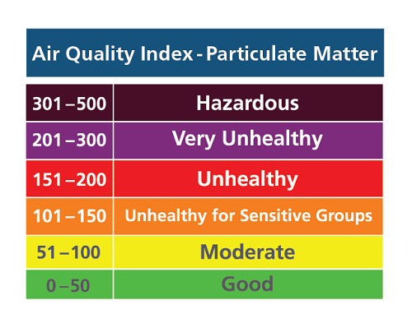
Conclusion
One variable cannot explain the big picture.
Large variety in lapse rate and wind speed
More severe during winter but relevant in summer as well.
Higher humidity values during summer also poses concern.
Would like to compare to AQI values in the future.
Also, comparing more atmospheric data (Possibly
(other dates/time periods).
Notes:
Humidity affects air quality in a few ways
Bacteria and viruses that cause respiratory infections thrive in extremely high and extremely low humidity.
Mold spores, dust mites and other allergens survive best in high humidity environments.
Higher humidity can increase the levels of noxious chemicals in the air, which may include ozone and formaldehyde.
High humidity can also make warm temperatures feel even warmer, leading to an increase in heat-related illnesses like heat rash, muscle cramps, heat exhaustion, and even heat stroke.

Slide 18
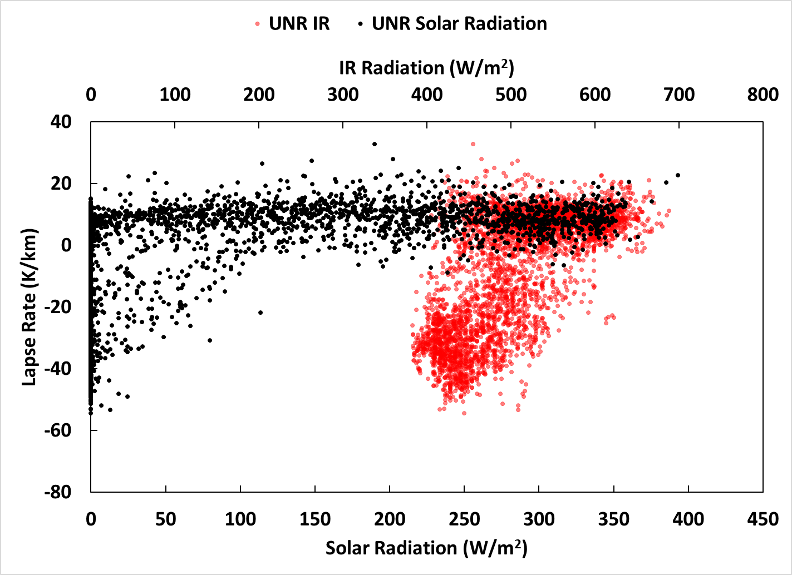
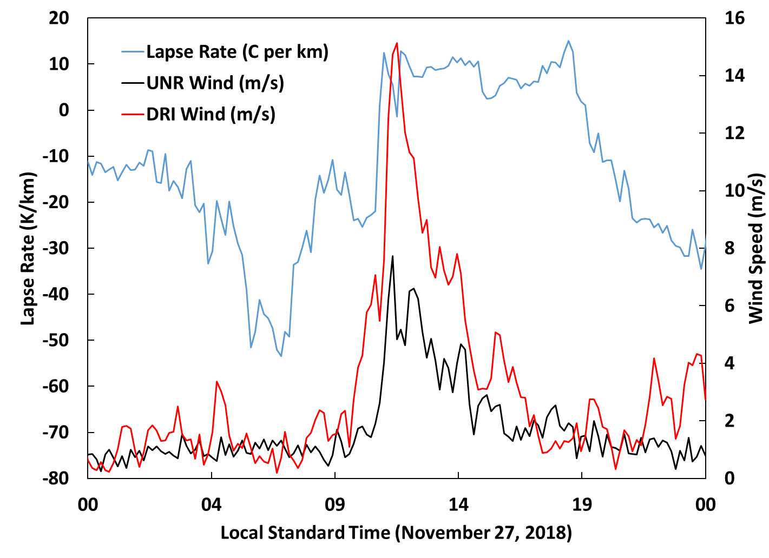
Extra Slide
November 2018
November 27, 2018

Slide 19

Stability
Environmental Lapse Rate
$$Γ=−\frac{dT}{dZ}$$
Dry Adiabatic Lapse Rate
$$Γ=−\frac{dT}{dZ}=\frac{g}{c_{p}}=\frac{9.8℃}{m}$$
Saturated Adiabatic Lapse Rate
$$Γ=g\frac{1+\frac{H_{v}r}{R_{sd}T}}{c_{pd}+\frac{H_{v}^{2}r}{R_{sw}T^{2}}}$$
Notes:
The Earth’s temperature change can vary as altitude increases, but in terms of weather and cloud formation, we will focus on the troposphere where most of the world’s weather takes place.
This continuous decline in temperature with increasing altitude at a given time and location is called the atmosphere’s Environmental Lapse Rate as shown.
There are two main explanations: the warmth rising from the surface and the air becoming insufficiently diluted with altitude. Dilute air indicates less absorption of heat and greater reflectance off the Earth’s surface. This agrees with the previous statement of declining temperatures with altitude.
There are two specific types of ALR. When air is unsaturated, this rate is roughly 10°C per thousand meters and called the Dry Adiabatic Lapse Rate (DALR) and the Saturated Adiabatic Lapse Rate (SALR) is gradually reduced when the air cools with height and water vapor condenses at low latitudes
When higher, air tends to contain less water which in turn has less latent heat to release and becomes about 5°C per thousand meters. Implying the humid air rising remains unstable much longer compared to rising dry air

