Slide 1

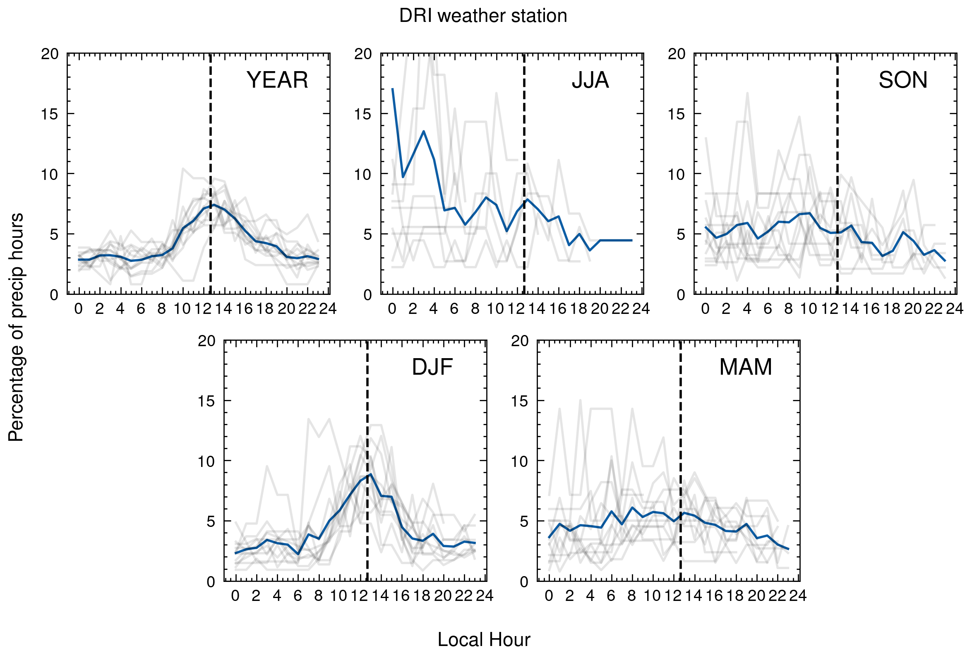
Data – Precipitation: By Ludving Cano, Atmospheric Sciences Grad Student
DRI manages an AWS at Reno Campus. It reports precipitation every 10 minutes.
But after thinking better, this may be because of the gauge itself
In the months of major precipitation in Reno looks like a peak

