Slide 1
Evaluation of the WS-5000 for Wind, Pressure, Solar Radiation, and Temperature Measurements
ATMS 360 Class
April 2025
Contact Pat Arnott for questions.
Goals:
Learn about weather stations and meteorological measurements
Discuss measurement accuracy and precision
Evaluate performance of a new, inexpensive, wireless (convenient) weather station with comparison to data from an established 3D Anemometer (RM Young) and UNR weather station data.

Slide 2
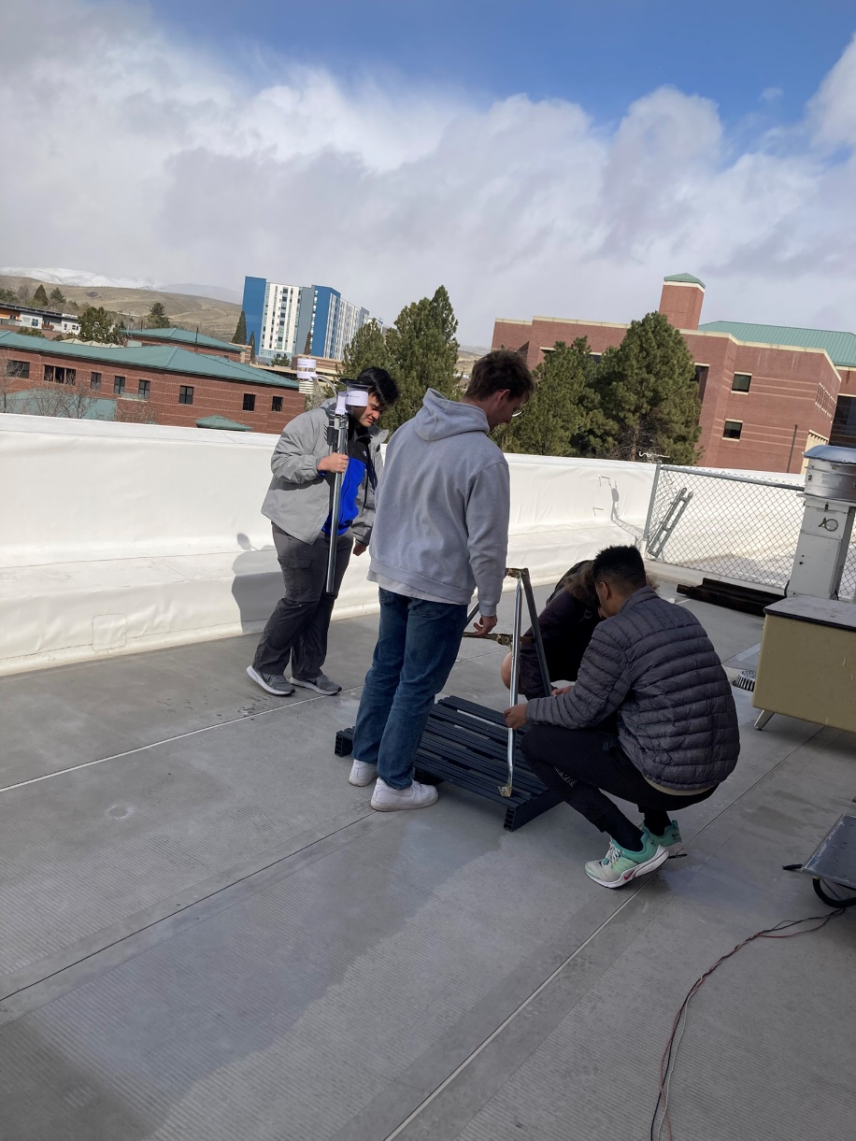
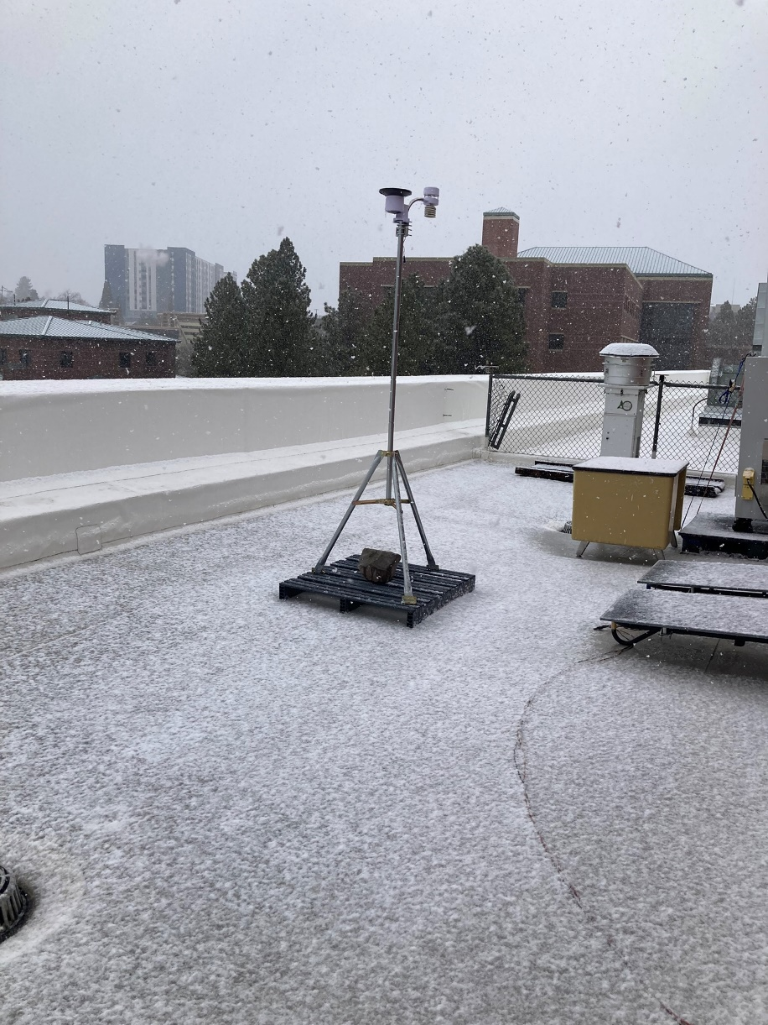
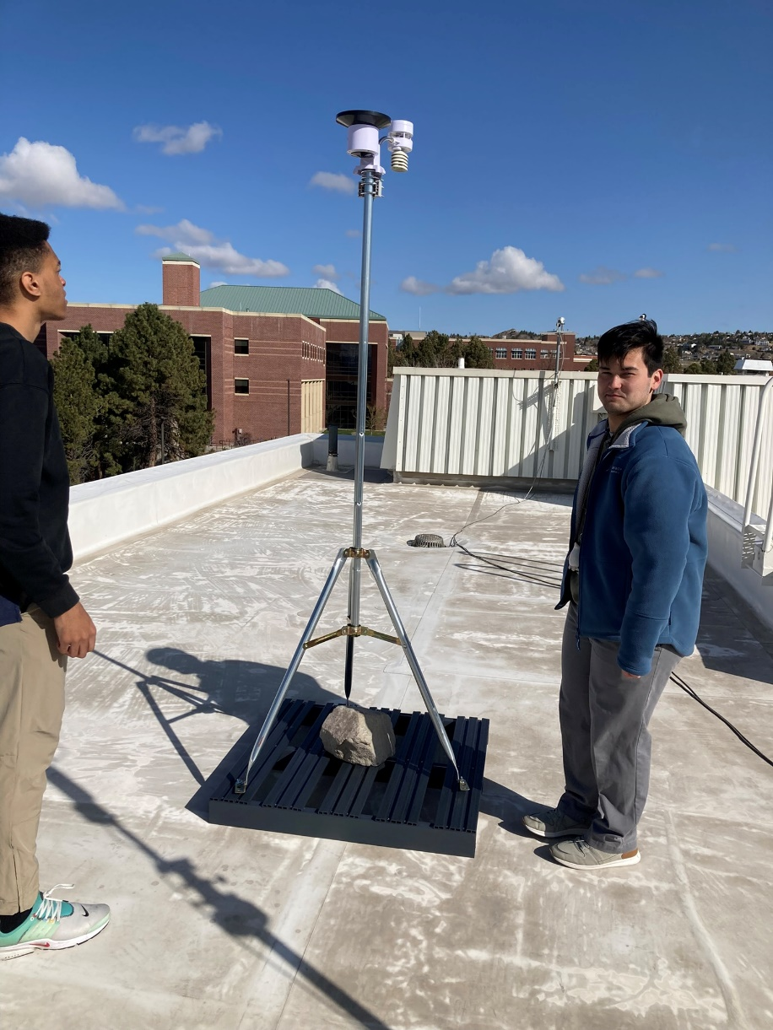
Photos
Setting up the WS5000 on the 4th floor roof.
Testing the WS5000 on the 4th floor roof, looking to the Northwest. Snow was falling.
Moved the WS5000 to the 5th floor roof to be near the 3D sonic anemometer.

Slide 3
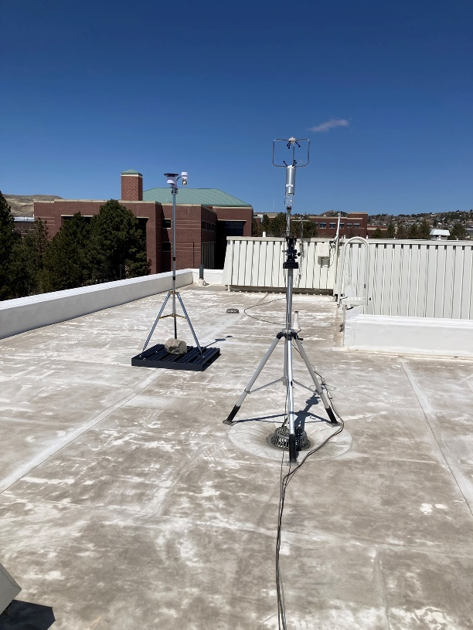
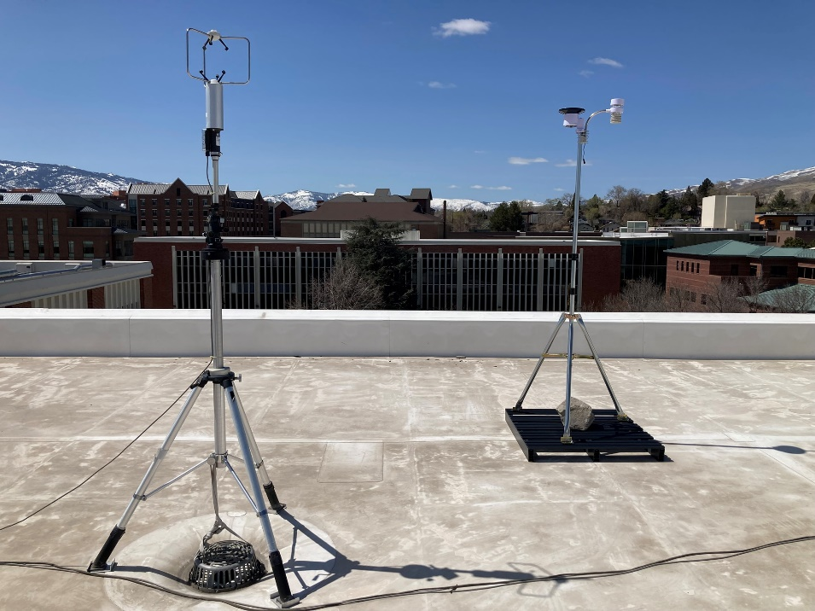
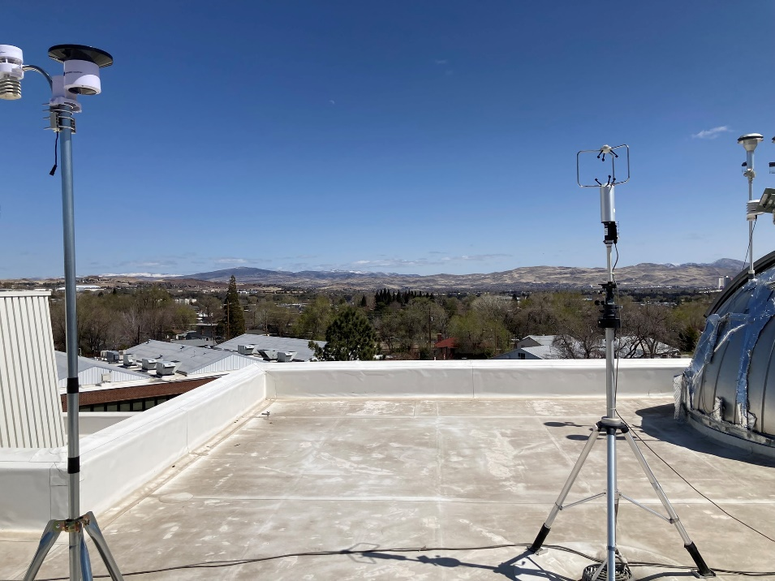
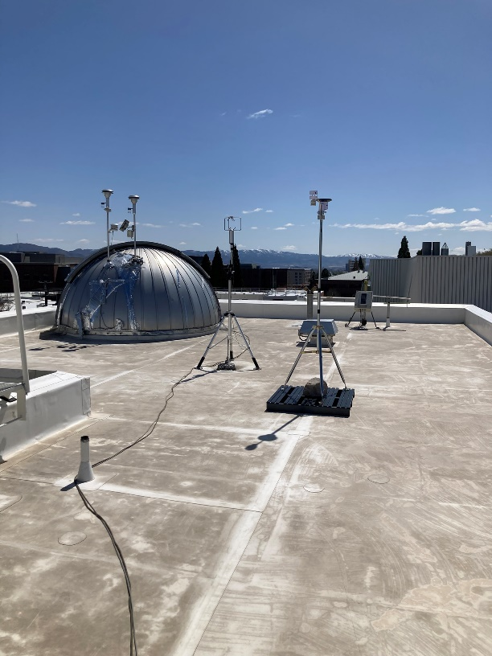
Photos Continued
Looking to the north
RM Young Sonic Anemometer
WS5000
Looking to the south
Anemometers looking to the west
Anemometers looking to the east

Slide 4
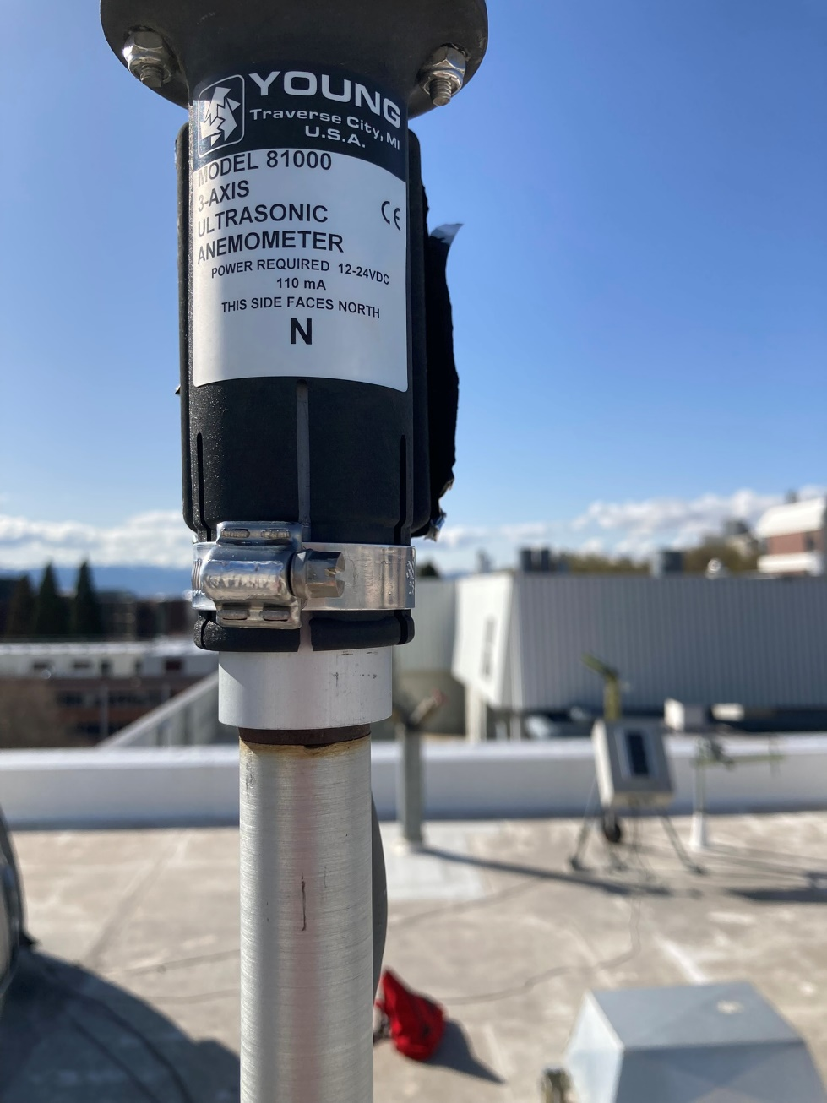
Photos Continued
RM Young Sonic Anemometer

Slide 5
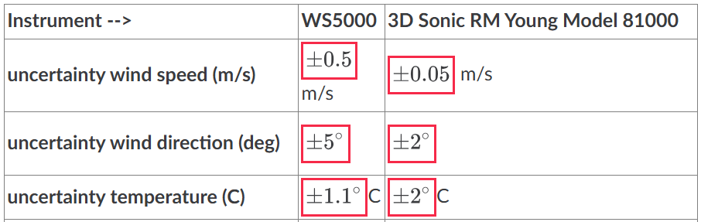
Weather Station and Sonic Anemometer Specifications

Slide 6
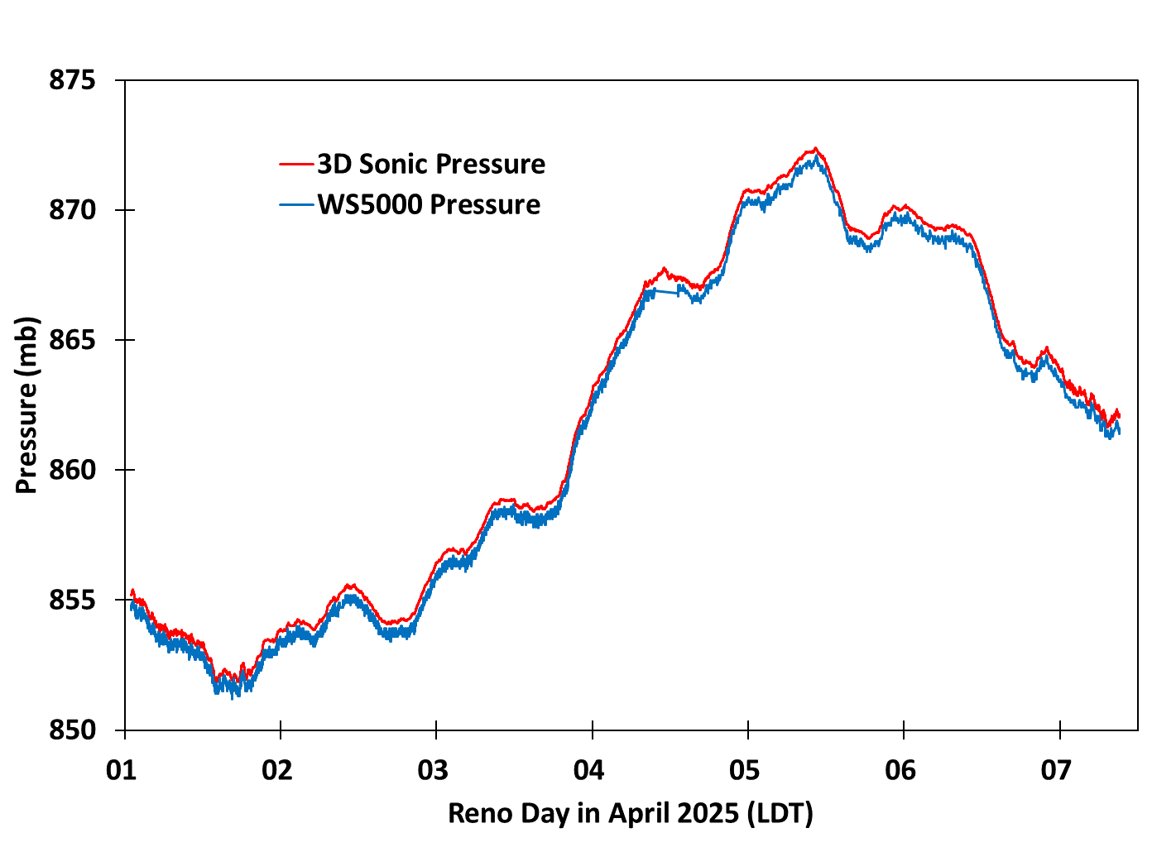
Pressure Measurements
High Pressure, Fair Weather
Stormy
Variable weather allowed for a good comparison of weather station data.

Slide 7
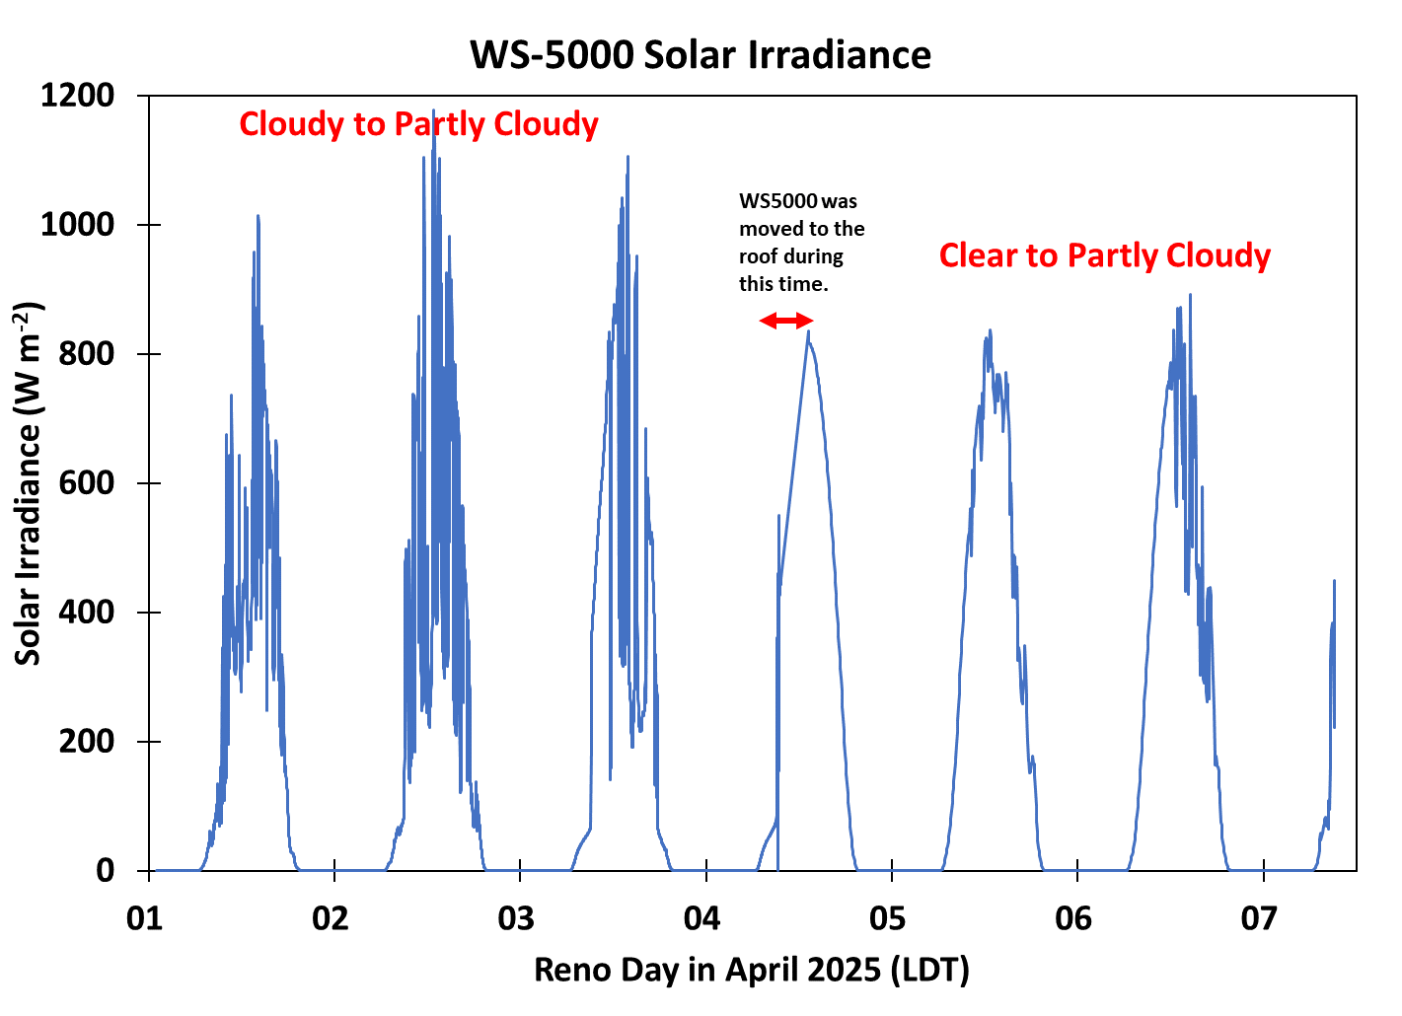
Solar Radiation from the WS5000

Slide 8
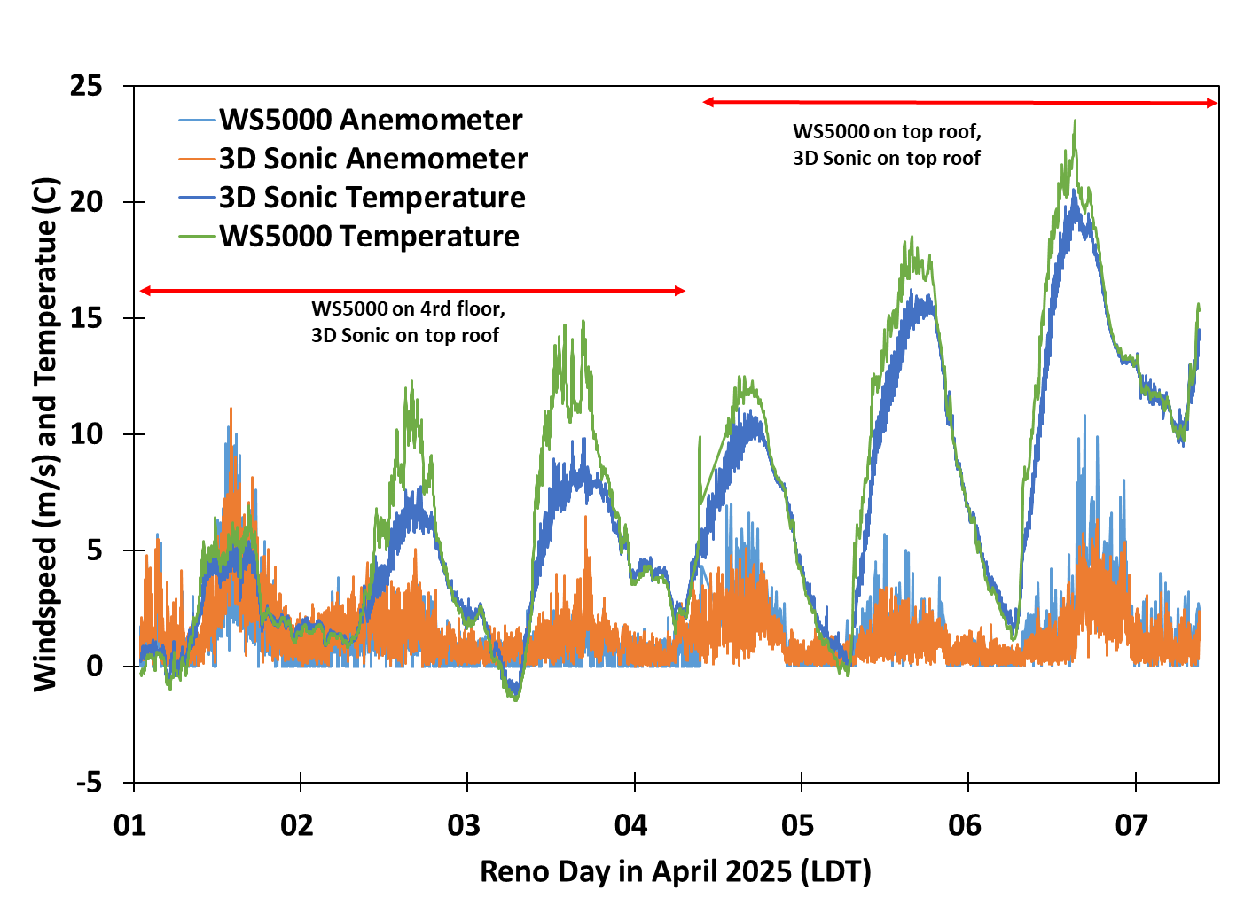
Wind Speed and Temperature Measurements
The WS5000 seems to be heated by sunlight during the day. Night time and cloudy are very similar.
2 C

Slide 9
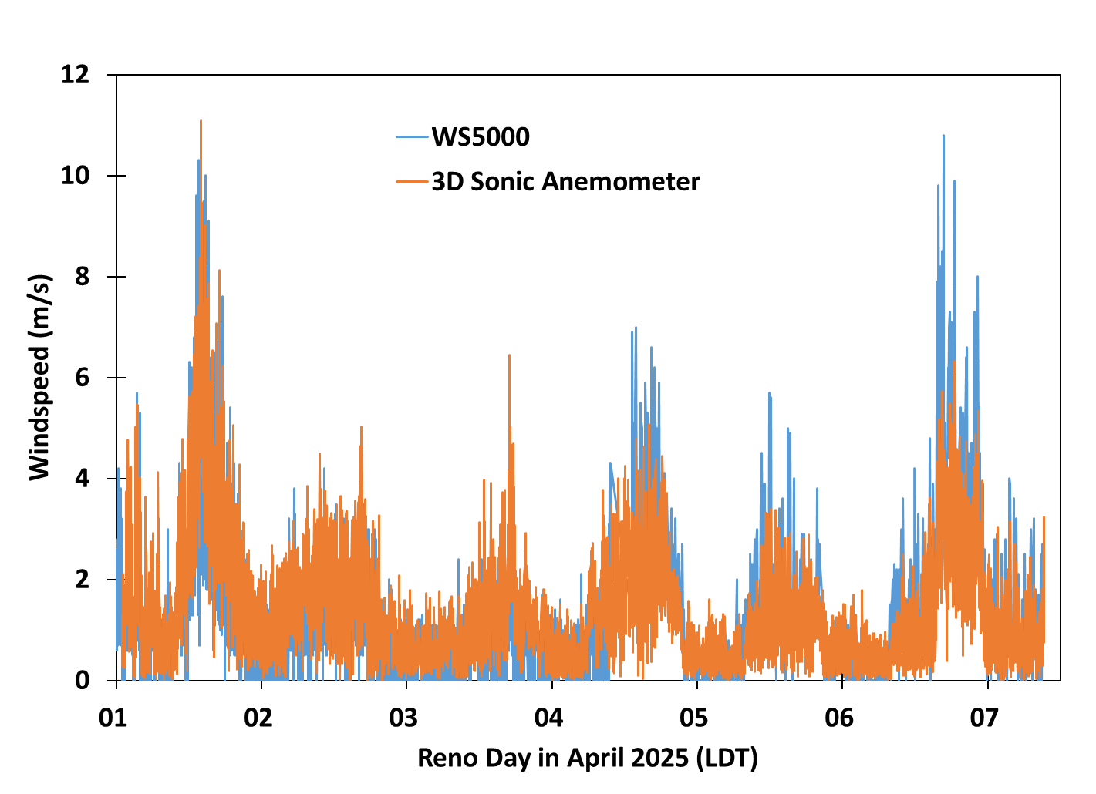
Windspeed Measurements
At this level of study, they both are responding similarly to wind speed.

Slide 10
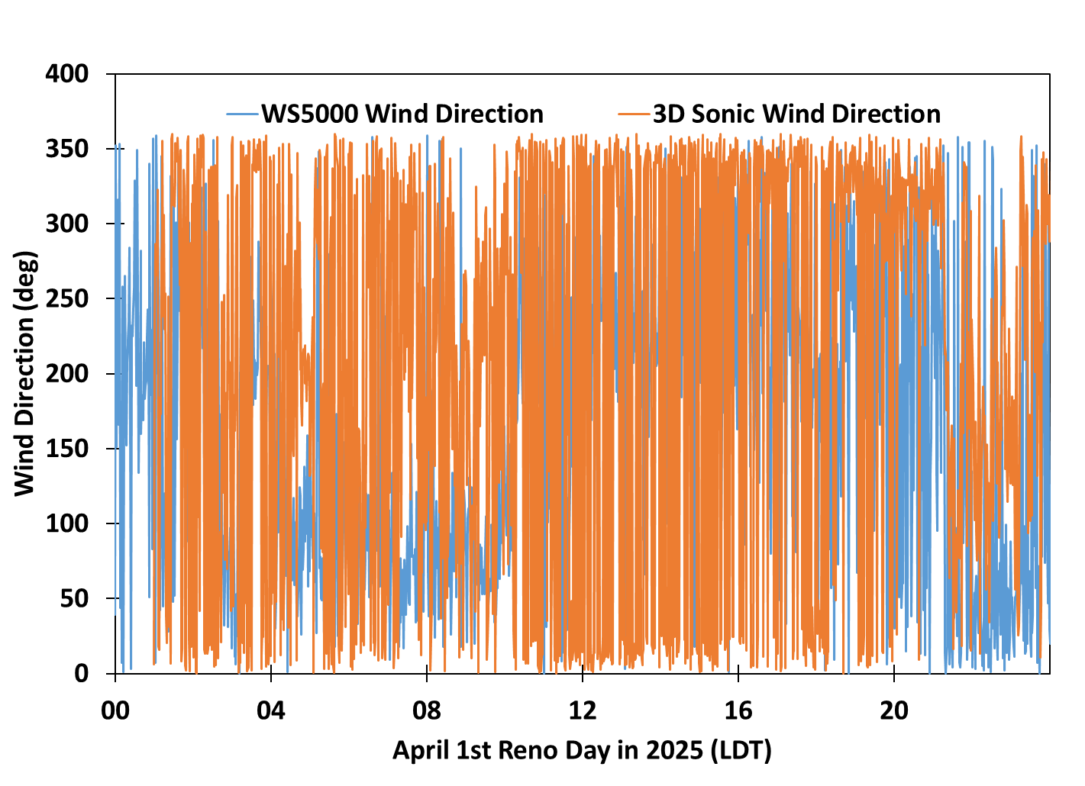
Wind Direction Measurements
Wind direction is difficult to judge in time series graphs.

Slide 11
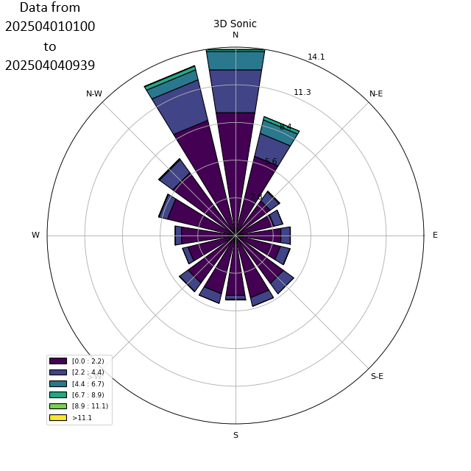
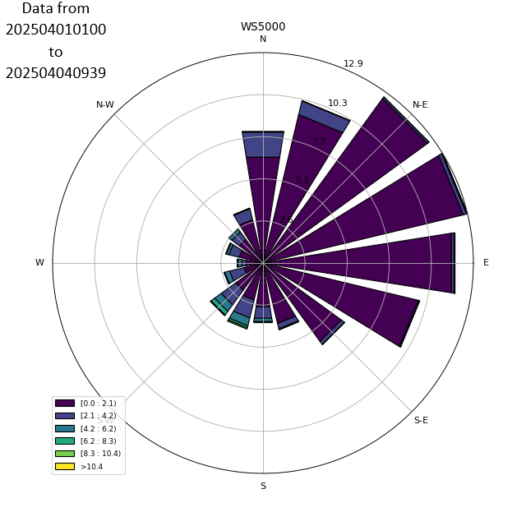
WS5000 on 3rd Floor, 3D Sonic on 4th Floor
Wind directions are quite different. Maybe because they are on different floors?
3D Sonic 4th Floor
WS5000 3rd Floor
1 minute Data
1 minute Data

Slide 12
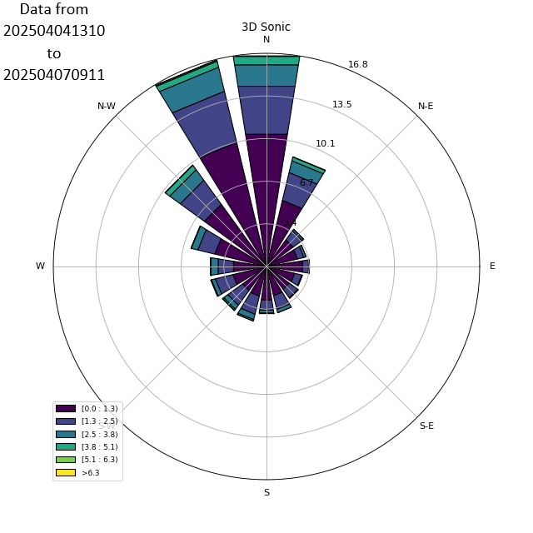
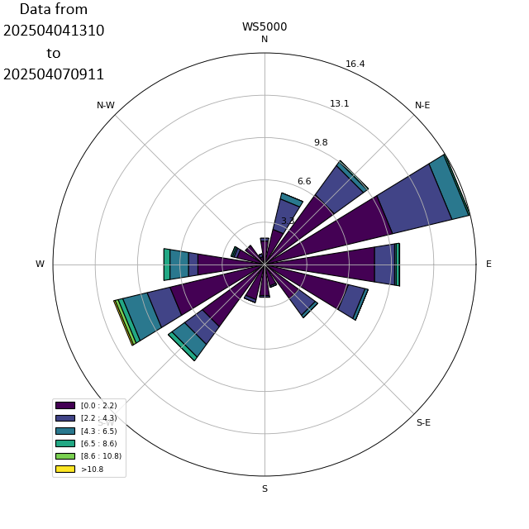
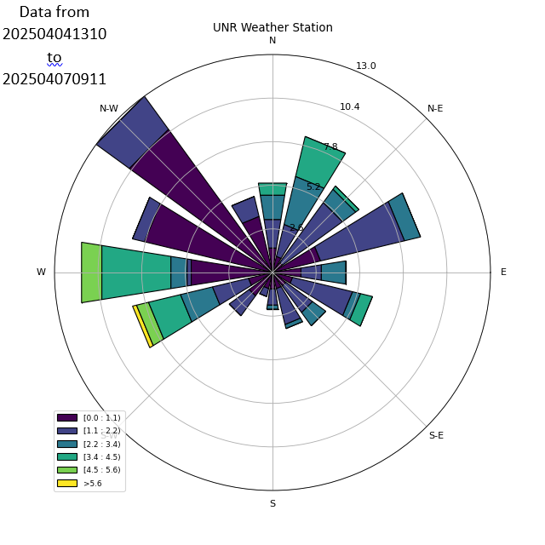
WS5000 on 3rd Floor, 3D Sonic on 4th Floor
1 minute Data
5 minute Data
10 minute Data
3D Sonic 4th Floor
WS5000 4th Floor
UNR Weather Station Valley Road
Wind directions are quite different even when close to each other. The UNR weather station is 1.5 km east of campus, and is about 100 meters lower than the other sensors.

Slide 13
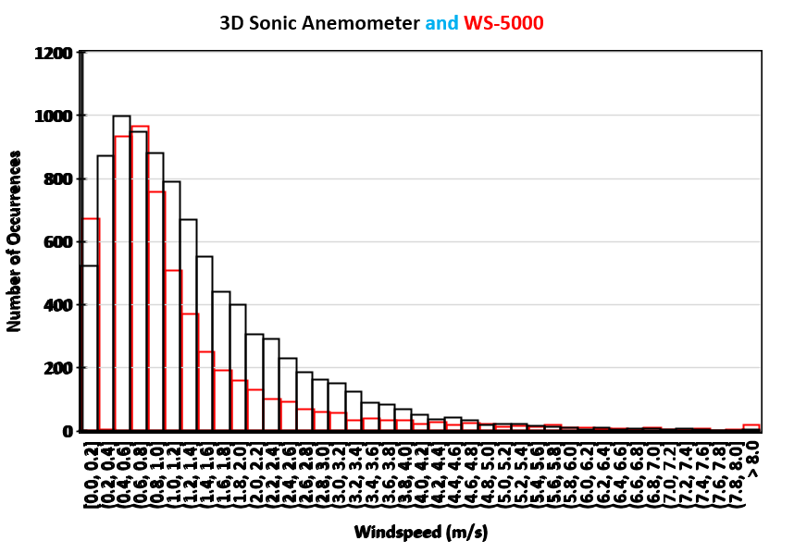
All Data Including Lower Level

Slide 14
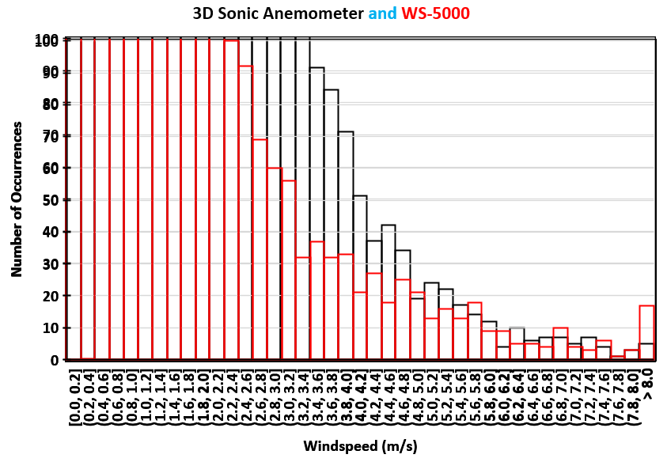
All Data Including Lower Level

Slide 15
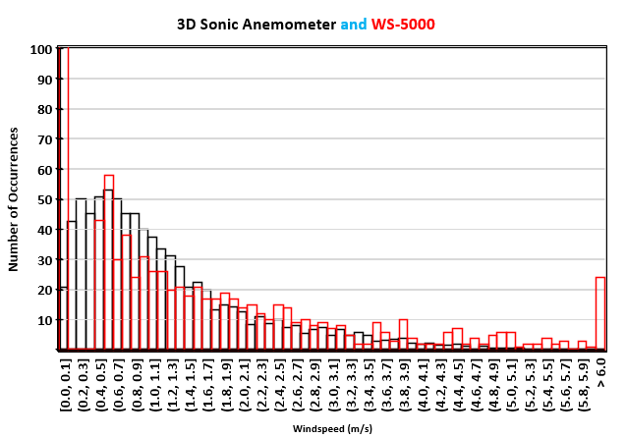
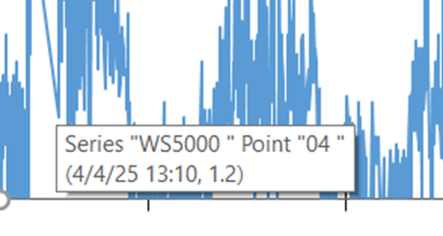
Side by side comparison: WS 5000 was doing 5 minute data and 3D Sonic was 1 minute data.
Note: The 3D sonic anemometer has a lower level of detection of 0.01 cm/s.
The WS5000 has a lower level of detection of 0.4 m/s, not great for the lowest wind speeds.
The WS-5000 reset to 5 minute averages when we moved it upstairs. The number of occurrences were scaled to match that.

Slide 16
Summary
The WS5000 wind speed measurement for wind about 0.4 m/s seems accurate enough for use.
Wind direction comparisons with the WS5000 and the RM Young 81000 sonic anemometer (3D Sonic) don’t agree well, though more measurements are needed with both sensors reporting data at 1 minute intervals.
The 3D Sonic measures at 10 Hz and 1 minute averages are provided.
The WS5000 appears to average data for 5 seconds and report that as the 1 minute or 5 minute time average, likely to allow it to be solar-charged and battery powered and not with the microcontroller busy all the time.
The temperature sensor in the WS5000 seems to suffer from being solar heated.
The cost of the WS5000, tripod, and mounting pallet is about $600.

