Slide 1
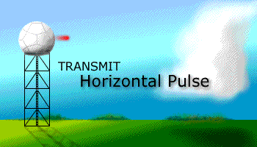
Radar Meteorology
Purpose:
Explain the basic principles of radar. What is dbz? This is related to the power backscattered by hydrometeors.
Explain how radar can be used to measure the fall speed of hydrometeors and the wind direction.
Discuss the NEXRAD radar used by the National Weather Service.
Become aware of the advantages and disadvantages of radar.

Slide 2
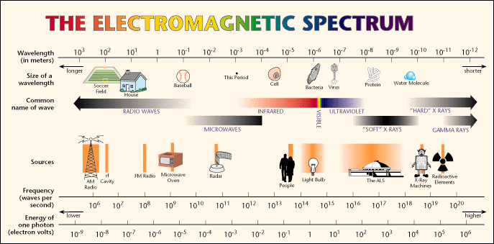
The frequency of the em wave used depends on the application. Some frequencies travel through clouds with virtually no attenuation.
ALL em waves move at the speed of light

Slide 3
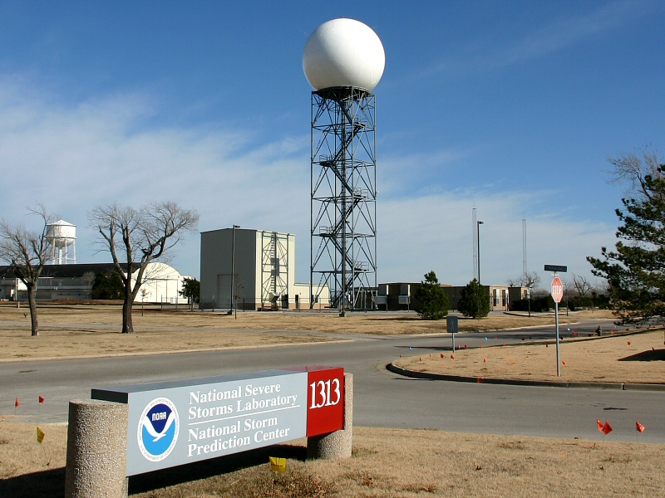
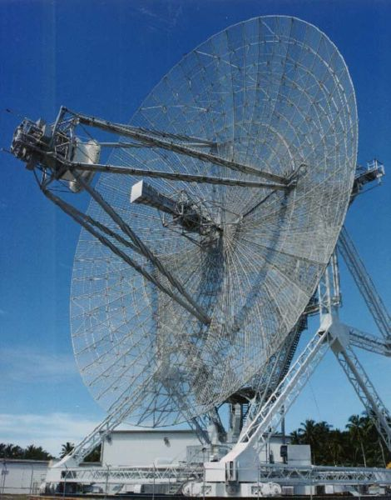
Definitions
RADAR is an acronym. RAdio Detection And Ranging.
Advanced Research Project Agency (ARPA) Long-range Tracking and Identification Radar (ALTAIR). Ballistic Missiles and Space Surveillance (military).
NEXRAD Weather Radar

Slide 4
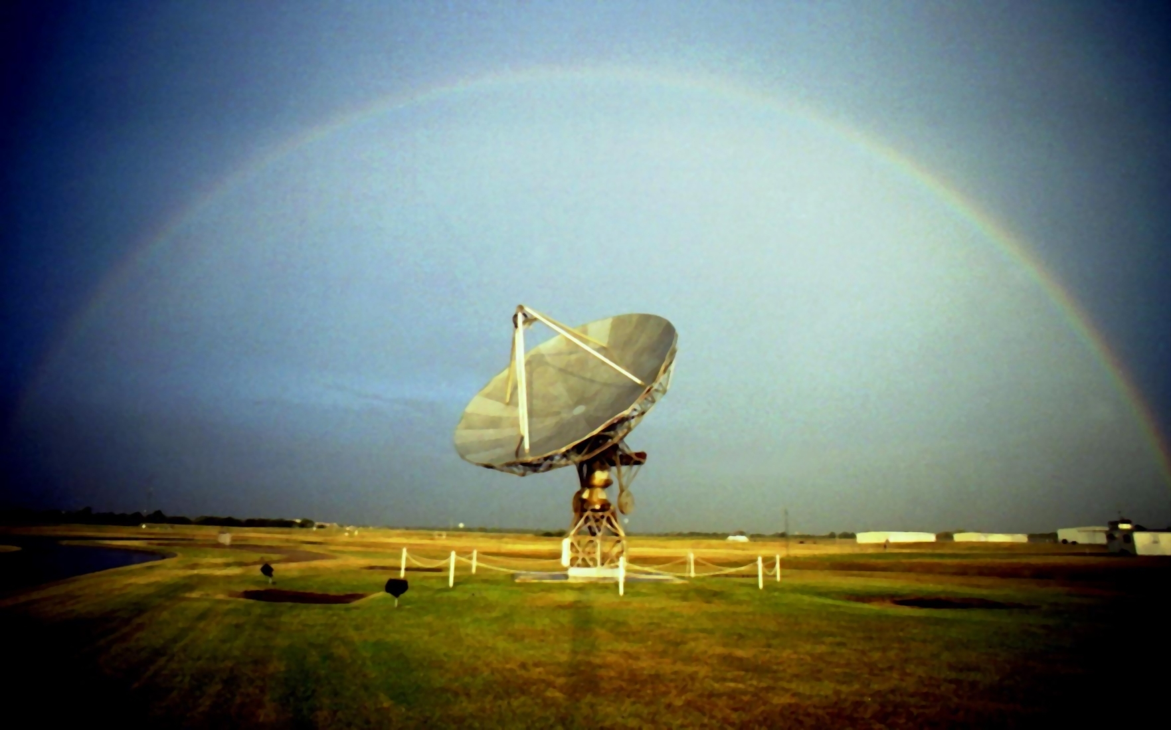
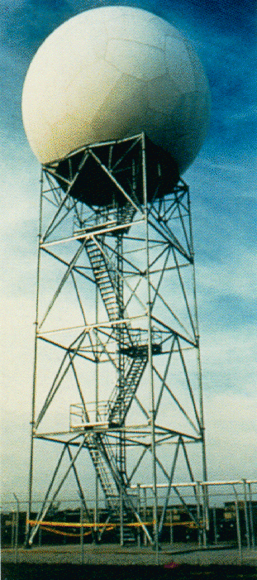
NEXRAD RADAR: What’s in the dome
Dish diameter 9.1 m, 30’. Rotates and tilts to scan 360 deg.
https://en.wikipedia.org/wiki/NEXRAD

Slide 5
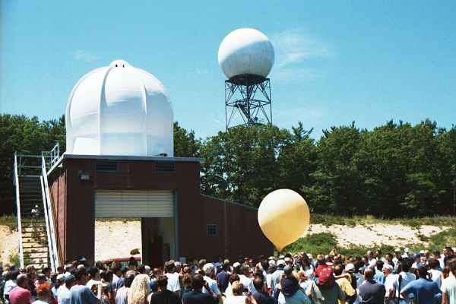
NEXRAD RADAR
NEXRAD (background) and weather balloon launch facility.

Slide 6
NEXRAD RADAR
Named WSR-88D
Weather surveillance radar, 1988, doppler
S-band radar
Radiation wavelength is λ = 10.7 cm
Power is 750 kW
  Can be damaged by winds and lightning strikes

Slide 7
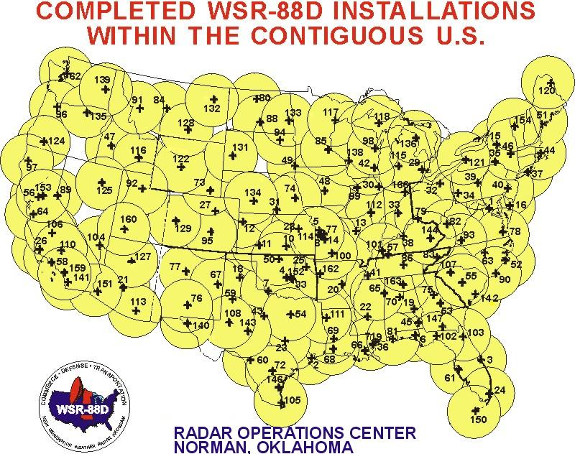
NEX RAD SITES IN THE U.S.

Slide 8
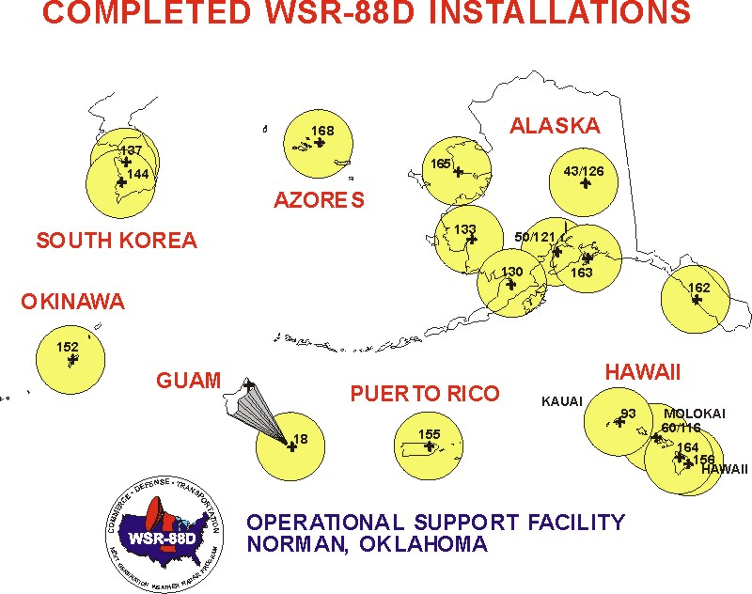
NEXRAD SITES IN THE OUTSIDE OF THE CONTINENTAL US.

Slide 9
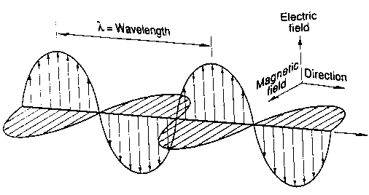
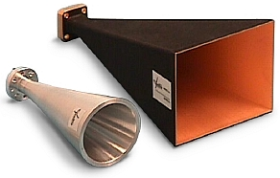
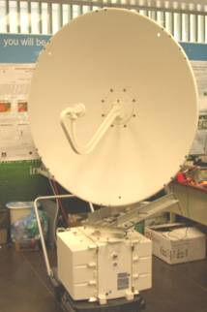
Antennas
Antenna is a transition passive device between the air and a transmission line that is used to transmit or receive electromagnetic waves.

Slide 10

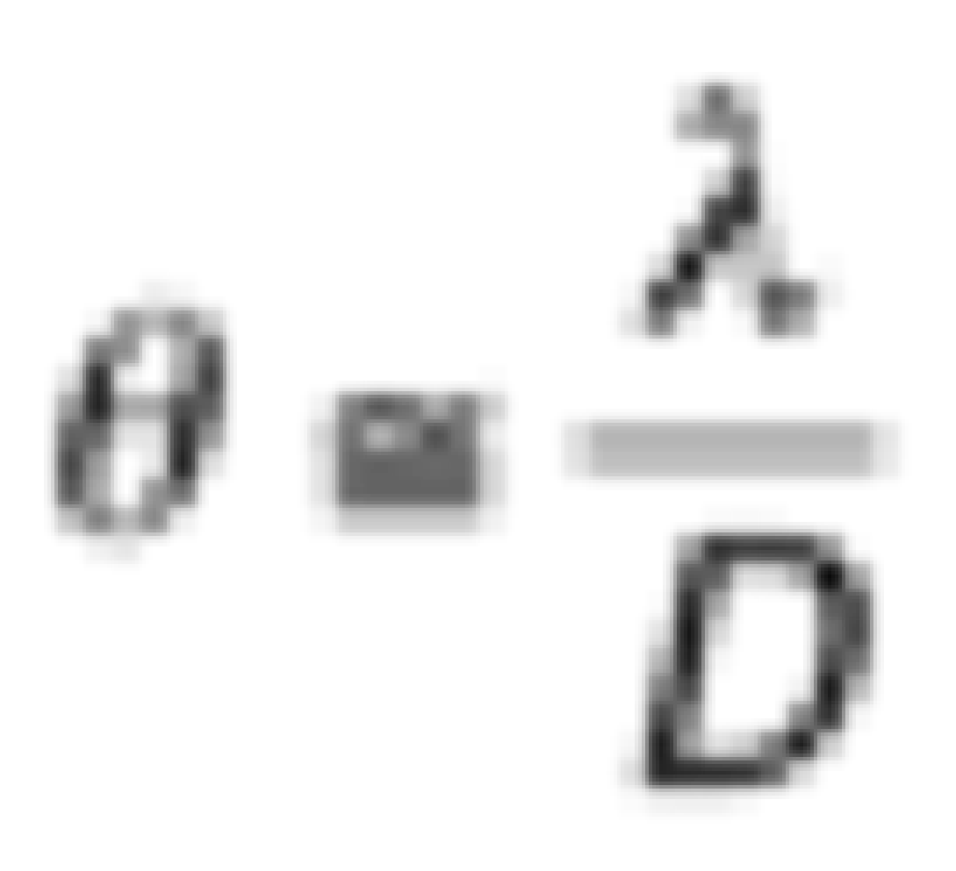
Antenna Beamwidth
radians
D is the antenna diameter
λ is the wavelength of signal in air
Tradeoff:
Small wavelengths (high frequencies) = small antennas
But small wavelengths attenuate more

Slide 11
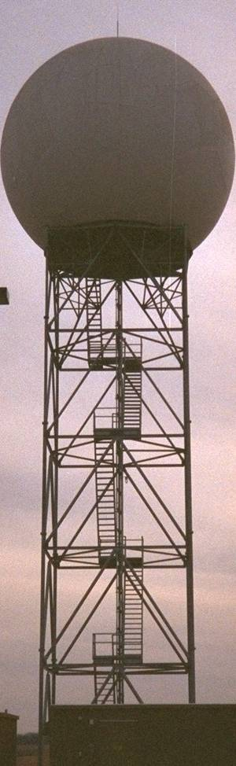
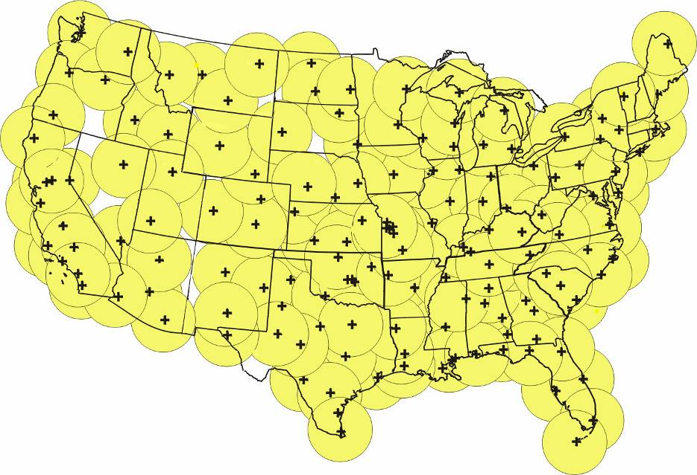
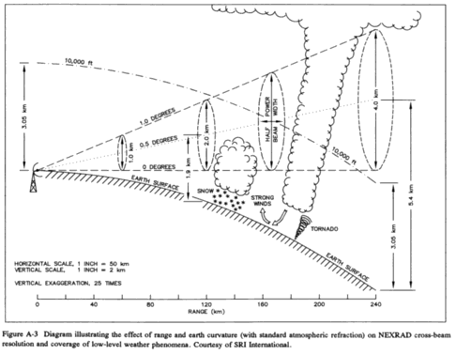
NEXRAD Location Issues
Gap

Slide 12
Radar: The Quickest Path to dbZ, The Quantity Commonly Reported By Weather Radar
Absorption, scattering and extinction cross sections.
Backscattering cross section.
Cross section in the Rayleigh limit (particle diameter is much smaller than the wavelength of the radiation.)
Radar cross section for a particle in the Rayleigh limit.
Radar cross section for N particles in the Rayleigh limit.
Note: Key results are circled by a red box like this. A possible homework assignment is also given by a red box.

Slide 13
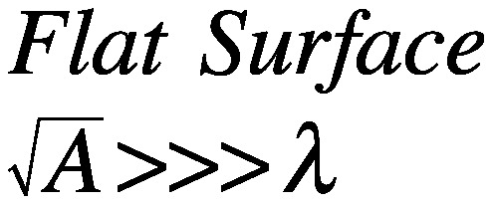
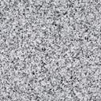
Definitions: Optical Coefficients for a Flat Surface
Sunlight
I₀ (W/m²)
λ
Sunlight
I₀ (W/m²)
λ
Black Surface
Area A (m²)
a = albedo = 0
Absorptance = (1-a) = 1
Arbitrary Surface
Area A (m²)
a = albedo
Absorptance=(1-a)
Power Scattered,
Power Absorbed
P_{sca} = 0
P_{abs} = I₀ A
σ _{abs} = A
Power Scattered,
Power Absorbed
P_{sca} = I₀ A a
P_{abs} = I₀ A(1-a)
σ _{abs} = (1-a) A

Slide 14
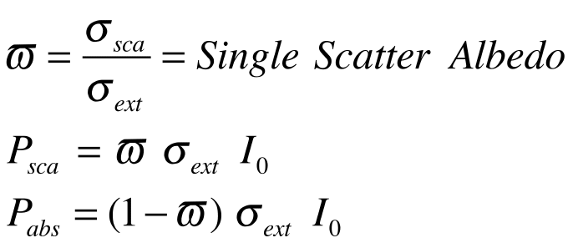
Definitions: Optical Coefficients for a Surface and a Particle
Beam of Sunlight
I₀ (W/m²)
λ
Sunlight
I₀ (W/m²)
λ
Thing (particle, molecule, flea, etc)
Absorption, less light through thing.
Scattering, light redirected by thing.
Arbitrary Surface
Area A (m²)
a = albedo
Absorptance=(1-a)
Power Removed From Beam
I₀ σ_{ext} = P_{ext}
I₀ σ_{abs} = P_{abs}
I₀ σ_{sca} = P_{sca}
Power Scattered,
Power Absorbed
P_{sca} = I₀ A a
P_{abs} = I₀ A(1-a)
σ _{abs} = (1-a) A
σ_{abs}=(1-ω) σ_{ext}

Slide 15
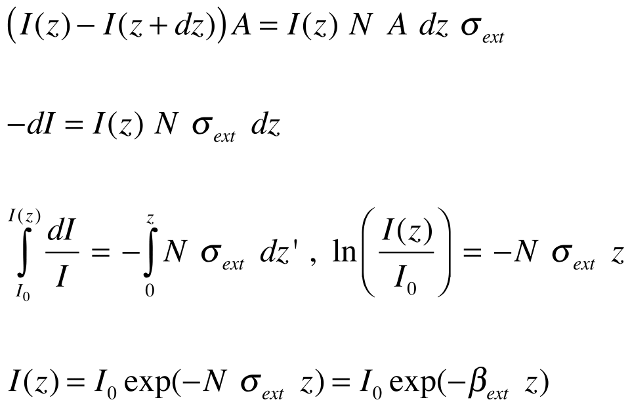
Optics of N identical (particles / volume)
Light beam area = A
z
dz
z+dz
Power removed in dz: = I(z) N A dz σ_{ext}
Bouger-Beer
“law”
(direct beam only!)

Slide 16
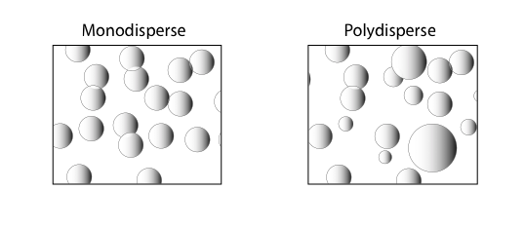
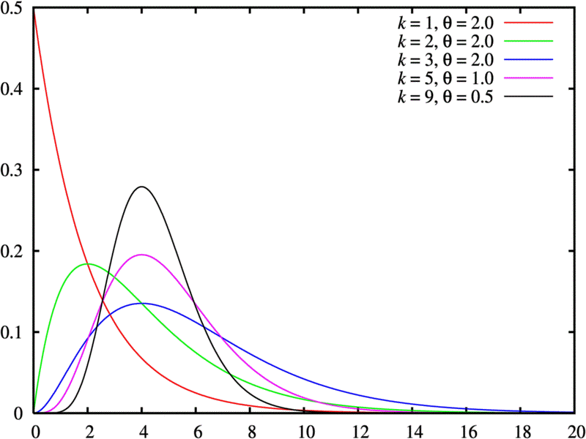
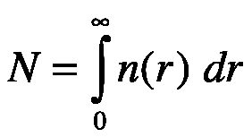
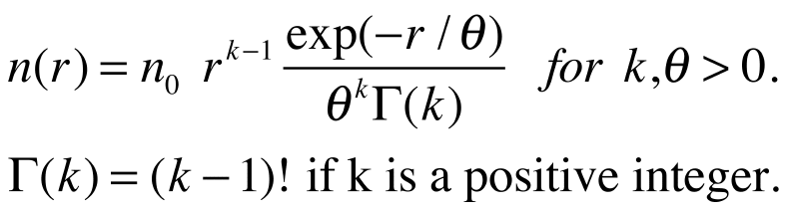

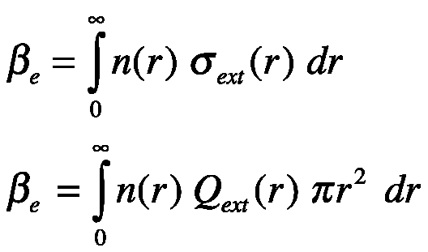
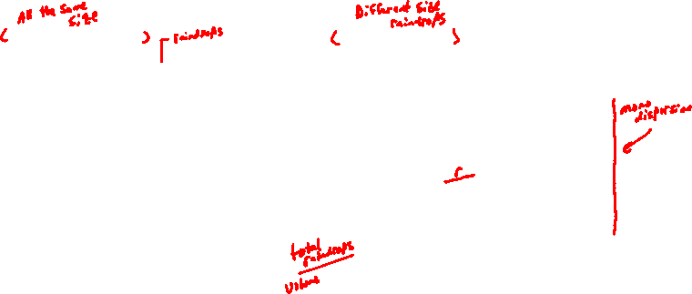
Monodispersons and Polydispersions
n
N particles / volume.
All of radius r.
r

Slide 17



Radar Theory Part 1

Slide 18


Radar Theory Part 2: Typical Values of Z_{dbZ}
Clear air mode of NEXRAD: -28 dbZ to 28 dbZ.
Precipitation mode of NEXRAD: 5 dbZ to 75 dbZ.
Light rain: 20 dbZ.

Slide 19
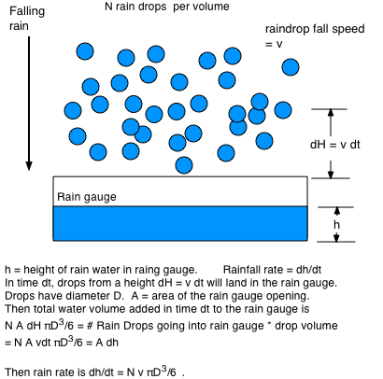
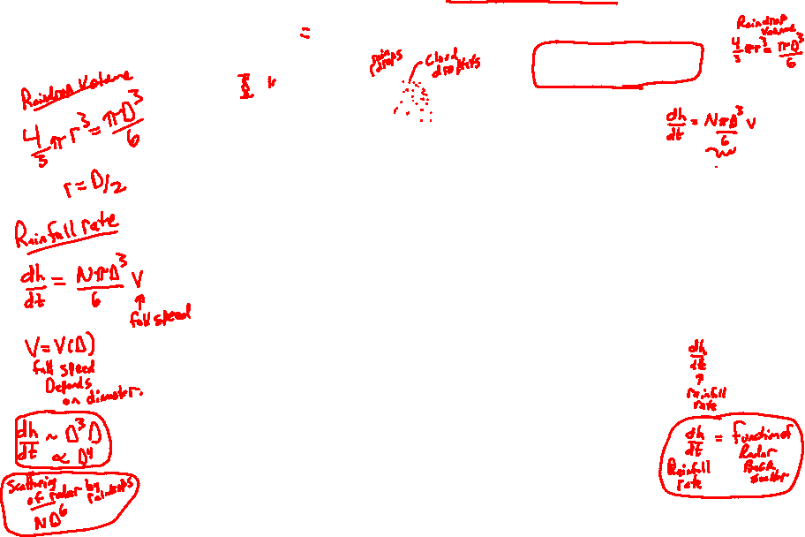
Rain Fall Rate for Monodispersion

Slide 20
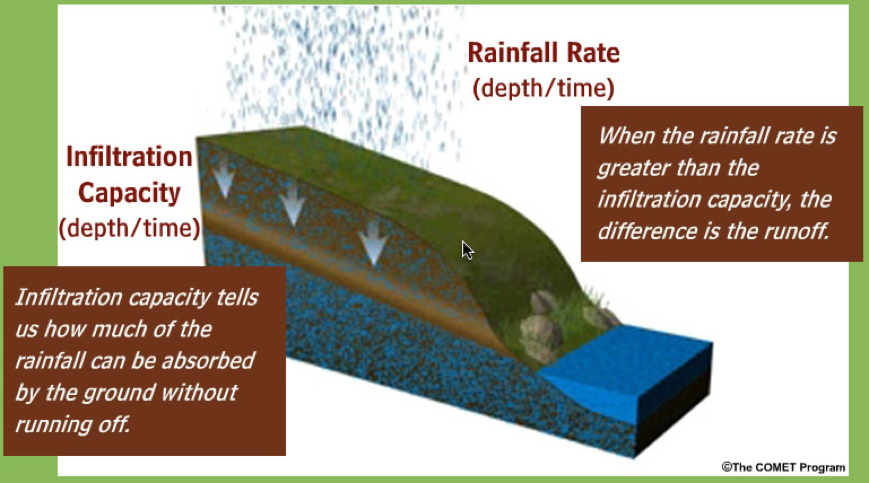
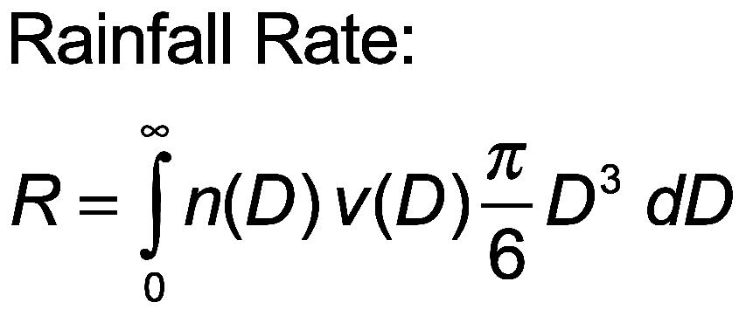
Radar Theory Part 3: Rainfall Rate Estimate From Radar
Definition of rainfall rate and what happens after rain hits the surface. Rainfall rate depends on the mass of water droplets and their fall speed.

Slide 21

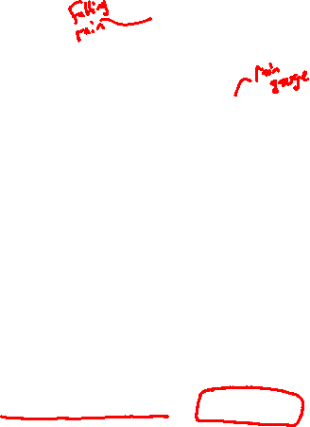
Rainfall Rate Analogy
Falling rain: Coffee is being
poured at some rate.
Height of coffee = H
Rainfall Rate = Height of Coffee / time elapsed pouring it.
Rainfall Rate = dH / dt

Slide 22
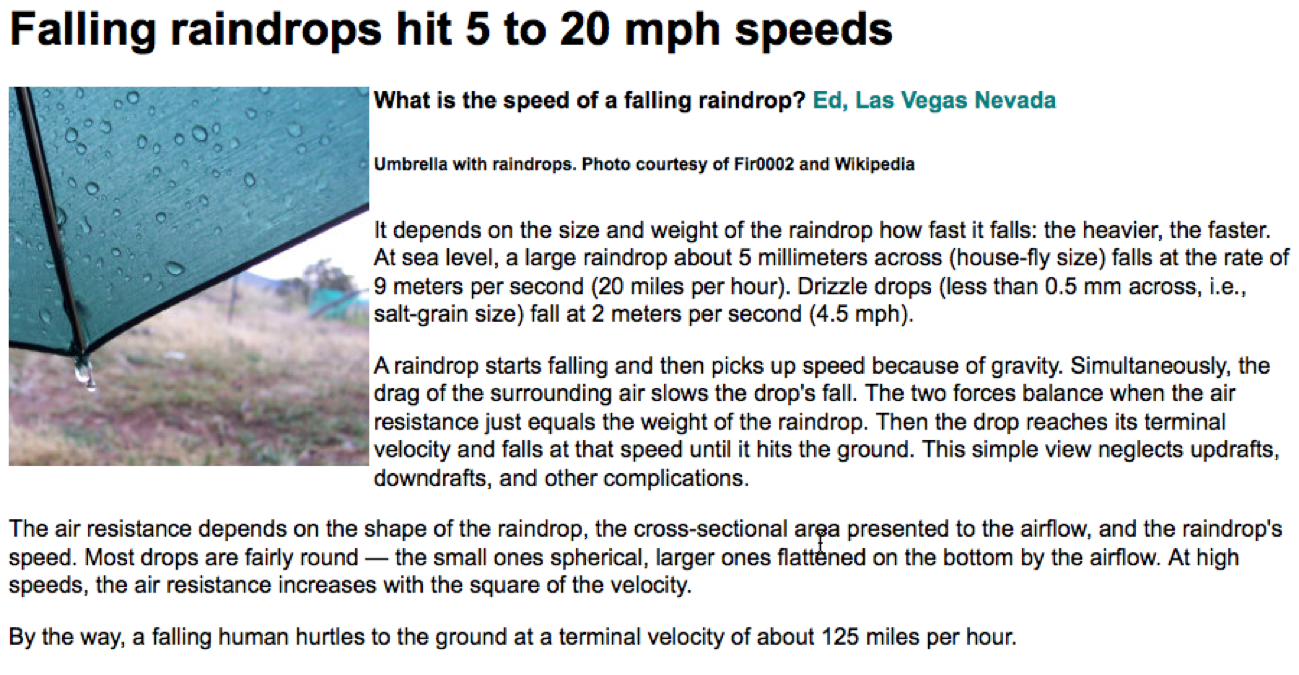
Rain Drop Fall Speed

Slide 23
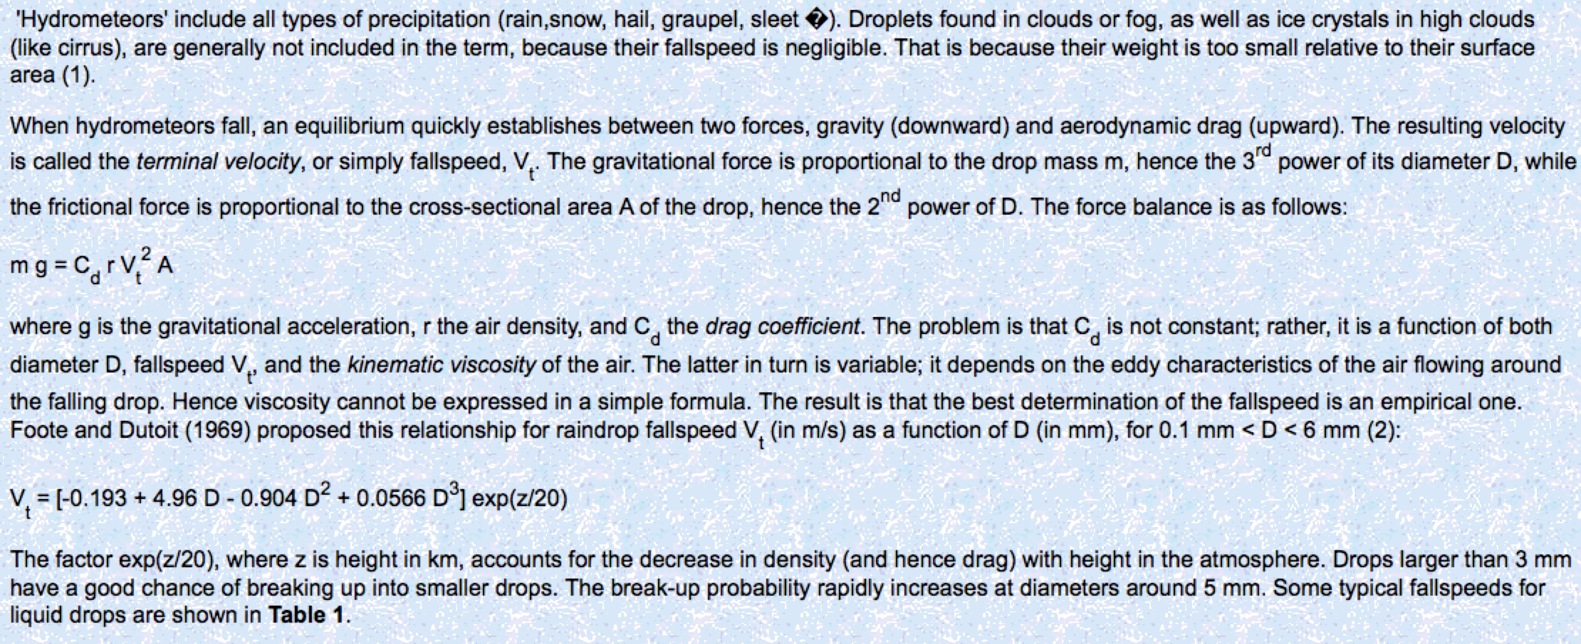
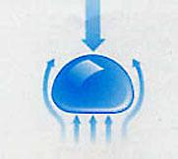
Rain Drop Fall Speed: A balance of Forces, Drag and Gravity

Slide 24
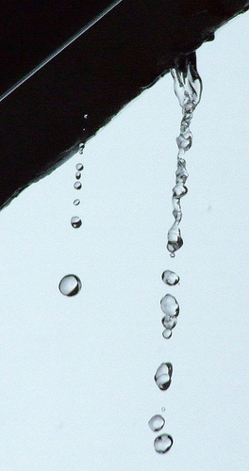
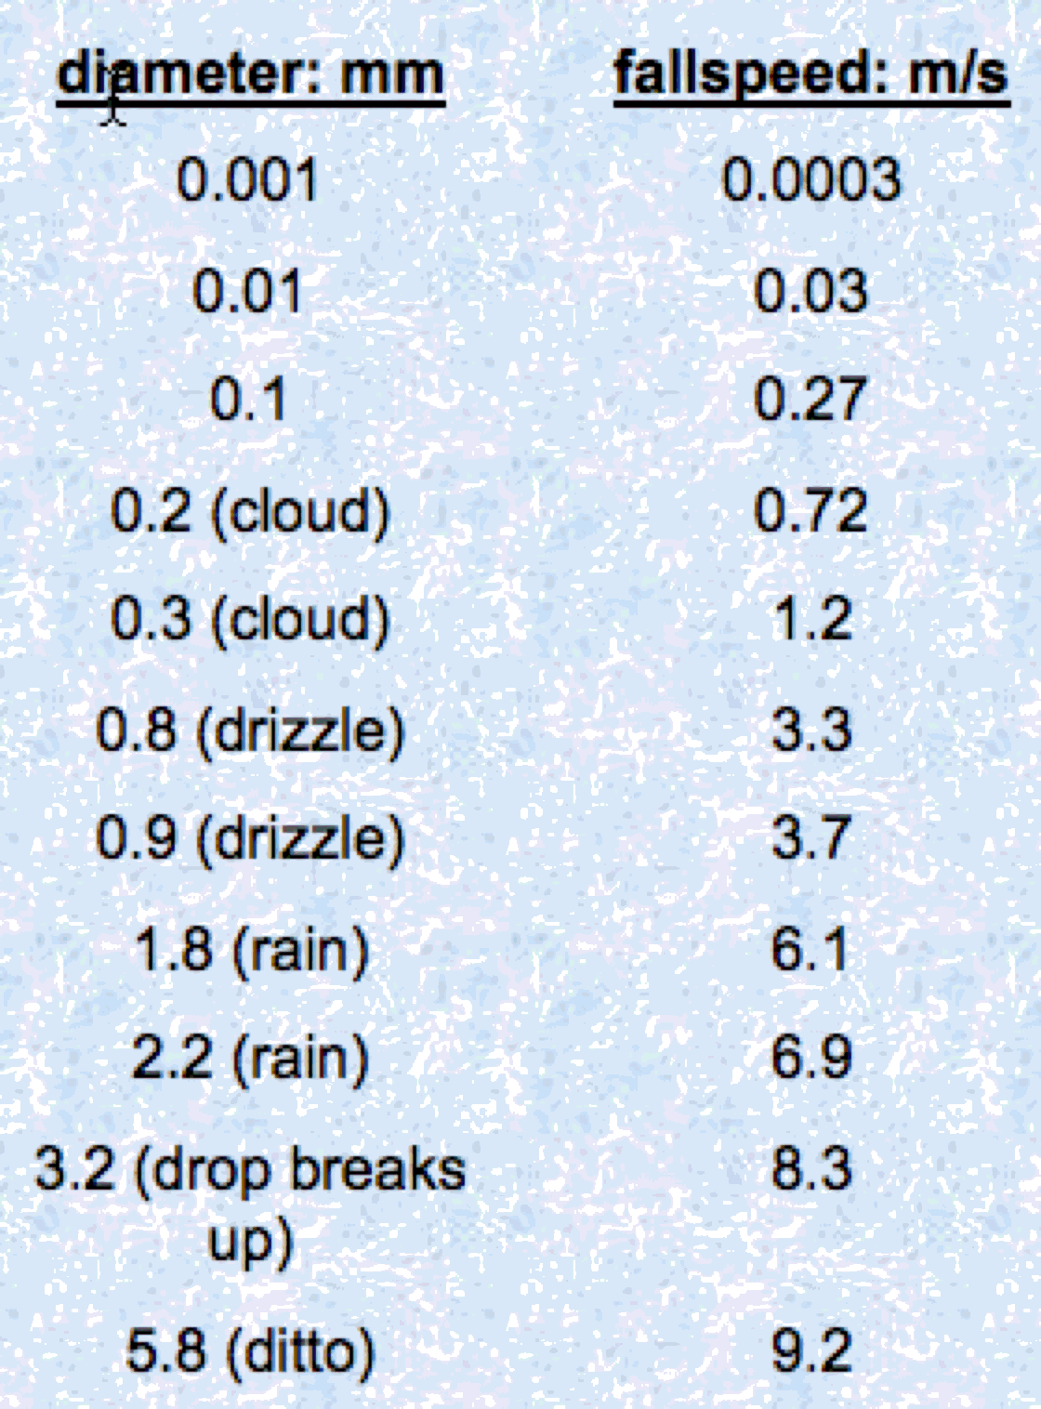
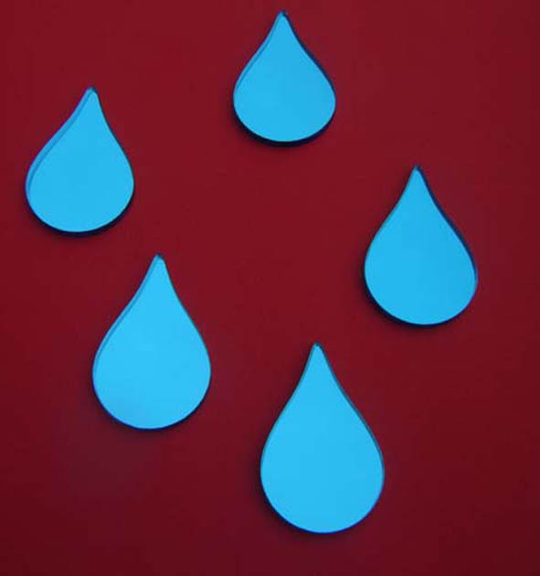
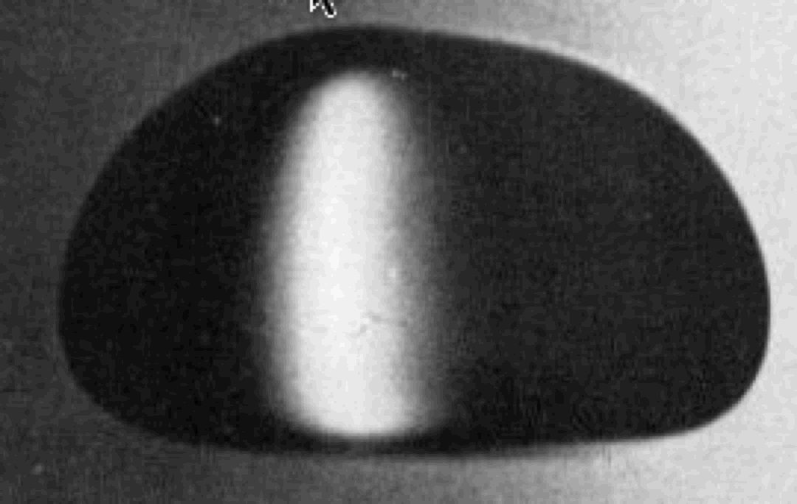
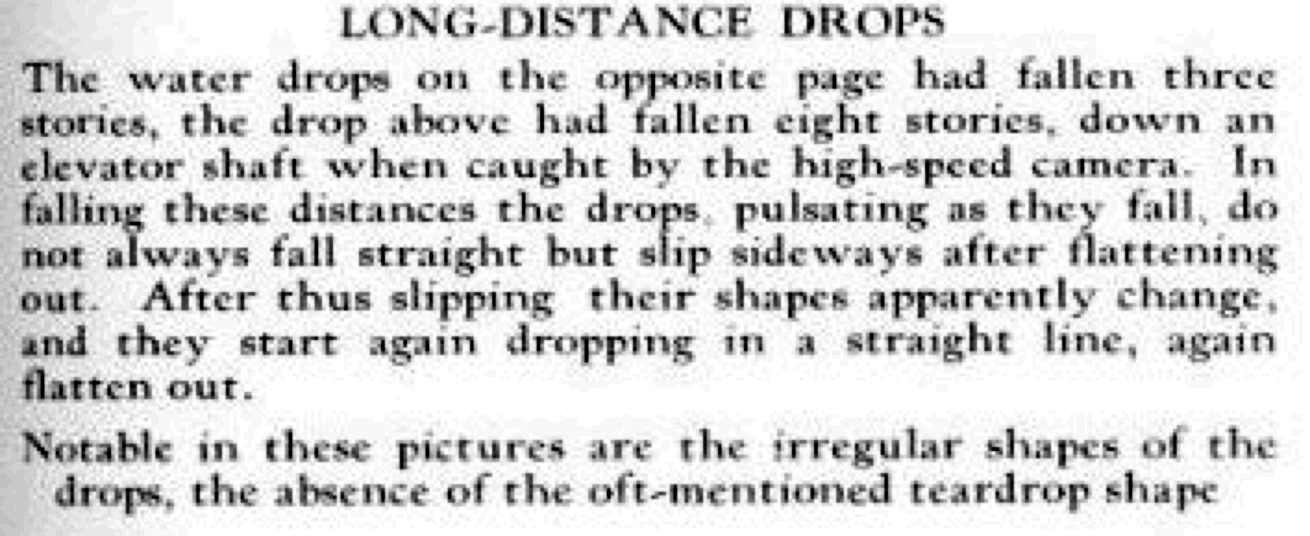
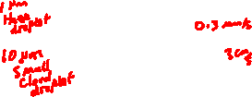
Fall Speed Is a Function of Size: Note the Shape in Terminal Flow
Ugggh!
NOT!!!

Slide 25
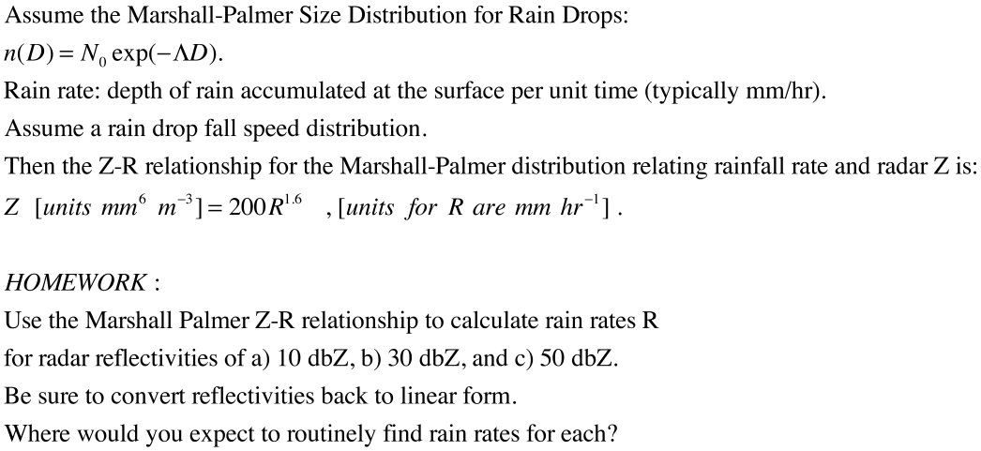
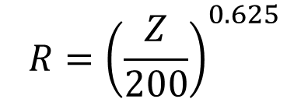

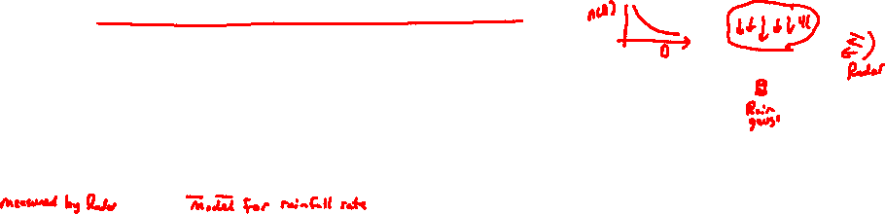
Radar Theory Part 3: Rainfall Rate Estimate From Radar
This is one relationship used to get rainfall rate (depth / time) from radar.
Problem: People have developed many such relationships! Which is correct, if any?????
Example:
$$Z={10}^{dBz/10}$$
$$R={\left(\frac{Z}{200}\right)}^{0.625}$$

Slide 26
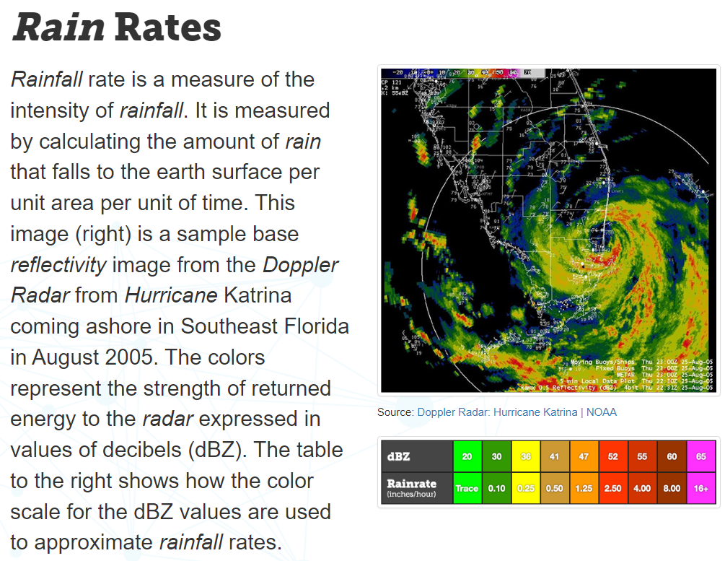
Rainfall Rate Example
From https://learn.weatherstem.com/modules/learn/lessons/114/12.html

Slide 27
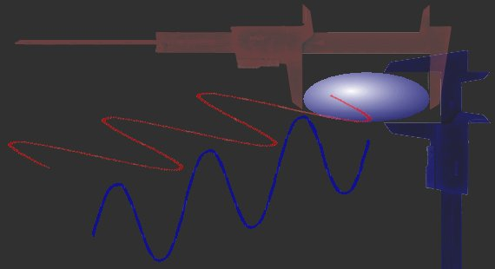
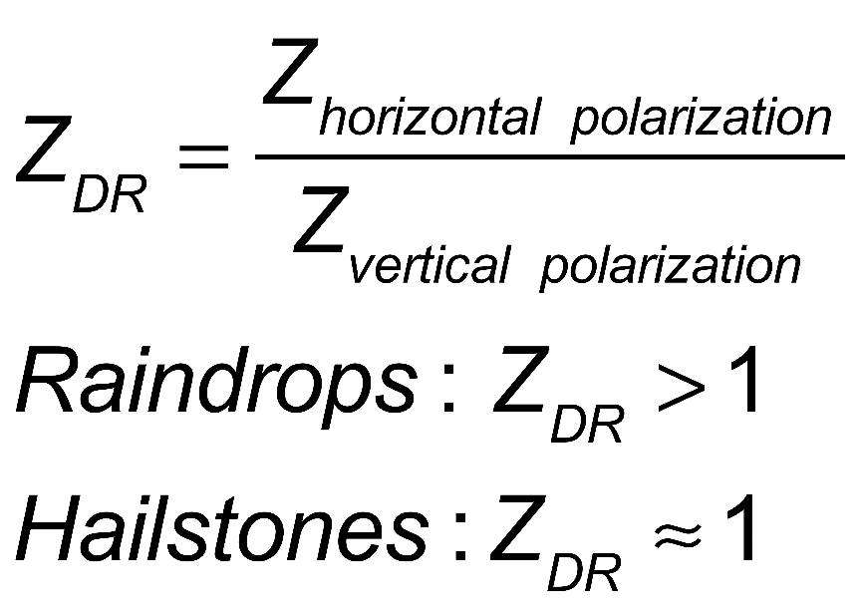
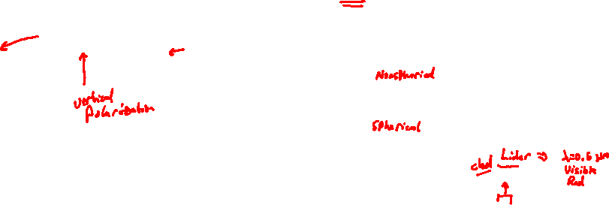
Polarization Diverse Radar: Update of the WSR88D.
Radar sends out horizontally and vertically polarized pulses.
Hydrometeors like raindrops are flattened. The horizontal cross sections are larger than the vertical.
Therefore for large raindrops the horizontal polarization backscatter amount is larger than the vertical amount.
Hail stones are more symmetrical and have less polarization diversity.

Slide 28
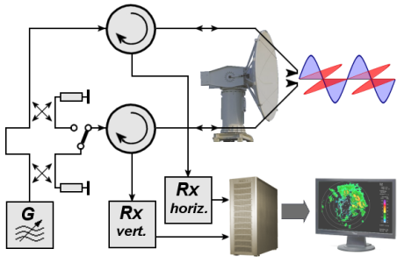
WSRP-2010D: Polarization Diverse Radar
Polarimetric radar
The next major upgrade was polarimetric radar, which adds vertical polarization to the current horizontal radar waves, in order to more accurately discern what is reflecting the signal. This so-called dual polarization allows the radar to distinguish between rain, hail and snow, something the horizontally polarized radars cannot accurately do. Observations showed that rain, ice pellets, snow, hail, birds, insects, and ground clutter all have different signatures with dual-polarization, which made a significant improvement in forecasting winter storms and severe thunderstorms. The deployment of the dual polarization capability to NEXRAD sites began in 2010 and lasted until 2012.

Slide 29
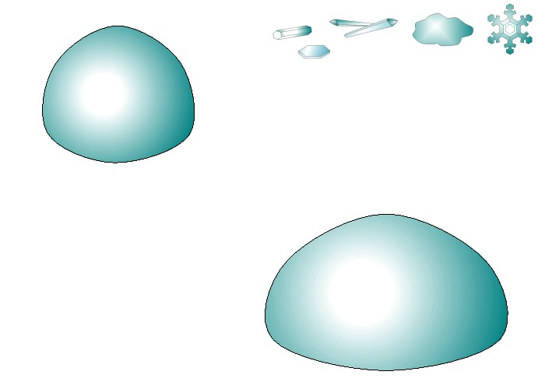
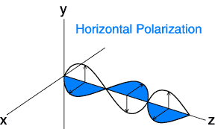

POLARIMETRIC RADAR?
Conventional
Radar (NEXRAD)
Polarimetric
Radar (ARMOR)
Notes:
`

Slide 30

ZDR is usually reported in logarithm form
$10 \log_{10}\left(\frac{Z_{horizonal}}{Z_{vertical}}\right)$ dB
Adapted from Radar Operations Center notes

Slide 31

Typical Z_{dr} Values
$10 \log_{10}\left(\frac{Z_{horizonal}}{Z_{vertical}}\right)$ dB
Adapted from Radar Operations Center notes

Slide 32
Polarimetric Variables
Reflectivity factor Z at horizontal polarization
- Measure of size and concentration of scatters
  (dominated by SIZE)
2. Differential reflectivity Z_{DR}
- Measure of median drop diameter→ SIZE, SHAPE
- Useful for rain / hail / snow discrimination→ SIZE, SHAPE, PHASE
3. Differential phase Φ_{DP} (Specific Differential Phase- K_{DP})
- Efficient for accurate rainfall estimation→ NUMBER, SHAPE
- Immune to radar miscalibration, attenuation, and partial beam blockage
4. Correlation coefficient ρ_{hv}
- Indicator of mixed precipitation → SHAPE, PHASE
- Efficient for identifying nonmeteorological scatterers
Small ZDR Large ZDR
vs

Slide 33

Advantages of a Dual-Polarization Radar
A method for distinguishing hydrometeor types, rain, snow, hail, against debris, insects, birds, bats, etc.
More accurate rainfall estimation (10-20% max accumulation error as opposed to 200-300%).
  Why? Because we collect information on drop size/shape/concentration and are able to mitigate hail contamination.
Identification of precipitation types and discrimination between meteorological and non-meteorological scatterers
Improvement in radar data quality: Self consistent way to calibrate using polarimetric variables
Small ZDR Large ZDR
Small drops Large drops
Mitigates the multiple Z-R issues!
vs
Hail Rain
Insects
Rain
vs
vs

Slide 34


Doppler Effect: Frequency Change Due to Relative Motion
No Doppler shift perpendicular to the direction of motion
Δf = V/λ=Vf₀/c where $V=\vec{V}⋅\hat{r}$.
$\vec{V}$ is the wind vector.
$\hat{r}$ is a unit vector that goes from the point of interest to the radar.
Inbound: negative and cool colors
Outbound: positive and warm colors (“red shifted”).
Zero Contour: zero velocity component (perpendicular to the beam). Called a “ zero isodop”.
Doppler Effect for Sound and Light

Slide 35

Radar Rotates 360 degrees and Scans in the Vertical
Height increases with distance from
radar for elevated scans.
The base reflectivity images in Precipitation Mode are available at four radar "tilt" angles, 0.5°, 1.45°, 2.40° and 3.35°

Slide 36
Doppler examples: Radar is in the Center
Wind increasing with height
Example:
Radar elevation angle 4 degrees
Wind convention
1 knot=1.15 mph
N
Blue colors:
Wind towards radar.
Named inbound wind.
Red colors:
Wind away from radar.
Named outbound wind.
W
E
S

Slide 37
Doppler examples: Radar is in the Center
Blue color:
Wind towards radar.
Named inbound wind.
Red color:
Wind away from radar.
Named outbound wind.
Radar elevation angle 4 degrees

Slide 38
Veering Wind
CVW:
Clockwise rotation of wind with height.
Known as veering wind.
Warm air moving in.

Slide 39
Backing Wind
CCBC:
Counter-clockwise rotation of wind with height.
Known as backing wind.
Cold air moving in.

Slide 40

Rotation: Tornado
Note intense flow near center.
Tornado not right over the radar.
Radar location relative to rotation

Slide 41

Incoming Cold Front And Constant Flow:

Slide 42

Outgoing Cold Front Veering and Backing Winds:

Slide 43

Divergence: For example, from a thunderstorm downdraft

Slide 44
Putting it all together…spatial and temporal variation of storms
From Markowski and Richardson 2010

Slide 45






Light Scattering Basics (images from Wallace and Hobbs CH4).
Angular Distribution of scattered radiation (phase function)
x
Sphere, radius r, complex refractive index n=m_{r} + im_{i}
x
Dipole scattering
Dimensionless Parameters:
Size Parameter=x=$\frac{2 π r}{λ}$
Scattering Efficiency=Q_{s}=$\frac{σ_{sca}}{πr^{2}}$
x
x
m_{r}=1.5
x
Q_{s}
$$Lines: \\ r=\frac{x}{2π}λ$$
x
W. P. Arnott, AAAR tutorial, Sept. 2007
45
Notes:
45

Slide 46

Rayleigh Scattering Phase Function: Angular Distribution of Light Scattered by a Dipole: x << 1
vertical polarization
state
3D rendering
horizontal polarization
state
The Peanut!
Average of both
polarization states.

Slide 47


Mie Radar Backscatter Efficiency for Water and Ice Spheres
Non Rayleigh
strong backscatter by water drops
compared to that of ice!!
Rayleigh
WSR-88D NWS Doppler Radar

Slide 48

Radar Bright Band: Strong Scattering from Melting Hydrometeors
Snowflakes
Melting level
Raindrops
Most intense radar backscatter from melting level
due to both liquid water and large hydrometeor diameter
http://www.radar.mcgill.ca/bright_band.html

Slide 49

abnormal atmospheric conditions
subrefraction
superrefraction
ducting
cool, moist air aloft
warm, dry air below
Unstable?
warm dry air aloft
cool, moist air below
Stable!
Really Stable!

Slide 50


WIND PROFILER
The wind profiler is a ground based array of multiple beam Doppler radar units which measures and displays wind information up to an altitude of 16 km. This instrument is generally used to detect low level wind shear.

Slide 51



Clear-Air Wind Profilers
Notes:
51

Slide 52

Tornado Vortex Signature

