Slide 1
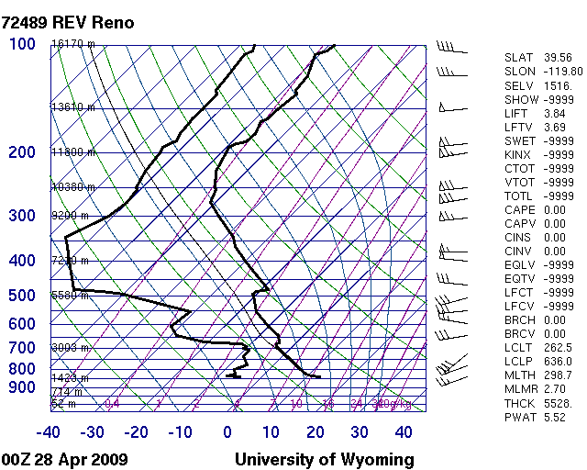
Weather Balloon’s/Radiosonde

Slide 2
Types of Balloons
EXTENSIBLE
INEXTENSIBLE
Most balloons are extensible or they stretch. The volume of the balloon increases until it explodes at a set altitude.
A balloon that doesn’t stretch it will ascend until the buoyancy is balanced with the weight of the balloon and payload and maintains a constant altitude.

Slide 3
Kinds of weather balloons
Pilot Balloons
Sounding Balloons
No payload or instruments so they are smaller weighing around 10-100 g.
Can carry a variety of instruments weighing 600 to 1800 g.
Even larger balloons are available for special payloads.

Slide 4
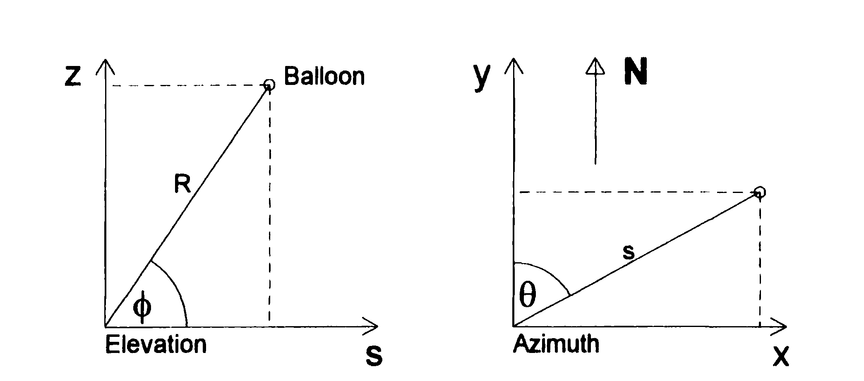
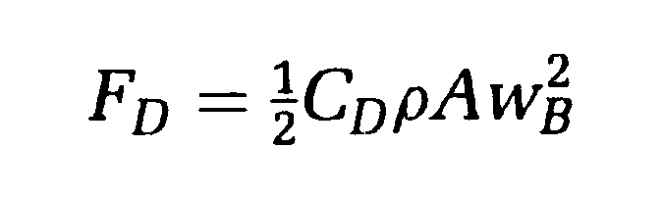
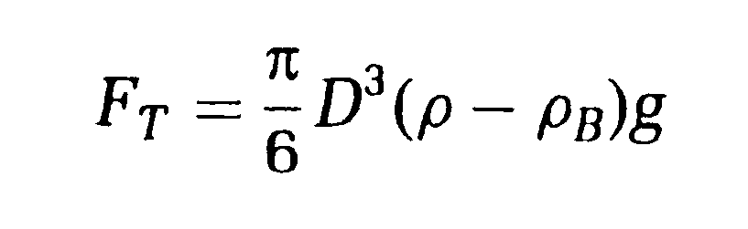
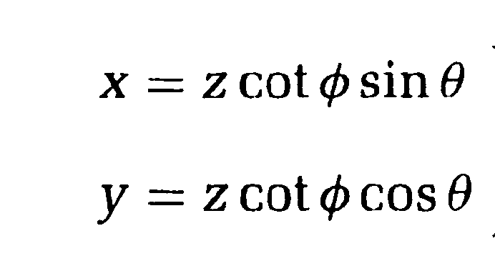
Pilot Balloons
Used for wind direction and speed they are tracked by theodolites or radar.

Slide 5
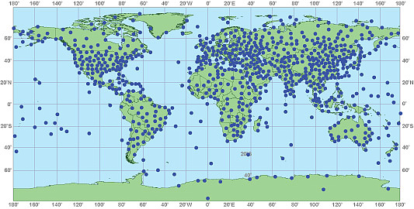
World wide locations for radiosonde launches
https://www.weather.gov/jetstream/radiosondes

Slide 6
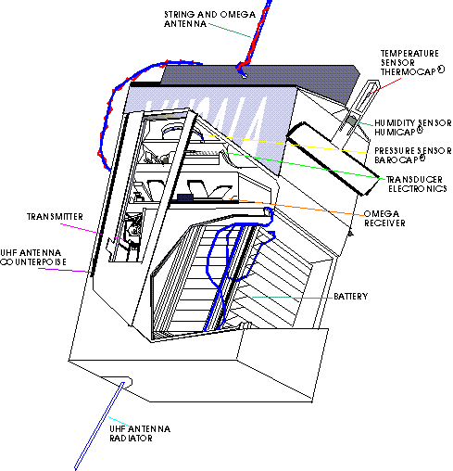
Radiosonde

Slide 7
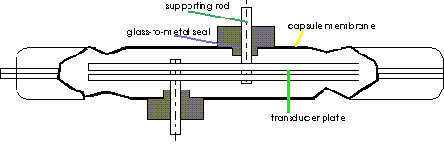
Pressure Sensor (BAROCAP)

Slide 8
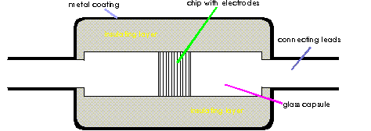
Temperature Sensor (THERMOCAP)

Slide 9
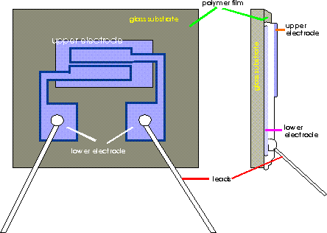
Humidity Sensor (HUMICAP)

Slide 10
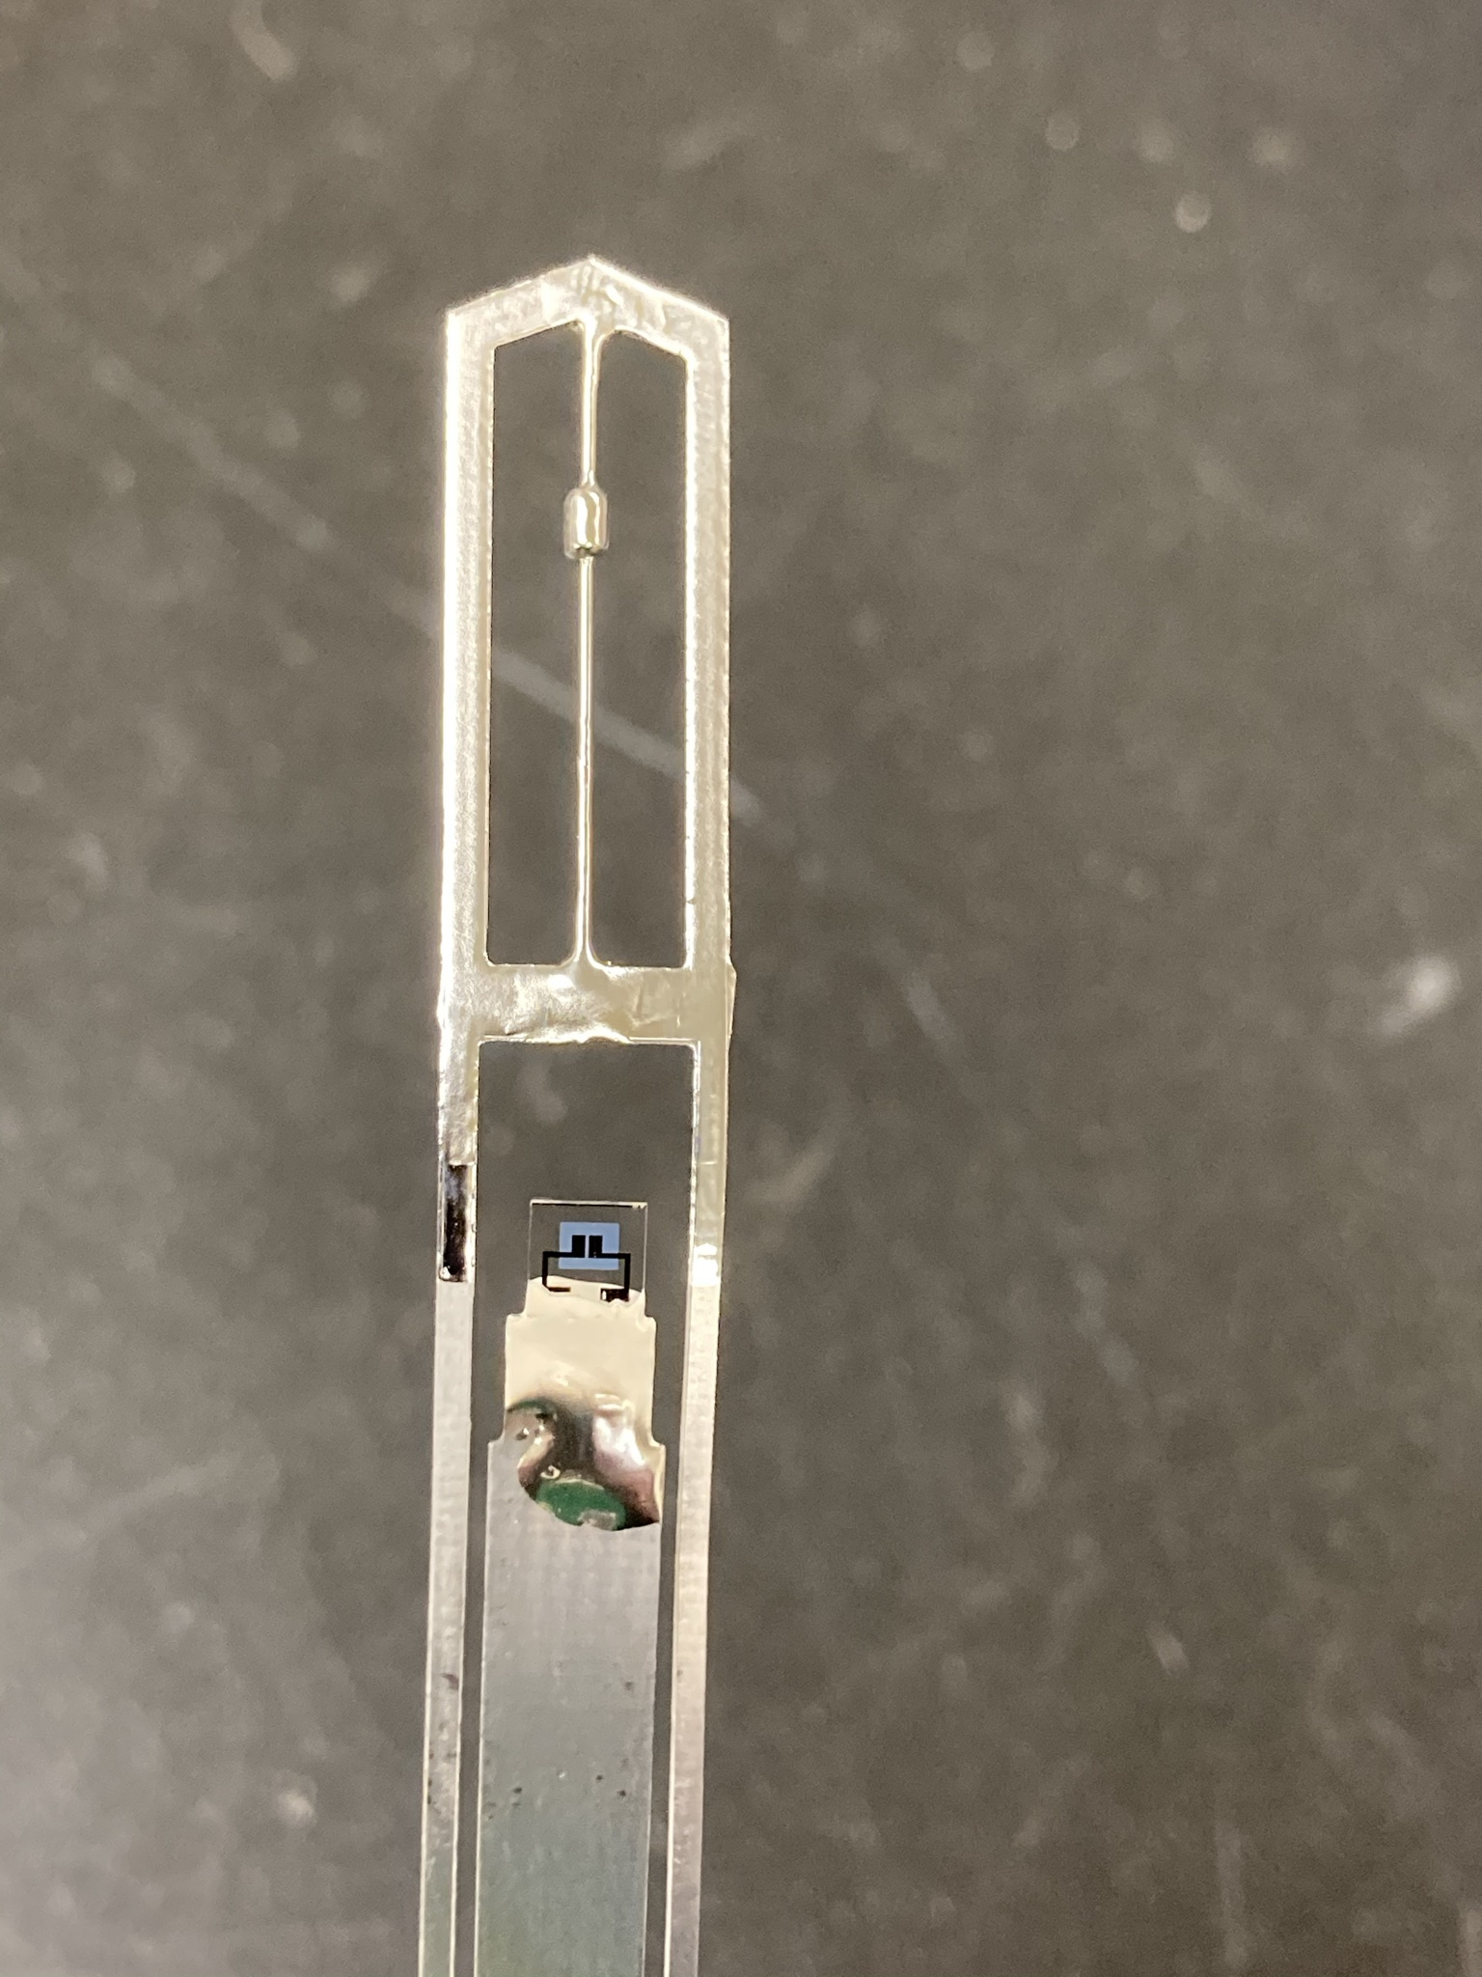
Photo of Sensors
Temperature
Humidity (Cover removed)

Slide 11
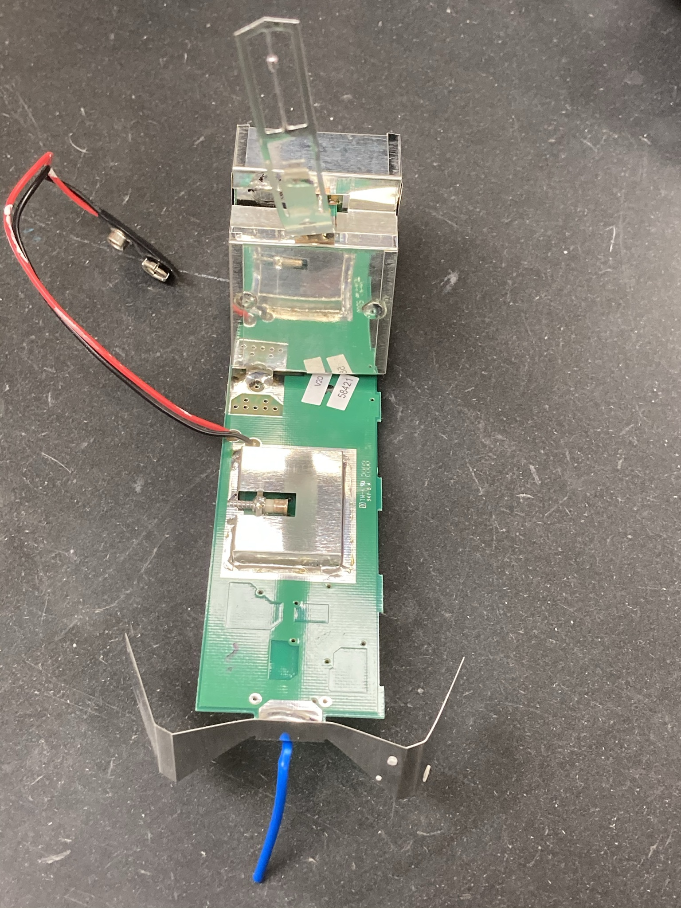
Sensors and Shielding
Obtain measurements, transmit data to the ground by radio. Shielding needed for sensitive detection electronics to keep the radio signal from causing interference.

Slide 12
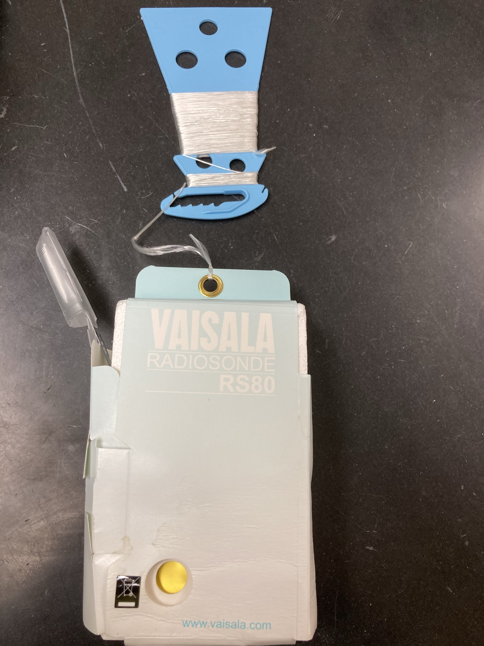
Example of a radiosonde packaged for flight.
Remove sensor cover before flight.

Slide 13
http://weather.uwyo.edu/upperair/sounding.html
http://meteora.ucsd.edu/wx_pages/stuff/Blank_Skew-T.pdf

