Slide 1
HYSPLIT
Samantha Faulstich
ATMS 748

Slide 2
What is HYSPLIT?
Hybrid Single-Particle Lagrangian Integrated Transport model
Lagrangian frame of reference: specific air parcels are followed through time
Air parcel trajectories and complex transport, dispersion, chemical deposition and transformation
Backwards or forwards trajectory calculations
Variety of particles (PM2.5, radioactive particles, volcanic ash, ozone, dust)

Slide 3
History
1949: back trajectory sourcing of radioactive particles from Soviet atomic testing detected by aircraft.
All calculations done by hand using winds from twice daily weather balloon data
Remarkably accurate
1960s: MESODIFF model in response to safety concerns about radioactive material release at Idaho’s National Reactor Testing Station.
Gaussian puff model using gridded data to account for spatial variability of horizontal wind flow near the surface
1970s: Gaussian puff model and trajectory calculations combined to compute long-range concentration models of specific particles
1980s: the first version of HYSPLIT as we know it

Slide 4
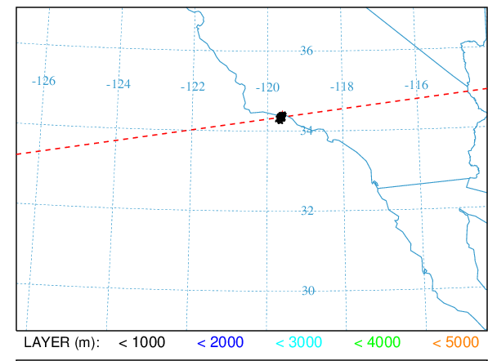
Particle Cross Section Example

Slide 5
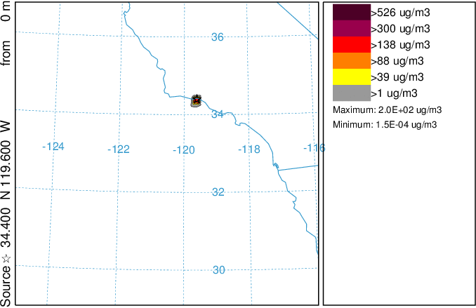
Particle Concentration Example

Slide 6
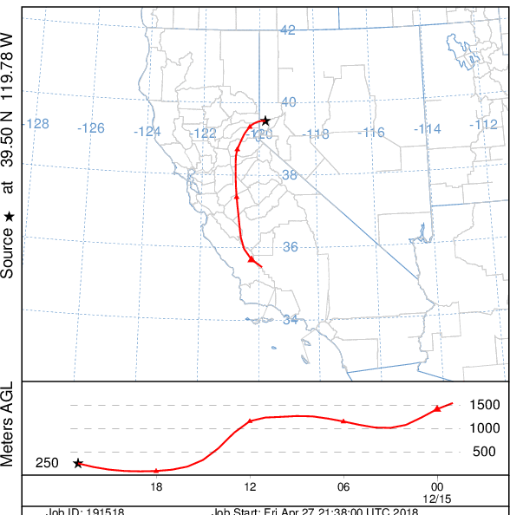
Back Trajectory Example

Slide 7
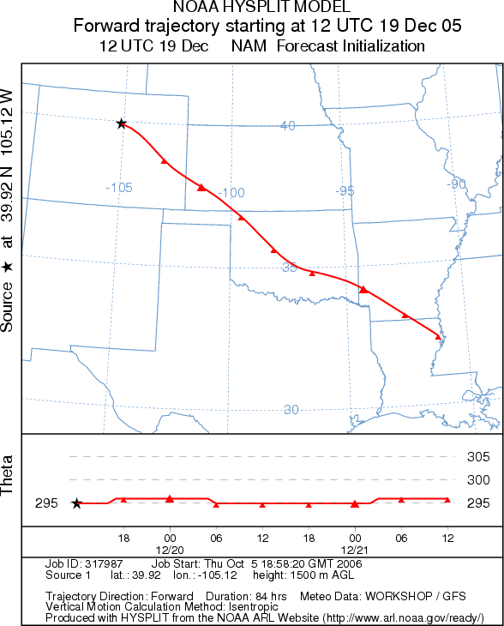
Forward Trajectory Example

Slide 8
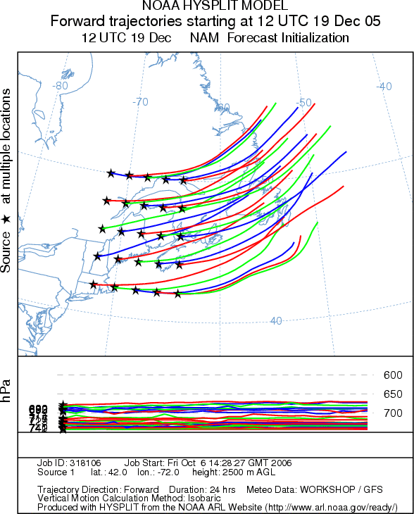

Slide 9
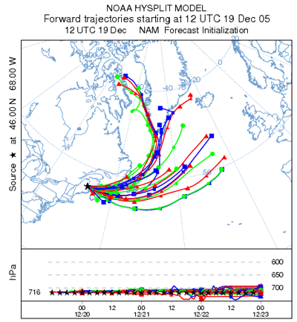

Slide 10
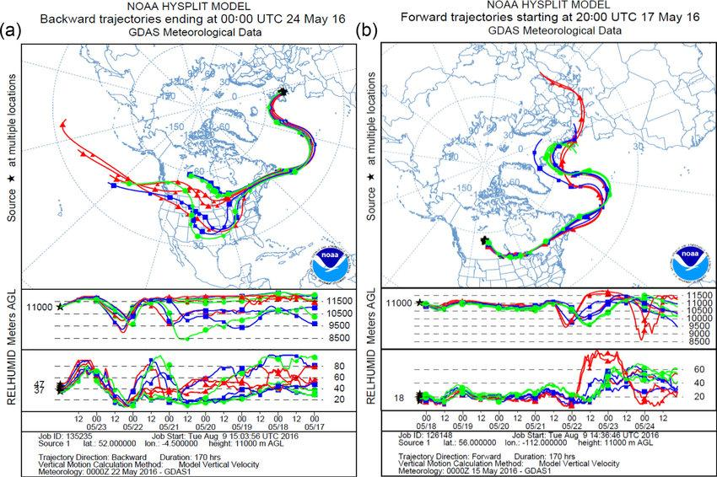

Slide 11
References
https://ready.arl.noaa.gov/HYSPLIT.php
https://journals.ametsoc.org/doi/full/10.1175/BAMS-D-14-00110.1
https://en.wikipedia.org/wiki/Lagrangian_and_Eulerian_specification_of_the_flow_field

