Slide 1
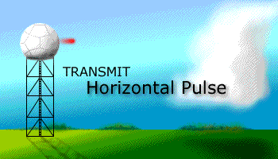
Radar Meteorology
Purpose:
Explain the basic principles of radar. What is dbz? This is related to the power backscattered by hydrometeors.
Explain how radar can be used to measure the fall speed of hydrometeors and the wind direction.
Discuss the NEXRAD radar used by the National Weather Service.
Become aware of the advantages and disadvantages of radar.

Slide 2
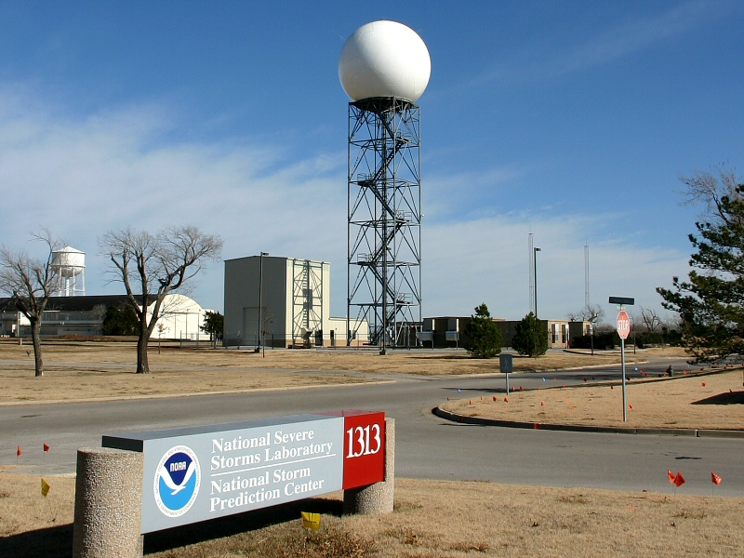
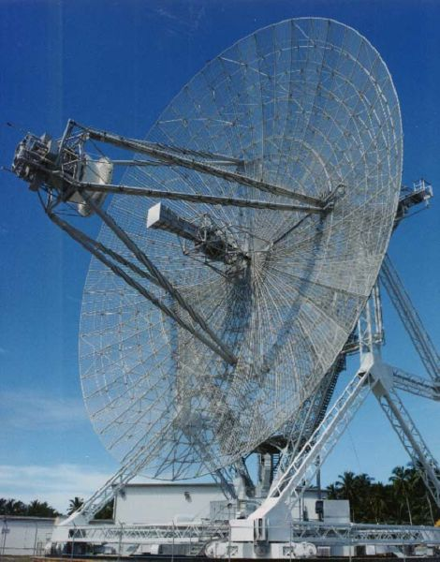
Definitions
RADAR is an acronym. RAdio Detection And Ranging.
Advanced Research Project Agency (ARPA) Long-range Tracking and Identification Radar (ALTAIR). Ballistic Missiles and Space Surveillance (military).
NEXRAD Weather Radar

Slide 3
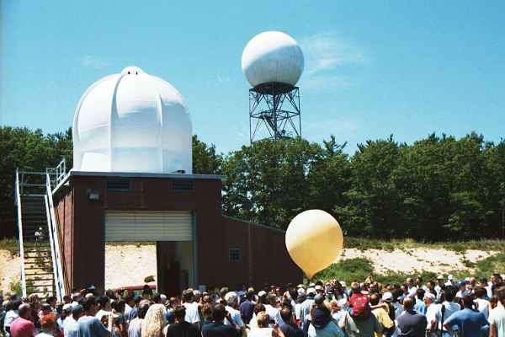
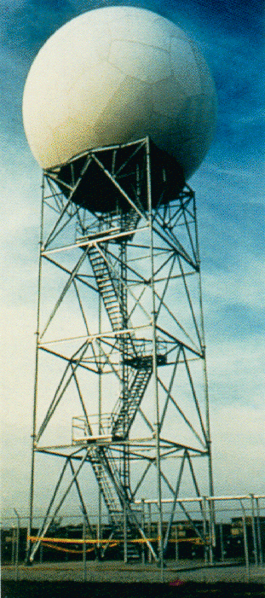
NEXRAD RADAR
NEXRAD (background) and weather balloon launch facility.

Slide 4
NEXRAD RADAR
Named WSR-88D
S-band radar
radiation wavelength is λ = 10.7 cm
Power is 750,000 kW
Tallahassee (right)

Slide 5
More Definitions: NEXRAD and WSR-88D
NEXRAD or Nexrad (Next-Generation Radar) is a network of 159 high-resolution Doppler weather radars operated by the National Weather Service, an agency of the National Oceanic and Atmospheric Administration (NOAA) within the United States Department of Commerce. Its technical name is WSR-88D, which stands for Weather Surveillance Radar, 1988, Doppler.
NEXRAD detects precipitation and atmospheric movement or wind. It returns data which when processed can be displayed in a mosaic map which shows patterns of precipitation and its movement. The radar system operates in two basic modes, selectable by the operator: a slow-scanning clear-air mode for analyzing air movements when there is little or no activity in the area, and a precipitation mode with a faster scan time for tracking active weather. NEXRAD has an increased emphasis on automation, including the use of algorithms and automated volume scans.
(wikipedia).

Slide 6
Precipitation Estimation using the Z-R Relationship
The equation used for
the Z-R relationship can be changed to produce different outputs. Private companies or researchers may use a different Z-R relationship for different geographical regions or climatic zones
R = aZ^{b}
where
R = Rain Estimation
a = 300
Z = Radar Reflectivity
b = 1.5

Slide 7
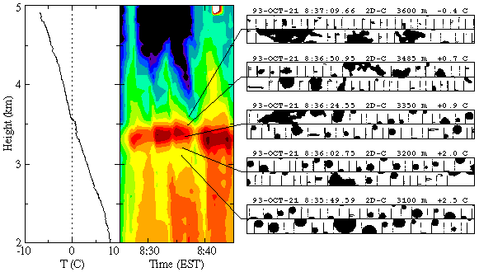
Radar Bright Band: Strong Scattering from Melting Hydrometeors
http://www.radar.mcgill.ca/bright_band.html

Slide 8
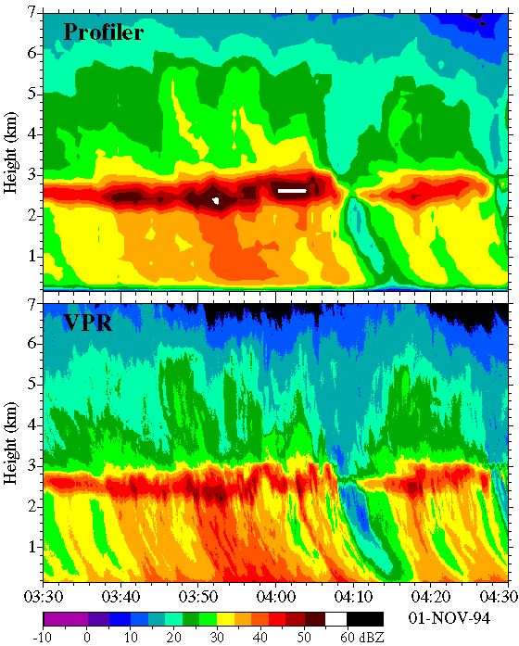
The Radar “Bright” Band
Notes:
8

Slide 9
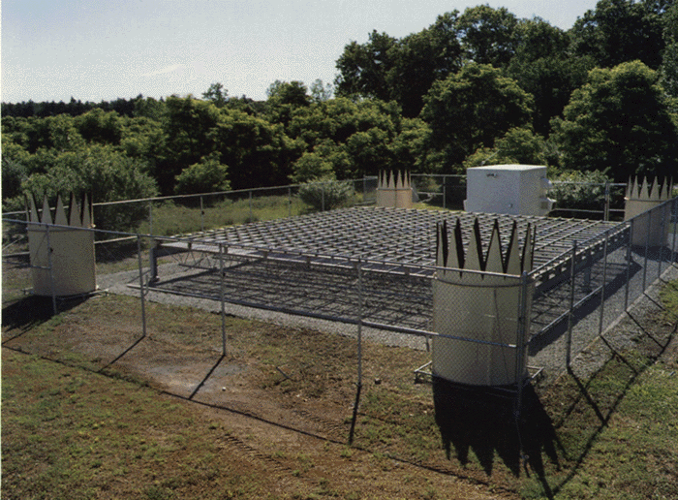
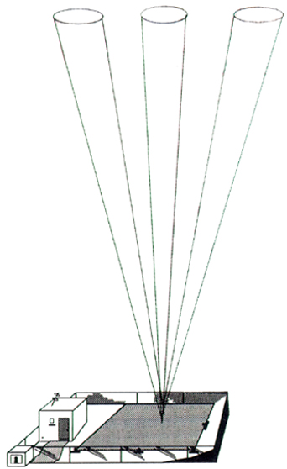
WIND PROFILER
The wind profiler is a ground based array of multiple beam Doppler radar units which measures and displays wind information up to an altitude of 16 km. This instrument is generally used to detect low level wind shear.

Slide 10
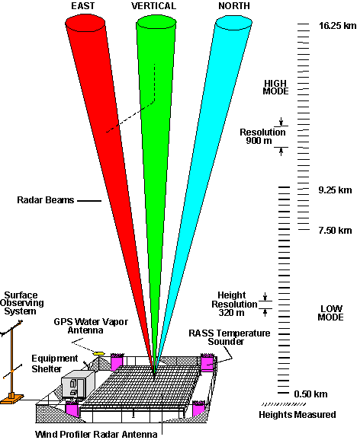
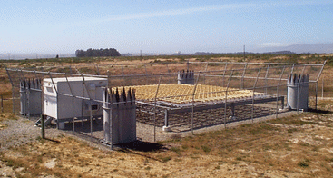
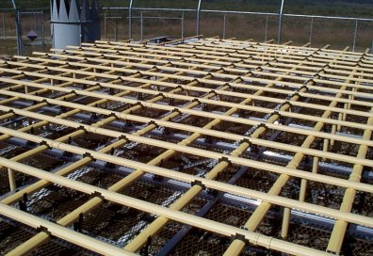
Clear-Air Wind Profilers
Notes:
10

Slide 11
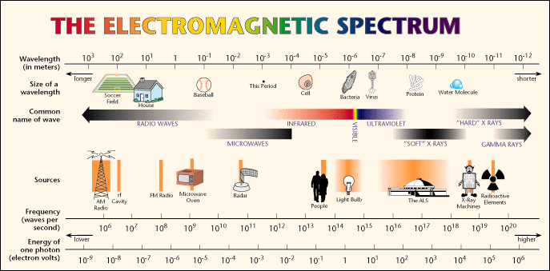
The frequency of the em wave used depends on the application. Some frequencies travel through clouds with virtually no attenuation.
ALL em waves move at the speed of light

Slide 12
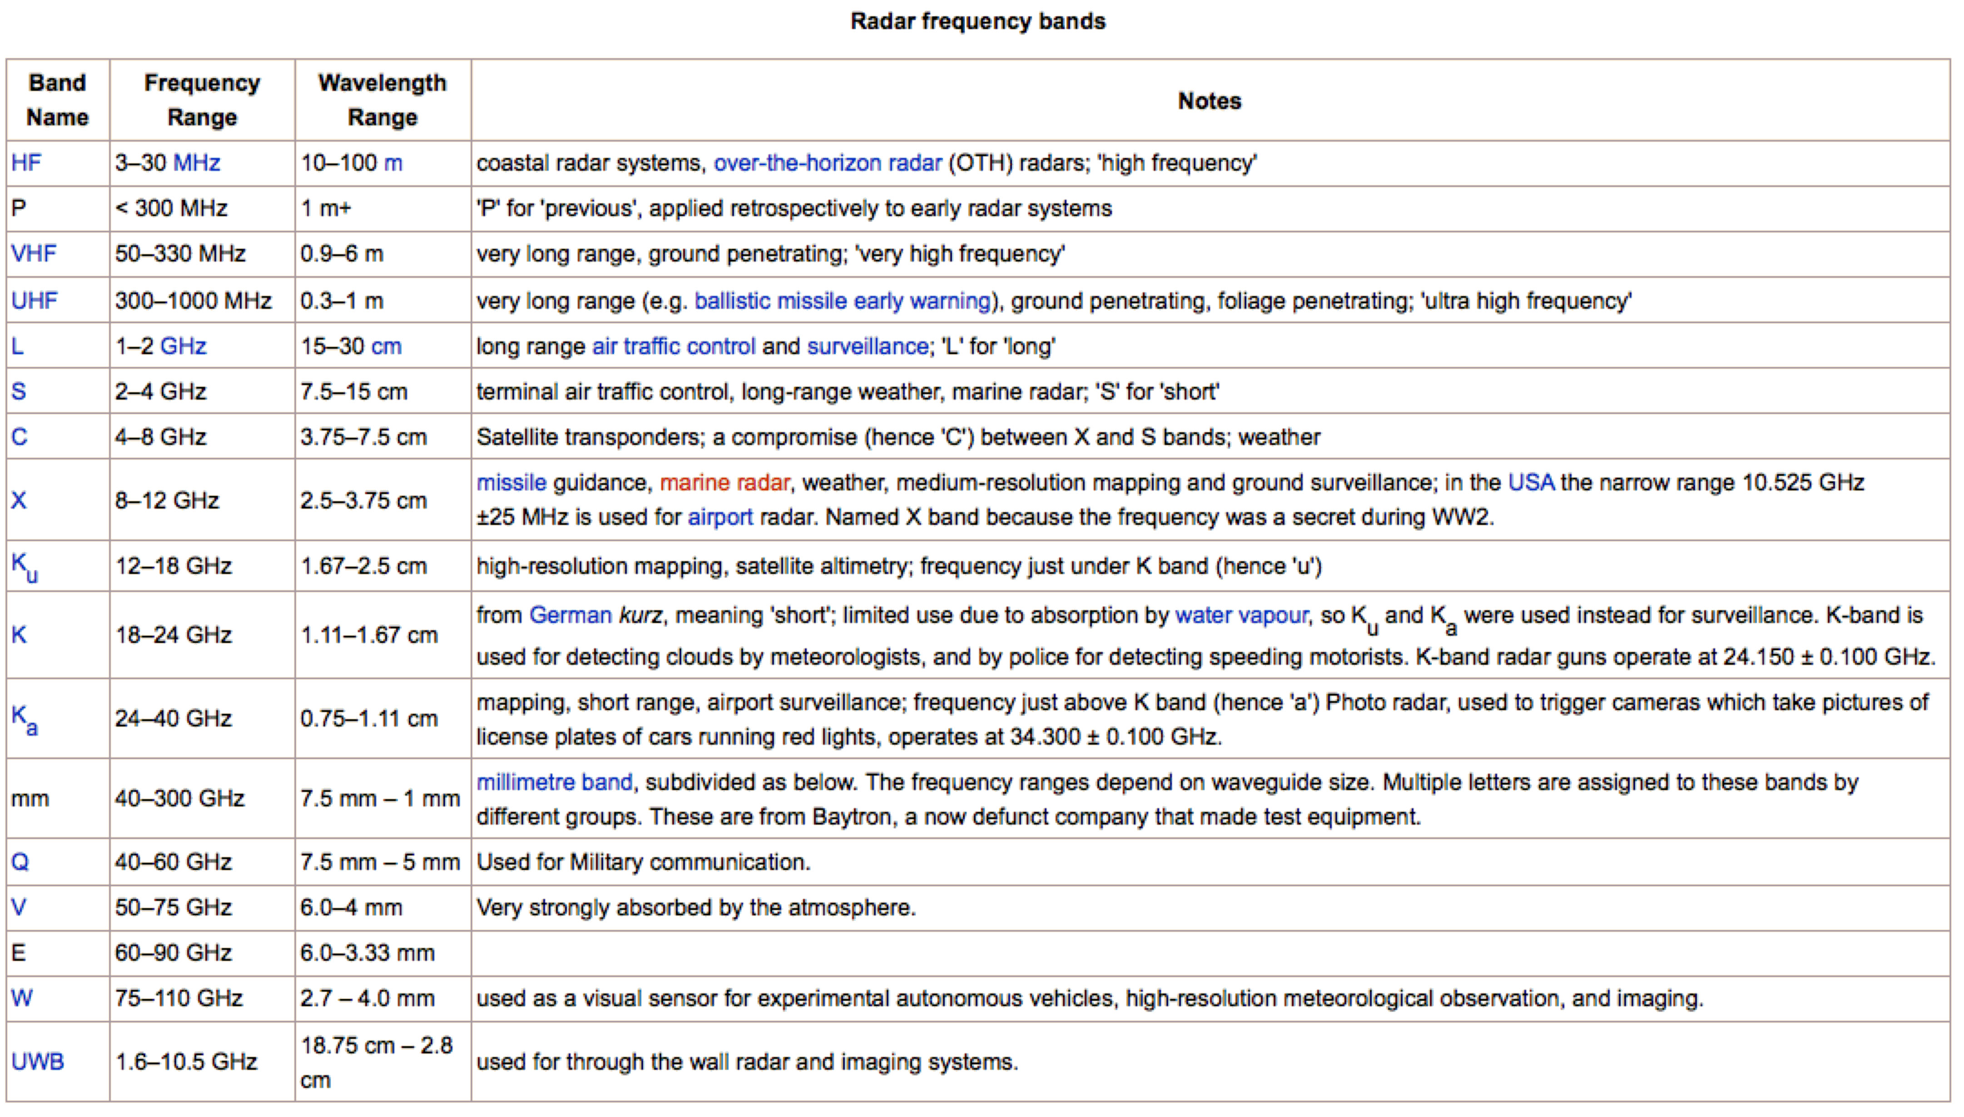
Radar Frequency Bands
λf = c, c=3x10⁸ m/s, λ=wavelength, f= frequency

Slide 13
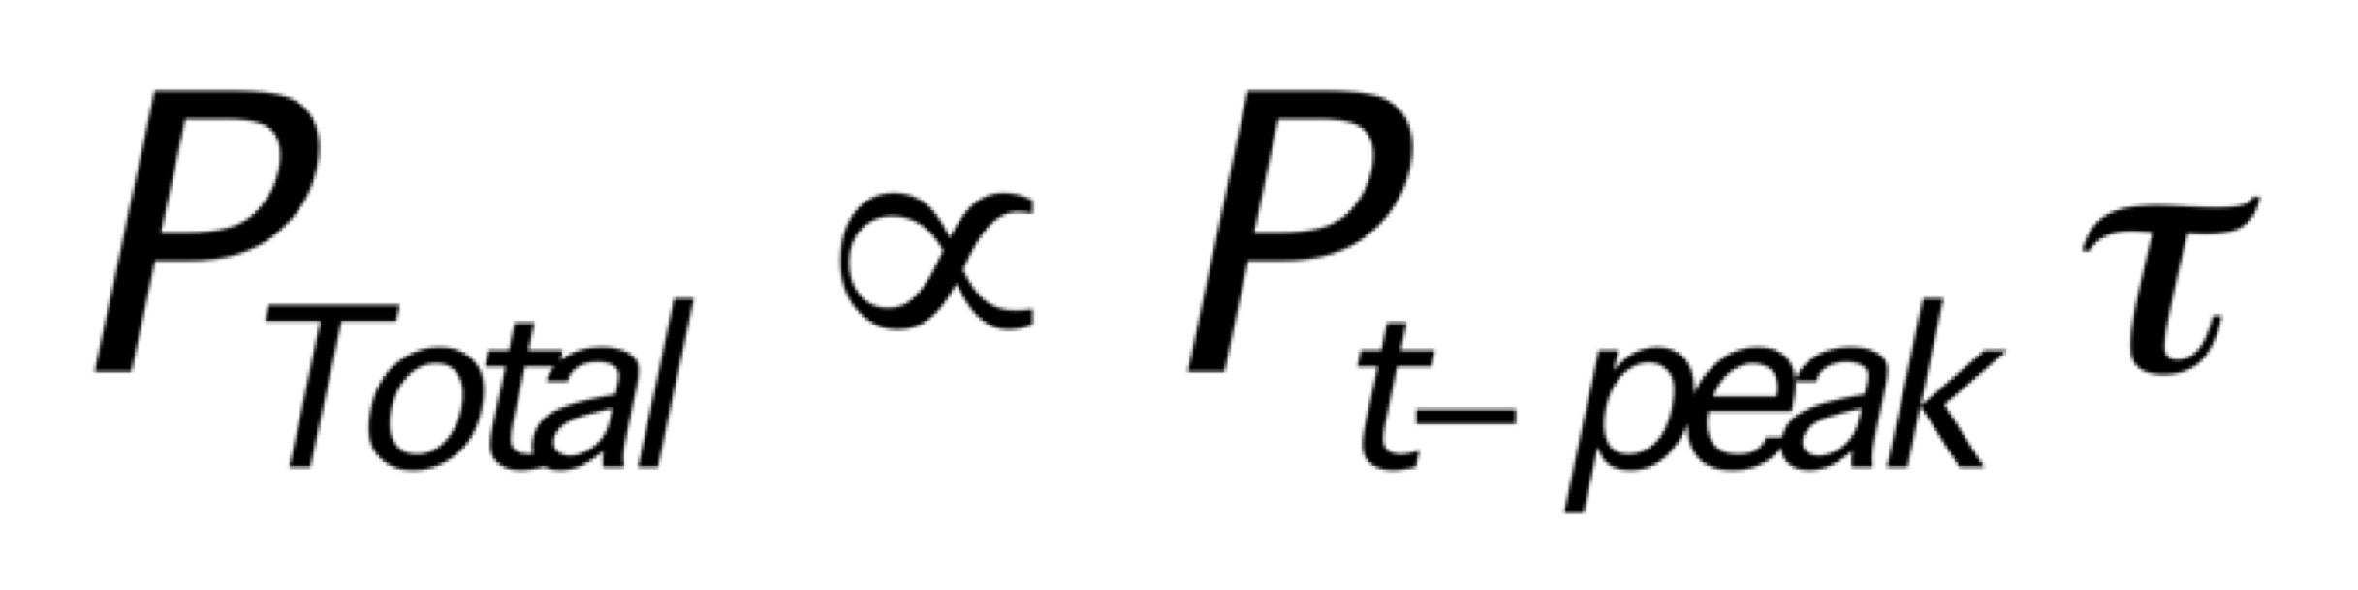

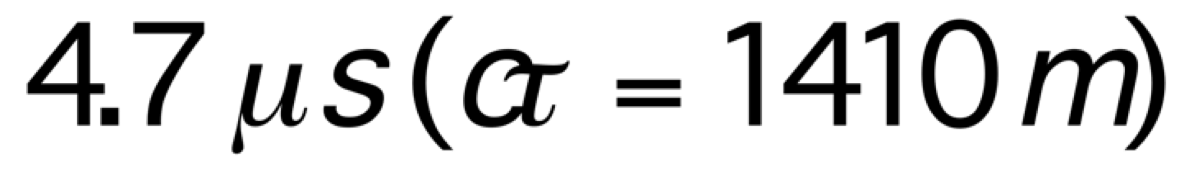
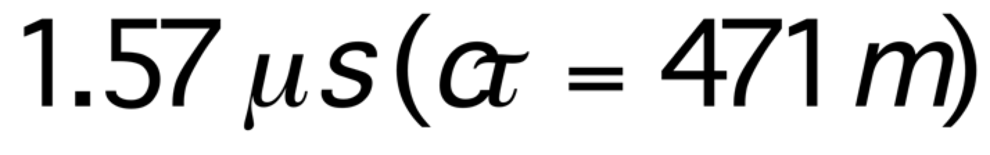
Pulse Lengths for WSR-88D Radar [Weather Surveillance Radar, 1988, Doppler]
Total radiated power in a radar pulse
Range Resolution:
Long Pulse:
Short Pulse:

Slide 14
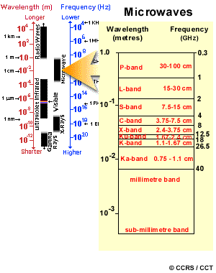
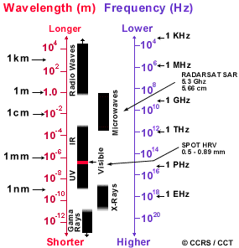
Introduction to Meteorological Radar
Notes:
14

Slide 15
94 GHz
35 GHz
Maximum
Propagation
Distance
Energy Absorbed by Atmosphere
10-15 km
20-30 km
3.2 mm
8 mm
Radar Wavelength
Notes:
15

Slide 16
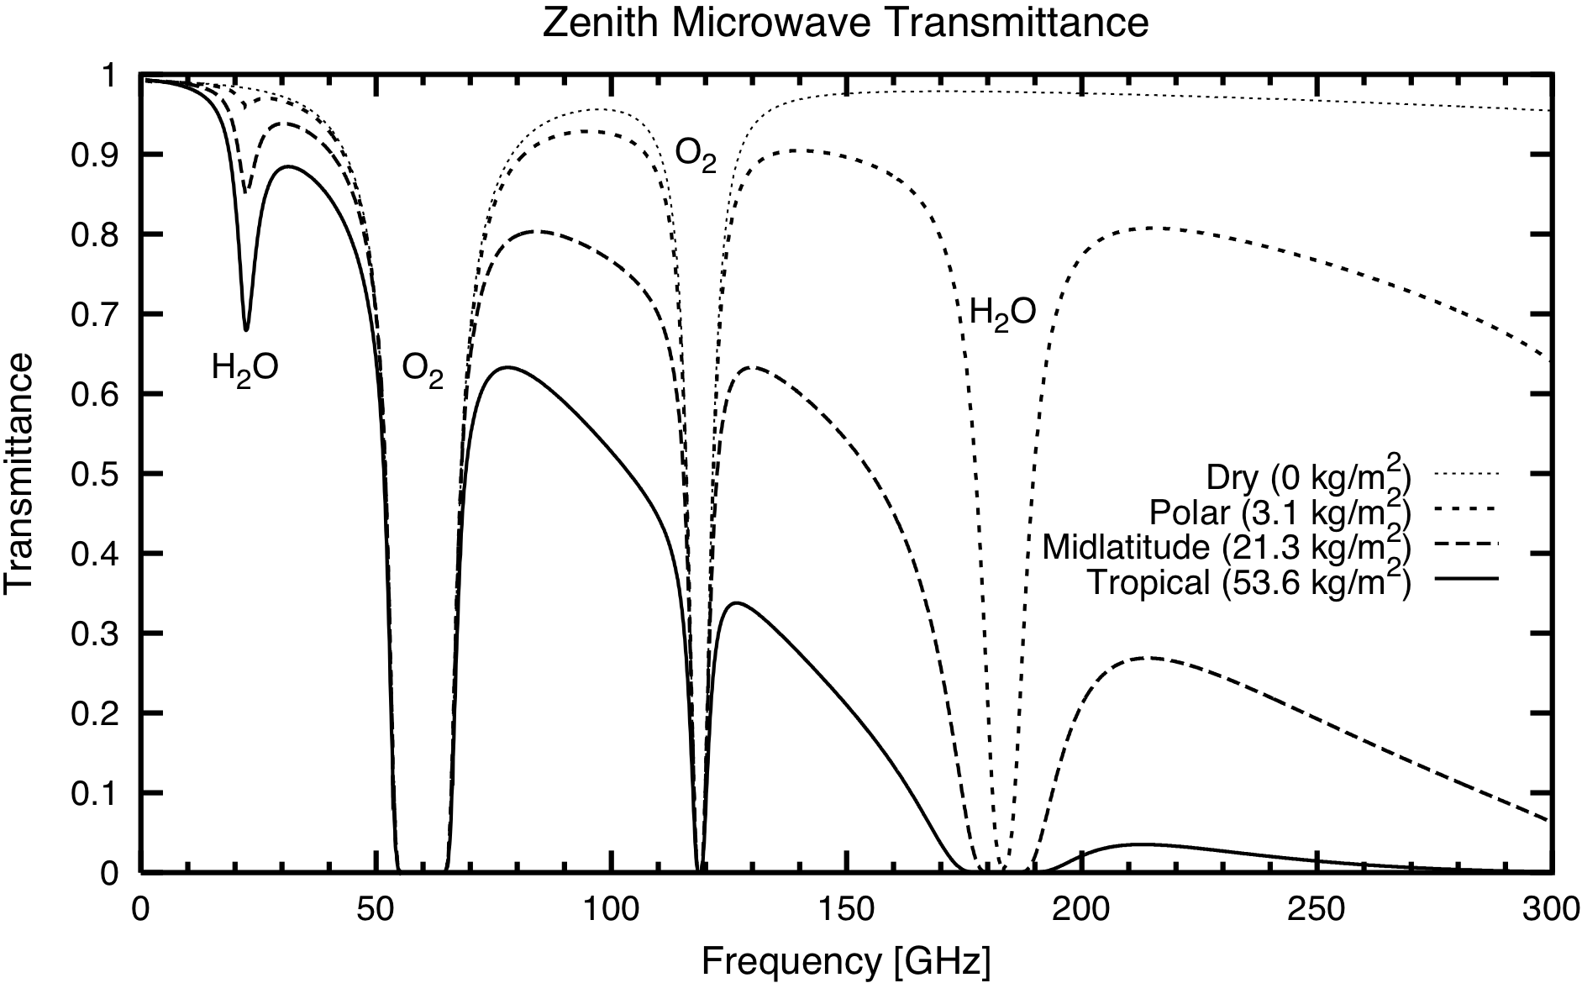
Zenith Microwave Transmittance: Cloud Free Atmospheres
Water
Vapor
Rotational
Lines
Choose microwave frequencies for cloud emissivity measurement where transmittance is high!!! Water vapor is variable; choose low frequency.

Slide 17
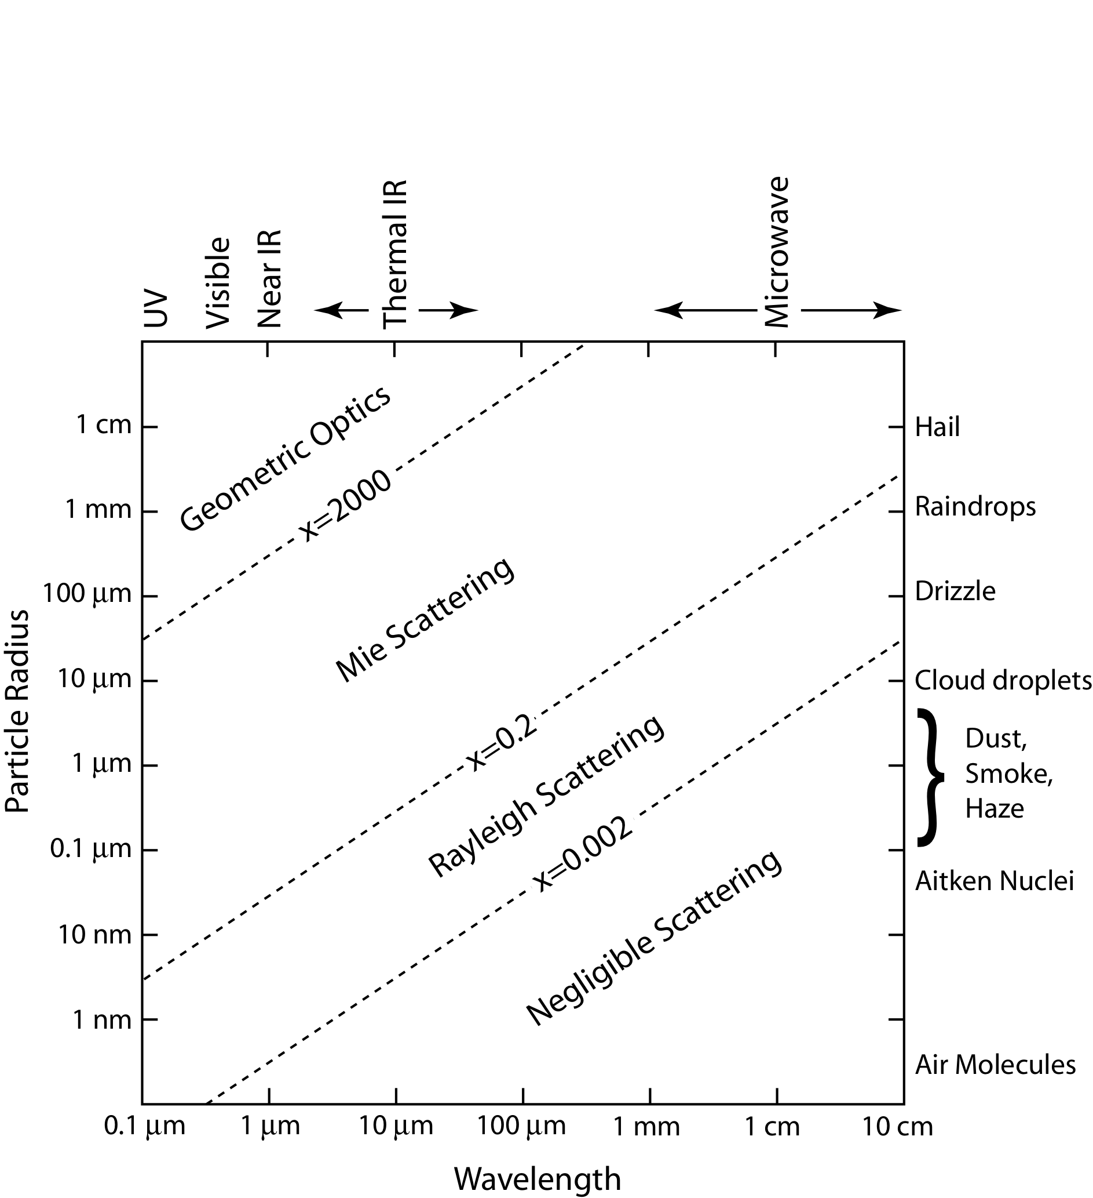
Scattering and Absorption by Particles
Summary of Scattering Regimes: Note Particle Sizes
and wavelengths of radiation!!

Slide 18
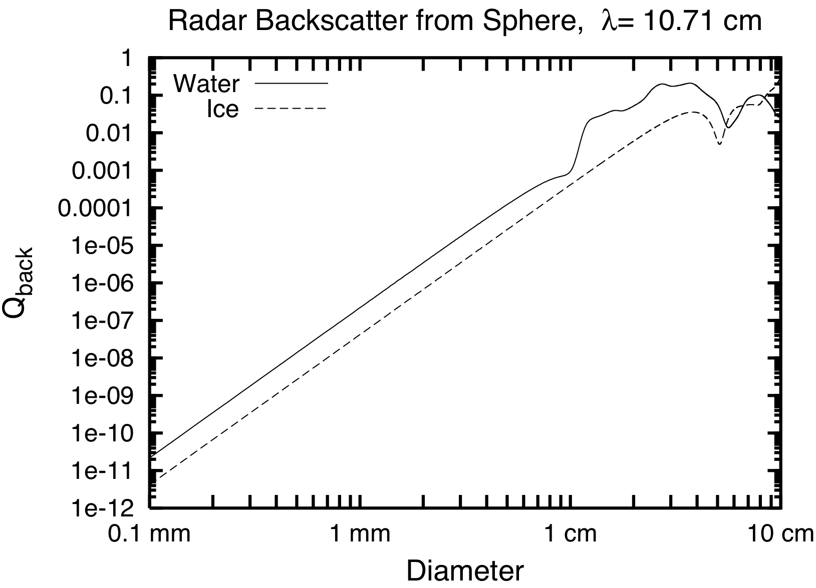
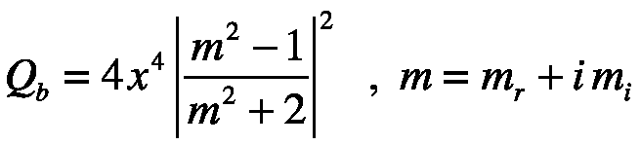
Mie Radar Backscatter Efficiency for Water and Ice Spheres
Non Rayleigh
strong backscatter by water drops
compared to that of ice!!
Rayleigh
WSR-88D NWS Doppler Radar

Slide 19
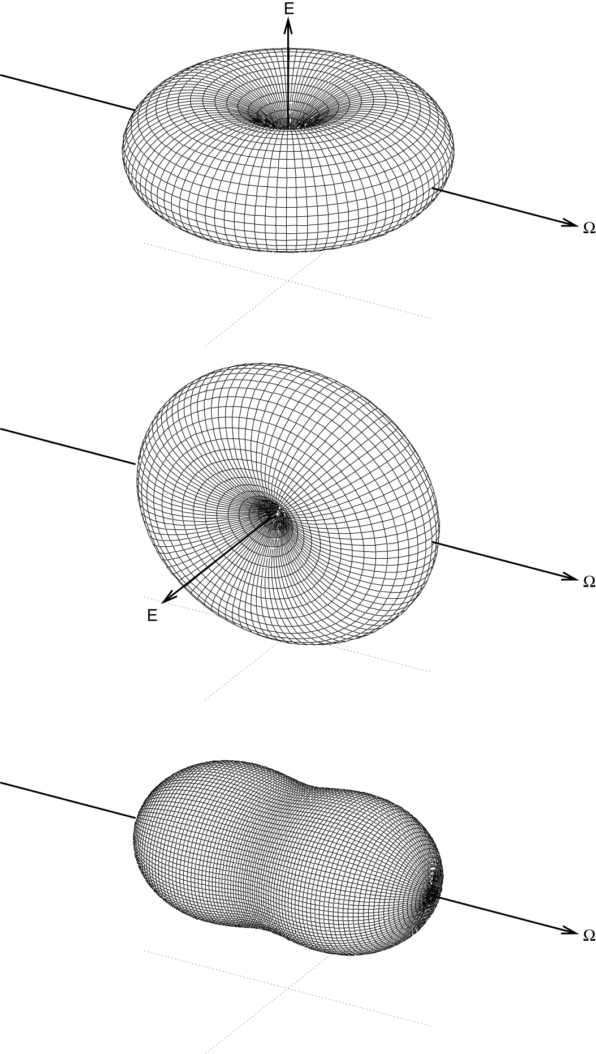
Rayleigh Scattering Phase Function: Angular Distribution of Light Scattered by a Dipole
vertical polarization
state
3D rendering
horizontal polarization
state
The Peanut!
Average of both
polarization states.

Slide 20
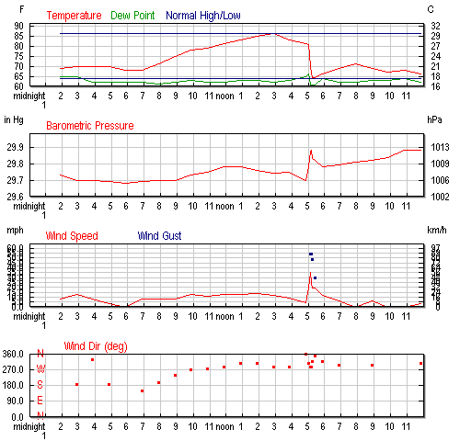
Example: June 27, 2008, Omaha Nebraska.
Check out those
monster spikes
near 5 pm!!
More than 0.5” rain
in less than 15 minutes.

Slide 21
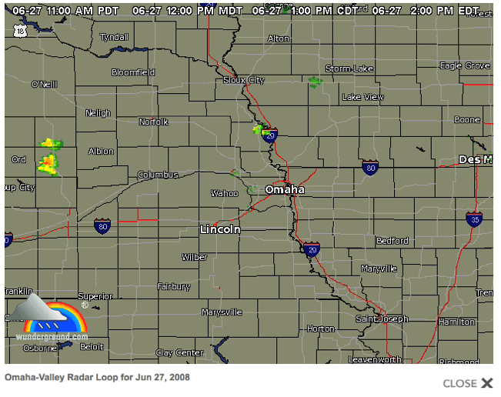
NEXRAD Radar in Omaha Nebraska, 27 June 2008.

Slide 22
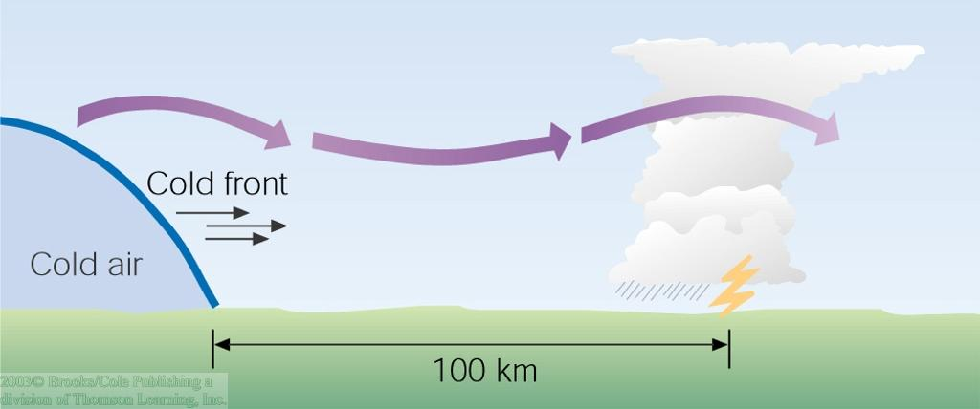
Gravity Waves
Pre-frontal squall line formation is not fully understood.
One theory suggests that a surging cold front may initiate "gravity waves" aloft, where the rising motion of the wave causes cumulus cloud development.

Slide 23

Trailing Stratified Clouds
An extensive region of stratified clouds may follow behind a squall line.
This figure shows a loop of rising and falling air that supplies the moisture to the stratiform clouds and associated light precipitation.

Slide 24
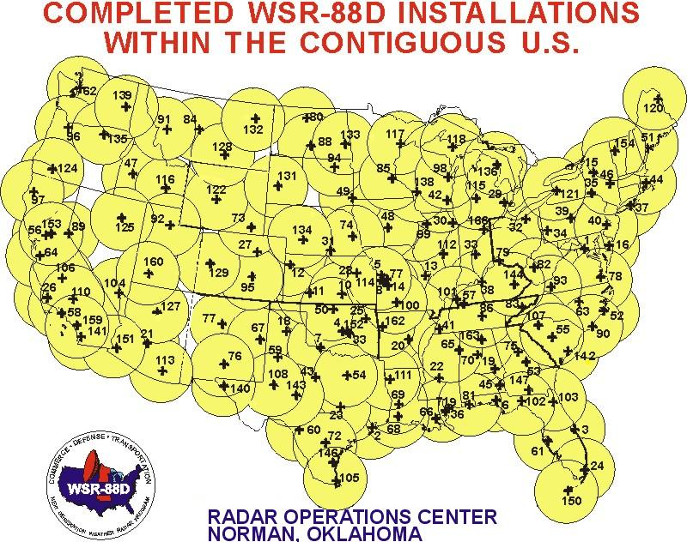
NEX RAD SITES IN THE U.S.

Slide 25
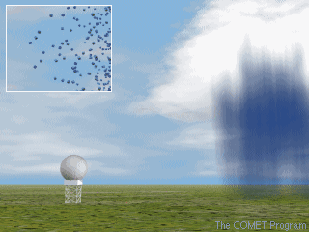

Slide 26

Compare to: Acoustic Echo-location
hello

Slide 27


Acoustic Echo-location
hello

Slide 28

Acoustic Echo-location
hello
distance

Slide 29

Hi !!
Hi !!
time
t = 2 x range / speed of sound
Example: range = 150 m
Speed of sound ≈ 340 meters/second
t = 2 X 150 / 340 ≈ 1 second

Slide 30
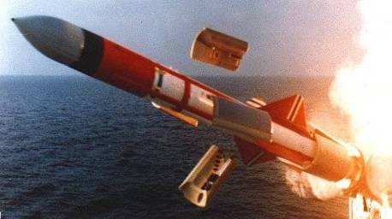

RADAR Echolocation (RADAR ~ RAdio Detection And Ranging) “Microwave Echo-Location”
Tx
Rx
Microwave
Transmitter
Receiver

Slide 31
Radars work by…
Transmitting microwave pulses….
and measuring the …
Time delay (range)
Amplitude
Frequency
Polarization
… of the microwave echo in each range gate

Slide 32
Target Spatial Orientation
Large Drops
Polarization
P_{t}
Small Drops
Polarization
P_{s}
Closer look at Large drop

Slide 33

Example: Weather Echoes
Microwave
Transmitter
Receiver

Slide 34
Echo versus Range (range profile)
Transmitted Pulse #1
Cloud Echo
time

Slide 35
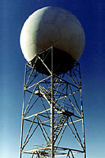
Why Radar Can't (Usually) See Tornadoes
The network of WSR-88D Doppler radars across the US has certainly proven itself for the ability to detect severe weather. Tornado warnings, in particular, are much better now that National Weather Service forecasters have this fantastic new (new as of the early 1990s) tool.
But did you know that Doppler radar (usually) can't see an actual tornado? When Doppler radar is cited in a tornado warning it is generally because meteorologists see evidence the storm itself is rotating. It is a supercell thunderstorm or at least contains an area of rotation called a mesocyclone.
When can and when can't Doppler radar see a tornado? It's math! Let's figure it out. We'll be looking into two factors:
1) the first is something you learned in school a loooong time ago - the earth is curved, and
2) the radar "beam" is 1 degree wide.

Slide 36
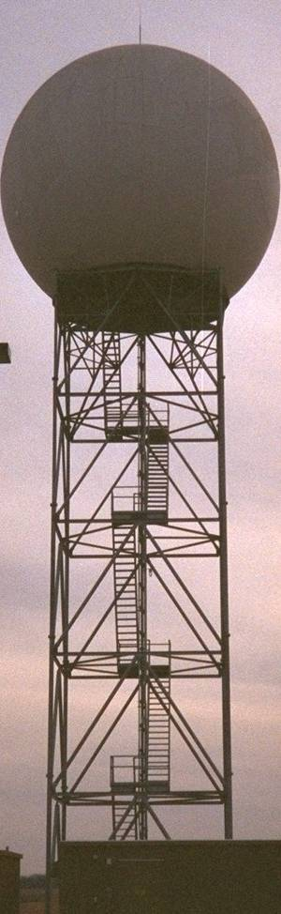
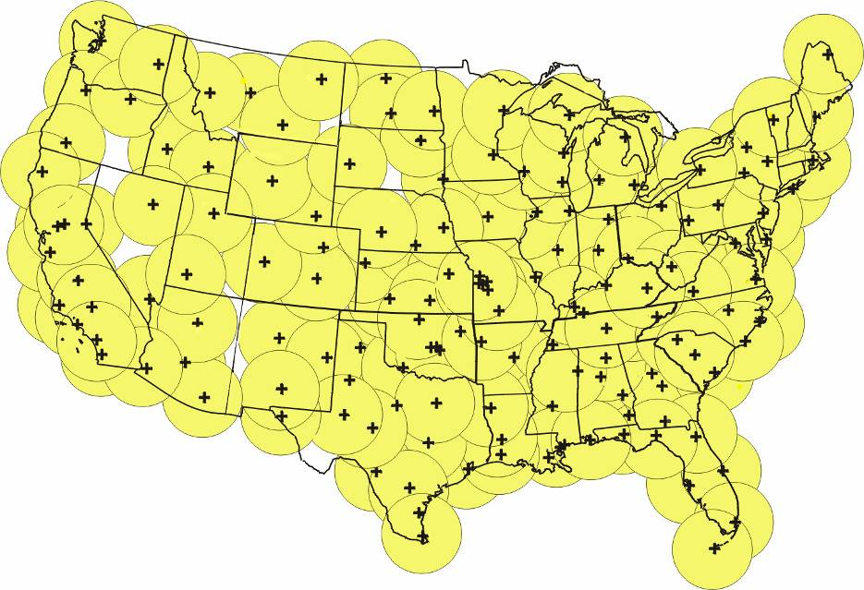
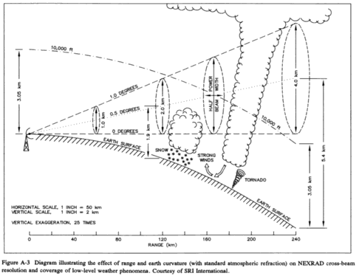
NEXRAD System Today
Gap

Slide 37
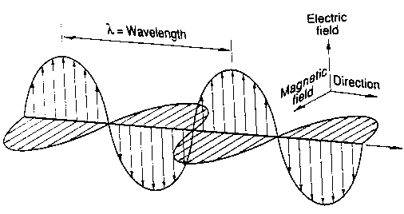
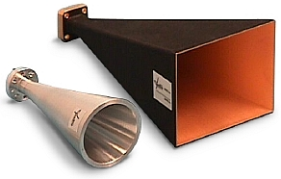
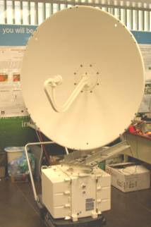
Antennas
Antenna is a transition passive device between the air and a transmission line that is used to transmit or receive electromagnetic waves.

Slide 38

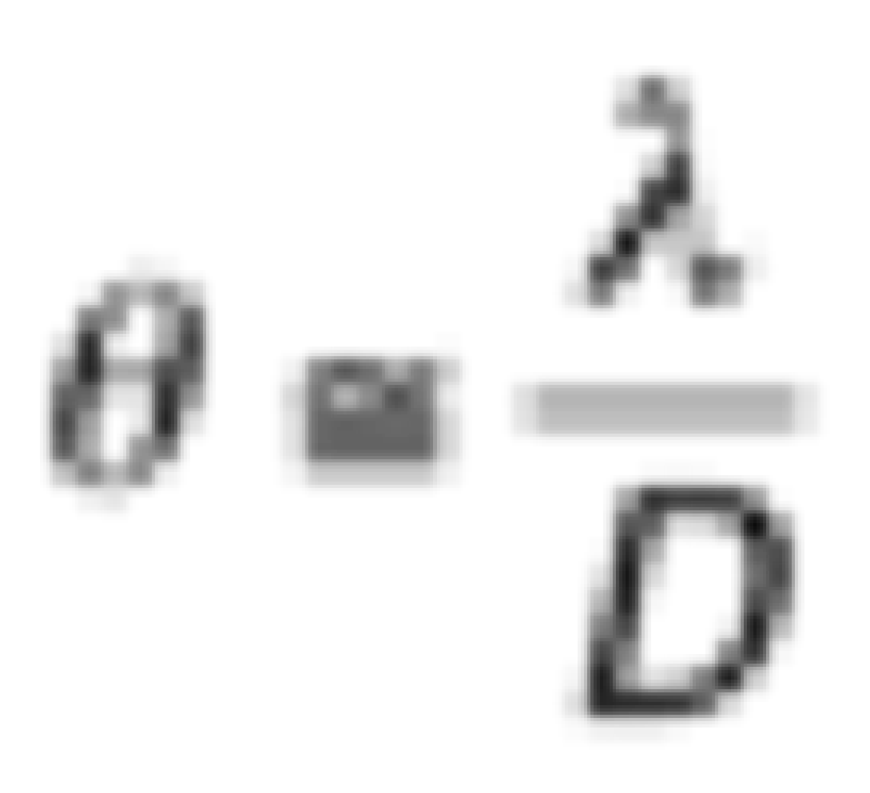
Antenna Beamwidth
radians
D is the antenna diameter
λ is the wavelength of signal in air
Tradeoff:
Small wavelengths (high frequencies) = small antennas
But small wavelengths attenuate more

Slide 39
Object Size
How wide and tall are various things we want to see?
Width of Meteorological Objects (i.e. Storms, Tornadoes)
Object | Width | Height or Depth
Supercell thunderstorm | 10-30 mi | 28,000-55,000 ft
Circulation within the supercell thunderstorm | 2-8 mi | 2,000-55,000 ft
Tornado | 0.1 - 1.0 mi | Cloud base - 0.5 - 1.5 mi*
Individual storm cell within a squall line | 2-8 mi | 4,000-55,000 ft
Circulation embedded within a squall line | 2-5 mi | 4,000-40,000 ft

Slide 40
Understanding and Interpreting NWS WSR-88D Doppler Radar
From the National Weather Service
Greenville-Spartanburg, SC

Slide 41
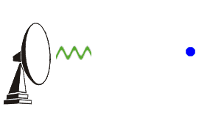
Quick Overview
Antenna emits series of radio waves
Listens for amount of energy reflected back
The better the target is reflecting (i.e. more raindrops) the stronger the signal or echo will be
Interesting Tidbit: The WSR-88D takes about 0.0000016sec to emit a pulse or radio wave. This means for every hour, the Radar is “on” for 7 seconds and “listens” for the remaining 59min and 53sec
From the National Weather Service
Greenville-Spartanburg, SC

Slide 42
How Doppler Works
The Doppler effect: change in frequency depending upon movement toward or away from observer
When a train passes, what sound does it make?
Velocity data useful during severe weather and detecting rotation such as tornadoes
From the National Weather Service
Greenville-Spartanburg, SC

Slide 43
Scan Patterns
From the National Weather Service
Greenville-Spartanburg, SC
Clear Air Mode
Used when no precipitation is present
Can detect smoke plumes, clouds, fog, birds and insect swarms
One full scan every 10 minutes
Precipitation Mode
Switches over from Clear Air Mode
automatically when considerable precipitation is detected
One full scan every 5-6 minutes

Slide 44
Ground Clutter
Most prevalent on 0.5° reflectivity and velocity images
Radar beam is striking stationary ground targets
Usually appears as an area of uniform returns surrounding radar site
Velocities usually near zero on velocity images
Some is filtered but it is impossible to remove it all
Especially bad during inversions or after frontal passages
From the National Weather Service
Greenville-Spartanburg, SC

Slide 45
Beam Spreading
Actual Depicted
The beam widens as it moves away from the radar. If a small storm is a considerable distance from the radar...it may not be big enough to completely fill the beam.
Since the radar cannot discern things thinner than the beam, it assumes the storm is filling it entirely. This can make a storm look bigger than reality.
From the National Weather Service
Greenville-Spartanburg, SC

Slide 46
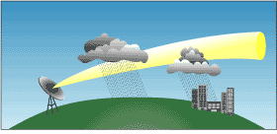
Beam Height vs. Distance
Lowest elevation slice is 0.5° so it is not totally horizontal.
Earth’s curvature also plays a role.
Radar beam gets higher off the ground farther from the radar.
Makes low level precipitation invisible to radar at considerable distances.
From the National Weather Service
Greenville-Spartanburg, SC

Slide 47
Products Available
Reflectivity Images
Velocity Images (Doppler)
Precipitation Estimates
Vertically Integrated Liquid
Echo Tops
Animated Loops of Most Products
Many Other Products
From the National Weather Service
Greenville-Spartanburg, SC

Slide 48
Reflectivity Images
Base Reflectivity and Composite Reflectivity
Base Reflectivity
Composite Reflectivity
0.5° elevation slice
Shows only the precipitation at the lowest tilt level
May underestimate intensity of elevated convection or storm cores
Displays the maximum returned signal from all of the elevation scans
Better summary of precipitation intensity
Much less deceiving than Base Reflectivity
Subtle 3-D storm structure hidden
From the National Weather Service
Greenville-Spartanburg, SC

Slide 49
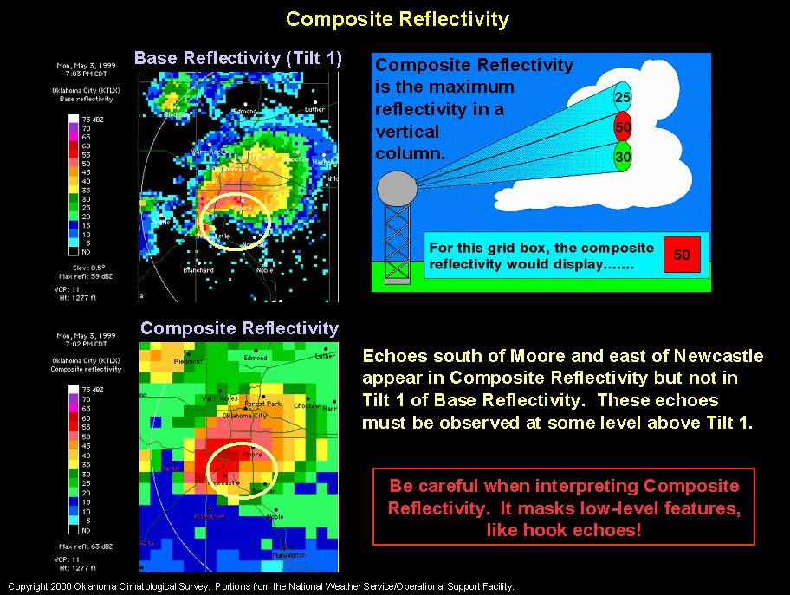
Reflectivity Images
Composite Reflectivity
Displays the maximum returned signal from all of the elevation scans to form a single image
Can often mask some Base Reflectivity signatures such as a hook echo
From the National Weather Service
Greenville-Spartanburg, SC

Slide 50
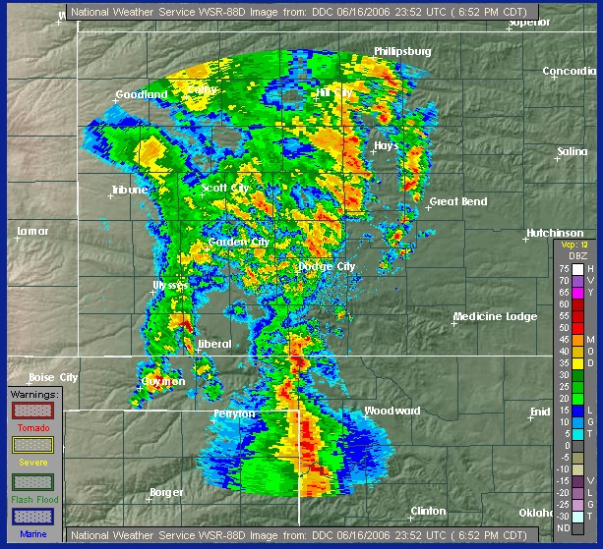
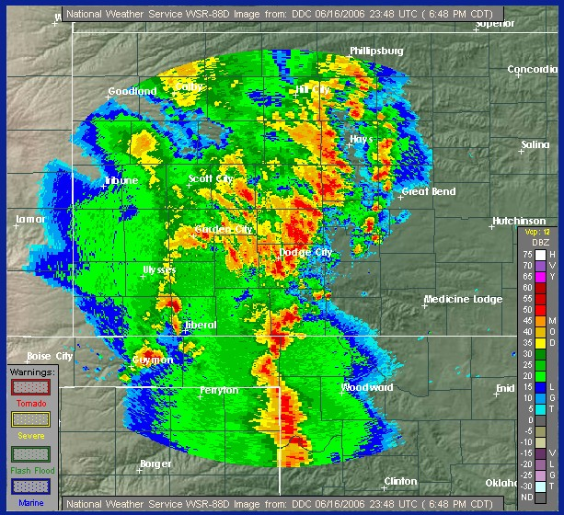
Base vs Composite Reflectivity
Which is which?
Base Reflectivity Image
Composite Reflectivity Image
Notice the heavier returns and more coverage
Notice the lighter returns
From the National Weather Service
Greenville-Spartanburg, SC

Slide 51
Velocity Imagery
Warm colors are winds moving away from radome
(reds, +)
Cool colors are winds moving toward radome
(greens, -)
Wind speed is in knots
Tight area of opposing winds (+ and -) can indicate convergence or rotation. Circled area called a couplet. Indicates a possible tornado.
From the National Weather Service
Greenville-Spartanburg, SC

Slide 52
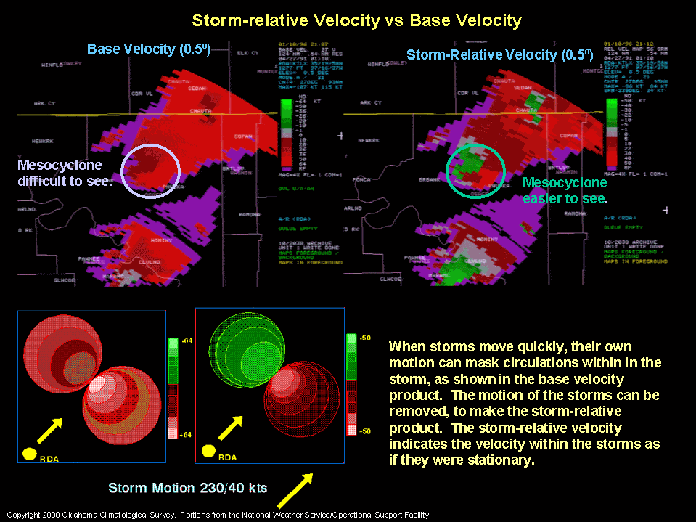
Storm Relative Motion
From the National Weather Service
Greenville-Spartanburg, SC

Slide 53
Examples of Velocity Images
From the National Weather Service
Greenville-Spartanburg, SC
Circled areas are MARC signatures
- Mid-Altitude Radial Convergence -
These indicate a strong likelihood of a downburst wind.
- Circled pink areas (sometimes purple) indicate ‘range folding’ (RF); areas where velocity data cannot be determined.
-This can be due to distance from antenna or interference of data.

Slide 54
How to read the intensity scale
Extreme
Intense
Severe
Heavy
Moderate
Light
Very light
Light Precipitation
Very light precipitation
Fog, Clouds, Smoke
Dust, Insects, Birds
The time listed is usually in UTC or Z time. To convert this to eastern daylight time, subtract 4 hours; for standard time subtract 5.
Units are decibels of Z (reflectivity).
Precipitation Mode Scale
Clear-Air Scale
From the National Weather Service
Greenville-Spartanburg, SC

Slide 55
Hail Detection
Returns > 55 dBz usually indicate hail.
However, the probability of hail reaching the ground depends on the freezing altitude.
Usually, a freezing level above 14,000 feet will not support much hail.
This is because the hail melts before reaching the ground.
Freezing level can be determined from an upper air sounding.
From the National Weather Service
Greenville-Spartanburg, SC

Slide 56
Hail?
Max return of 60 dbZ
Max return of 65 dbZ
Freezing level was 7,000 feet Freezing level was 17,000 feet
Produced golfball sized hail Produced no hail
Hence, hail production depends directly on freezing level.
From the National Weather Service
Greenville-Spartanburg, SC

Slide 57
Vertically Integrated Liquid (VIL)
Take a vertical column of the atmosphere: estimate the amount of liquid water in it.
High VIL values are a good indication of hail.
The white pixel indicates a VIL of 70.
This storm produced golfball size hail.
Trouble with VIL is that the operator has to wait for the scan to complete before getting the product.
From the National Weather Service
Greenville-Spartanburg, SC

Slide 58
The Hail Spike
Also called Three-Body Scattering
A dense core of wet hail will reflect part of the beam to the ground, which then scatters back into the cloud, and is bounced back to the antenna.
The delayed returns trick the radar into displaying a spike past the core.
Usually, will only result from hail 1 inch in diameter or larger (quarter size).
From the National Weather Service
Greenville-Spartanburg, SC

Slide 59
Echo Tops
Fairly accurate at depicting height of storm tops
Inaccurate data close to radar because there is no beam angle high enough to see tops.
Often has stair-stepped appearance due to uneven sampling of data between elevation scans.
From the National Weather Service
Greenville-Spartanburg, SC

Slide 60
Precipitation Estimates
An incredibly powerful tool to the meteorologist
Storm Total Precipitation
Total estimated accumulation for a set amount of time.
Totals are in inches
Time range is sometimes listed on image.
Resets storm total whenever there is no rain detected for an hour.
From the National Weather Service
Greenville-Spartanburg, SC

Slide 61
One Hour Precipitation Total
From the National Weather Service
Greenville-Spartanburg, SC
-Updated once per volume scan.
Shows accumulated rainfall for the last hour.
Useful for determining rainfall rate of ongoing convection.

Slide 62
Doppler Precipitation Estimate
Advantages and Limitations
Great for scattered areas of rain where no rain gauges are located
Has helped issue flash flood warnings more efficiently
Helps fill in the holes where ground truth information is not available
Much better lead time for warnings
Provides a graphical ‘map’ of rainfall for an entire region
Data can be overlaid with terrain and watersheds to predict reservoir and waterway crests
Estimates based on cloud water levels and not ground level rainfall
‘Hail Contamination’ causes highly inflated values
High terrain causes underestimates
Lower resolution than reflectivity images
Useful as a supplement, not replacement for ground truth information
From the National Weather Service
Greenville-Spartanburg, SC

Slide 63
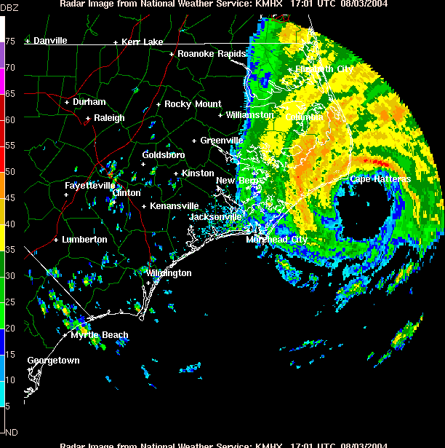
Radar Loops
From the National Weather Service
Greenville-Spartanburg, SC

Slide 64
A few examples
Tornadic couplet
Heavy rains along the coast
From the National Weather Service
Greenville-Spartanburg, SC

Slide 65
Bow Echoes
Detecting and Predicting Downbursts
Bow echoes are caused by severe downbursts, accelerating part of a line of thunderstorms ahead of the rest.
The strongest downbursts occur under and just north of the apex of the bow, but can occur elsewhere too.
Surface winds can exceed 70mph in strong bow echoes.
Bow echoes can move at over 50 mph.
Highest reflectivities and strongest velocities are found at the apex.
Look for a tight gradient of reflectivity.
From the National Weather Service
Greenville-Spartanburg, SC

Slide 66
Small Scale Outflow Boundaries
From the National Weather Service
Greenville-Spartanburg, SC
And their effects on convective storms
Are boundaries separating thunderstorm-cooled air from surrounding air
Characteristics similar to small cold fronts
Can move 100 miles from point of origin
Eventually stall and can persist for more than 24 hours after forming
Boost new and developing convection
←
Leftover outflow boundary
←
Five hours later

Slide 67
Sun Spike
Visible at sunrise and sunset. It is electromagnetic interference from the sun when radar antenna is aimed directly at it.
From the National Weather Service
Greenville-Spartanburg, SC

Slide 68
Radar Ornithology: The study of birds
A unique use of the WSR-88D
- NEXRAD is much more sensitive than previous radars.
- Most commercial image providers remove clutter such as birds from imagery, so few actually see them.
- Ornithologists track migrations and movement of large groups of birds using radar.
- Only useful when precipitation is not present.
Purple Martins flying off a lake in S.C., 30 minutes before sunrise
From the National Weather Service
Greenville-Spartanburg, SC

Slide 69

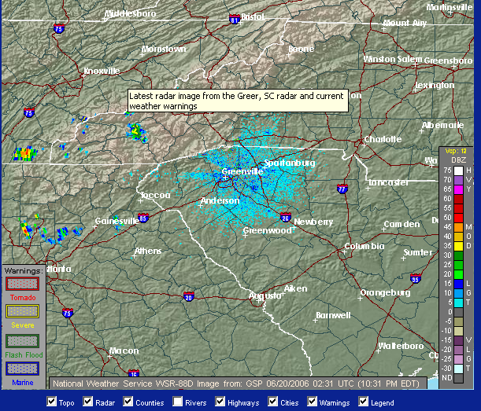
Where to find radar imagery
Some internet resources
Go to our web page: weather.gov/GSP and look under the “Radar Imagery” Menu
R.I.D.G.E radar: Radar Integrated Display with Geospatial Elements
You can still get our old style radar display by clicking on “Standard Radar”
From the National Weather Service
Greenville-Spartanburg, SC

Slide 70
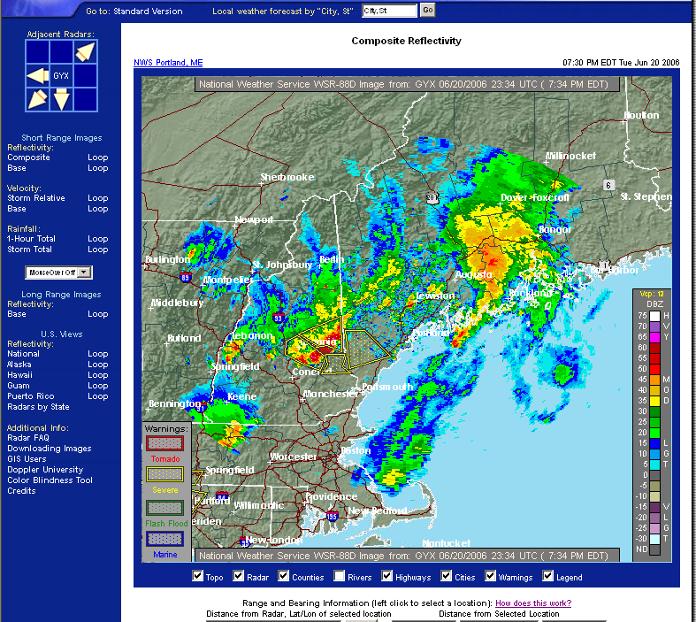
R.I.D.G.E. & Severe Weather
From the National Weather Service
Greenville-Spartanburg, SC
Warning boxes are now an optional overlay with the R.I.D.G.E. graphics
Warning boxes are updated practically in real time
Polygon is an actual representation of Warning Box
Better assessment of severe threat than county based warning

Slide 71
Where to find radar imagery, continued
The NWS web pages don’t have all of the radar products discussed today. We allow universities and 3rd party vendors to display this data.
http://weather.cod.edu/analysis/analysis.radar.html : College of DuPage; velocity, reflectivity, VIL, precip estimates. All free of charge.
Numerous other commercial vendors
From the National Weather Service
Greenville-Spartanburg, SC

Slide 72
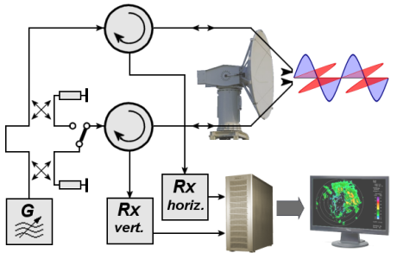
What Next for NEXRAD? WSRP-2010D
Polarimetric radar
The next major upgrade is polarimetric radar, which adds vertical polarization to the current horizontal radar waves, in order to more accurately discern what is reflecting the signal. This so-called dual polarization allows the radar to distinguish between rain, hail and snow, something the horizontally polarized radars cannot accurately do. Early trials have shown that rain, ice pellets, snow, hail, birds, insects, and ground clutter all have different signatures with dual-polarization, which could mark a significant improvement in forecasting winter storms and severe thunderstorms. The deployment of the dual polarization capability to nexrad sites will begin in 2010 and last until 2012.

Slide 73
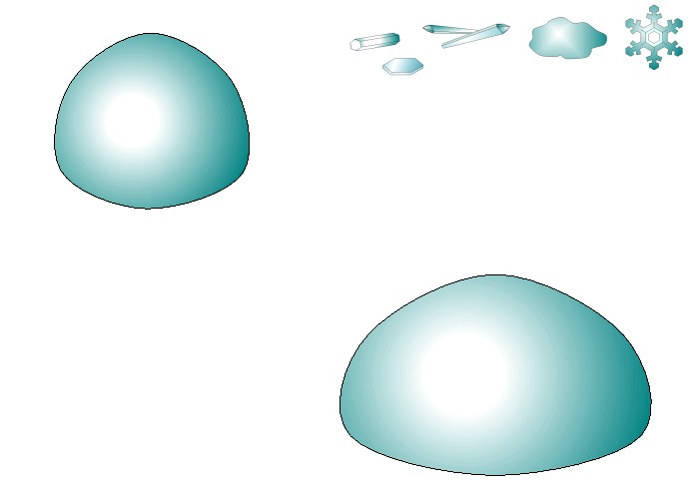
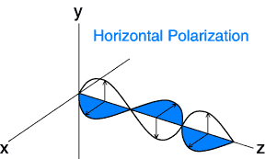

POLARIMETRIC RADAR?
Conventional
Radar (NEXRAD)
Polarimetric
Radar (ARMOR)
Notes:
`

Slide 74
Polarimetric Variables
Reflectivity factor Z at horizontal polarization
- Measure of size and concentration of scatters
(dominated by SIZE)
2. Differential reflectivity Z_{DR}
- Measure of median drop diameter→ SIZE/SHAPE
- Useful for rain / hail / snow discrimination→ SIZE/SHAPE/PHASE
3. Differential phase Φ_{DP} (Specific Differential Phase- K_{DP})
- Efficient for accurate rainfall estimation→ NUMBER/SHAPE
- Immune to radar miscalibration, attenuation, and partial beam blockage
4. Cross-correlation coefficient ρ_{hv}
- Indicator of mixed precipitation → SHAPE/PHASE
- Efficient for identifying nonmeteorological scatterers
Operational:
NEXRAD, TV
Small ZDR Large ZDR
vs
Research:
NCAR, CSU, NASA, UND, DLR, BMRC, NOAA-ETL
ARMOR

Slide 75

Advantages of a Dual-Polarization Radar
Really just a self-consistent way of obtaining a more complete description of the particle types and shapes present in a given volume of space.
More accurate rainfall estimation (10-20% max accumulation error as opposed to 200-300%).
Why? Because we collect information on drop size/shape/concentration and are able to mitigate hail contamination.
Identification of precipitation types and discrimination between meteorological and non-meteorological scatterers
Improvement in radar data quality: Self consistent way to calibrate using polarimetric variables
Small ZDR Large ZDR
Small drops Large drops
Mitigates the multiple Z-R issues!
vs
Hail Rain
Insects
Rain
vs
vs

