Slide 1
Radar: The Quickest Path to dbZ
Absorption, scattering and extinction cross sections.
Backscattering cross section.
Cross section in the Rayleigh limit (particle diameter is much smaller than the wavelength of the radiation.)
Radar cross section for a particle in the Rayleigh limit.
Radar cross section for N particles in the Rayleigh limit.
Note: Key results are circled by a red box like this. The homework assignment is also given by a red box.

Slide 2
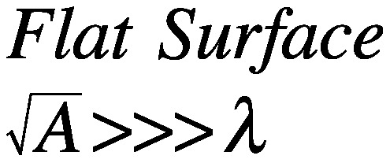

Definitions: Optical Coefficients for a Flat Surface
Sunlight
I₀ (W/m²)
λ
Sunlight
I₀ (W/m²)
λ
Black Surface
Area A (m²)
a = albedo = 0
Absorptance = (1-a) = 1
Arbitrary Surface
Area A (m²)
a = albedo
Absorptance=(1-a)
Power Scattered,
Power Absorbed
P_{sca} = 0
P_{abs} = I₀ A
σ _{abs} = A
Power Scattered,
Power Absorbed
P_{sca} = I₀ A a
P_{abs} = I₀ A(1-a)
σ _{abs} = (1-a) A

Slide 3
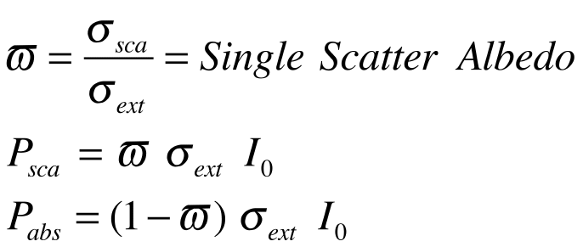
Definitions: Optical Coefficients for a Surface and a Particle
Beam of Sunlight
I₀ (W/m²)
λ
Sunlight
I₀ (W/m²)
λ
Thing (particle, molecule, flea, etc)
Absorption, less light through thing.
Scattering, light redirected by thing.
Arbitrary Surface
Area A (m²)
a = albedo
Absorptance=(1-a)
Power Removed From Beam
I₀ σ_{ext} = P_{ext}
I₀ σ_{abs} = P_{abs}
I₀ σ_{sca} = P_{sca}
Power Scattered,
Power Absorbed
P_{sca} = I₀ A a
P_{abs} = I₀ A(1-a)
σ _{abs} = (1-a) A
σ_{abs}=(1-ω) σ_{ext}

Slide 4
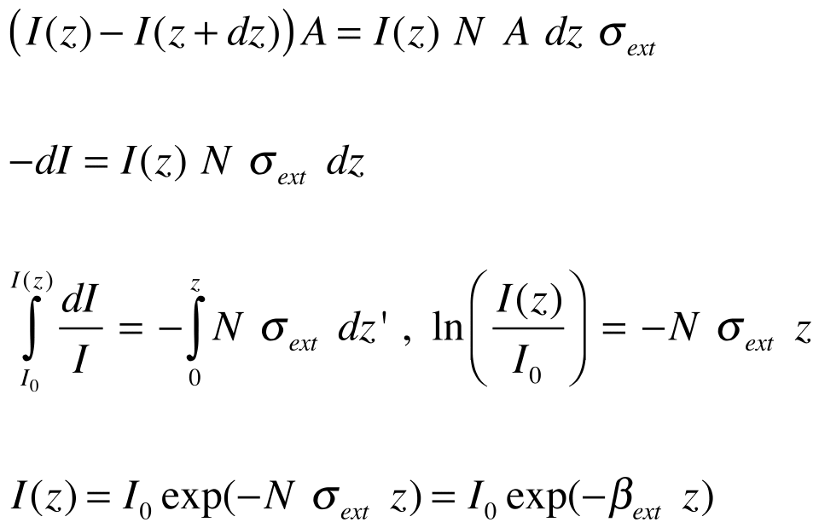
Optics of N identical (particles / volume)
Light beam area = A
z
dz
z+dz
Power removed in dz: = I(z) N A dz σ_{ext}
Bouger-Beer
“law”
(direct beam only!)

Slide 5
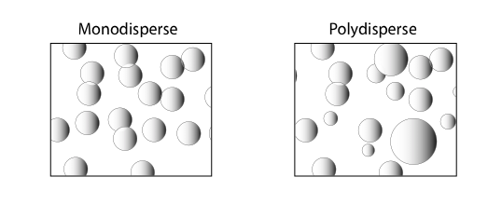
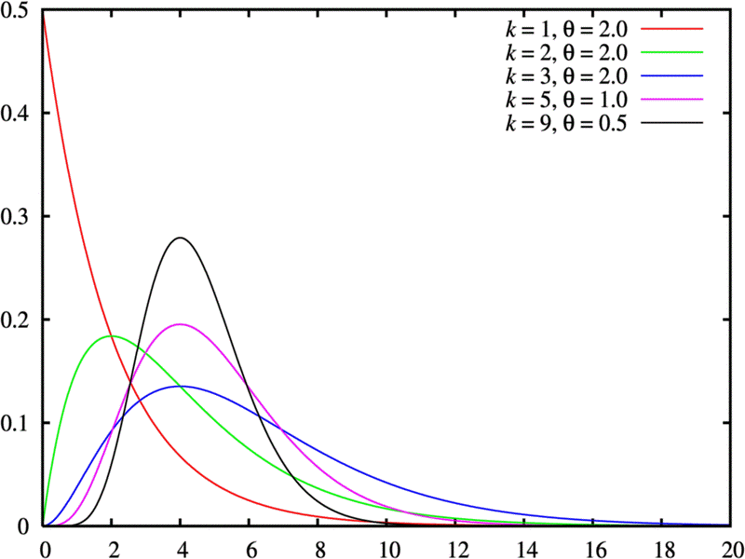
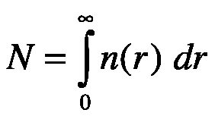
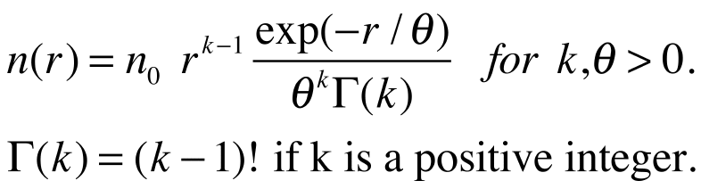

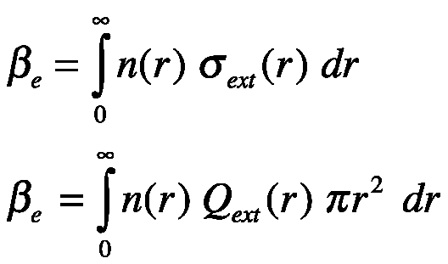
Monodispersons and Polydispersions
n
N particles / volume.
All of radius r.
r

Slide 6
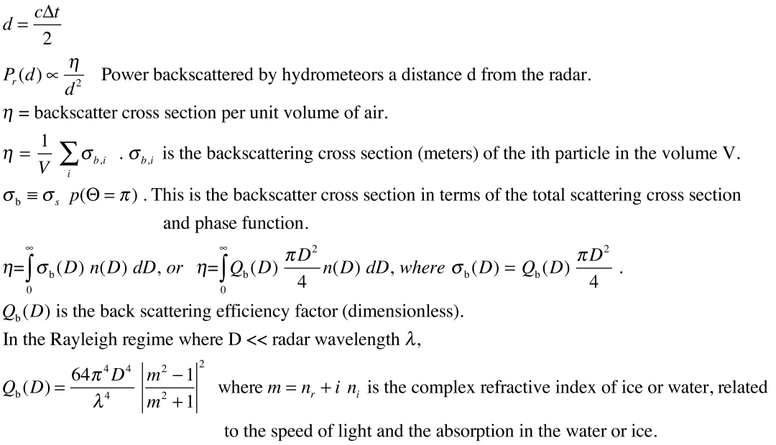
Radar Theory Part 1

Slide 7
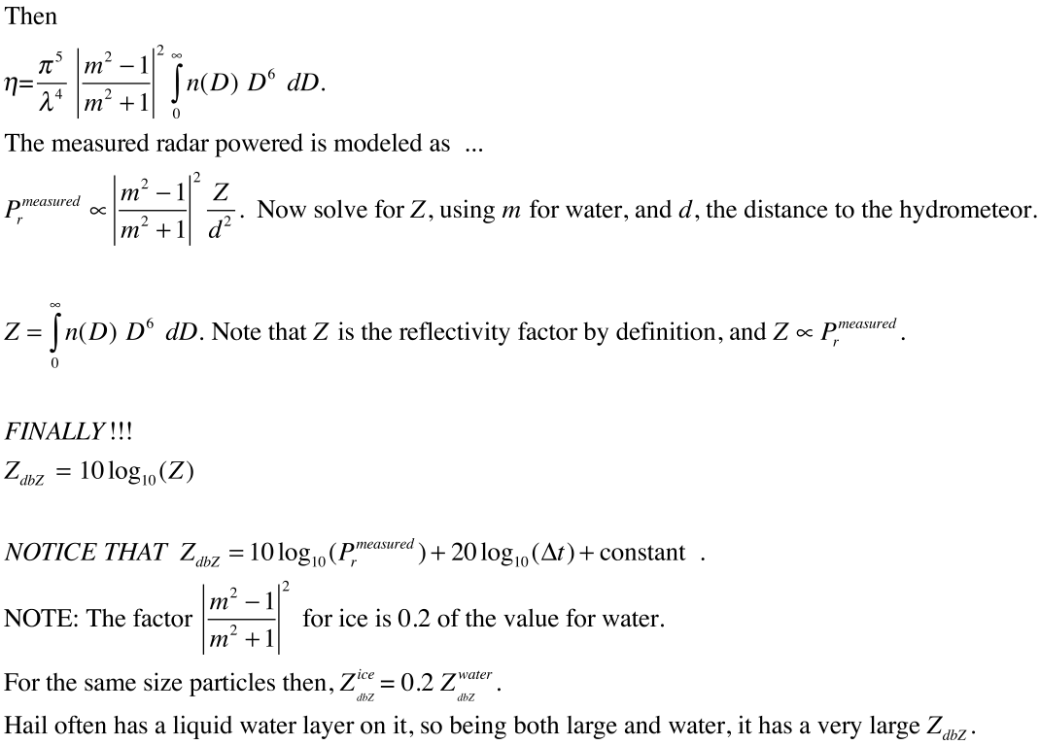
Radar Theory Part 2: Key Results!!!
This is what is reported on radar graphs!!!

Slide 8
Radar Theory Part 2: Typical Values of Z_{dbZ}
Clear air mode of NEXRAD: -28 dbZ to 28 dbZ.
Precipitation mode of NEXRAD: 5 dbZ to 75 dbZ.
Light rain: 20 dbZ.

Slide 9
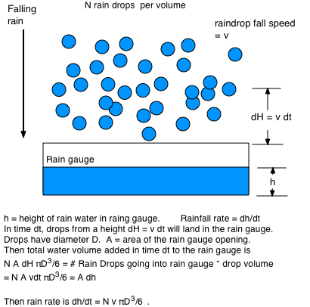
Rain Fall Rate for Monodispersion

Slide 10
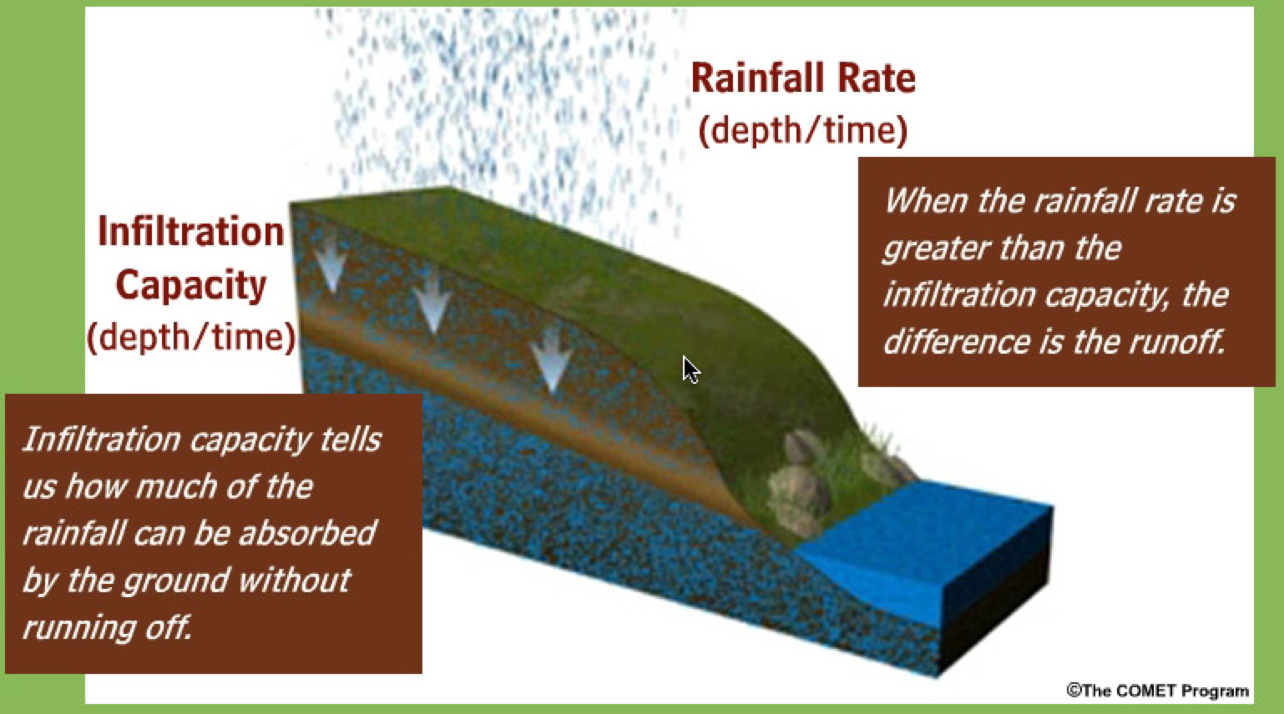
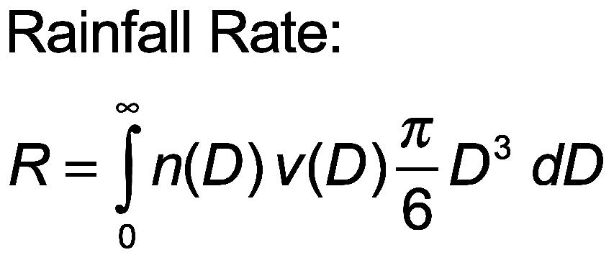
Radar Theory Part 3: Rainfall Rate Estimate From Radar
Definition of rainfall rate and what happens after rain hits the surface. Rainfall rate depends on the mass of water droplets and their fall speed.

Slide 11

Rainfall Rate Analogy
Falling rain: Coffee is being
poured at some rate.
Height of coffee = H
Rainfall Rate = Height of Coffee / time elapsed pouring it.
Rainfall Rate = dH / dt

Slide 12
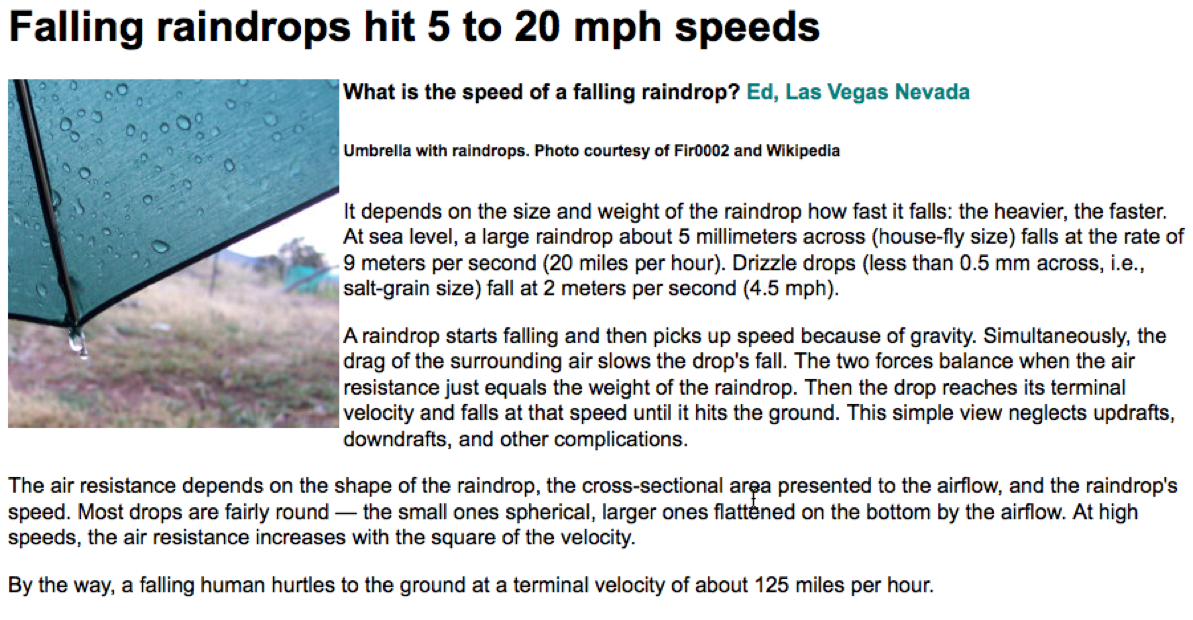
Rain Drop Fall Speed

Slide 13
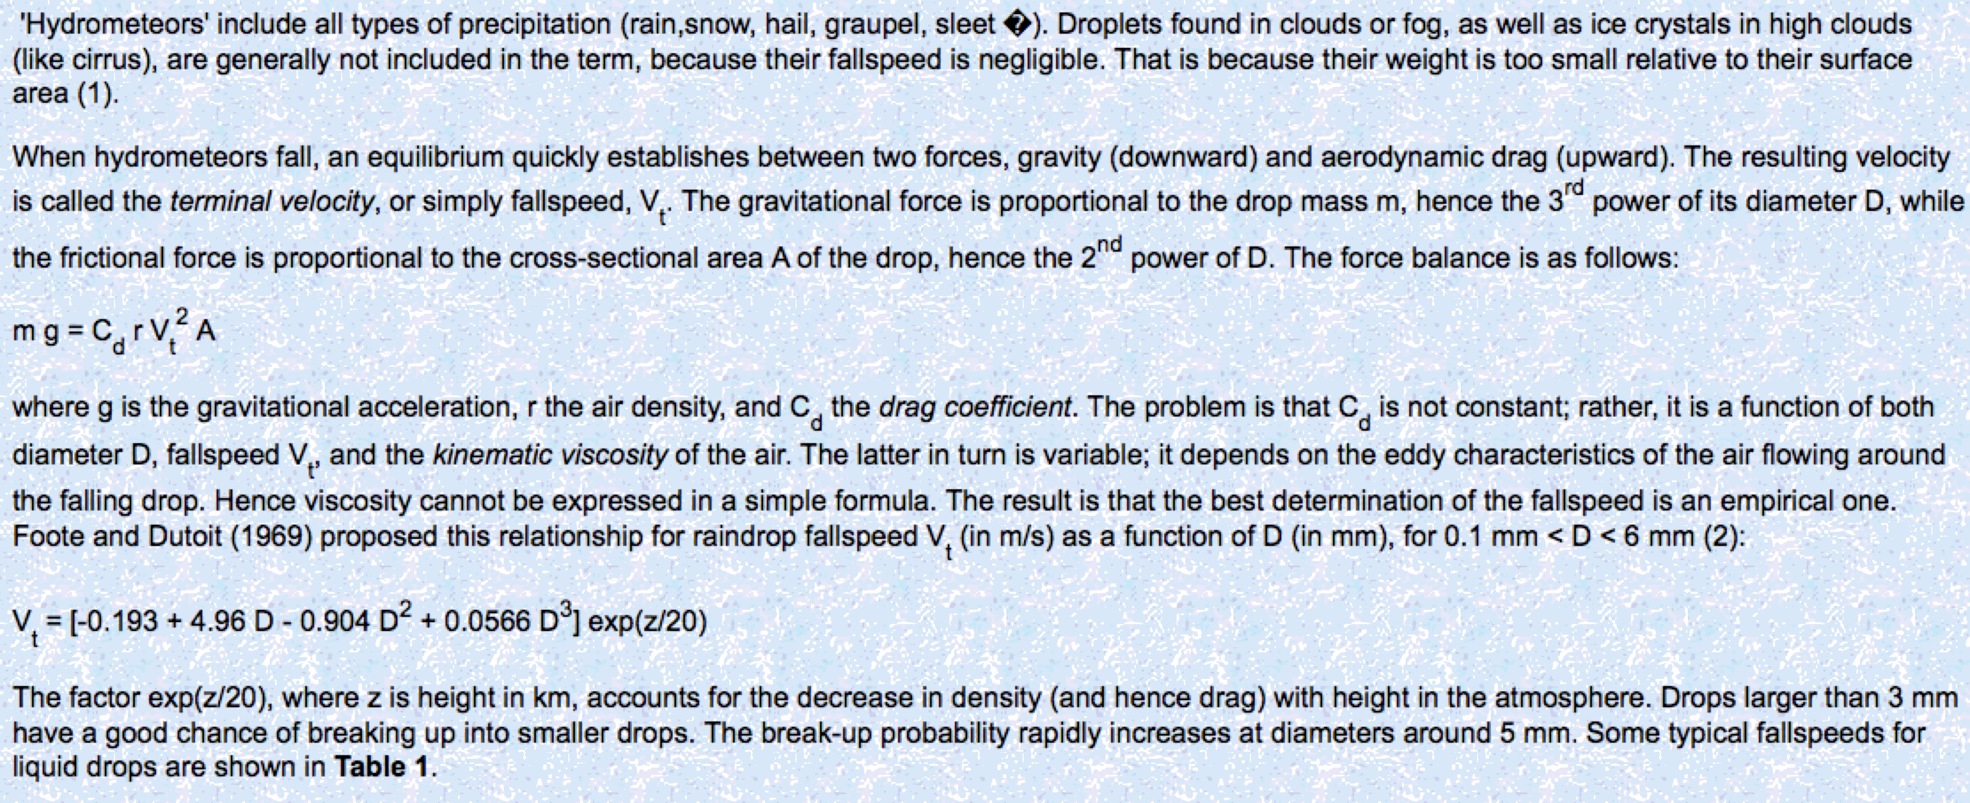
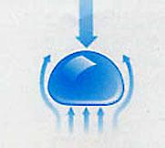
Rain Drop Fall Speed: A balance of Forces, Drag and Gravity

Slide 14
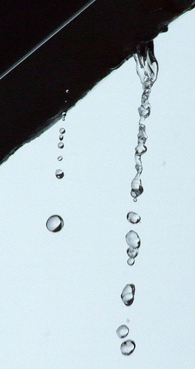
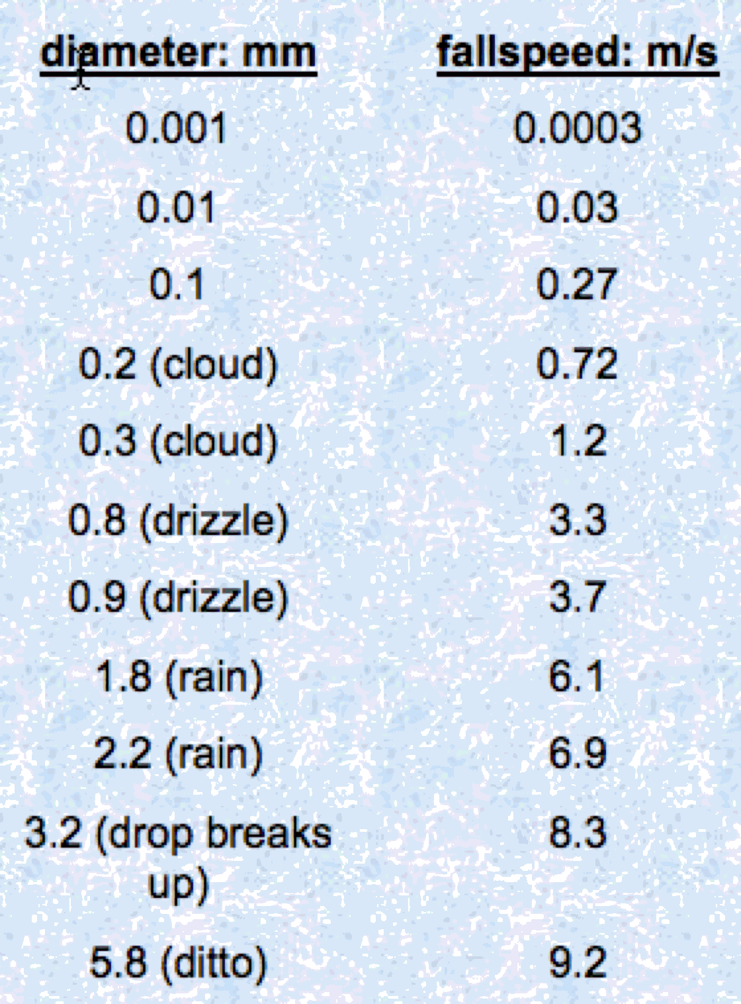
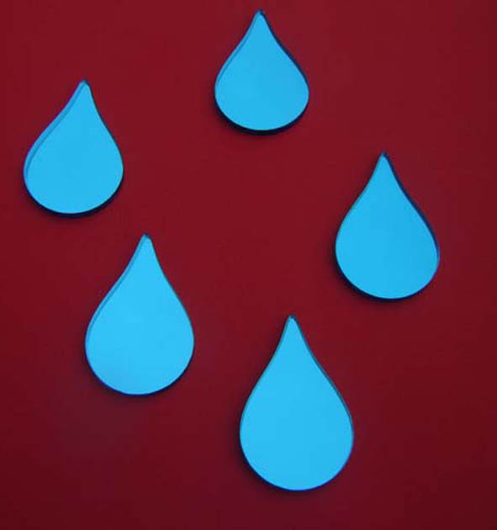
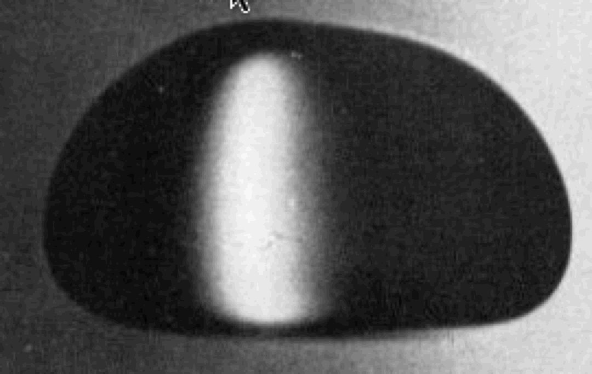
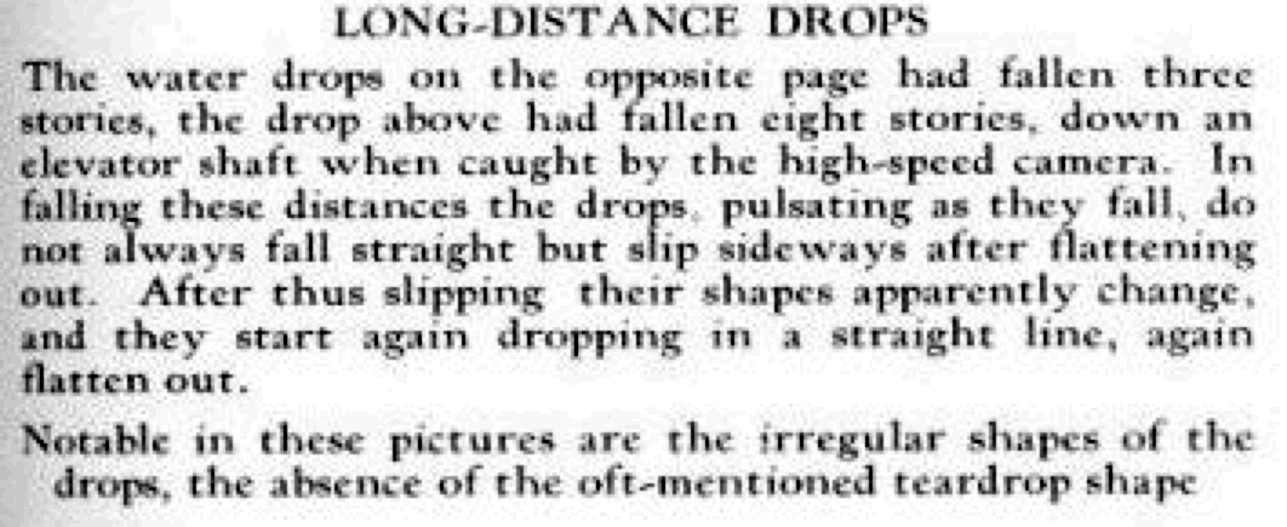
Fall Speed Is a Function of Size: Note the Shape in Terminal Flow
Ugggh!
NOT!!!

Slide 15
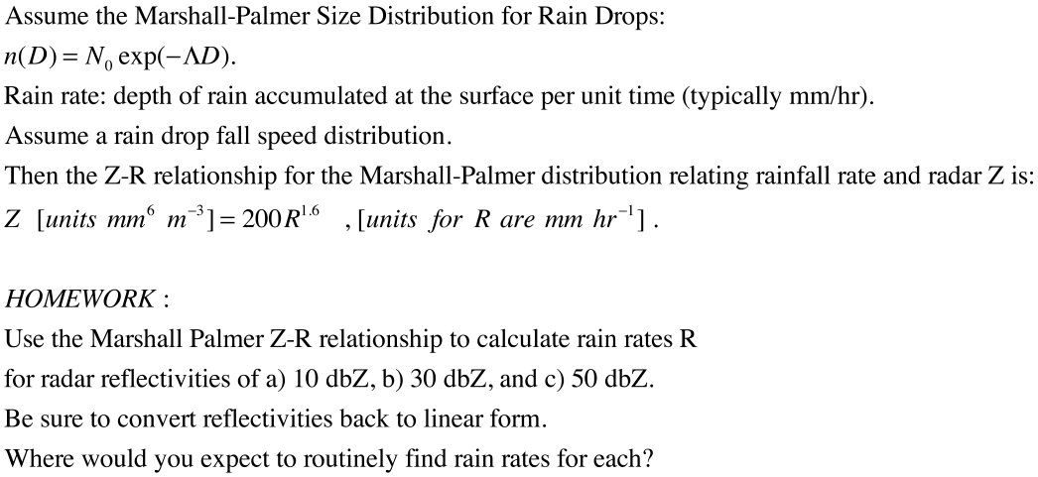
Radar Theory Part 3: Rainfall Rate Estimate From Radar
This is one relationship used to get rainfall rate (depth / time) from radar.
Problem: People have developed many such relationships! Which is correct, if any?????

Slide 16
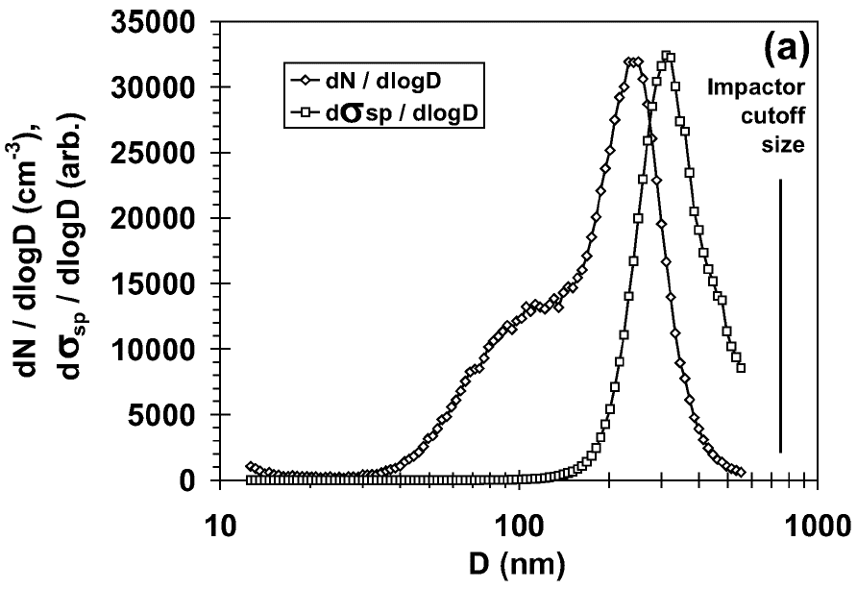
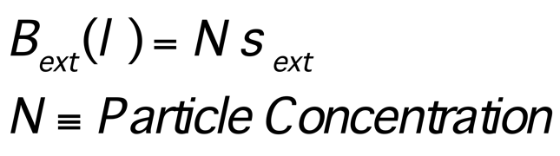
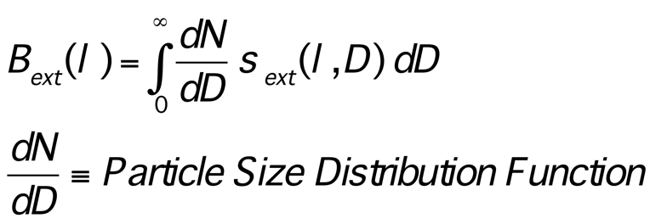
Definitions: Optical Coefficients for Particles
Extinction coefficient for particle mono dispersions
Extinction coefficient for particle dispersions
Sheridan, P. J., W. P. Arnott, J. A. Ogren, B. E. Anderson, D. B. Atkinson, D. S. Covert, H. Moosmuller, A. Petzold, B. Schmid, A. W. Strawa, R. Varma and A. Virkkula (2005). "The Reno aerosol optics study: Overview and summary of results." Aerosol Science & Technology 39: 1-16.
Nebulized, dried
Ammonium Sulfate
532 nm
Slowik, Jay, G., Eben S. Cross, Jeong-Ho Han, Paul Davidovits,Timothy B. Onasch, John T. Jayne, Leah R. Williams, Manjula R. Canagaratna, Douglas R. Worsnop, Rajan K. Chakrabarty, Hans Moosmüller, William P. Arnott, Joshua P. Schwarz, Ru-Shan Gao, DavidW. Fahey, Gregory L. Kok, and Andreas Petzold (2007). An Inter-Comparison of Instruments Measuring Black Carbon Content of Soot Particles. Aerosol Science and Technology, 41:295–314, 2007.
W. P. Arnott, AAAR tutorial, Sept. 2007
16
Notes:
16

Slide 17
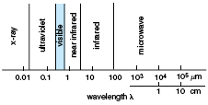
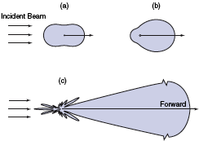
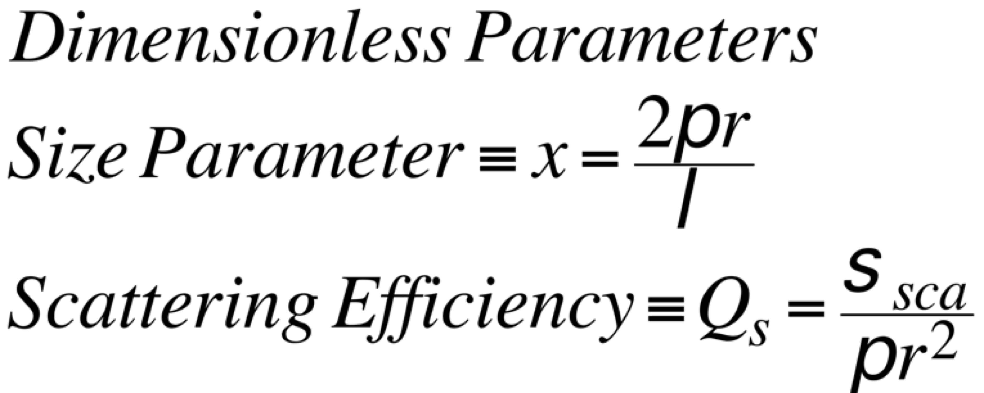
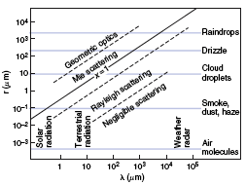
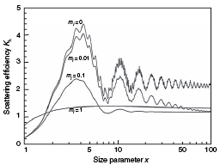
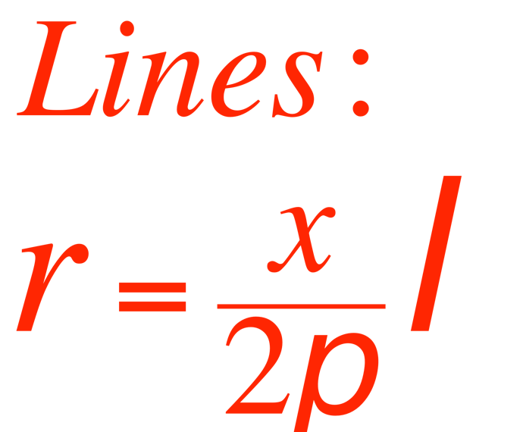
Light Scattering Basics (images from Wallace and Hobbs CH4).
Angular Distribution of scattered radiation (phase function)
x
Sphere, radius r, complex refractive index n=m_{r} + im_{i}
x
Dipole scattering
x
x
m_{r}=1.5
x
Q_{s}
x
W. P. Arnott, AAAR tutorial, Sept. 2007
17
Notes:
17

Slide 18
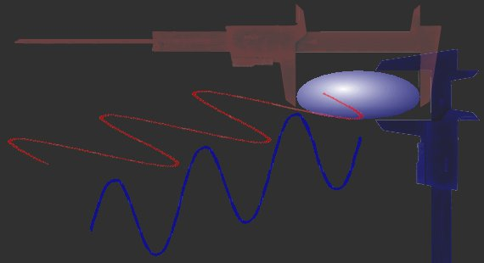
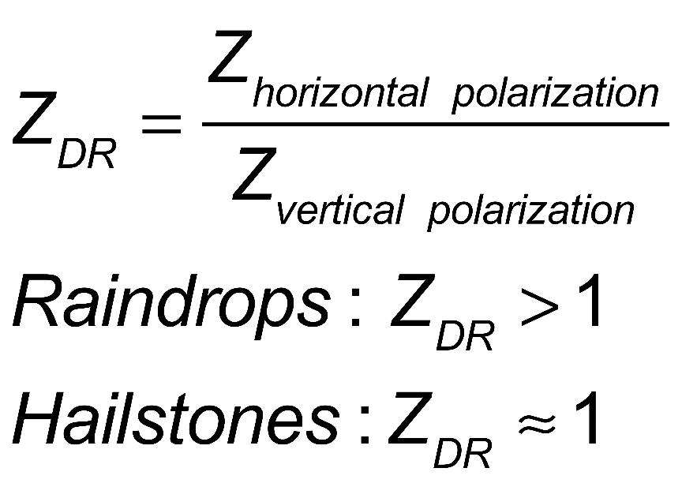
Polarization Diverse Radar: Coming to the NWS in the next few years.
Radar sends out horizontally and vertically polarized pulses.
Hydrometeors like raindrops are flattened. The horizontal cross sections are larger than the vertical.
Therefore for large raindrops a the horizontal polarization backscatter amount is larger than the vertical amount.
Hail stones are more symmetrical and have less polarization diversity.

