Slide 1
Atmospheric Thermodynamics
Objectives:
Develop and/or review basic relations for atmospheric temperature, humidity, density, and pressure.
Use the UNR, DRI, and Slide Mountain pressure to estimate the mean virtual temperature of the the layer between the stations.
Investigate the error involved with this estimate by the propagation of error through the equation for mean virtual temperature.
Understand and compare with balloon sounding data from the National Weather Service.

Slide 2
Equation of State for an Ideal Gas: Air
molecule size is ignorable.
molecules don’t interact (attract or repel each other).
molecular collisions are like hard point like spheres.
V = volume
Most primitive, intuitive form of the
I.G.L. (ideal gas law):
PV = NkT
P = pressure
N = # molecules
T = absolute temperature (Kelvin)
k = Boltzmann’s constant = 1.38 x 10⁻²³ Joules / (molecule K)
Now we manipulate to find a satisfying form of the I.G.L for analysis:

Slide 3
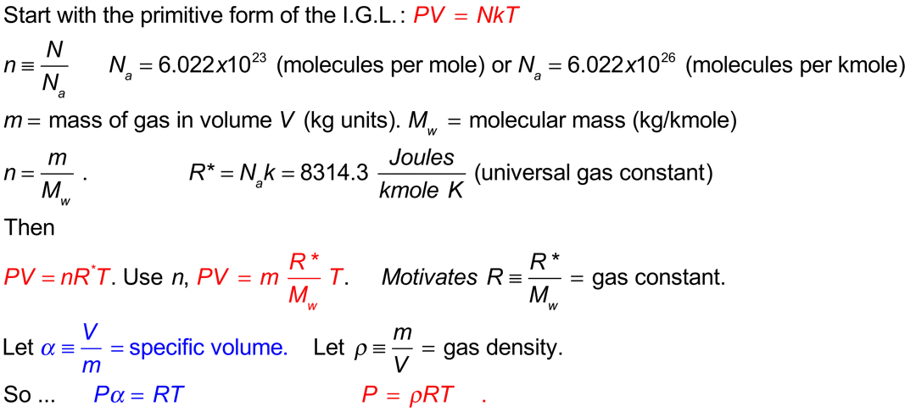
Various Equivalent Forms of the I.G.L.
Note the useful bottom line form Pα=RT: We will use this most often.

Slide 4
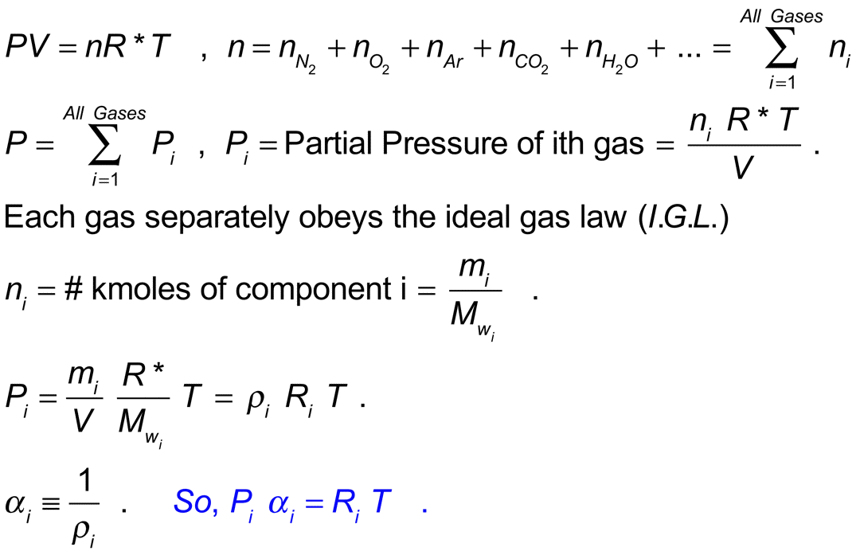
Partial Pressure and Ideal Gas Mixtures
EACH GAS SEPARATELY OBEYS THE IDEAL GAS LAW.

Slide 5
Applications of Dalton’s Law of Partial Pressures…
What is the total pressure in the room?
What is the partial pressure due to nitrogen molecules N₂?
What is the partial pressure due to oxygen molecules, O₂?
What is the partial pressure due to carbon dioxide molecules, CO₂?
Wait a minute… how can it be that these molecules apply pressure according to their number concentration? They don’t all have the same mass… What is going on?
The fine print from Wikipedia…
Dalton's law is not exactly followed by real gases. Those deviations are considerably large at high pressures. In such conditions, the volume occupied by the molecules can become significant compared to the free space between them. Moreover, the short average distances between molecules raises the intensity of intermolecular forces between gas molecules enough to substantially change the pressure exerted by them. Neither of those effects are considered by the ideal gas model.

Slide 6
Applications of Dalton’s Law of Partial Pressures…
What is the total pressure in the room? 860 mb ish.
What is the partial pressure due to nitrogen molecules N₂? 860 mb * 0.78 = 670 mb. Air is composed of 78% N₂ molecules.
What is the partial pressure due to oxygen molecules, O₂? 860 mb * 0.21 = 180 mb.
What is the partial pressure due to carbon dioxide molecules, CO₂?
860 mb * 0.000385 = 0.34 mb.
For 10 mb water vapor partial pressure, air is about 1% water vapor.

Slide 7
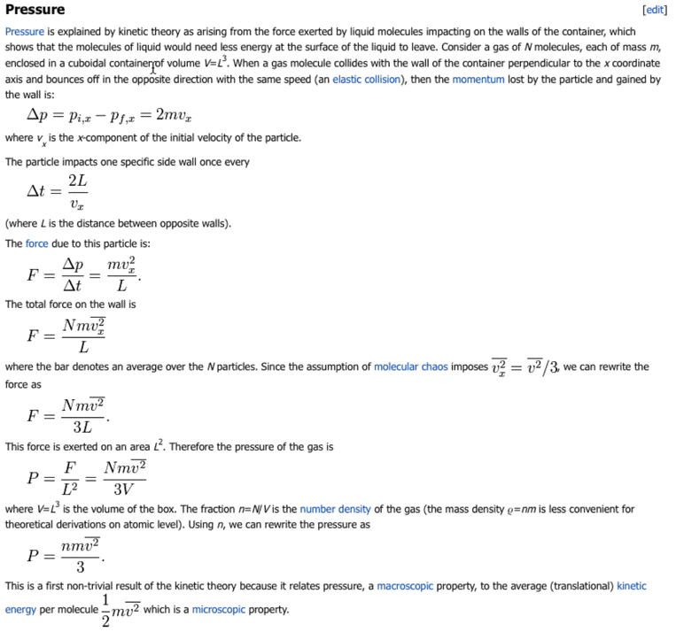
Kinetic Theory of Pressure (Wikipedia…)
Box of sides L
Nature is fair …
On average, molecules share the burden of random kinetic energy, also known as heat. K.E.=mv²/2. On average, molecules with smaller m move faster than large m molecules.
m
v_{x}
Pressure in the kinetic theory of gases …

Slide 8
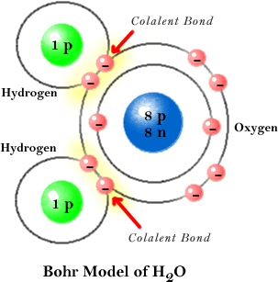
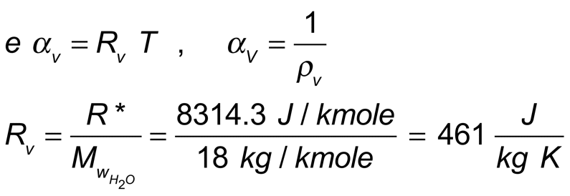
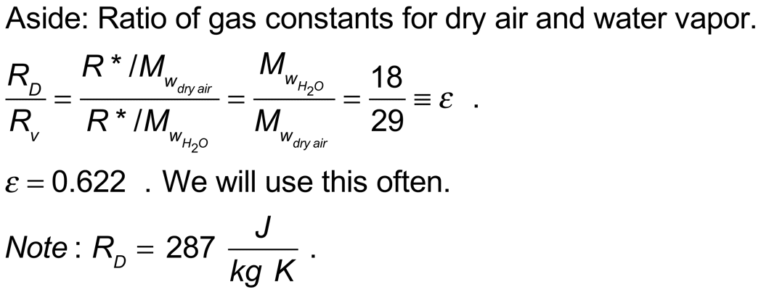
Special Case: Partial Pressure of Water Vapor, e

Slide 9
Virtual Temperature T_{v}.
dry air
moist air
same for both
T = temperature
P = pressure
V = volume
N = # molecules
P = P_{D}+e
P = P_{D}
Total pressure=
partial pressure
due to dry air + water vapor.
Total pressure=
partial pressure
due to dry air.
ρ_{dry air} > ρ_{moist air}
P = ρRT
TWEAK …
Raise the temperature of the dry air on the left to lower its density so that it is the same as the density of the moist air on the right. We have to let some of the molecules out of the box.
This raised temperature is the virtual temperature by definition. It is a useful construct because the I.G.L. for dry or moist air is written P α = R_{D} T_{v} .

Slide 10
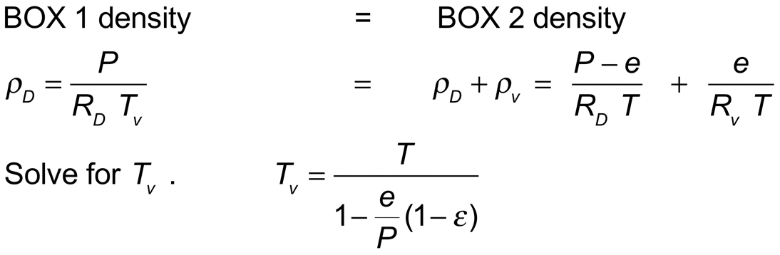
Virtual Temperature T_{v} Calculation.
dry air
moist air
box 1
same for both
T = temperature
P = pressure
V = volume
box 2
T_{v}
P = P_{D}+e
T
P = P_{D}
Total pressure=
partial pressure
due to dry air + water vapor.
Total pressure=
partial pressure
due to dry air.
P = ρRT
Crank up the temperature of box 1, keeping pressure and volume constant (let some dry air molecules leak out), until the mass (density) of box 1 is the same as that of box 2.
From the I.G.L.
General Note:
T_{v}>T.

Slide 11
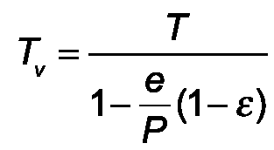
Virtual Temperature Example
Let
e=10 mb
P=1000 mb
T=280 K
Remember
ε=0.622
Then T_{v} ≈ T [1+e(1-ε)/P] = T(1+0.0038) ≈ 281 K
(binomial expansion was used to show an equivalent form)
This gives us a rough idea of the temperature increase needed to make dry air have the same density as the moist air described above.

Slide 12
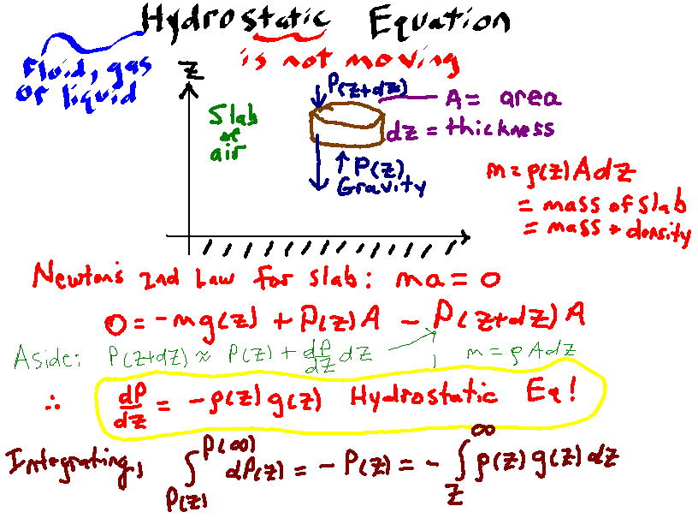

Slide 13
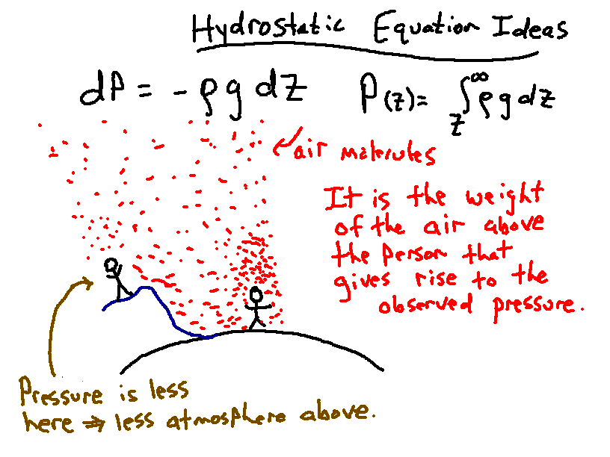

Slide 14
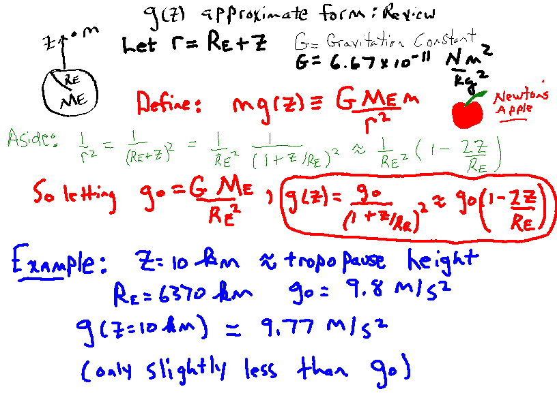

Slide 15
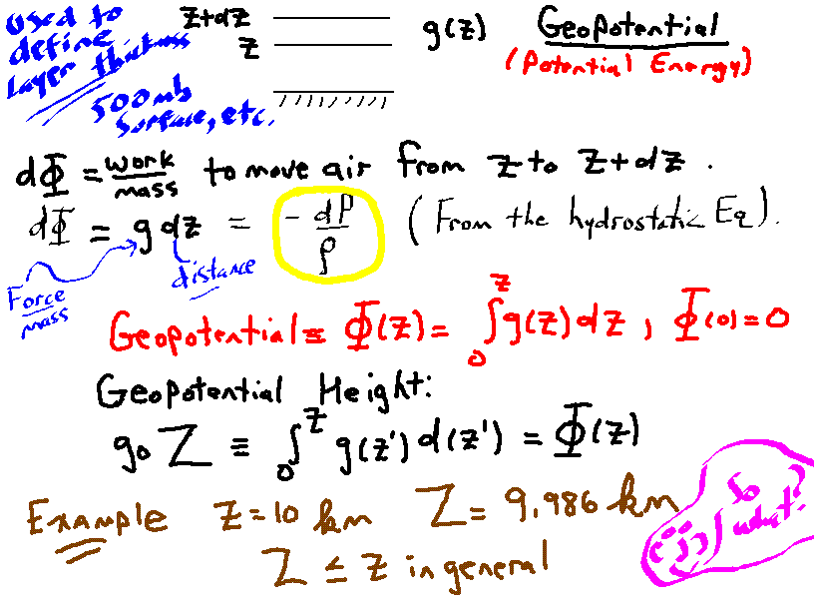

Slide 16
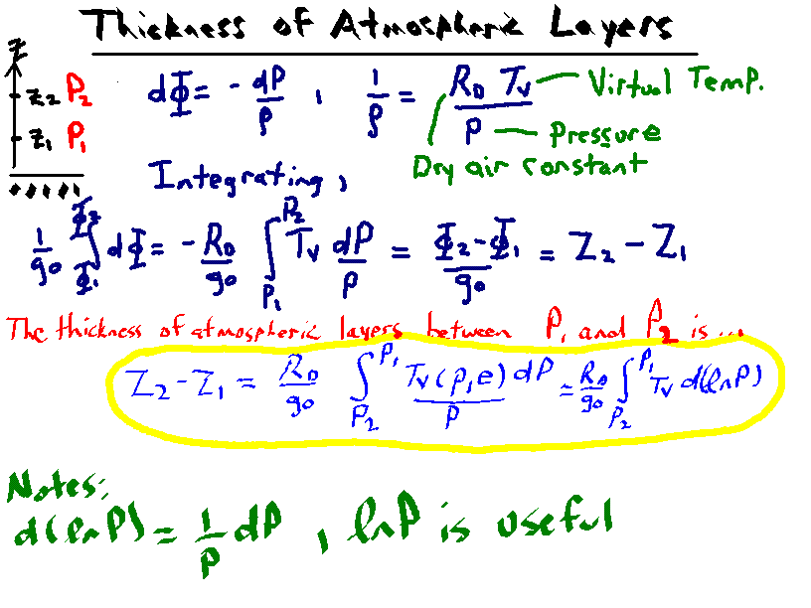

Slide 17
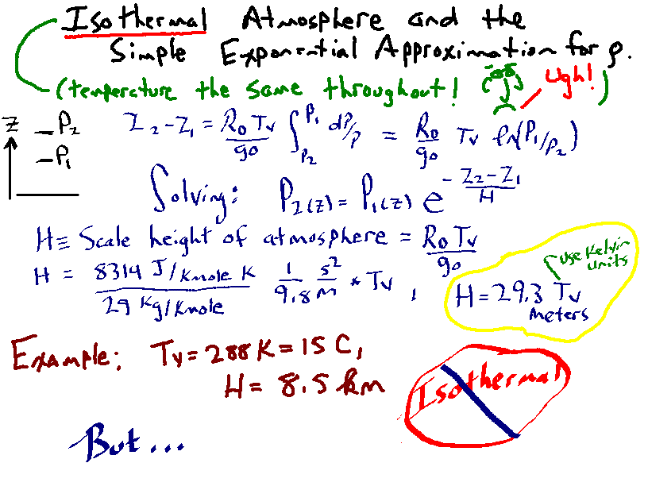

Slide 18
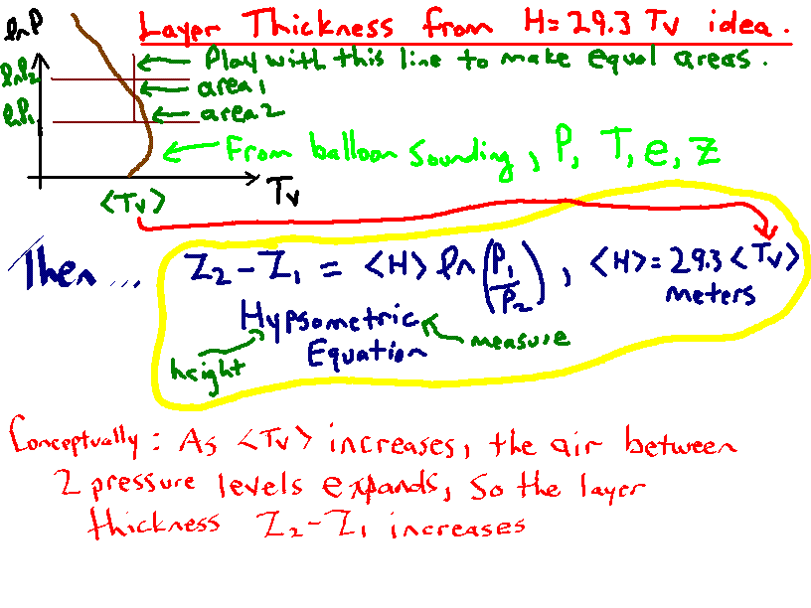

Slide 19
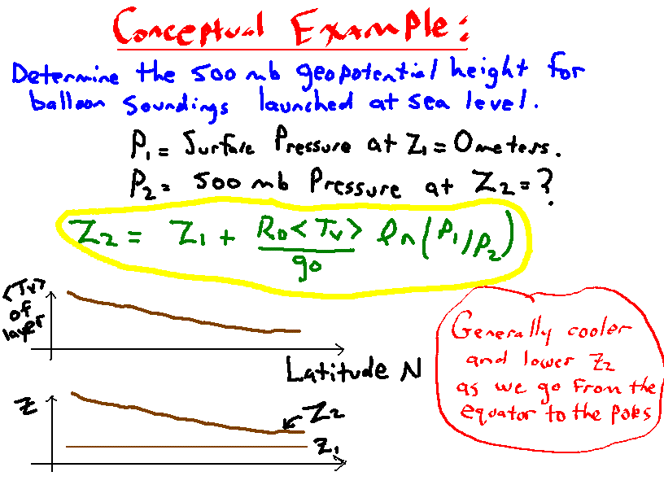

Slide 20
Measurement Uncertainty
Inevitable part of all measurements
Sometimes called measurement error, not usually meant as a blunder or negligent action
Can be reduced by measurement method, design
My mass is 103.1334563345 kg. What’s wrong with this statement? What would be a better statement, given that my scale has a display that reads like 100.0, 100.2, 100.4 ?

Slide 21
Measurement Precision and Accuracy
We have 4 scales to independently measure oranges. Here are the measurements.
Scale 1: 0.3 kg (not very precise)
Scale 2: 0.23 kg (more precise) Scale 3: 0.22459 kg (even more precise, rounds to scale 2) Scale 4: 0.210713 kg (most precise, different from 2 and 3)
What is the mass of the oranges? Maybe scale 4 is extremely precise, but is calibrated wrong, so is it inaccurate?

Slide 22
Measurement and Uncertainty
Measured Value of M = M_{best} ± δM
We’re saying that the answer is between
M = M_{best} + δM
and
M = M_{best} - δM
If we know the distribution of measurement values (for example, ’normal’ distribution) a more detailed answer can be given about how certain the value of M_{best} is and in what range we would expect measurement values would lie.

Slide 23
Measurement Precision and Accuracy
Implied accuracy
Scale 1: 0.3 kg ± 0.1 kg
Scale 2: 0.23 kg ± 0.01 kg
Scale 3: 0.22459 kg ± 0.00001 kg
Scale 4: 0.210713 kg ± 0.000001 kg
Scales 1 and 2 measurements are ‘consistent within uncertainty’ to scale 3. Scale 4 is most precise, but disagrees, within uncertainty, with scales 2 and 3. What is the mass of the oranges?

Slide 24
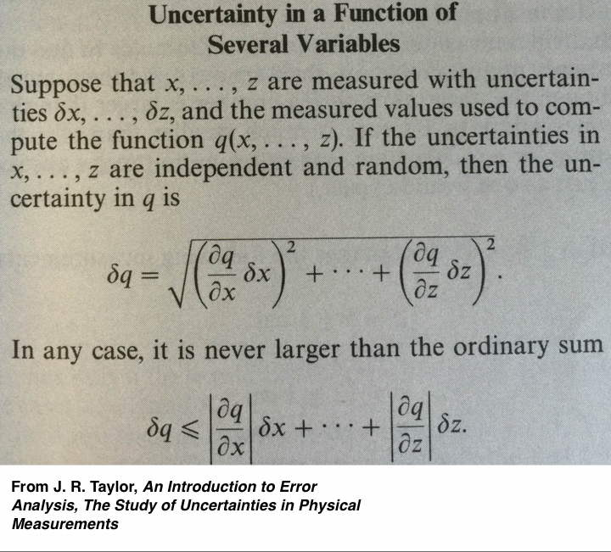
Uncertainty in a Function of Several Variables

Slide 25
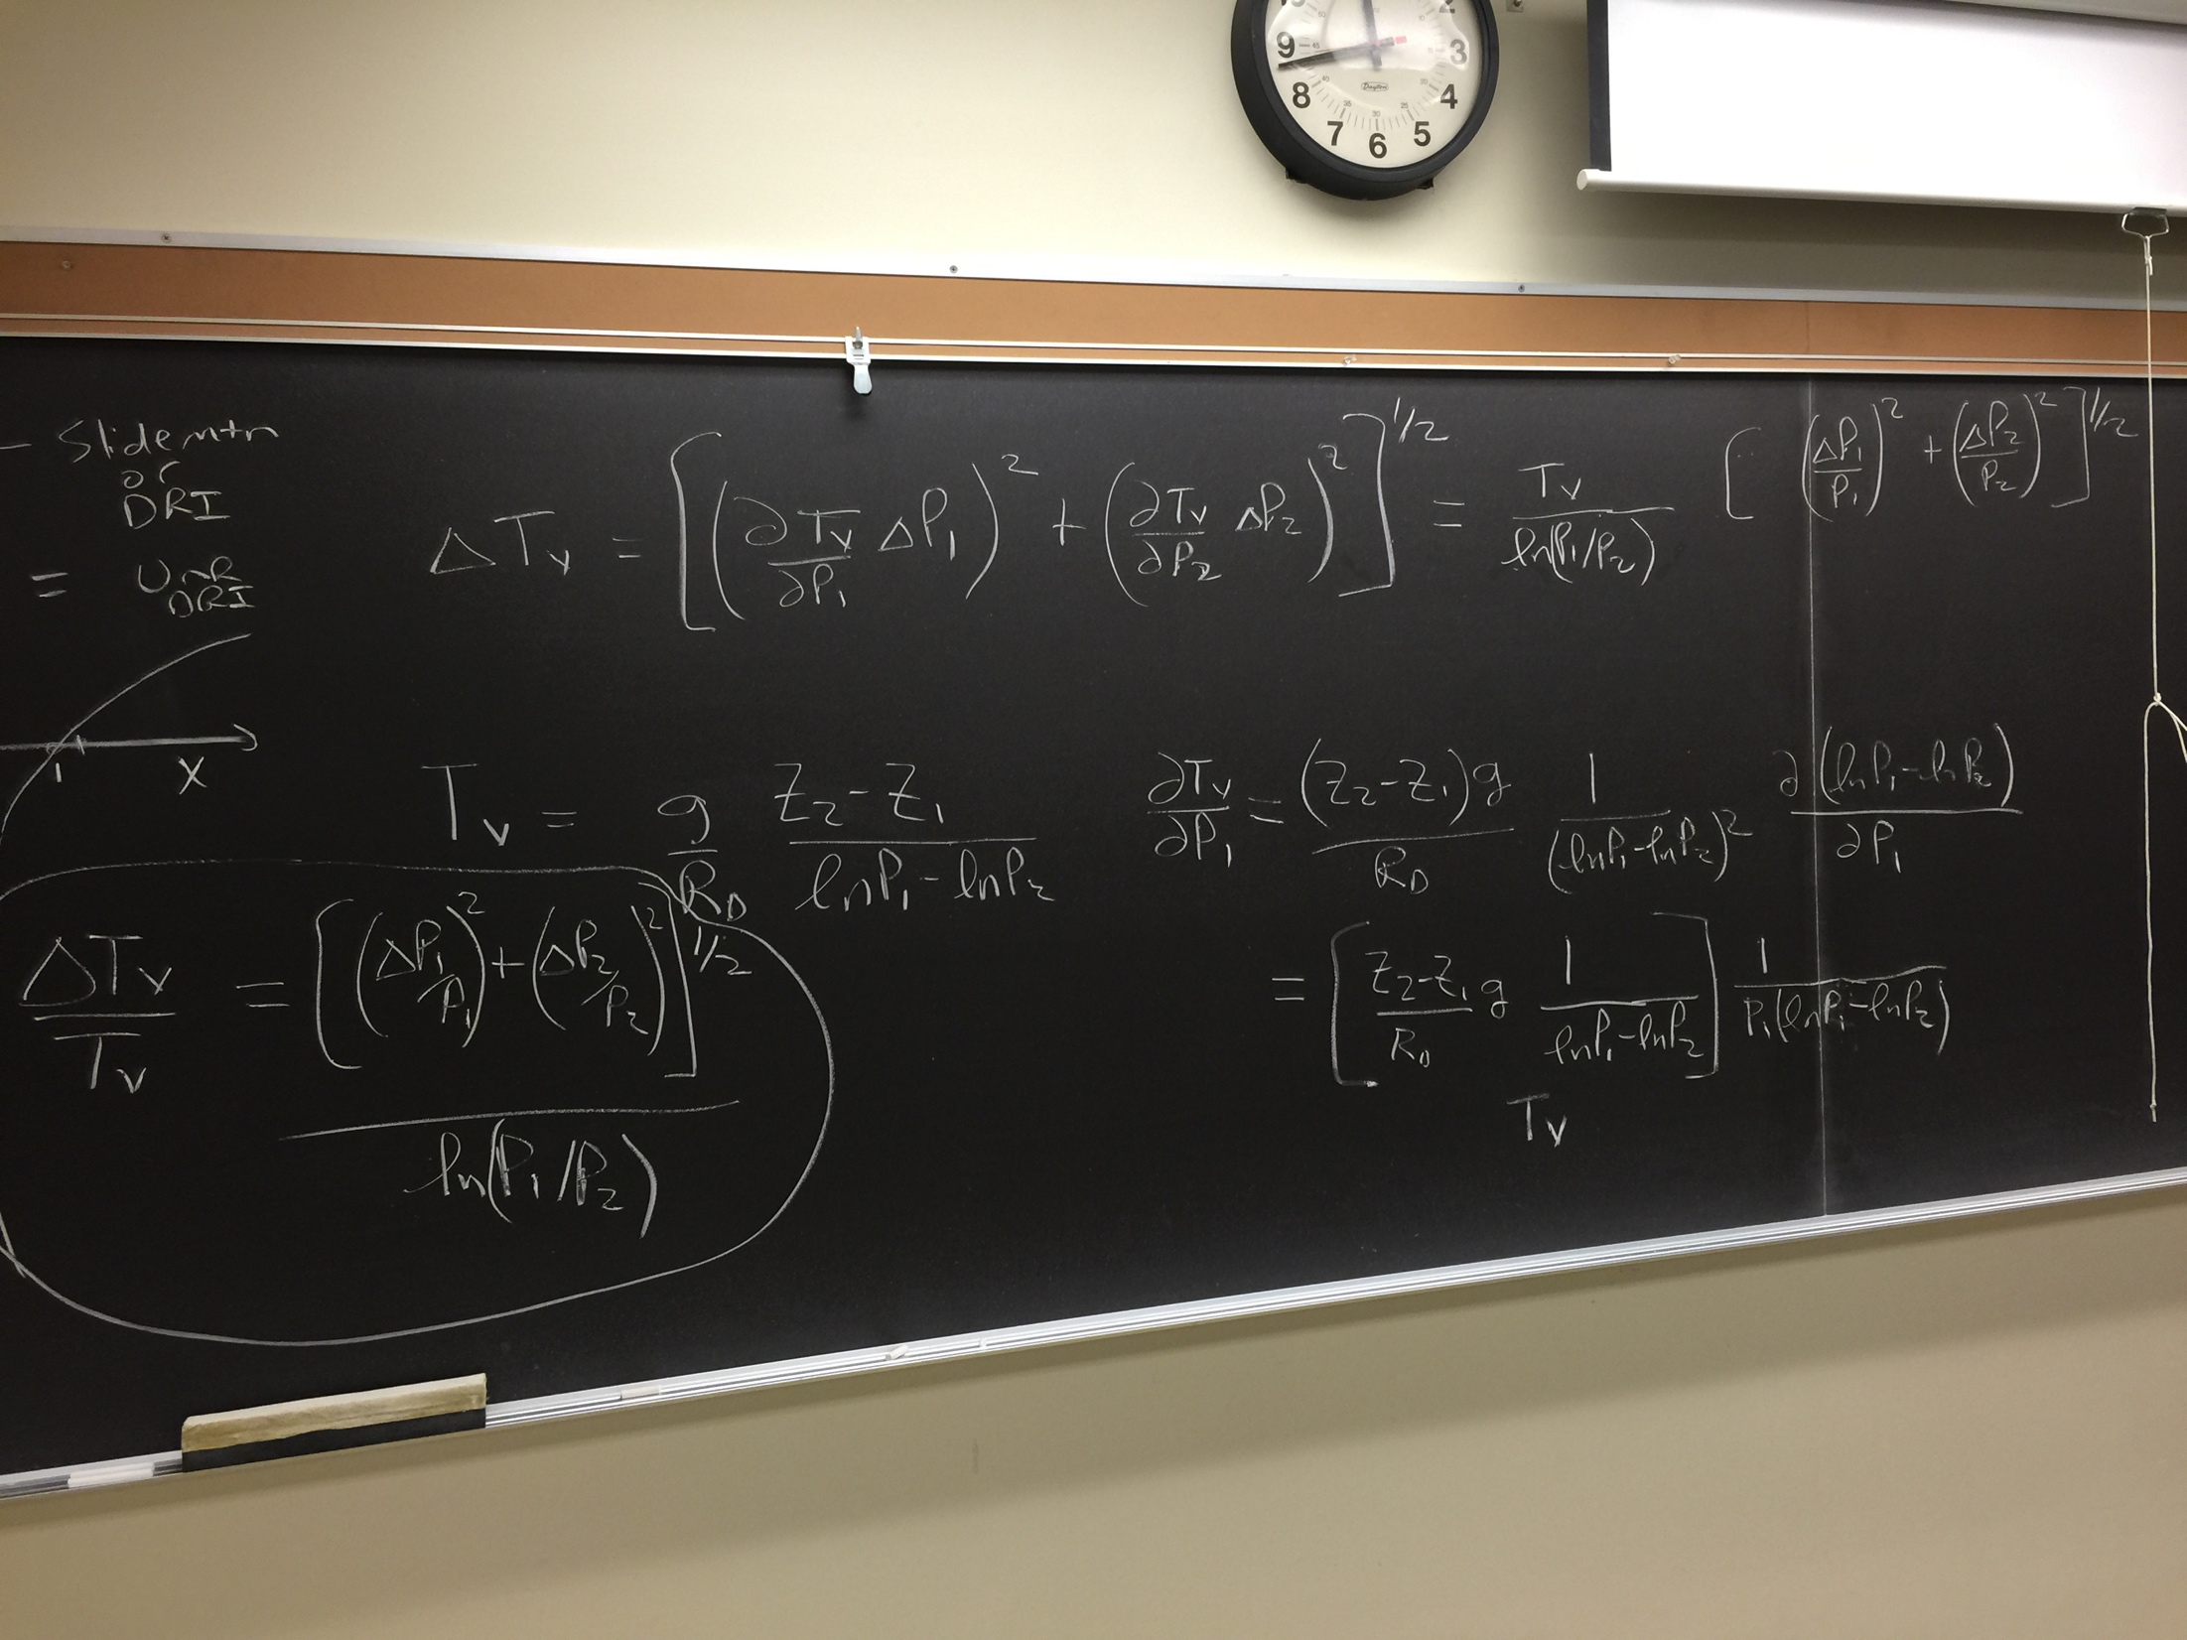
Mean Virtual Temperature and Uncertainty

Slide 26
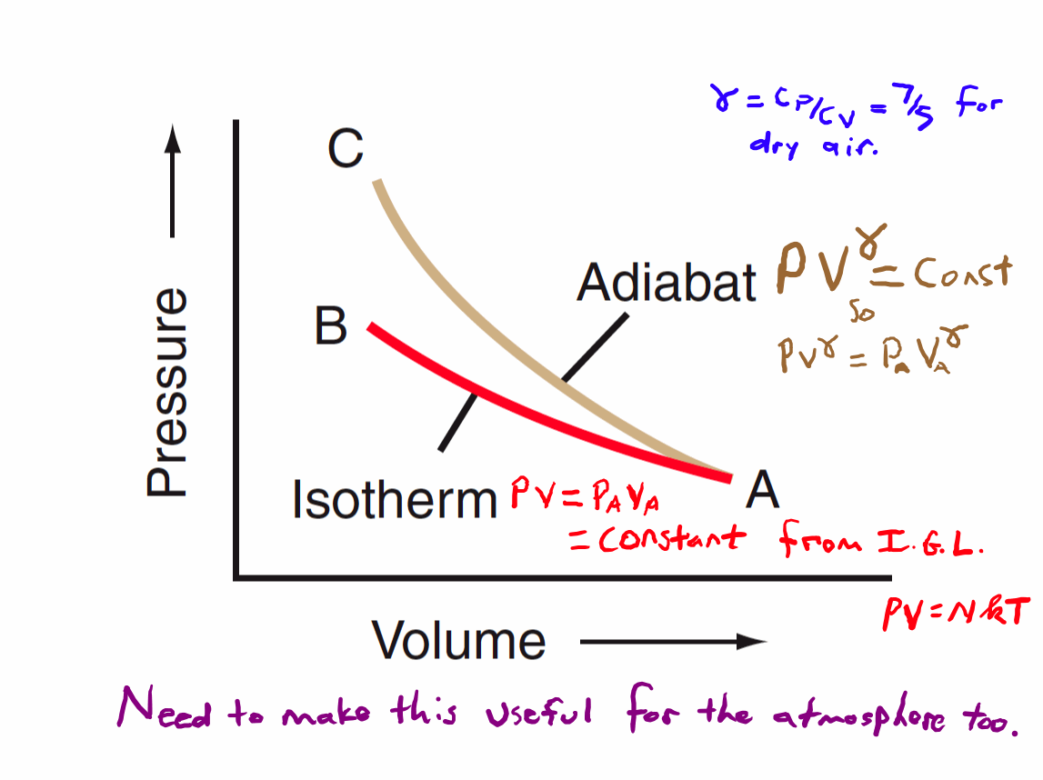

Slide 27
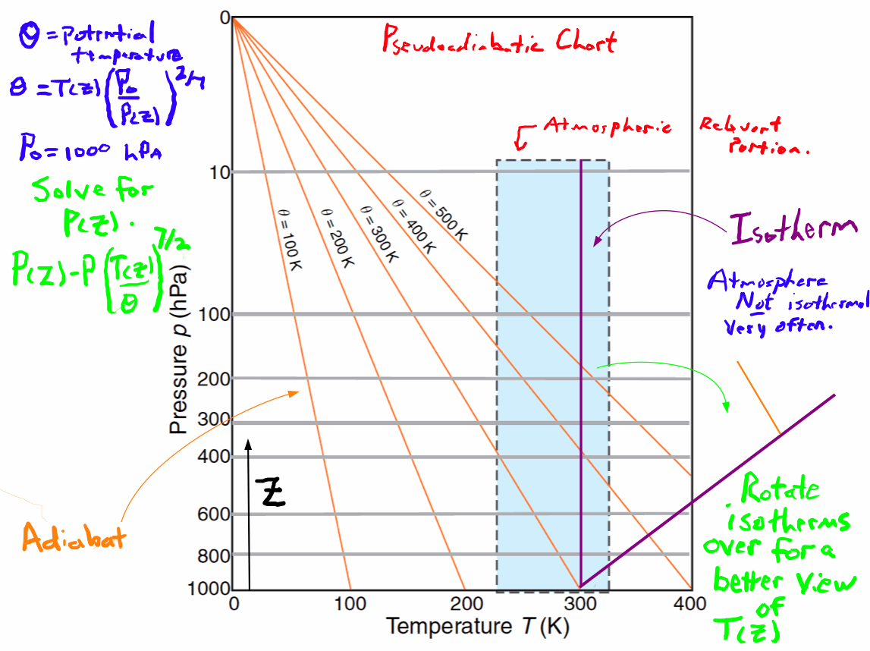

Slide 28
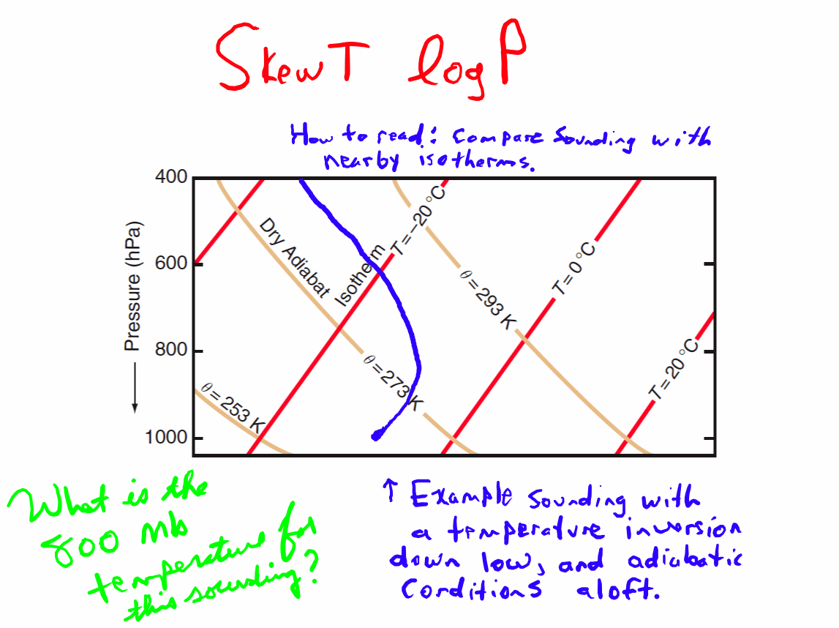

Slide 29
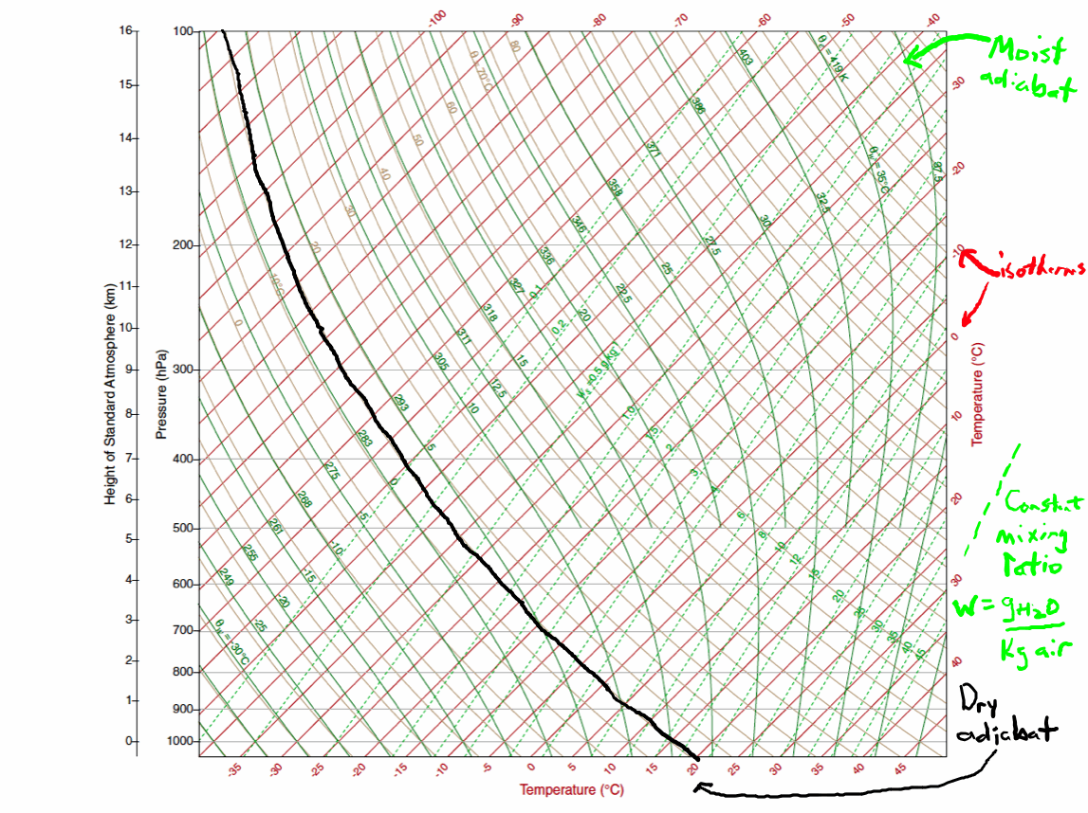

Slide 30
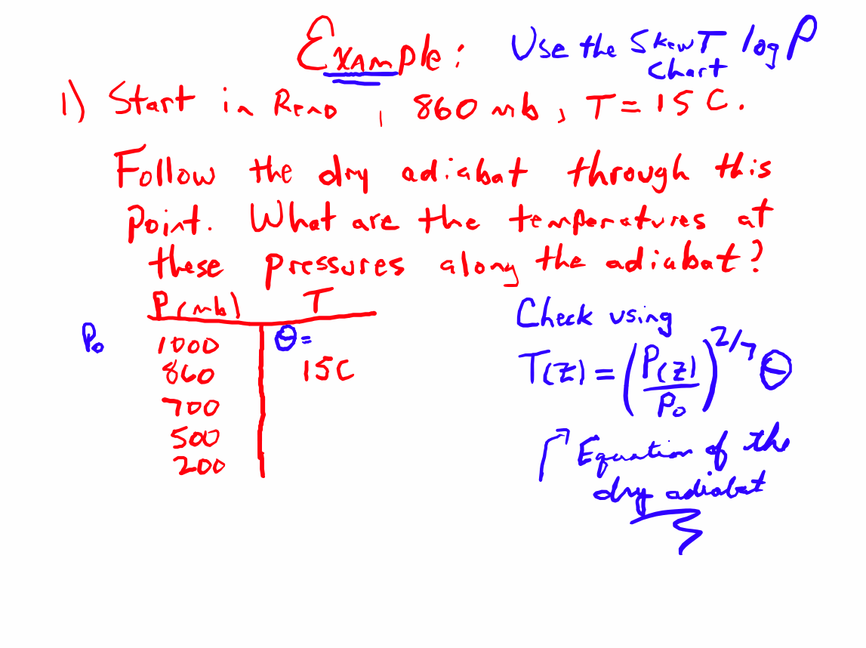

Slide 31
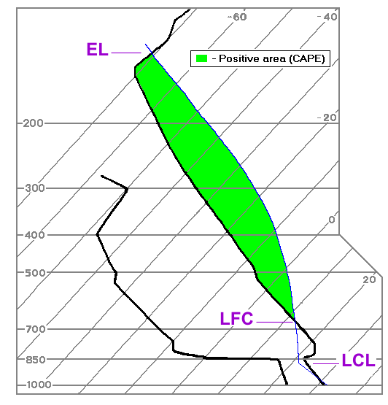
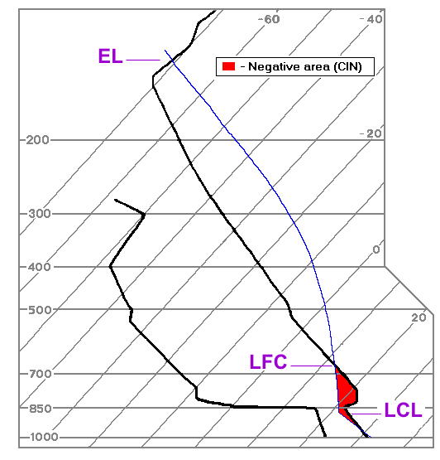
CAPE (J/kg): 0-1000 (small) 1000-2500 (moderate)
2500-4000 (large) > 4000 (extreme).
CIN (J/kg): 0 to -25 (weak) -25 to -50 (moderate)
- 50 to -100 (strong convective inhibition)
LCL: Lifting condensation level.
LFC: Level of free convection.
EL: Equilibrium level.
CAPE: Convective available potential energy.
CIN: Convective inhibition.
Solar heating, surface convergence promote parcels to the LFC: Must pass above the inversion in the CIN area.

Slide 32
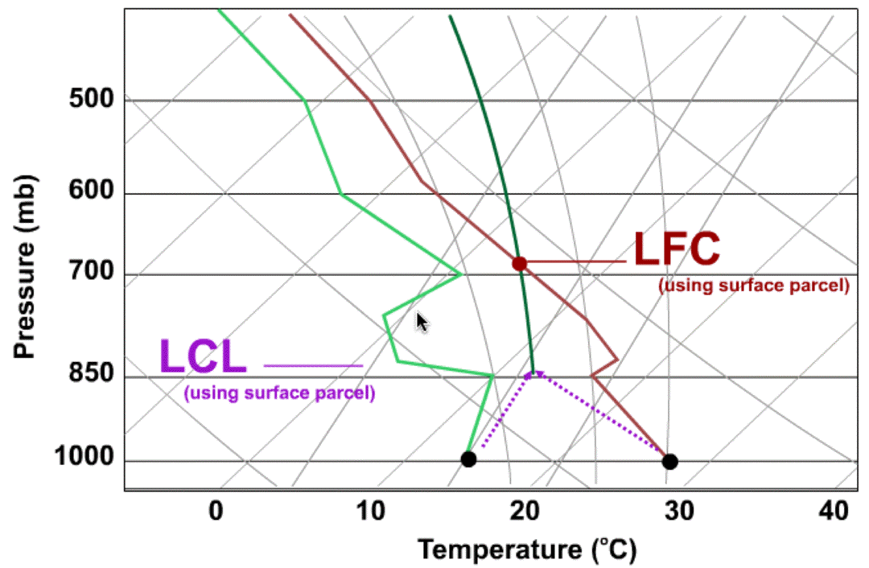

Slide 33
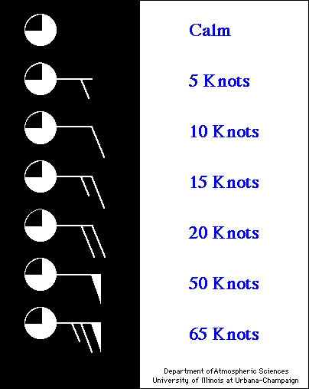
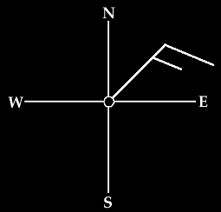

Winds on Skew T Log P Charts
wind is 15 knots
coming from the northeast.

Slide 34
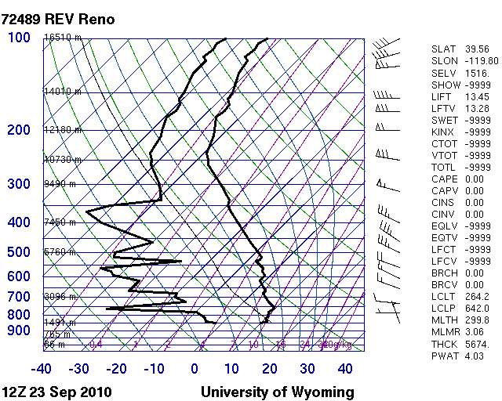

Slide 35
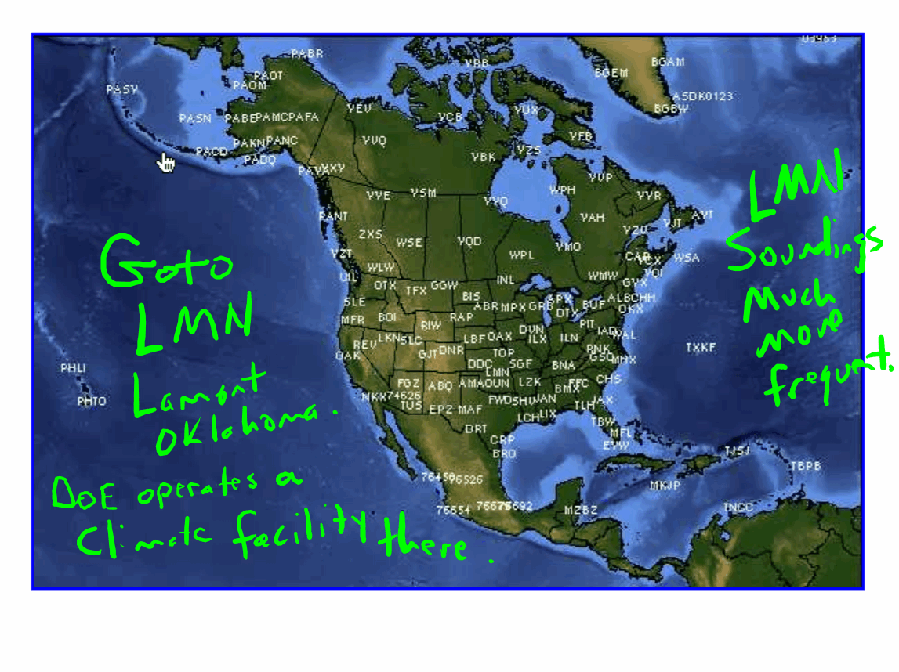

Slide 36
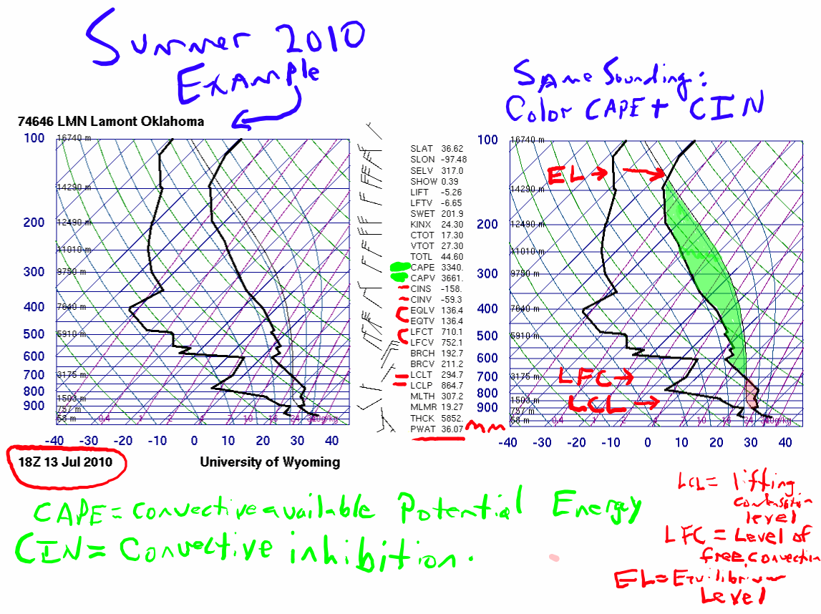

Slide 37
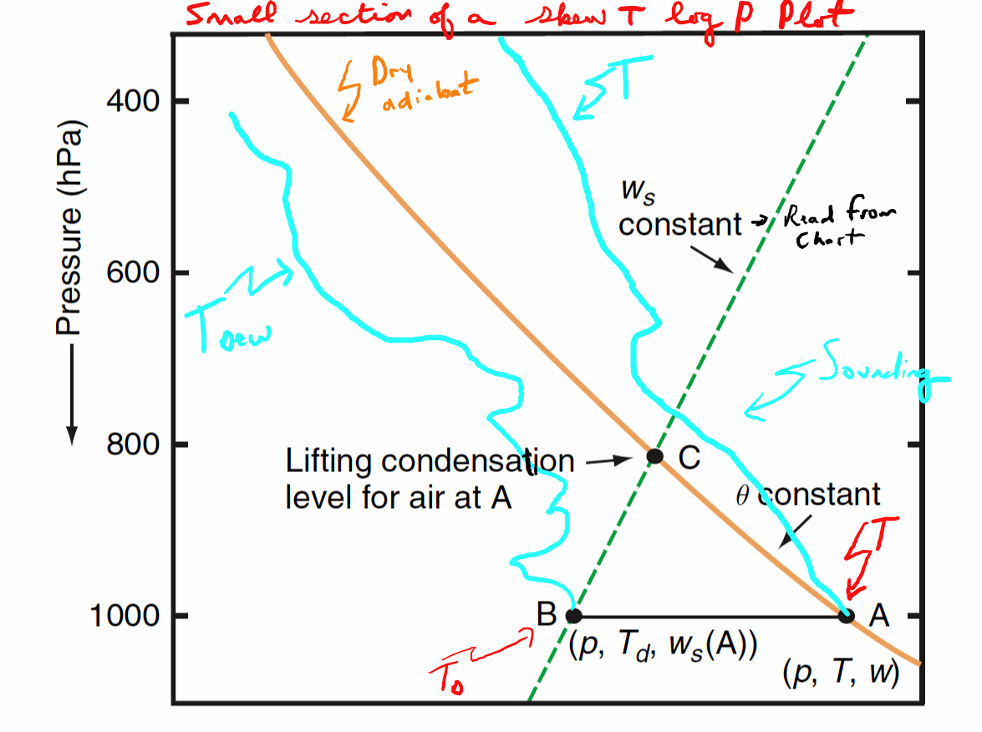

Slide 38
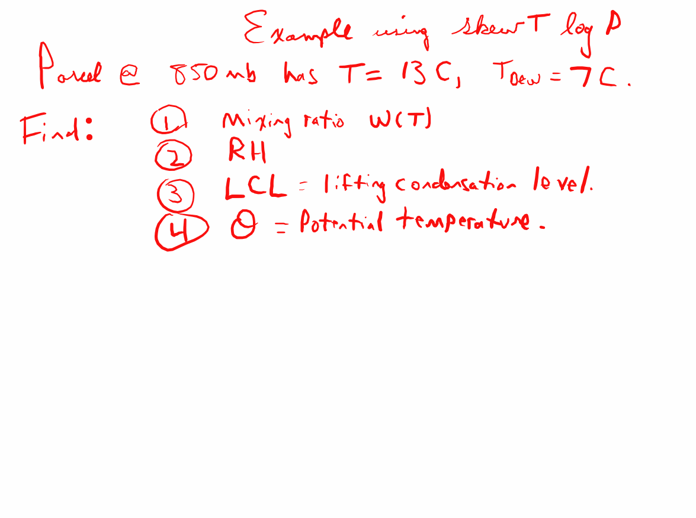

Slide 39
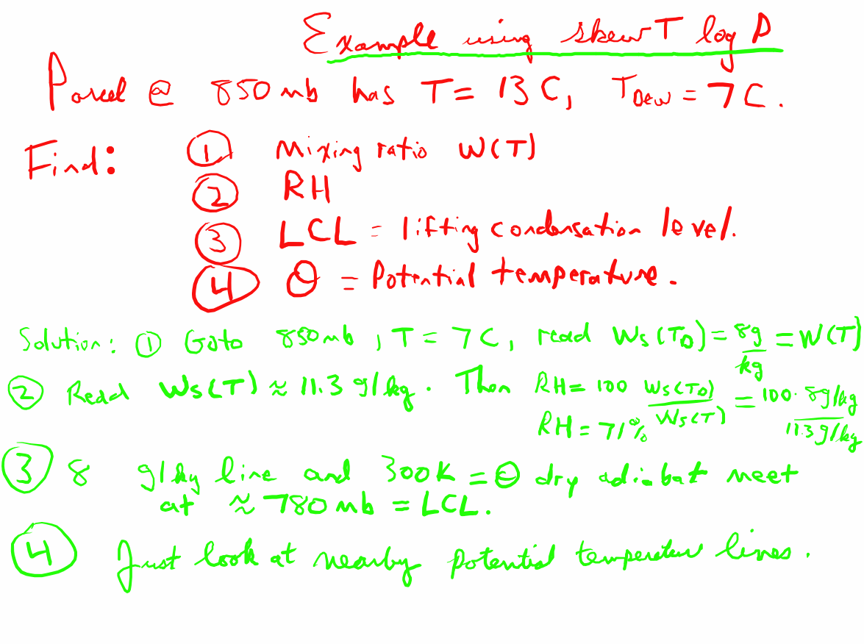

Slide 40
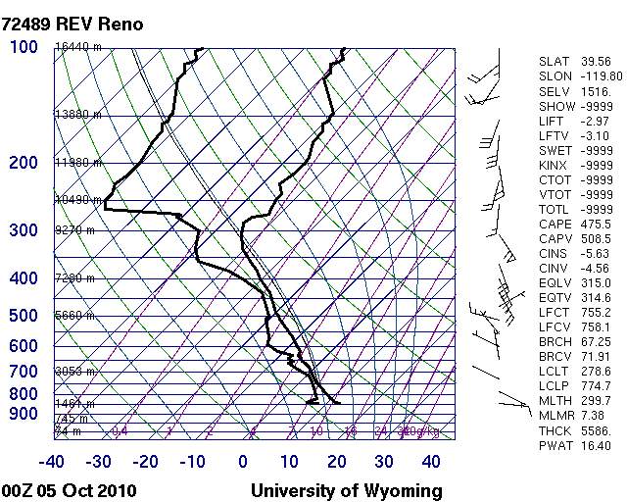
Moist Adiabats: Trajectories of Saturated Parcels.
Pseudoadiabats because products of condensation may fall out of the parcel as precipitation. Trace a few of them below.

Slide 41
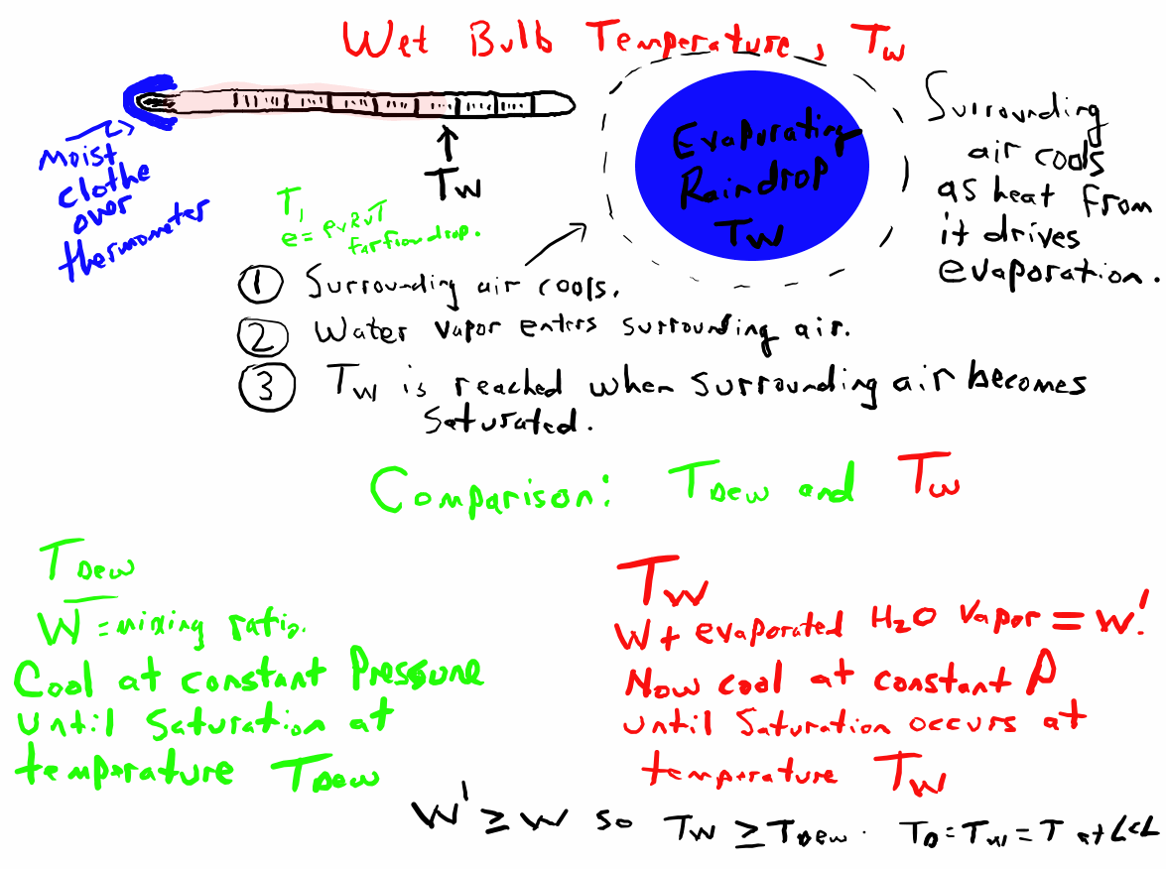

Slide 42
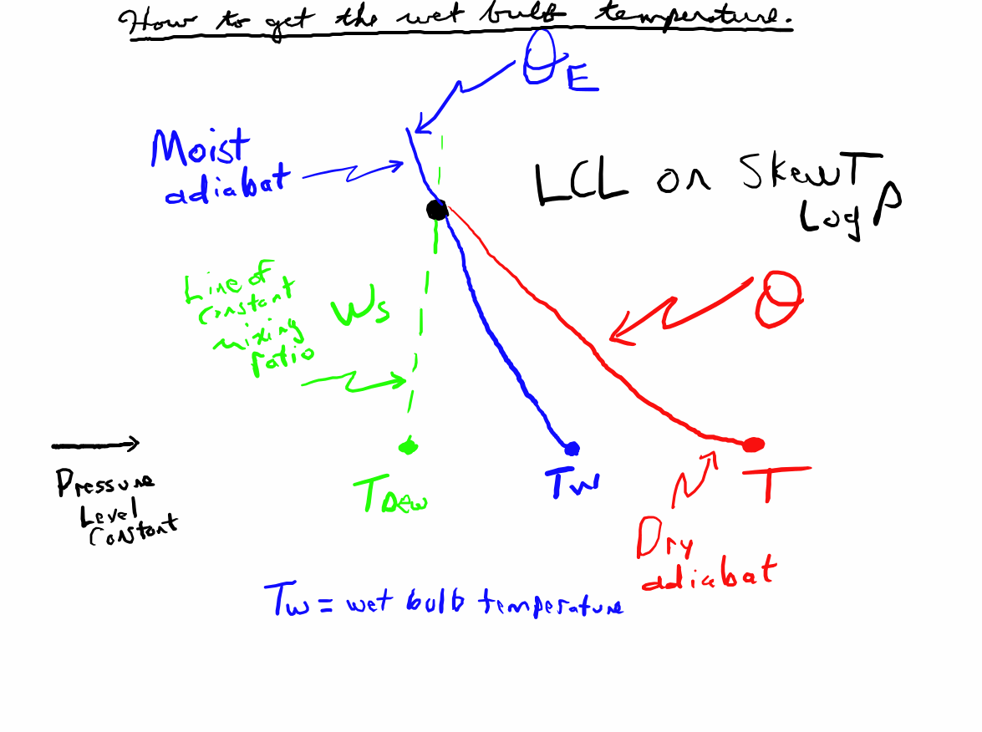

Slide 43
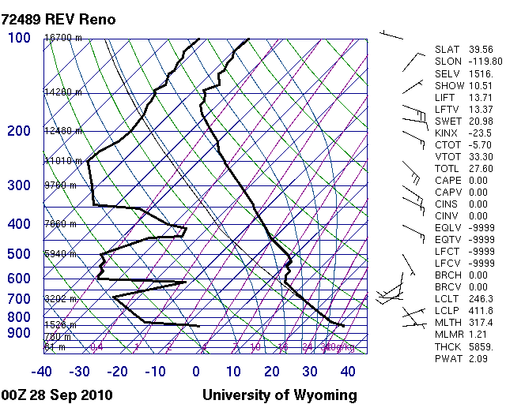
Find the LCL for a surface parcel: find Tw, the wet bulb temperature.

Slide 44
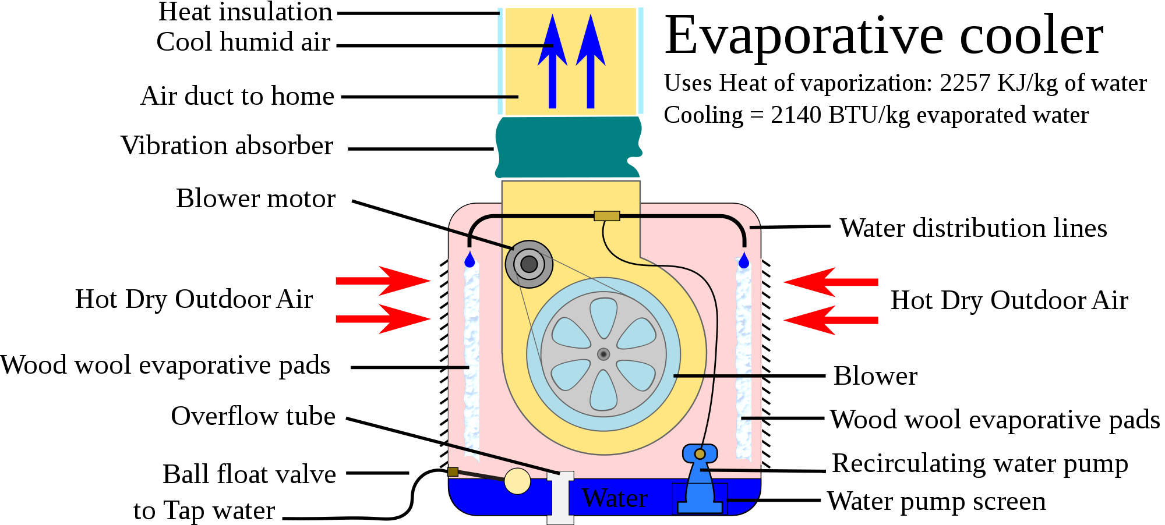
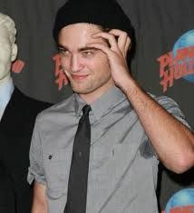
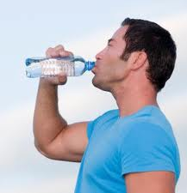
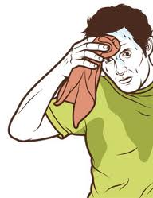
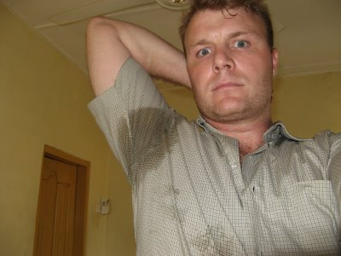
Evaporative Cooler: Swamp Cooler.

Slide 45
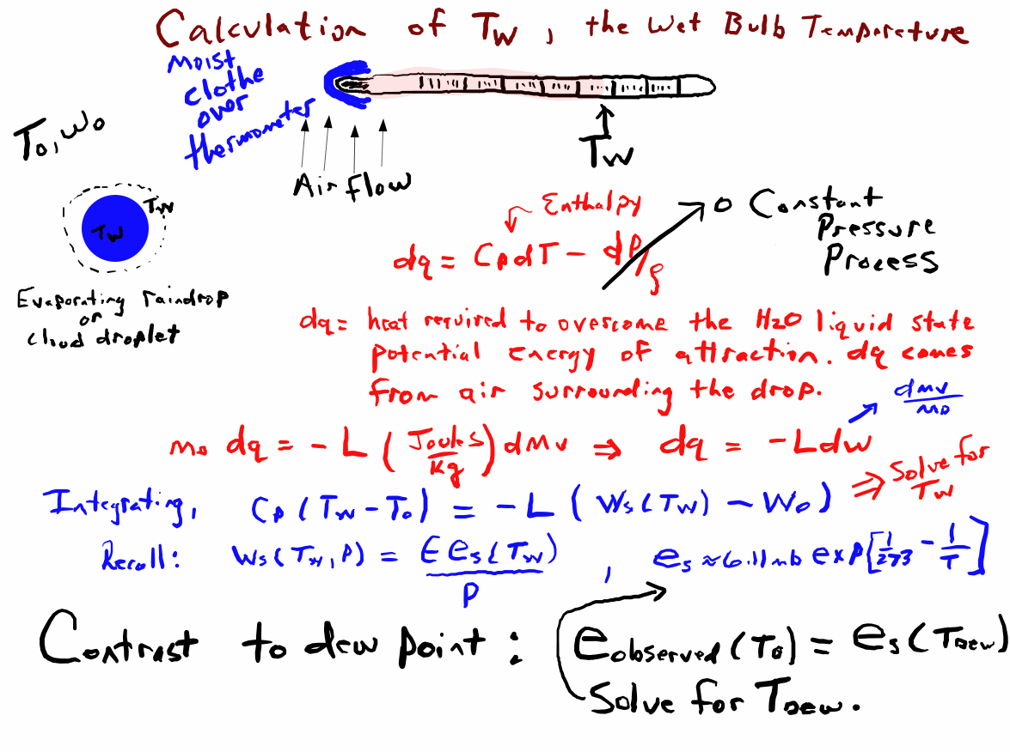

Slide 46
