Slide 1
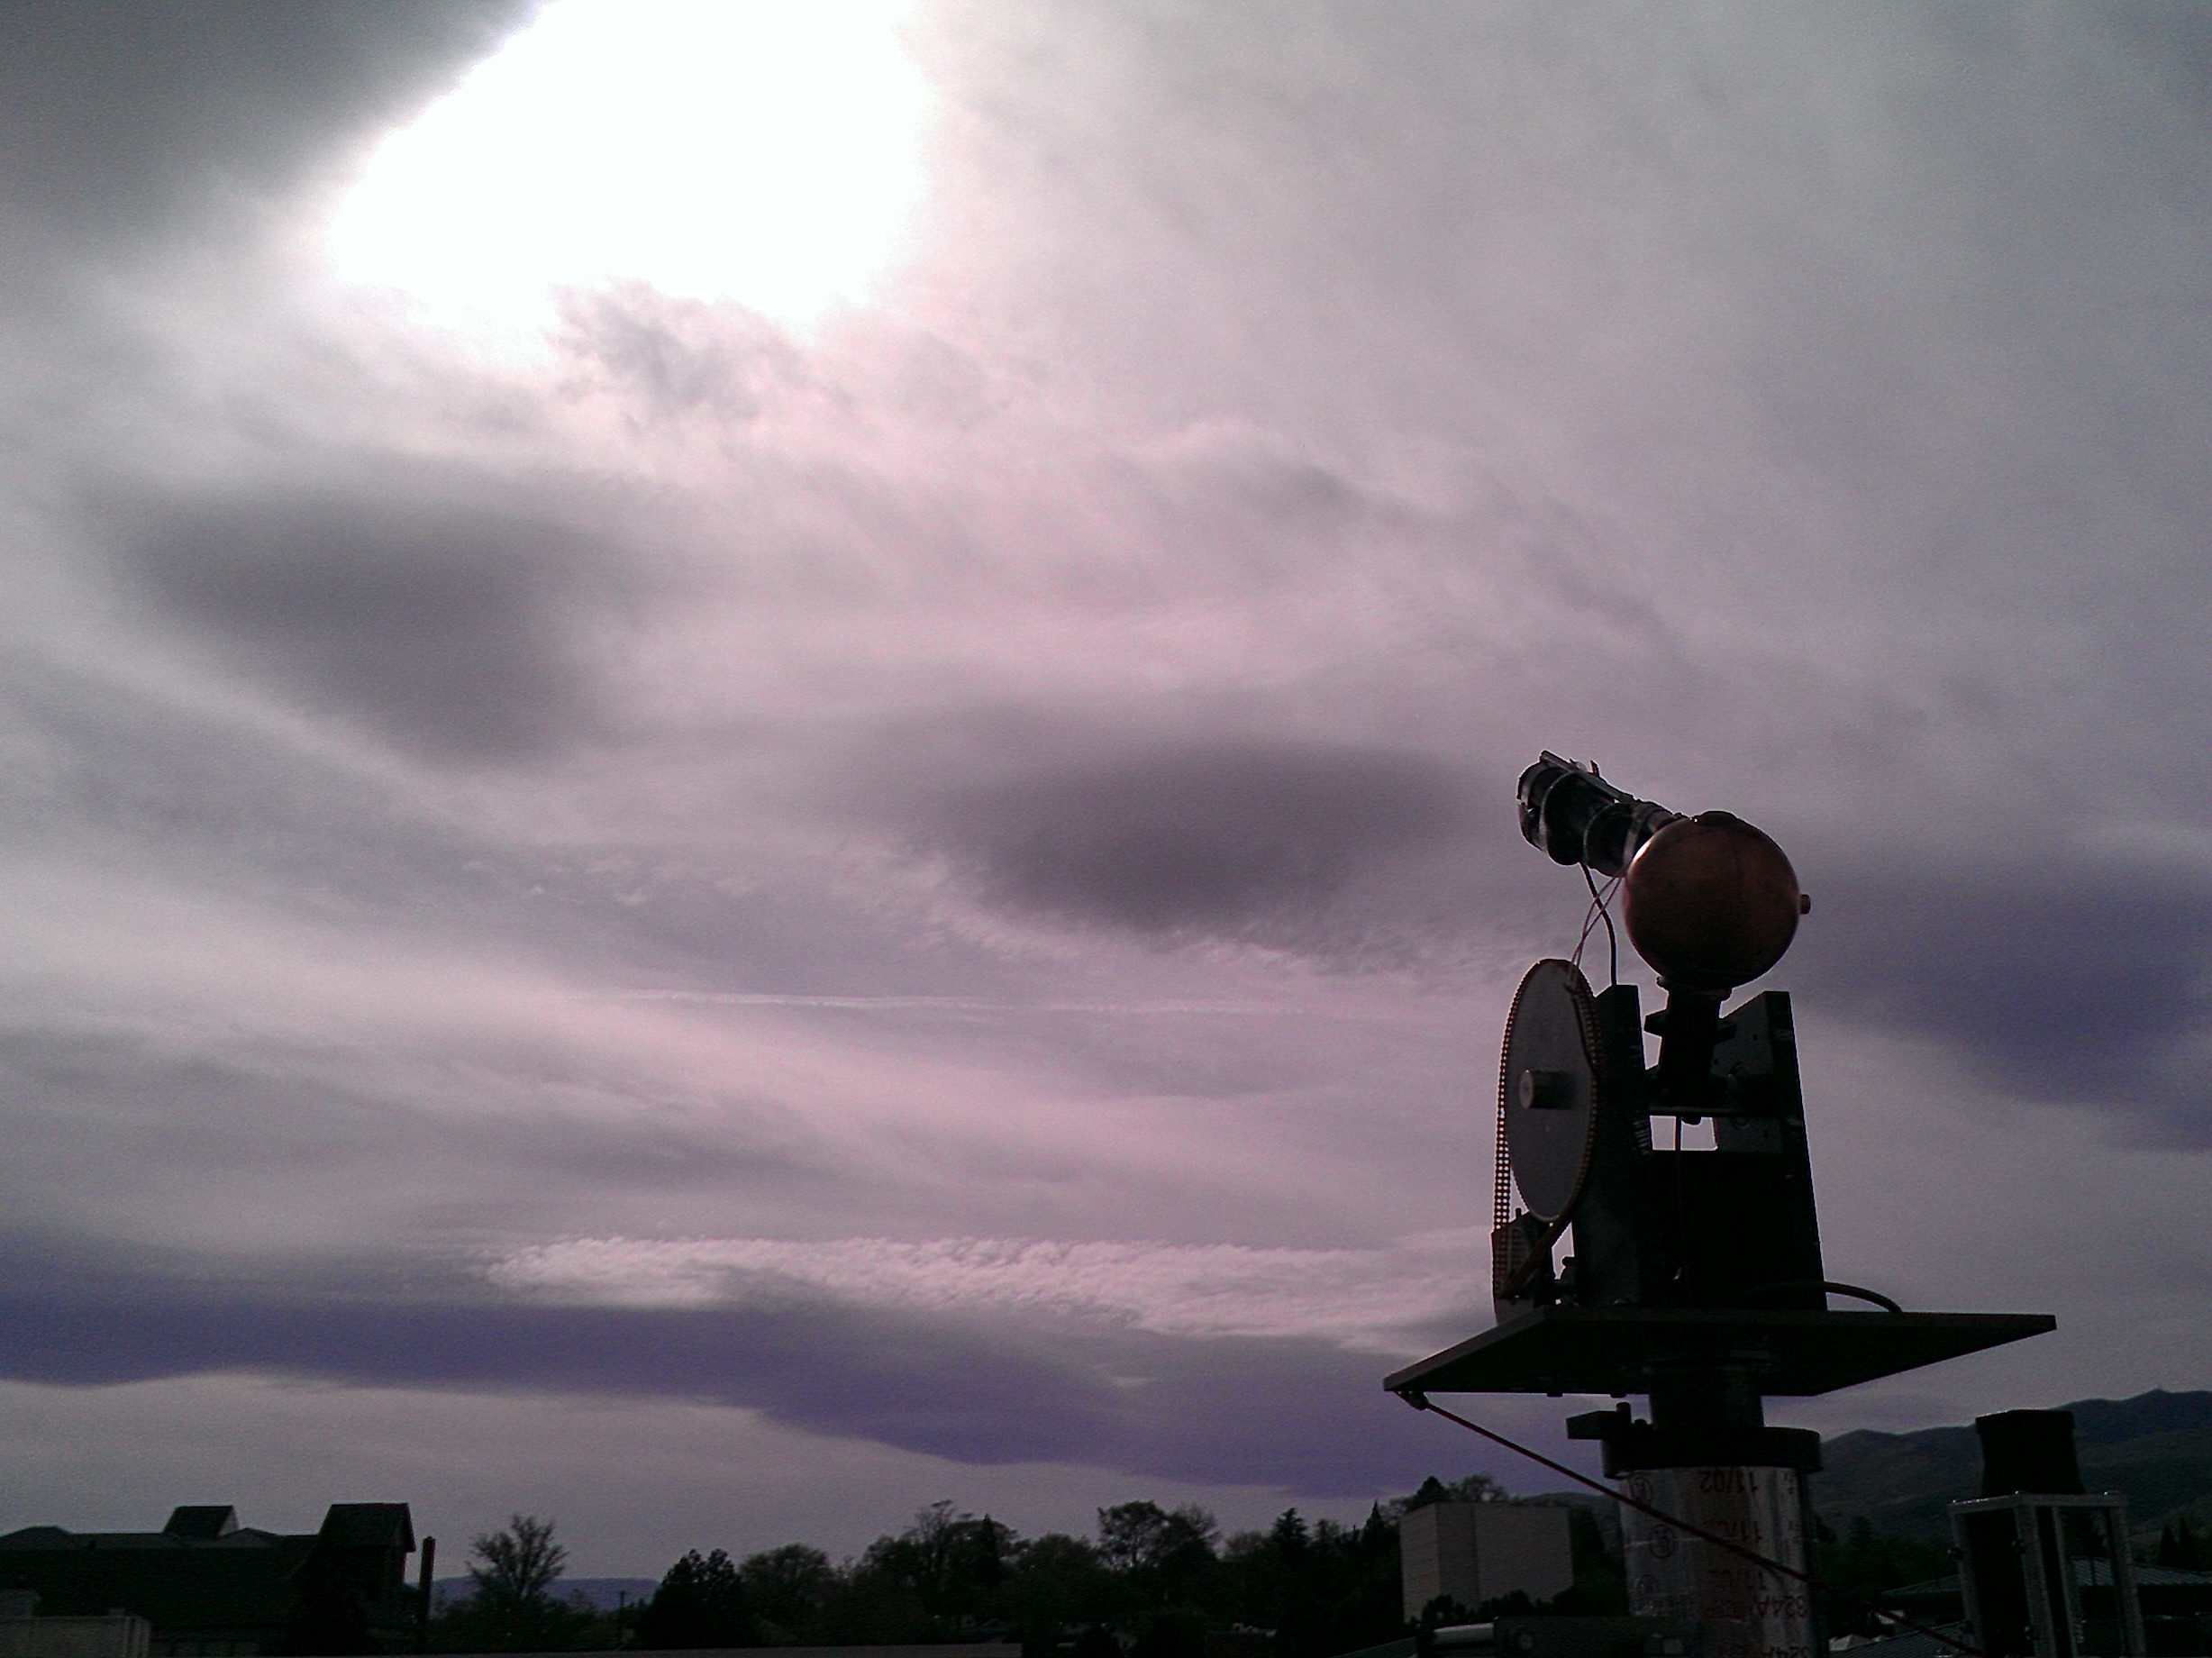
Automated Solar Broadband Spectrophotometer
Bryan Rainwater
Mac Murphy

Slide 2
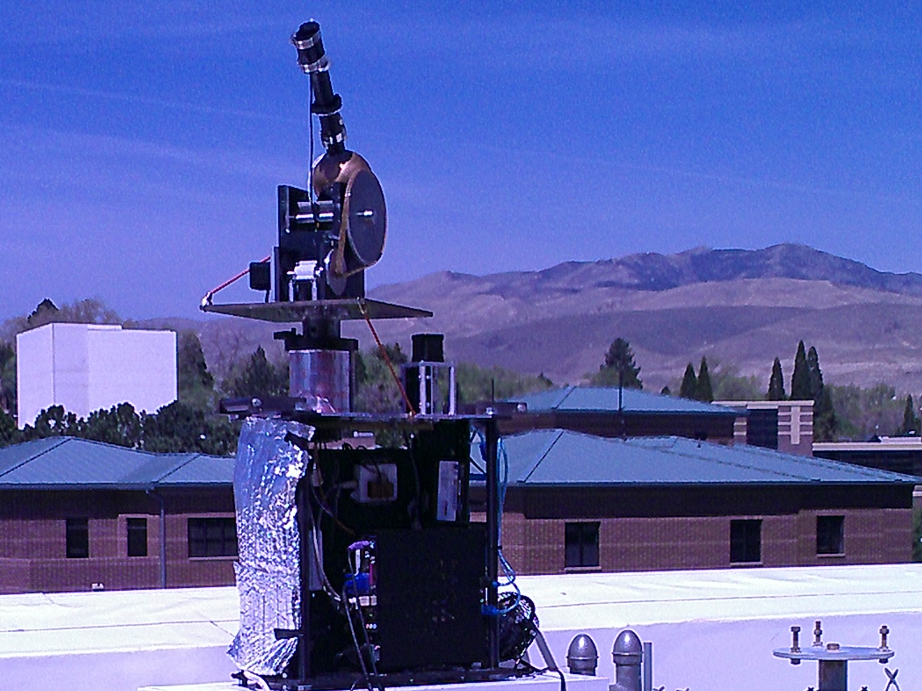
Instrument Design

Slide 3
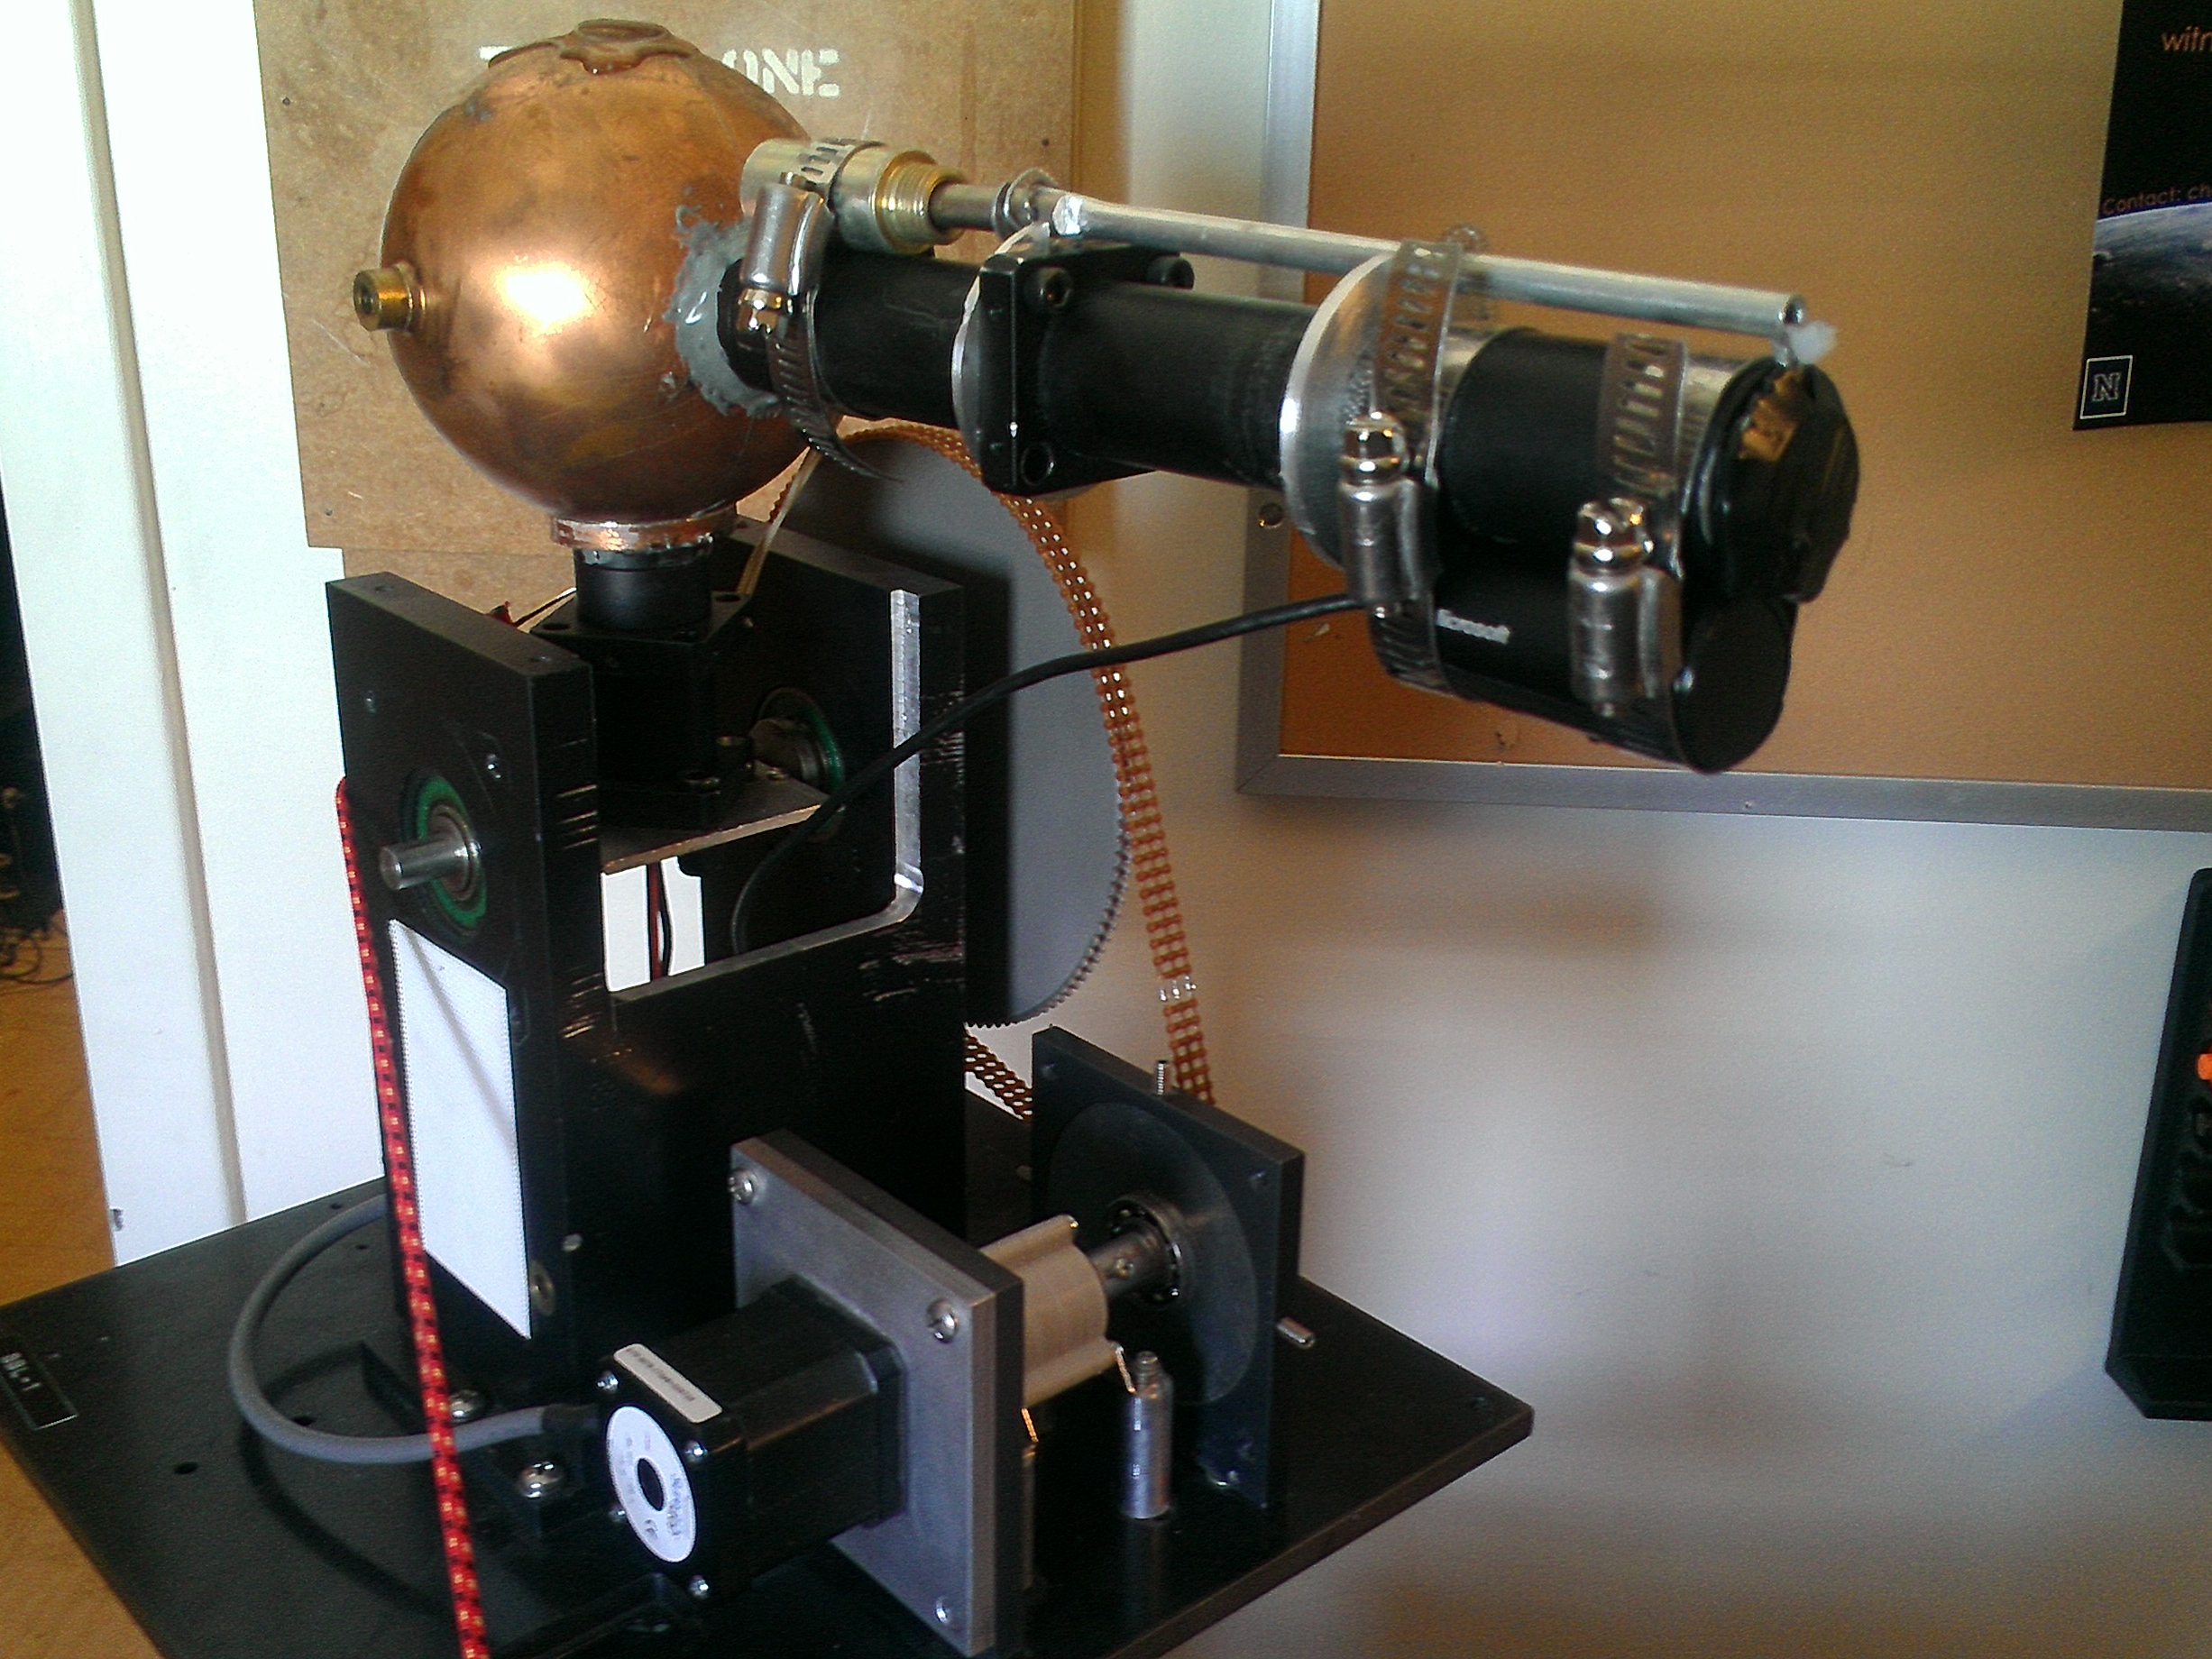
Integrating Sphere
Notes:
The integrating sphere round copper sphere that you see pictured here, which has been modified from a toilet bob into a scientific instrument. It is painted with a special reflective coating known as Avian-D which is used to take direct sunlight and diffuse it homogenously around the entirety of the sphere. Currently an 800um fiber optic cable is coming up into the bottom of the integrating sphere to record the diffuse sunlight that reaches the fiber optic cable. Within the long tube, there are several apertures which allow the instrument to point directly at the sun to achieve a maximum of direct solar irradiance so we can interpret how the atmosphere is affecting this direct solar irradiance. Mounted on the bottom of the tube is a camera with a dark neutral density filter to allow the camera to take photographs of the sun without problems of overexposure. These pictures are interpreted by the program and analyzed to determine the exact location of the sun, from which the motors will fine align to accommodate this. Once the sun has been located, the solenoid as pictured closer to the integrating sphere on the top of the tub, will inactive for a dark measurement, followed by activation to pull the flap open on the front for a light reading.

Slide 4
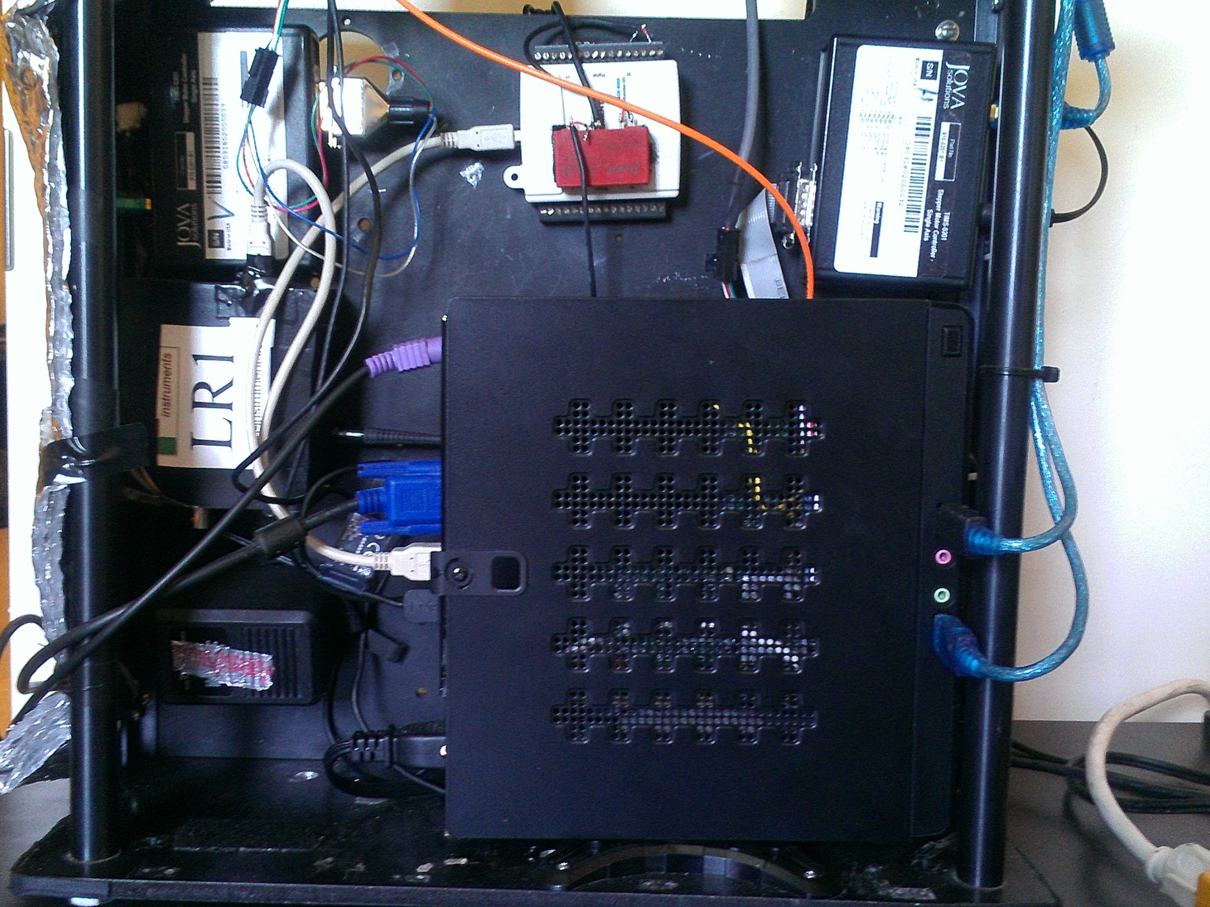
Main Enclosure
Notes:
This is the main enclosure of the device, composed of the computer, spectrometer, stepper motor controllers, data acquisition card, relay, and horizontal gear system just above the picture. The computer holds the labview program for controlling the entire operation which I will show in a few moments. The upper left and upper right components are the stepper motor controllers which interpret signals from the computer to move the motors by specified amounts. The spectrometer located in the middle of the left side of the picture pulls in readings when specified in sync with the solenoid movements. The upper middle device is the data acquisition card with a relay mounted to it. The data acquisition card provides a logic high or low voltage to trigger the relay, which means that when the relay receives the logic high 5V signal, it opens to allow 24 volts and 1.8A of current to pass through it to power the solenoid, and when close to 0V is provided, it switches back off the power to the solenoid.

Slide 5
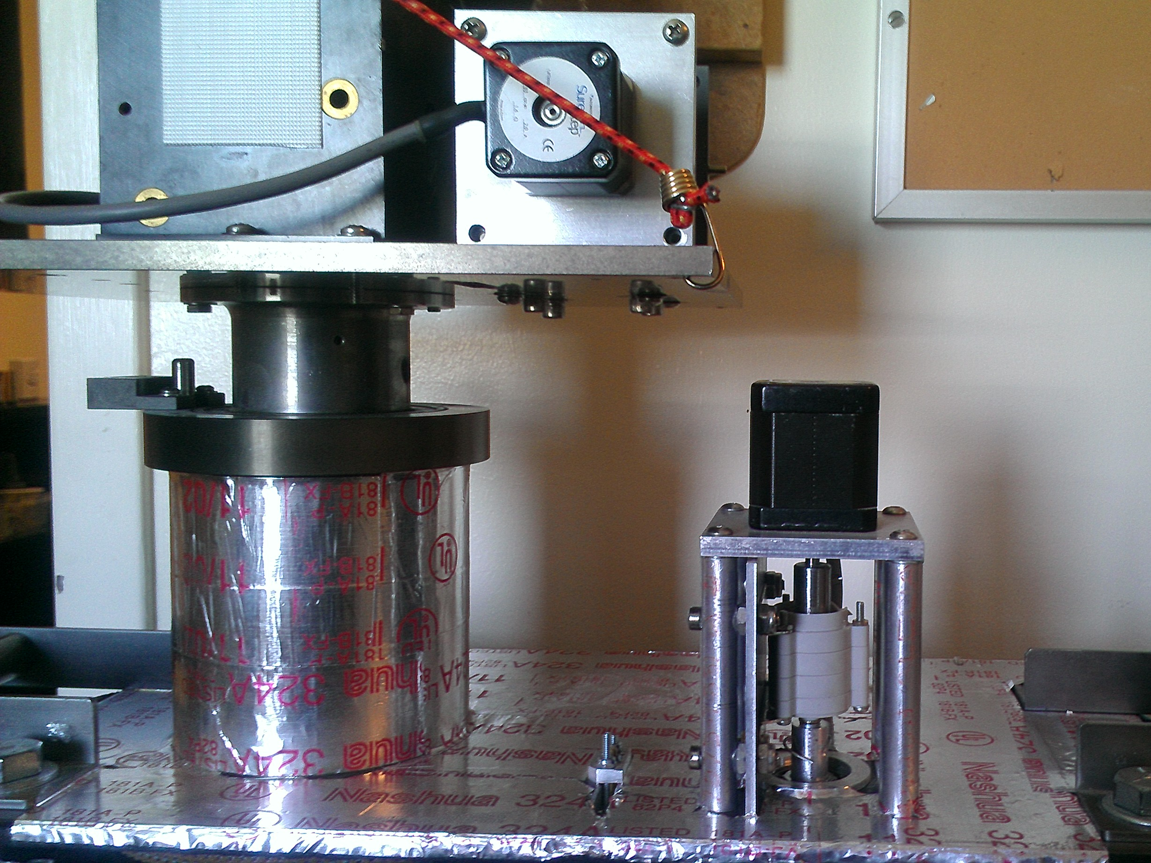
Motors
Notes:
Pictured here are the two motors that control vertical and horizontal motion of the machine. Connected to the black motor is a planetary gear just below it to allow for precision movements of the entire system. Paired with the gear that you saw in the first picture, it makes it to where 77,000 half steps will move the device 360 degrees, which allows for very fine and precise movements.

Slide 6
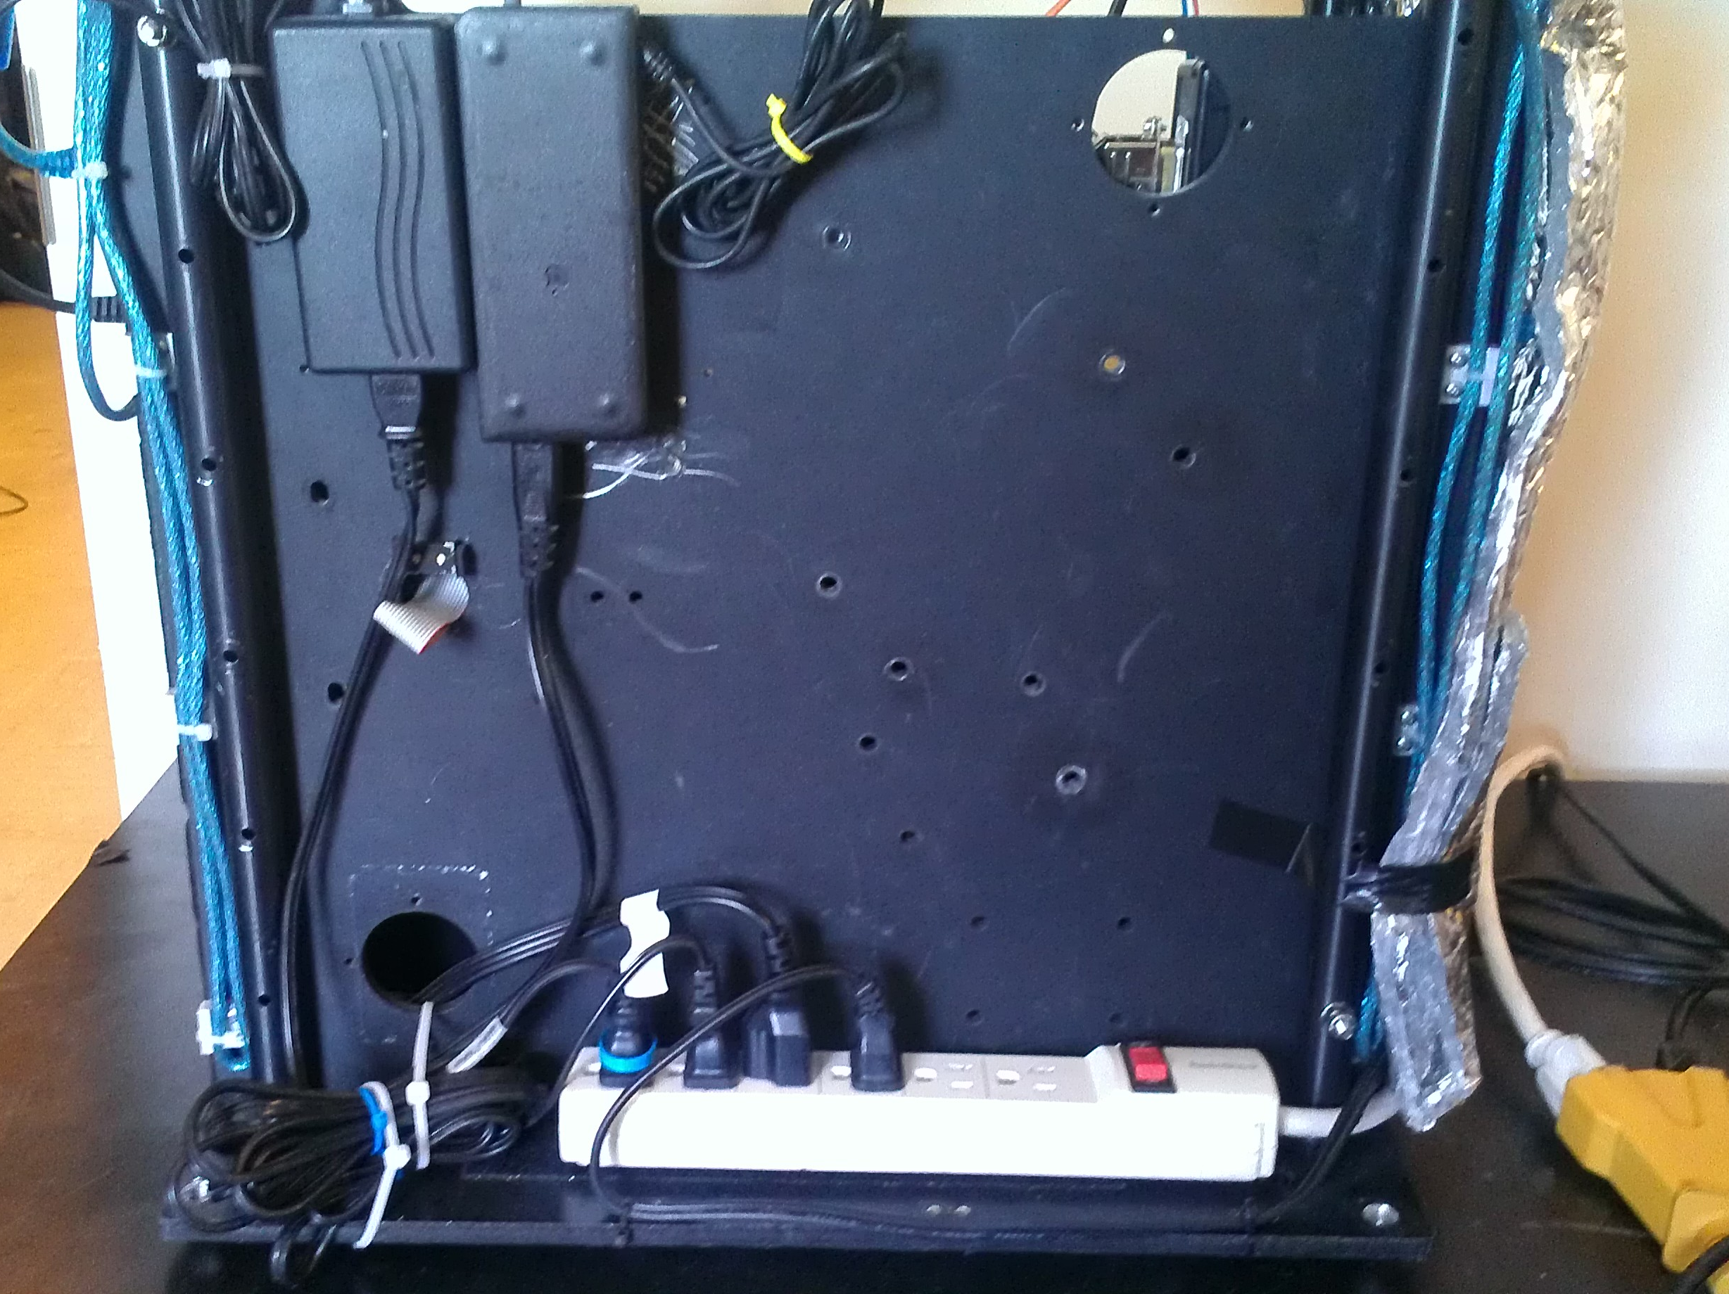
Power
Notes:
This is simply where the power comes from, allowing for expansion of the device at some point.

Slide 7
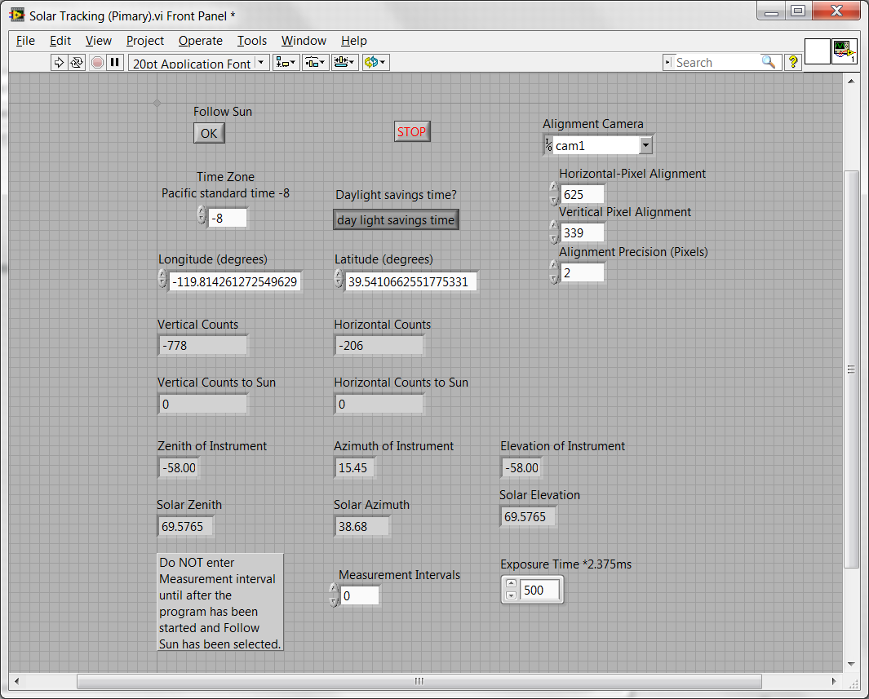
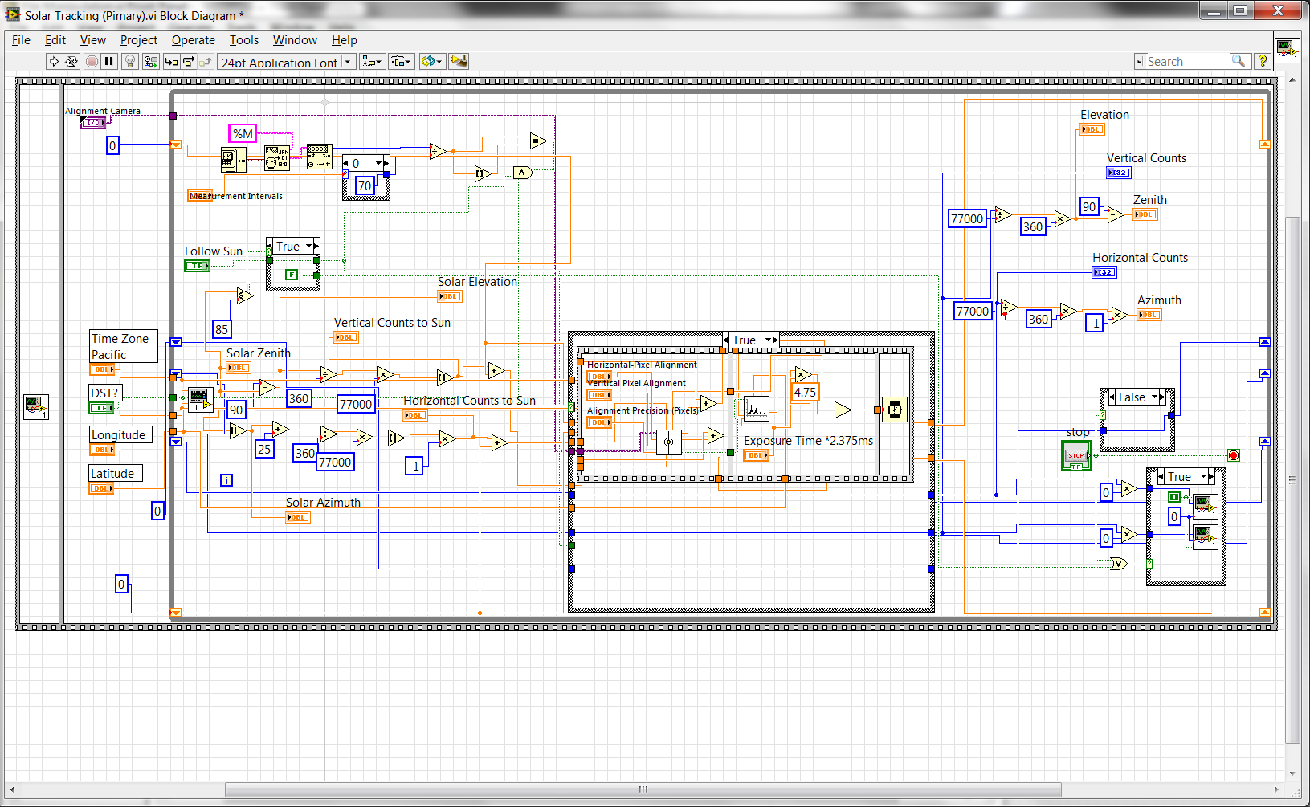
Labview Code
Notes:
This is the front panel of the device, controlling everything that you have seen above. I keep most of the parameters fixed such as longitude, latitude, camera choice, etc,; however, recently I have been commonly modifying the integration time, alignment pixels, precision, measurement interval, etc.
Pictured now is the actual guts of the labview panel that you saw before. Everything on here uses the parameters on the front panel to reference other programs and make the entire system work. Very basically, the code pictured here begins the program, begins course alignment, and begins fine alignment on specified intervals. Located in the center of this code is the actual measurement sequence once the program gives the okay. If you notice, the first part of the measurement sequence is the camera alignment, which lets the camera take over before actually completing a measurement. Once the camera gives the okay, the measurement sequence proceeds.

Slide 8
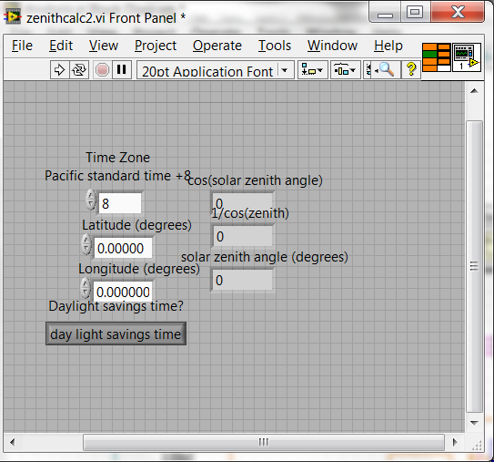
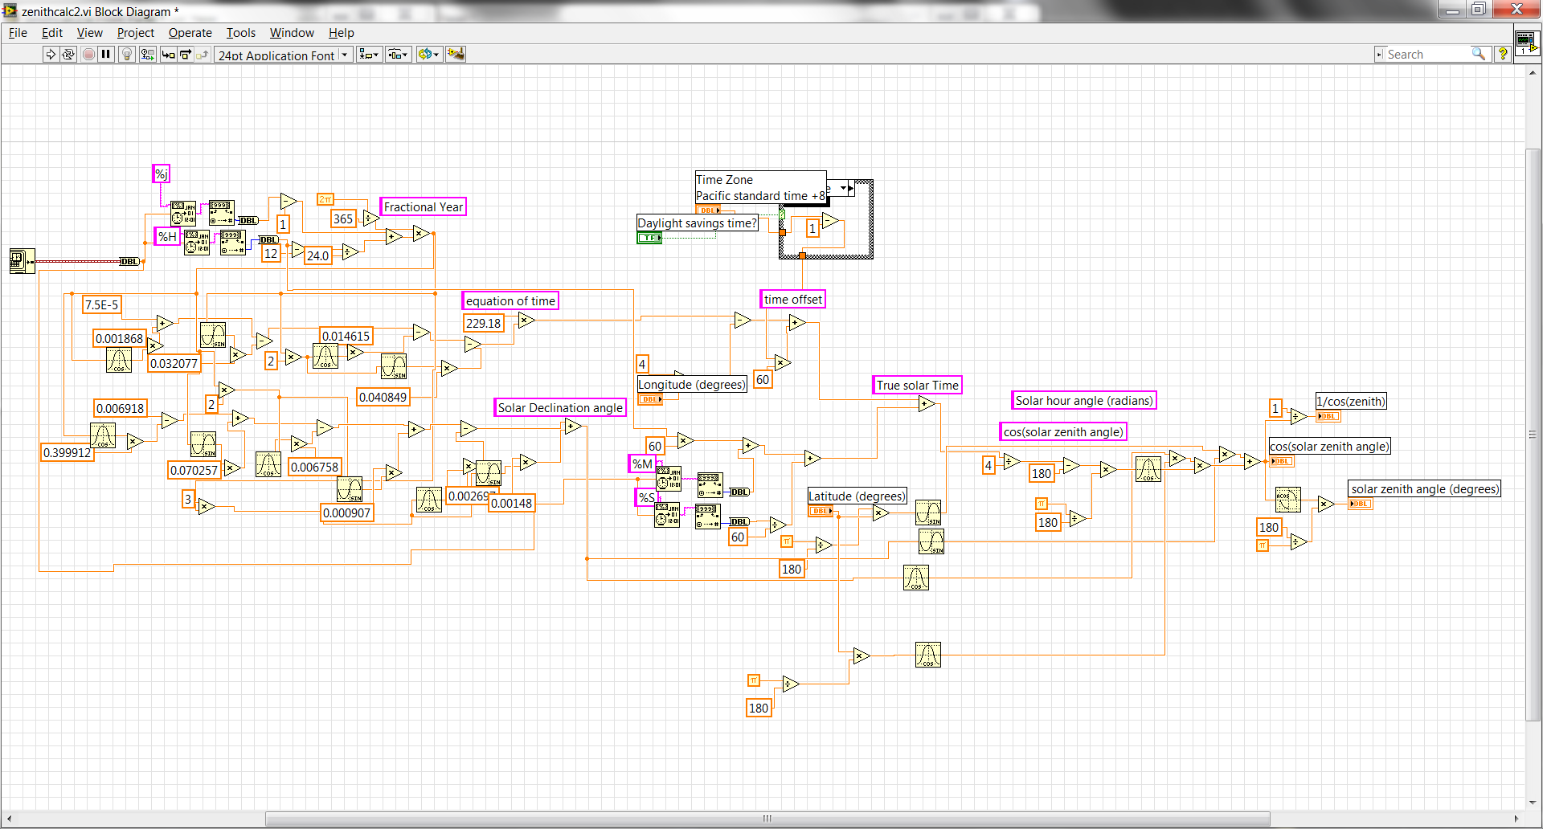
Notes:
This is the calculation that, based on global position, will tell us where the sun is located

Slide 9
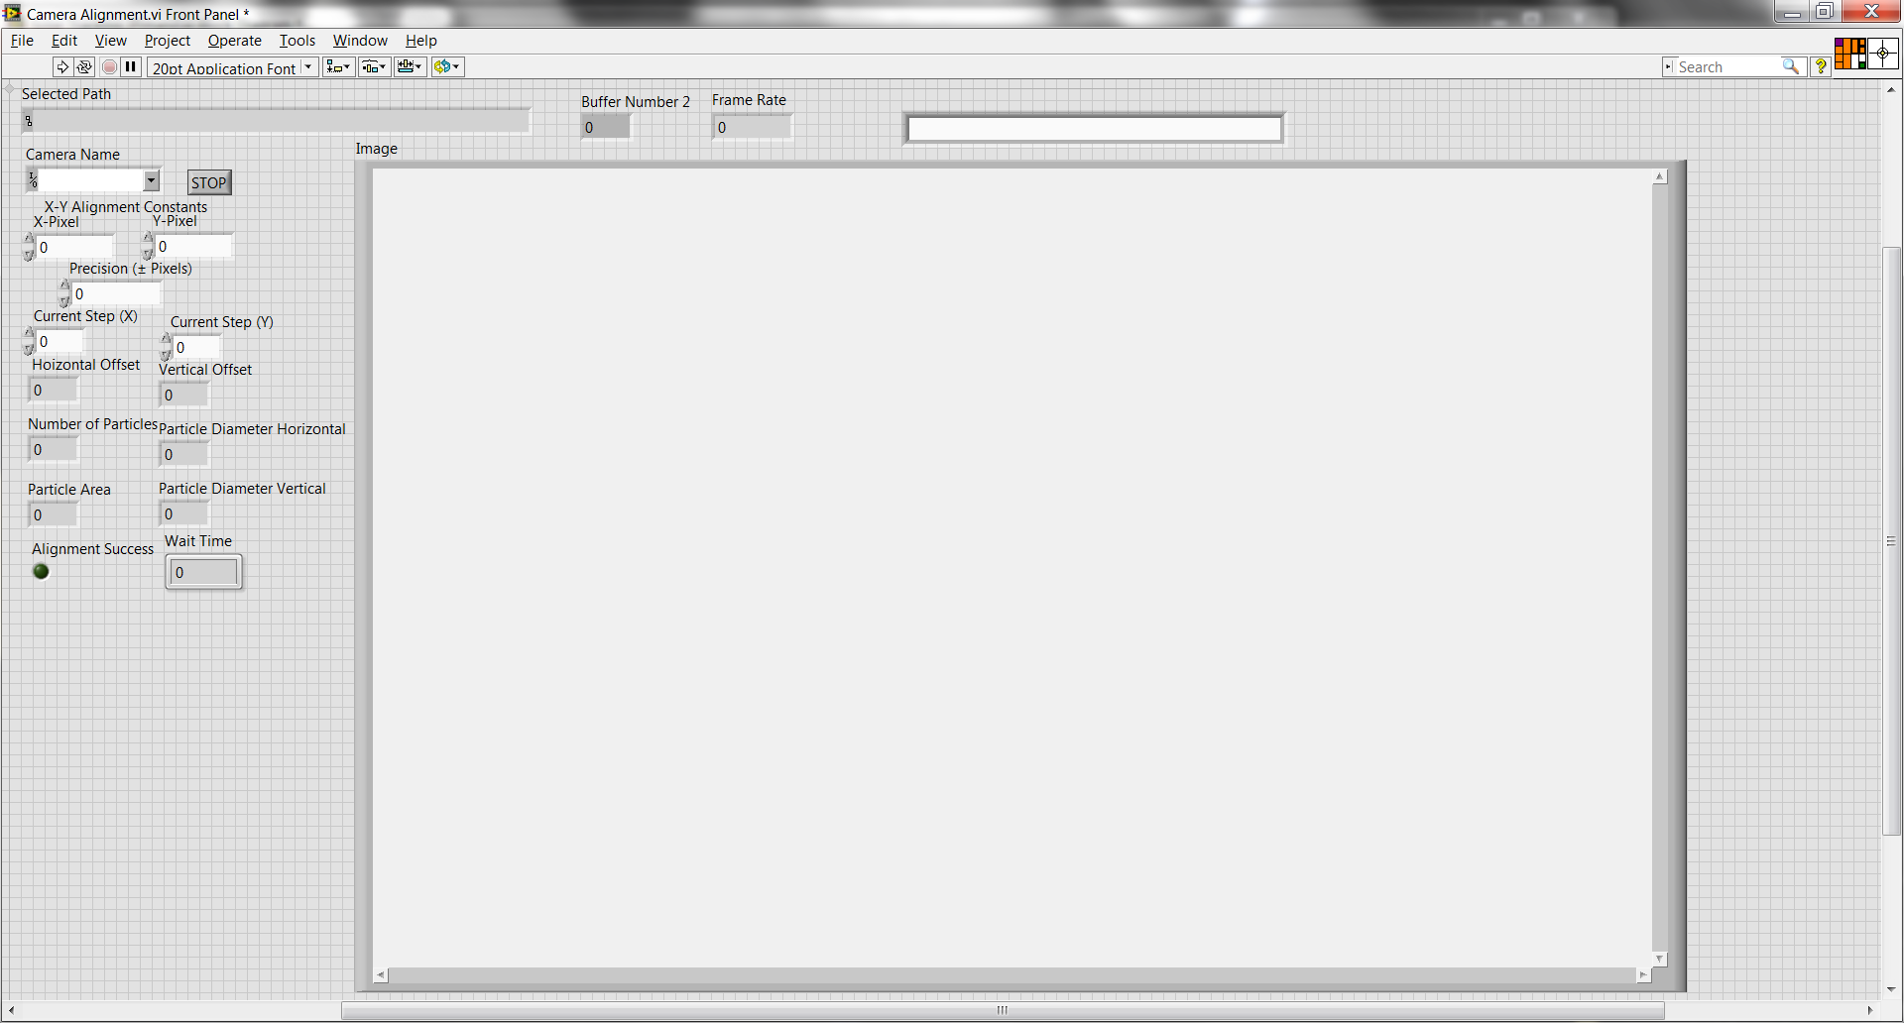
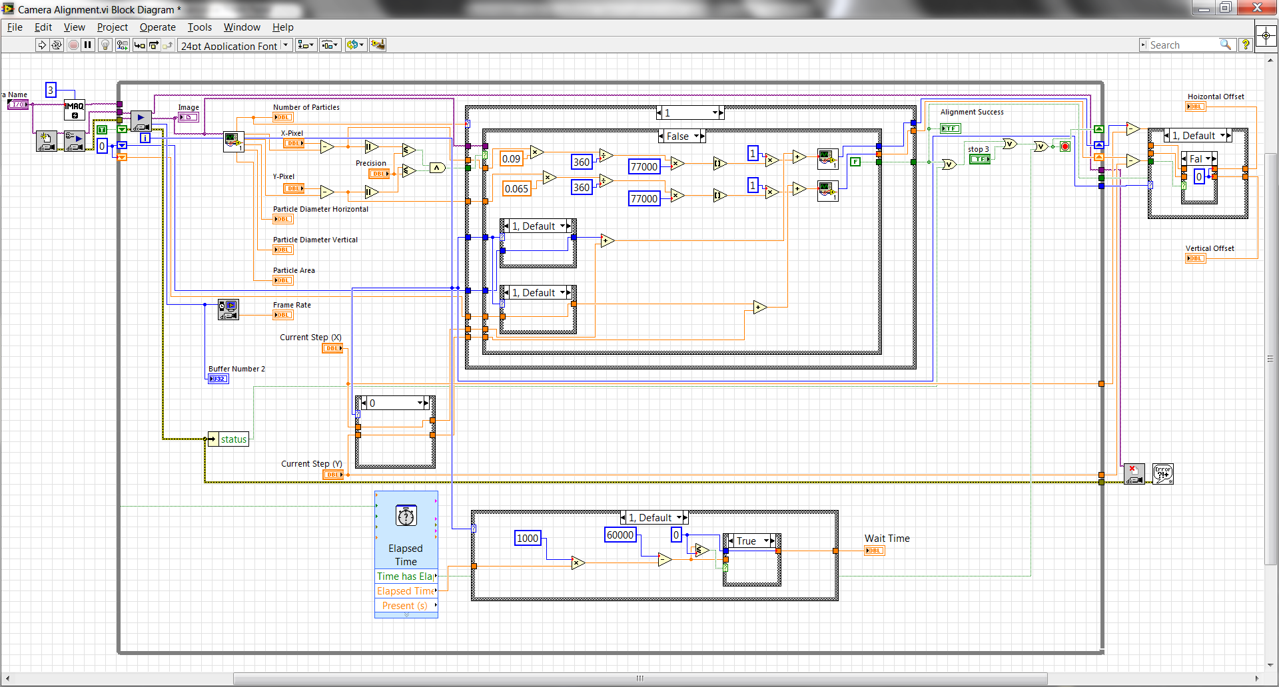
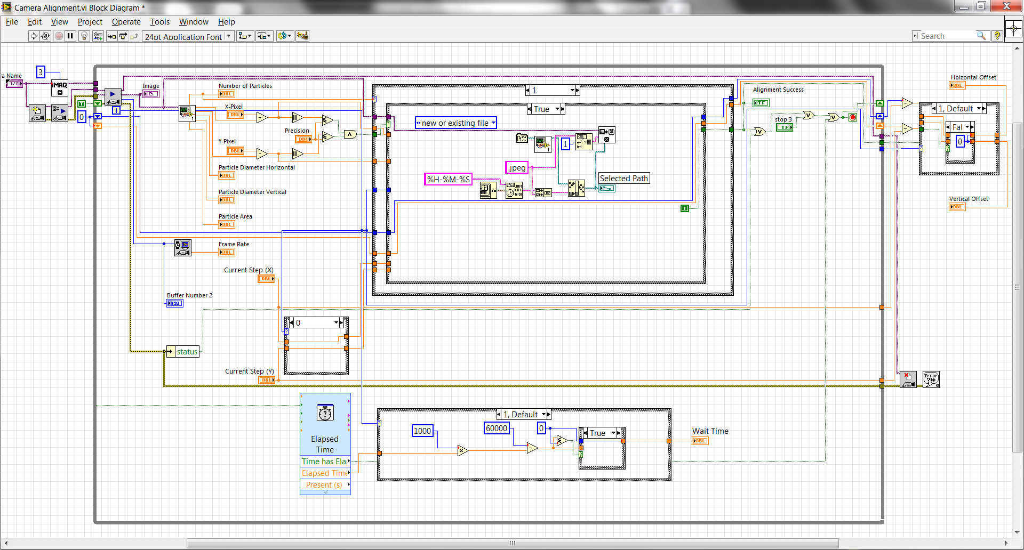
Notes:
This is the camera alignment subVI which was referenced in the first Labview code picture. Once again this front panel, takes parameters from the mainVI, references them and incorporates some of its own to provide for a fine alignment. This works by the code pictured here, by repeatedly taking pictures, using image analysis to continually find the location of the sun and finally outputting a success or non success result followed by saving the aligned picture.

Slide 10
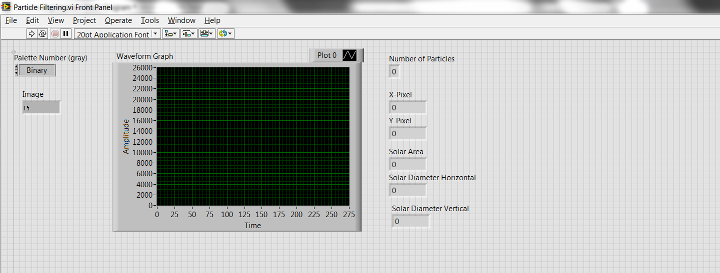
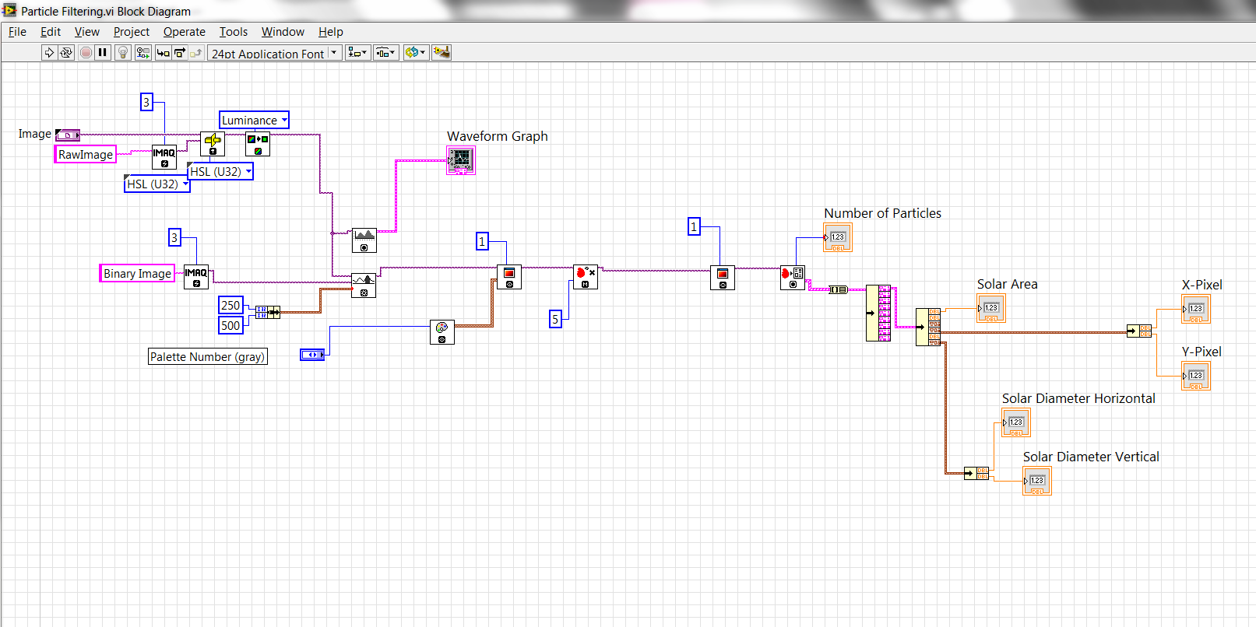
Notes:
This is the image processing program which basically takes a picture, turns it into a binary image, seperates parts of the image based on intensity and tells me information about where the sun is located in the image.

Slide 11
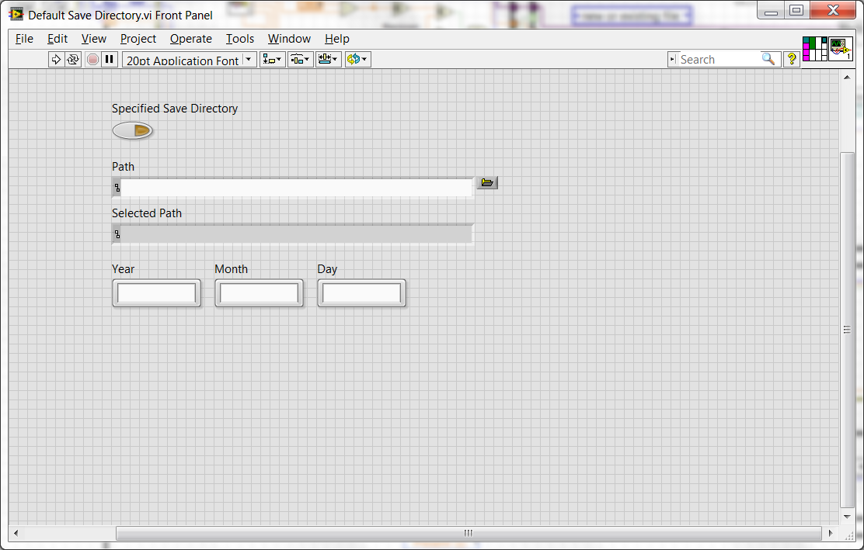
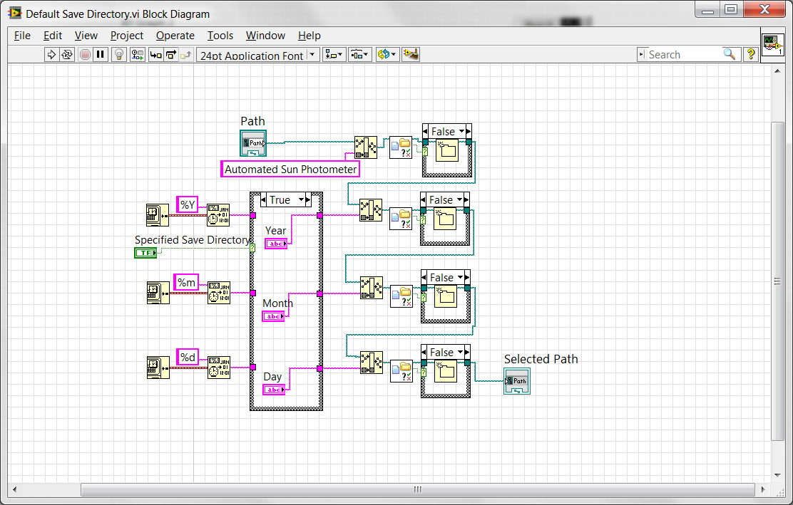
Notes:
This is the file IO operations that creates folders so that I can save the data in an organized fashion

Slide 12
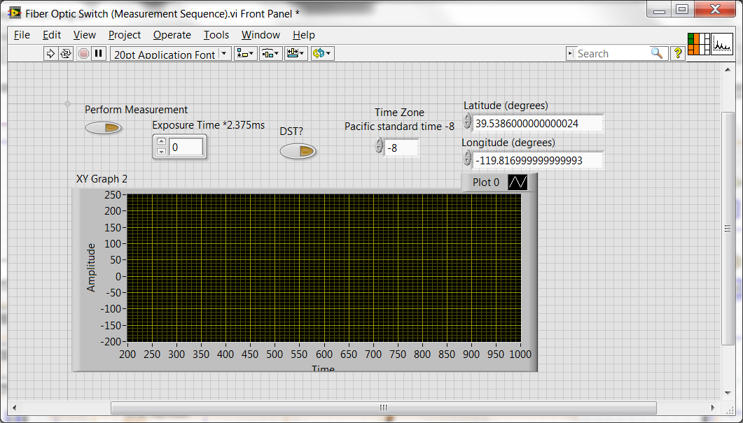
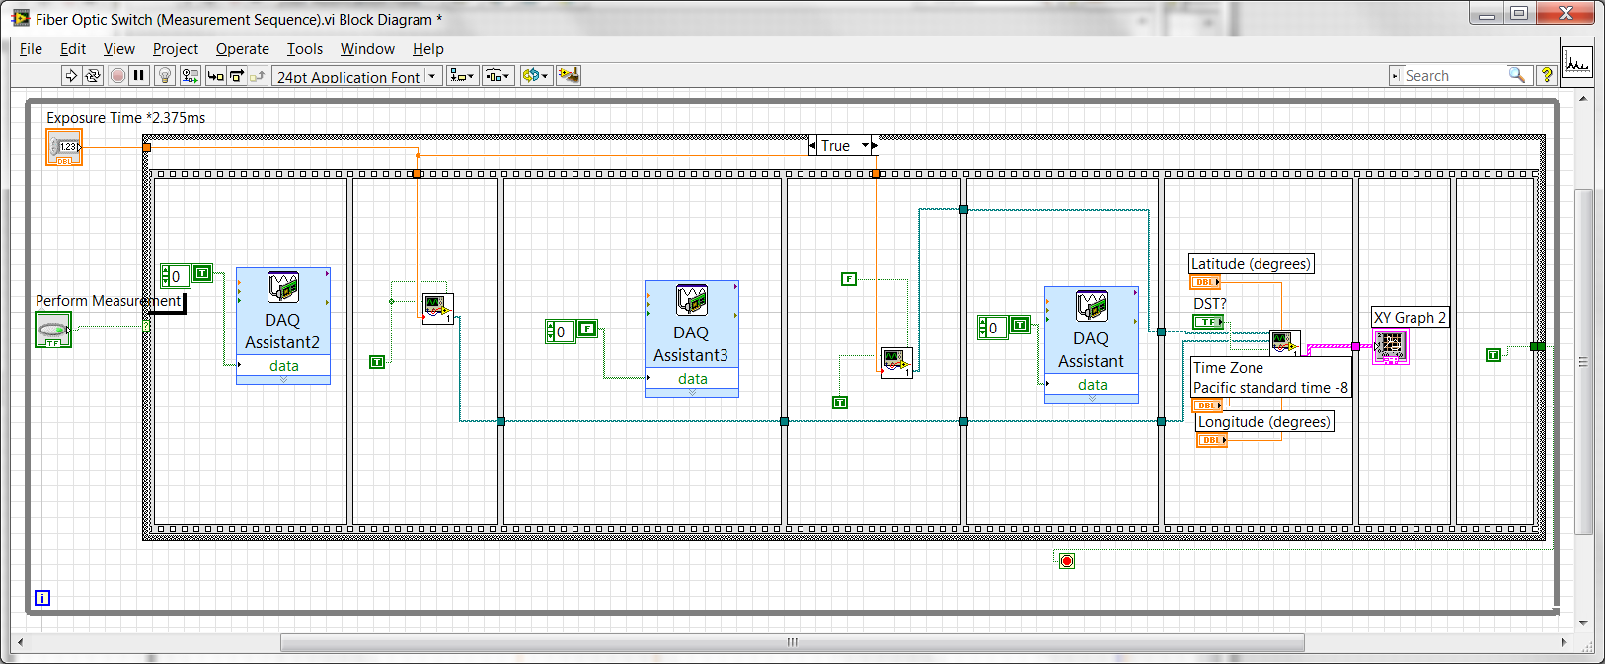
Notes:
Finally, this is the measurement sequence that allows for the data to come in. Each of the DAQ assistants that you see, close or open the relay, followed by spectrometer sequences. Once the data is pulled in and saved, the last part of this sequence processes all of the data into an organized fashion and ultimately into langley files.

Slide 13
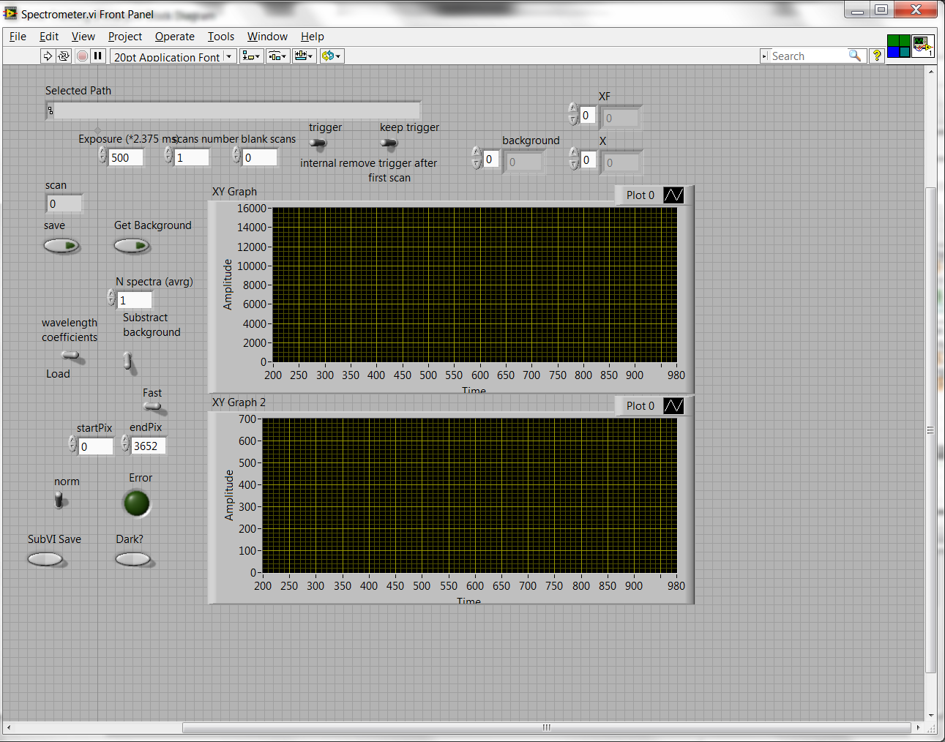
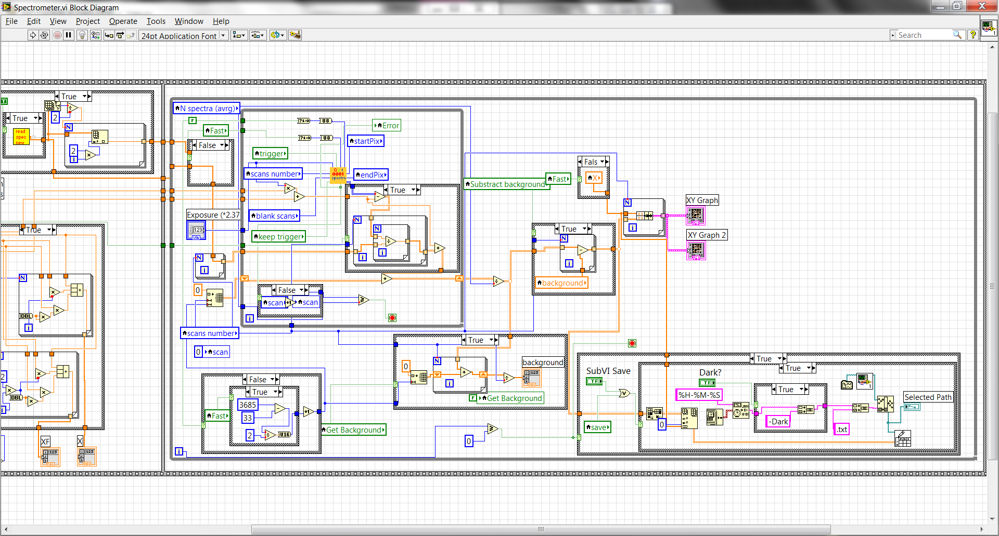
Notes:
This is the spectrometer sequence that I received from the company to take manual readings. The only thing I programmed here, aside from small modifications, is the saving sequence that you see here.

Slide 14
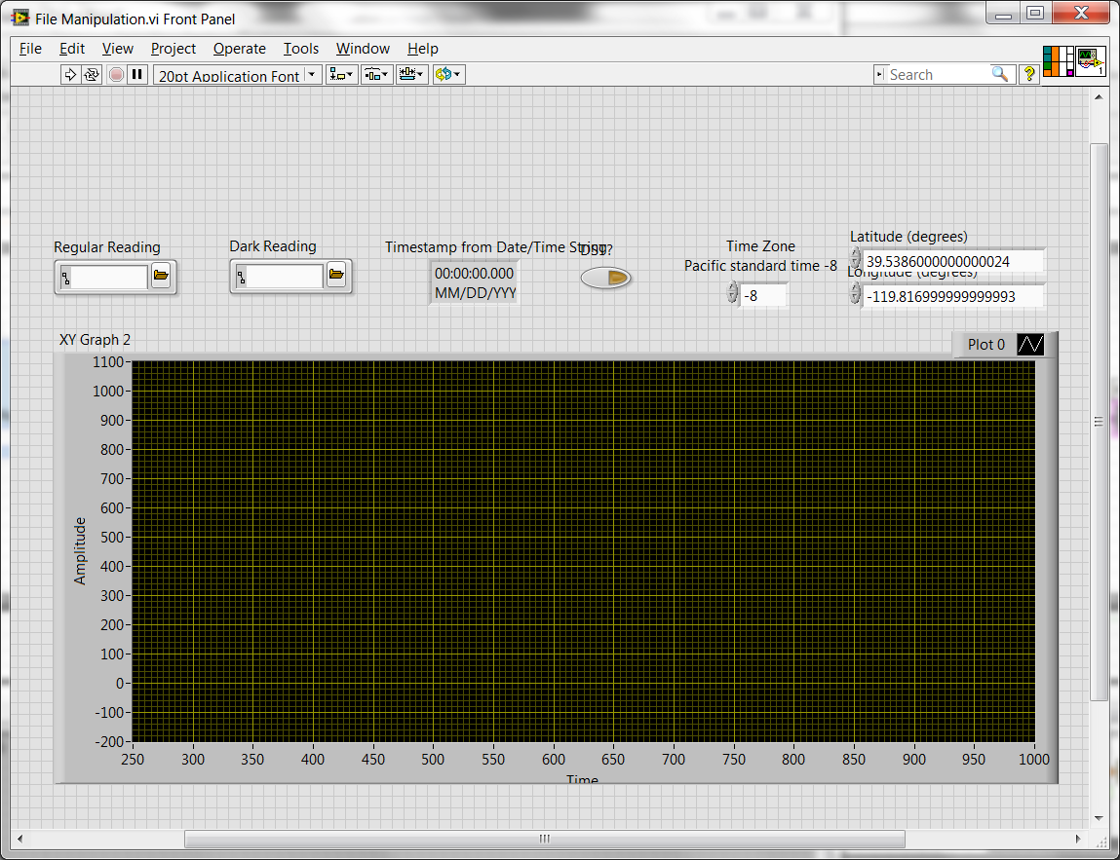
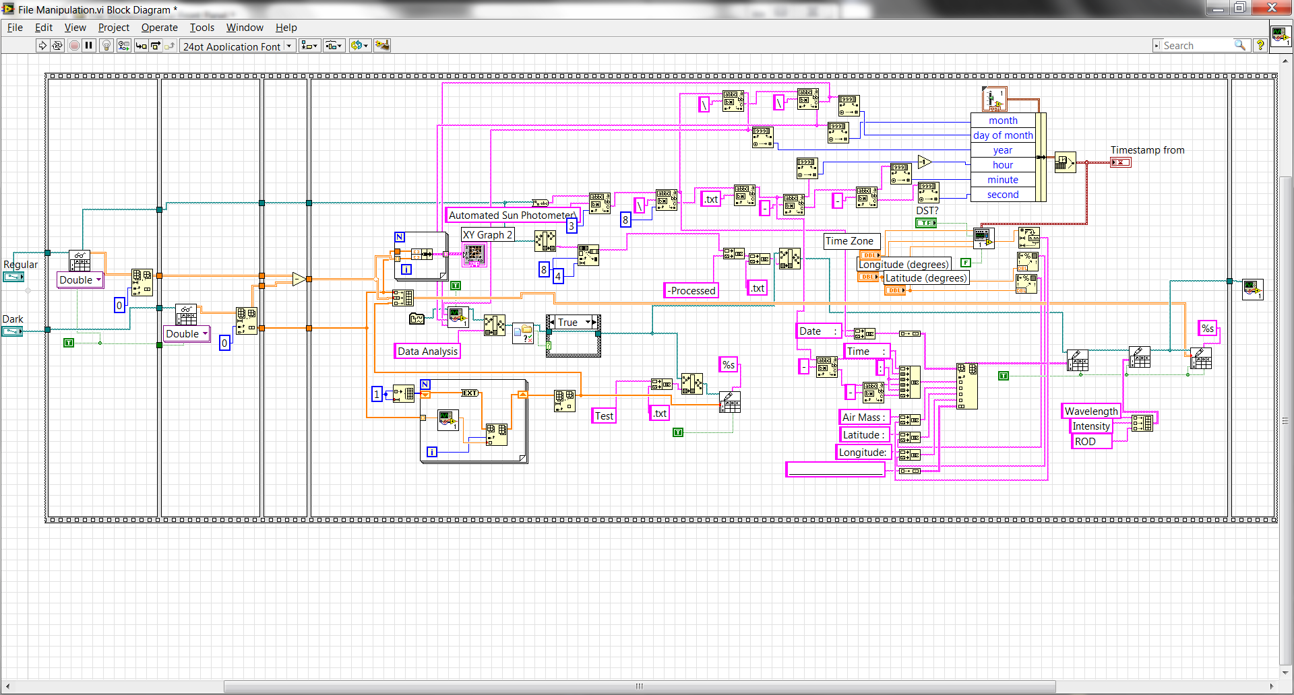
Notes:
This takes the raw data from the spectrometer readings, subtracts the dark measurement, and analyzes them into processed file, then the final sequence processes that data into a final langley file.

Slide 15
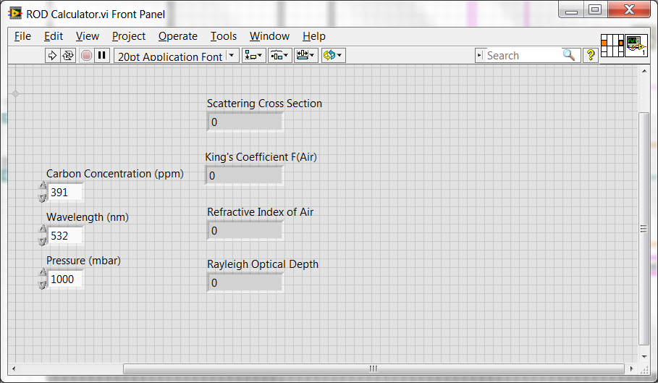
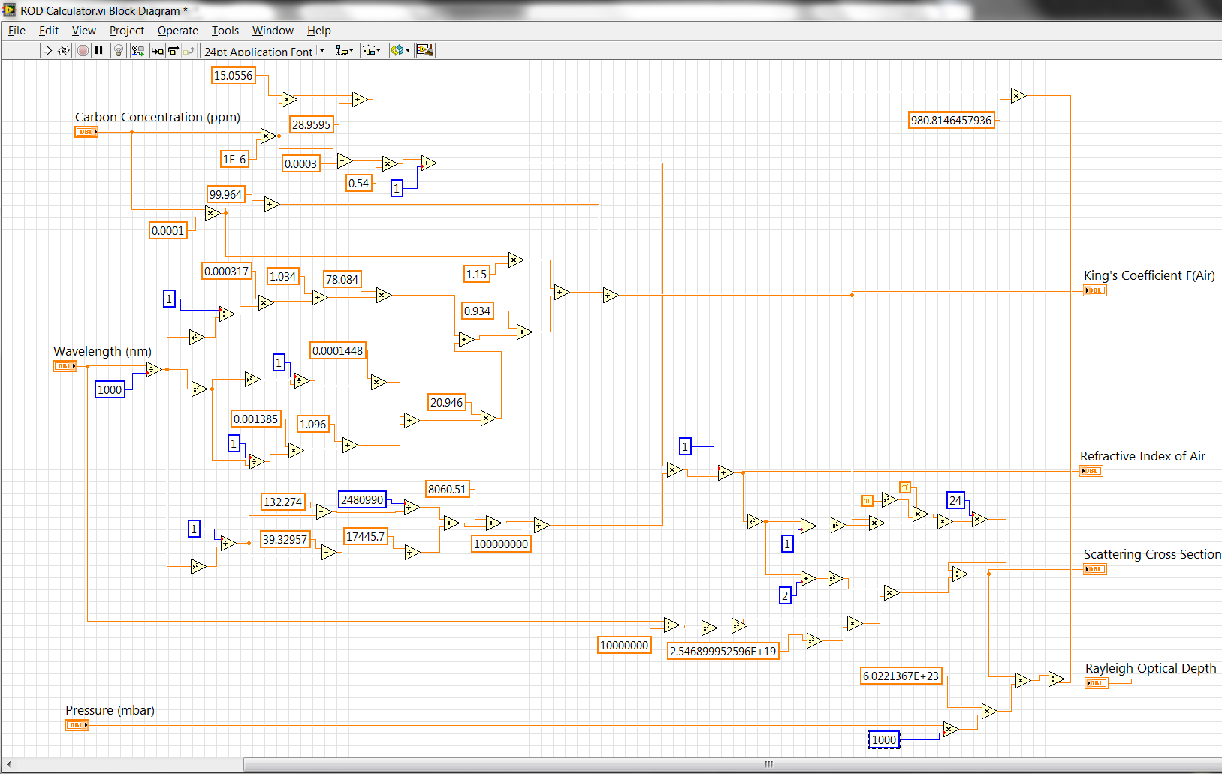
Notes:
This is the ROD calculator that inputs ROD data into the processed file.

Slide 16
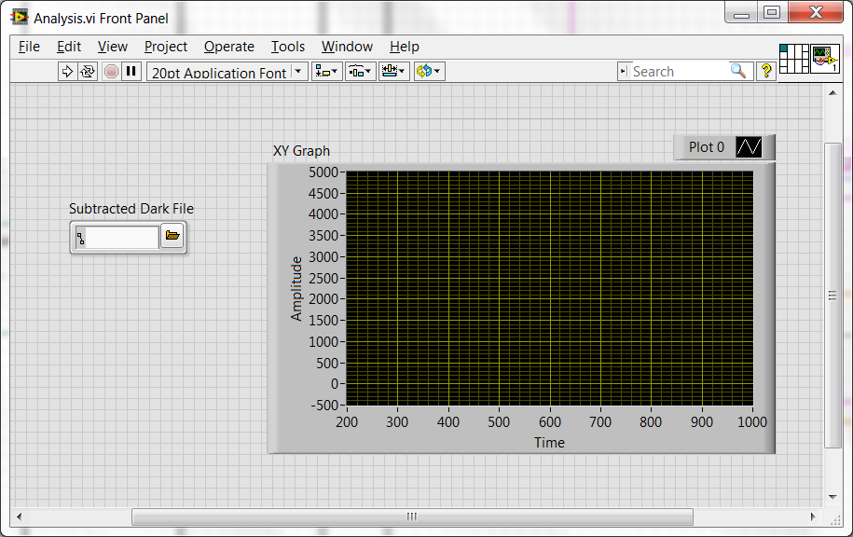
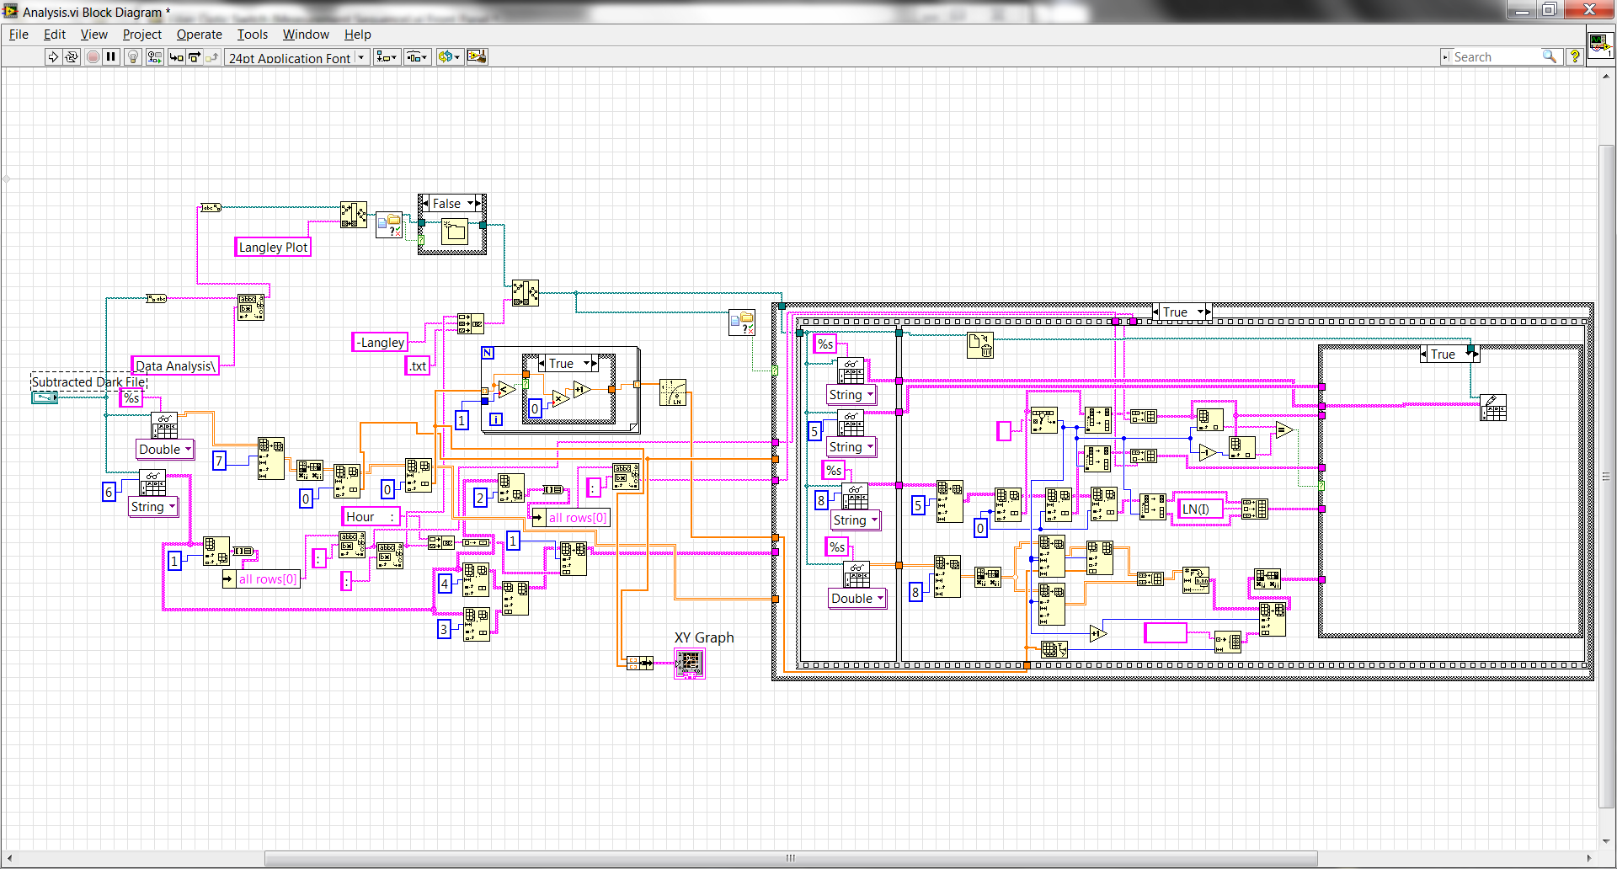
Notes:
This is the analysis section that finally takes all of it, shows me what the spectra looks like and inputs it into a langley file.

Slide 17
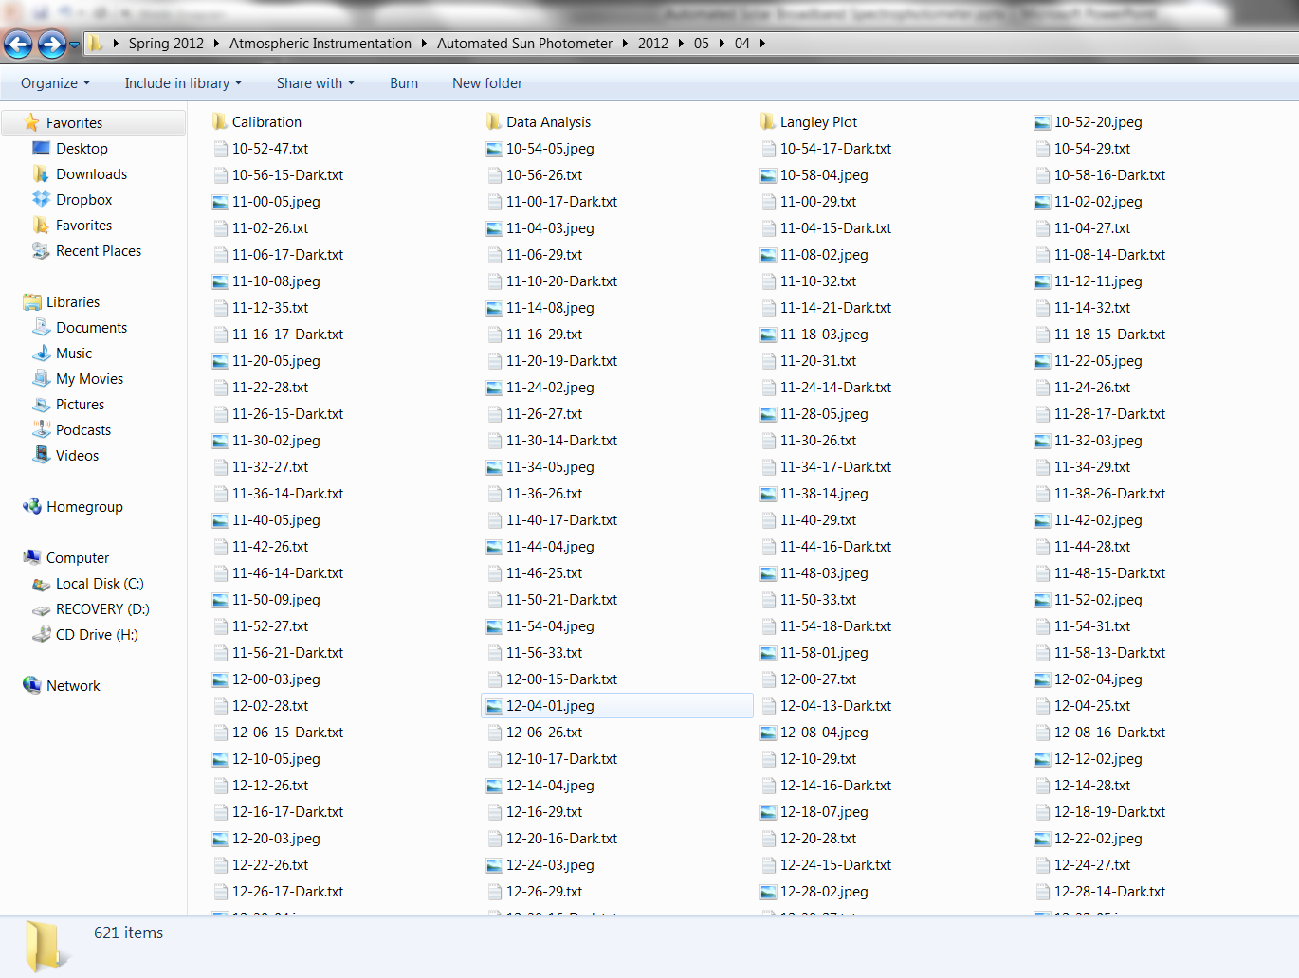
Notes:
Here is my the organization that each of the programs before creates, taking aligned pictures, dark and light measurements, subtracting them into the data analysis folder then processing those into an hourly langley file within the langley plot folder.

Slide 18
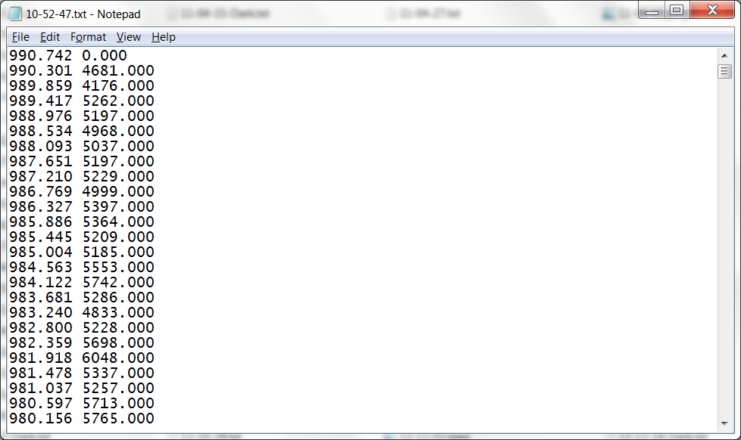
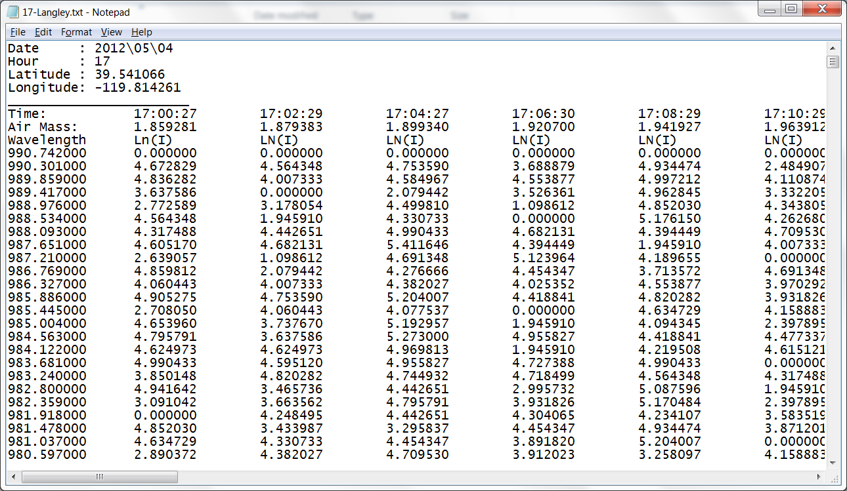
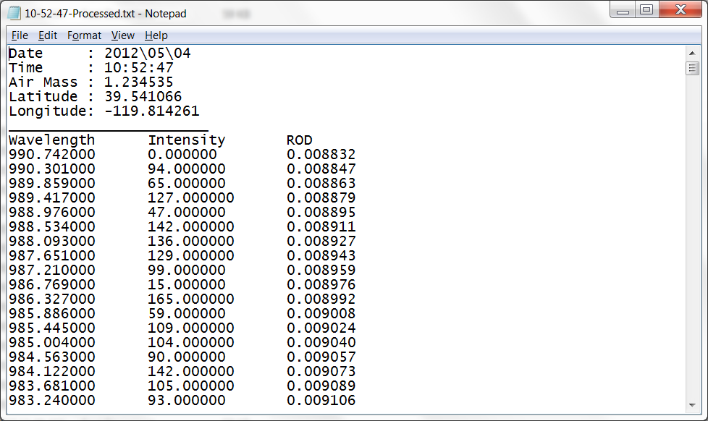
Notes:
The raw data can be pictured first, then the subtracted dark from light measurement, followed by placement into a langley file.

Slide 19
Preliminary Results
Notes:
Here is our first set of preliminary results that we have taken. As you can see, it is complete mess, due to the random contrails that system passed over which we can explore later.

Slide 20
TOD, ROD, vs. AOD
May 4, 2012 – 1100 Hours
Notes:
The next few sequences show the progression of several hours of the best day for measurements that we have been able to measure for. This one is also pretty messy like the previous one. We believe this was due more to the fact that the air mass was not changing very much than to contrails since the time lapse photography shows that it was a relatively clear day.

Slide 21
Notes:
Elaborate on why we do not know exactly why this has happened other than possibly a malfunction with the solenoid or perhaps a malfunction with the spectometer.

Slide 22
TOD, ROD, vs. AOD
May 4, 2012 – 1300 Hours
Notes:
Elaborate merely on the hour and the lack of change of air mass and possibly upper level clouds. Also, had to use the positive slope on this graph rather than the negative slope that is used on all of the other graphs, which provides further evidence that perhaps the spectrometer malfunctioned for a small time.

Slide 23
TOD, ROD, vs. AOD
May 4, 2012 – 1400 Hours
Notes:
Quickly go through slide. Data is finally becoming a little more clear and everything seems to be working properly again.

Slide 24
TOD, ROD, vs. AOD
May 4, 2012 – 1500 Hours
Notes:
Note that as the spectra becomes less scattered, I have begun to change the scatter plot to connecting lines to smooth out the mess of data and see how the AOD, TOD, and ROD changes with wavelength. The data becomes progressively more usable as the day wears on the air mass changes more each other.

Slide 25
TOD, ROD, vs. AOD
May 4, 2012 – 1600 Hours
Notes:
Once again, elaborate on the smoothing of the curve

Slide 26
TOD, ROD, vs. AOD
May 4, 2012 – 1700 Hours
TOD, ROD, vs. AOD
May 4, 2012 – 1700 Hours
Notes:
Now we can see our best set of data so far with a greatly changing air mass. These lines are smoothing our and we can actually somewhat characterize what the AOD, and TOD is doing with wavelength. Still not as crisp as we would like it to be, but certainly good enough to do some basic analysis of.

Slide 27
Comparison and Remarks
Notes:
This is a comparison of the previous data to what it should look like. This was a measurement sequence done by David by his handheld sun photometer and as you can see, this is slightly better and more crisp than the prior one; however, a few differences should be noted, such as the very crisp oxygen A-band peak.

Slide 28
Future Plans
Notes:
Eventually plan to use the device to determine the top of atmosphere solar irradiance so that real time aerosol optical depth can be determined.

