Slide 1
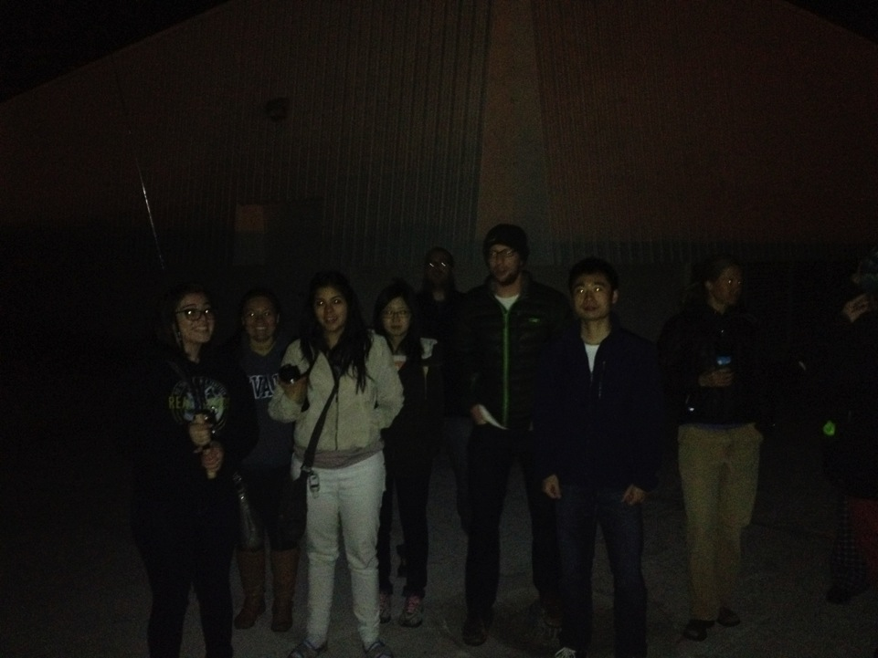
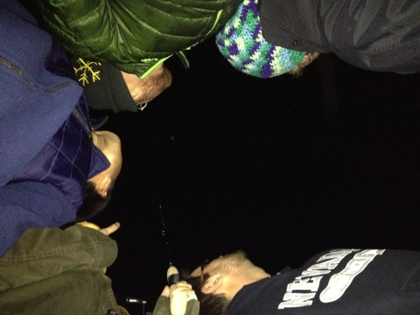
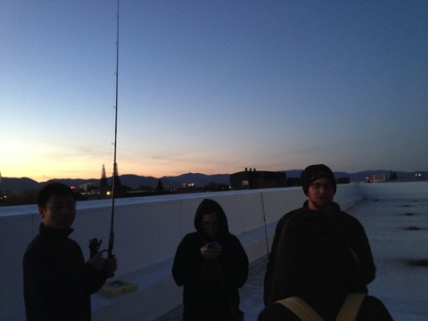
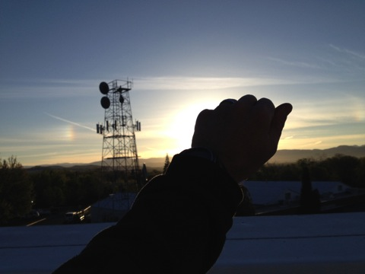
1 May 2014
Atmospheric Instrumentation
Tethered Balloon Experiment
4:39 a.m.
5:08 a.m.
5:41 a.m.
6:34 a.m.

Slide 2
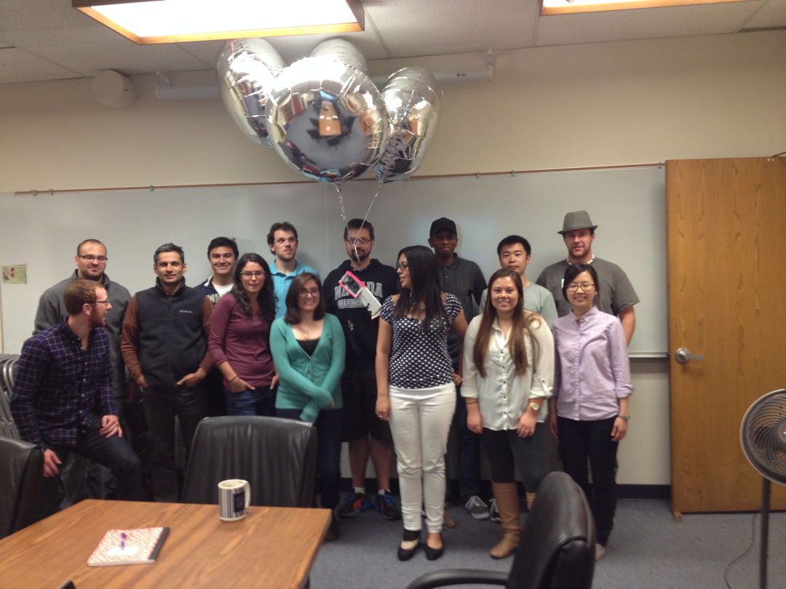
Class of 2014

Slide 3
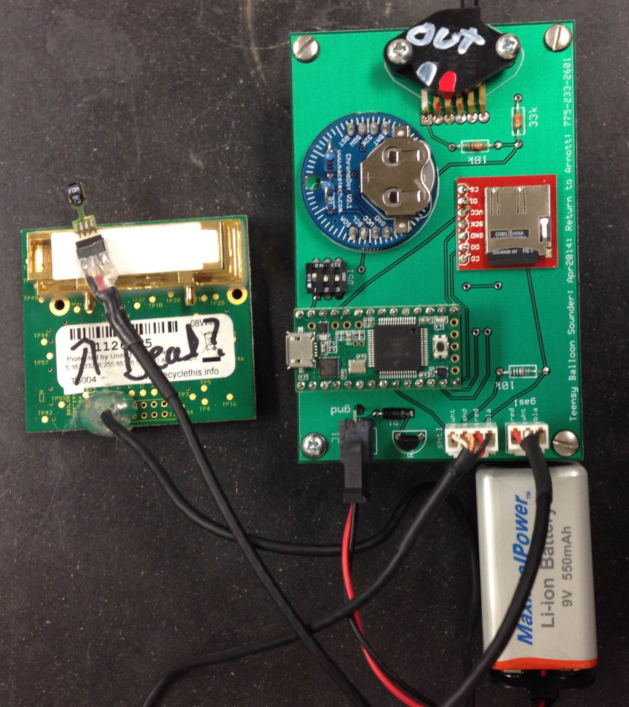
Atmospheric Sounding Package
Freescale pressure transducer
Chronodot real time clock
Four 36” diameter He filled
balloons lofted this package
to about 100 meters above
ground level.
Purpose:
Study inversion breakup.
Provide in situ data for
FTIR retrieval algorithm
development.
Proof of concept.
The boards were assembled
by students after bread
boarding up the design.
CO2 and pressure were
from analog inputs. All other
sensors were digital. CO2 is
uncalibrated in this data set,
but relatively relevant.
SHT75 temperature and RH
micro SD card
Teensy 3.1 microcontroller
Telaire 6004 CO₂

Slide 4
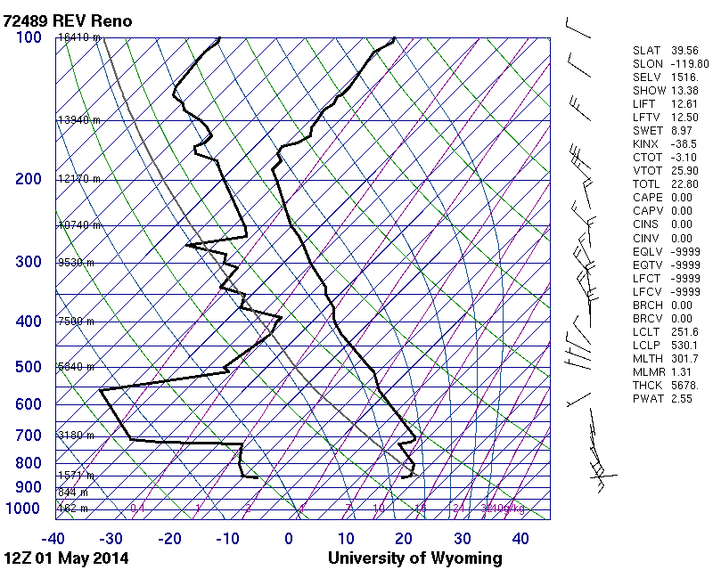
4 a.m. Sounding: Mild Temperature Inversion
Dry morning

Slide 5
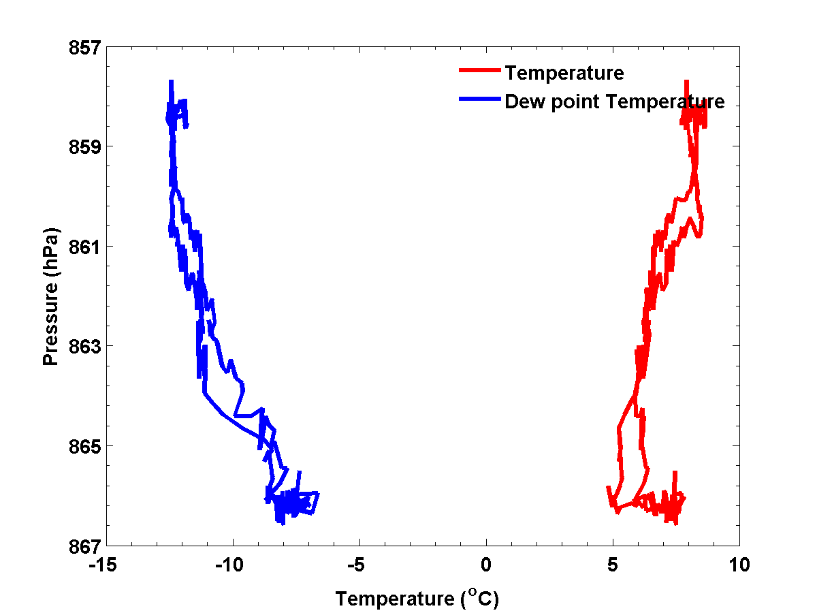
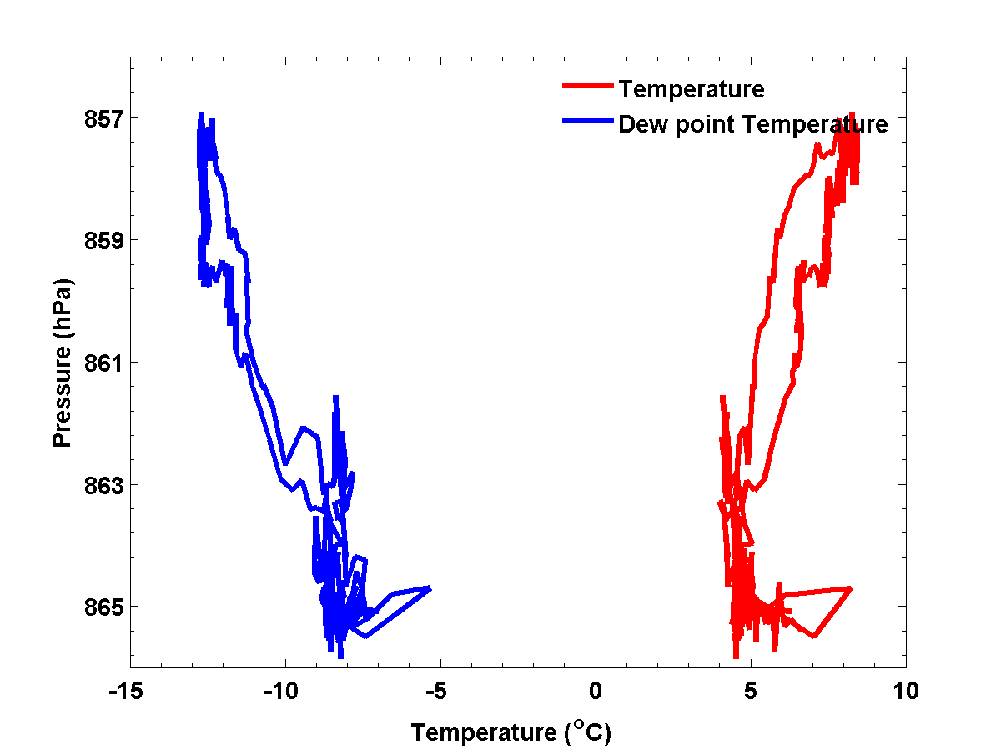
Temperature and Dew Point Soundings

Slide 6
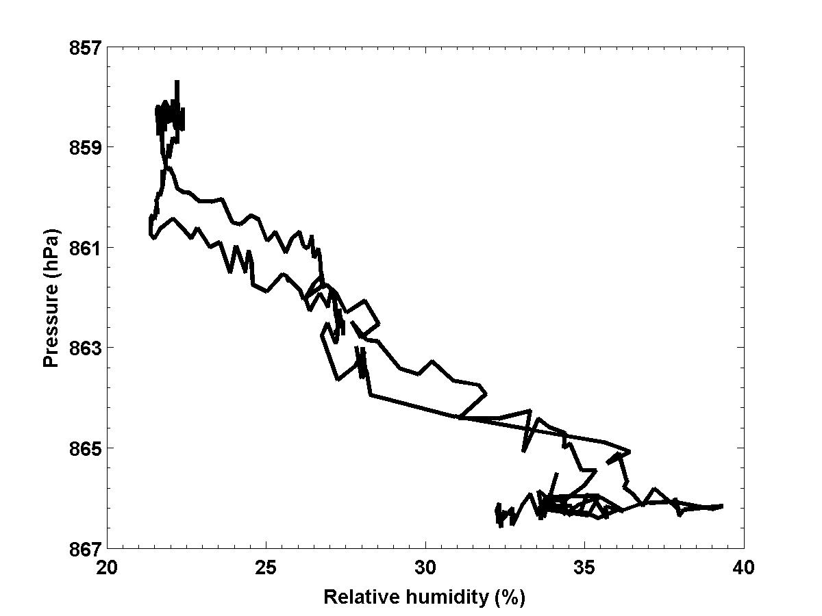
Relative Humidity Sounding 1

Slide 7
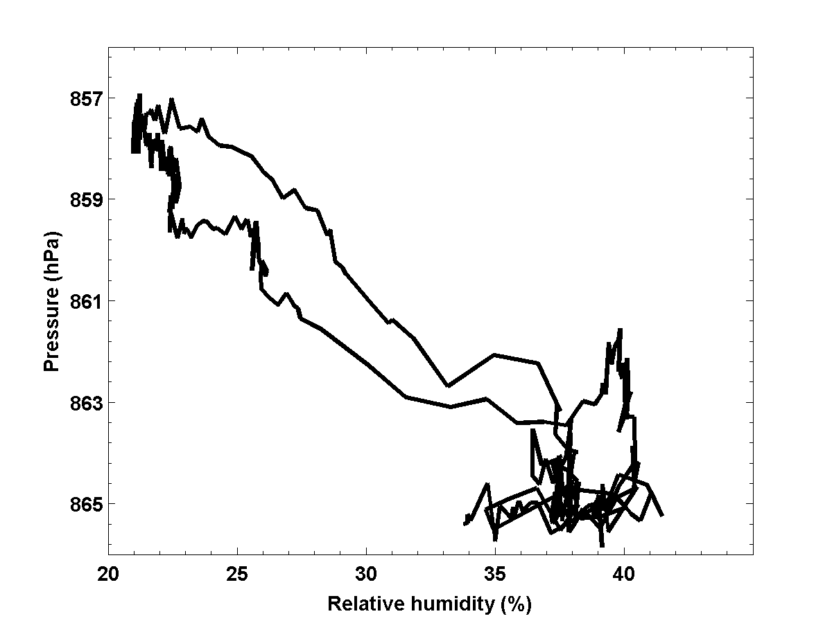
Relative Humidity Sounding 2

Slide 8
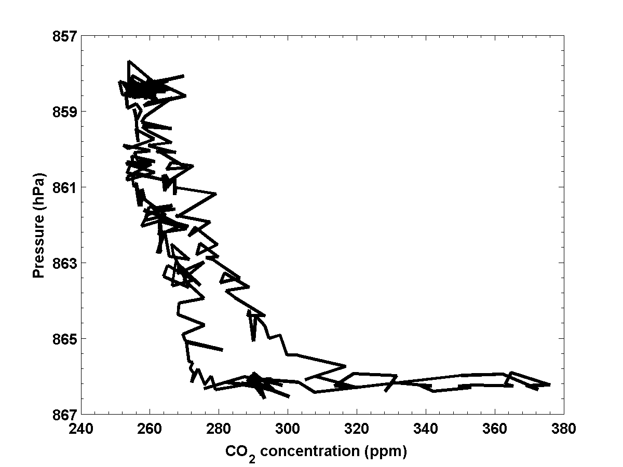
CO₂ Sounding: Uncorrected

Slide 9
Broad View of the FTIR Data

Slide 10
Narayan’s Detailed FTIR Spectra:
Inversion develops much from 4:30 to 6:00 am

Slide 11
Ultrasonic Anemometer Vertical Velocity: Interesting Spikes near 7:15 and 7:45 a.m.
Interesting!!

Slide 12
Last Flight Balloon Data: Rapid ascent, long loiter, slow descent to the surface
dry layer aloft and inversion

Slide 13
Last Flight Balloon Data: Rapid ascent, long loiter, slow descent to the surface. CO2 data.
WOW! What’s going on?

Slide 14
The Solar Semi-diurnal pressure wave produces a minimum pressure and a maximum pressure twice a day; minimums occur about three hours before sunrise and a few hours before sunset; maximums occur a few hours after sunrise and a few hours after sunset. As the Sun heats the atmosphere, (particularly the upper parts of the atmosphere, where ozone and water vapor are very effective at absorbing energy), and the Earth rotates, the mass of air is redistributed on the Earth. The heated, expanded atmosphere literally pushes air ahead of the rising Sun in a bi-modal wave, causing peaks and valleys of pressure, and resulting in a slightly decreased pressure a few hours before sunrise; the decrease in pressure can translate to a slightly decreased air temperature.
http://www.newton.dep.anl.gov/askasci/wea00/wea00042.htm

