Slide 1
Chapter 6 Section 6.4
Goals:
Look at vertical distribution of geostrophic wind.
Identify thermal advection, and backing and veering winds.
Look at an example map.

Slide 2
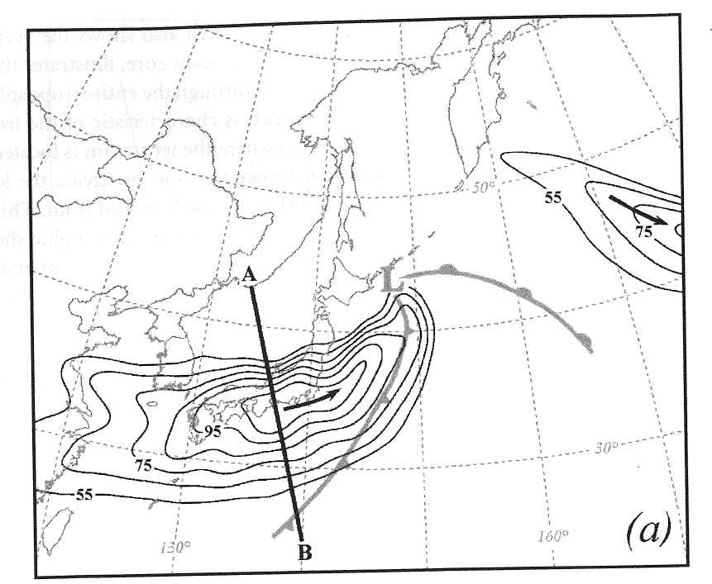
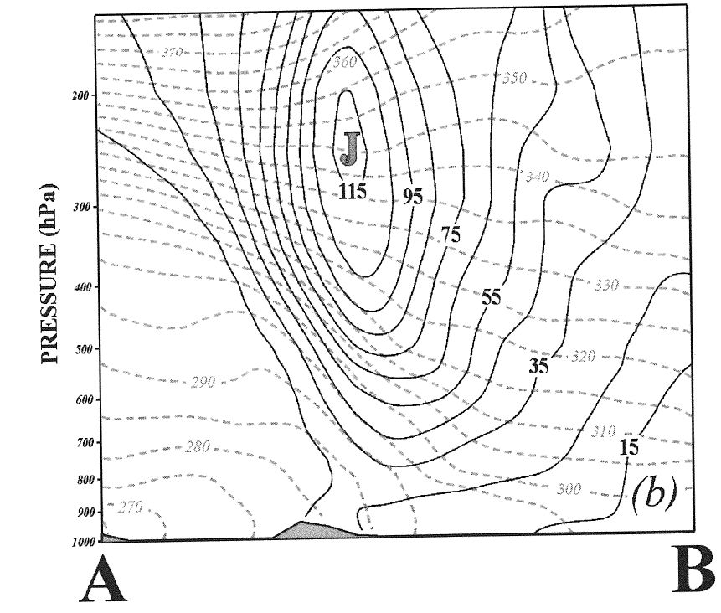
Thermal Wind
300 hPa isotachs of the geostrophic wind at 00 UTC
23 February 2004 in m/s, 10 m/s contours. Arrow
shows wind direction. The cross section AB is shown
on the right. From Martin, pg 94. Surface front is shown
in light grey with the low at ‘L’.
Vertical cross section of isotachs are solid
lines and dashed lines are potential
temperature (isentropes). Maximum
vertical wind shear is in the region of
maximum horizontal temperature gradient.
Our goal is to understand this.

Slide 3
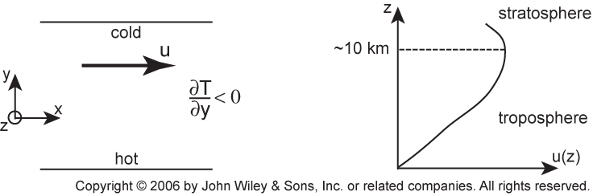
Thermal Wind Equation
Case where isobars are parallel to isotherms: Not always necessary

Slide 4
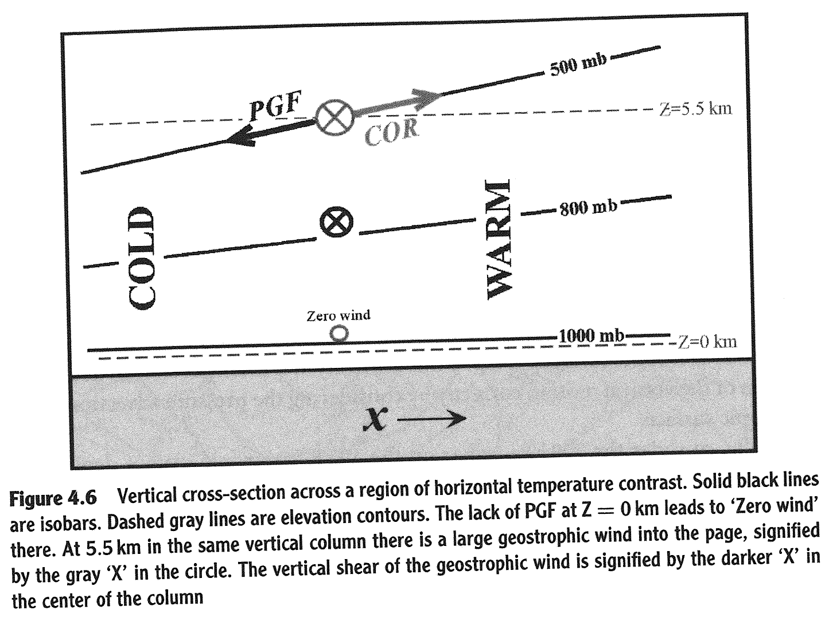
Vertical cross section across a horizontal temperature gradient (from Martin, pg 90)

Slide 5
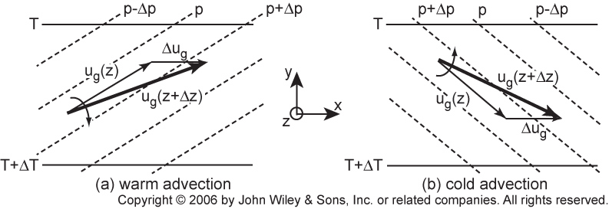
Thermal Wind
Case where isotherms are isobars are not lined up (baroclinic conditions)
pressure contours give geostrophic
flow at level z
Warm air advection, wind blows warm air.
Wind direction turns clockwise with height.
Knows as ‘veering’ wind in N.H.
Warm advection leads to anticyclonic turning
with height.
Cold air advection. Wind blows cold air.
Wind direction turns counter clockwise.
with height.
Knows as ‘backing wind’ wind in N. H.
Cold advection leads to cyclonic turning
with height.

Slide 6
Temperature Advection: Wind blows air of different temperature over station
Cooler air
wind
station
Warmer air
Thermal Wind:
MKSA Units of temperature advection are Kelvin / second.

Slide 7
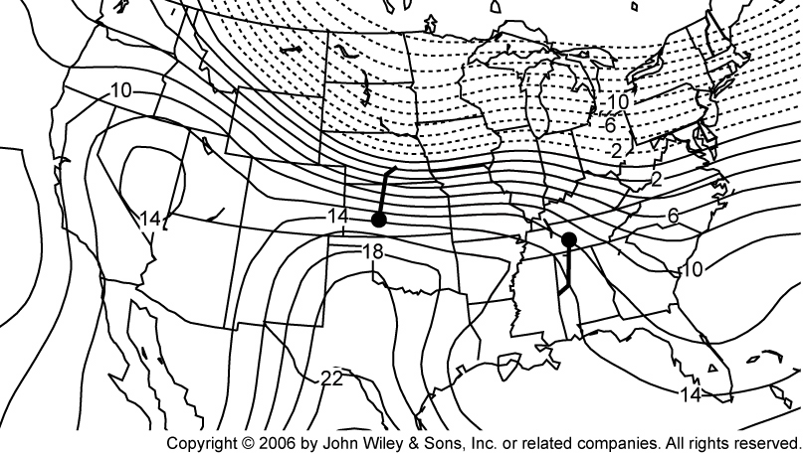
Which Station Has Veering and Which Backing Winds?
Contours of 925 hPa air temperature (in C) valid at 00 UTC 15 Feb 2003. Also shown are the surface wind reports for Dodge City, Kansas and Nashville, Tennessee.

Slide 8
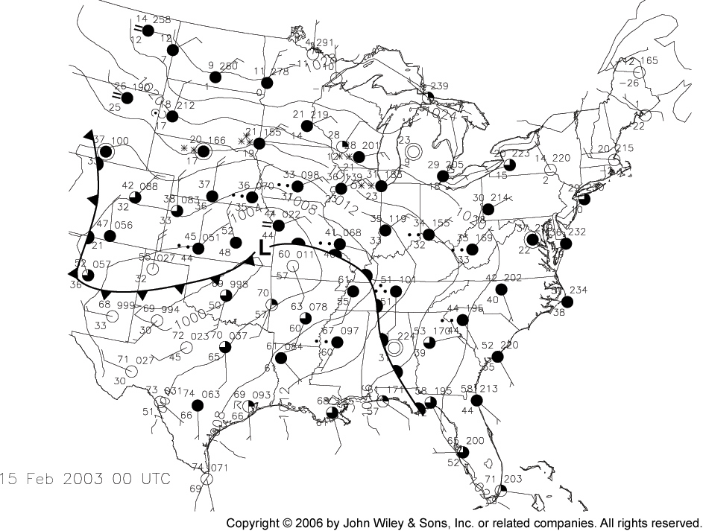
Review of Map For Last Slide

Slide 9
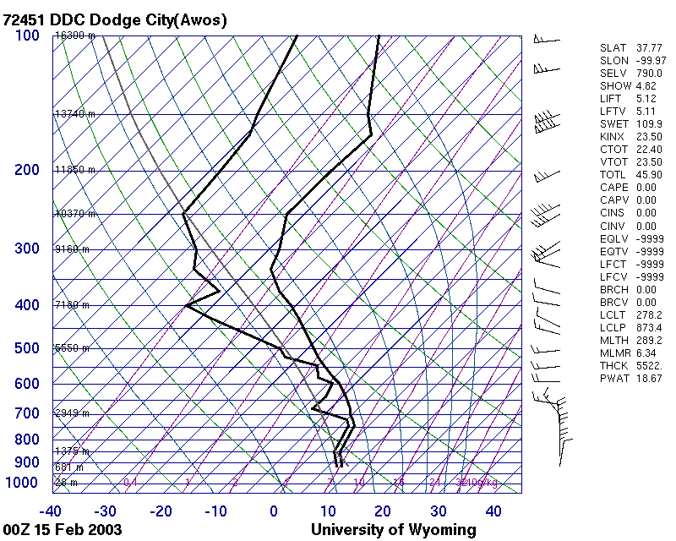
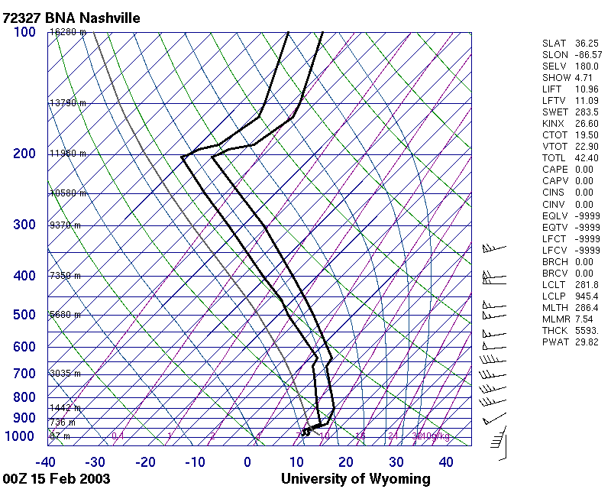
Soundings for Dodge and Nashville

Slide 10
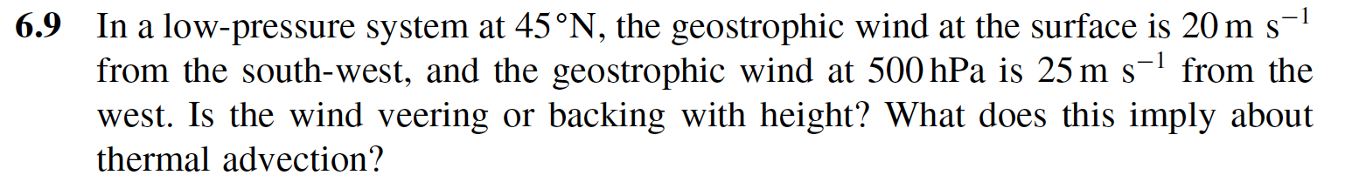
Problem 6.9
500 mb
(U_{g}, V_{g})
(U_{g}, V_{g})
Surface
Both terms are > 0
Anticyclonic rotation of the wind vector with height:
Veering wind (N.H.) and warm advection.

Slide 11
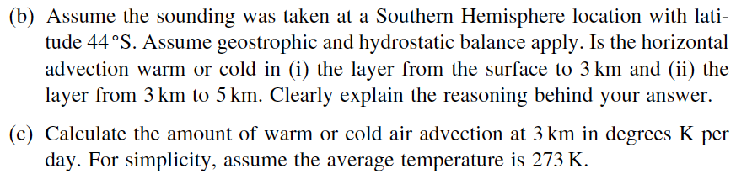
Problem 6.13

Slide 12
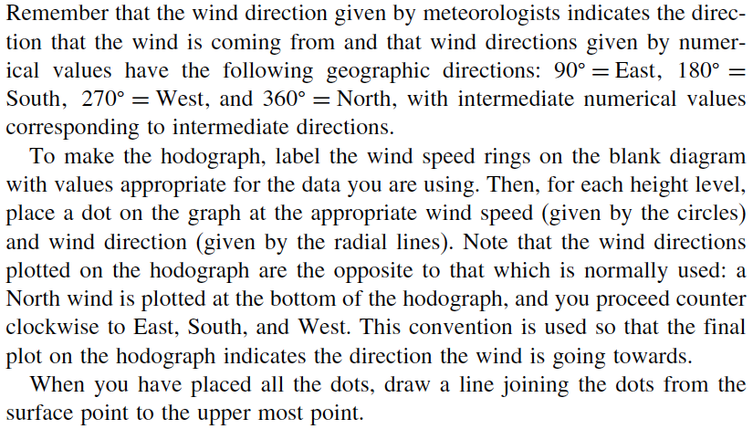
Problem 6.13 continued

Slide 13
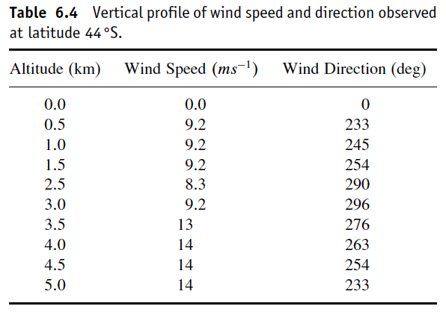
Problem 6.13 continued

Slide 14
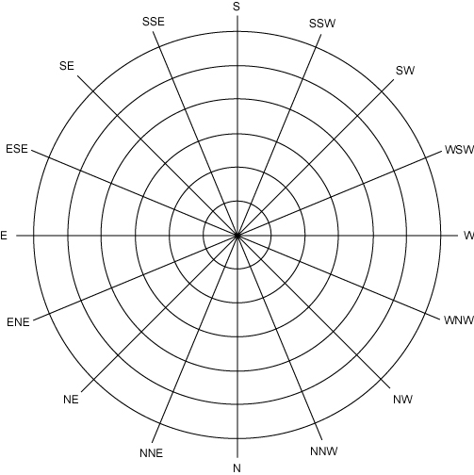
Problem 6.13 continued

Slide 15
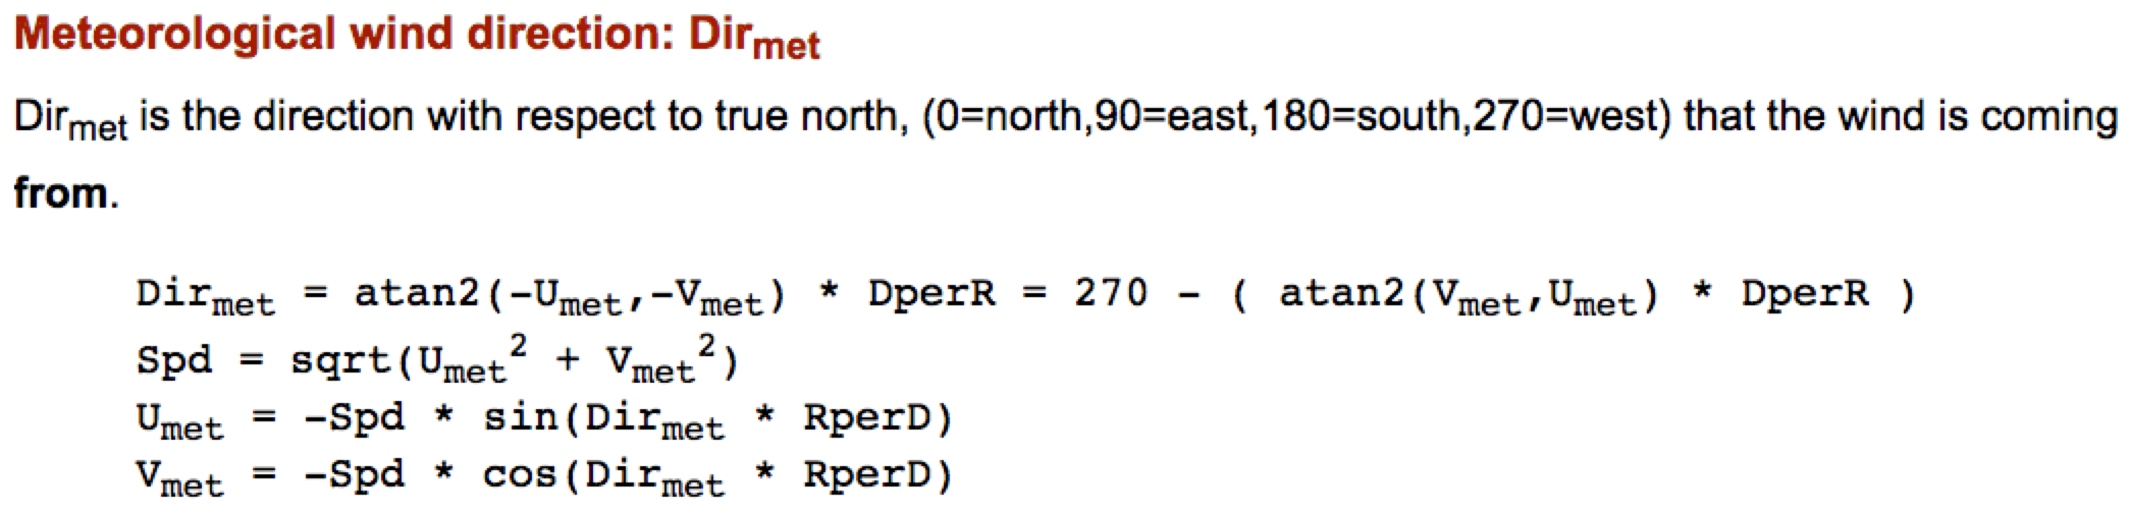
Problem 6.13 continued

