Slide 1
Include basic long wave patterns.
https://www.noaa.gov/jetstream/upper-air-charts/basic-wave-patterns
Discuss short waves.
Show results of derivation for Rossby waves and wave speed.

Slide 2
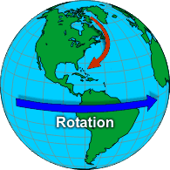
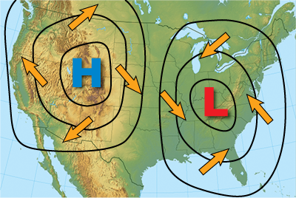
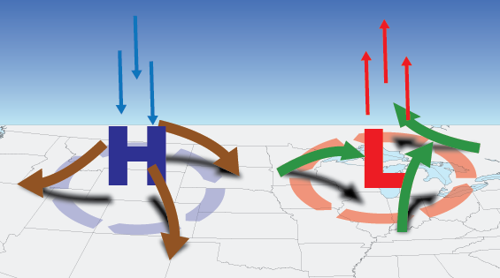
Review of Fronts and Meteorology
Covers …
Basic state of the atmosphere
Weather maps
Air masses
Fronts
Much of the theory from the Norwegian School, Tor Bergeron, circa 1928.
Sketch the 300 mb wind
(jet stream)
Divergence
Convergence
Images from weather.gov/jetstream

Slide 3
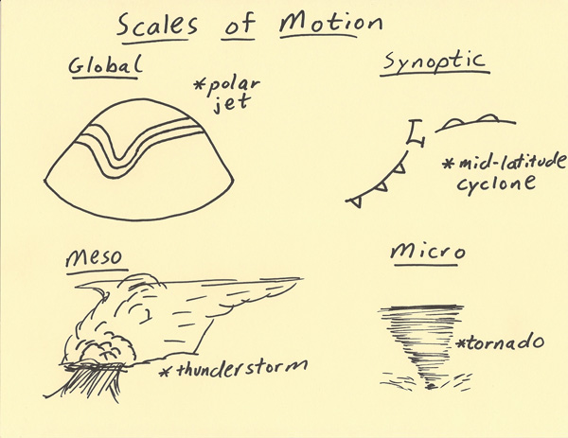
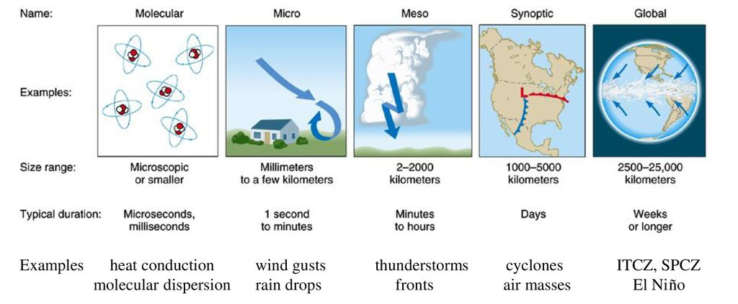
Weather Scales
Adapted from fsu gen meteorology and haby hints

Slide 4
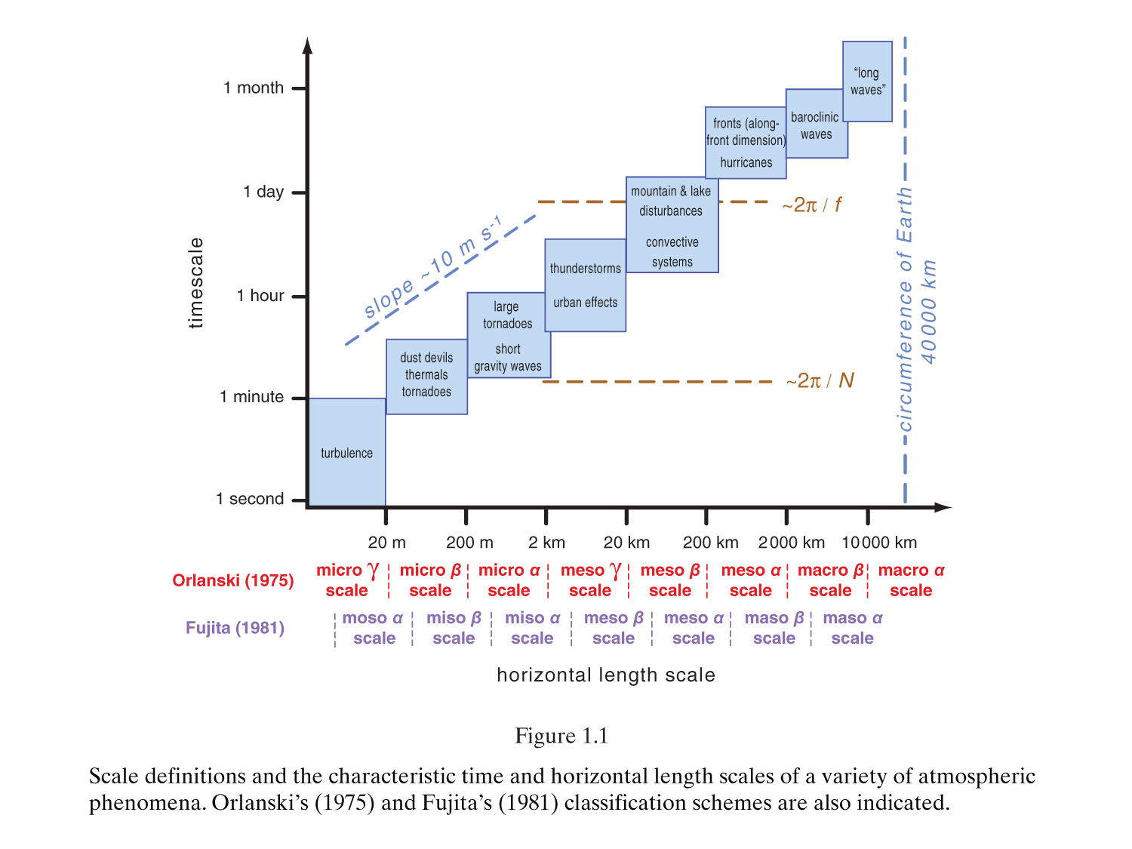
From Markowski and Richardson Mesoscale Meteorology in Midlatitudes
f is the Coriolis parameter, N is the Brunt-Vaisalla frequency

Slide 5
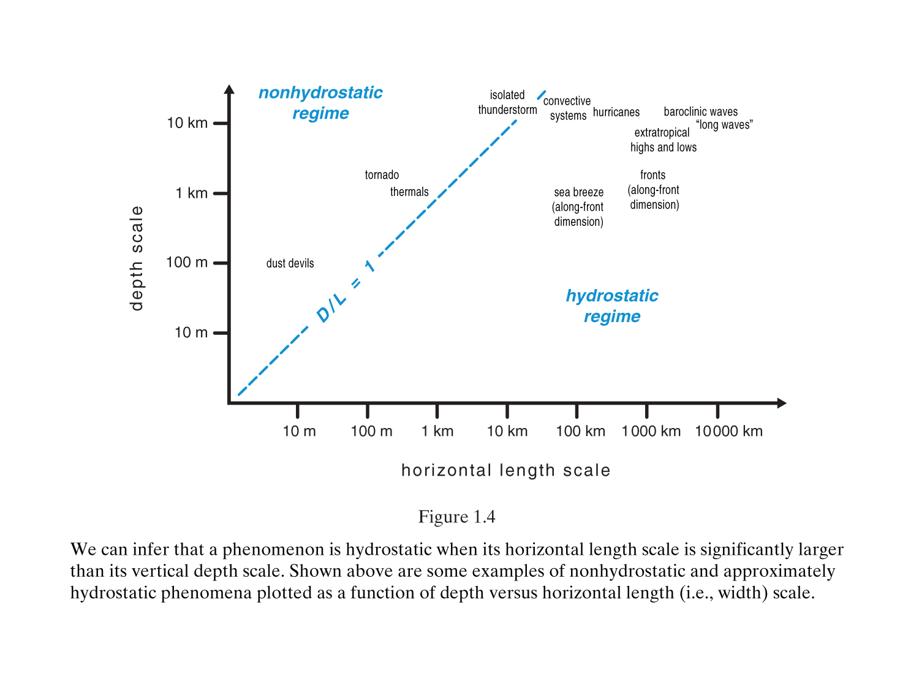
Fluid Model for Atmospheric Phenomena
From Markowski and Richardson Mesoscale Meteorology in Midlatitudes

Slide 6
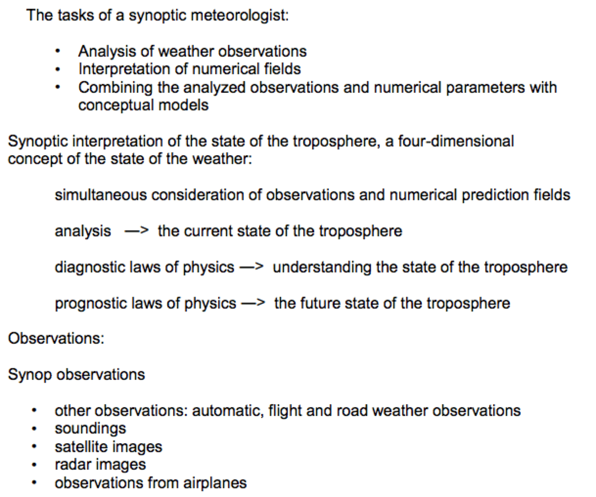
Synoptic Scale Meteorology
The word synoptic means "view together" or "view at a common point". Therefore, synoptic meteorology is primarily concerned with viewing the weather at a common point -- time. (https://www.weather.gov/jetstream/synoptic_intro)
From http://eumetrain.org/synoptic_textbook.html

Slide 7
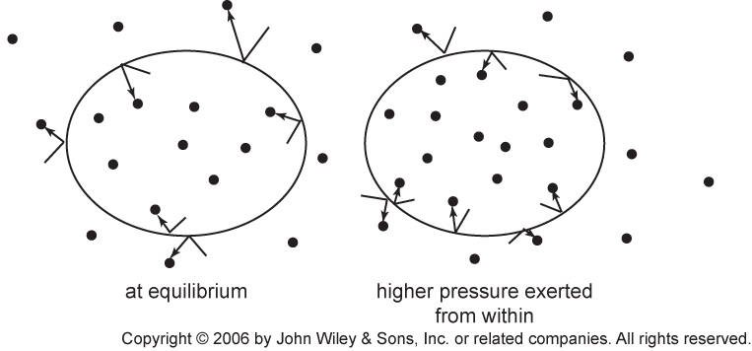
Air can be thought of as an ideal gas
PV=NkT Ideal gas law in fundamental form.
Assumes molecules are point like (no volume) and interact only at short range
Average kinetic energy of each molecule is: <1/2 mv²> = 3/2 kT
More massive molecules (mass m) move slower on average.

Slide 8
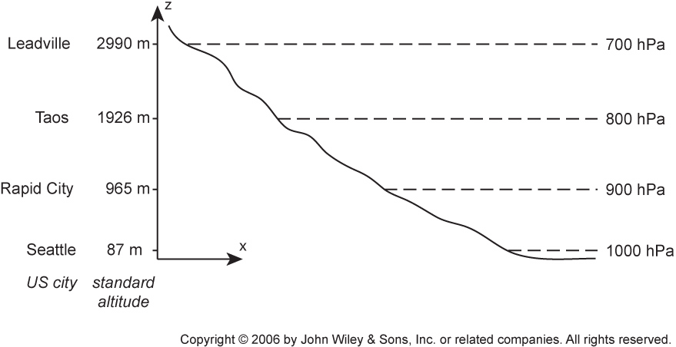
Pressure drops with height
It’s like being in a swimming pool; the mass of water per unit area above you
determines the pressure you feel.

Slide 9

Pressure changes horizontally across the Earth → Winds ☺. Draw the geostrophic and surface-influenced wind directions for the northern hemisphere.
Newton’s laws of motion (cast for fluids as the Navier Stokes Equation),
mass continuity, and the ideal gas law are used to understand fluid
motions. Pressure in mb or hecta Pascal.

Slide 10
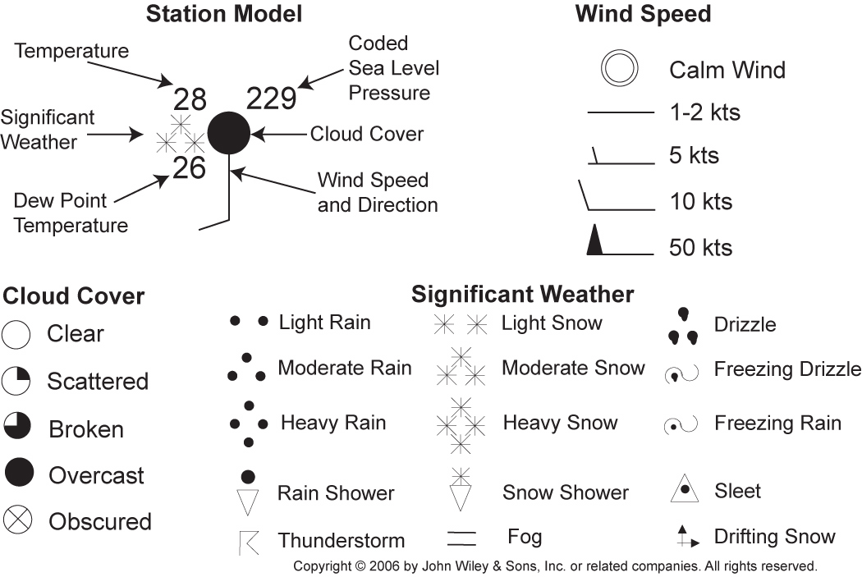
Station Model for Weather Symbols
1 Knot = 1 nautical mile per hour = 1.151 mph
Coded sea level pressure > 500, place a 9 in front.
Coded sea level pressure < 500, place a 10 in front.
So above, 229 becomes 1022.9 hPa = 1022.9 mbar. 1 hPa = 100 Pa.

Slide 11
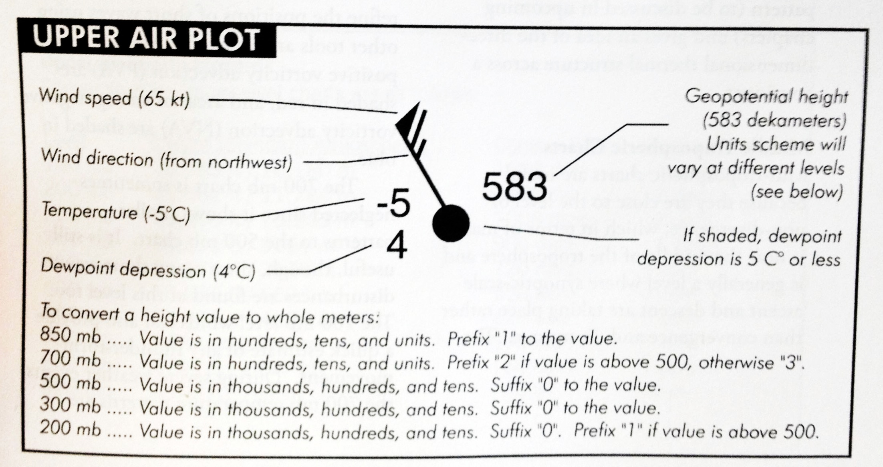
Upper Level Station Model:
Example for the 500 mb surface

Slide 12
Air Masses and Fronts
Chapter 11
Ahrens
Meteorology
Review

Slide 13
Air Masses
Extremely large body of air whose temperature and humidity are similar in any horizontal direction.
Source Regions: area where air mass originates, usually flat and uniform composition with light surface winds
Ideal source regions are usually those areas dominated by surface H.

Slide 14
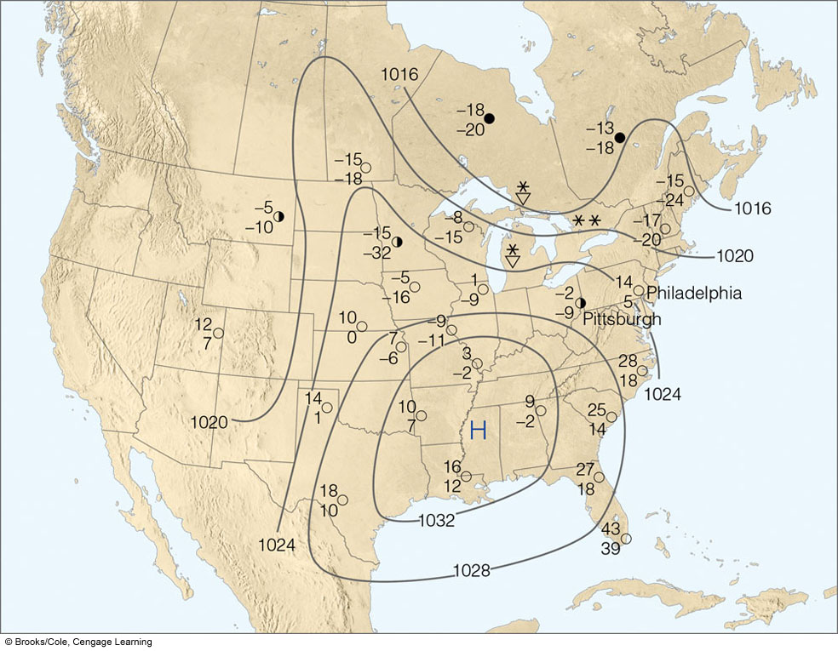
A cold air mass is dominating weather over much of the US
Notes:
FIGURE 11.1 Here, a large, extremely cold winter air mass is dominating the weather over much of the United States. At almost all cities, the air is cold and dry. Upper number
is air temperature (ºF); bottom number is dew point (ºF).

Slide 15
Air Masses
Classification
  Classification based upon temperature and humidity related to its source region.
    P = polar
    T = tropical
    A = Arctic
    m = maritime
    c = continental

Slide 16
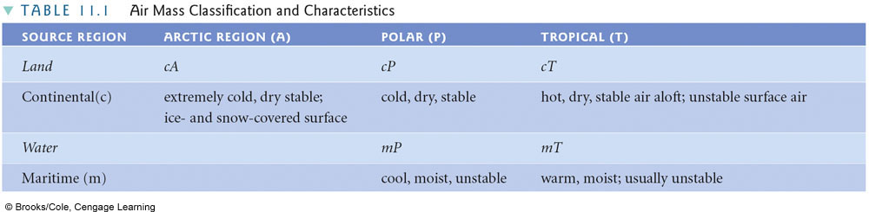
Notes:
TABLE 11.1 Air Mass Classification and Characteristics

Slide 17
Air Masses
North America cP and cA
  Source region: N. Canada, Alaska
  Dry, cold, stable (A more extreme)
Example: Lake Effect Snow
  cP air passes over unfrozen lake, absorbs moisture and drops snow on leeward side of lake

Slide 18
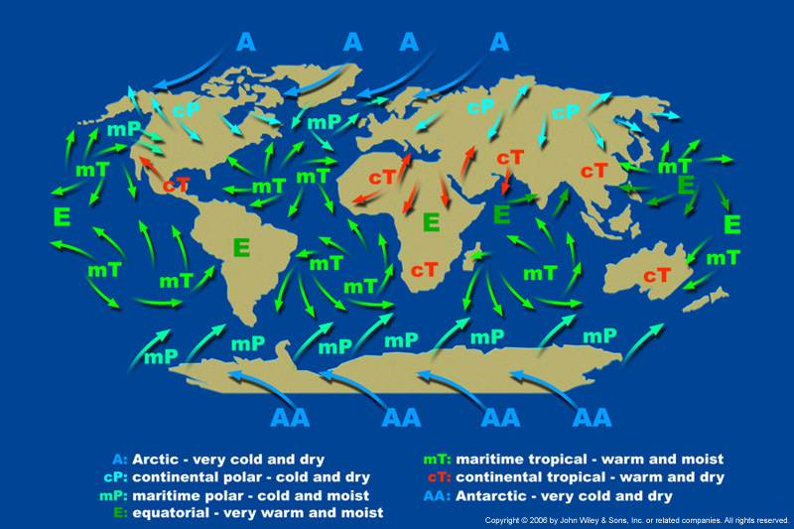
Typical Air Masses around the World

Slide 19
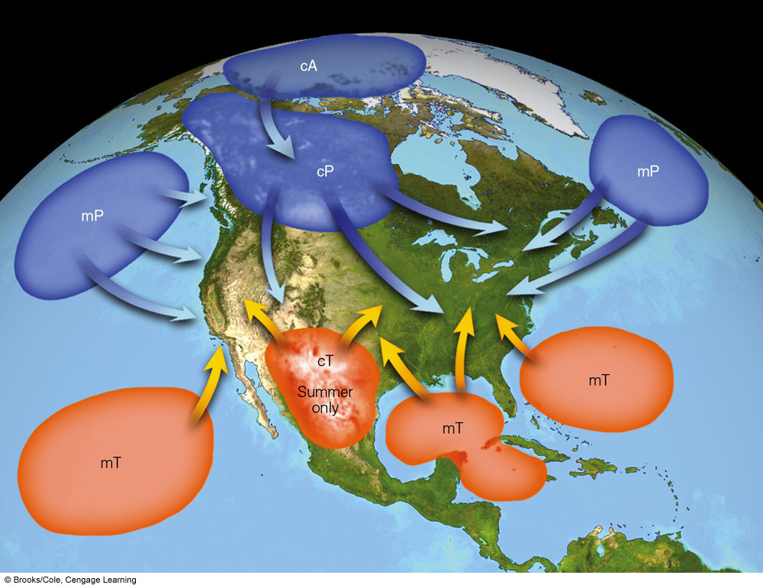
Air Masses
North American mP
  Source region: North Pacific, North Atlantic
  Cool, moist, unstable
North American mT
  Source region: Gulf of Mexico, Caribbean, SE Pacific
  Wet, warm, unstable
North American cT
  Source Region: SW US, Mexican Plateau
  Hot, dry, stable

Slide 20
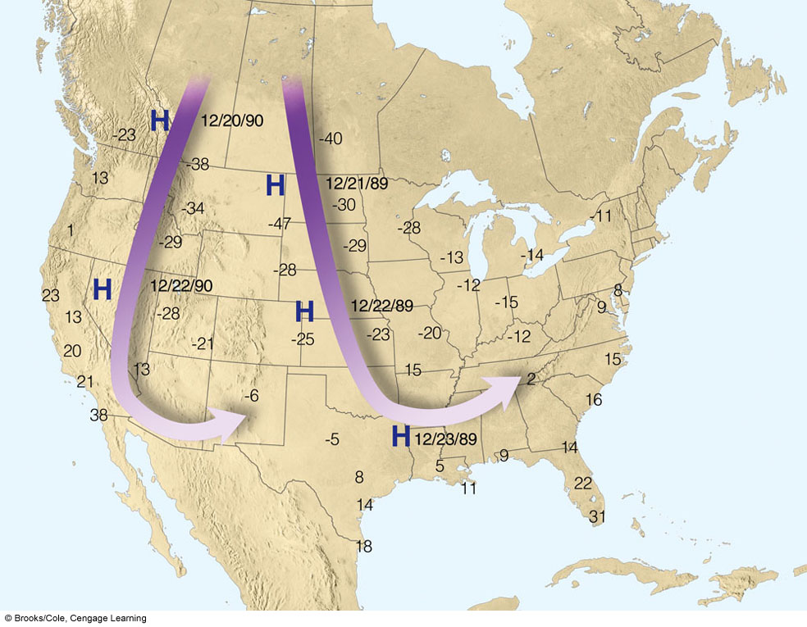
Two different cold events when Arctic air intruded into the lower 48
Notes:
FIGURE 11. 4 Average upperlevel
wind flow (heavy arrows) and
surface position of anticyclones (H)
associated with two extremely cold
outbreaks of arctic air during
December. Numbers on the map
represent minimum temperatures (ｰF)
measured during each cold snap.

Slide 21
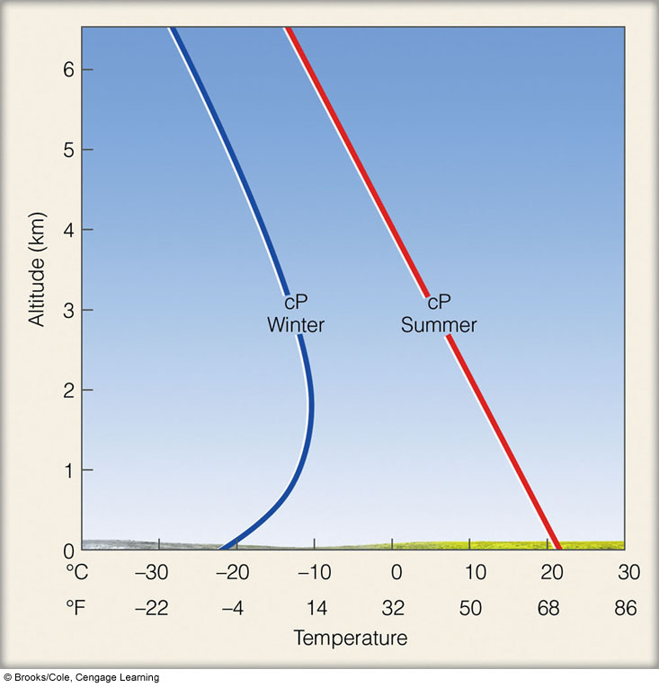
Solar radiation mixes atmosphere
Radiation inversions and/or
subsidence from high pressure
are associated with
inversions
Notes:
FIGURE 11. 5 Typical vertical temperature profile over land for a
summer and a winter cP air mass.

Slide 22
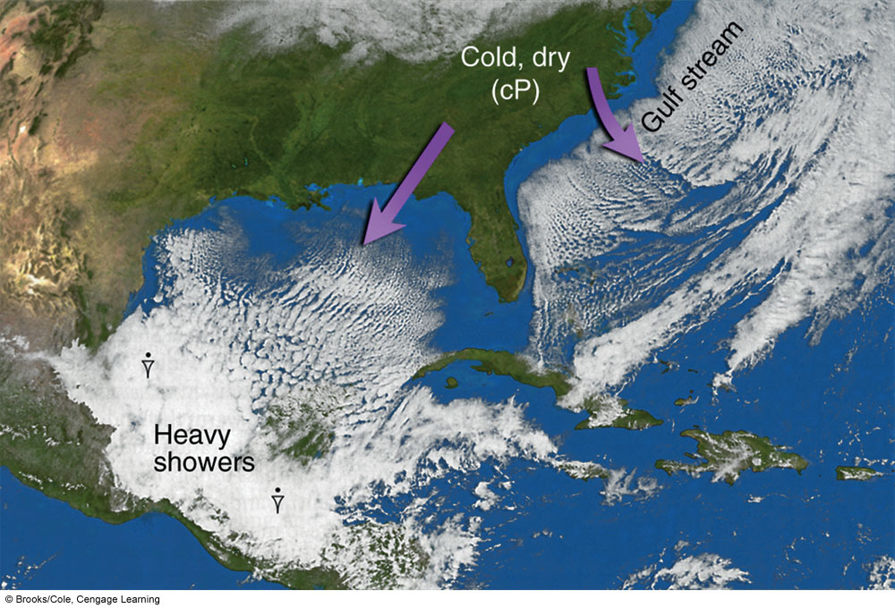
Cold polar air gets modified as in intrudes on warm ocean
Notes:
FIGURE 11. 6 Visible satellite image showing the
modification of cold continental polar air as it moves
over the warmer Gulf of Mexico and the Atlantic
Ocean.

Slide 23
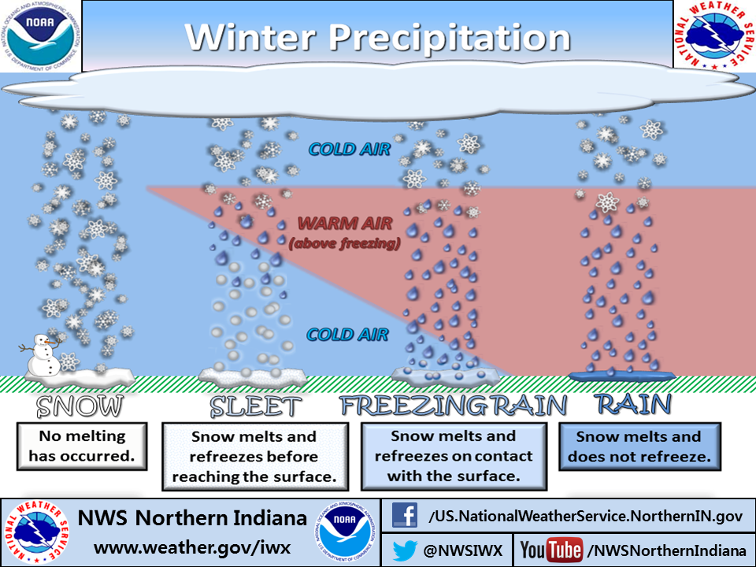
Winter Precipitation

Slide 24
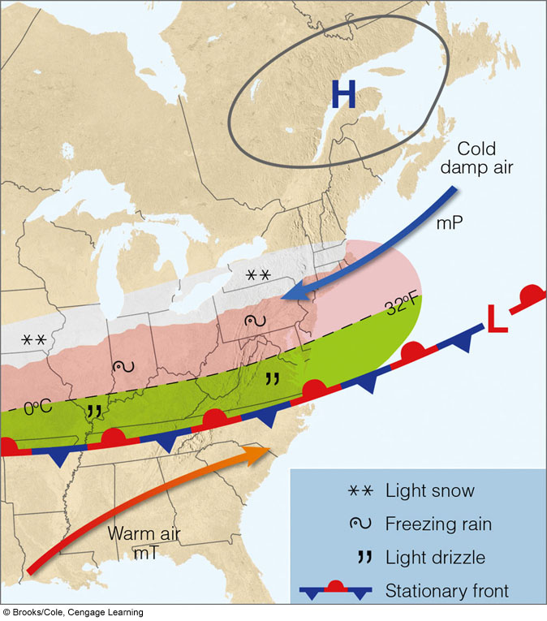
Invasion of cold, moist maritime polar air
snow
Freezing rain
Light rain
Notes:
FIGURE 11. 9 Winter and early spring surface weather pattern
that usually prevails during the invasion of cold, moist mP air into the
mid-Atlantic and New England states. (Green-shaded area represents
light rain and drizzle; pink-shaded region represents freezing rain and
sleet; white-shaded area is experiencing snow.)

Slide 25
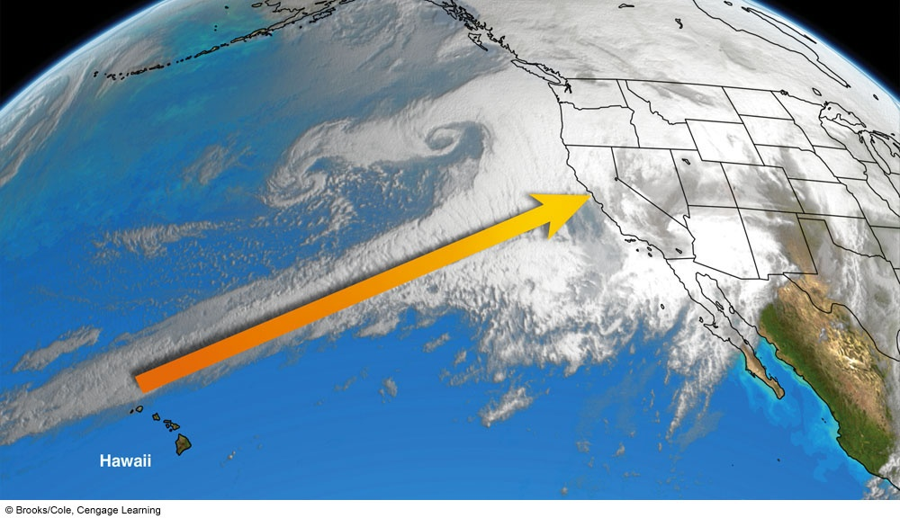
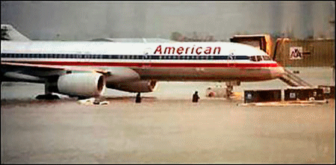
January 1st 1997 Reno flooded: Warm tropical air brought rain on snow in the
mountains: example of atmospheric river. Note the low off the coast of Oregon.
  Called the
  Pineapple Express
Notes:
FIGURE 11.10
An infrared satellite image
that shows maritime
tropical air (heavy yellow
arrow) moving into
northern California on
January 1, 1997. The
warm, humid airflow
(sometimes called “The
pineapple express”)
produced heavy rain and
extensive flooding in
northern and central
California.

Slide 26
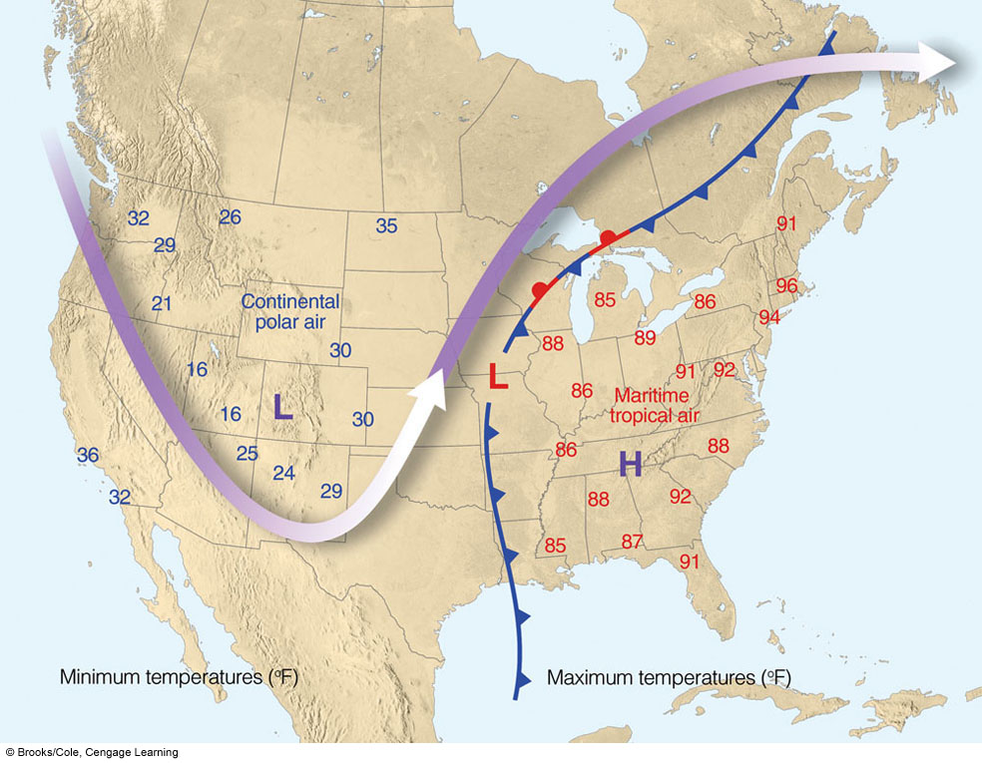
Unseasonably hot spell, Eastern US, 15-20 April 1976
Upper level flow
Maximum Temperatures
Upper level trough
Upper level ridge
Notes:
FIGURE 11.11 Weather conditions
during an unseasonably hot
spell in the eastern portion of the
United States that occurred between
the 15th and 20th of April, 1976. The
surface low-pressure area and fronts
are shown for April 17. Numbers to
the east of the surface low (in red) are
maximum temperatures recorded
during the hot spell, while those to
the west of the low (in blue) are minimum
temperatures reached during
the same time period. The heavy
arrow is the average upper-level flow
during the period. The purple L and
H show average positions of the
upper-level trough and ridge.

Slide 27
Fronts
Transition zone between two air masses of different densities
Identification on Charts
  Sharp temperature change
  Sharp change in dew point
  Shift in wind direction
  Sharp pressure change
  Clouds and precipitation

Slide 28
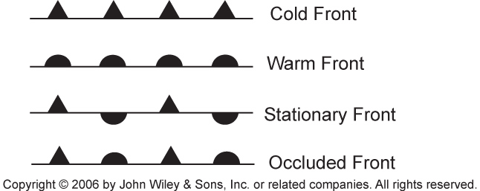
Types of Fronts
Cold front: Cold air advancing, warm air retreating.
Warm front: Warm air advancing, cold air retreating.
Stationary front: Boundary between two air masses is stationary, or nearly so.
Occluded front: Separates air masses that have only a small temperature contrast,
typically separates cold and cool air masses.

Slide 29
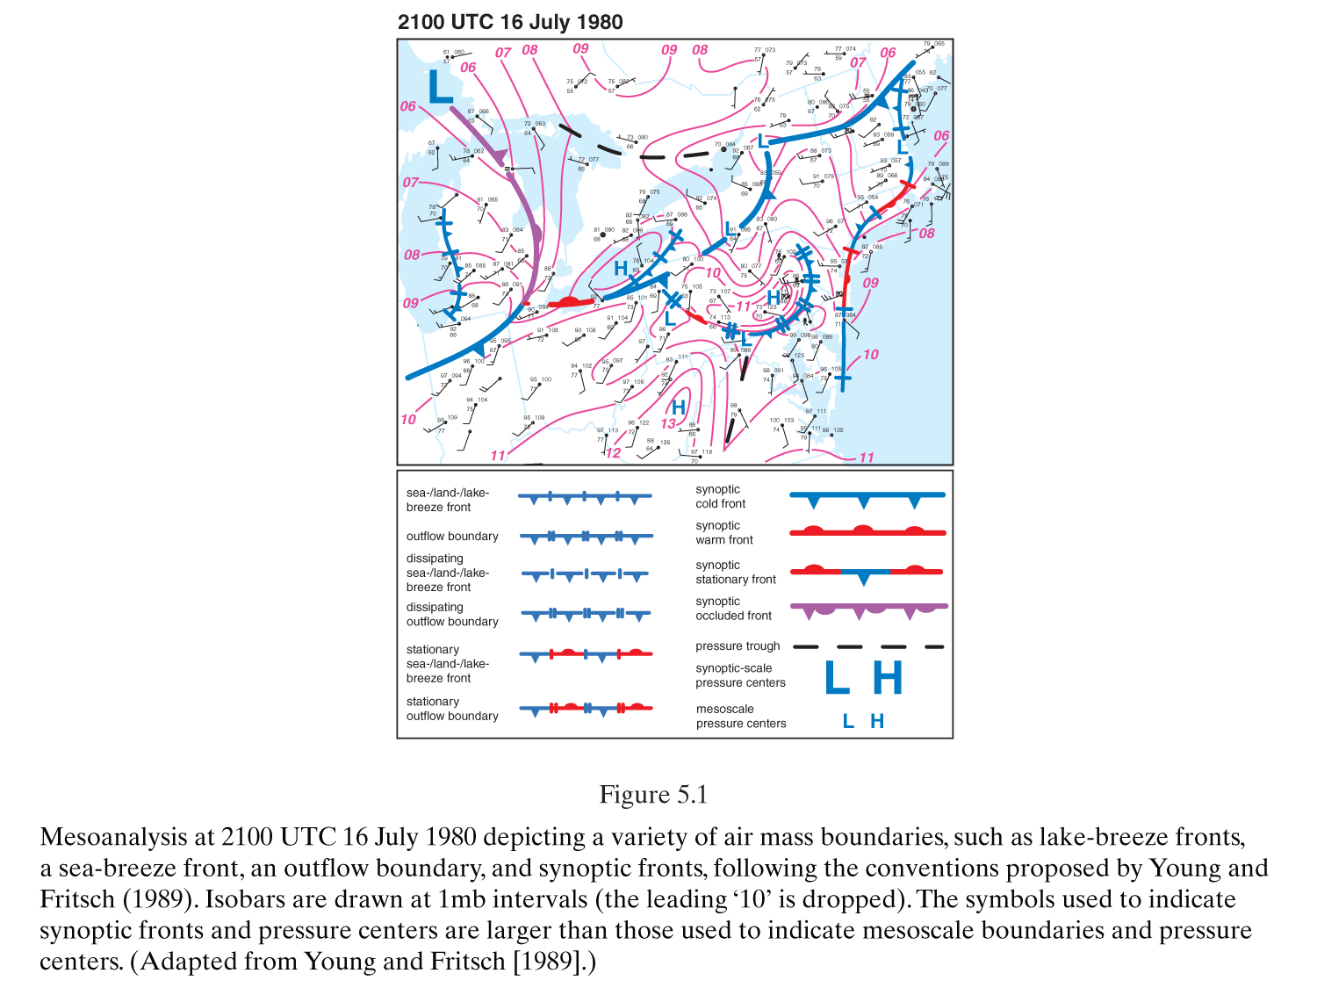
Air Mass Boundaries and Synoptic Fronts
From Markowski and Richardson.

Slide 30
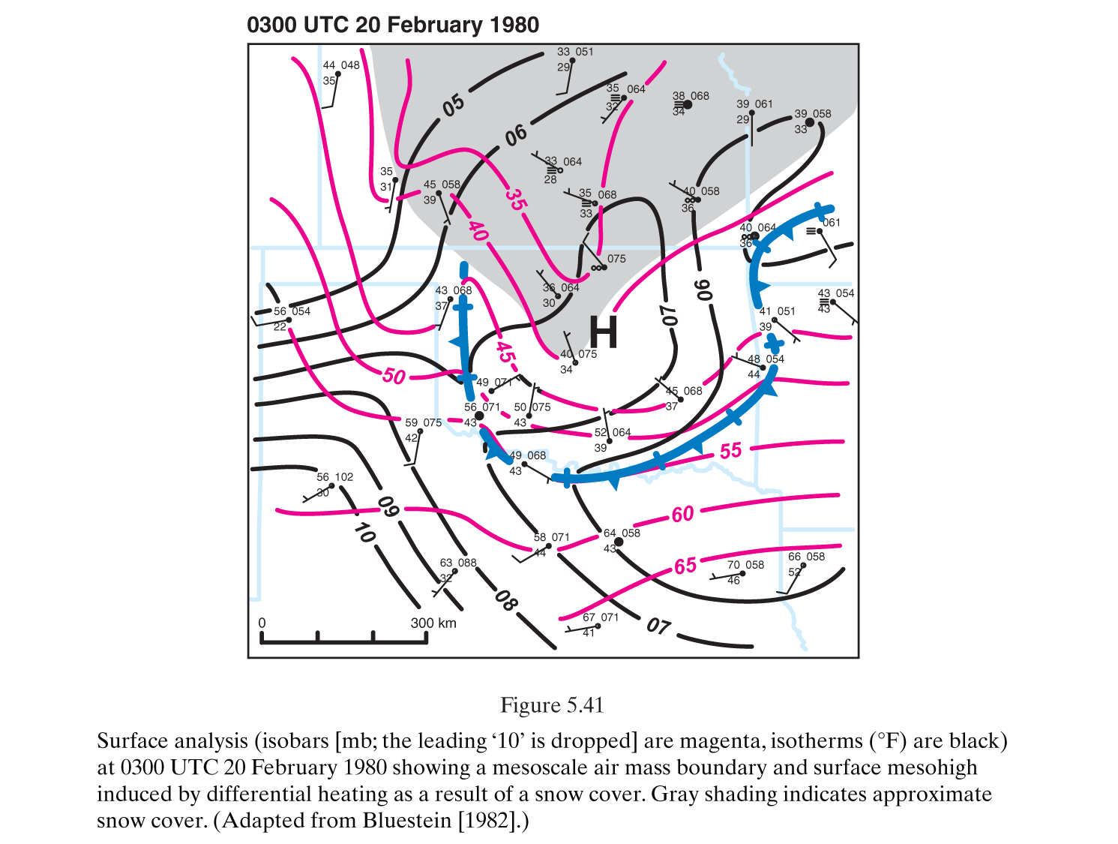
Snow cover
in gray
Mesoscale High
example, due to
snow cover
reducing the
amount of
sunlight
absorbed.
black
magenta

Slide 31
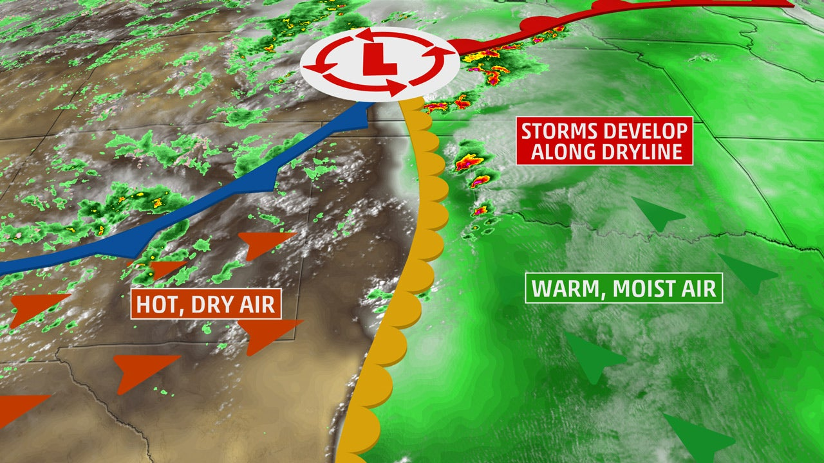
Dry Line Front: Dewpoint Change Across the boundary
https://weather.com/science/weather-explainers/news/dryline-severe-weather-tornado-storms-plains

Slide 32
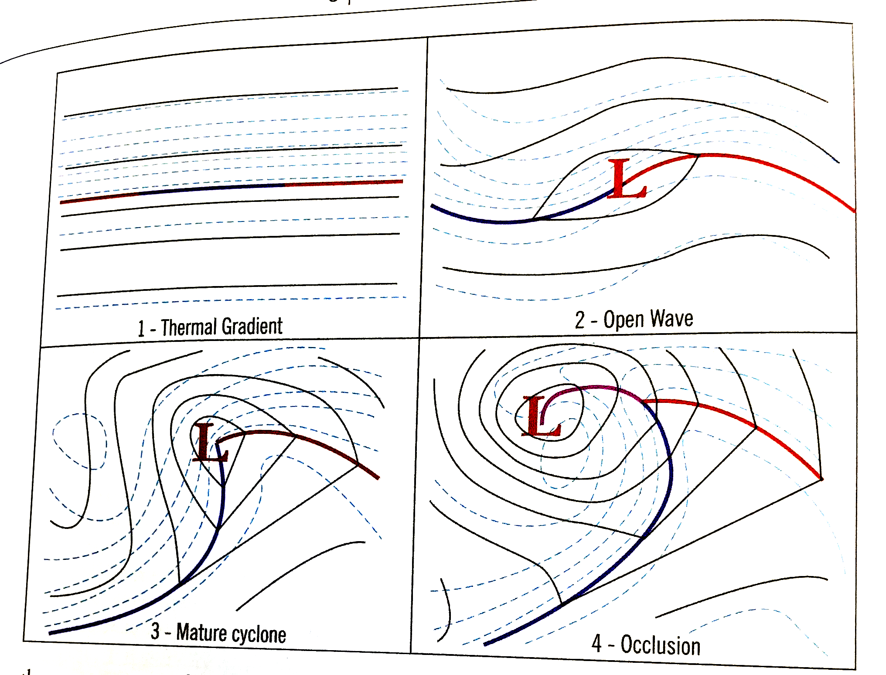
4 Stages of Baroclinic Cyclogenesis: From Vasquez Weather Analysis and Forecasting Handbook 2nd edition page 115.
Divergence
in the upper
level jet
stream
removes
mass from
the column,
causing the
low.
Cold Air
Polar Front
Warm Air
Clinic:
Sloped
Cool Air
Baroclinic low
retreats on
the cold side
of the thermal
gradient.
Barotropic
conditions
return
Cold Air
Warm Air
Solid lines : Isobars (lines of constant pressure)
Dashed lines: 1000-500 mb thickness (average temperature of this column)
1. Barotropic starting point along the polar front.
3. Highly baroclinic conditions: Temperature contours are not parallel to isobars

Slide 33
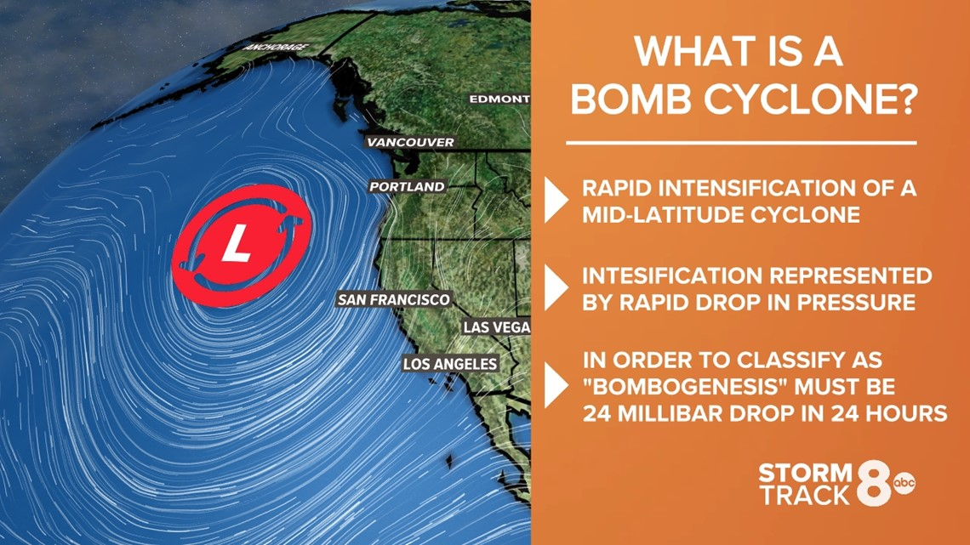
Bomb Cyclone

Slide 34
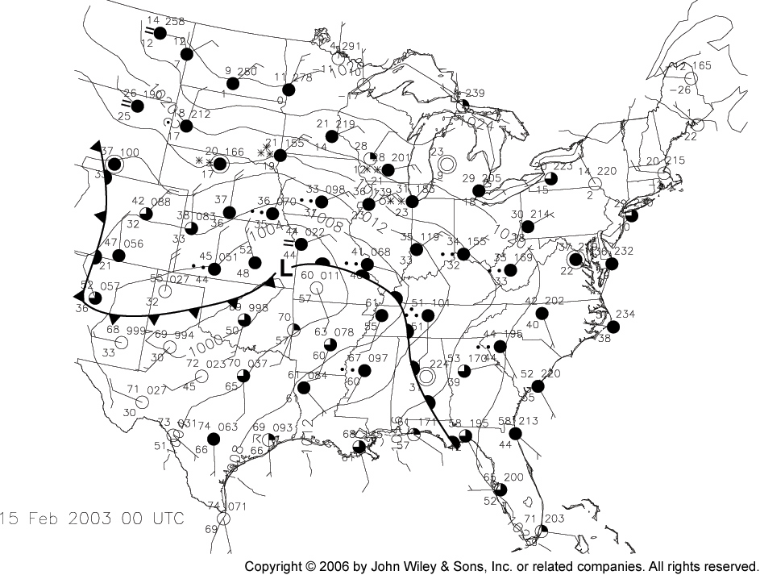
February 2003 Cyclone Surface Map

Slide 35
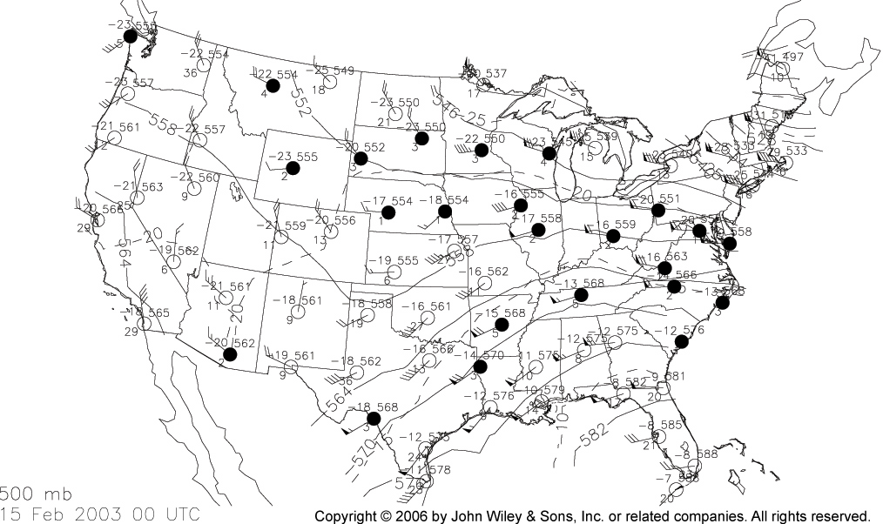
February 2003 Cyclone 500 mb Level Map, Approximately 5.5 km altitude. 552=5520 meters.
Isotherms are dashed lines
Short waves
Long wave pattern
Baroclinic:
Isotherms cross
isoheight contours.
Barotropic:
They are parallel.
(rare).
T in C, Tdew as depression, height in decimeters (tens of meters). Filled circles
have dewpoint depression < 5 C, probably cloudy. Troughs are cold, ridges warm.

Slide 36
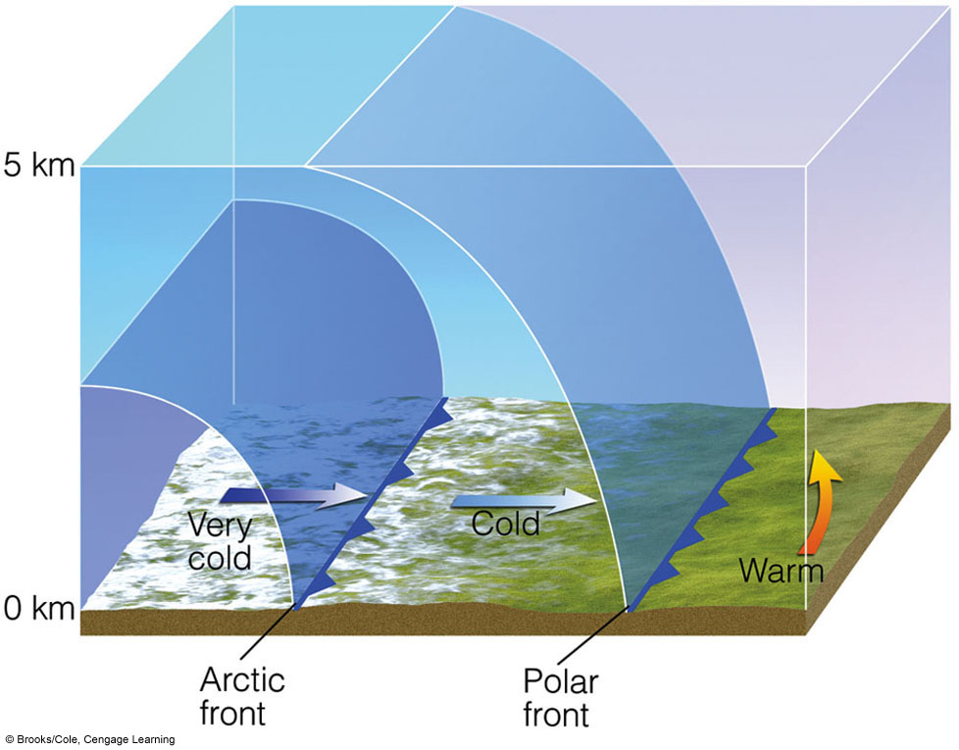
Shape of cold and very cold fronts

Slide 37
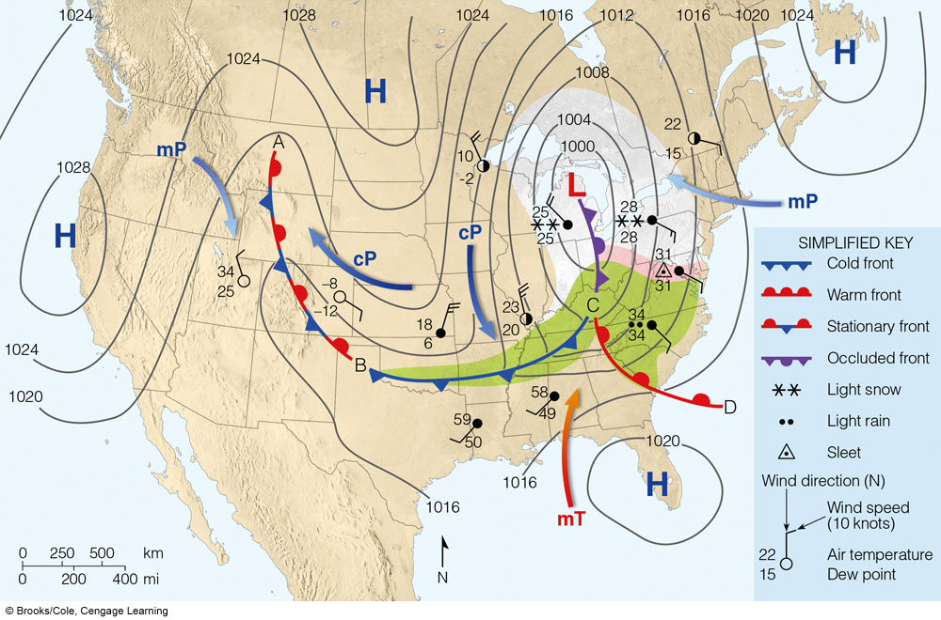
A surface weather map showing surface-pressure systems, air masses, fronts, and isobars
Notes:
FIGURE 11.14 A surface weather map showing surface-pressure systems, air masses, fronts, and isobars (in millibars) as solid gray
lines. Large arrows in color show air flow. (Green-shaded area represents rain; pink-shaded area represents freezing rain and sleet;
white-shaded area represents snow.)

Slide 38
Fronts
Stationary
  Front with no movement
  Winds parallel but opposite direction
  Variable weather
  Alternating red and blue line with blue triangles and red semi-circles
  Often a cold core sits at their the surface

Slide 39
Fronts
Cold
  Cold, dry stable air replaces warm, moist unstable air
  Clouds of vertical development
  Thunderstorms, squall lines (line of thunder storms)
  Blue line with blue triangles

Slide 40
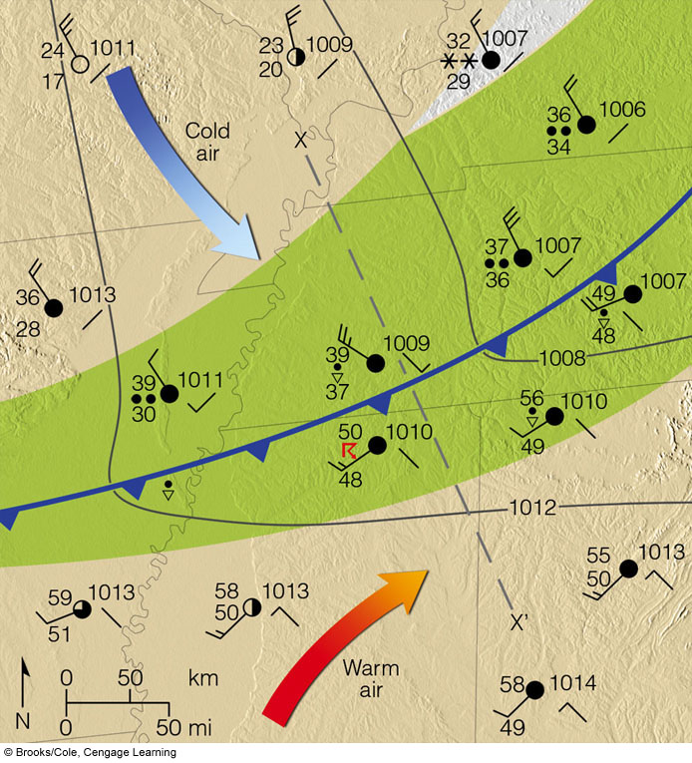
Surface weather associated with the cold front situated in the southern United States
Notes:
FIGURE 11.15 A closer look at the surface weather associated with the cold front situated in the southern United States in Fig. 11.14. (Gray lines are isobars. Green-shaded area represents rain; white-shaded
area represents snow.)

Slide 41
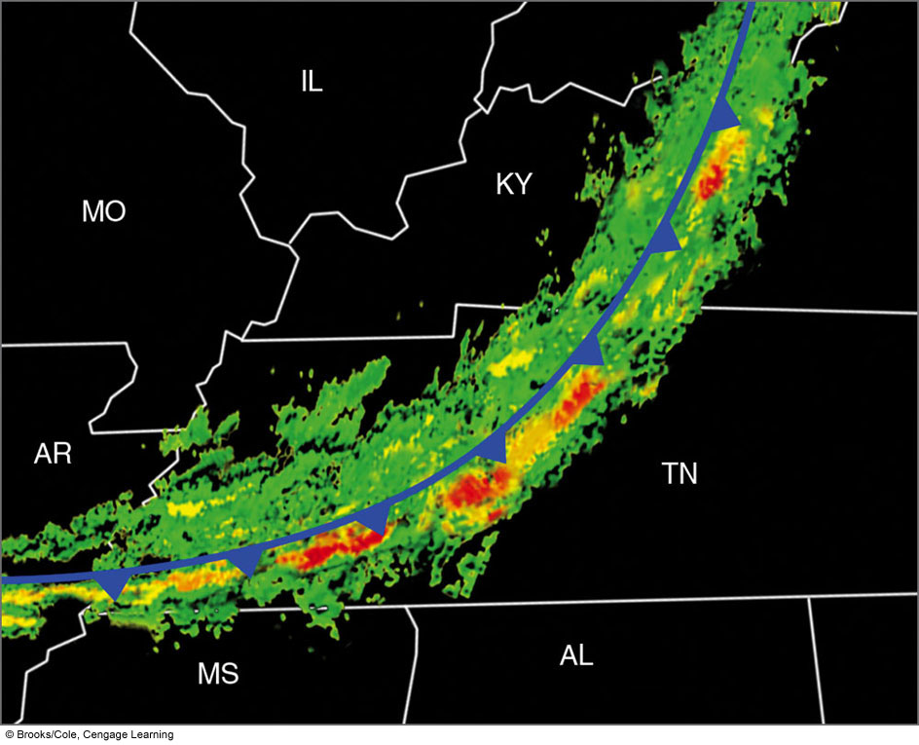
Radar showing precip along frontal boundary
Notes:
FIGURE 11.16 A Doppler radar image showing precipitation patterns along a cold front similar to the cold front in Fig. 11.15. Green represents light-to-moderate precipitation; yellow represents heavier
precipitation; and red the most likely areas for thunderstorms. (The cold front is superimposed on the radar image.)

Slide 42
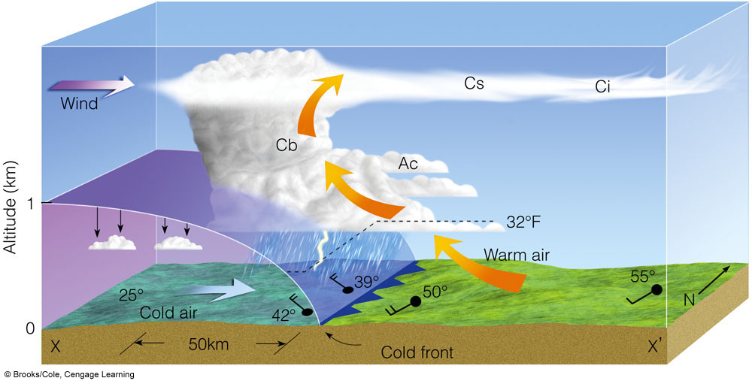
Vertical view of the weather across the cold front
Frontolysis: as temperature contrast lessens the front weakens and dissipates.
Frontogenesis: if the temperature contrast increases the front strengthens.
Notes:
FIGURE 11.17 A vertical view of the
weather across the cold front in Fig. 11.15
along the line X–X .

Slide 43
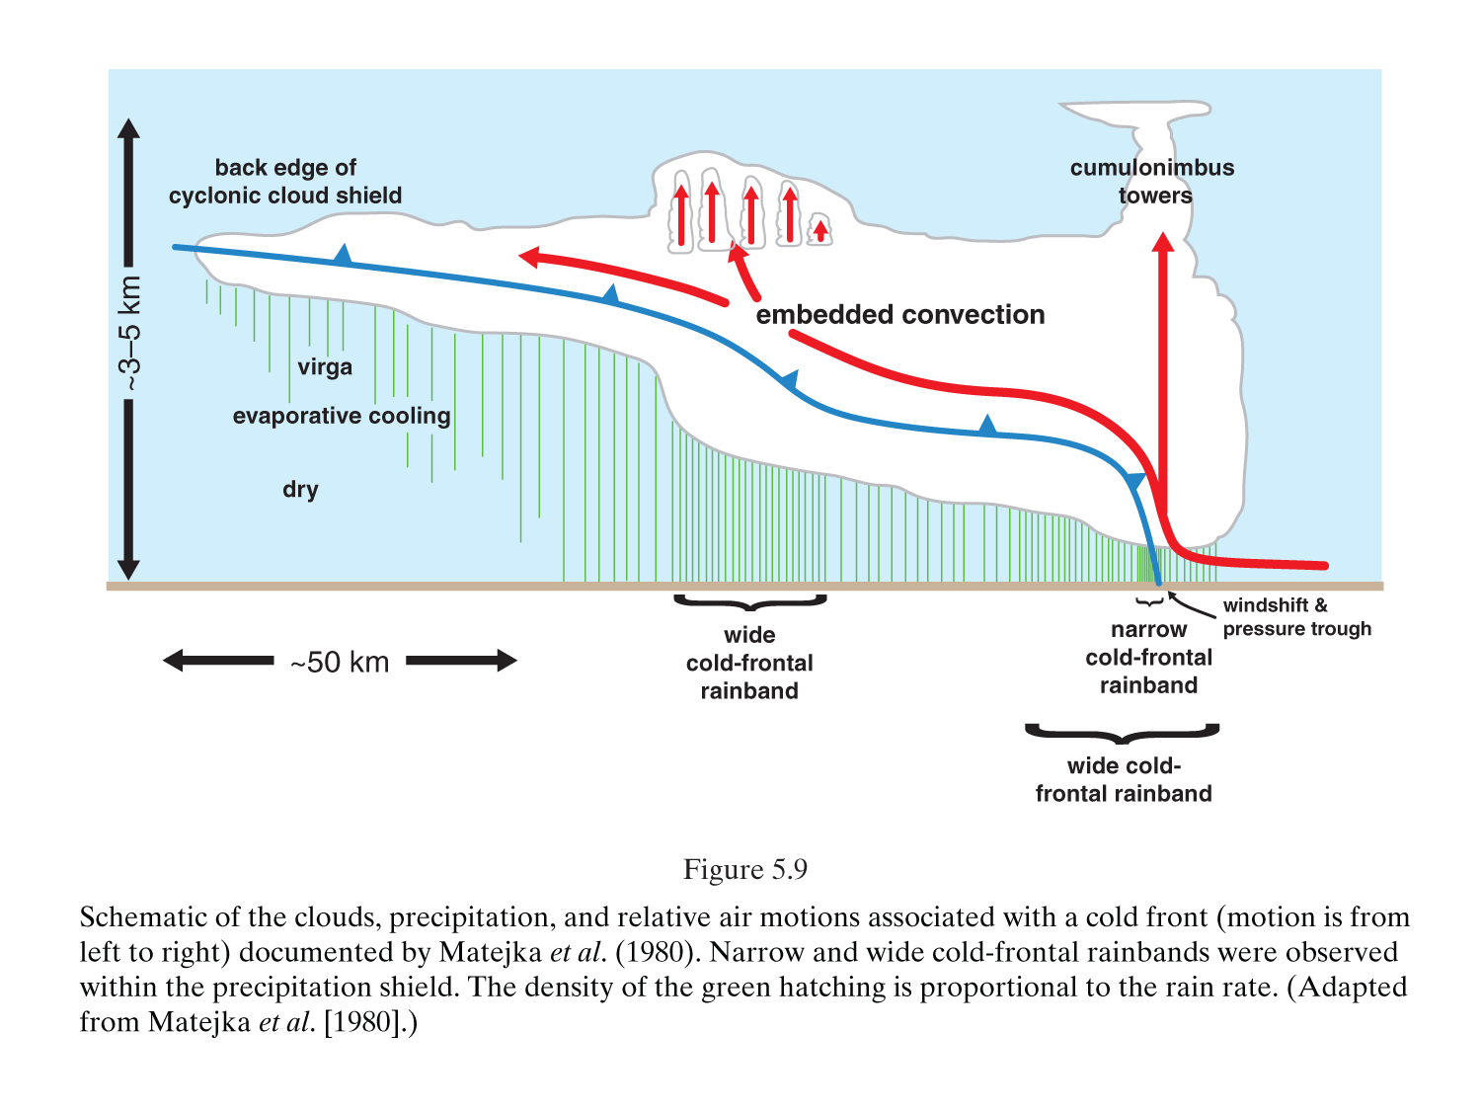
From Markowski and Richardson Mesoscale Meteorology in Mid Latitudes

Slide 44
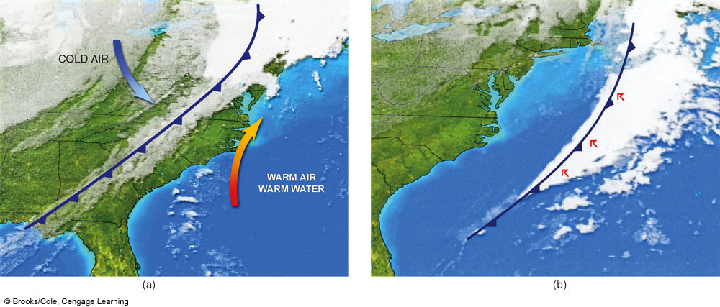
Weak Cold Front 21 November → intensifies over warm ocean water 22 November
Notes:
FIGURE 11.18 The infrared satellite image (a) shows a weakening cold front over land on Tuesday morning, November 21, intensifying into
(b) a vigorous front over warm Gulf Stream water on Wednesday morning, November 22.

Slide 45
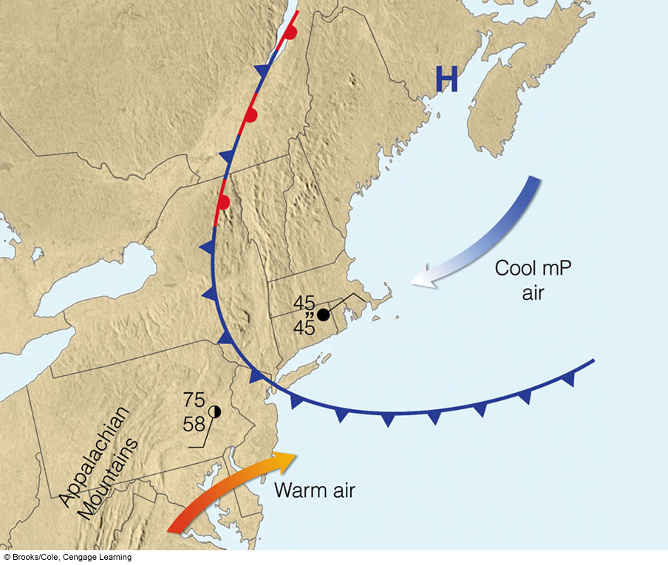
Unusual ‘back door’ cold front
Notes:
FIGURE 11.19 A “Back door” cold front moving into New England
during the spring. Notice that, behind the front, the weather is cold
and damp with drizzle, while to the south, ahead of the front, the
weather is partly cloudy and warm.

Slide 46
Fronts
Warm
  Warm, moist unstable air overrides cold, dry stable air
  Horizontal cloud development with steady rain
  Red line with red semi-circles
Topic: Dry Line
  Not a cold or warm front but a narrow boundary of steep change in dew point. It separates moist air from dry air
Notes:
Figure 12.19

Slide 47
Fronts
Topic: Wavy Warm Front
  Mountain blocking path of cold air (cold air damming) causes wave shape
Occluded Front
  Cold front catches up to and over takes a warm front
  Cold occlusion, warm occlusion
  Purple line with purple triangles and semi-circles

Slide 48
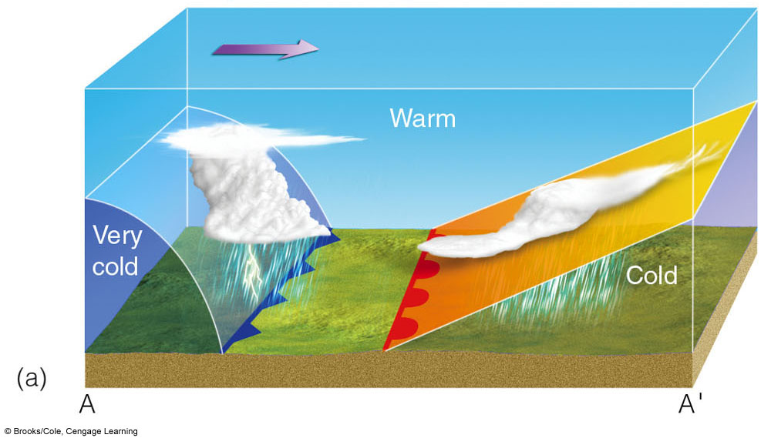
The formation of a cold-occluded front. The faster-moving cold front (a).
Notes:
FIGURE 11. 22 The formation of a cold-occluded front. The
faster-moving cold front (a) catches up to the slower-moving warm
front (b) and forces it to rise off the ground (c). (Green-shaded area in
(d) represents precipitation.)

Slide 49
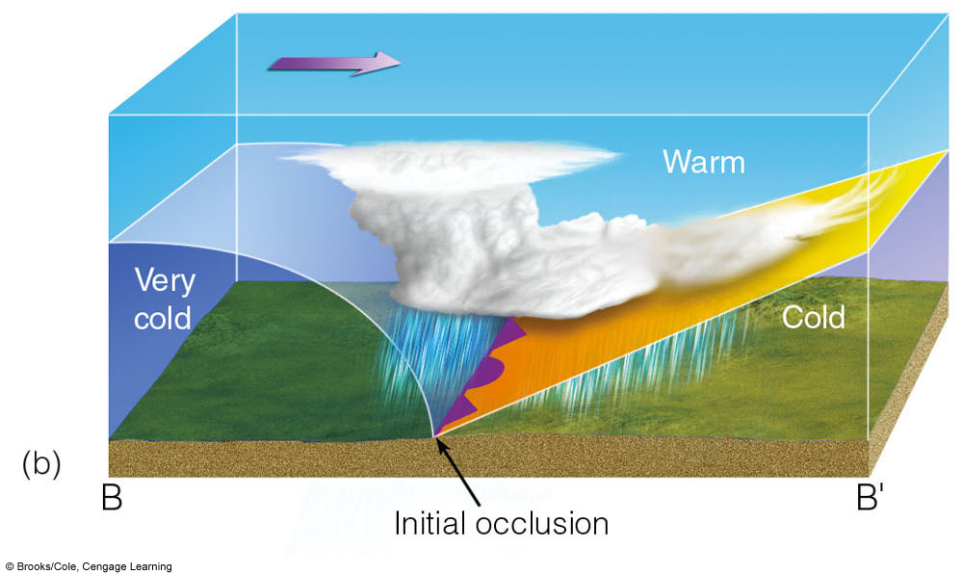
(b) catches up to the slower-moving warm front and
Notes:
FIGURE 11. 22 The formation of a cold-occluded front. The
faster-moving cold front (a) catches up to the slower-moving warm
front (b) and forces it to rise off the ground (c). (Green-shaded area in
(d) represents precipitation.)

Slide 50
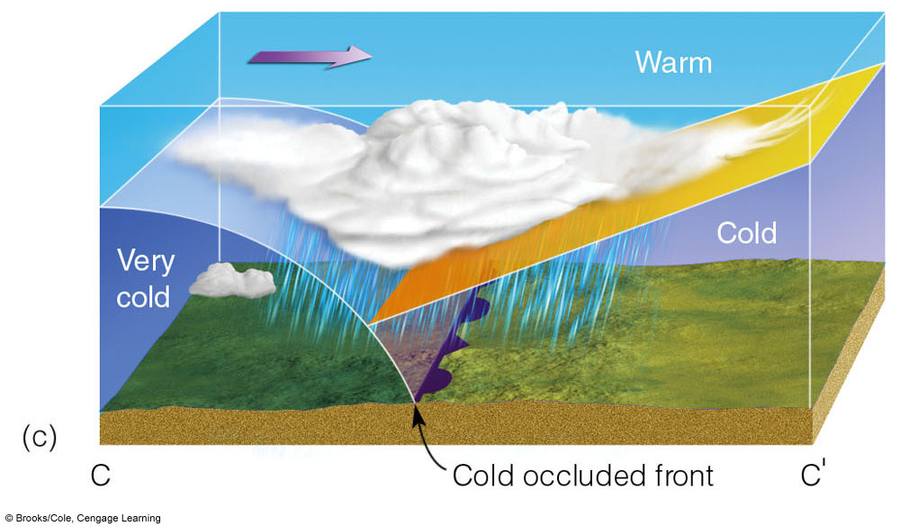
(c). forces it to rise off the ground
Notes:
FIGURE 11. 22 The formation of a cold-occluded front. The
faster-moving cold front (a) catches up to the slower-moving warm
front (b) and forces it to rise off the ground (c). (Green-shaded area in
(d) represents precipitation.)

Slide 51
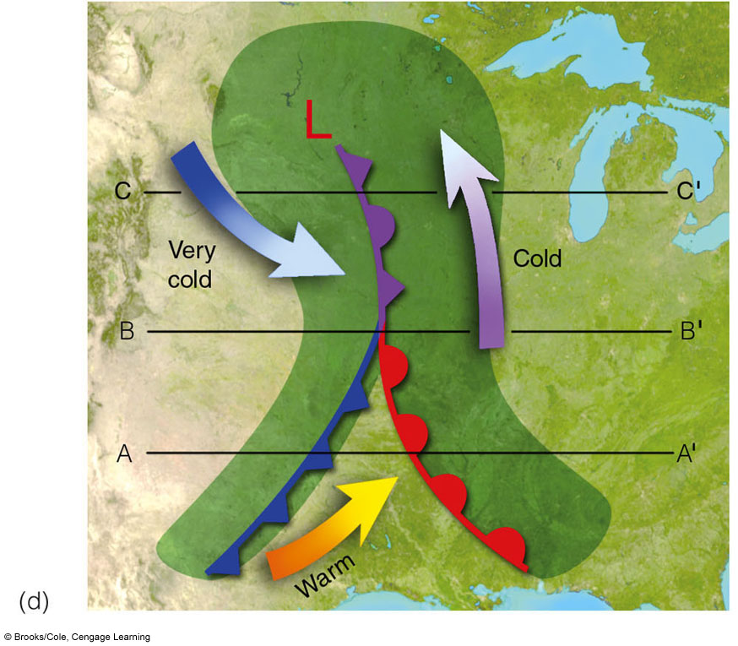
d) Green-shaded area in represents precipitation.
Notes:
FIGURE 11. 22 The formation of a cold-occluded front. The
faster-moving cold front (a) catches up to the slower-moving warm
front (b) and forces it to rise off the ground (c). (Green-shaded area in
(d) represents precipitation.)

Slide 52
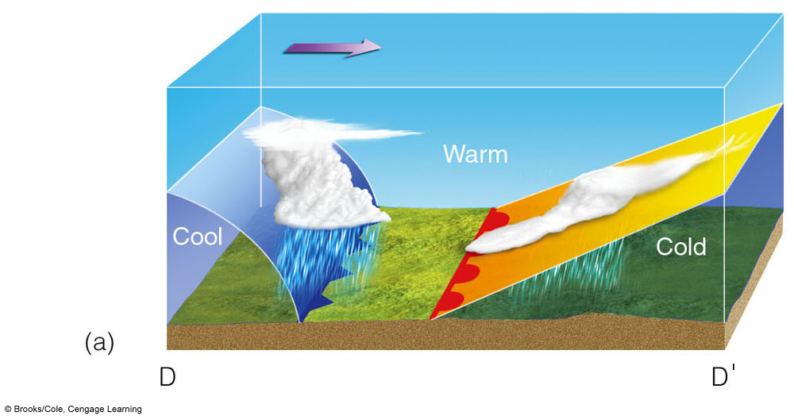
Warm occluded front formation:
Notes:
FIGURE 11. 23 (at left) The formation of a warm-type occluded
front. The faster-moving cold front in (a) overtakes the slower-moving
warm front in (b). The lighter air behind the cold front rises up and
over the denser air ahead of the warm front. Diagram (c) shows a surface
map of the situation.

Slide 53
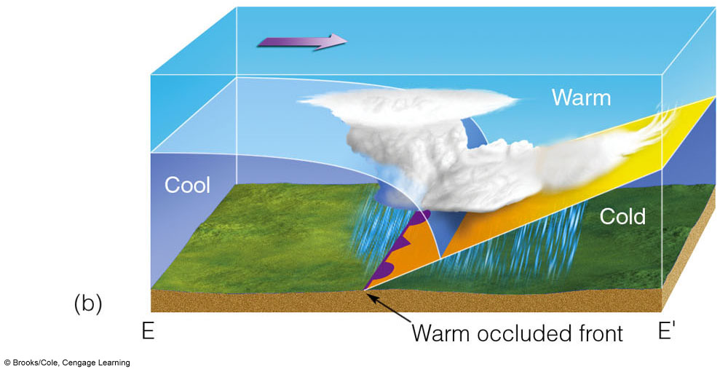
The formation of a warm-type occluded
front. The faster-moving cold front in (a) overtakes the slower-moving
warm front in (b). The lighter air behind the cold front rises up and
over the denser air ahead of the warm front. Diagram (c) shows a surface
map of the situation.
Notes:
FIGURE 11. 23 (at left) The formation of a warm-type occluded
front. The faster-moving cold front in (a) overtakes the slower-moving
warm front in (b). The lighter air behind the cold front rises up and
over the denser air ahead of the warm front. Diagram (c) shows a surface
map of the situation.

Slide 54
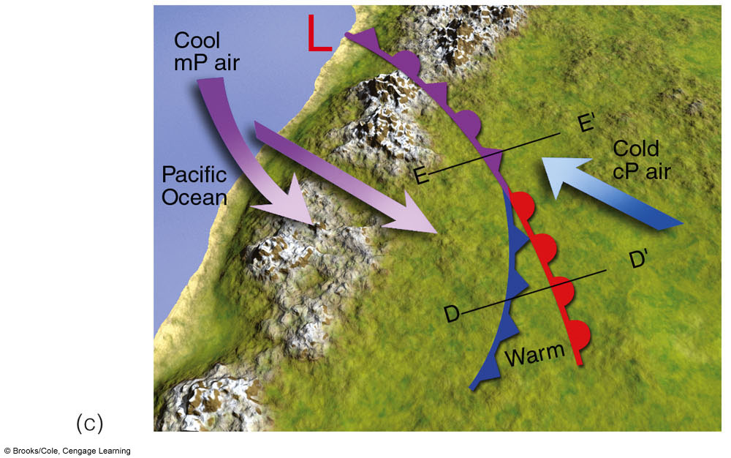
Diagram (c) shows a surface
map of the situation.
Notes:
FIGURE 11. 23 (at left) The formation of a warm-type occluded
front. The faster-moving cold front in (a) overtakes the slower-moving
warm front in (b). The lighter air behind the cold front rises up and
over the denser air ahead of the warm front. Diagram (c) shows a surface
map of the situation.

Slide 55
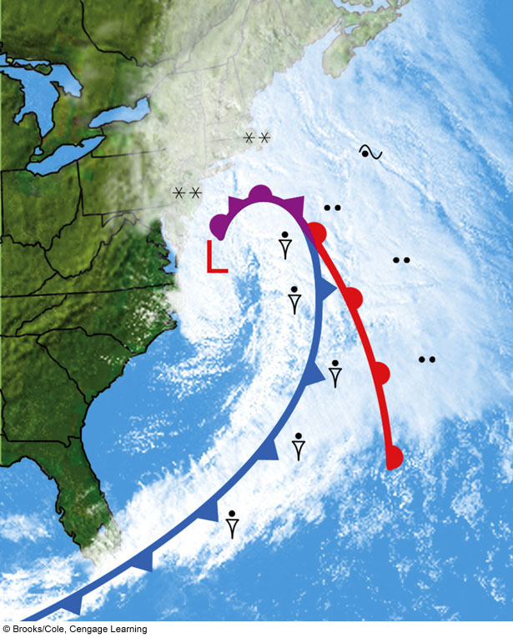
A visible satellite image showing a mid-latitude cyclonic storm with its weather fronts over the Atlantic Ocean during March, 2005. Superimposed on the photo is the position of the surface cold front, warm front, and occluded front. Precipitation symbols indicate
where precipitation is reaching the surface
Notes:
FIGURE 11. 24 A visible satellite image showing a mid-latitude
cyclonic storm with its weather fronts over the Atlantic Ocean during
March, 2005. Superimposed on the photo is the position of the surface
cold front, warm front, and occluded front. Precipitation symbols indicate
where precipitation is reaching the surface.

Slide 56
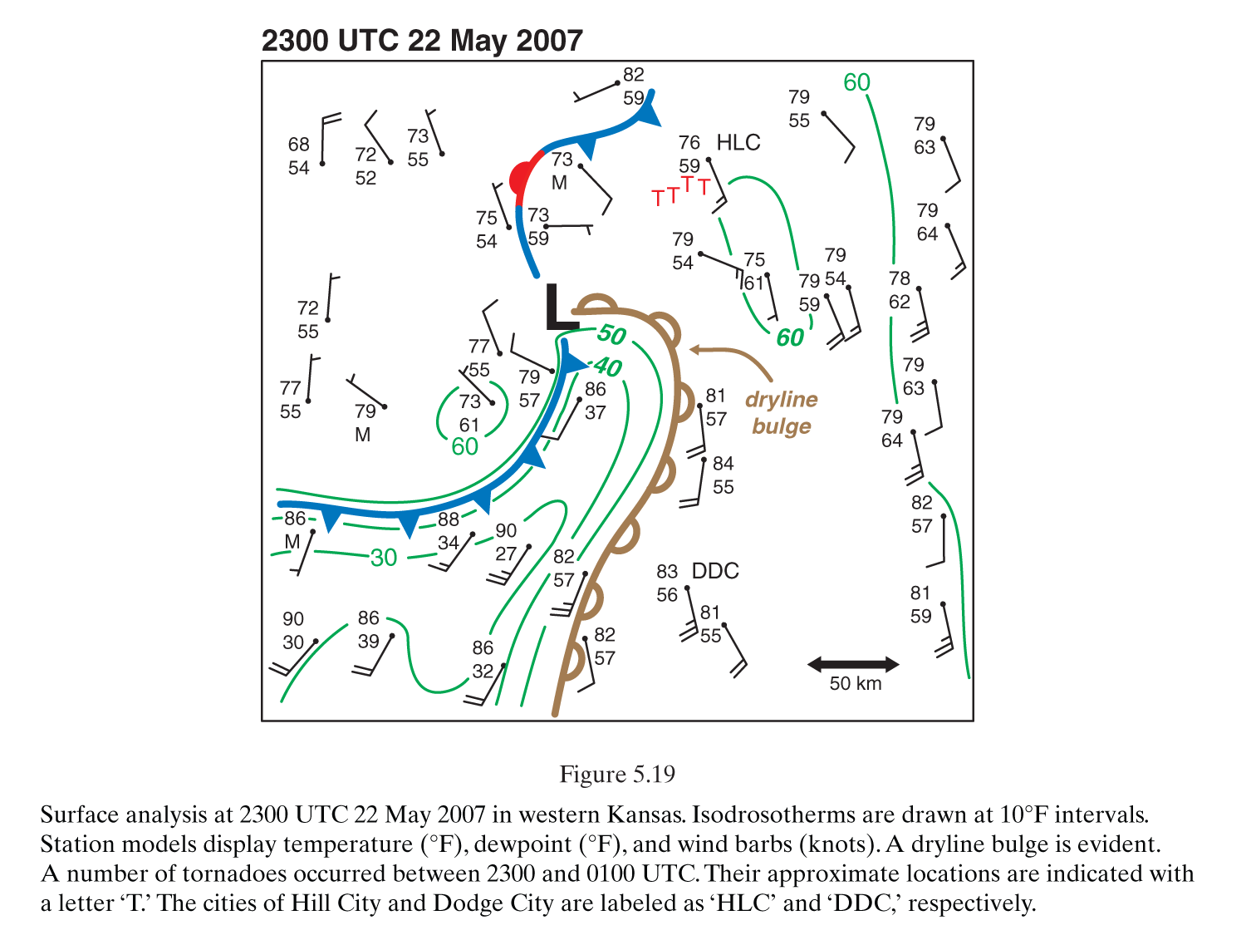
Dryline, Midwest US
At night the
motion at the dryline can change direction.
moist air
dry air
From Markowski and Richardson

Slide 57
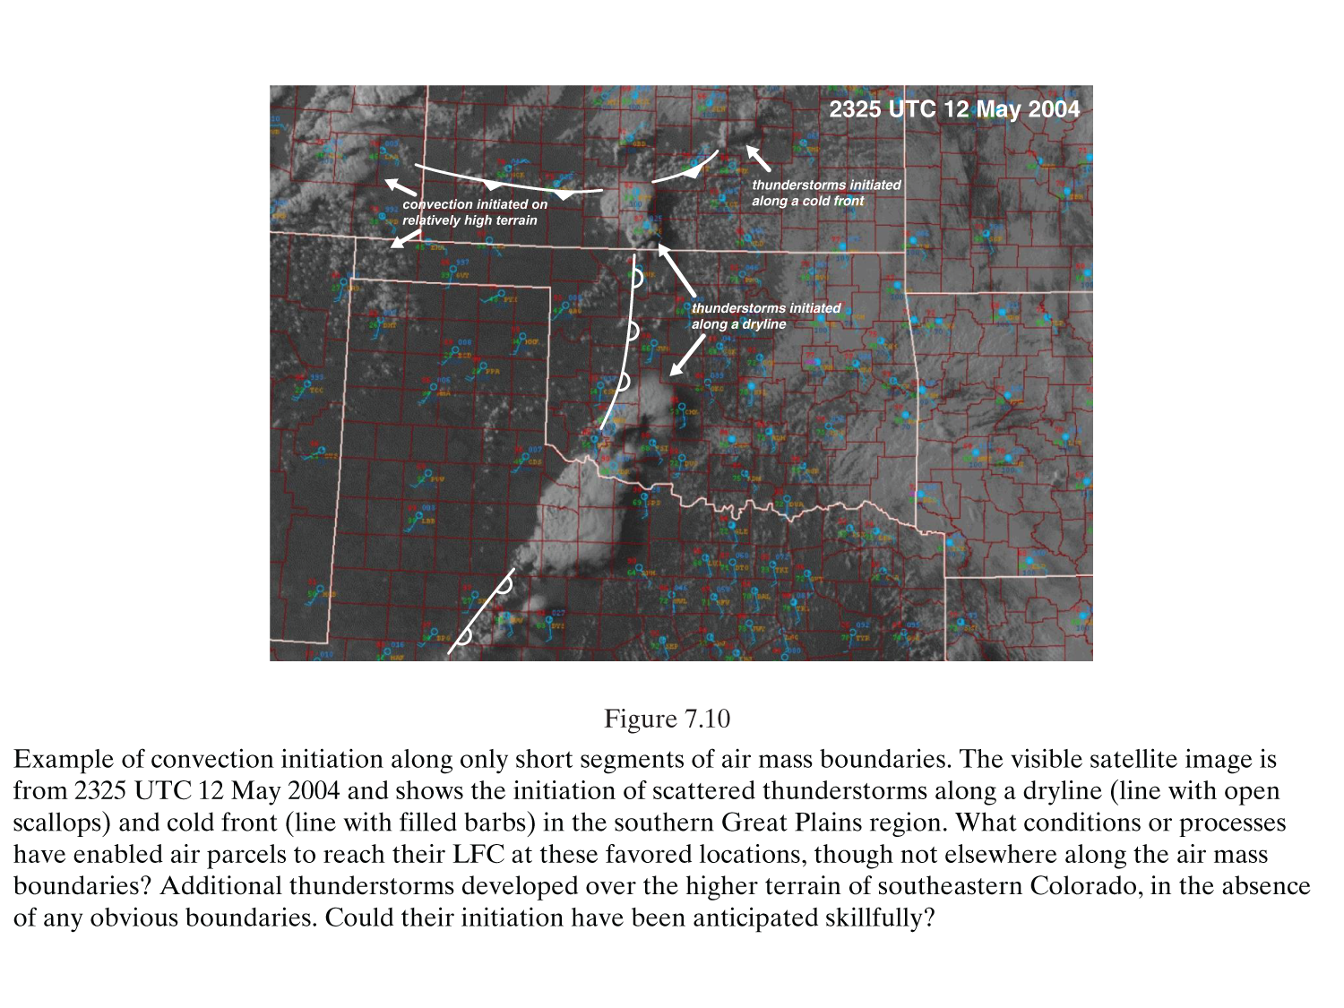
Here and There Convection On This day
Visible satellite image
From Markowski and Richardson

Slide 58
Fronts
Upper-Air Fronts
  Front aloft
  Tropopause dips downward and folds under the Polar jet
  Impacts surface weather

Slide 59

Upper Air front (Upper level front) Tropopause dips downward and folds
under the polar jet.

Slide 60

Air Motion Near a Cyclone (animation)
From Lynch and Cassano, Applied Meteorology.

Slide 61

Stages in the life cycle of an extra-tropical cyclone. 500 hPa contour as dashed lines
Young
Middle age
Mature stage
Young: Cyclones form along the polar front
Divergence occurs near the upper level short wave trough (left), promoting the cyclone,
the low forms
Middle: Cold and warm fronts advance, the small wave when young amplifies to form
an open wave cyclone; trough forms to the left as cold air dives south, ridge as warm
air intrudes towards the north; cyclone is steered NE by the 500 mb winds; upper level
trough is tilted to the west of the surface low
Mature: Cold front advances more quickly than warm front; warm air is forced aloft;
occlusion occurs; now a cold core cyclone; 500 hPa trough is centered over the surface
low and the cyclone decays.

Slide 62

Birth of a storm
From http://eumetrain.org/synoptic_textbook.html

Slide 63

Mature stage of ideal
cyclone

Slide 64

Map of old age for front
New low forming
Cold continental air
advects over warm ocean
Occluded front

Slide 65

500 mb map showing trough slightly west of the surface low
for this old age cyclone

Slide 66
Clash of Warm and Cold Air on a Frontal Zone: Idealized example with zonal flow
Zonal flow:
No meander of
the jet stream.
Adapted from Reiter, Jetstreams

Slide 67


Summary of Jet Action
$$PV=−g\left(ζ+f\right)\frac{dθ}{dP}$$
isentropes
250 K
SOUTH
NORTH
θ=T at the surface if P=1000 mb
Isentropes slope up to colder temperature

Slide 68

Example Cross Section from Tropical Tidbits
Note the 2PVUnits surface and the peak wind location.

Slide 69

Example Cross Section from Tropical Tidbits
Note the 2PVUnits surface and the peak wind location.

Slide 70

Example Cross Section from Tropical Tidbits
Note the 2PVUnits surface and the peak wind location.

Slide 71

Example Cross Section from Tropical Tidbits
Note the 2PVUnits surface and the peak wind location.

Slide 72

Example Cross Section from Tropical Tidbits
Note the 2PVUnits surface and the peak wind location.

Slide 73

More Comprehensive View
From: http://das.uwyo.edu/~geerts/cwx/notes/chap01/tropo.html

Slide 74





Meander of the Jet Stream
200 mb jet
Wind flowing from a ridge toward a trough is decreasing in height above the surface. Conversely, wind flowing from a trough into a ridge is increasing in height. Where is it cold and warm?
From: https://www.weather.gov/jetstream/verses

Slide 75

Relationship between surface low and upper atmosphere flow:
Red arrows show air motion between levels
Divergence
300 mb Level
Convergence
Surface Level
Divergence
Adapted from http://www.atmo.arizona.edu/students/courselinks/fall12/atmo170a1s1/coming_up/week_3/lect9_upper_level_charts.html

Slide 76

Relationship between surface low and upper atmosphere flow

Slide 77



Global Forecast System (GFS) prediction for the 250 mb map
Jet Streak

Slide 78

Jet Streak Effect on Trough-Ridge system
http://www.theweatherprediction.com/habyhints/256/

Slide 79


Summary of Jet Action: Top figure shows top view from above of jet maximum.
Bottom view shows vertical motions for divergence and convergence aloft.
NORTH
East
West
South

Slide 80

Another look at jet streaks …
y
x
(1) Pressure Gradient Force and Coriolis are in balance. Wind is geostrophic (parallel to height contours)
(2) Parcel enters region of higher wind speed. This increases the Pressure gradient force at the same time the Coriolis has not been changed much. Wind will tend to flow toward the longest vector, which is the PGF. This causes convergence in the Left Rear Quad (sinking air at letter A) and divergence in the Right Rear Quad (rising air at letter D). The tropopause is just above jet stream level. Convergence at the jet stream level forces air to sink because the highly stable tropopause prevents air from rising.
(3) The Coriolis once again balances the Pressure Gradient Force.
(4) As a parcel leaves the jet streak it must decelerate. The Pressure Gradient Force weakens at the same time the Coriolis has not had time to adjust and decrease. This causes convergence in the Right Front Quad (sinking air at letter B) and divergence in the Left Front Quad (rising air at letter C).
(5) Pressure Gradient Force and Coriolis once again balance
This example has been for a jet streak in a zonal flow. A jet streak in a curved flow, such as the case when a jet streak is in the base of a trough, will have divergence and rising air to the north of the jet and convergence and sinking air to the south of the jet.
The jet stream is a powerful forecasting tool. Not that it can give exact highs/ lows/ and precipitation chances, but because it gives information such as when to expect the next storm system and whether temperatures will be above or below normal. It gives clues to how the upper levels will promote rising air or sinking air. It gives clues to the character of the next storm system. Jet streaks alone provide much information of how a trough or ridge will develop over the next couple of days. Verbatim from https://www.weather.gov/source/zhu/ZHU_Training_Page/winds/JetStream_Stuff/300_200_chart.htm.

Slide 81

Another view of jet streaks …
y
x
https://www.weather.gov/source/zhu/ZHU_Training_Page/Miscellaneous/Divergence/divergence.html

Slide 82

Northern and Southern Hemisphere View of Ridges and Troughs (CW and CCW flow)
From http://www.atmo.arizona.edu/students/courselinks/fall12/atmo170a1s1/coming_up/week_3/lect9_upper_level_charts.html

Slide 83

Forecast Models And Resolution:
Most current models are ‘convection allowing’.
http://www.weathergraphics.com/waf2/

Slide 84

Computing time used by various models
http://www.weathergraphics.com/waf2/

Slide 85

Data Assimilation:
Data used to initiate models.
Note the satellite coverage.
Surface, buoy, balloon
Commercial Aircraft
http://www.weathergraphics.com/waf2/
Satellite

Slide 86

Nudging model to observations
http://www.weathergraphics.com/waf2/

Slide 87



Grids Used for Numerical Models
Traditional Constant
Latitude. Severe
bunching at the poles.
Hexagon grids with
high resolution over US.
NCAR model for prediction
across scale.
Cubed sphere discretization GFS model.
https://cliffmass.blogspot.com/2016/03/the-national-weather-service-selects.html

Slide 88

Grid choice examples for winds (u,v) and temperature, etc, given by q.
NCAR
GFS
https://cliffmass.blogspot.com/2016/03/the-national-weather-service-selects.html

Slide 89

Example Forecast Differences.
NCAR
GFS
https://cliffmass.blogspot.com/2016/03/the-national-weather-service-selects.html

Slide 90




Model Examples
GFS
ECMWF

Slide 91


Model Examples
GFS
ECMWF

Slide 92

Switch back and forth
GFS
ECMWF

Slide 93




Model Examples
GFS
ECMWF

Slide 94



GFS Model Initialized At Different Times

