Slide 1
Long Waves and Short Waves
In part, adapted from:
https://www.youtube.com/watch?v=byzFKuXYjfU
&
https://www.youtube.com/watch?v=WLP4nKzxliA&t=201s

Slide 2
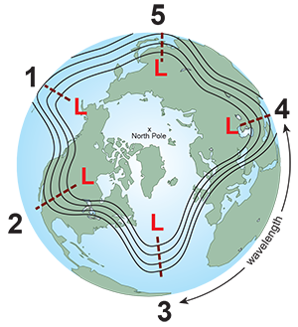
Example of 5 planetary wave pattern for Rossby waves, aka longwaves
wavelength
From <https://www.noaa.gov/jetstream/upper-air-charts/longwaves-and-shortwaves>

Slide 3
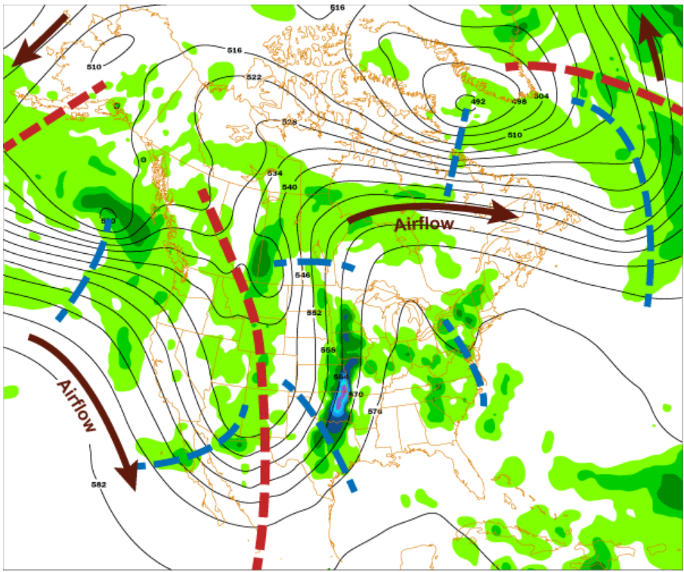
500 mb chart example
Height contours are in black. Brown arrows indicate direction of airflow. Large red dashed lines represent the location of the long wave troughs.
Shorter blue dashed lines represent the location of the of the more prominent shortwaves (There are more short waves than indicated.) Green areas represent precipitation totals. The areas of precipitation are mainly associated with shortwaves as they pass through longwaves. Like railroad cars on a train track, shortwaves will generally follow height contours.
From <https://www.noaa.gov/jetstream/upper-air-charts/longwaves-and-shortwaves>

Slide 4
Example 500 mb height chart (recent) (look at an animation with more detailed map to hunt for shortwaves in the longwave pattern.)

Slide 5
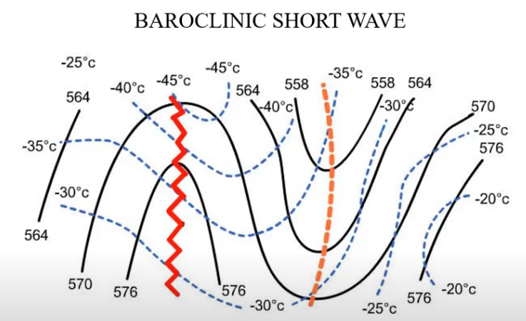
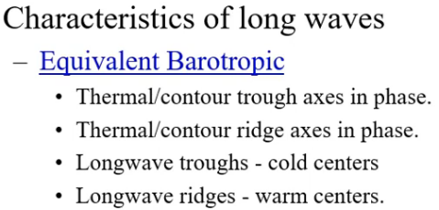
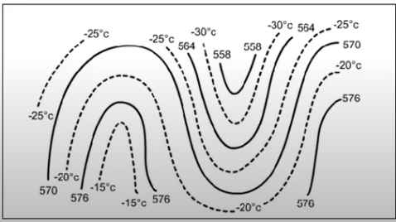
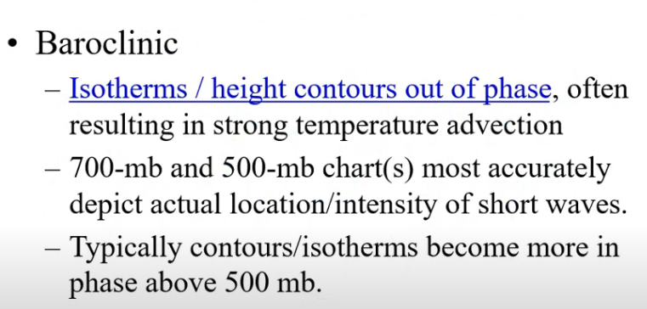
Baroclinic and Barotropic Examples
2000 to > 5000 km long
500 – 2000 km long

Slide 6
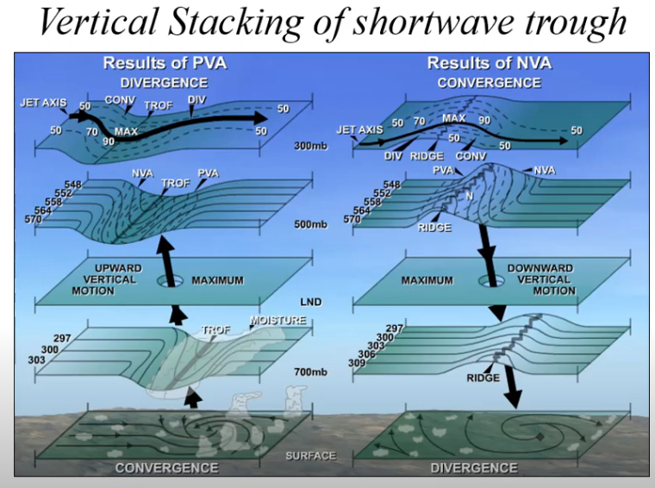

Slide 7
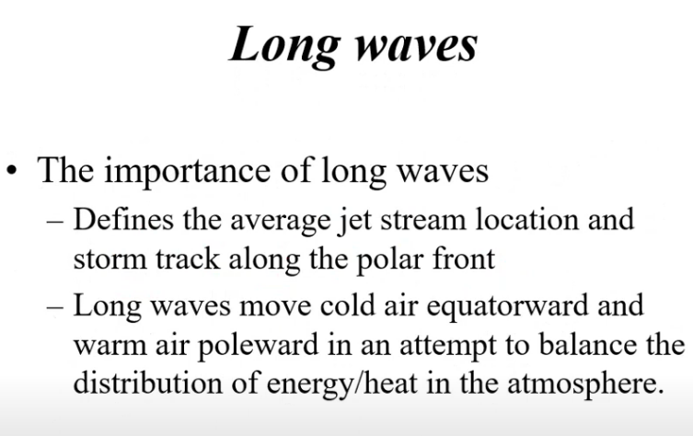
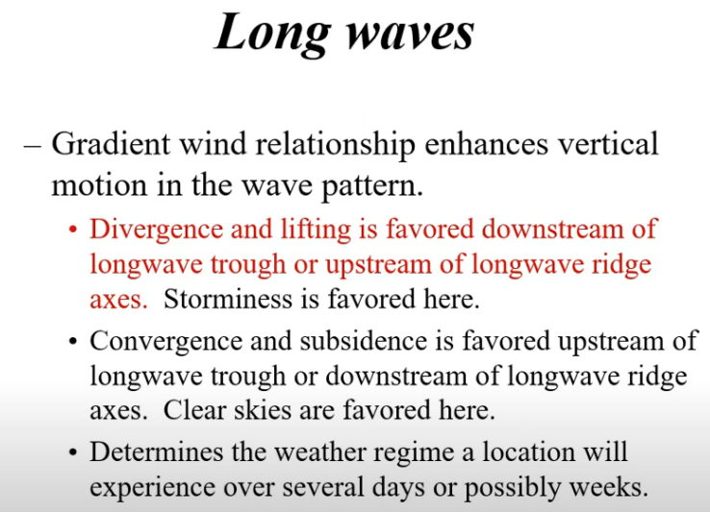
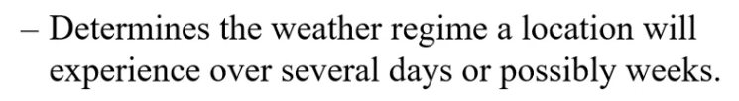
Long Waves: Rossby Waves

Slide 8
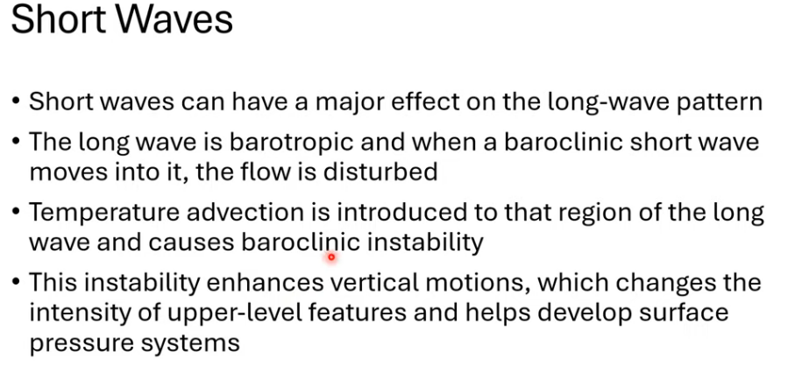
IMPORTANT EXAMPLE.

Slide 9
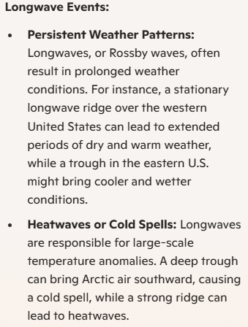
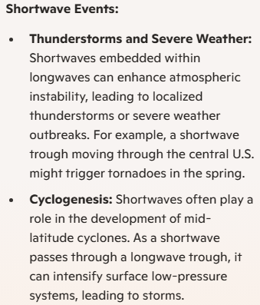
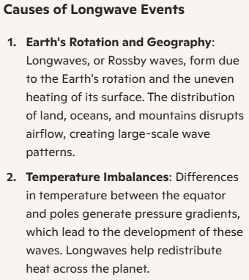
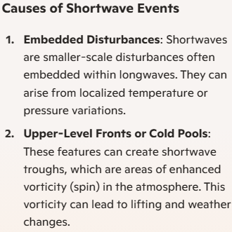
Comparison of Short and Long Waves

